Slide 1

Classroom Workstation Reimage
Giang To
December 11, 2019
IAE-457
Senior Design Project I

Slide 2
Problem background
Problem: computers in classrooms not regularly reimaged
Effects:
Security: software out of date, may be exploited
Non-security: decreased performance on computers
People affected:
Students who use classroom computers
University’s administration
Broad question: can classroom computers be reimaged regularly to improve security and students’ learning experience?

Slide 3


Idea justification
Overall need
Existing procedure not optimal against exploits
Intended results
More secure computers
Better learning experience for students
Preventative method for University’s administration

Slide 4
Assumptions
Project manager has experience with Windows Deployment Services
Resources:
Material: pen, notebook
Technological: laptop, VMware Workstation, Windows Server 2016 image, classroom workstations
Logistical: time, access to classroom for testing
Referential: research done before and during project execution

Slide 5



constraints
Project manager’s time
Anticipated barriers:
To completion of project:
Networking issues between WDS server & client workstations
To large-scale implementation of project:
Speed due to number of workstations

Slide 6
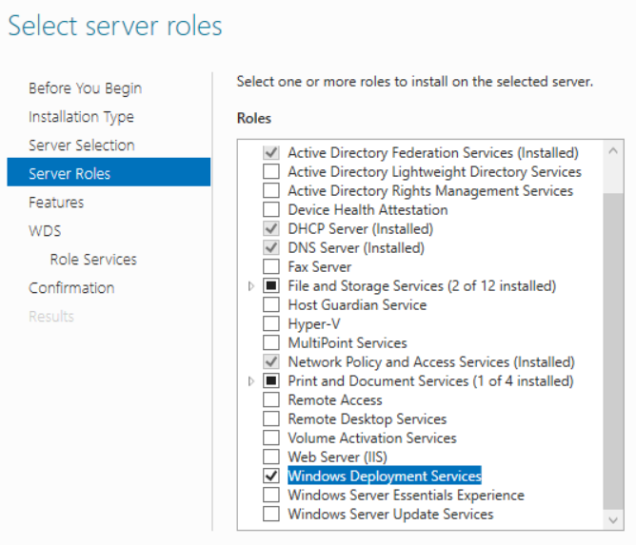
Multiple solutions analysis
Proposed solution – Windows Deployment Services
Strengths:
Doesn’t require boot devices
Base image can contain all necessary software
Can be installed using GUI exclusively
Weakness:
Comes with Windows Server – not free software
Figure 1. Installing Windows Deployment Services

Slide 7
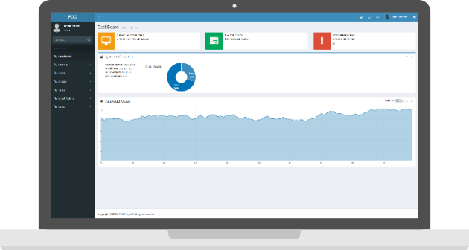
Multiple solutions analysis (cont.)
Alternate solution – FOG
Strengths:
Free software that runs on Linux
Can be used for printer setup after imaging
Weaknesses:
Linux-based program, less user-friendly
May have hardware compatibility issues
No technical support teams
Figure 2. FOG Dashboard (FOG Project, n.d.)

Slide 8
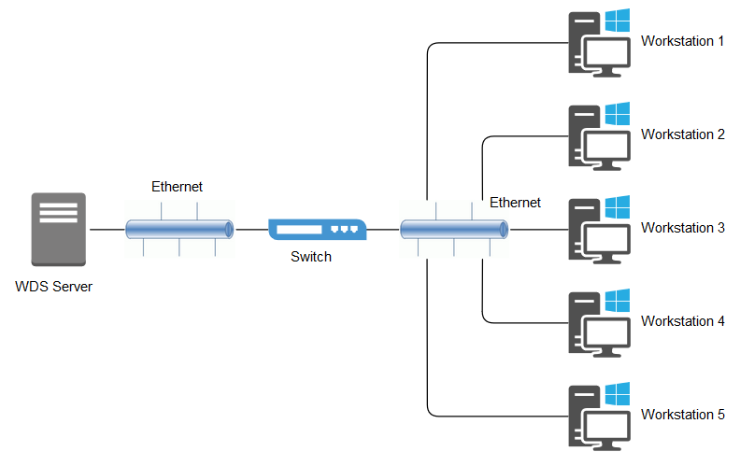
Project proposal
Measurable objectives
Configure Windows Deployment Services
Perform test deployment in a classroom
Diagram
Figure 3. Network Diagram

Slide 9
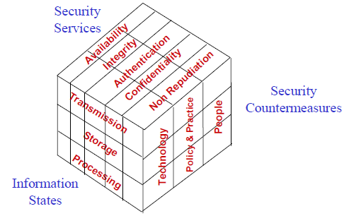
McCumber’s Cube relevance
Security services
Confidentiality: obtain personal information
Integrity: modify obtained information
Availability: malware renders computer unusable
Information states
Storage: access files stored on flash drive
Processing: legal document being filled out
Transmission: intercept email messages
Figure 4. Information Assurance Model (Maconachy, Schou, Ragsdale, & Welch, 2001)

Slide 10

Requirement specifications
Capture base images from model workstations
Store different images for different classrooms/areas
Reimage 20 workstations in under 4 hours
Reachable from all classroom workstations
Provide documentation
Maintainable without vendor’s aid

Slide 11
Project budget & supports
Direct Costs: $0.00
Personally owned laptop: $0.00
Personally owned Cat5e Ethernet cable: $0.00
VMware Workstation 15 Pro: $0.00
Windows Server 2016 image: $0.00
WDS imaging solution: $0.00
Windows 10 Education Image: $0.00
Support Costs
Access to a computer-equipped test classroom
Access to all computers in the test classroom
Access to the switch stack in the test classroom
Access to CTU’s virtual library
Opportunity Costs
Using personal laptop: save over $3,700
Using WDS: save over $6,500

Slide 12
Initial project schedule
Task | Start Date | Due Date
Build server Create Windows Server 2016 virtual machine Install latest patches Install antivirus software | 1/13/20 1/13/20 1/14/20 1/16/20 | 1/17/20 1/13/20 1/15/20 1/17/20
Create base image Create Windows 10 virtual machine Install latest patches Install antivirus software Install Microsoft Office applications, Firefox, Dev-C++ | 1/20/20 1/20/20 1/21/20 1/23/20 1/24/20 | 1/24/20 1/20/20 1/22/20 1/23/20 1/24/20

Slide 13
Initial project schedule (cont.)
Task | Start Date | Due Date
Configure WDS server Add and configure WDS role Add boot image Capture base image Add install image | 1/27/20 1/27/20 1/30/20 2/3/20 2/6/20 | 2/7/20 1/29/20 1/31/20 2/5/20 2/7/20
Perform test deployment Deploy base image to workstations in test classroom Troubleshoot Optimize deployments | 2/10/20 2/10/20 2/10/20 2/24/20 | 2/28/20 2/21/20 2/21/20 2/28/20
Create documentation Create configuration guide Document issues and resolutions | 3/2/20 3/2/20 3/16/20 | 3/20/20 3/13/20 3/20/20

Slide 14
Literature/technology/professional environment review
Literature
The Critical Elements of the Patch Management Process (Gerace, & Cavusoglu, 2009)
Background information on patch management
Survey of IT professionals
The Case for Disappearing Cyber Security (Dykstra, & Spafford, 2018)
Current situation regarding end users and cybersecurity
Suggests users shouldn’t actively participate in cybersecurity
A Model for Information Assurance: An Integrated Approach (Maconachy, Schou, Ragsdale, & Welch, 2001)
Explains necessity to expand on original McCumber’s Cube
Dimensions: information states, security services, security countermeasures, time

Slide 15
Literature/technology/professional environment review (cont.)
Technology
Windows Deployment Services (Microsoft, 2018)
Technical documentation of tool
Professional environment
Top 10 IT Issues, 2018: The Remaking of Higher Education (Grajek, 2018)
Top issue: information security

Slide 16
Classroom Workstation Reimage
Giang To
December 11, 2019
IAE-457
Senior Design Project I

Slide 17
References
Cable Matters snagless Cat 6a, Cat6a (SSTP, SFTP) shielded Ethernet cable in blue 30 feet. (n.d.). Retrieved from https://www.amazon.com/Cable-Matters-Snagless-Shielded-Ethernet/dp/B00HEM525A?th=1
Dell 24 monitor – P2419H. (n.d.). Retrieved from https://deals.dell.com/en-us/work/productdetail/33cq
Dell premier wireless keyboard and mouse – KM717. (n.d.). Retrieved from https://www.dell.com/en-us/work/shop/dell-premier-wireless-keyboard-and-mouse-km717/apd/580-afll/pc-accessories
Dykstra, J., & Spafford, E. H. (2018). The case for disappearing cyber security. Communications of the ACM, 61(7), 40-42. doi: 10.1145/3213764
FOG introduction. (n.d.). Retrieved from https://wiki.fogproject.org/wiki/index.php?title=Introduction
Gerace, T., & Cavusoglu, H. (2009). The critical elements of the patch management process. Communications of the ACM, 52(8), 117-121. doi: 10.1145/1536616.1536646
Grajek, S. (2018). Top 10 IT issues, 2018: The remaking of higher education. Retrieved from https://er.educause.edu/articles/2018/1/top-10-it-issues-2018-the-remaking-of-higher-education
Maconachy, W. V., Schou, C. D., Ragsdale, D., & Welch, D. (2001). A model for information assurance: An integrated approach. Proceedings of the 2001 IEEE Workshop on Information Assurance and Security, 306-310.
Microsoft (2018). Windows Deployment Services. Retrieved from https://docs.microsoft.com/en-us/windows/win32/wds/windows-deployment-services-portal
Microsoft pricing and licensing for Windows Server 2019. (n.d.). Retrieved from https://www.microsoft.com/en-us/cloud-platform/windows-server-pricing
Precision 5820 tower workstation. (n.d.). Retrieved from https://www.dell.com/en-us/work/shop/workstations-isv-certified/precision-5820-tower-workstation/spd/precision-5820-workstation/xctopt5820us_2
SmartDeploy. (n.d.). Retrieved from https://www.smartdeploy.com

