Slide 1
Docker tutorial for reproducing R analysis
Giang Le

Slide 2

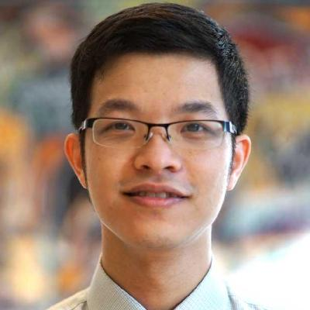
The problems
But it works on my machine!!!
Why is your code not working?

Slide 3

Docker
Scripts

Slide 4
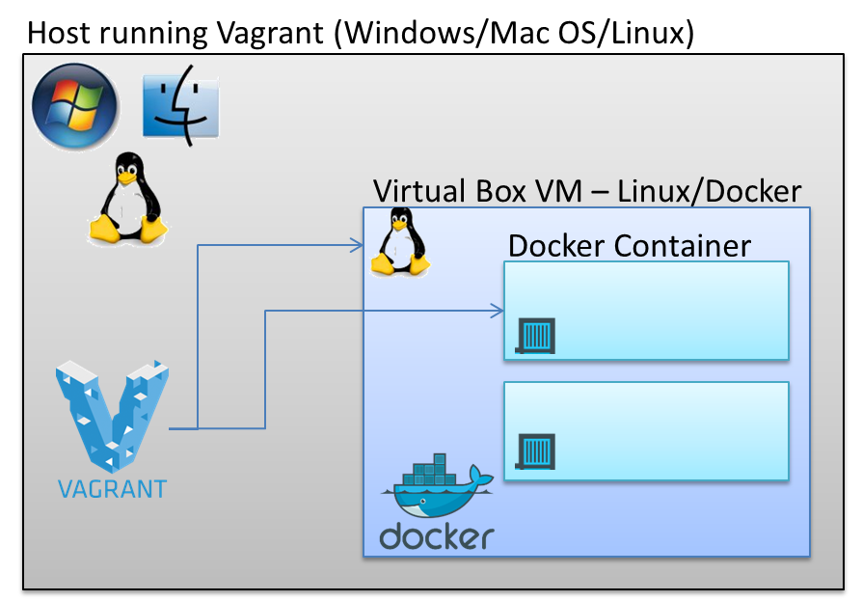
What is Docker?

Slide 5
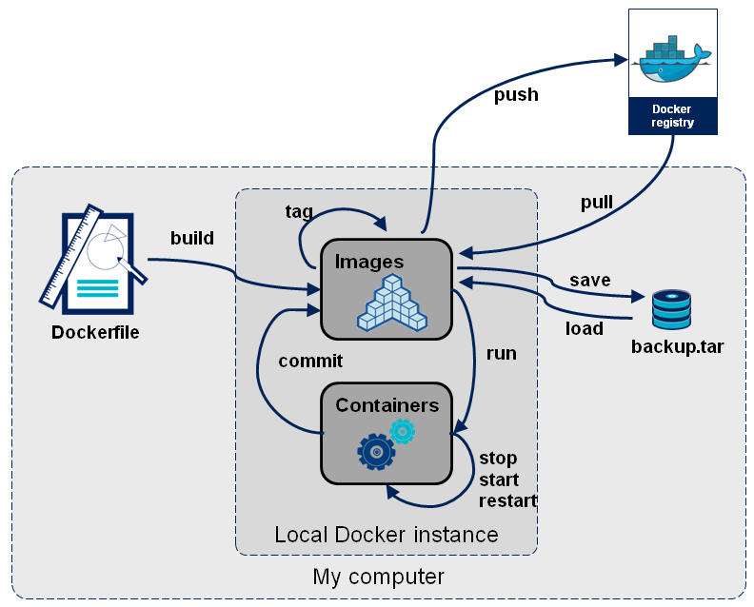
Docker in a nutshell

Slide 6

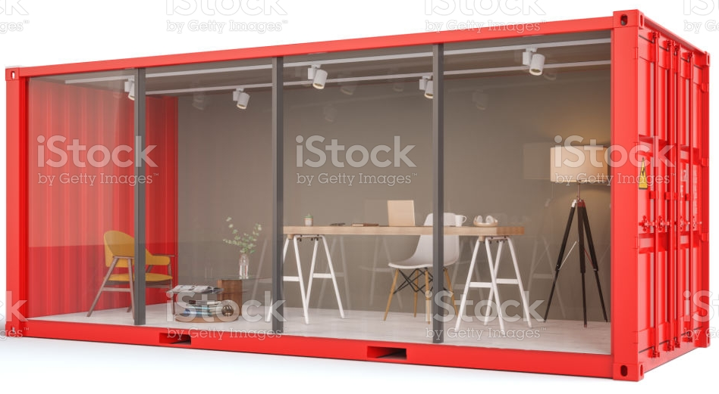
Simplify of Docker
File
Image
Container
Dockerfile
Build
Run
The base to build containers

Slide 7
Tutorial covers
File
Image
Container
Dockerfile
Build
Run
Complex
Typy type and Clicky click

Slide 8
Images searching
Go to https://hub.docker.com/
Search for rocker/rstudio
Overview
  Can get/pull the latest image
Tag
  Select specific version or latest

Slide 9
Pull R image
docker pull rocker/rstudio:4.0.4
  Or
docker run --rm -p 8787:8787 -e PASSWORD=yourpasswordhere rocker/rstudio :4.0.4
  Docker will pull image automatically if is not on the machine
  Creates a temporary container, executes the command in it and stops the container when it is done.

Slide 10
Running the image
Port for Rstudio (must be 8787)
Mount volume to container’s folder
“$(pwd)”
Start the image
docker run --rm -p 8787:8787 -e PASSWORD=mumc -v /mnt/c/Users/giang/Documents/:/home/rstudio rocker/rstudio:4.0.4
Environmental variables:
Username, password and others
Image name
Hub channel:Tag
remove image after use

Slide 11
Access the localhost
http://localhost:8787/
Username: rstudio
Password: mumc

Slide 12
Modifying the image
Install R packages
Plot beautiful figures

Slide 13
Accessing files
/bin/bash
  Interactive
Docker exec –it << Docker image >> /bin/bash (bash if on path)
Docker cp << Docker image >> :file/path wanted/path
Docker ps -a
  Executes a command on a running container.

Slide 14
Saving new image
Docker commit << Image name >> newname:tag
Docker save image:tag > newname.tar

Slide 15
Pushing to the hub
Docker push

Slide 16
Stopping the image
Ctrl + C
Exit
Docker stop container_name

Slide 17
Clean up
Docker images take up space
  Host on the hub and remove unused images
Docker rmi
  To remove images

Slide 18
Restore
Docker load < tarfile.tar

Slide 19
Docker Rstudio Github
File > New Project > Version Control > Git
Username & Password
Ready to rock !!!
Git commit example

Slide 20
What have you learned
Search for images
Create Modify and Using container
Use R with github

Slide 21
Conclusion
Collaboration on reproducible results
Reproducible
makes coding great again !!!

