Slide 1


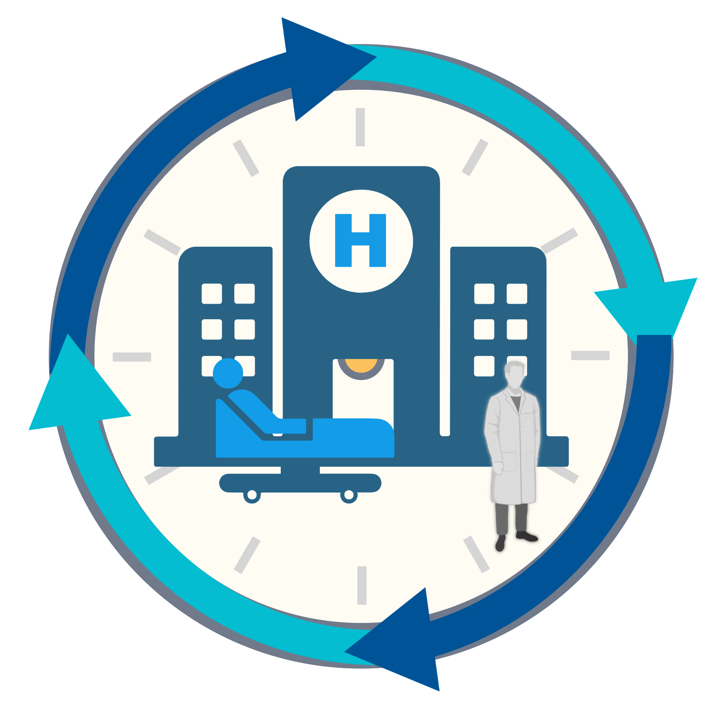
A Circadian-Friendly Hospital
Managing sleep-wake disruption due to hospitalisation: The Circadian Care Project
Gianluca Giusti PhD Student
Faculty of Health and Medical sciences
School of Biosciences
Prof. Sara Montagnese (supervisor)
Prof. Debra J. Skene (supervisor)
Notes:
Circadian-friendly hospital is the idea behind

Slide 2
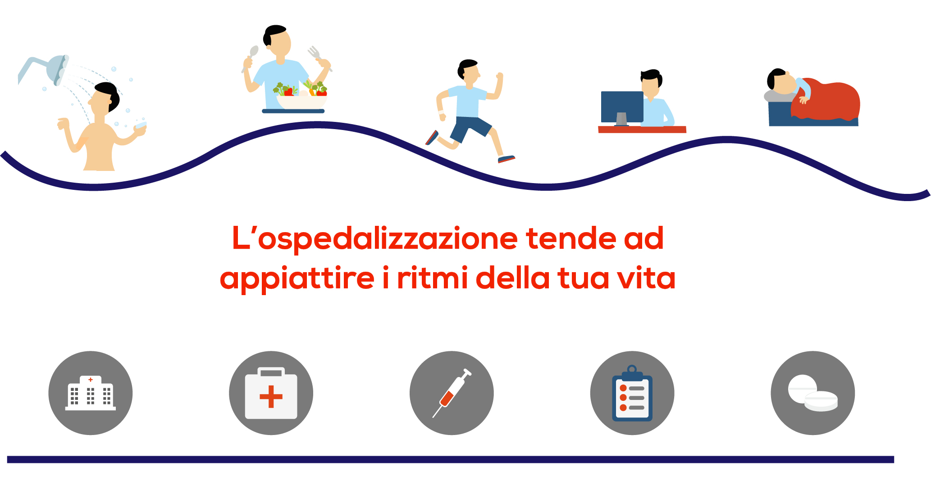

Everyday life
Hospitalisation
Circadian-friendly hospital
Notes:
While in everyday life…expose…meal/activity timing and light entrain CC -> habitual daily routines
Patients often have trouble adjusting to the clinical environment. In hospital: weak / inefficient zeitgebers …increase the risk for circadian misalignment
In hospital you have to set your schedule according to the timing of the ward -> loss of habitual daily routines
Loss of habitual daily routines, noise and abnormal exposure to light often cause sleep and circadian rhythm disorders amongst medical inpatients.

Slide 3
Aims
To test a management system that limits the circadian impact of hospitalisation thorough assessment of patients’ specific circadina features and needs and an ad-hoc, personalized light-dark, meal and activity schedule to cover the whole of the stay

Slide 4
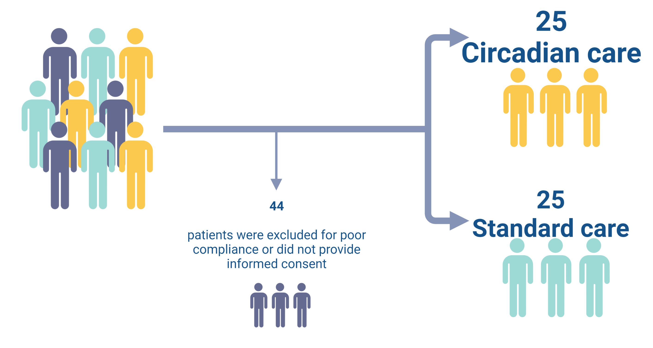
Randomised controlled trial (RCT)
94
Patients
Notes:
simple randomization with stratification according to/by the circadian care group
94 patients admitted into the medical ward Clinica Medica V of Padua University Hospital for other reasons within 24 hour were screened.
The others 50 patients were randomised to the treatment or the control group.
The majority of patients hospitalized for liver/biliary/pancreatic diseases (42%). Other diagnoses on admission were cardiovascular diseases (34%), infections (including pneumonia, urinary tract infection and erysipelas; 12%), and gastrointestinal bleeding or acute anemia (12%).

Slide 5
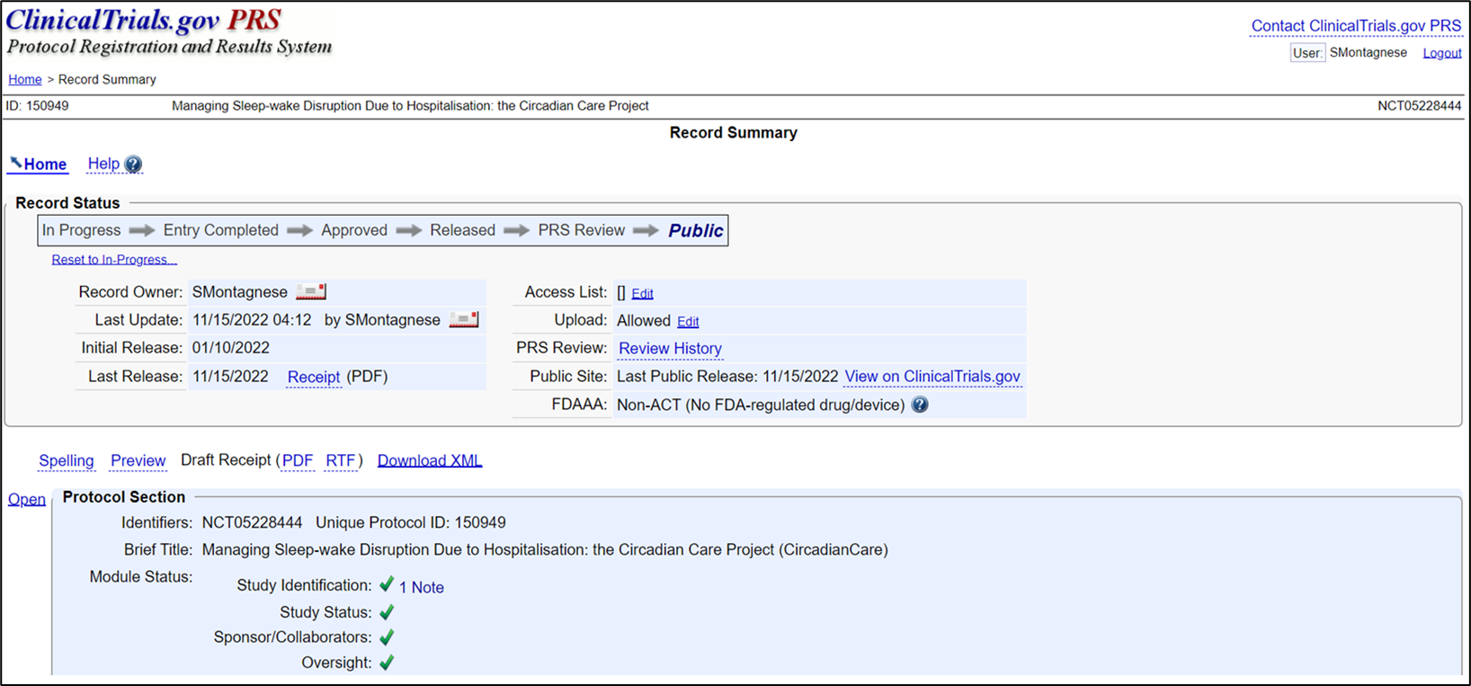
Notes:
ClinicalTrials.gov is a US government web-based resource maintained by the National Library of Medicine (NLM) at the National Institutes of Health (NIH) where clinical studies can be registered, information updated, and if required, results and documents posted. One of the most important database.
Purpose:
-some journal require that clinical trials were registered on publicly accessible database to support compliance with rules and regulations.
-promote transparency and scientific integrity.

Slide 6
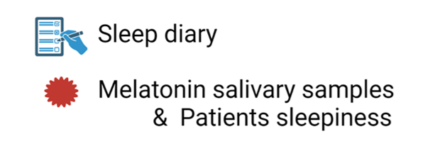
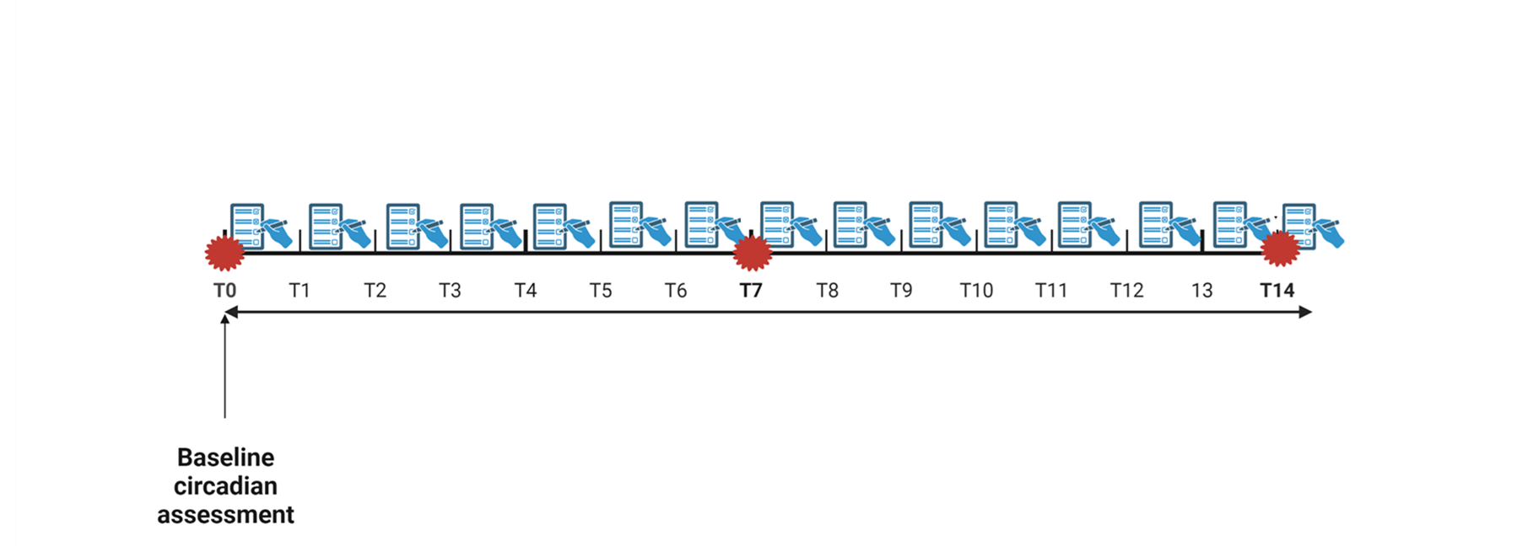
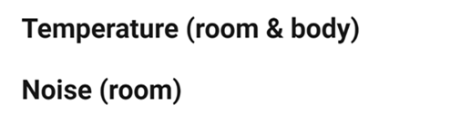
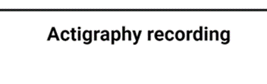
Experimental design
Notes:
->Based on the known, the average length of the hospitalization is 9-10 days
Complete a sleep diary daily, recording bedtime, sleep onset, time taken to fall asleep, wake up time, get up time, and the number and duration of any night awakenings and/or daytime naps.
Feasibility - Discharge

Slide 7
Baseline circadian assessment
Standard demographics
Charlson co-morbidity index
Habitual meal timing
Pittsburgh Sleep Quality Index (PSQI)
microMCTQ questionnaire
The self-morningness/eveningness (Self-ME)
Notes:
Standard demographics (sex, age, BMI and level of education)
The Charlson Comorbidity Index was used for purposes of assessment of disease severity/comorbidity. This ranges from 0 to 37, and a weight is assigned to each of 19 medical conditions, based on the corresponding relative risk of death within 12 months (Charlson et al., 1987).
Information on habitual meal timing
Subjective sleep quality over the preceding month, Pittsburgh Sleep Quality Index (PSQI)
Sleep-wake behaviour on working days and free days, microMCTQ questionnaire
The self-morningness/eveningness (Self-ME): An extremely concise and totally subjective assessment of diurnal preference.

Slide 8
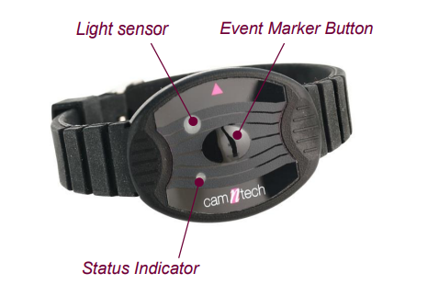
MotionWatch 8
Notes:
No use of mark button

Slide 9
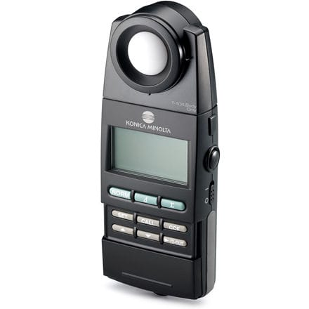
Lux meter T-10 A
Illuminance measurements were obtained 4 times per day, every 2 days :
After wake-up time
Close to lunch time
Between 4:00 to 4:30 pm
Close to the dinner time
Konica Minolta Business Solutions (UK) Ltd.
Basildon, Regno Unito
Notes:
The measurements of the light were measured at eye-level for each patient. If he was not in the room, no recording was obtained
Recorded the room lighting, position of the shutters and number of people in the room.

Slide 10
Noise levels in the patients surroundings
micW i436 phonometer
T0,T7,T14
24 hours record
Notes:
day 0,7,14 for 24 hours
(close to the headboard of the bed) close as possible to the patient
Open noise app for apple phone

Slide 11
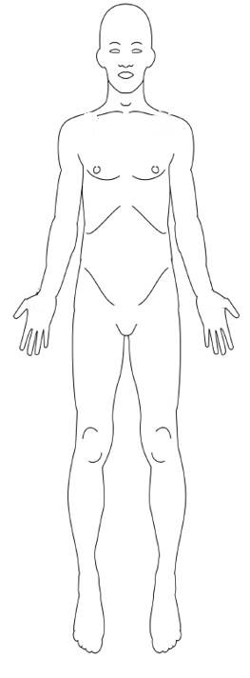
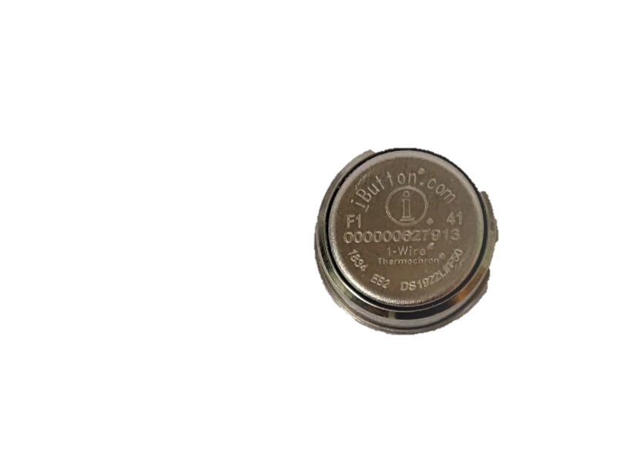
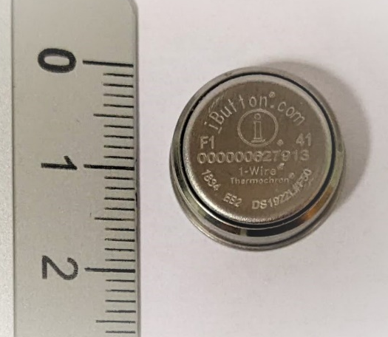
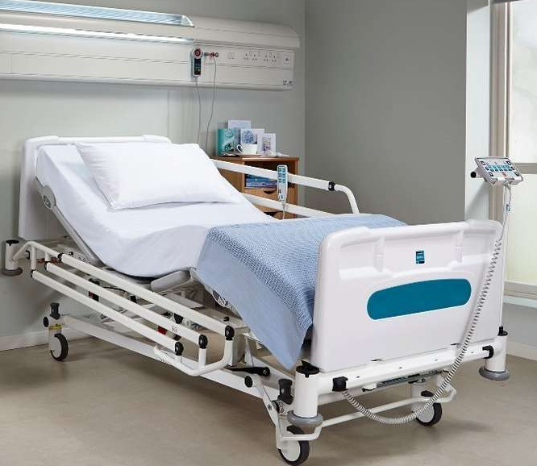
Skin & Room temperature
T0,T7,T14
24 hours record
5 Wireless iButtons
Notes:
Surgical tape to fix the button on the patient’s body
Longato et al (2017)

Slide 12
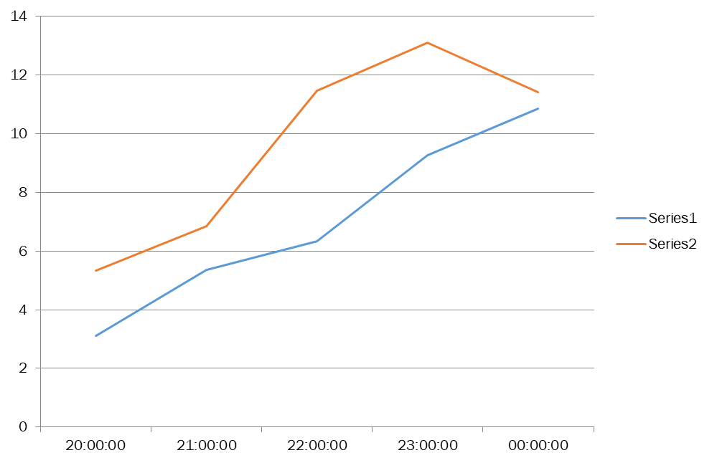
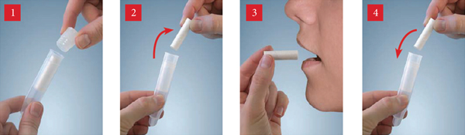
Circadian assessment by the dim-light melatonin onset (DLMO)
Day 1
Day 7
Participants collect saliva samples beginning 3h before the habitual sleep onset and for the next 4h (5 samples)
Notes:
day 0,7,14

Slide 13



Treatment arm
light/dark
meal timing
activity timing
Notes:
Standard arm was managed as per standard of care in the hospital, while treatment arm entered the CircadianCare management system, which include modulation of light/dark hygiene, meal timing and physical activity.
Active or passive physiotherapy (they are sick patients)

Slide 14
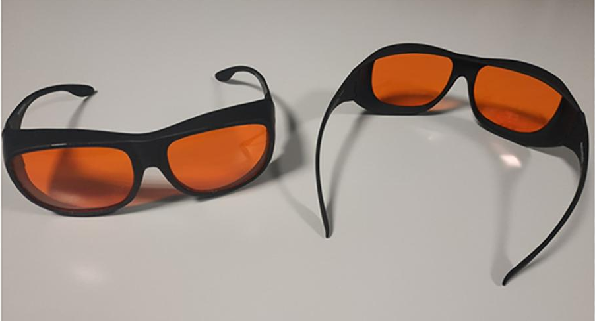

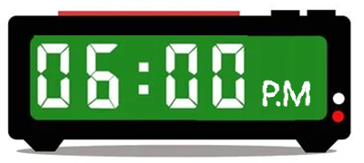
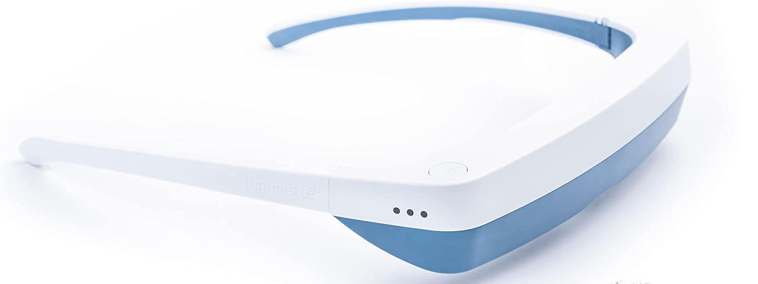
Light-Dark Treatment Schedule
45’
Notes:
CircadianCare management system
Luminette® light glasses (Langevin et al., 2014) (Lucimed, Villers-le-Bouillet, Belgium; Figure 1A), which can be worn over prescription glasses, are equipped with eight Light Emitting Diodes (LEDs) distributed on the upper part of the two lenses (four on each side), outside the patient’s visual field. The LEDs reflect light (2000 lux; blue-enriched 400–750 nm) toward the eye via a diffractive lens, thus focusing light toward the lower part of the retina, regardless of the position of the head. This also allows for uniform illumination and for dazzling avoidance (Bragard and Coucke, 2013).
Short-wavelength filter glasses (MelaMedic, Viborg, Denmark; Figure 1B), which can be worn over prescription glasses, filter light in the blue range of the spectrum, i.e., the one our visual circadian timing system is most sensitive to (Foster, 2005). Thus they limit exposure to awakening light signals at times when the natural environment is dark but the artificial one inside the hospital is well lit or the patients use mobile phones, tablets, reading devices which emit relatively strong and blue-enriched light (Gringras et al., 2015).

Slide 15



Morning | Evening
06:45 | 20:00
07:45 | 21:00
08:45 | 22:00
Breakfast | Lunch | Dinner
07:00 | 12:30 | 18:30
08:00 | 13:30 | 19:30
09:00 | 14:30 | 20:30
Morning | Evening
08:00-08.30 | 18:00-18:30
09:00-09:30 | 18:30-19:00
10:00-10:30 | 19:00-19:30
Notes:
To ensure that patients are exposed to as much natural light as possible over the daytime hours and darkness is ensured overnight Enforced rolling shutter policy
Active or passive physiotherapy (they are sick patients)

Slide 16

Primary outcome (Actigraphy & Diary)
Change in :
sleep onset latency
sleep duration
sleep awakening (WASO)
sleep efficiency

Slide 17
Change in daytime sleepiness (Karolinska Sleepiness Scale “KSS”)
Change in sleep regularity measured by actigraphy : Interdaily variability (IV) & Intradaily stability (IS)
Salivary melatonin shift measured using the Dim Light Melatonin Onset (DLMO)

Slide 18
Secondary Outcome Measures:
Monitoring environment temperature
Monitoring environment noise
In addition to sociodemographic data, several secondary outcomes were used to describe the population at baseline and as control variables in the analyses

Slide 19
Thank you
For your attention

Slide 20
Additional slides

Slide 21
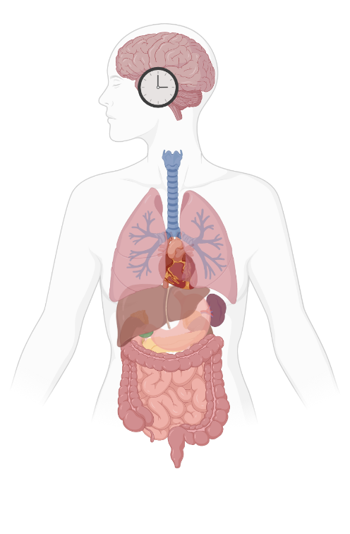
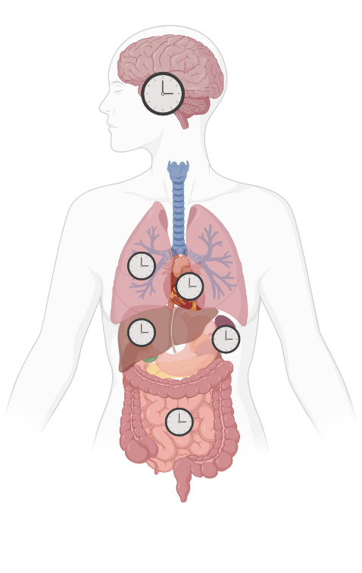
Circadian rhythm
Central clock
Self-sustained rhythm of ~ 24 hours
Synchronizes with environment:
entrainment
Peripheral clocks
Regulates sleep timing & other physiological rhythms
Created with biorender.com
Notes:
Endogenous rhythm, circa 24 hours in hormones melatonin and cortisol and core body temperature
generated by the Central clock in the brain
Besides the central clock there is a clock present in nearly every cell of the body called peripheral clocks
They are synchronized by the central clock (such as the central clock in the brain is the conductor of the peripheral clocks in the body)

Slide 22
Why is this research needed?
Although there are evidences on how environmental condition affects personal well-being, there are few initiatives that has been used to change environments for hospitalized patients.
Few studies that involve more than one environment parameter
Notes:
Sleep–wake disturbances are common in hospitalized patient, but few studies have assessed them systematically!
Circadian and sleep disturbance remain an ongoing problem for hospitalized patients.

Slide 23
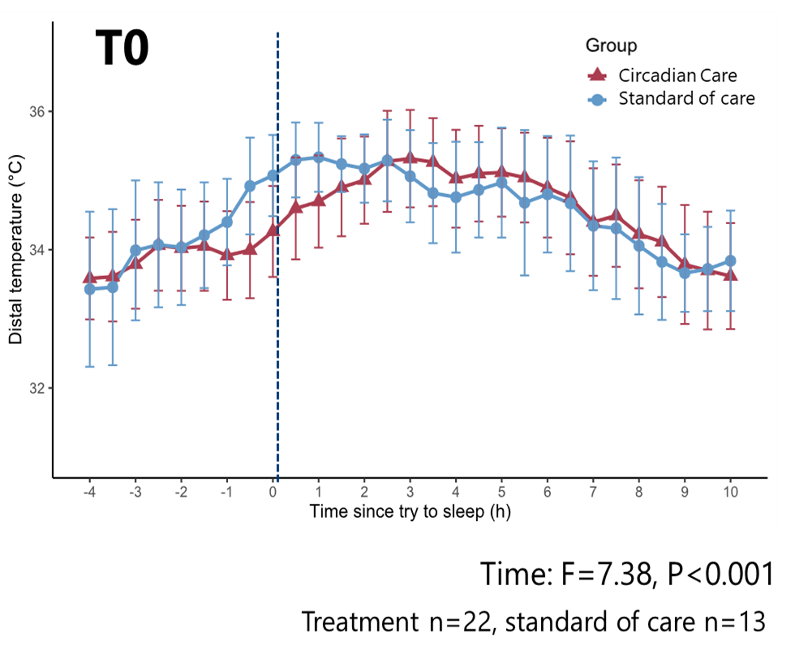
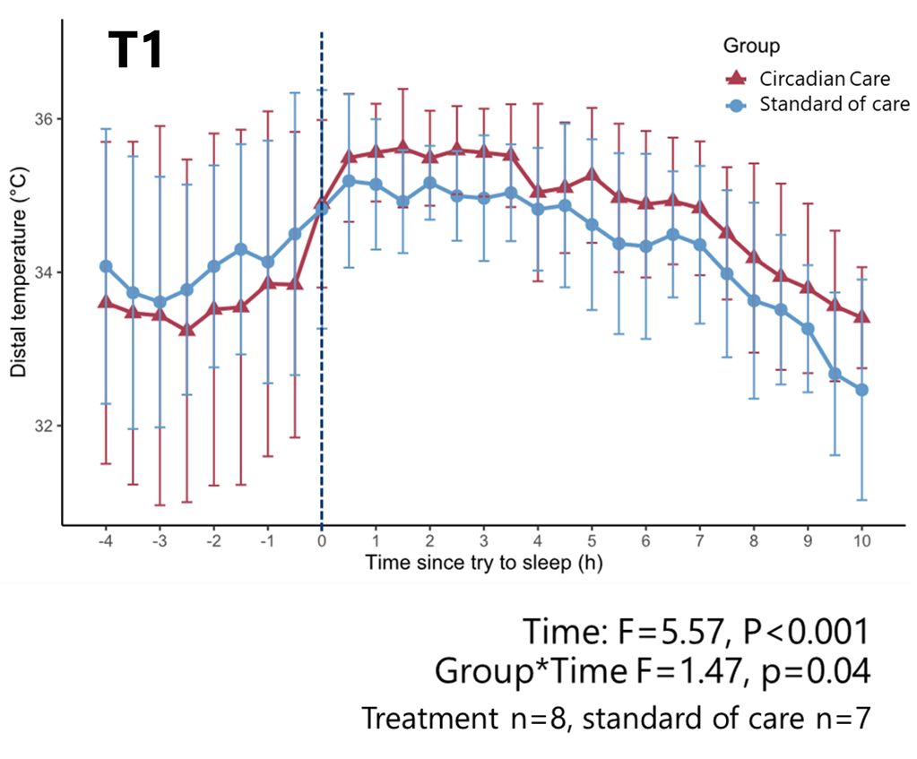
Distal skin temperature
Notes:
slight delay in increase in CC, but no significant differences between
T1 we can see a treatment effect since the temp variation is greater in the treatment group, being lower than the standard of care group before try to sleep time and higher after try to sleep time. The group*time interaction was significant.

Slide 24
 | Treated (n=25) | Untreated (n=25) | p value | t
HÖ | 58.4 ± 6.3 | 60.3 ± 11.2 | 0.466 | -0.734
PSQI | 7.8 ± 5.4 | 8.8 ± 4.4 | 0.513 | -0.660
Bed time (hh:mm) | 23:10 ± 00:43 | 22:51 ± 01:23 | 0.317 | 1.012
Start trying to sleep (hh:mm) | 23:23 ± 00:38 | 23:16 ± 01:14 | 0.675 | 0.422
Sleep latency (min) | 29.54 ± 46.79 | 20.52 ± 14.78 | 0.381 | 0.884
Sleep time (hh:mm) | 23:46 ± 00:47 | 23:37 ± 01:16 | 0.636 | 0.476
Number of awakenings (n) | 1.48 ± 1.18 | 2.39 ± 1.77 | 0.047 | -2.044
Wake up time (hh:mm) | 06:26 ± 01:17 | 06:54 ± 01:32 | 0.263 | -1.133
Get up time (hh:mm) | 06:47 ± 01:40 | 07:25 ± 01:41 | 0.136 | -1.518
Sleep quality (1-9) | 5.040 ± 2.524 | 4.909 ± 1.157 | 0.170 | 0.865
Notes:
At baseline, no differents between the two groups

Slide 25
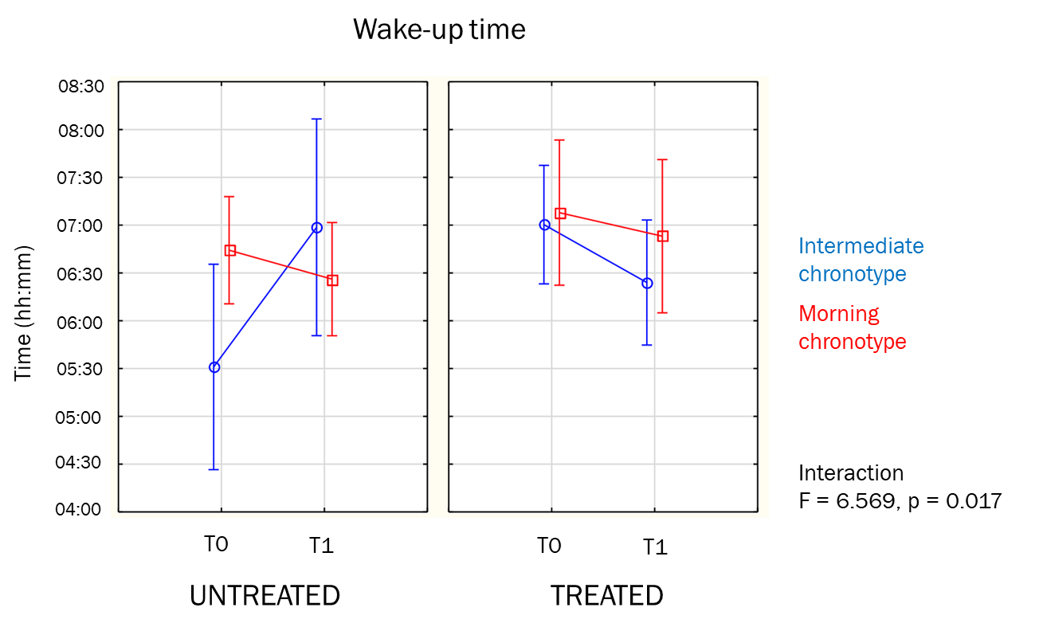
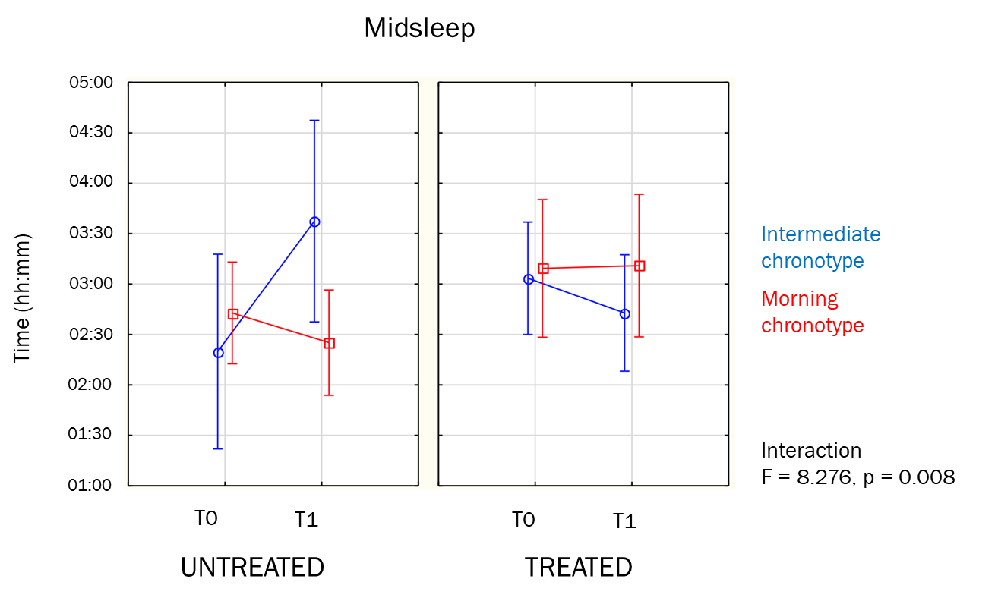
Actigraphy measures

Slide 26
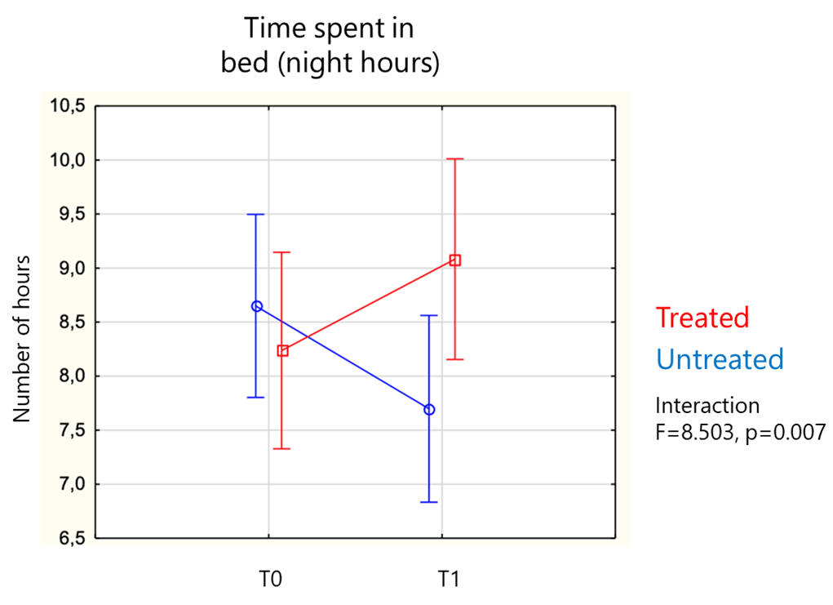
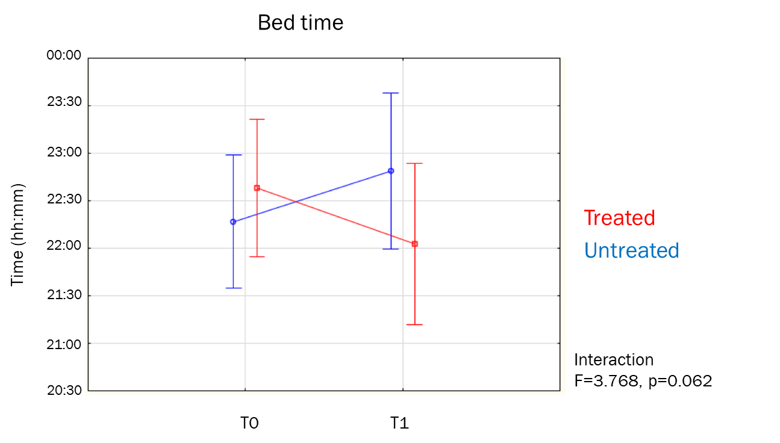
Sleep diaries

Slide 27
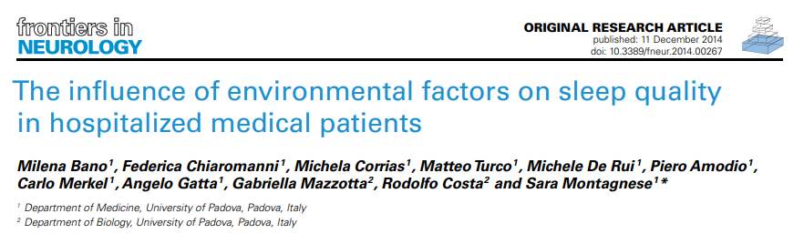
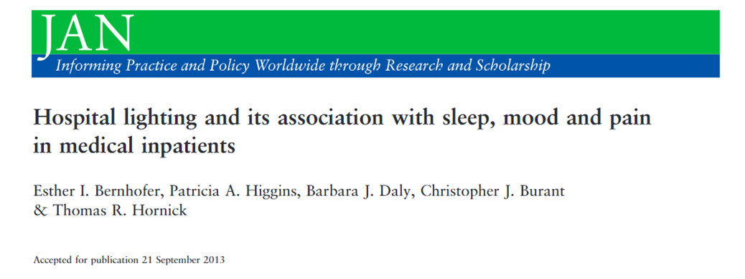
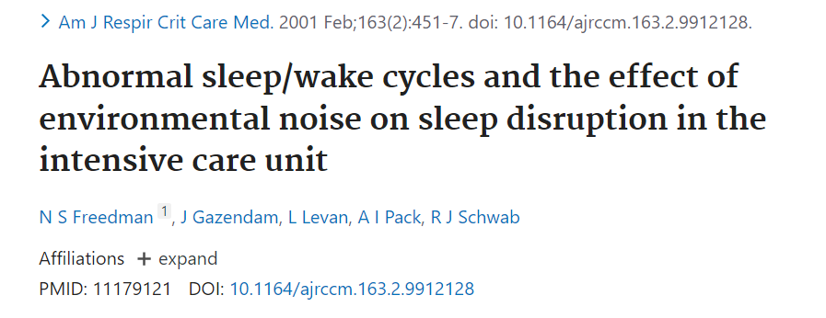
Notes:
When entrainment is compromised : circadian disorders
This misalignment appears to increase the risk for chronic disease, with impact seen in many areas of human health, including hypertension, diabetes, and cancer risk (Forman, Curhan, & Schernhammer, 2010; McMullan, Schernhammer, Rimm, Hu, & Forman, 2013; Schernhammer et al., 2001).

Slide 28
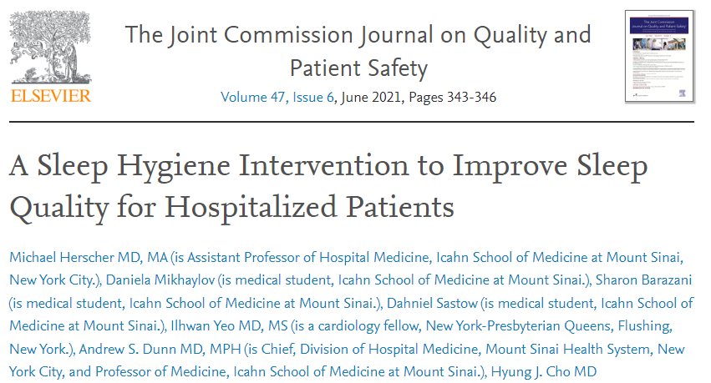

Slide 29
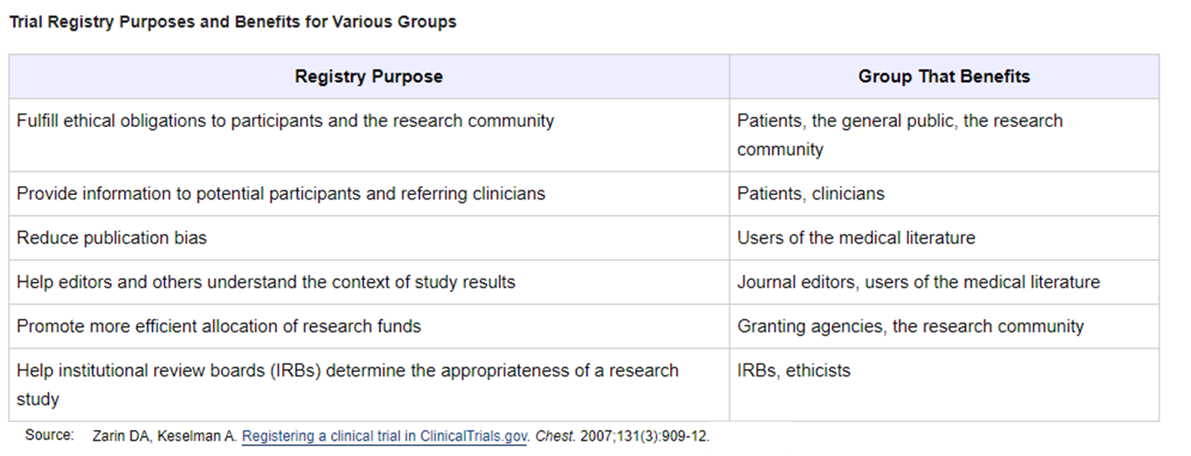
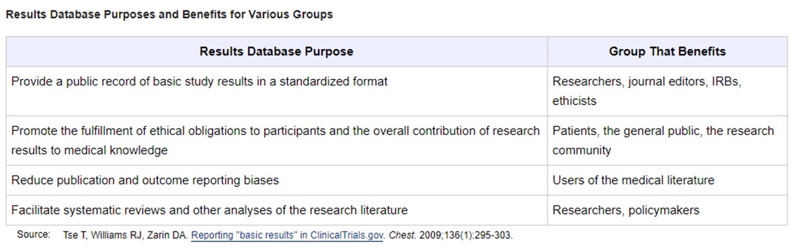

Slide 30
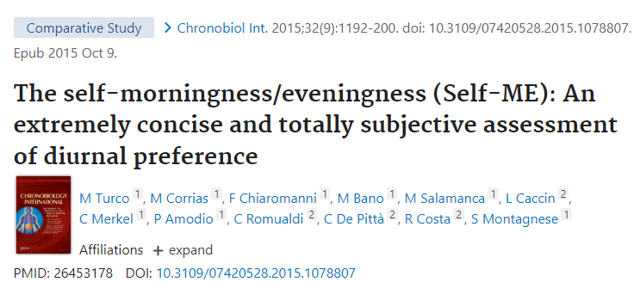
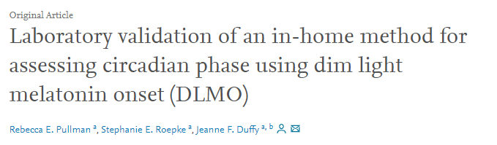

Slide 31
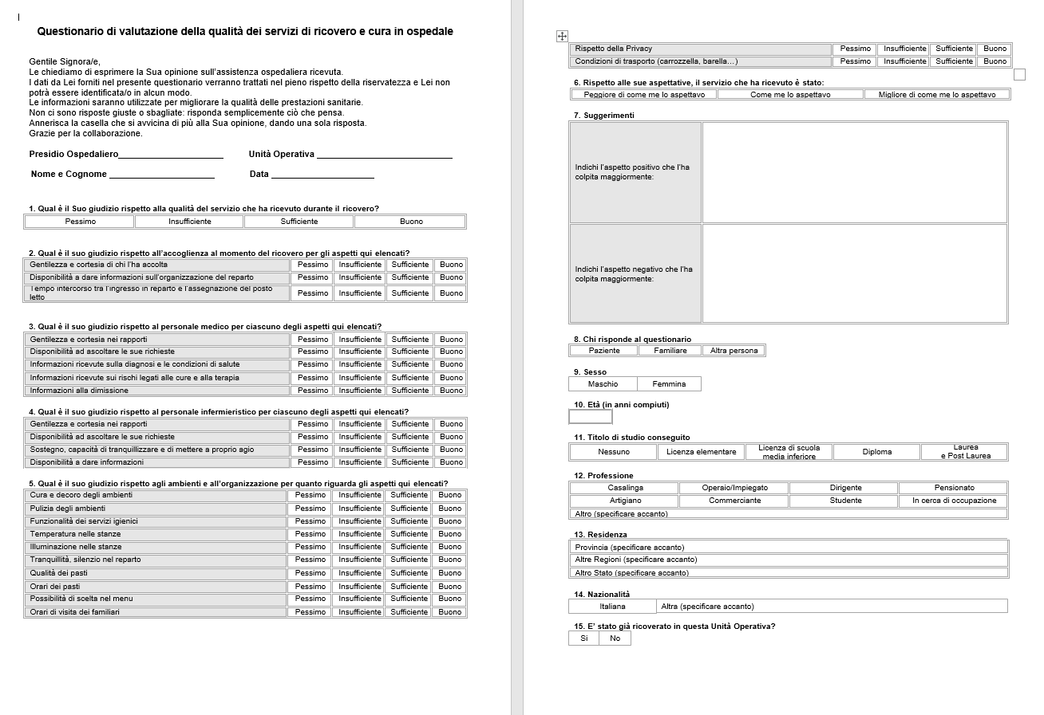
Quality hospitalitazion assessment

