Slide 1
Establishing a circadian-friendly University: developing strategies to improve students’ sleep and academic performance
Gianluca Giusti
PhD student,
University of Surrey

Slide 2
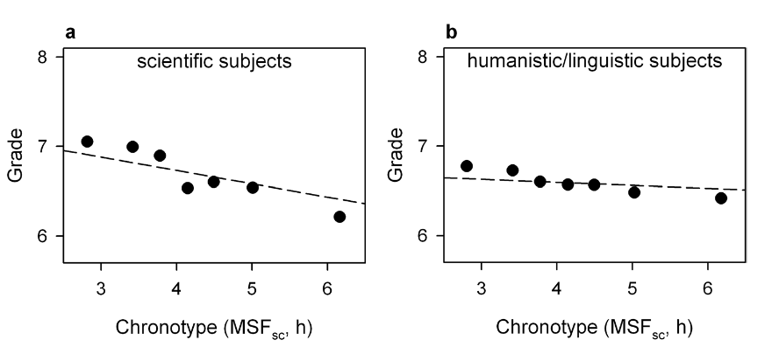
Influence of Chronotype (MSFsc) on grades by subject area in High school students
Zerbini et al., 2017

Slide 3
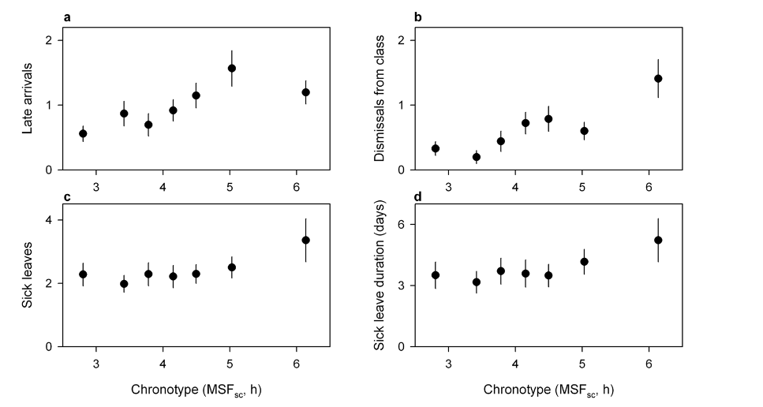
Influence of Chronotype (MSFsc) on school attendance in High school students
Zerbini et al., 2017

Slide 4
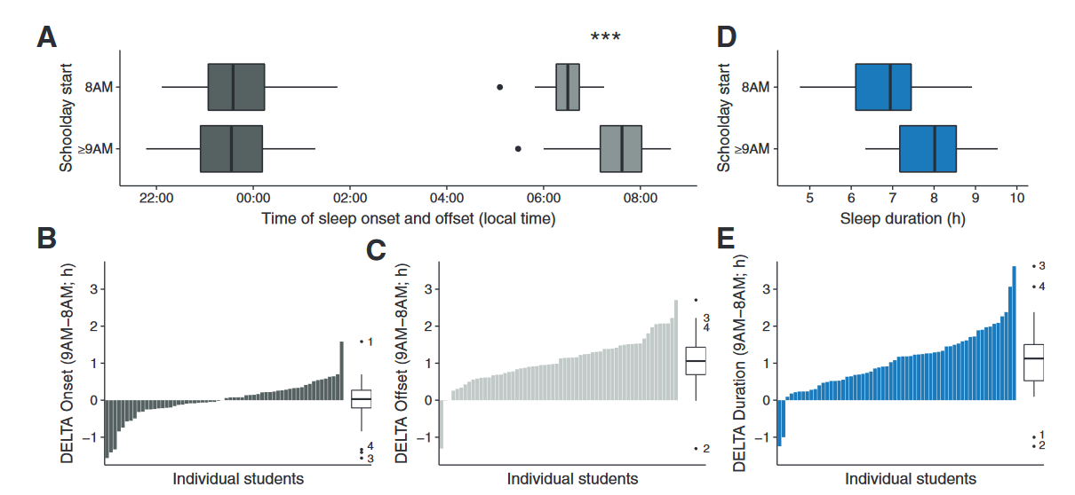
Comparison of sleep parameters between 8am days and >9 am days in the flexible system
Winnebeck at al., 2020
Notes:
Comparison of sleep parameters between 8 am-days and ≥9 am-days in the flexible system. Sleep parameters are from sleep diaries of the subcohort for 8 am/9 am-comparison (n = 60). (A) Average sleep onset (dark gray) and offset (light gray) times on 8 am and ≥9 am-days. The average absolute difference in these measures for each individual is depicted in (B) for sleep onset times (DELTA Onset) and in (C) for sleep offset times (DELTA Offset). (D) Average sleep duration on 8 am and ≥9 am-days. Each individual’s average difference in sleep duration is depicted in (E) in absolute terms (DELTA Duration) and in (F) in relative terms (RATIO Duration).

Slide 5
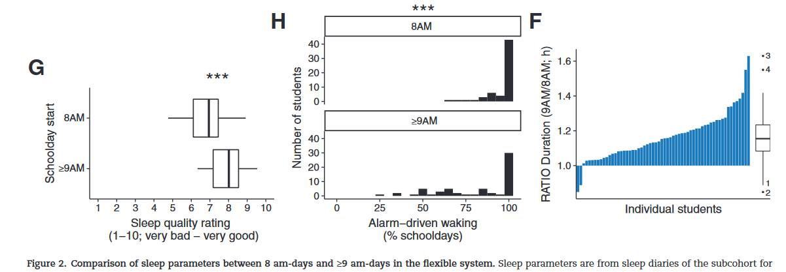
Winnebeck at al., 2020
Notes:
Comparison of sleep parameters between 8 am-days and ≥9 am-days in the flexible system. Sleep parameters are from sleep diaries of the subcohort for 8 am/9 am-comparison (n = 60). Each individual’s average difference in sleep duration is depicted in (E) in absolute terms (DELTA Duration) and in (F) in relative terms (RATIO Duration) (G) Average sleep quality rating. (H) Distributions of individuals’ frequency of alarm-driven waking on schooldays. Statistical analysis was performed via paired t-tests or Wilcoxon signed-rank tests with *p < 0.05; **p < 0.01; ***p < 0.001; Tukey boxplots. Numbers 1–4 identify the 4 over- and underbenefitting students as per DELTA duration in E

Slide 6
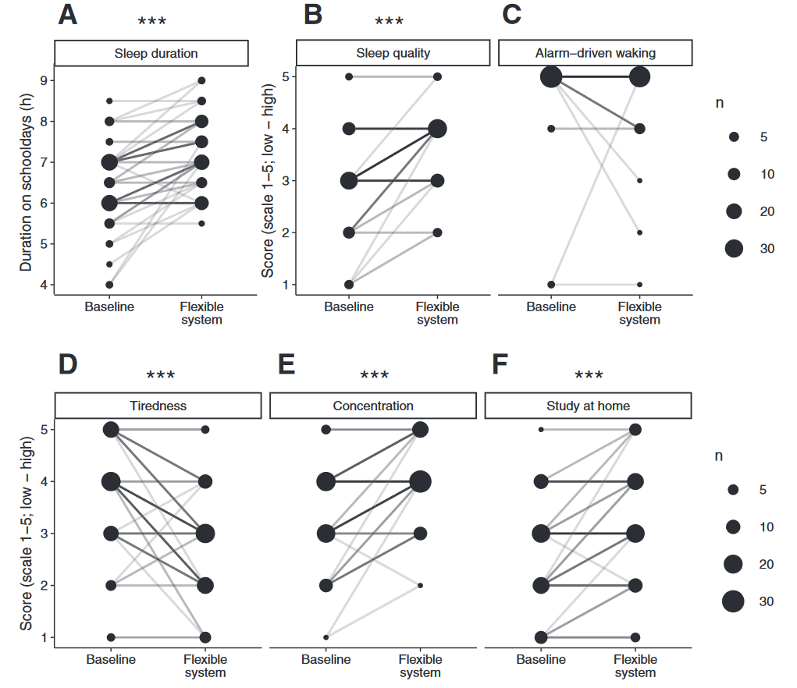
Student-rated benefit from the flexible system
Winnebeck at al., 2020
Notes:
Student-rated benefit from the flexible system. Depicted are the results of the final survey in which participants rated their subjective experience in the conventional and flexible system. Data are from 56 students of the main cohort of 65 (9 students did not return the final survey). (A) Sleep duration on schooldays in hours. (B) Sleep quality on schooldays. (C) Frequency of alarm-driven waking per school week. Subjective score for (D) tiredness during class, (E) ability to concentrate during class, and (F) ability to study at home after school. Data are displayed in bubble charts to represent the categorical nature of the data. The area of each circle indicates the number of data points represented. Lines show trajectories of each individual (within-subject trajectories); the darkness of each line illustrates the number of individual trajectories it represents. *p < 0.05; **p < 0.01; ***p < 0.001 for Wilcoxon signed-rank tests.

Slide 7
In-depth analyses of lecture timing in relation to University academic performance are not available.
Changes in University lecture start times have not been attempted to date.

Slide 8
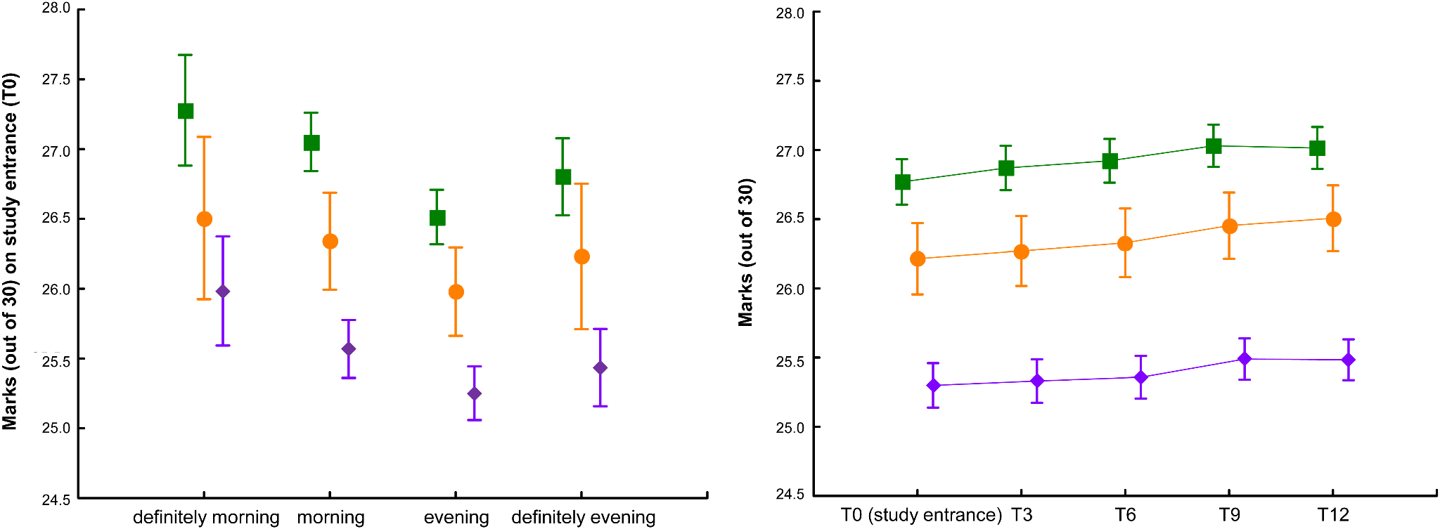
Average marks by study subject, chronotype, and over time

Slide 9
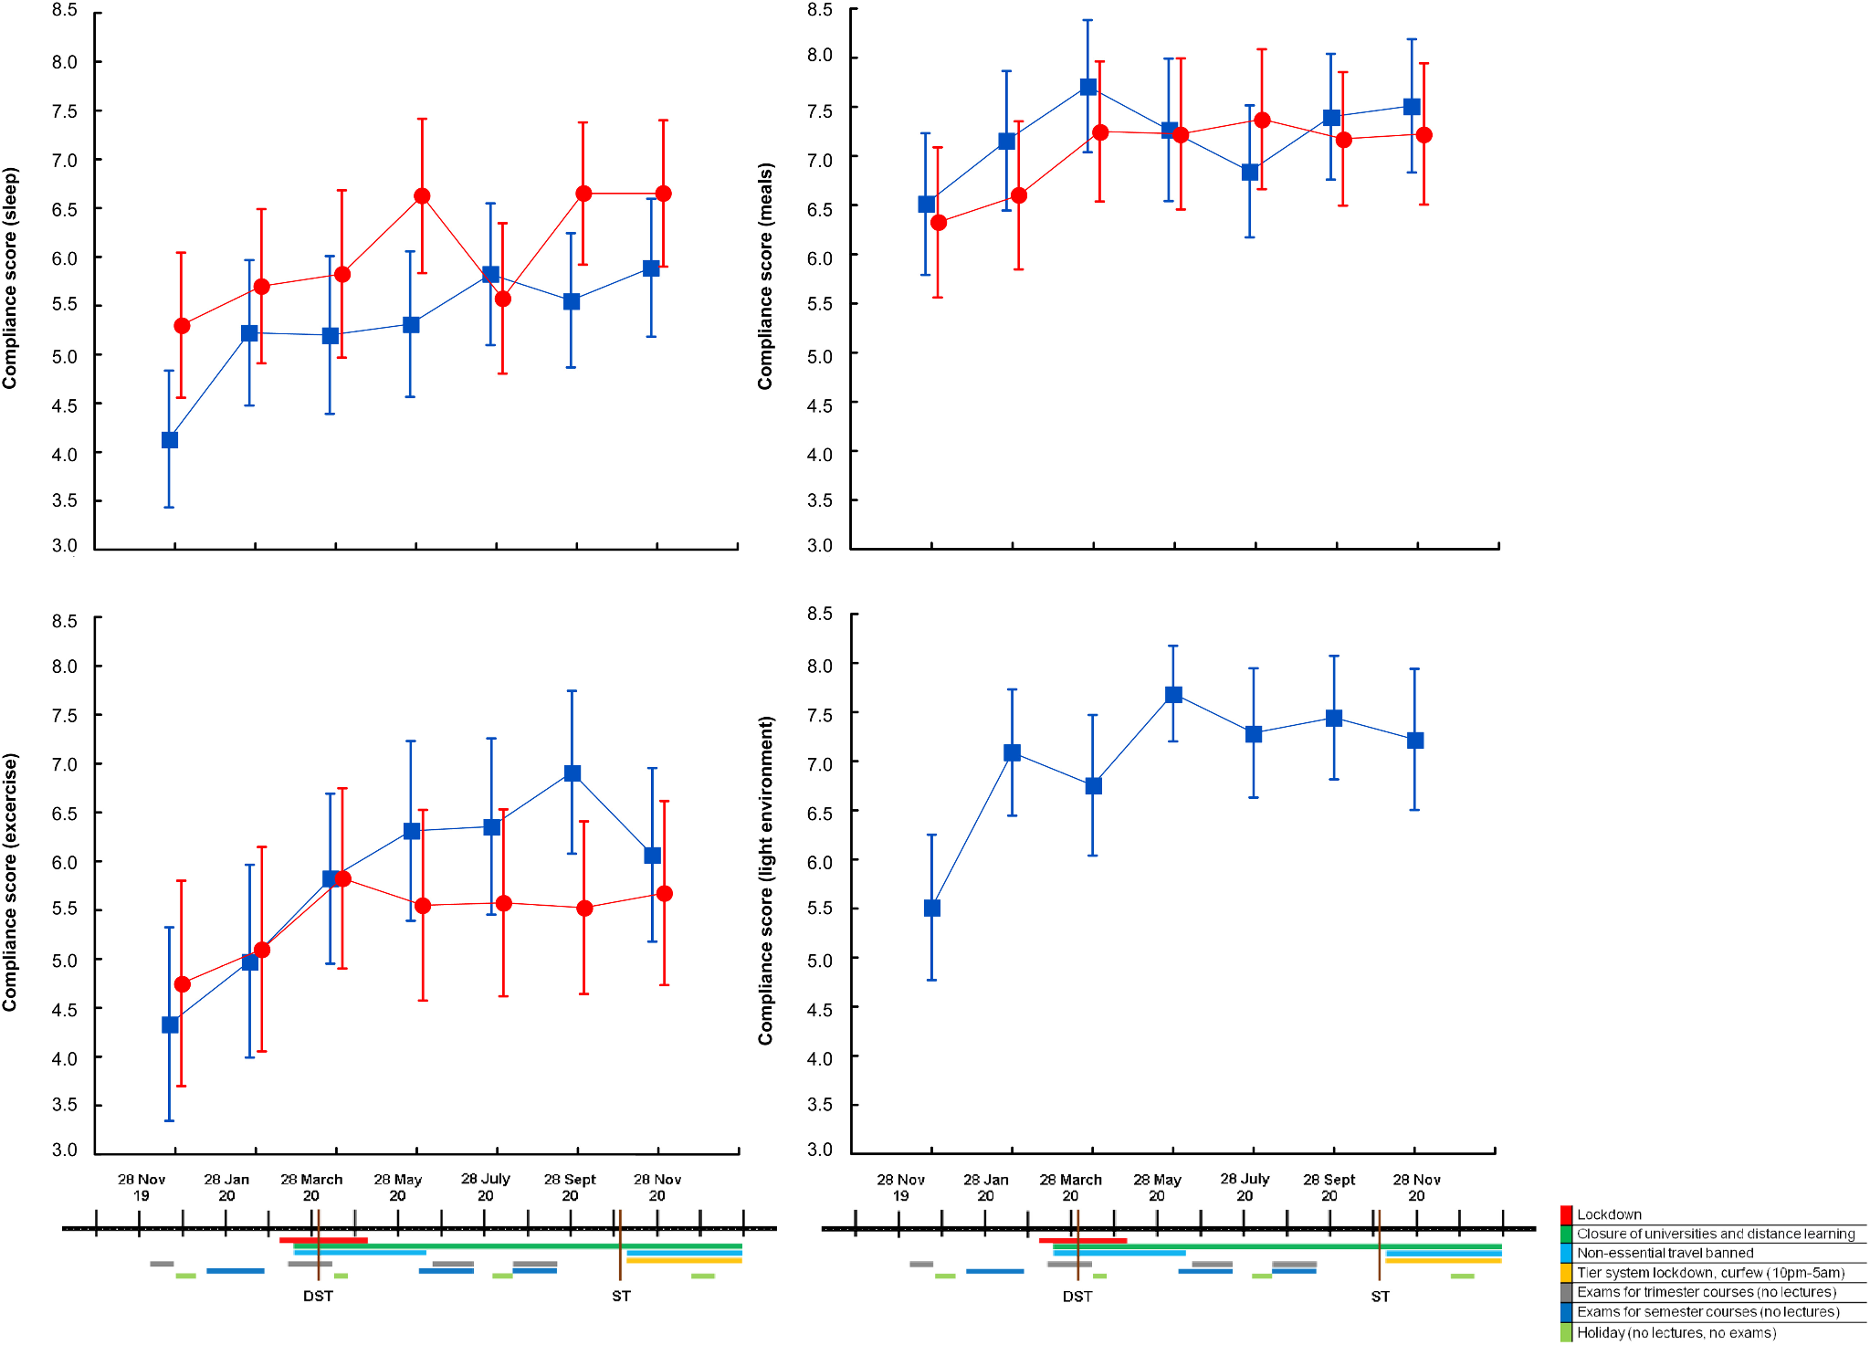

Slide 10
Aims:
The aims of this project are to collect comprehensive sleep quality and timing information, to evaluate the impact of a university welfare-based circadian hygiene initiative on sleep and academic performance, and to determine whether there is a correlation between the starting time of lectures and academic performance.

Slide 11
Hypothesis
Students starting later will perform and sleep better than their counterparts starting earlier

Slide 12
These results will represent the basis to plan a subsequent, prospective study comparing regular lecture times and delayed lecture times

Slide 13
Outcomes:
Compound index based on number of exams passed and average marks
Sleep quality assessed by a validated questionnaire

Slide 14

University Timetables Analysis
identify any available degrees/courses which already have 1-hour mismatched starting times
compare academic performances by lectures starting times compare sleep-wake indices by lectures starting times

Slide 15
Benefits of a Circadian-Friendly University
Improved sleep quality and duration.
Better academic performance and grades.
Reduced risk of mental health problems.
Increased attendance and engagement.

Slide 16
Expected impact
Strong basis for the subsequent research, as randomised controlled study comparing regular lecture times VS DSST in a group of collaborating Universities
Influence public opinion and major stakeholders within both public health and education authorities (‘impact case’ study)
Sensitise University students, who are most likely to become decision-makers as adults, to circadian hygiene and circadian education.

Slide 17
Thank you for your time and attention

