Slide 1
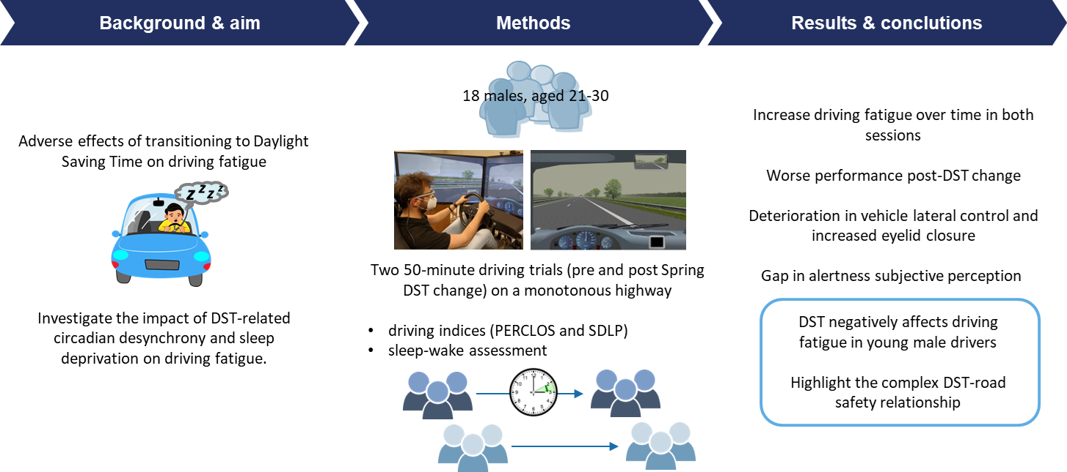
Study 2: Driving fatigue and DST study
Notes:
*performed in two different days, separated by one week exactly. The first trial took place in the week preceding the switch to DST (March 21st – 25th, 2022), the second one in the week after (March 28th – April 1st, 2022)
*an average temperature between 20°C and 22°C, and a 4-lx illuminance were maintained in the driving simulator room.
*compare with a historical control group that underwent two trials without a time change
*hindering fatigue-coping strategies

