Slide 1



Spotify & Youtube Songs Statistics FRANGI Francesco Frigato, Andrea Felline, Gianluca Antolini
Master’s Degree in Computer Engineering
Database 2 – Group Project - A.Y. 2023/23
Notes:
Intro

Slide 2

TOPIC
Spotify Songs
Streams, music info, artists, albums, playlists,
…
Youtube Videos
Views, likes,
comments, channels,
…
Notes:
Topic is popular spotify songs (with all their related info) and their related youtube video

Slide 3





DATASETS
DATA CLEANING
Different timestamps, duplicate data, …
DATA MERGE
Id matching
DATA LOADING
Entities and data properties,
object properties linking
SERIALIZATION
Single Turtle (.ttl) file
Spotify and Youtube
Spotify songs
https://www.kaggle.com/datasets/salvatorerastelli/spotify-and-youtube
https://www.kaggle.com/datasets/sujaykapadnis/spotify-songs
Id Artist Url_spotify Track Album Album_type Uri Danceability Energy Key Loudness Speechiness Acousticness Instrumentalness Liveness Valence Tempo Duration_ms Url_youtube Title Channel Views Likes Comments Description Licensed official_video Stream
track_id track_name track_artist track_popularity track_album_id track_album_name track_album_release_date playlist_name playlist_id playlist_genre playlist_subgenre danceability energy. key loudness mode speechiness acousticness instrumentalness liveness valence tempo duration_ms
Notes:
Datasets from kaggle, 30.8 MB (about 20k rows) and 8 MB (28k rows), all the columns, some of them we removed

Slide 4
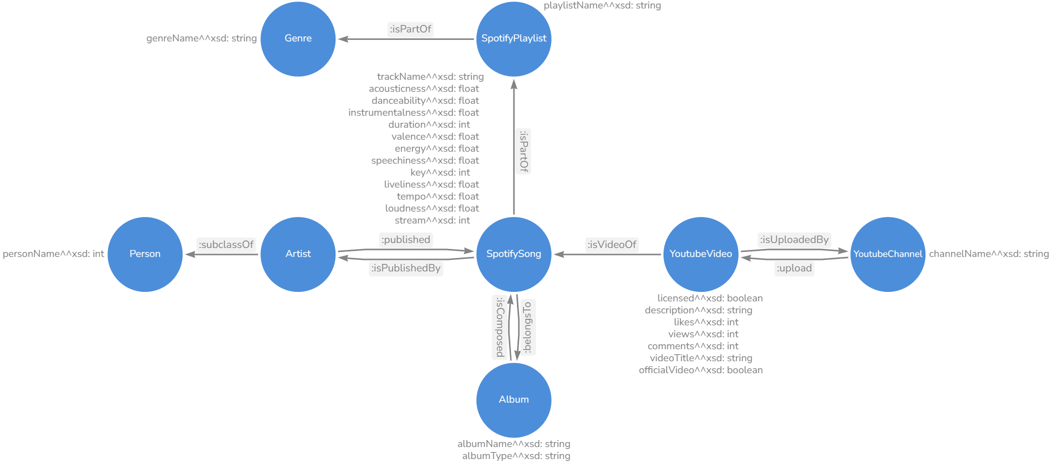
PIPELINE
DATA CLEANING
Different timestamps, duplicate data, …
DATA MERGE
Id matching
DATA LOADING
Entities and data properties,
object properties linking
SERIALIZATION
Single Turtle (.ttl) file
Notes:
- Once we choosed the datasets we worked on the cleaning and merging of the data - There were some main problems with the data that we had to fix:
- multiple rows for the same song because of multiple artists
- different values of number of streams
- we keep the highest value because is a MONOTONOUS INCREASING FUNCTION of time (highest = most recent)
- similar reasoning for comments, likes, views and officiality of a video
- officiality is not a monotonous increasing function of time so WE ASSUMED CHRONOLOGICAL ORDER
- Then we merged the data based on track id (managing eventual different data format of some fields)
- At this point we had a single file with all the data
- We loaded it on a graph
- For each row we added the individuals and the links between them
- The final graph was then serialized and saved in turtle format

Slide 5
ONTOLOGY
Notes:
When loading the data we followed our ontology schema.
As you can see the main class is about the spotify songs,
and many of the others are linked to it.
But lets take a look in details.

Slide 6
ONTOLOGY
Notes:
Here you can see the data properties of the songs (name, duration, num streams)
Then there is the class of Artists that published a song, that are a subclass of person.
The class person was made by hand, and not imported from FOAF, since we only needed the name.
Here there is the playlists class (a song is part of a playlist).
A playlist has
- a name
- a main genre
- a more specific subgenre
(we differenciate them by using skos broader and narrower).

Slide 7

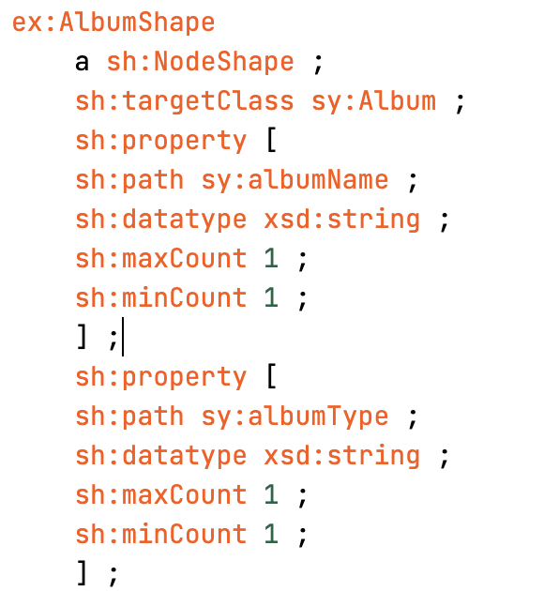
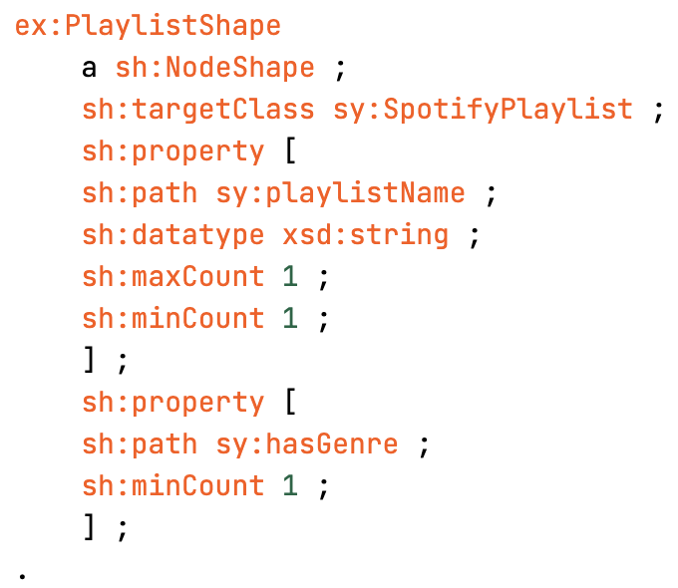
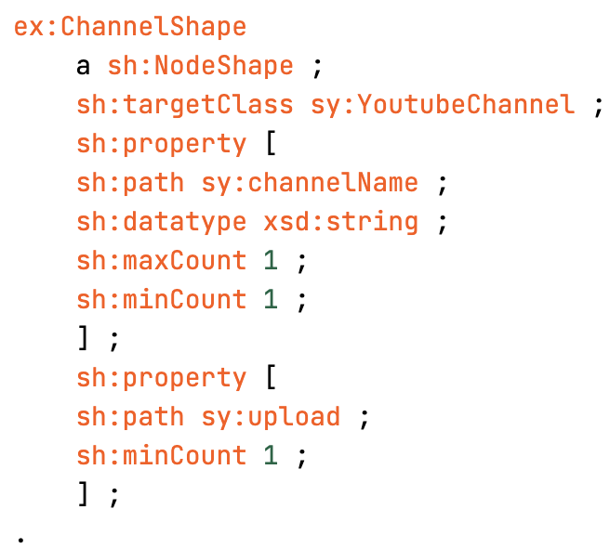
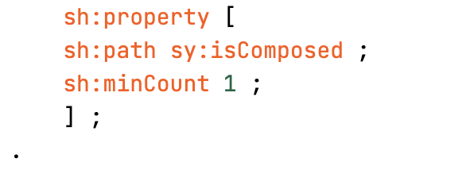
ONTOLOGY
Notes:
Then there is the Album class
We use it also to differentiate between the varius album types (normal album, single, compilation).
Then there is the part of youtube videos, which is composed by:
- the video class itself, with some information about it
- the class of the channels that uploaded it

Slide 8
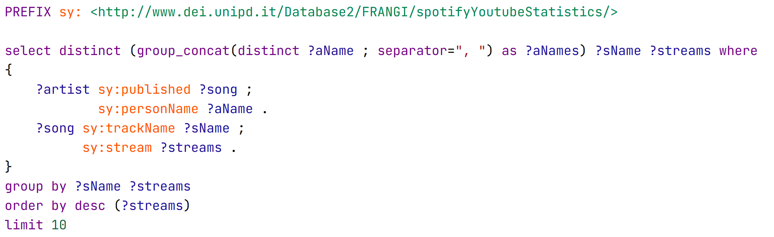
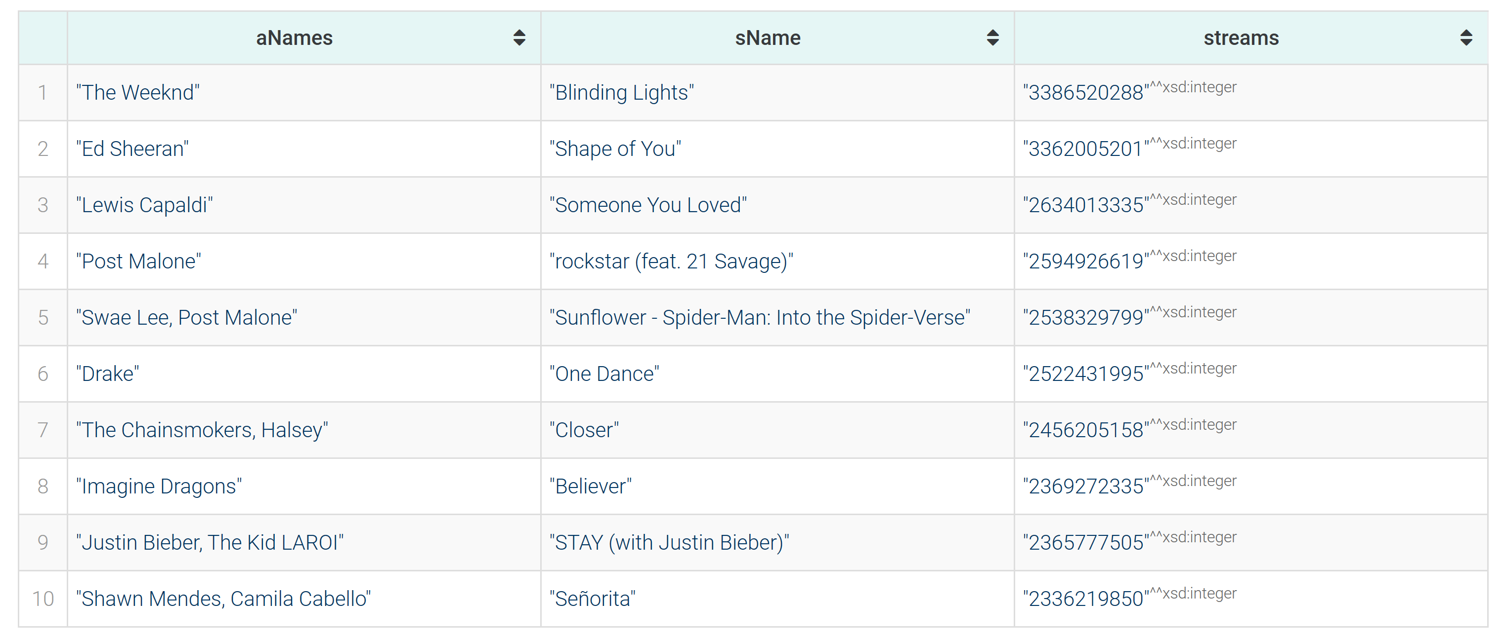
VALIDATION
Notes:
Once the data was loaded, we implemented some SHACL shapes to ensure the correct format of all data.
No problems were found and so the validation process returned positive results.
Now my colleague will show the main queries that we proposed for this database.

Slide 9
QUERIES (1)
Top 10 songs by number of streams

Slide 10
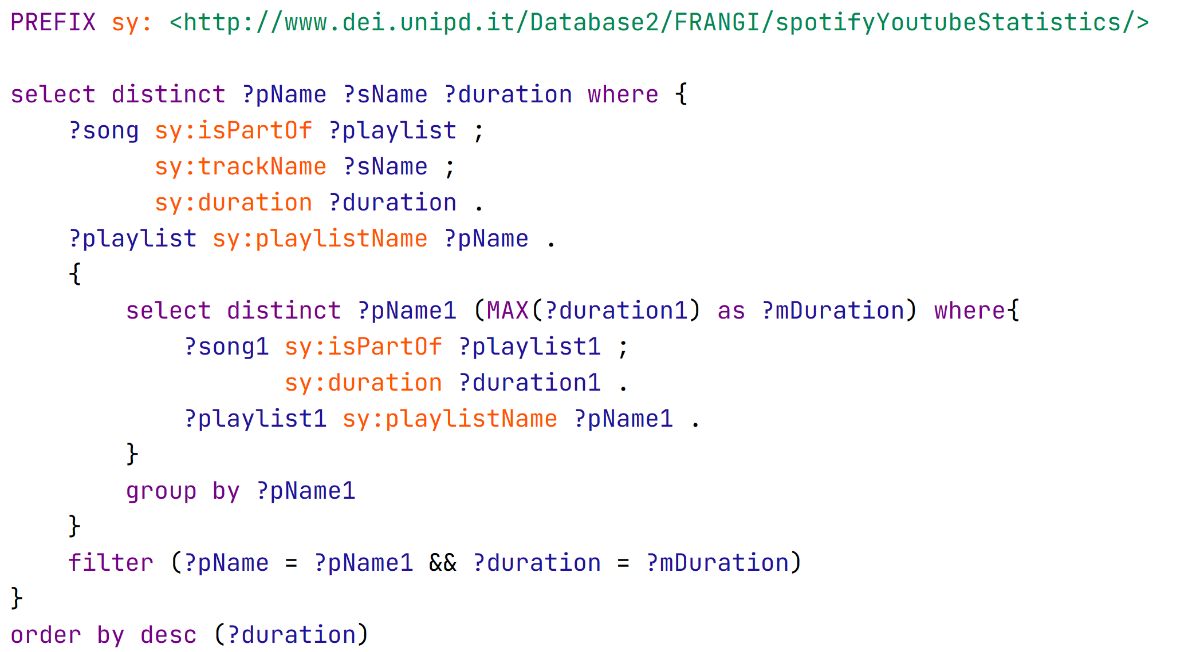
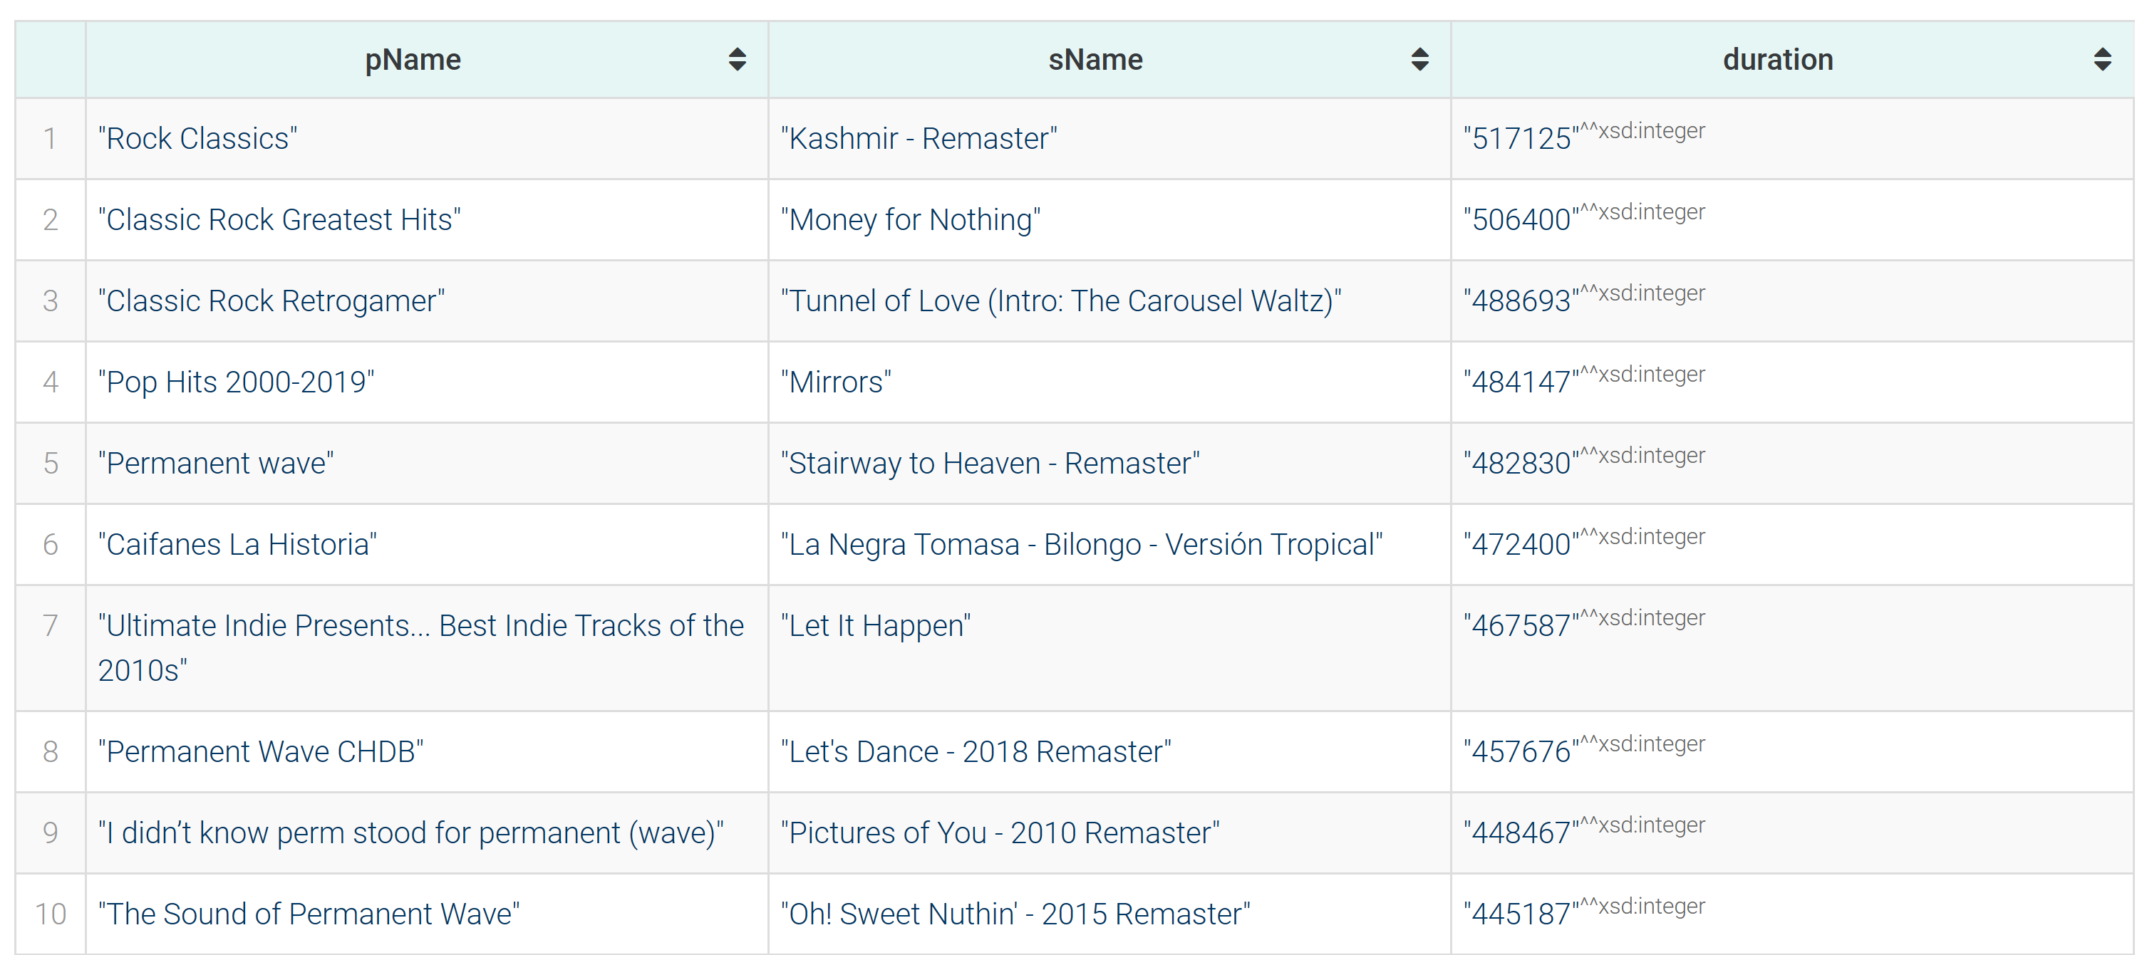
QUERIES (2)
Song with max duration for each playlist, ordered by duration

Slide 11
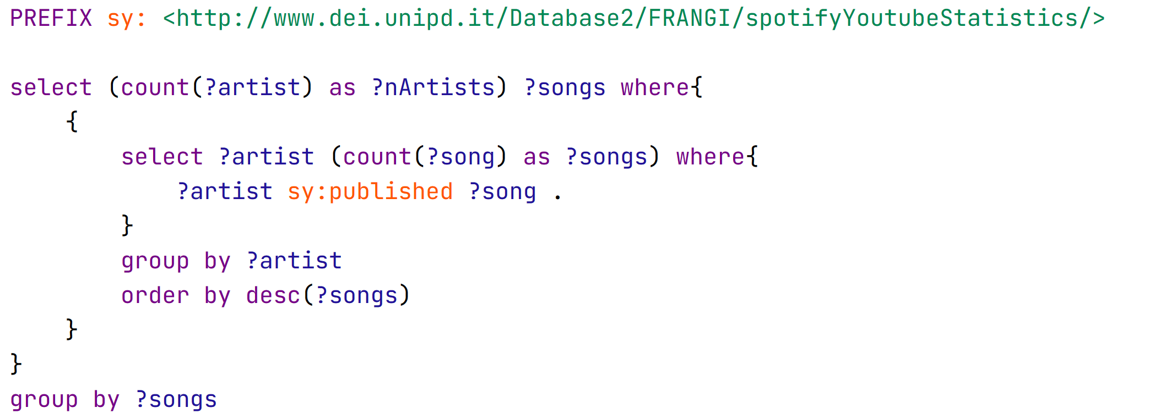
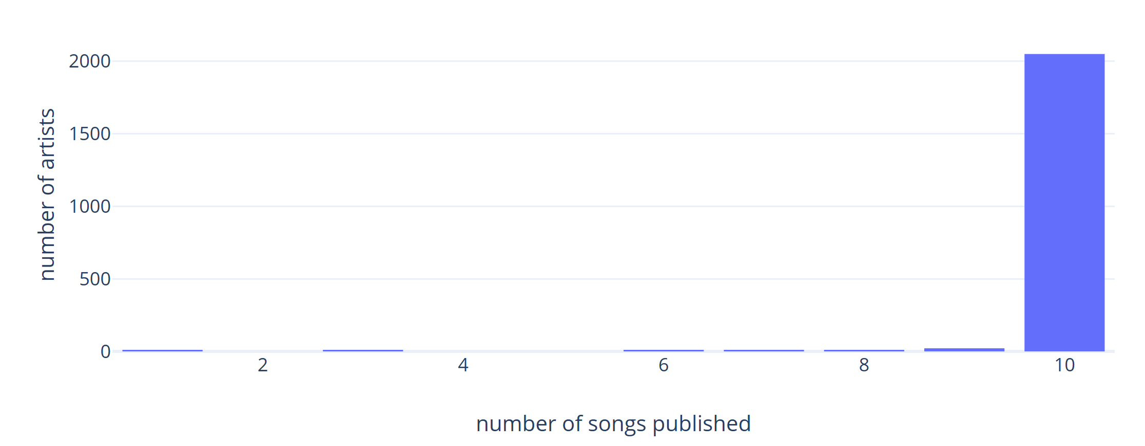
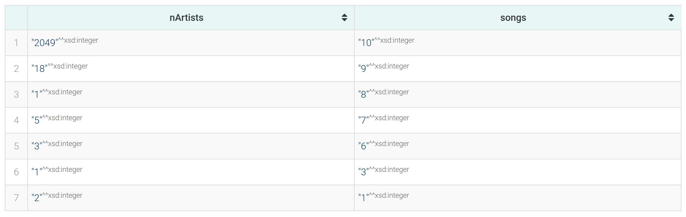
QUERIES (3)
How many artists published n songs
Notes:
Note discrepancy, maybe is because of the datasets we used.

Slide 12
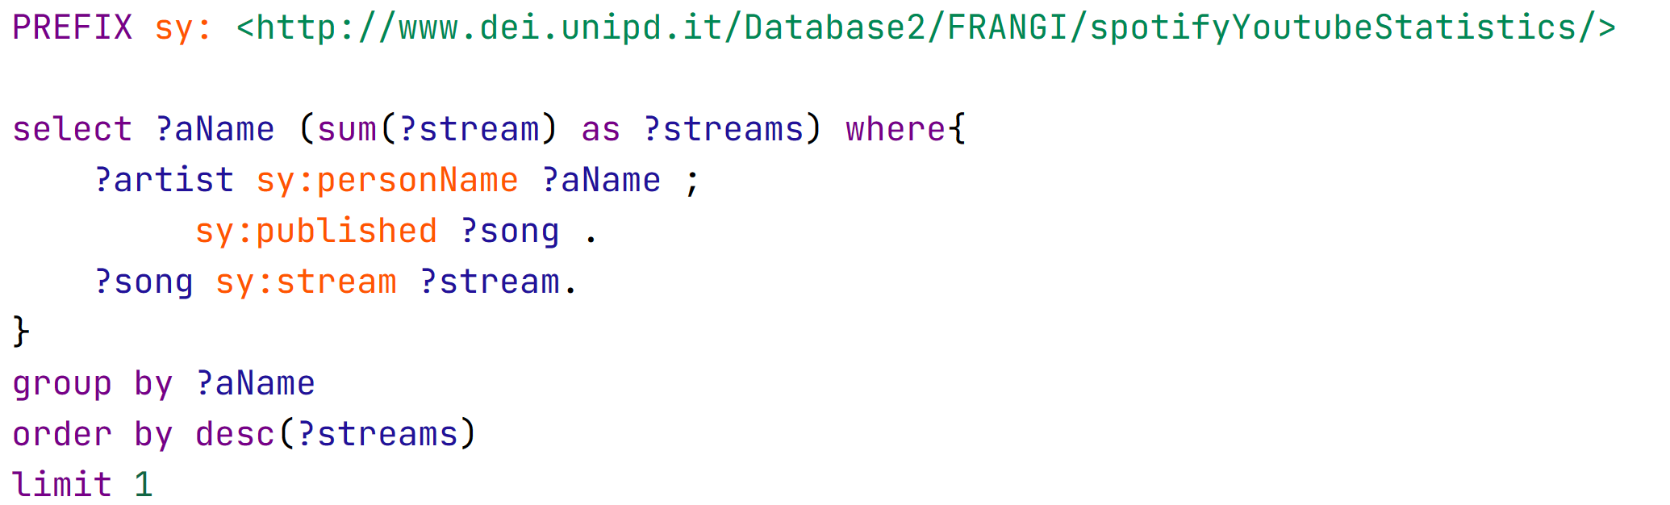
QUERIES (4)
Artist that produced the most streams

Slide 13
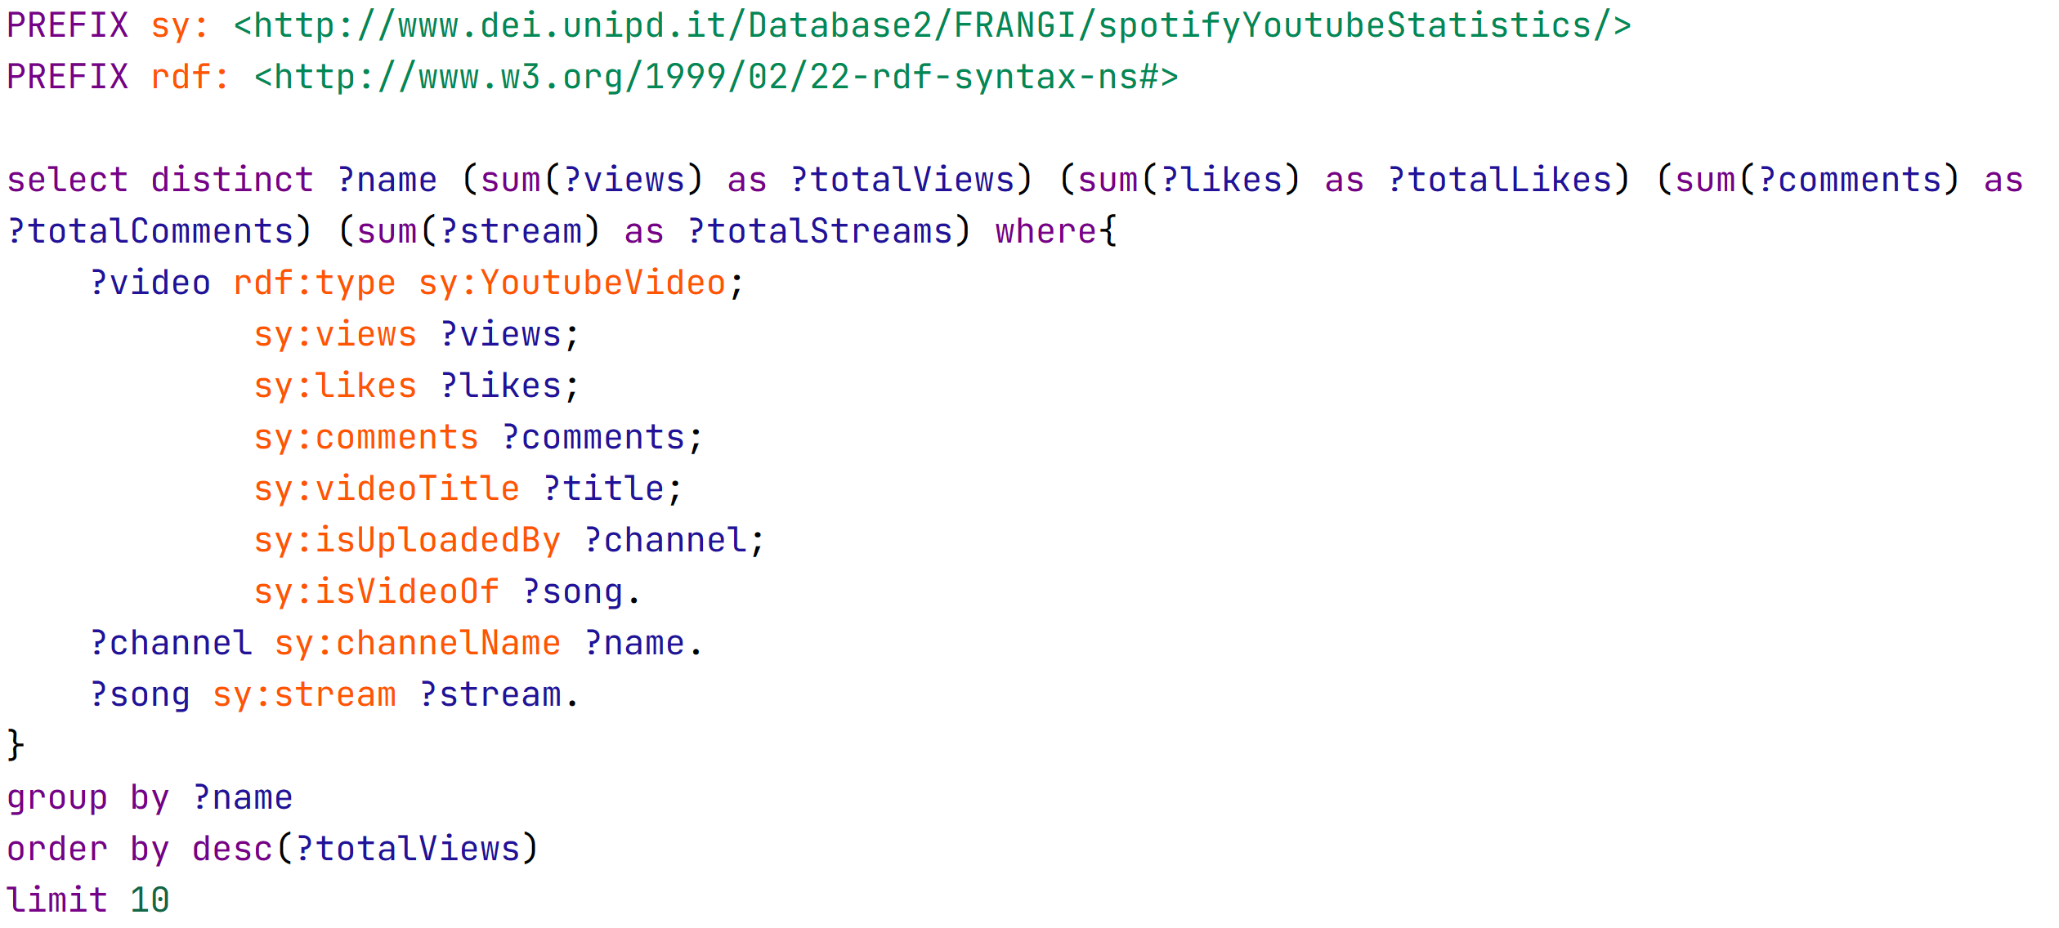
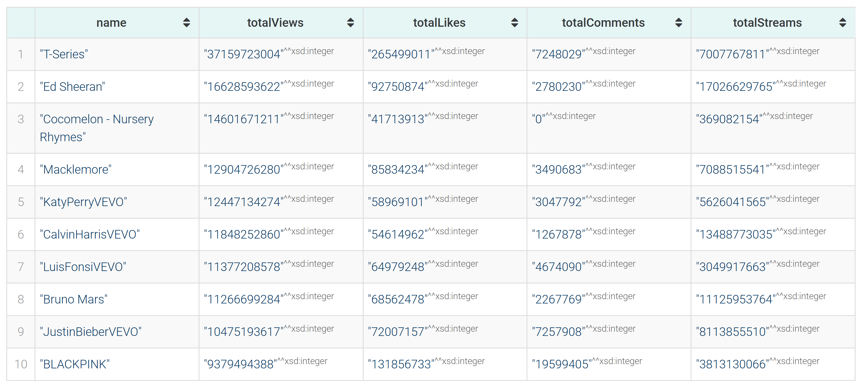
QUERIES (5)
Top 10 channels by number of views, with also likes and comments
Notes:
Turns out Indian music is very listened, also kids music, but they disabled comments

Slide 14
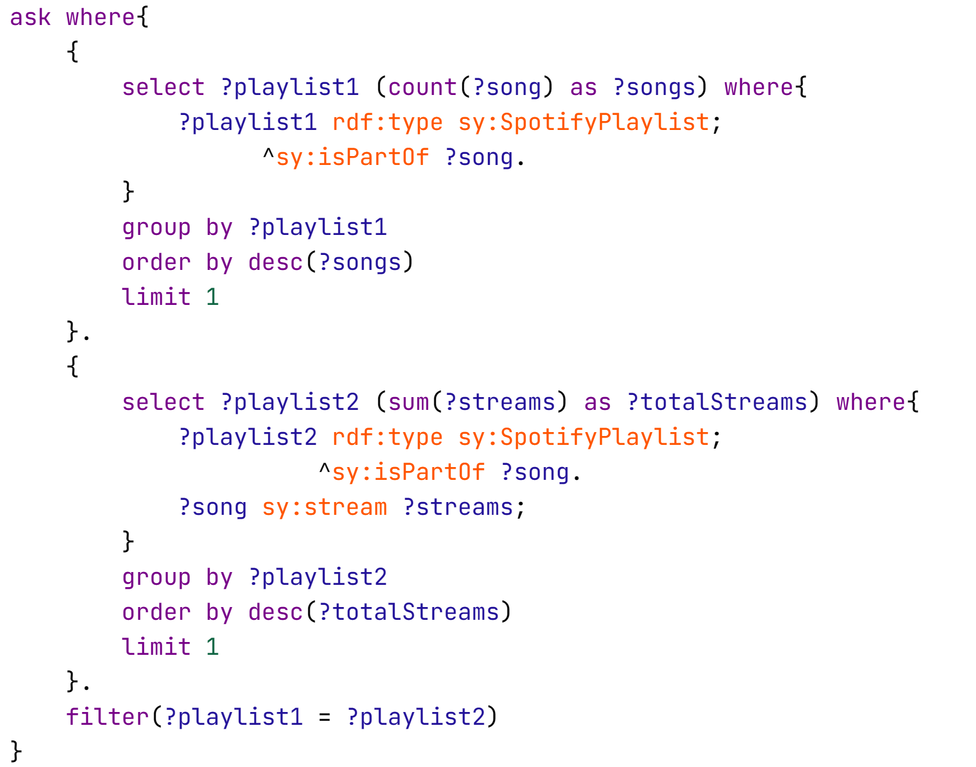

QUERIES (6)
Is the playlist with most songs the one with most streams?
Notes:
Expected, there are songs with very big n of streams

Slide 15
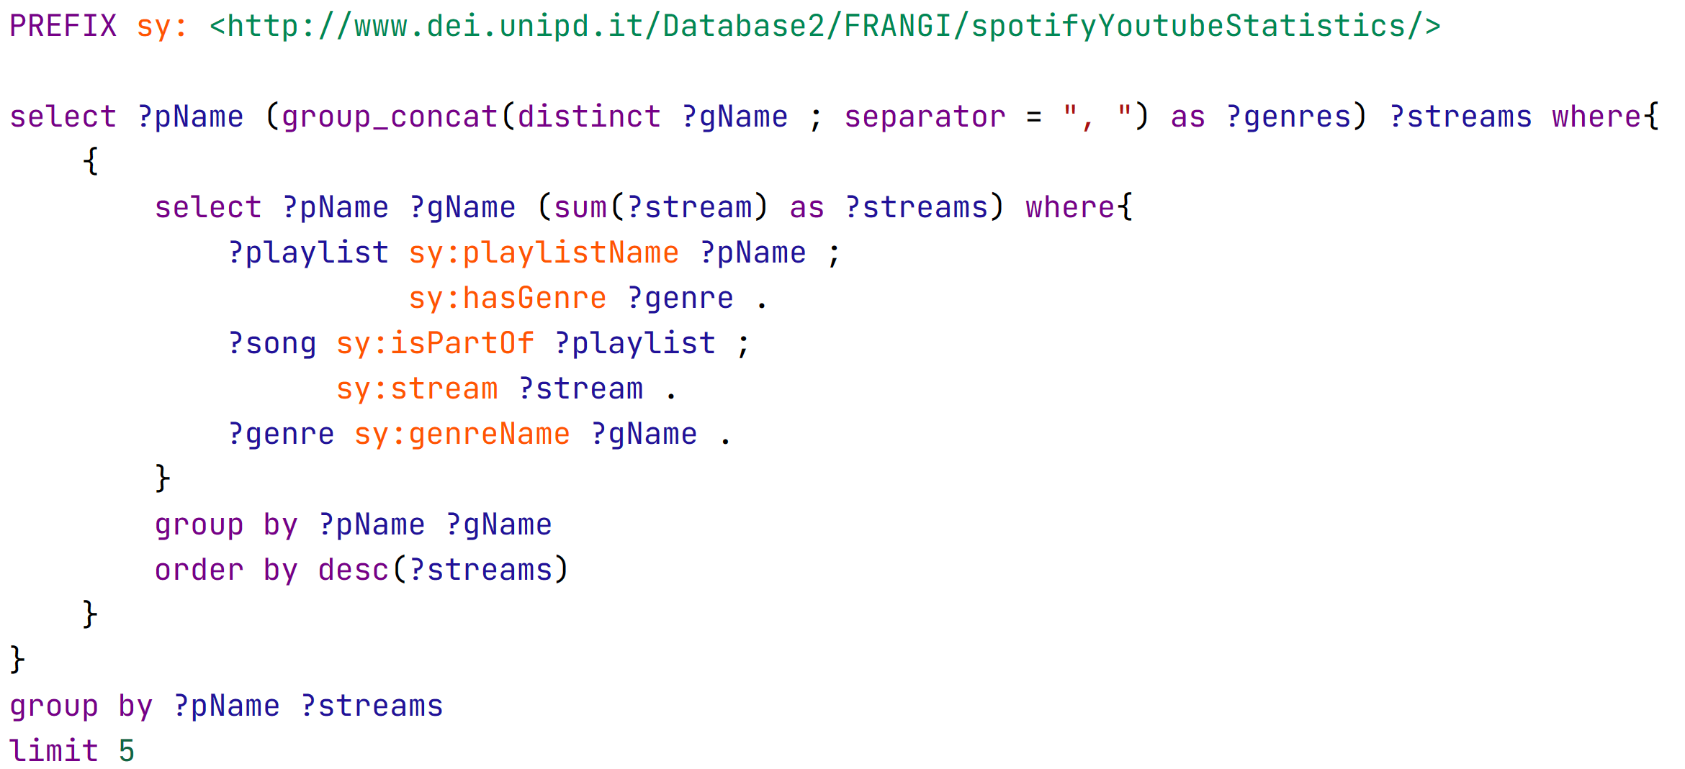
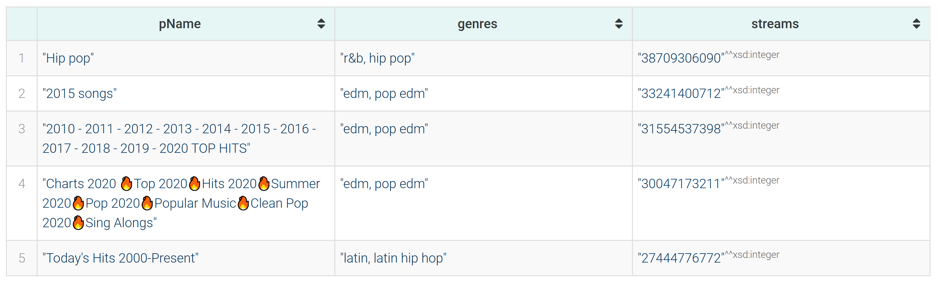
QUERIES (7)
Genre of top 5 playlists with most played songs
Notes:
Shows what people like atm.

Slide 16
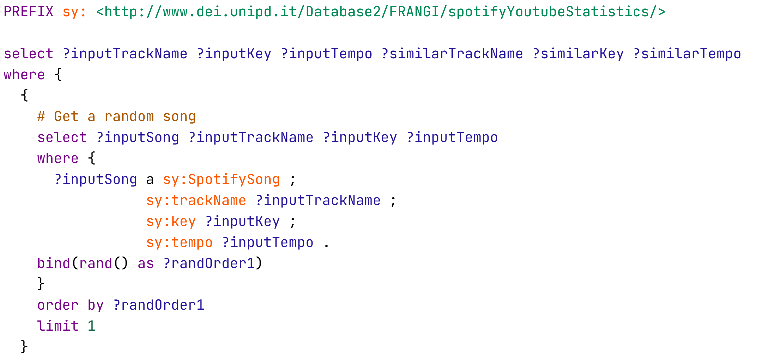
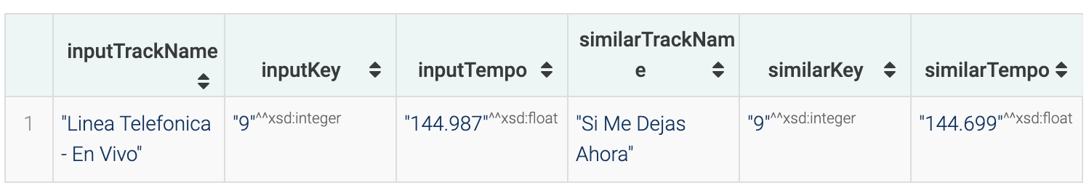
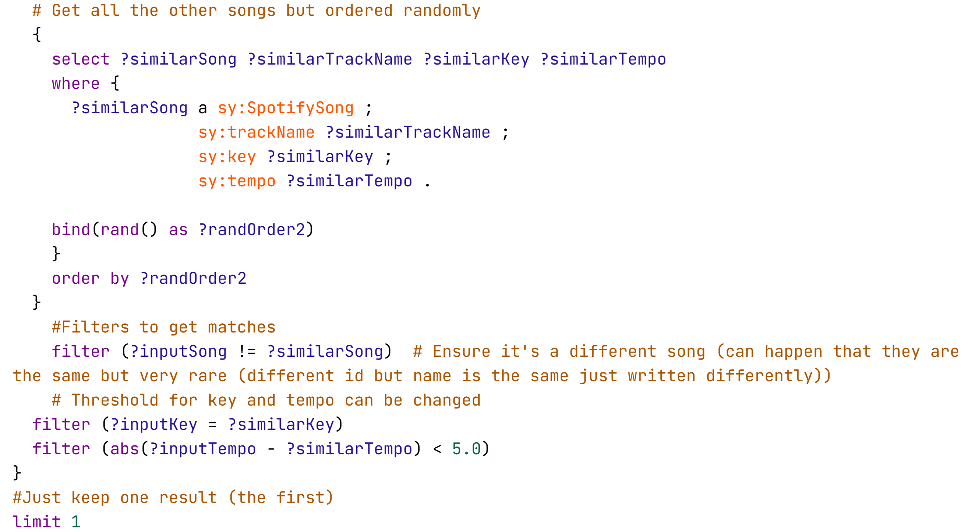
QUERIES (8)
Random pair of songs that have similar tempo and key (useful for DJs)
Notes:
Note the use of random in graphDB, very hard to use, using bind and rand() as random ordering. Can choose threshold of key and tempo similarity.

Slide 17
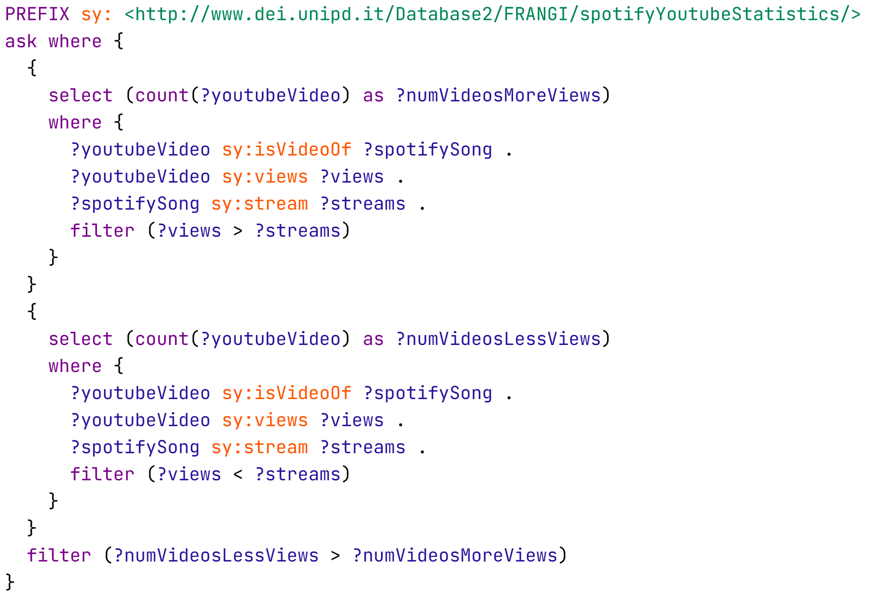

QUERIES (9)
Are number of streams of a song higher than the number of views of their related youtube video (in general)?

Slide 18
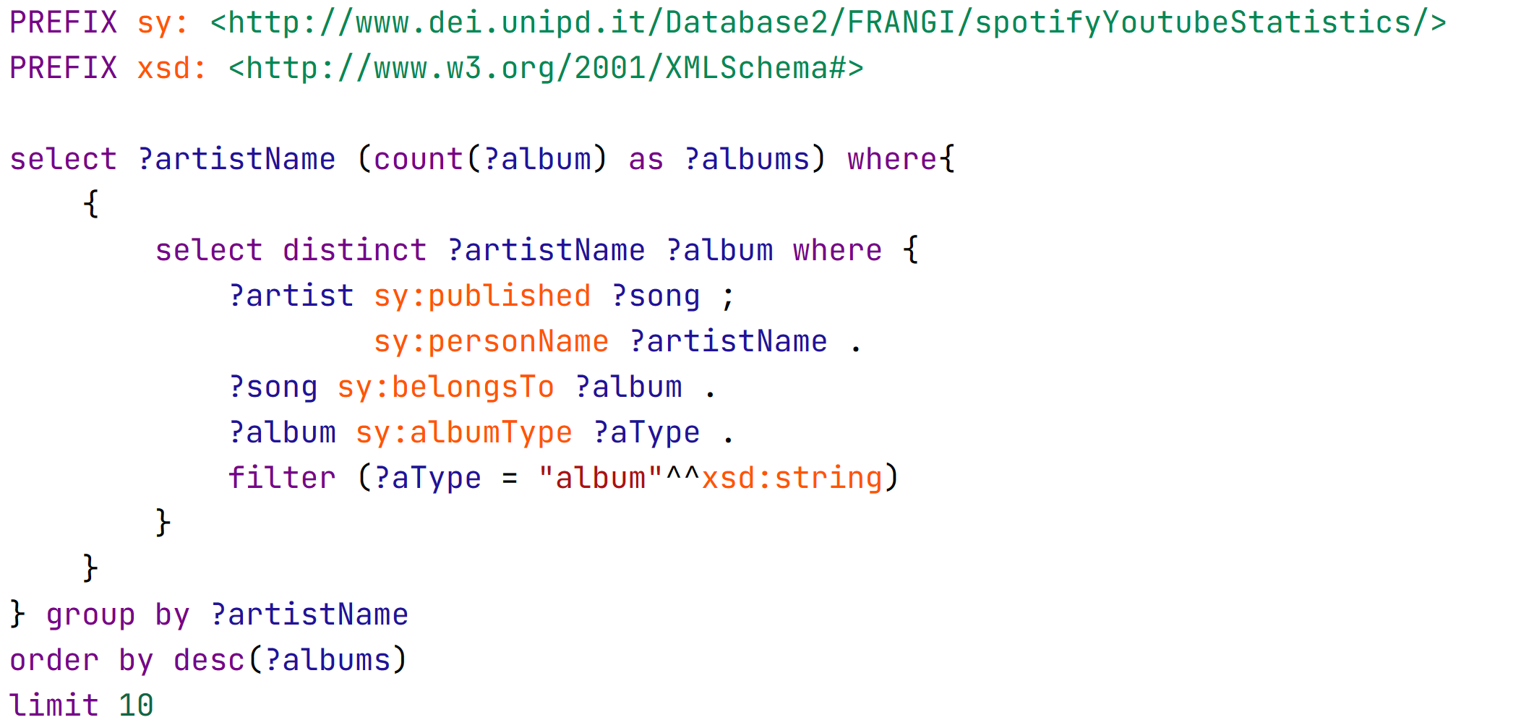
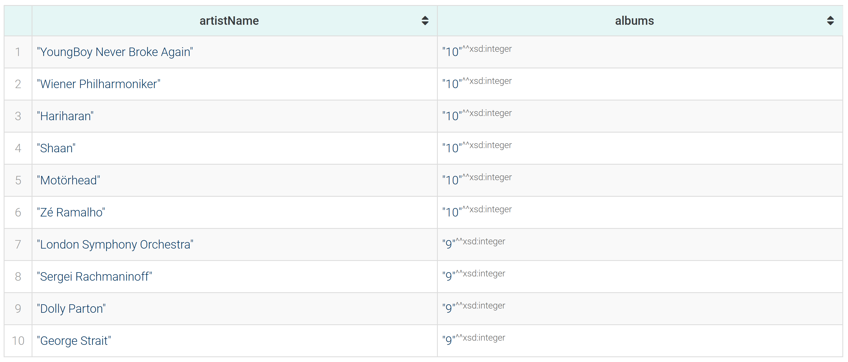
QUERIES (10)
Top 10 artists by number of albums published

Slide 19
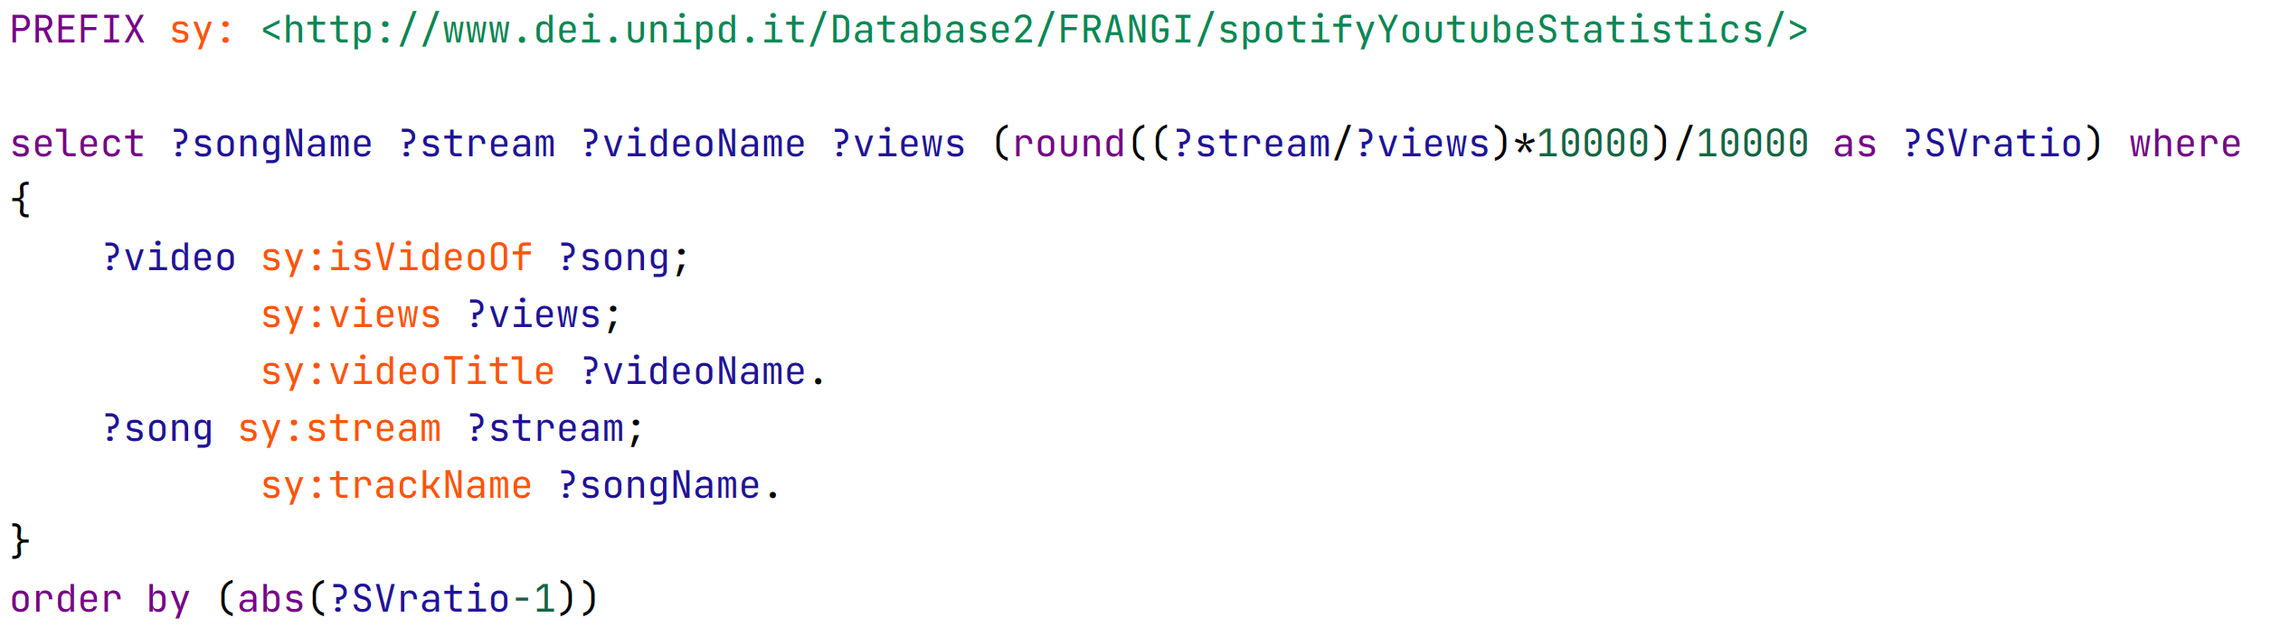
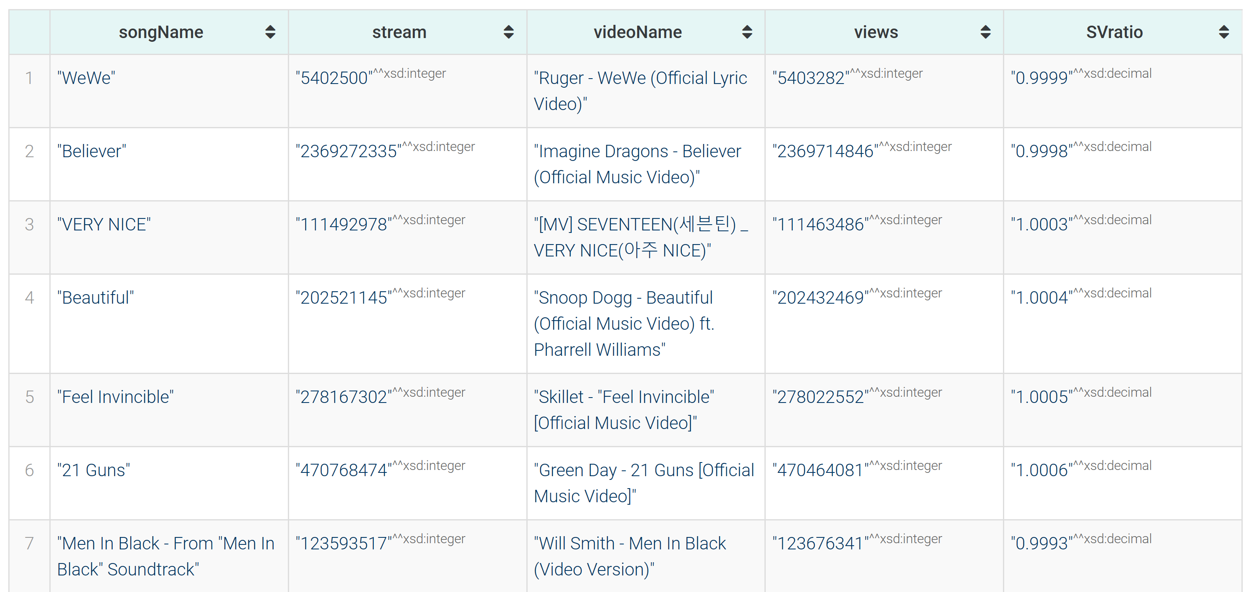
QUERIES (11)
Relation between YouTube video views and corresponding song
Notes:
We found out some songs with similar streams to yt video views. A lot of popular songs have way higher streams than views.

Slide 20
THANKS FOR YOUR ATTENTION!
Francesco Frigato, Andrea Felline, Gianluca Antolini

