Slide 1


WEB APPLICATIONS EAGTF GROUP
Gianluca Antolini
Tommaso Bergamasco
Andrea Felline Francesco Frigato Emilio Risi
Web Applications
A.Y. 2023/2024 Master’s Degree in
Computer Engineering

Slide 2



Simplify meal planning by looking at suggested recipes based on the ingredients you already have!
Just input your available ingredients and voila!

Slide 3


MAIN FEATURES
• Search suggested recipes
• Get reccommended recipes • Look at top ranked recipes
Insert new recipes that
other users can look at
Like & save your
favourite recipes

Slide 4
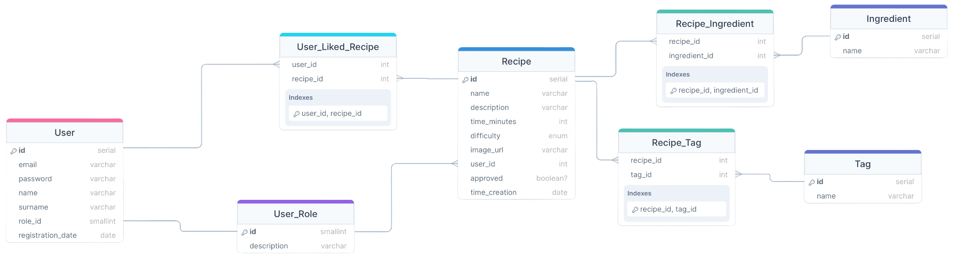
DATABASE - INFO
Food.com - Recipes and Reviews dataset

Slide 5

DATABASE - SCHEMA

Slide 6
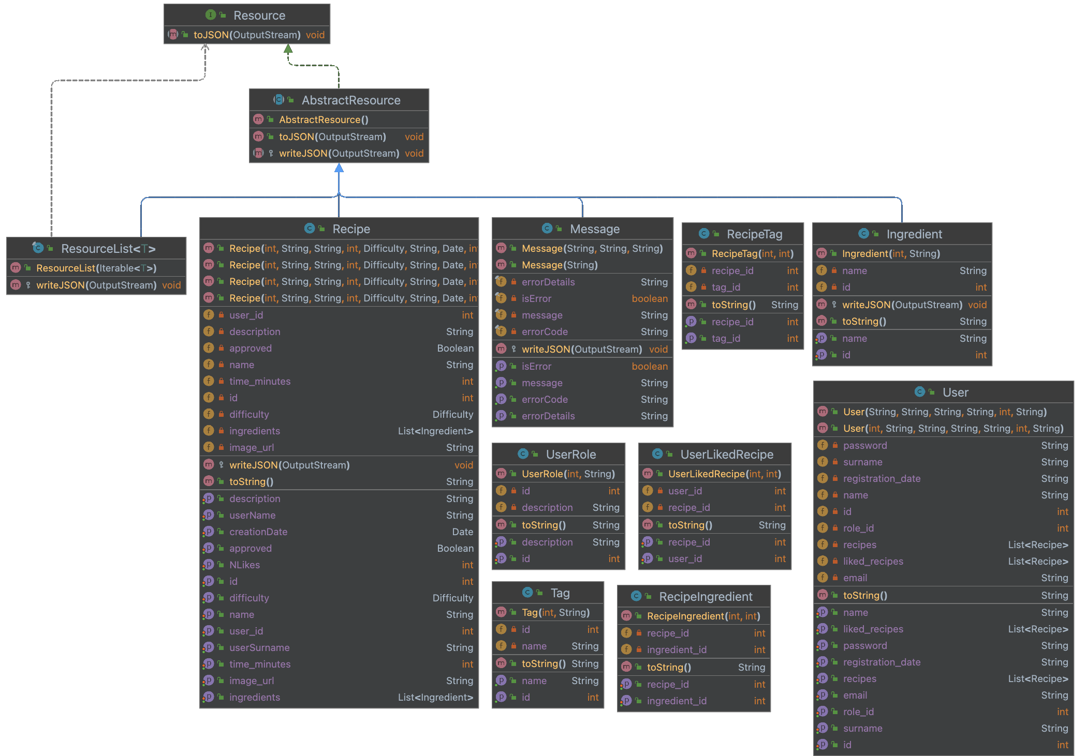
BACKEND - INFO
Resources
DAO
MVC pattern
Servlets
JSP
REST

Slide 7
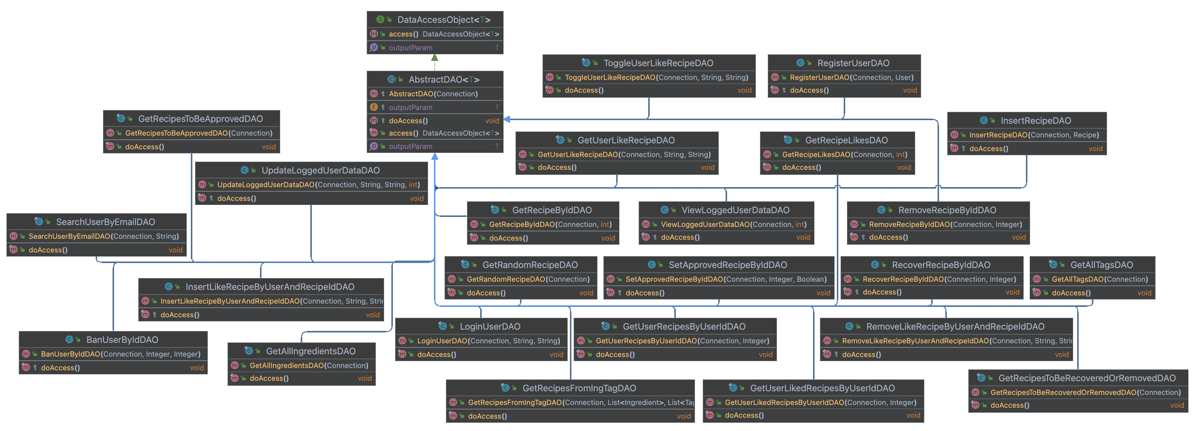
BACKEND - RESOURCES

Slide 8
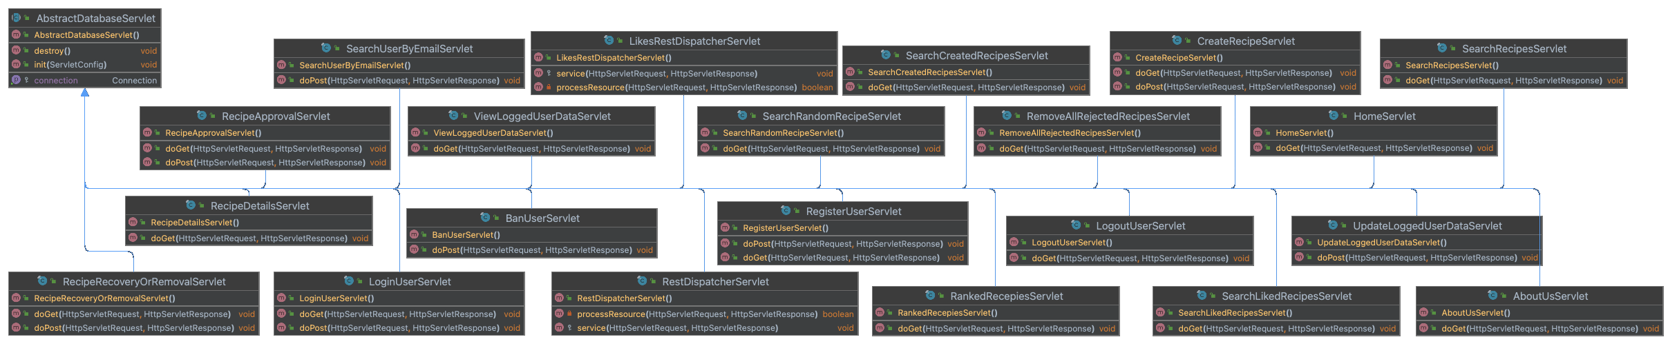
BACKEND - DAO

Slide 9
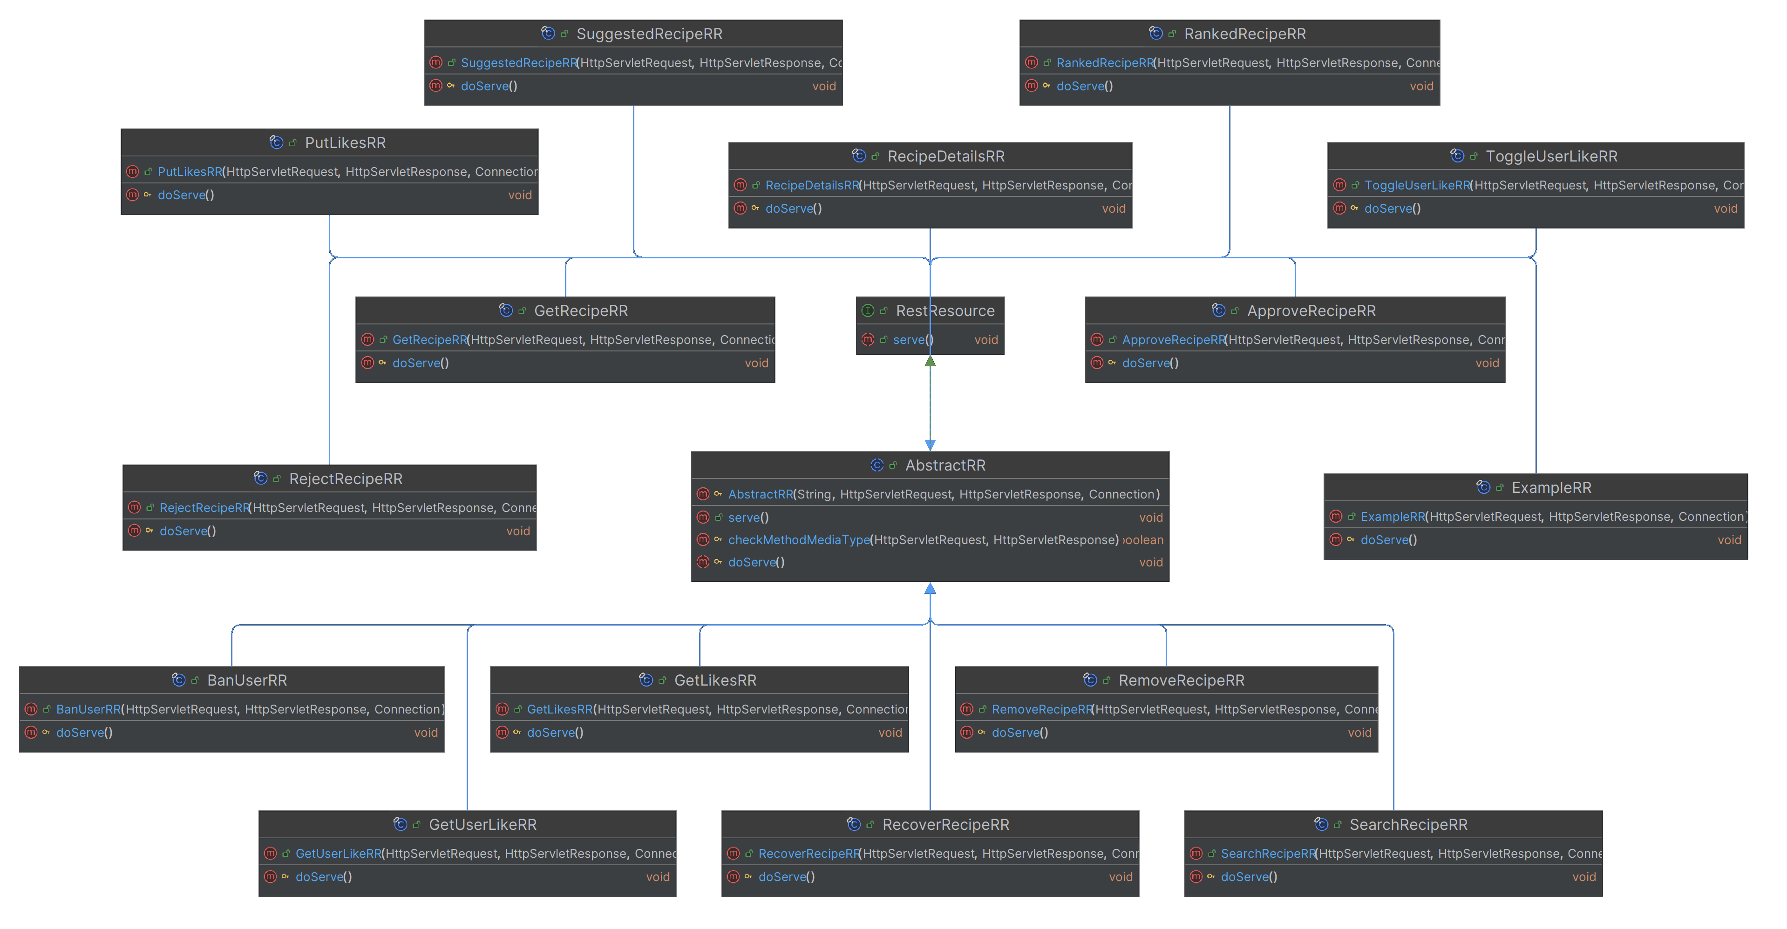
BACKEND - SERVLETS

Slide 10
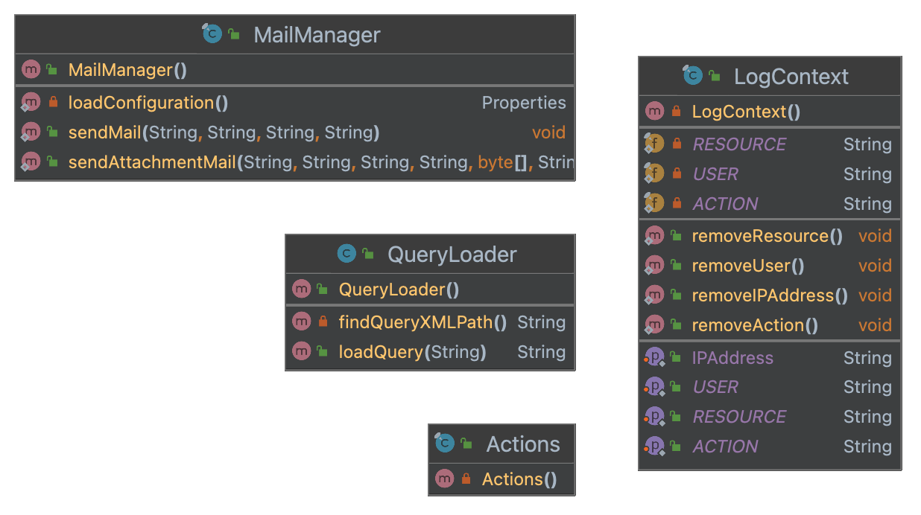
BACKEND - REST

Slide 11


BACKEND - OTHER

Slide 12
FRONTEND

Slide 13
DEMO TIME

Slide 14
THANKS FOR YOUR ATTENTION!

