Slide 1

iPhone Deal-Finder
Machine learning that predicts an iPhone's fair value and
spots underpriced listings, on live data, in seconds.
€299 iPhone 13 Pro
Fair value €409
+31% margin · score 0.76
STRONG BUY
Advanced Python · ESADE · Final Project
Regression · Web scraping · XGBoost · 13,745 real listings

Slide 2
01 · PROJECT EXPLANATION /10
The goal: a price brain for second-hand iPhones
Question “Of all iPhones for sale right now, which are the best deals to buy and resell?”
Model supervised regression that predicts fair market value, plus calibrated uncertainty.
On top an investment score → a clear BUY / HOLD / SKIP decision with reasons.
Context Wallapop is Spain's largest second-hand marketplace; prices are noisy and inconsistent.
Real use resale arbitrage and smart buying: rank live listings by expected profit, flag scams.
Why it matters
A 28% margin on a €420 phone is €120 profit.
if you can tell a deal from a dud before it sells.
Deals vanish in hours.
Speed + objectivity beat manual eyeballing.

Slide 3
THE PRODUCT
One command → ranked deals
$ python -m src.cli scan --model "iPhone 13 Pro" --city madrid --max-price 700
€299
iPhone 13 Pro · TIENDA/GARANTÍA
Fair value: €409 [300–403]
Margin +31.0% · Confidence MEDIUM
Investment score 0.76
€300
iPhone 13 Pro Max 256GB Titanio
Fair value: €569 [347–596]
Margin +82.2% · Confidence LOW
Investment score 0.73
STRONG BUY
BUY

Slide 4
02 · CHALLENGE DEFINITION /15
Why this is genuinely hard
No labels
Wallapop shows asking prices, never sold prices, so the model learns fair value from the crowd.
Messy free text
Specs hide in Spanish prose: “batería 92%”, “como nuevo”, storage often omitted.
Bot walls
eBay & Backmarket fingerprint the TLS handshake and 403 datacenter IPs.
Uncertainty
A single price isn't enough; a recommendation needs calibrated confidence.

Slide 5

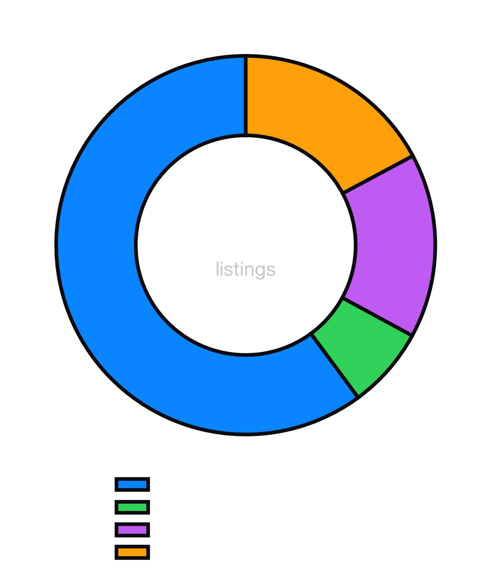
DATA STRATEGY
13,745 real listings · 4 marketplaces
Wallapop · 8,262 scraped LIVE from its JSON backend (no API, no keys). 20 models × 6 Spanish cities. Deployment market.
eBay sold · 957 real completed-sale prices with dates, via sold-listings HTML.
eBay archive · 2,165 historical 2023 US listings for temporal depth.
US e-commerce · 2,361 2026 resale records, sale-evidenced.
Normalized all prices → EUR, stored in Parquet, quality-weighted at merge.

Slide 6
03 · TECHNICAL SOLUTION /25
System architecture
Scrapers
Wallapop · eBay
Data
validate · parquet
FeaturePipeline
parse · encode
Models
XGBoost · quantile
Scorer
margin × conf
Report
CLI · plots
Single FeaturePipeline fitted once, serialized, reloaded at inference → identical features at train & serve (zero skew).
Clean OOP abstract BaseScraper / BaseModel, __slots__ containers, custom exception hierarchy, typed config, structured logging.

Slide 7
FEATURE ENGINEERING
From Spanish prose to 105 features
raw listing
Regex + fuzzy model, storage, battery, colour, condition from free text (97% model-ID rate).
TF-IDF top-50 description tokens capture wording signal.
Engineered days-since-posted, seller activity, photo count, city tier.
Market / source indicator features let one model serve multiple marketplaces.
Imputation battery/storage by model-family median; nothing dropped silently.
“iPhone 13 Pro 256GB Sierra Blue batería 92% como nuevo”
↓ parsed
model iPhone 13 Pro · year 2021
storage 256 GB
battery 92%
colour sierra blue
condition like-new (4/5)

Slide 8
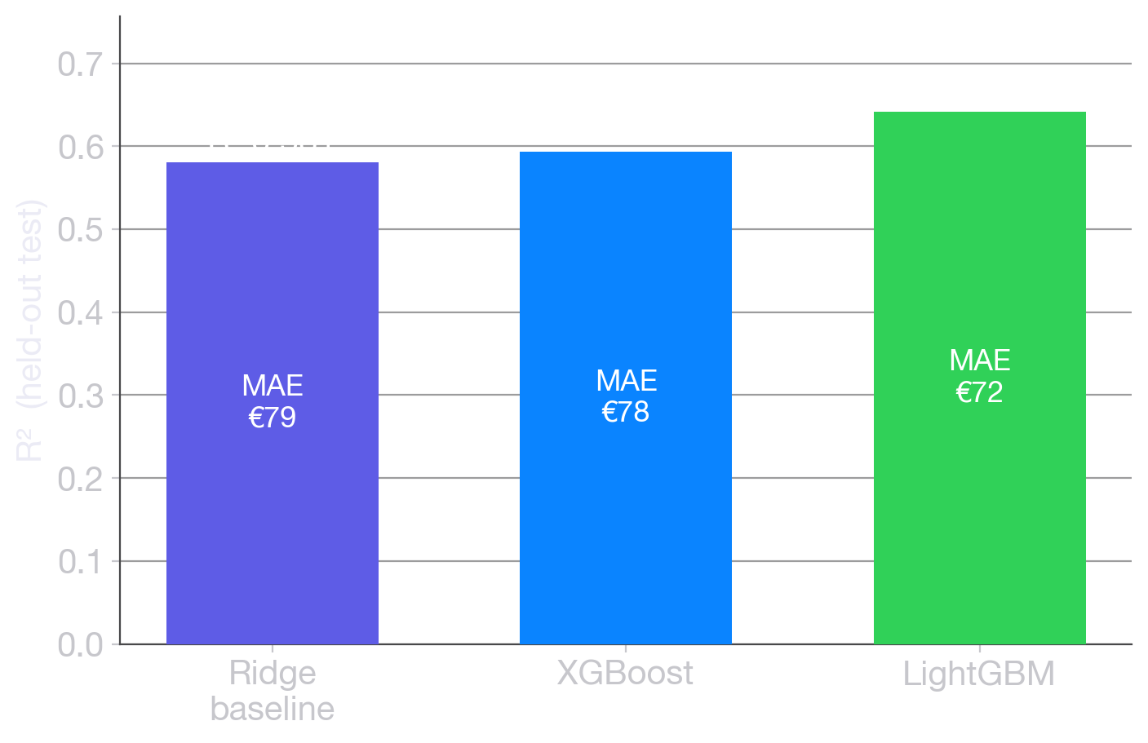
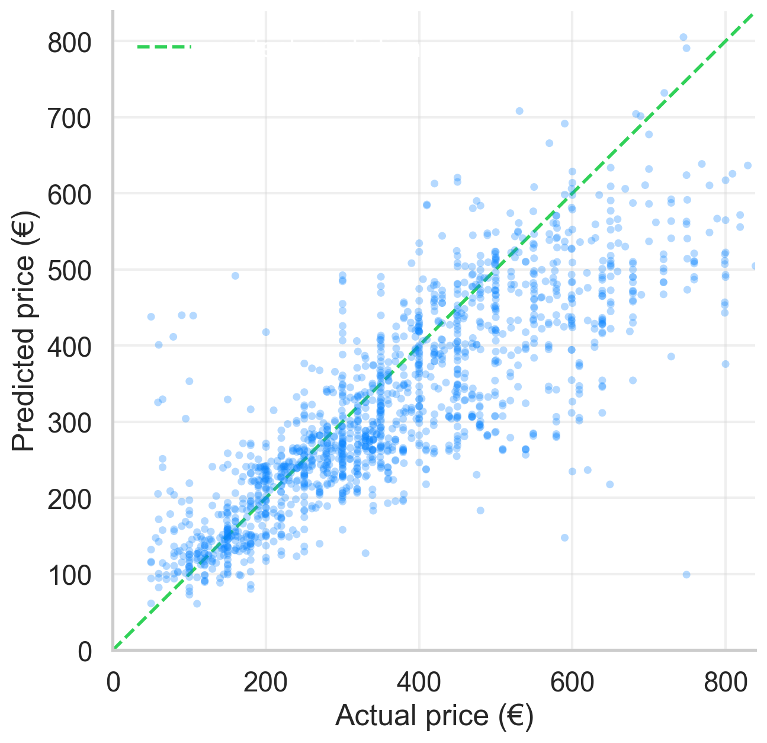
03 · TECHNICAL SOLUTION /25
Baseline → boosting → calibrated intervals
Out-of-time split (no future leakage) · LightGBM best: R² 0.642, MAE €72 · 80% prediction intervals via Conformalized Quantile Regression

Slide 9
THE RECOMMENDATION ENGINE
Investment score → decision
investment_score =
0.5 · σ(margin·5) + 0.3 · confidence + 0.2 · (1 − risk)
Risk heuristics
• Price < 30% of fair → scam flag
• No battery info
• Fewer than 2 photos
• “para piezas” / damaged wording
• iCloud-locked / suspicious
STRONG BUY
≥ 0.75
BUY
0.55–0.75
HOLD
0.35–0.55
SKIP
< 0.35

Slide 10
04 · VALUE OR IMPACT /15
Why it beats eyeballing
Resellers
rank hundreds of listings by expected profit in seconds, never overpay.
Buyers
an objective fair-value second opinion + a scam radar before you message a seller.
Researchers
a reproducible, versioned pipeline for second-hand price dynamics.
vs manual objective (model, not gut) · exhaustive (every listing) · fast (~1,670 listings/sec) · uncertainty-aware.
vs naive baseline Ridge floor R² 0.58 → boosting 0.64; calibrated intervals turn a guess into a confidence.

Slide 11
05 · STRUGGLES & PROBLEM-SOLVING /15
Six real problems, six fixes
● Quantile intervals under-covered (60%) → Conformalized Quantile Regression → ~80%.
● eBay/Backmarket returned HTTP 403 → curl_cffi TLS (JA3) impersonation + cookie-warming.
● eBay's sold search is capped → diagnosed; scaled via narrow model×storage queries.
● Merging US + ES data dropped R² 0.74→0.61 → added market & source features; reweighted to the ES market.
● SHAP crashed on XGBoost 2.x → used XGBoost's native tree-SHAP (pred_contribs).
● Accessories/parts polluted the data → title junk filter + damaged-device risk flag.

Slide 12
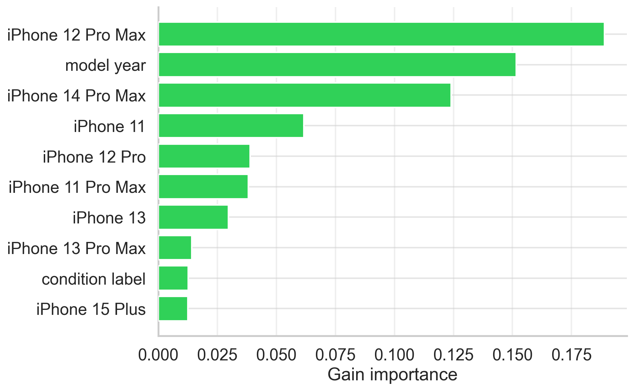
WHAT WE USED FROM THE COURSE
Concepts → code
S1 OOP
abstract classes · __slots__ · exceptions
S2 Performance
parquet · vectorized · timeit (5.9× CSV)
S3 Visualization
7 figure types
S4 Parallel & Exceptions
retry/backoff · custom errors
S5 Web Scraping
JSON API · sold HTML · TLS impersonation
S6 Time Series
out-of-time split · TimeSeriesSplit
S7 Supervised ML
Ridge·XGBoost·LightGBM · CQR · SHAP
36 tests · 4 notebooks · modular package

Slide 13
06 · NEXT STEPS /10
Where this goes next
Counterfeit detection a CNN on listing photos to flag probable fakes (S7 deep learning).
Time-to-sell predict liquidity (how fast a deal sells) as a 4th score dimension.
True panel data scheduled daily scrape to detect actual sales, price drops, time-on-market.
Productionize FastAPI serve mode, CI on the test suite, GA hyperparameter search vs grid.
Live data → fair value → a confident buy/skip call.
Academic project · the investment score is not financial advice · do your own due diligence.

