Slide 1

9:41
Deal-Finder
ADVANCED PYTHON · ESADE · FINAL PROJECT
3 strong buys near Madrid
iPhone Deal-Finder
iPhone 13 Pro
Madrid
€299
STRONG BUY
Machine learning that predicts an iPhone's fair value and spots underpriced listings, on live data, in seconds.
iPhone 13 Pro · Garantía
Fair value
€409
Expected margin
+31%
Investment score
0.76
Regression
Web scraping
XGBoost
13,745 real listings
€300
13 Pro Max · Titanio
BUY
TEAM
Gianluca Bavelloni · Lorenzo Giovanni Costa · David Puchala · Aumkar Prasad Wagle
Notes:
Open with the one-liner: a machine-learning system that finds underpriced second-hand iPhones on live data. ESADE Advanced Python final project.

Slide 2
01 · PROJECT EXPLANATION
10 pts
The goal: a price brain for second-hand iPhones
Question
“Of all iPhones for sale right now, which are the best deals to buy and resell?”
Model
Supervised regression that predicts fair market value, plus calibrated uncertainty.
Why it matters
€120 profit on a €420 phone
On top
An investment score → a clear BUY / HOLD / SKIP decision, with reasons.
at a 28% margin · if you can tell a deal from a dud before it sells.
Context
Wallapop is Spain's largest second-hand marketplace; prices are noisy and inconsistent.
Real use
Resale arbitrage and smart buying · rank live listings by expected profit, flag scams.
Deals vanish in hours
Speed and objectivity beat manual eyeballing.
Notes:
The goal is a price brain for second-hand iPhones: predict fair value, then turn it into a clear buy/hold/skip call with reasons.

Slide 3
THE PRODUCT
One command → ranked deals
$
python -m src.cli scan --model "iPhone 13 Pro" --city madrid --max-price 700
€299
STRONG BUY
€300
BUY
iPhone 13 Pro · Tienda / Garantía
iPhone 13 Pro Max 256 GB · Titanio
Fair value
€409 [300–403]
Fair value
€569 [347–596]
Margin · confidence
+31.0% · MEDIUM
Margin · confidence
+82.2% · LOW
Investment score
0.76
Investment score
0.73
Notes:
One command scans a live market and returns ranked deals with a fair-value estimate, a margin, a confidence band and a decision.

Slide 4
02 · CHALLENGE DEFINITION
15 pts
Why this is genuinely hard
No labels
Messy free text
Wallapop shows asking prices, never sold prices · so the model learns fair value from the crowd.
Specs hide in Spanish prose: “batería 92%”, “como nuevo”, storage often omitted entirely.
Bot walls
Uncertainty
eBay and Backmarket fingerprint the TLS handshake and return 403 to datacenter IPs.
A single price isn't enough; a recommendation needs calibrated confidence to be trusted.
Notes:
Four things make this genuinely hard: no sold-price labels, messy Spanish free text, anti-bot walls, and the need for calibrated uncertainty.

Slide 5

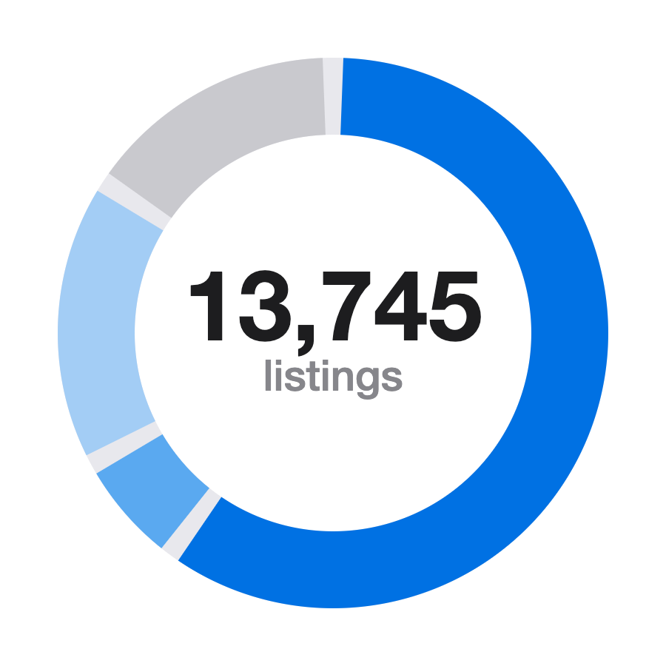

DATA STRATEGY
13,745 real listings across 4 marketplaces
Wallapop
8,262
Scraped live from its JSON backend · no API, no keys. 20 models × 6 Spanish cities. The deployment market.
eBay sold
957
Real completed-sale prices with dates, via sold-listings HTML.
US
US e-commerce
2,361
2026 resale records, sale-evidenced.
eBay archive
2,165
Historical 2023 US listings for temporal depth.
Normalized ·all prices → EUR, stored in Parquet, quality-weighted at merge.
Notes:
13,745 real listings across four marketplaces. Wallapop is the live deployment market; eBay sold gives true completed-sale prices; the rest add temporal and cross-market depth. All normalized to EUR.

Slide 6
03 · TECHNICAL SOLUTION
25 pts
System architecture
→
→
→
→
→
Scrapers
Data
FeaturePipeline
Models
Scorer
Report
Wallapop · eBay
validate · parquet
parse · encode
XGBoost · quantile
margin × conf
CLI · plots
Single FeaturePipeline
Clean OOP
Fitted once, serialized, reloaded at inference → identical features at train & serve. Zero training–serving skew.
Abstract BaseScraper / BaseModel, __slots__ containers, custom exception hierarchy, typed config, structured logging.
Notes:
Six stages from scrapers to report. The key idea: one FeaturePipeline fitted once and reloaded at inference, so train and serve see identical features · zero skew.

Slide 7
FEATURE ENGINEERING
From Spanish prose to 105 features
Raw listing
Regex + fuzzy
iPhone 13 Pro 256GB Sierra Blue batería 92% como nuevo
Model, storage, battery, colour, condition from free text · 97% model-ID rate.
TF-IDF
↓ parsed
Top-50 description tokens capture wording signal.
model · year
iPhone 13 Pro · 2021
Engineered
storage
256 GB
Days-since-posted, seller activity, photo count, city tier.
battery
92%
Market / source
colour
Sierra Blue
Indicator features let one model serve multiple marketplaces.
condition
like-new · 4/5
Imputation
Battery / storage by model-family median; nothing dropped silently.
Notes:
A messy Spanish title becomes 105 features. Regex and fuzzy matching pull structured specs; TF-IDF captures wording; engineered and market features round it out. 97% model-ID rate.

Slide 8
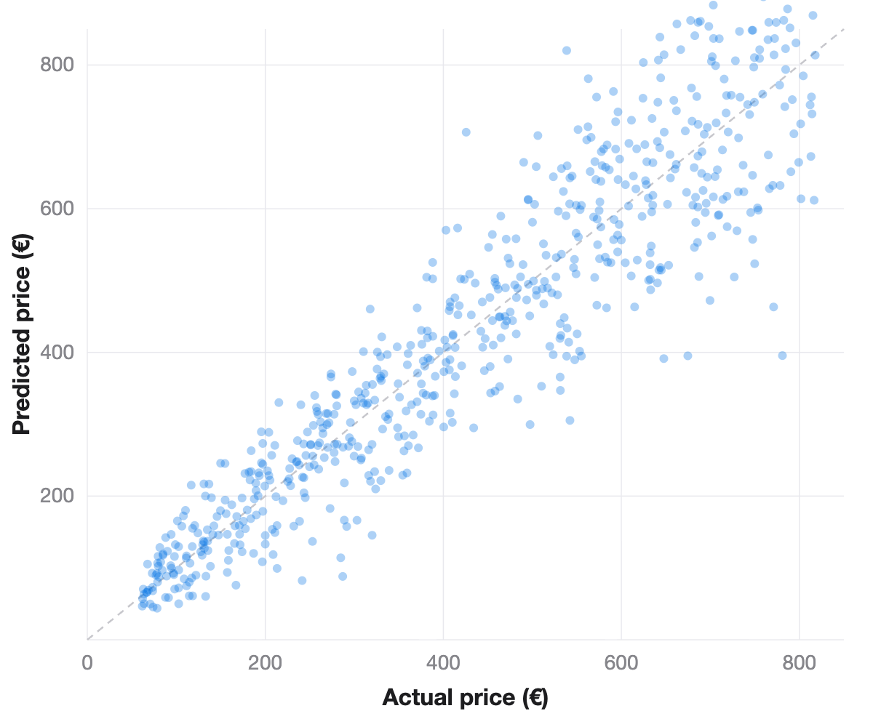
03 · TECHNICAL SOLUTION
25 pts
Baseline → boosting → calibrated intervals
Out-of-time split · no future leakage
80% intervals via Conformalized Quantile Regression
Held-out R² by model
Predicted vs actual
MAE shown inside each bar
LightGBM, held-out test set
0.642
0.580
0.594
MAE €72
MAE €79
MAE €78
Ridge
XGBoost
LightGBM
Notes:
Out-of-time split to avoid leakage. LightGBM wins at R-squared 0.642 and MAE 72 euros, with 80% prediction intervals from conformalized quantile regression.

Slide 9
MODEL INSIGHT
What drives the predicted price
Top features by gain importance · model identity and release year carry the most weight.
iPhone 12 Pro Max
0.188
Model year
0.150
iPhone 14 Pro Max
0.123
iPhone 11
0.061
iPhone 12 Pro
0.039
iPhone 11 Pro Max
0.038
iPhone 13
0.030
iPhone 13 Pro Max
0.013
Condition label
0.012
iPhone 15 Plus
0.011
Gain importance · LightGBM
Notes:
Which features the model leans on. Model identity and release year dominate gain importance, with condition adding signal — exactly what you'd expect from resale pricing.

Slide 10
THE RECOMMENDATION ENGINE
Investment score → decision
investment_score = 0.5·σ(margin·5) + 0.3·confidence + 0.2·(1−risk)
Risk heuristics
·
Price < 30% of fair value → scam flag
·
No battery information
STRONG BUY
·
Fewer than 2 photos
≥ 0.75
·
“para piezas” / damaged wording
BUY
0.55 – 0.75
·
iCloud-locked / suspicious
HOLD
0.35 – 0.55
SKIP
< 0.35
Notes:
The investment score blends margin, confidence and risk into one number that maps to a four-tier decision. Risk heuristics catch scams and bad listings before you message a seller.

Slide 11
04 · VALUE & IMPACT
15 pts
Why it beats eyeballing
Resellers
Buyers
Researchers
Rank hundreds of listings by expected profit in seconds · and never overpay.
An objective fair-value second opinion plus a scam radar before you message a seller.
A reproducible, versioned pipeline for second-hand price dynamics.
vs manual
vs naive baseline
Objective (model, not gut) · exhaustive (every listing) · fast (~1,670 listings/sec) · uncertainty-aware.
Ridge floor R² 0.58 → boosting 0.64; calibrated intervals turn a guess into a confidence.
Notes:
Three audiences benefit. Versus manual eyeballing it's objective, exhaustive and fast · about 1,670 listings per second. Versus a naive baseline, boosting plus calibrated intervals turn a guess into a confidence.

Slide 12
05 · STRUGGLES & PROBLEM-SOLVING
15 pts
Six real problems, six fixes
Quantile intervals under-covered (60%)
eBay / Backmarket returned HTTP 403
→ Conformalized Quantile Regression → ~80%
→ curl_cffi TLS (JA3) impersonation + cookie-warming
eBay's sold search is capped
Merging US + ES data dropped R² 0.74 → 0.61
→ diagnosed; scaled via narrow model×storage queries
→ added market & source features; reweighted to ES
SHAP crashed on XGBoost 2.x
Accessories / parts polluted the data
→ used XGBoost's native tree-SHAP (pred_contribs)
→ title junk filter + damaged-device risk flag
Notes:
Six real problems and the fixes · from under-covered quantile intervals to 403 bot walls, capped search, cross-market R-squared drops, a SHAP crash, and polluted data.

Slide 13
WHAT WE USED FROM THE COURSE
Concepts → code
S1 · OOP
S2 · Performance
S3 · Visualization
S4 · Parallel & Exceptions
Abstract classes · __slots__ · exceptions
Parquet · vectorized · timeit (5.9× vs CSV)
7 figure types across the analysis
Retry / backoff · custom errors
S5 · Web Scraping
S6 · Time Series
S7 · Supervised ML
JSON API · sold HTML · TLS impersonation
Out-of-time split · TimeSeriesSplit
Ridge · XGBoost · LightGBM · CQR · SHAP
36 tests · 4 notebooks
Modular, packaged, reproducible
Notes:
Every course session shows up in the code: OOP, performance, visualization, parallelism and exceptions, web scraping, time series, and supervised ML · backed by 36 tests and 4 notebooks.

Slide 14
06 · NEXT STEPS
10 pts
Where this goes next
Counterfeit detection
Time-to-sell
A CNN on listing photos to flag probable fakes (S7 deep learning).
Predict liquidity · how fast a deal sells · as a 4th score dimension.
True panel data
Productionize
Scheduled daily scrape to detect actual sales, price drops, time-on-market.
FastAPI serve mode, CI on the test suite, GA hyperparameter search vs grid.
Live data → fair value → a confident buy/skip call.
Academic project. The investment score is not financial advice · do your own due diligence.
Notes:
Where it goes next: counterfeit detection from photos, time-to-sell prediction, true panel data from daily scrapes, and productionizing with FastAPI and CI. Close on the one-liner; note the disclaimer.

