Slide 1
ESADE - DATA SCIENCE FOR FINANCE · 2026
Predicting loan approvals
Teaching a model to make the same call a bank’s credit analyst would.
Gianluca Bavelloni · Riwad Irshied
Kaggle ESADE DSF26 · June 2026
Notes:
One-line pitch: we built a model to decide whether a personal loan should be approved, using messy data that was deliberately sabotaged. We tied for #1 on the public leaderboard without the planted leak and without the protected attributes that would have inflated the score.

Slide 2
02 · THE BUSINESS PROBLEM
A wrong loan decision costs the bank money in two different ways
Loan would be repaid
Loan would default
We approve
Our model has one job: make the same approve-or-reject call a human analyst would , for 5,000 new applications.
Right call
Costly mistake
Good loan, earns interest
Default & write-off
We reject
It learns the bank’s existing policy - so it must also avoid copying the analysts’ bias (see slide 7).
Costly mistake
Right call
Lost revenue & the customer
Bad loan avoided
Source: competition brief · binary classification, scored on accuracy
Notes:
This mirrors a real underwriting workflow. The model's job is to get both calls right. Two of the four outcomes cost the bank money: approving a loan that defaults, and rejecting a customer who would have repaid.

Slide 3
03 · THE DATA
We learn from 25,000 past decisions to predict one month we’ve never seen
25,000 past decisions
5,000 new
Training data · Jan 2022 → Apr 2026 · we know the answers
May 2026 · predict these
2022
the real task: forecast the next month →
2026
The answer is almost a coin flip
Because approvals and rejections are nearly even, guessing scores only ~52% . Every point of accuracy above that is genuinely earned.
52% approved
48% rejected
Source: competition train / test files · 24 features per application
Notes:
We have four years of past decisions to learn from, but the test set is a single future month we have never seen. That is why we validate by predicting held-back months, not with random splits. The target is nearly balanced, so a coin flip scores about 52%.

Slide 4
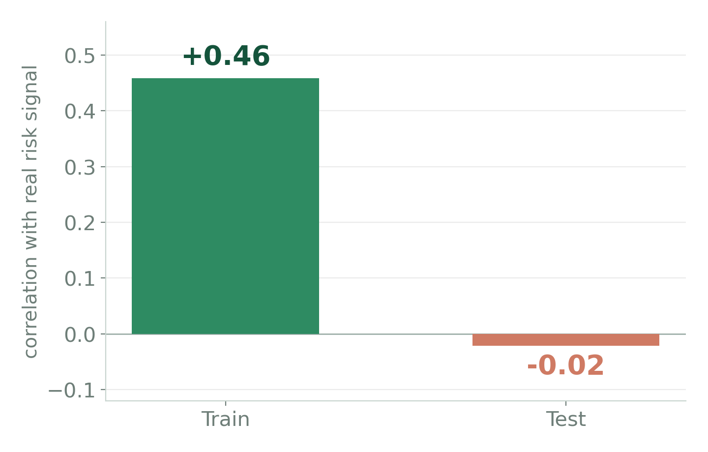
04 · THE TRAP
The rigged data - we hunted the traps before modeling
One “perfect” column, internal_code - promise vs reality
The column looked like the best predictor in the dataset. A simple integrity check gave it away: it lines up with real risk in the training data but is random noise in the test data - it was scrambled on purpose. We dropped it.
Four traps we caught and handled
DROP
Hidden leak - the “perfect” column above
INTERNAL_CODE
DROP
A column that vanishes in the test set
EXTERNAL_PD_SCORE
FIX
Incomes recorded in mixed units
76.4 or 76400
EXCLUDE
Race & religion - off-limits (slide 7)
RACE, RELIGION
Source: team forensic audit · integrity check on 10 suspect columns
Notes:
This is the slide that wins the project. One column looked almost perfect in our own tests, but a simple check showed it tracks real signal in training and is pure noise in the test set: it had been scrambled on purpose. Anyone who trusted it would see 99% in cross-validation and then collapse to about 55% on the real leaderboard.

Slide 5
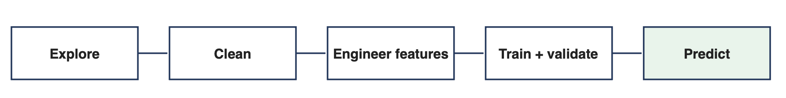
05 · CLEANING THE DATA
One pipeline turns 24 messy columns into 20 we can trust
→
→
→
CLEAN & STANDARDISE
24
• Fix mixed-unit incomes
• Parse two date formats
• Unify yes/no codes
• Z-score credit scores
• Add missingness flags
DROP 4 TRAPS
20
the leak · the missing column race · religion
raw columns from several legacy systems
features we trust, ready to model
The same script cleans training and test data identically, and adds missingness flags - ann_income_missing, other_income_missing, prev_default_missing - so “value absent” becomes usable signal.
Credit scores are z-scored using train-only statistics (no test leakage) - the correct, leak-free choice; for tree models the accuracy effect is ~0.
Source: src/prep.py · single shared cleaning module
Notes:
One shared script cleans the training and test data in exactly the same way, so the whole thing is reproducible and there is no leakage. We end with 20 features we trust, after dropping the four traps.

Slide 6
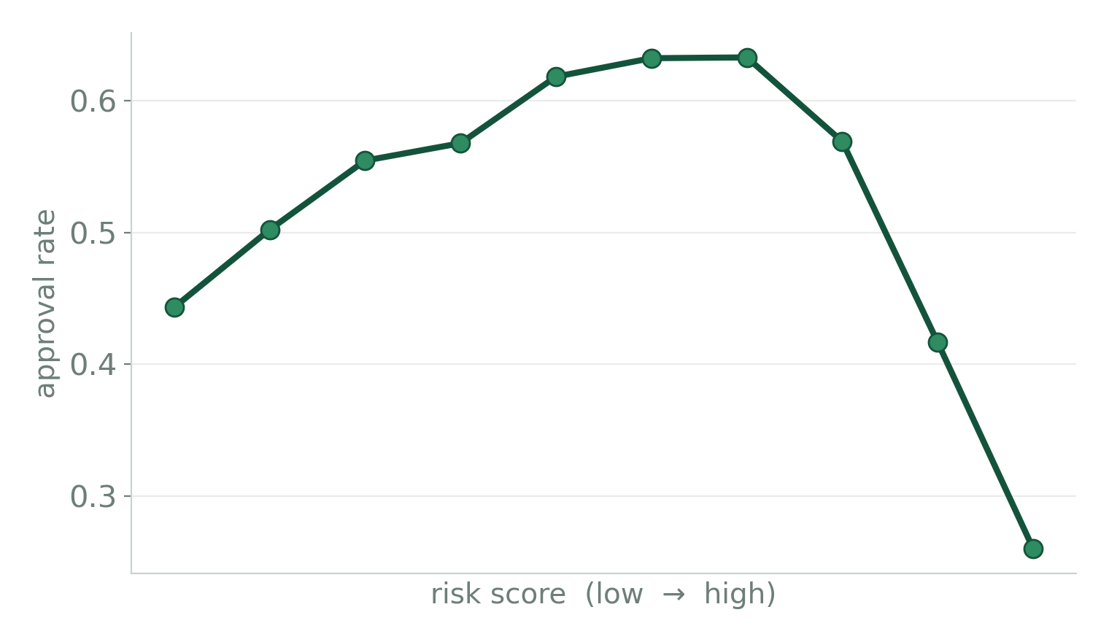
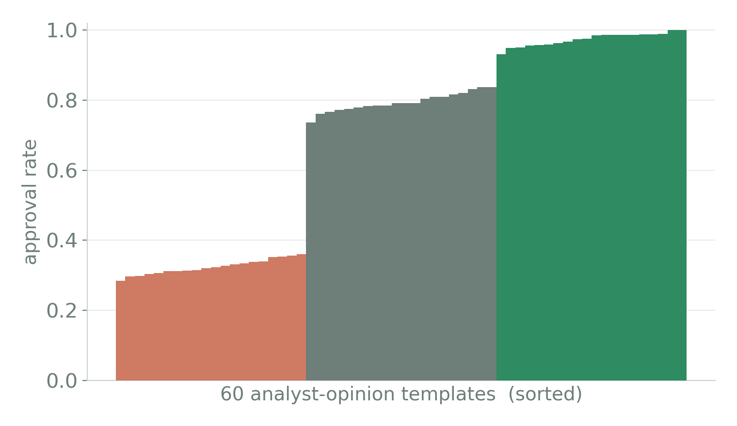
06 · THE SIGNALS THAT MATTERED
Two overlooked signals did most of the work
Risk is worst at the extremes
The analyst’s note gives it away
A straight-line check said the risk score was useless. The shape told the real story.
The free text is really 60 fixed comments in three tiers - no fancy text analysis needed.
Risk_indicator
Turn text to category
Gradient boost model (Lightgbm), no tf-idf
60 unique values across the entire dataset
Source: team analysis · final model uses 20 features
Notes:
Two insights did most of the work. First, the risk indicators looked useless on a straight-line correlation, but plotting them showed approval peaks in the middle and drops at both extremes. Second, the free-text analyst note is really 60 fixed sentences in three clear sentiment tiers, so we let the model learn each one's approval rate instead of doing fancy text analysis.

Slide 7
07 · ETHICAL CONSIDERATIONS
Using race or religion would lift accuracy - we said no
Accuracy, with and without protected data
+0.7 pt
87.0%
86.3%
of accuracy - almost certainly enough for first place.
These columns have no link to real credit risk , yet they change who gets approved - e.g. 56% vs 45% for two groups with the same risk.
Our model (no protected data)
If we added race & religion
So the gain isn’t better prediction. It’s discrimination - and it’s illegal. We left the points on the table.
Source: team fairness analysis · ECOA & EU anti-discrimination law
Notes:
We could have added race and religion for about +0.7 points and probably first place. We measured it and refused, because those columns have zero link to real credit risk yet shift approval rates by group. The gain is not better risk prediction; it is automated discrimination, and it is illegal under EU and US credit law.

Slide 8
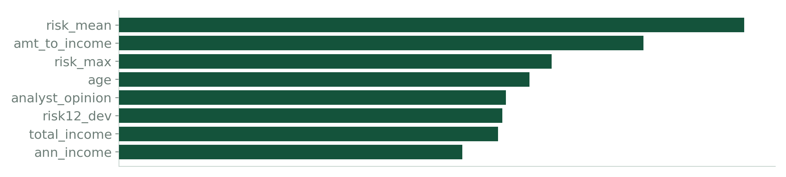
08 · HOW WE MODELED
How our model turns features into a decision
Random search
9 × LightGBM
Fast · native missing-value handling
3 configs × 3 seeds
Grid search
clean X
20 features
Weighted tuned blend
16 → 1 probability
smooth cutoff
approve if p > 0.527
3 × XGBoost
Different algorithm → adds diversity
3 seeds
4 × CatBoost
Best on categoricals (the analyst note)
2 configs × 2 seeds
Pseudo-labeling - learning from the new month
The ensemble's most confident test predictions (≥ 0.97) are added back into training as extra examples, at half weight, so the model adapts to the May-2026 patterns it has to predict.
Kept safe - only very confident rows, down-weighted - and the gain is measured, not assumed: +0.14 pt on rolling validation.
What drives the model - top features by gain
Why blend 16 models?
Different model families make different mistakes. Averaging their predictions cancels the random part of each model's error and leaves the genuine signal - so the ensemble beats any single model.
What each feature is → slide 9
Source: src/model_v10.py · 16-model ensemble (9 LGBM + 3 XGB + 4 CatBoost)
Notes:
Model selection: gradient-boosted trees won a 5-fold bake-off, from Naive Bayes 0.760 up to LightGBM 0.836. Adversarial validation shows a train-vs-test classifier scores AUC 1.000 on all features, but only because of the date (the test set is all May 2026); drop the date features and it falls to 0.497, proving train and test are identically distributed apart from time. Final labels use a smooth threshold, the average of the top 1% of candidate cutoffs, which is more robust than a single argmax cutoff.

Slide 9
09 · FEATURES WE BUILT
The features we engineered
Feature | What it is | Why we made it
risk_mean · risk_max | Average, and the higher (worse), of the two risk scores | One combined risk level - plus a flag when either source is high
risk_dev | How far the risk score sits from the safe middle (|risk − 55|) | Approval peaks mid-scale and drops at both ends - this captures that hump
amt_to_income | Loan amount ÷ total income | Affordability - loan size vs. what they earn (a credit standard)
total_income · log_income | Annual + other income combined (and its log) | Real disposable income; the log tames very large values
credit_z | The 3 bureau scores put on one scale and merged (FICO, Vantage and SCHUFA) | Each person has one score on a different scale - makes them comparable
has_score · *_missing | Flags for whether a value is present | Whether a field is missing is itself a useful signal
year · month | Taken from the application date | Captures the approval-rate trend over time (down toward 2026)
Source: src/prep.py · engineered features ranked on slide 8

Slide 10
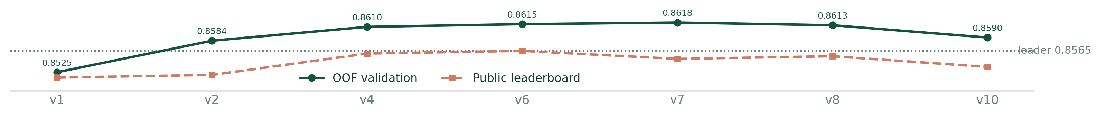
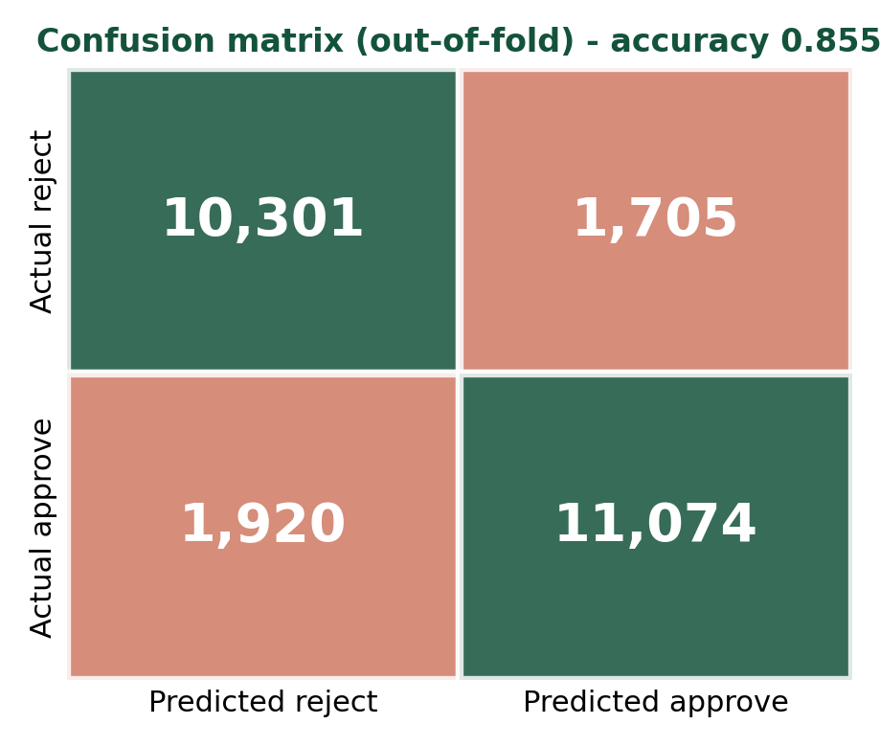
10 · RESULTS
Our own validation predicted the result in advance
0.8565
FINAL SUBMISSIONS SELECTED - v6 + v10
Ver
Approach
OOF
Public LB
Appr.
v1
Single LightGBM
0.8525
0.8515
0.506
v6
9× CatBoost blend
0.8615
0.8565
0.512
v10
Clean prep + pseudo-label + smooth threshold
0.8590
0.8535
0.509
Errors are balanced - the model favours neither approve nor reject.
Source: Kaggle public leaderboard · 10 submissions, v1 → v10
Notes:
We tied for first on the public leaderboard at 0.8565, cleanly, with no leak and no protected attributes. Final submissions are v6 (public-best) and v10 (clean prep, pseudo-labeling, smooth threshold; OOF 0.8590, ROC AUC 0.9377, public 0.8535, approval 0.509). v10's OOF is slightly lower than v6 and v7 by design: the smooth threshold is deliberately conservative and the z-scoring is now leak-free, not because the model is worse. Adversarial validation confirms the CV-to-leaderboard gap is distribution shift over time, not overfitting.

Slide 11
11 · KEY CODE
The code behind the method
Catching the planted leak
tr_op = train.analyst_opinion.map(approval_rate)
train.internal_code.corr(tr_op) # +0.46 real signal
test.internal_code.corr(te_op) # -0.02 noise -> DROP
The column that predicts in training is random noise in test - proof it was scrambled on purpose.
Fixing the legacy mess
ann_income = np.where(inc < 700, inc*1000, inc) # units
risk12 = risk_1.fillna(risk_2) # r1 == r2
risk_dev = (risk - 55).abs() # inverted-U
Three of the highest-value fixes: unit rescaling, one duplicate column, and the risk-shape feature.
Honest validation + robust cutoff
oof[val] = model.predict_proba(X.iloc[val])[:,1] # 5-fold OOF
t = thresholds[acc.argsort()[-6:]].mean() # smooth cutoff
Every row scored out-of-fold; the decision cutoff is averaged over the top-1% to avoid overfitting noise.
Source: src/prep.py · src/model_v10.py · full notebook in repo

Slide 12
12 · QUESTIONS
Thank you.
We’re happy to take questions.
Built clean
We caught the traps first
We measured our ethics
no planted trap, no protected data.
forensics mattered more than the algorithm.
refusing +0.7pt of pure bias.
Gianluca Bavelloni · Riwad Irshied
github.com/GianlucaBave/final-data-finance
Notes:
The two questions most likely to come up: why we dropped race and religion (lead with the +0.7pt number), and how we knew the column was a leak (it tracked real signal in training but was random in test). Both make us look rigorous.

