Slide 1
PROSIT:
A tool for optimal design of soft real-time systems
Bachelor Degree in Computer Science
14 July 2015
Student: Gianluca Bortoli
Supervisor: Prof. Luigi Palopoli
Notes:
<number>

Slide 2


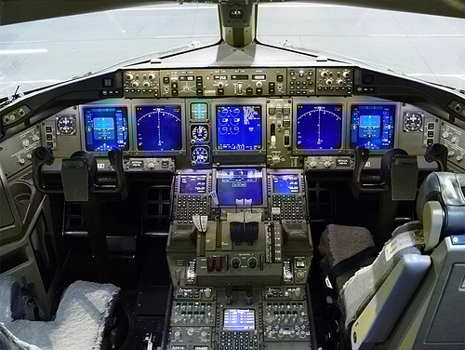

Introduction
Hard vs. soft
real-time systems
Safety-critical systems
Media streaming services
1

Slide 3
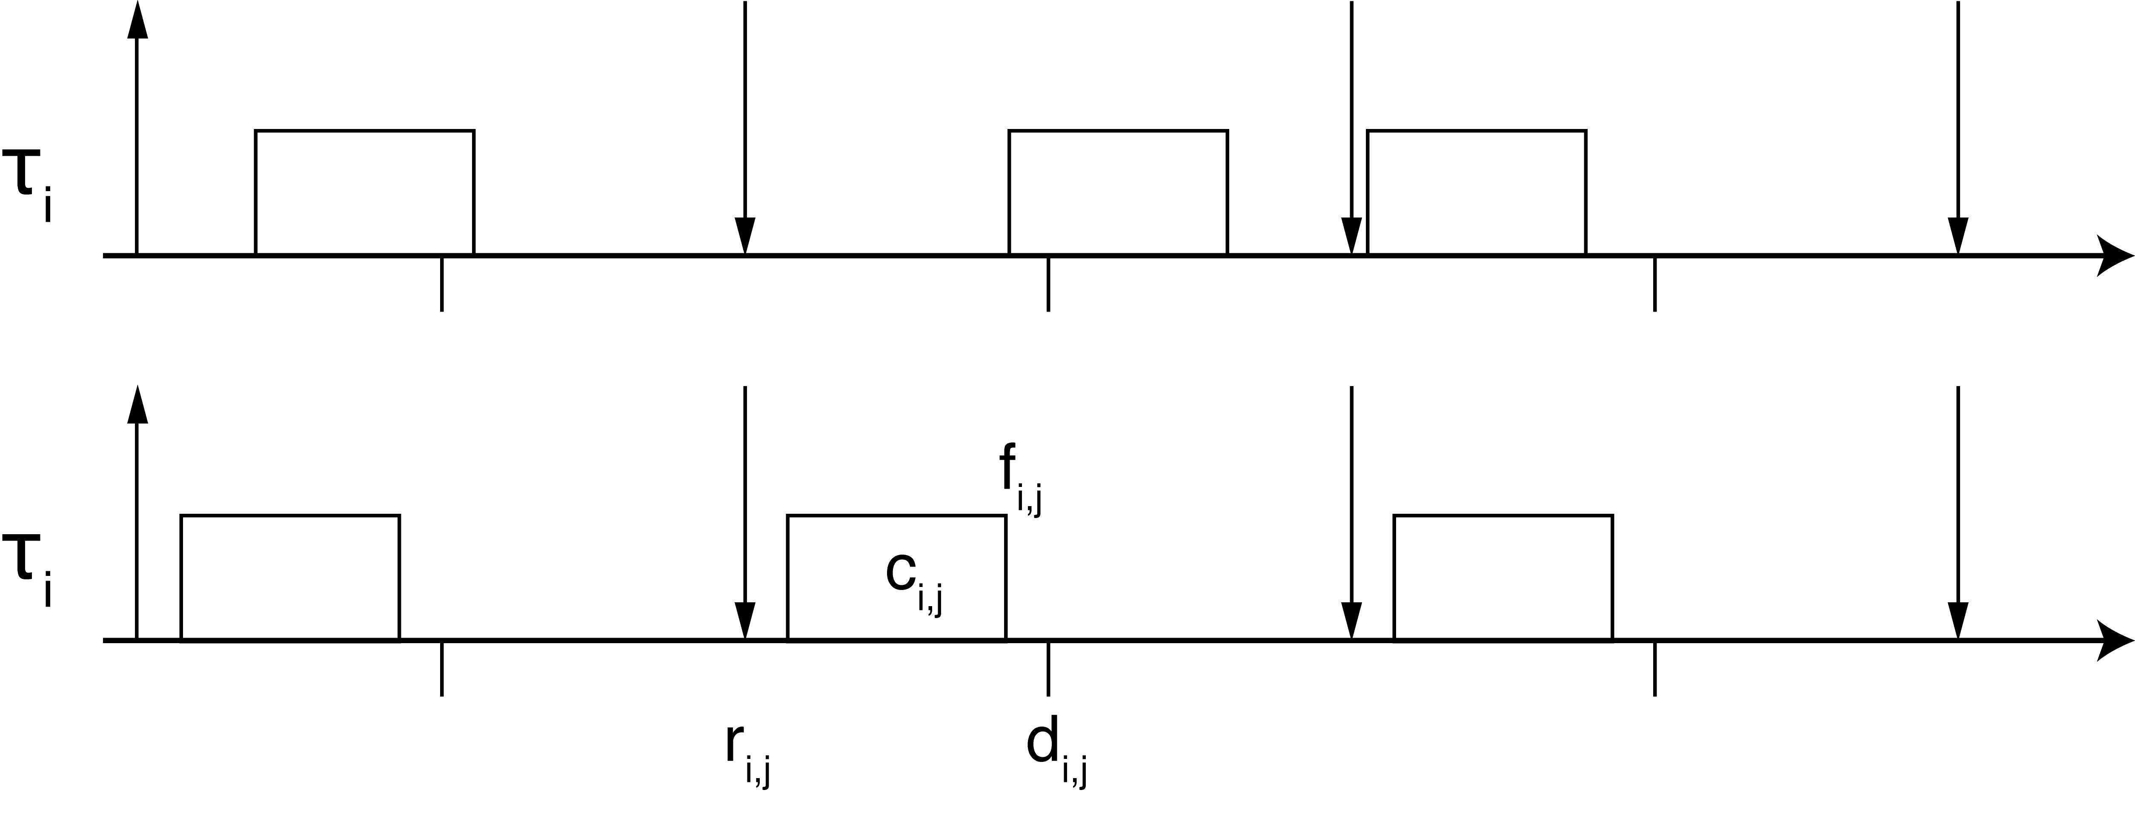
Task model
finishing
time
release
time
relative
deadline
release
time
computation
time
Probabilistic vs. deterministic deadline
2
Notes:
<number>

Slide 4



Resource Reservation scheduling
Model definition:
where:
is the budget
is the reservation period
3
Notes:
<number>

Slide 5
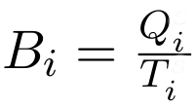
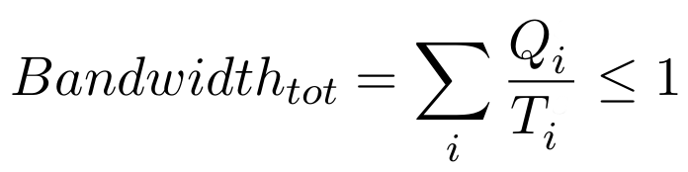
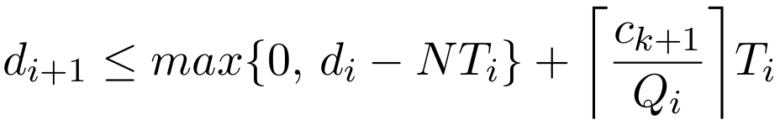
Resource Reservation scheduling
Bandwidth
Temporal isolation
Model
4
Notes:
<number>

Slide 6
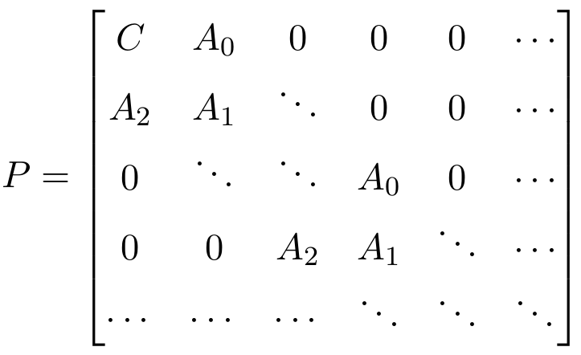
RR as Markov chain
Resource Reservation's transition matrix
Inner block structure
Quasi-Birth-Death process
5
Notes:
<number>

Slide 7
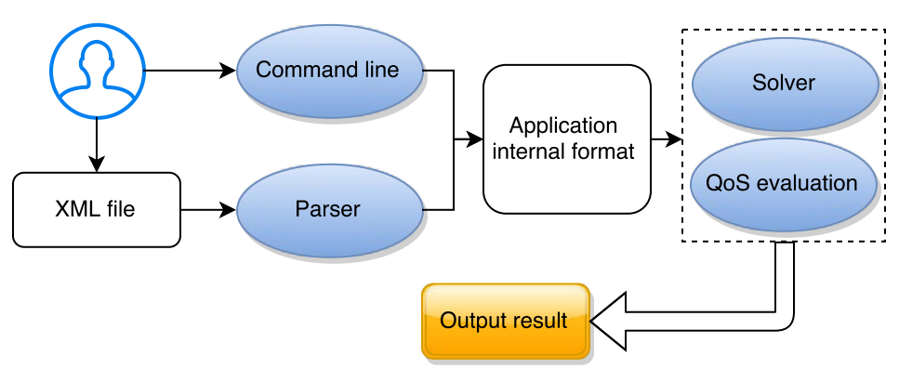
PROSIT
Challenges
Synthesis: (QoS) → Scheduling parameters
Analysis: (Scheduling parameters) → QoS
6
Notes:
<number>

Slide 8
PROSIT
Modules
XML parser
Probability distribution handler
Task descriptor
Probability solver
QoS evaluation
7
Notes:
<number>

Slide 9
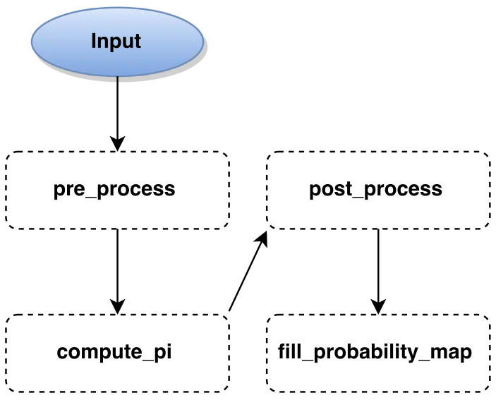
PROSIT
Processing
Matrix creation
Check results
Solution algorithms:
* Cyclic reduction
* Logarithmic reduction
* Companion
* Analytical
Store results
8
Notes:
<number>

Slide 10
pre_process
Optimisation
Huge performance boost
Bigger matrix handling without precision loss
9
Notes:
<number>

Slide 11
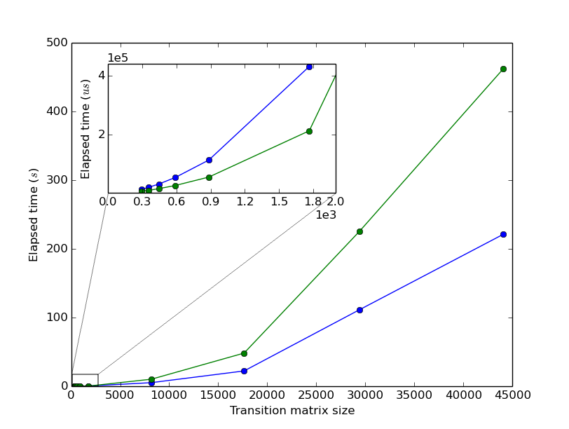
Performance comparison
10
Notes:
<number>

Slide 12
Thank you for your attention!

Slide 13
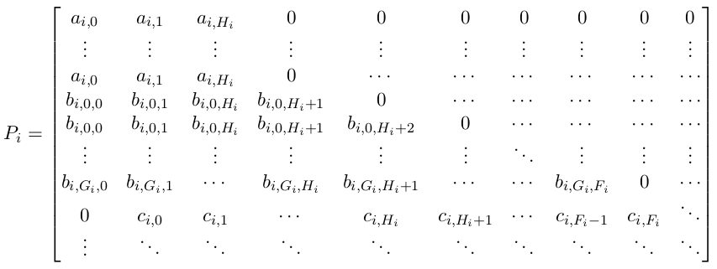
Transition matrix structure
Notes:
<number>

Slide 14
Why C++?
Tradeoff performance / abstraction
Eigen
Notes:
<number>

Slide 15
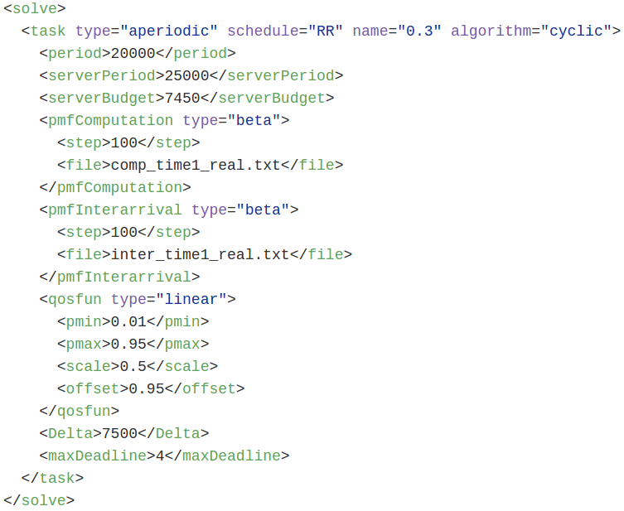
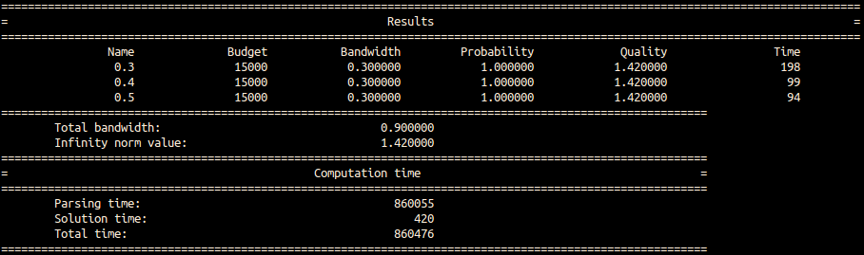
Example
Computation
Notes:
<number>

