Slide 1
PROSIT:
A tool for optimal design of soft real-time systems
Bachelor Degree in Computer Science
A.Y. 2014/2015
Student: Gianluca Bortoli
Supervisor: Prof. Luigi Palopoli
Notes:
<number>

Slide 2
Outline
Introduction
Task model
Resource Reservation scheduling
The tool
Transition matrix creation
Performance comparison
1
Notes:
<number>

Slide 3


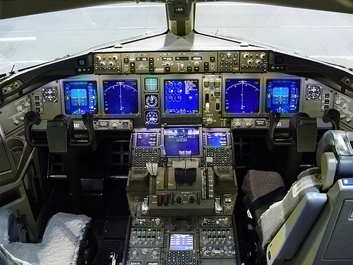

Introduction
Hard vs. soft real-time systems
Safety-critical systems
Media streaming services
2

Slide 4
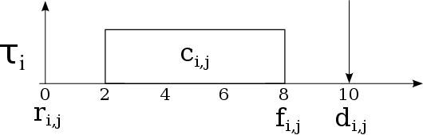
Task model
release
time
relative
deadline
release
time
computation
time
finishing
time
Probabilistic vs. deterministic deadline
3
Notes:
<number>

Slide 5
Resource Reservation scheduling
This model assigns to each task a reservation (Q, T), where:
Q is the budget
T is the reservation period
A task can execute for Q time units in every interval of length T (temporal isolation)
4
Notes:
<number>

Slide 6
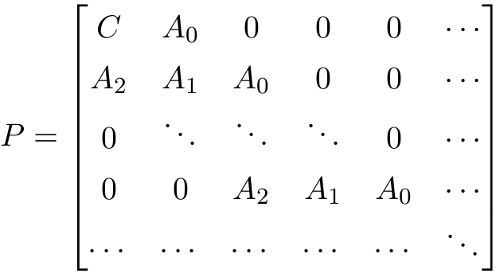
RR as Markov chain
The transition matrix P for a resource reservation task is structured as follows:
Inner block structure
Quasi-Birth-Death process
5
Notes:
<number>

Slide 7
The tool
PROSIT is developed in C++ and has a modular structure. It is composed of the following modules:
XML parser
Probability distribution handler
Task descriptor
Probability solver
QoS evaluation
6
Notes:
<number>

Slide 8
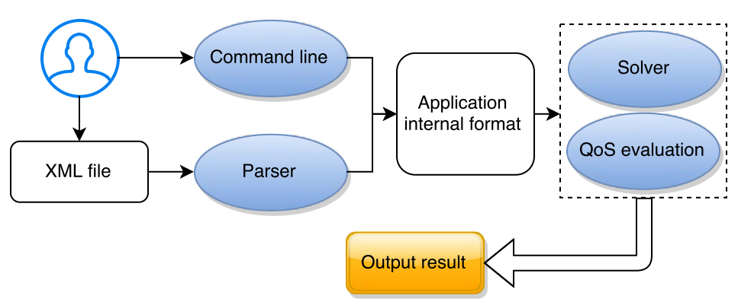
The tool
It aims to solve two problems:
Synthesis: finds the best scheduling parameters given a QoS value as input
Analysis: finds QoS value given the scheduling parameters as input
7
Notes:
<number>

Slide 9
The tool
The steps to obtain the probability value associated with the deadline are:
pre_process: creates the transition matrix for the QBDP
compute_pi: computes probability from the transition matrix
post_process: checks if the algorithm's output is reasonable
fill_in_probability_map: stores the results in a map, using the deadline as key
8
Notes:
<number>

Slide 10
Transition matrix creation
Exploiting the internal structure brings a huge performance boost, since the matrix is not created cell by cell
Bigger matrix can be handled and thus the precision of the results increases
9
Notes:
<number>

Slide 11
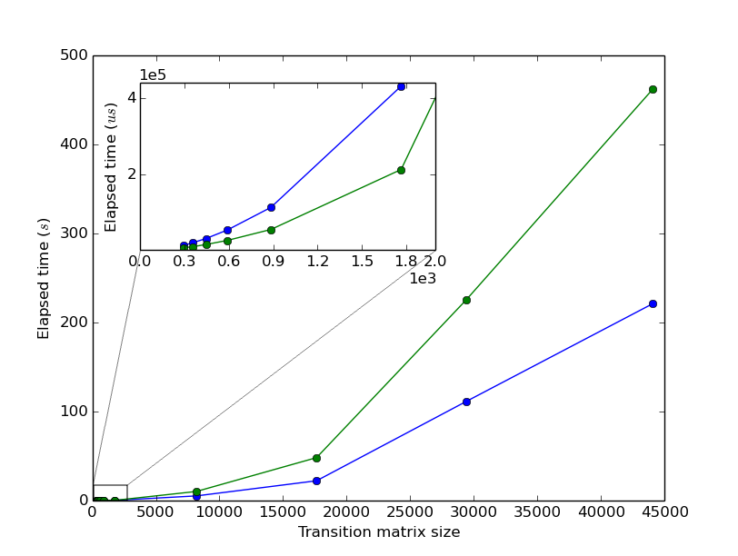
Performance comparison
10
Notes:
<number>

Slide 12
Thank you for your attention!

Slide 13
Why C++?
We decided to use C++11 for two main reasons:
It offers a good tradeoff between performance and abstraction
Eigen, that is a versatile, reliable and fast library for linear algebra. It is only available for this language
Notes:
<number>

Slide 14
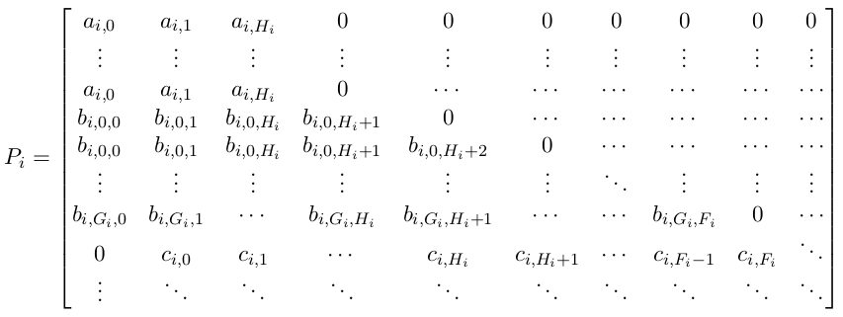
Transition matrix structure
Notes:
<number>

