Slide 1
PROSIT:
A tool for optimal design of soft real-time systems
Bachelor Degree in Computer Science
A.Y. 2014/2015
Student: Gianluca Bortoli
Supervisor: Prof. Luigi Palopoli
Notes:
<number>

Slide 2
Outline
Introduction
Task model
Resource Reservation scheduling
PROSIT
Transition matrix creation
Performance comparison
1
Notes:
<number>

Slide 3


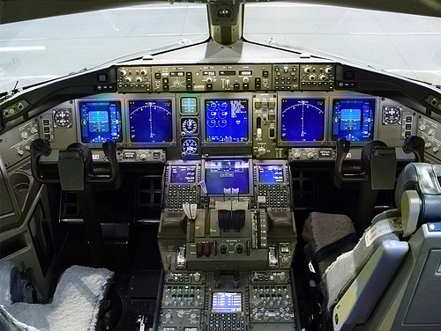

Introduction
Hard vs. soft
real-time systems
Safety-critical systems
Media streaming services
2

Slide 4
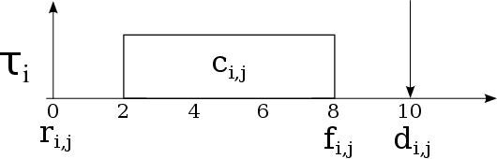
Task model
release
time
relative
deadline
release
time
computation
time
finishing
time
Probabilistic vs. deterministic deadline
3
Notes:
<number>

Slide 5



Resource Reservation scheduling
Model definition:
where:
is the budget
is the reservation period
4
Notes:
<number>

Slide 6
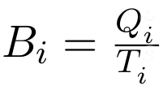
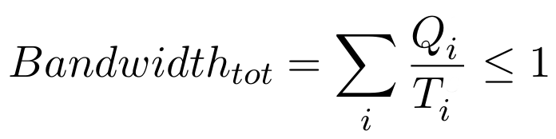
Resource Reservation scheduling
Bandwidth
Temporal isolation
5
Notes:
<number>

Slide 7
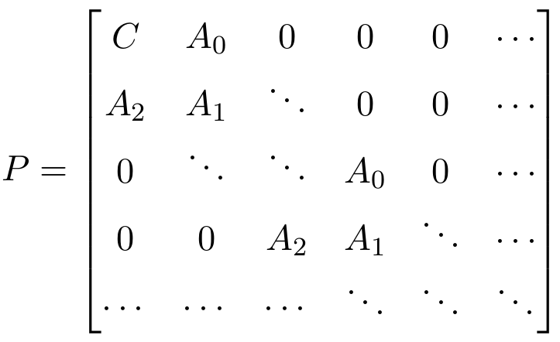
RR as Markov chain
Resource Reservation's transition matrix
Inner block structure
Quasi-Birth-Death process
6
Notes:
<number>

Slide 8
PROSIT
Modules
XML parser
Probability distribution handler
Task descriptor
Probability solver
QoS evaluation
7
Notes:
<number>

Slide 9
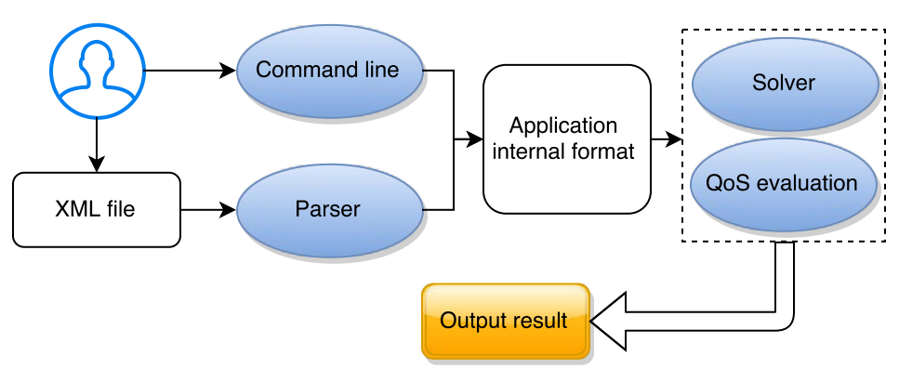
PROSIT
Challenges
Synthesis: (QoS) → Scheduling parameters
Analysis: (Scheduling parameters) → QoS
8
Notes:
<number>

Slide 10
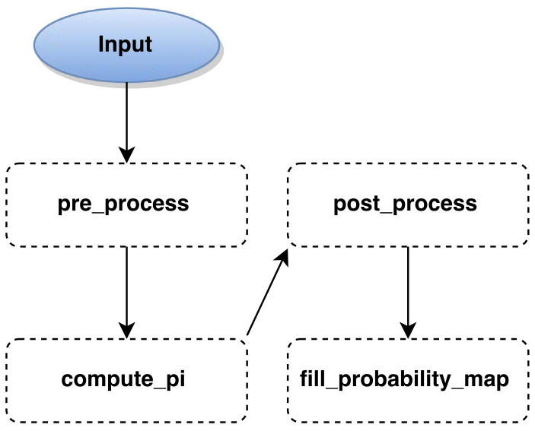
PROSIT
Processing
9
Notes:
<number>

Slide 11
pre_process
Optimisation
Huge performance boost
Bigger matrix handling
without precision loss
10
Notes:
<number>

Slide 12
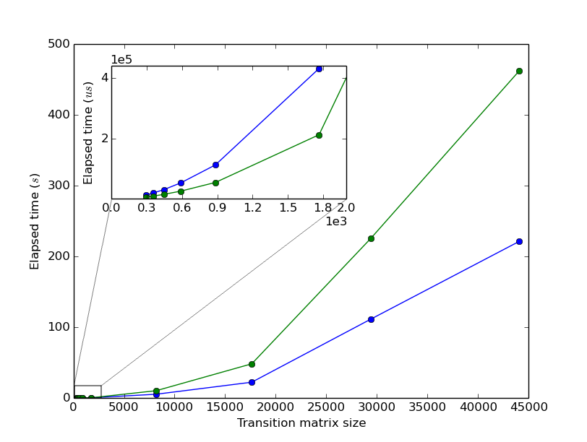
Performance comparison
11
Notes:
<number>

Slide 13
Thank you for your attention!

Slide 14
Why C++?
Tradeoff performance / abstraction
Eigen
Notes:
<number>

Slide 15
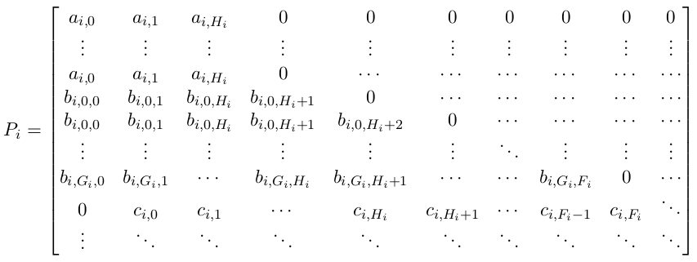
Transition matrix structure
Notes:
<number>

