Slide 1
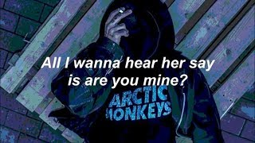
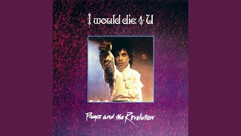
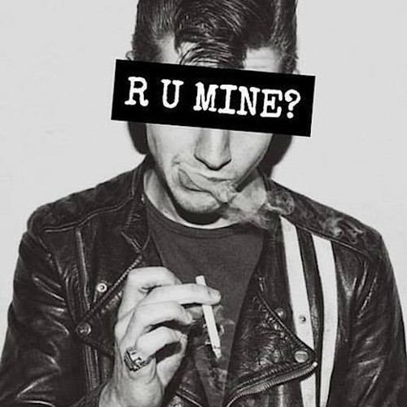
Notes:
Okay! Can you tell me what these two songs have in common? Ok… Exactly, these are songs that are written with examples of homophony. A homophone is a word that sounds exactly like another but has a different word surface.

Slide 2
GOOD-excellent, fine, superior, wonderful, marvelous, qualified, suited, suitable, apt, proper,capable, generous, kindly, friendly, pleasant, satisfactory, well-behaved, obedient, honorable, reliable, top-notch, worthy, grand, salubrious, noble, great, beneficial, splendid, first-rate, genuine, ample, estimable, valid, helpful, expedient, righteous, advantageous, sterling, superb, respectable, edifying, trustworthy , gracious, obliging,agreeable, safe, profitable, beneficial.
Notes:
Can you identify these for me? That's right, they are synonyms. That is, they are words with different word surfaces and the same meaning

Slide 3
PSET, a Phonetics-Semantics Evaluation Testbed
Notes:
On these very simple linguistic ideas we have built a new testbed for phonetic embeddings. Our testbed is controlled, which means that it is possible for us to easily isolate features related to phonetics and semantics. I will also talk a little about phonetic embeddings shortly. But first I'll tell you a little about the motivations of the paper

Slide 4
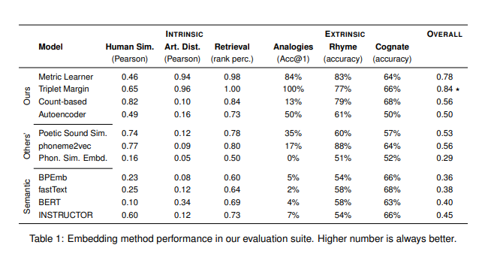
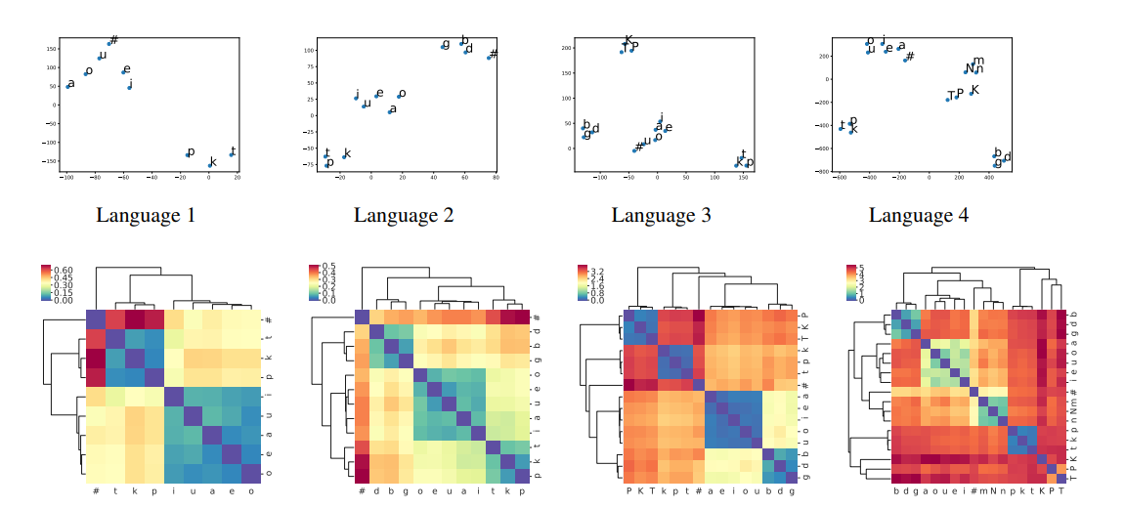
Notes:
There are not many benchmarks and tasks currently for phonetic embeddings. In the case above you see an example from the PWESuite which is a suite with 3 extrinsic and 3 intrinsic tasks. In the case below it is an interesting paper. In the paper they create 12 phonetically plausible languages. Each has different phonetic characteristics. The evaluation of the embeddings is therefore purely qualitative in terms of how well they capture phonetic characteristics.

Slide 5
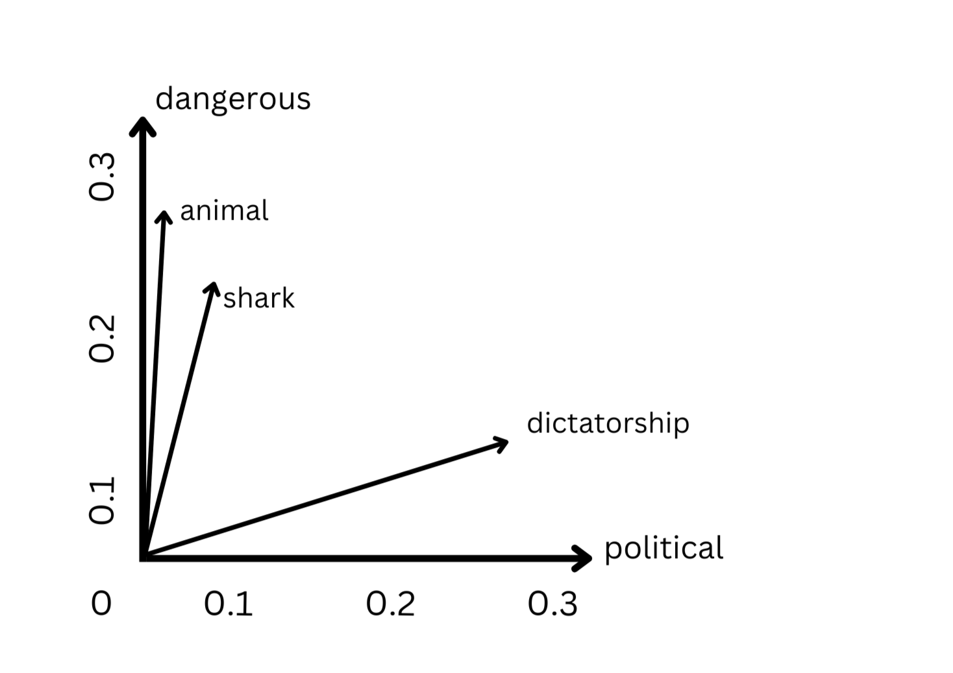
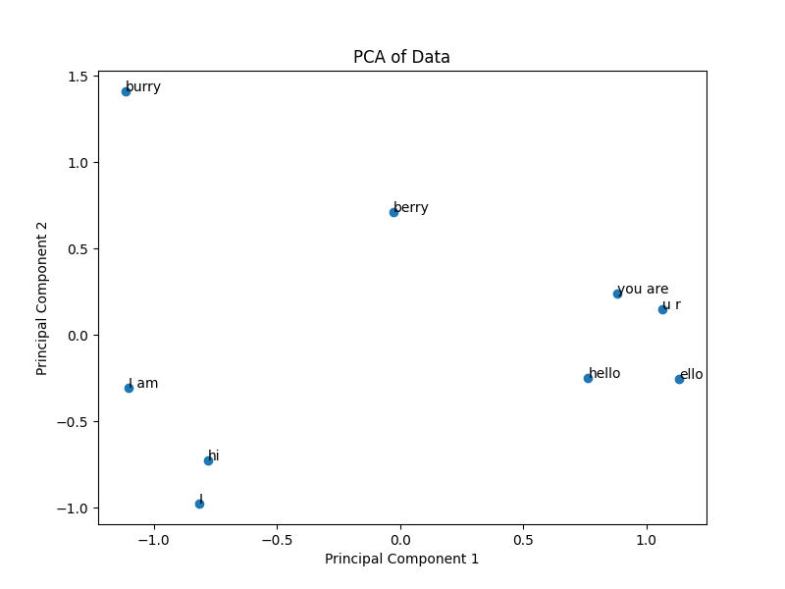
Notes:
Before going any further, however, I'll take a step back. Let me quickly introduce phonetic embeddings. Model must convert input text into numerical vectors called embeddings. Most embeddings focus on the meaning of the text. tional semantic models \cite{word2vec, fasttext} or through the attention mechanism \cite{vaswani, bert, gpt-3}. While semantic embeddings are powerful, they are not ideal when dealing with tasks centered on sound, such as rhyme detection. This is where \textbf{phonetic embeddings} come into play.

Slide 6
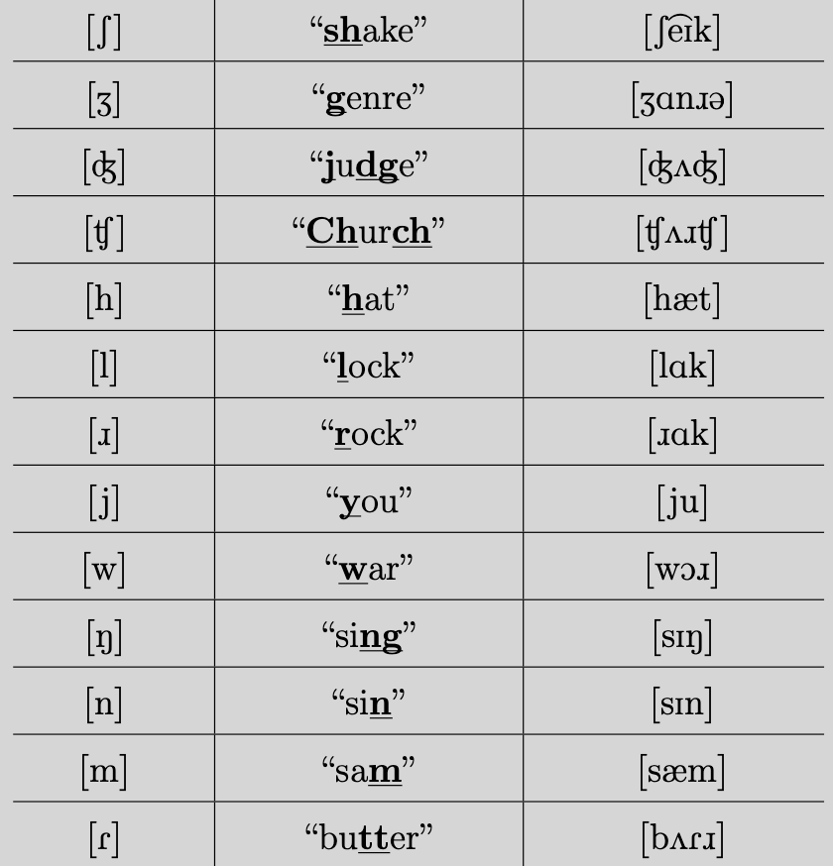
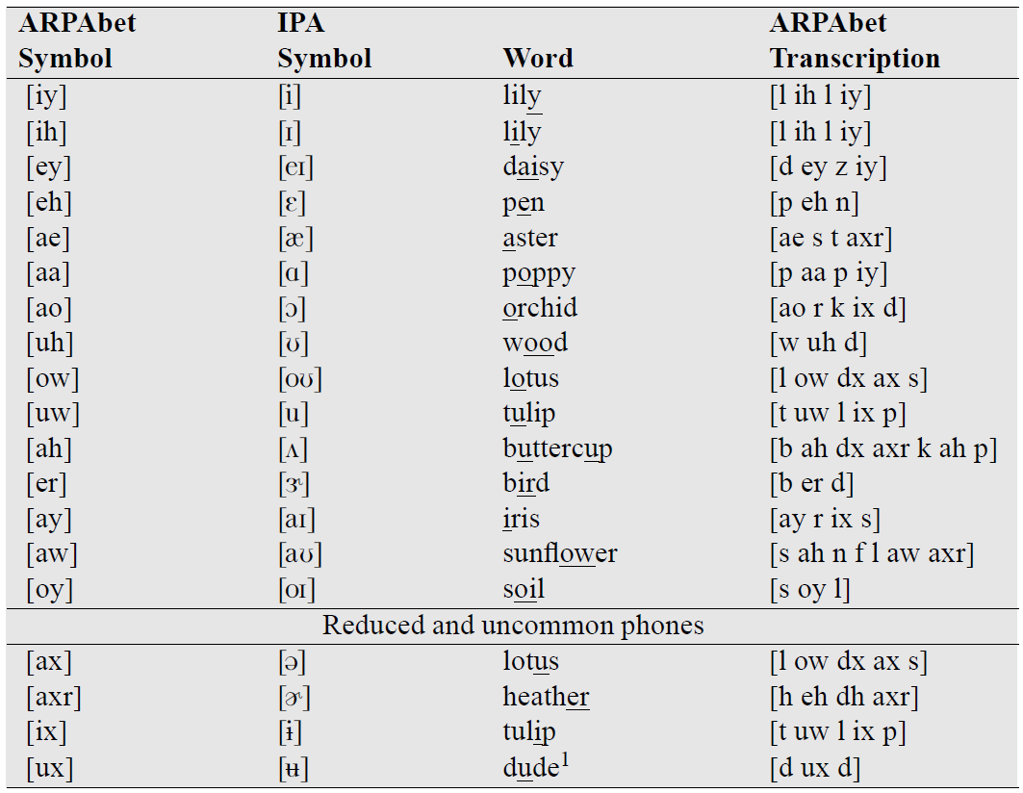

Slide 7
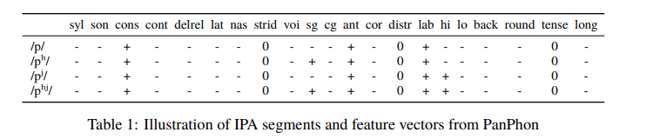
Notes:
We have various ways to create phonetic embeddings, but these are the most basic approaches I will present to you. We only have these for our early tests with the testbed. What you see is an example of panphon.

Slide 8
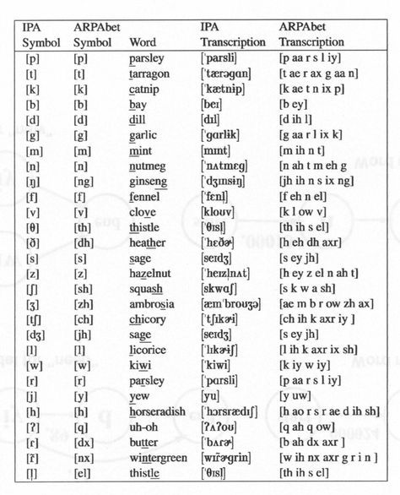

Slide 9
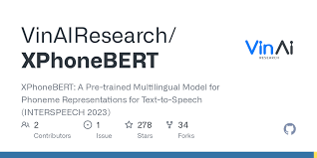
RoBERTa + IPA

Slide 10

GOOD-excellent, fine, superior, wonderful, marvelous, qualified, suited, suitable, apt, proper,capable, generous, kindly, friendly, pleasant, satisfactory, well-behaved, obedient, honorable, reliable, top-notch, worthy, grand, salubrious, noble, great, beneficial, splendid, first-rate, genuine, ample, estimable, valid, helpful, expedient, righteous, advantageous, sterling, superb, respectable, edifying, trustworthy , gracious, obliging,agreeable, safe, profitable, beneficial.

Slide 11
Central word, called Anchor
An homophone
A synonym
GOOD-excellent, fine, superior, wonderful, marvelous, qualified, suited, suitable, apt, proper,capable, generous, kindly, friendly, pleasant, satisfactory, well-behaved, obedient, honorable, reliable, top-notch, worthy, grand, salubrious, noble, great, beneficial, splendid, first-rate, genuine, ample, estimable, valid, helpful, expedient, righteous, advantageous, sterling, superb, respectable, edifying, trustworthy , gracious, obliging,agreeable, safe, profitable, beneficial.

Slide 12
Ferry
Fairy
Boat
Central word, called Anchor
An homophone
A synonym
GOOD-excellent, fine, superior, wonderful, marvelous, qualified, suited, suitable, apt, proper,capable, generous, kindly, friendly, pleasant, satisfactory, well-behaved, obedient, honorable, reliable, top-notch, worthy, grand, salubrious, noble, great, beneficial, splendid, first-rate, genuine, ample, estimable, valid, helpful, expedient, righteous, advantageous, sterling, superb, respectable, edifying, trustworthy , gracious, obliging,agreeable, safe, profitable, beneficial.
97 instance by now…

Slide 13
We state that phonetic embeddings should only primarily capture phonetic features.

Slide 14
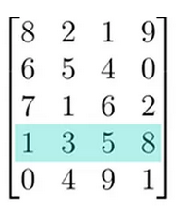
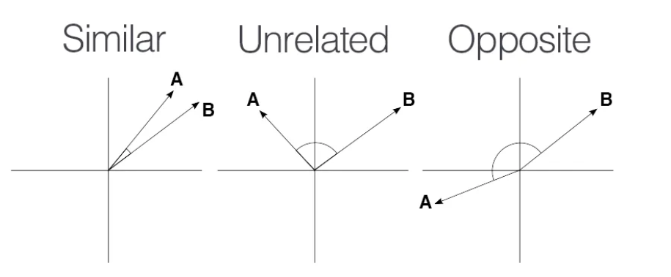
Ferry
Fairy
Boat
Central word, called Anchor
An homophone
A synonym

Slide 15
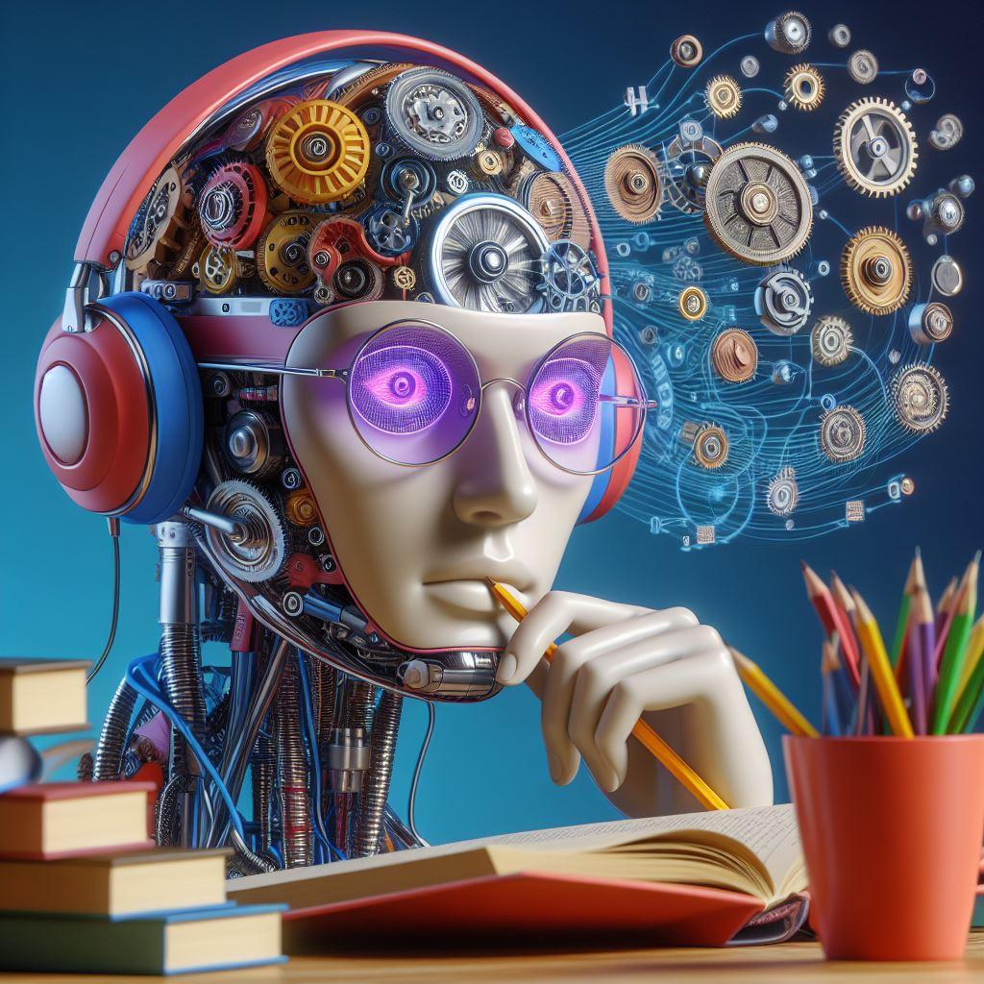
Ferry
Fairy
Boat
Central word, called Anchor
An homophone
A synonym
Personification of a NLP phoneme based model…

Slide 16
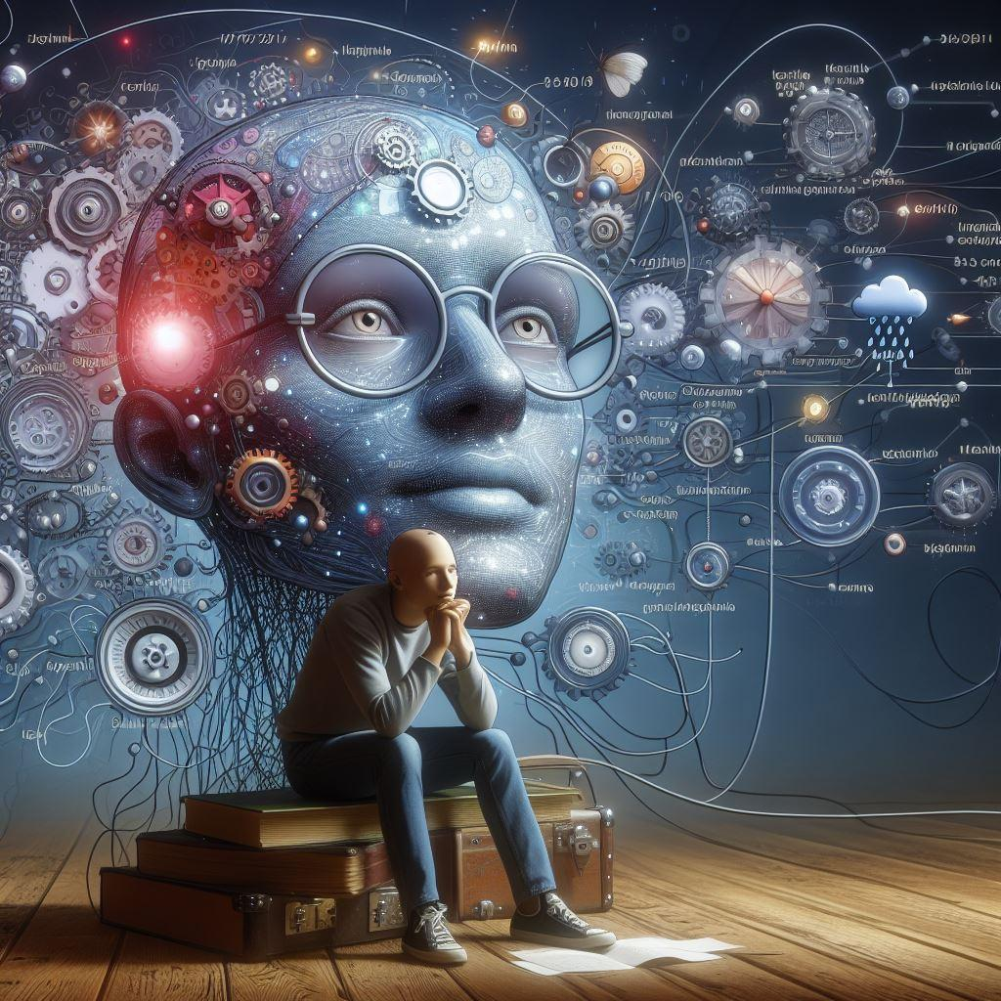
Ferry
Fairy
Boat
Central word, called Anchor
An homophone
A synonym
Personification of a NLP semantic based model…(? I guess)

Slide 17
Some examples from the dataset:
anchors,homophones,synonyms
bait,bate,torment
bawl,ball,holler
band,banned,ensemble
bare,bear,nude
cash,cache,money
cantor,canter,chanter
We made sure that each homophone had no semantic spheres in common with anchors. We chose the synonym that seemed most close to the word anchor.

Slide 18
we averaged the last hidden layer of the same word in 10 different contexts (data taken from wikitext)
 | Homopone
Models | Homophone | Synonym
Articulatory Phonemes | 1 | 0
P2V | 0,6 | 0,4
Word2Vec | 0,04 | 0,96
BERT | 0,07 | 0,93
XPhoneBert | // | //
we averaged the last hidden layer of the same word in 10 different contexts (data taken from wikitext) because automatic IPA transcription is computationally expensive

Slide 19
we averaged the last hidden layer of the same word in 10 different contexts (data taken from wikitext)
 | Homopone
Models | Homophone | Synonym
Articulatory Phonemes | 1 | 0
P2V | 0,6 | 0,4
Word2Vec | 0,04 | 0,96
BERT | 0,07 | 0,93
XPhoneBert | // | //
we averaged the last hidden layer of the same word in 10 different contexts (data taken from wikitext) because automatic IPA transcription is computationally expensive

Slide 20
we averaged the last hidden layer of the same word in 10 different contexts (data taken from wikitext)
 | Homopone
Models | Homophone | Synonym
Articulatory Phonemes | 1 | 0
P2V | 0,6 | 0,4
Word2Vec | 0,04 | 0,96
BERT | 0,07 | 0,93
XPhoneBert | // | //
ChatGpt (semantics - prompting) | 0 | 1
ChatGpt (phonetics - prompting) | 1 | 0
Gemini (semantics - prompting) | 0 | 1
Gemini (phonetics - prompting) | 0.03 | 0.97
we averaged the last hidden layer of the same word in 10 different contexts (data taken from wikitext) because automatic IPA transcription is computationally expensive
I'll give you word triplets. Each of these triplets is made up of a reference word, called the anchor word, a homophone of the word anchor and a synonym of the word anchor. Select the word most semantically similar to the anchor word for each of the triplets. I'll give you an example: bait, bate, torment. In this case the most similar word to bait is torment.
I'll give you word triplets. Each of these triplets is made up of a reference word, called the anchor word, a homophone of the word anchor and a synonym of the word anchor. Select the word most phonetically similar to the anchor word for each of the triplets. I'll give you an example: bait, bate, torment. In this case the most similar word to bait is bate.

Slide 21
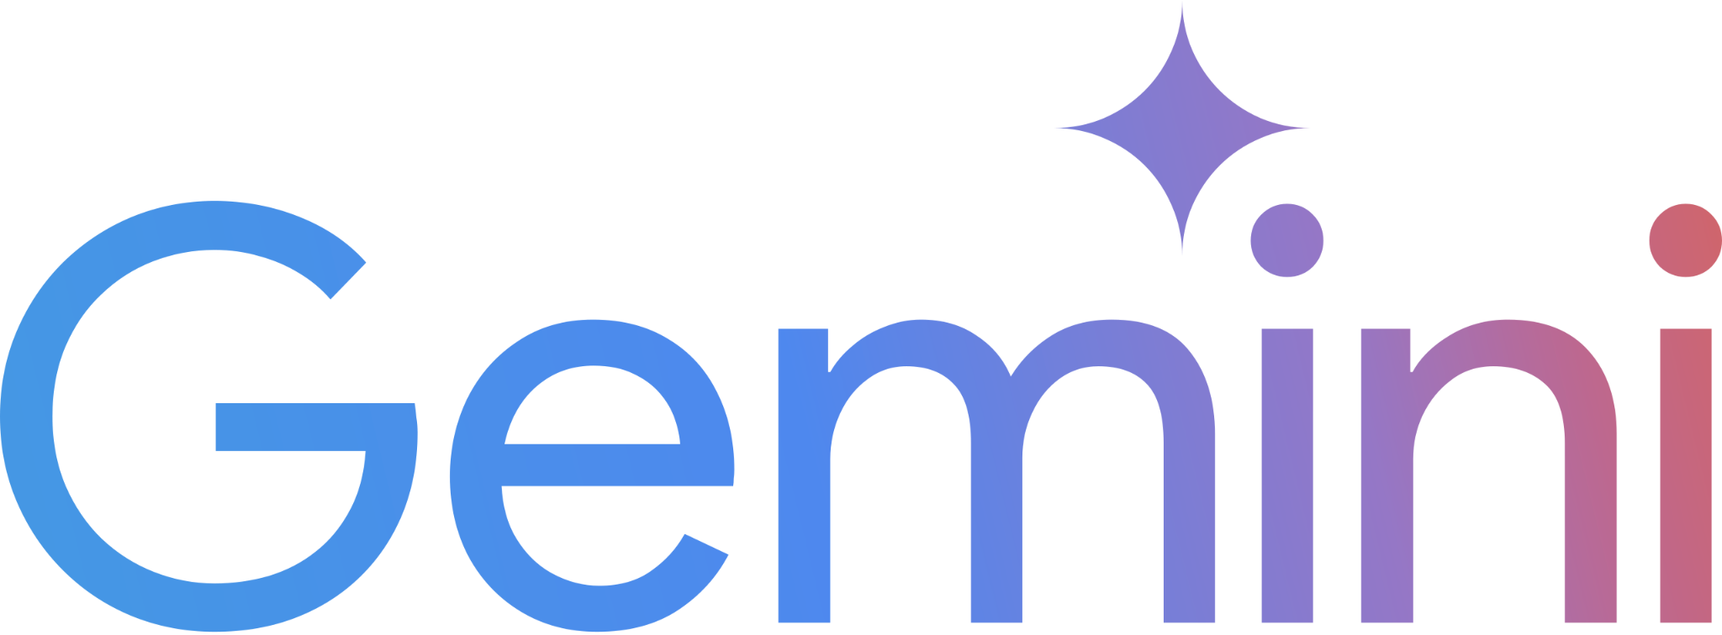
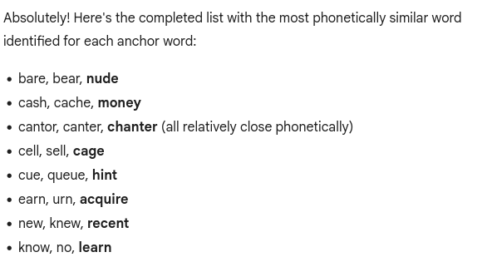
Here, bawl is the closest sounding word to ball. [ Both involve making a loud noise, though bawling is more about crying while balling can be a general shout. ]
some glimpse of phonetic knowledge, but doesn't answer correctly.

Slide 22
θæŋks!!!

