Slide 1
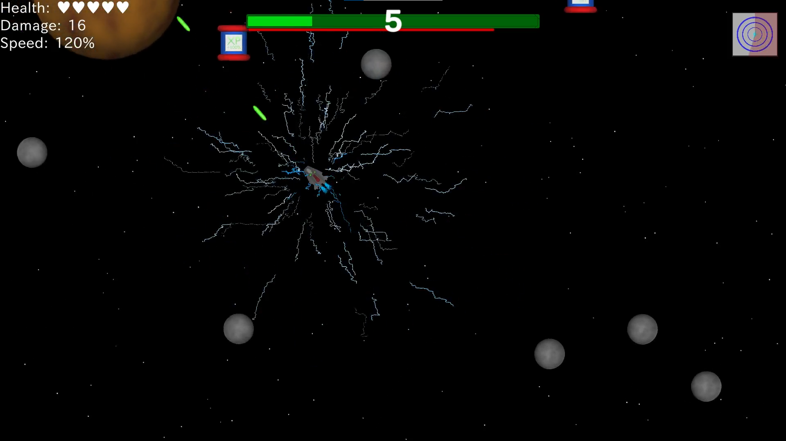
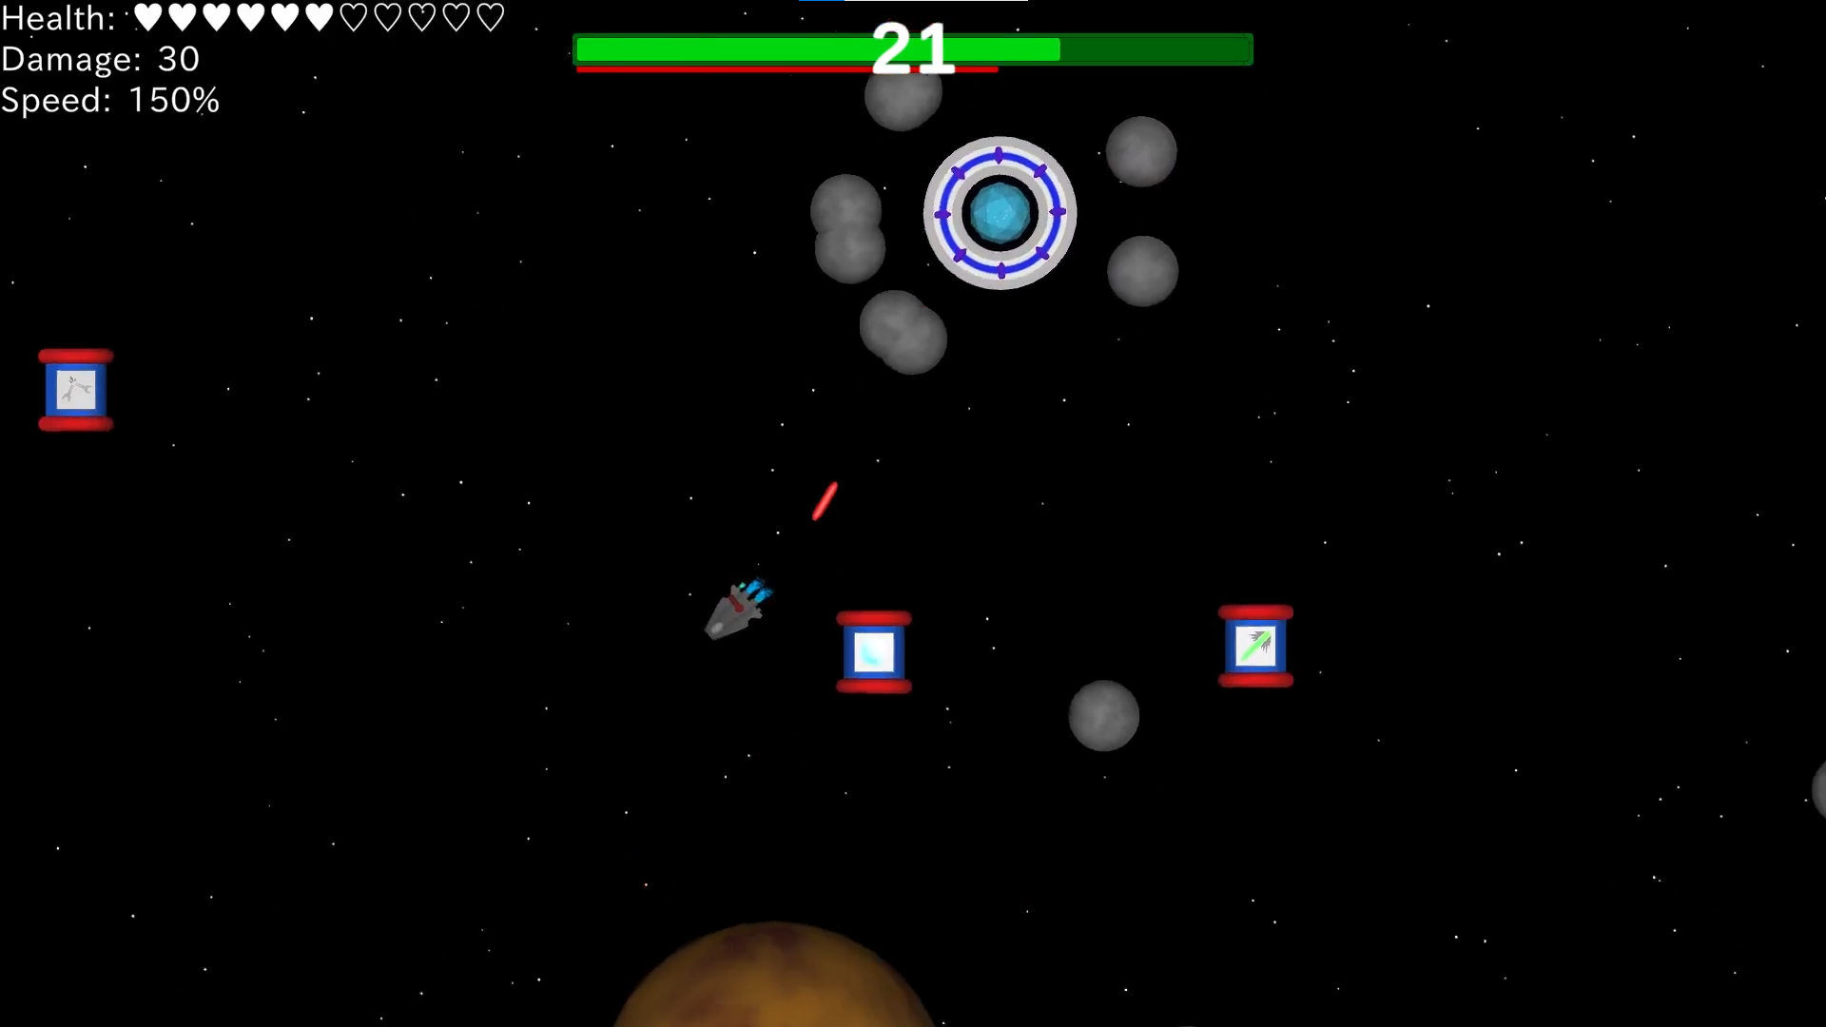
UNTITLED SPACESHOOTER
Finn Hess, Gianluca Towae, Marlon Wachsmuth
Open World 2d movement and shooting
Different abilties (e.g double shot, shield)
Intelligent enemy spawning logic
Unique enemies with different behaviours
Advanced boss mechanics with increasing difficulty
Custom textures created in Blender
More information in game

