Slide 1
Maven
Giacomo Tanganelli
PhD student @ University of Pisa
g.tanganelli@iet.unipi.it

Slide 2
Apache Maven - Concept
Software project management tool
Based on project object model (POM)
POM is the fundamental unit (XML file)
information
configuration
dependencies
de facto standard for large Java projects
Java library exported in Maven repositories

Slide 3
POM - Minimal
<project>
<modelVersion>4.0.0</modelVersion>
<groupId>it.unipi.iot</groupId>
<artifactId>iot-example</artifactId>
<version>1.0</version>
<packaging>jar</packaging>
</project>

Slide 4
Project inheritance
<project>
<modelVersion>4.0.0<modelVersion>
<parent>
<groupId>it.unipi.iot</groupId>
<artifactId>iot-example</artifactId>
<version>1.0</version>
</parent>
<groupId>it.unipi.iot</groupId>
<artifactId>server</artifactId>
<version>1.0</version>
<packaging>jar</packaging>
</project>
|--/iot-example
| --/server
| -- pom.xml
|--pom.xml

Slide 5
Project aggregation
<project>
<modelVersion>4.0.0<modelVersion>
<groupId>it.unipi.iot</groupId>
<artifactId>iot-example</artifactId>
<version>1.0</version>
<packaging>pom</packaging>
<modules>
<module>server</module>
</modules>
</project>
|--/iot-example
| --/server
| -- pom.xml
|--pom.xml

Slide 6
Dependencies
<dependencies>
...
<dependency>
<groupId>org.eclipse.californium</groupId>
<artifactId>californium-core</artifactId>
<version>${project.version}</version>
</dependency>
...
</dependencies>
Your project can rely on other project
Specify each project as a dependency
See it as “import jar into library path”
Import from where?

Slide 7
Repositories
</repositories>
…
<repository>
<id>repo.eclipse.org</id>
<name>Californium Repository</name>
<url>https://repo.eclipse.org/content/repositories/californium/</url>
</repository>
…
</repositories>
Each pom.xml inherits the standard repository
Some projects, i.e. Californium, have their repository

Slide 8
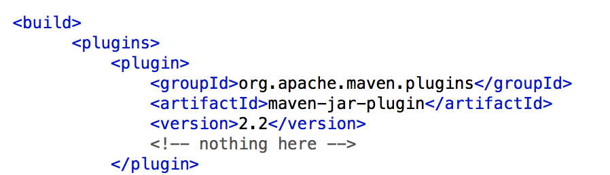
Plugins

Slide 9
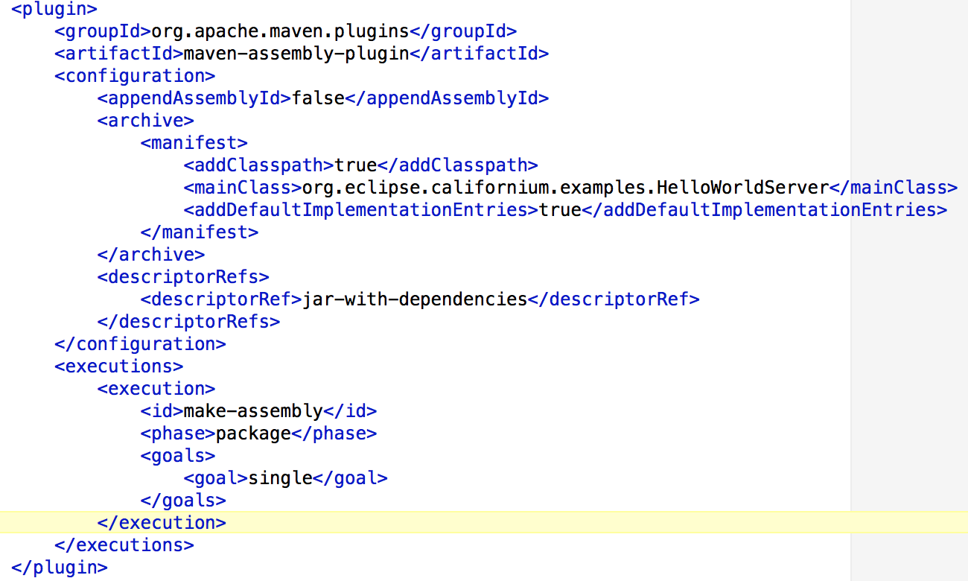
Plugins – 2

Slide 10
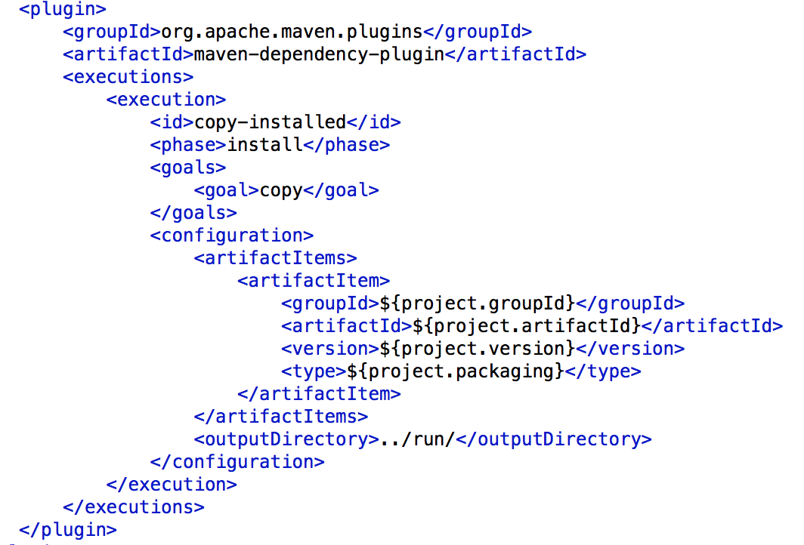
Plugins – 3

Slide 11
Compile and Install
In order to compile modules in the root of the project run:
$> mvn clean install
Usually jar files will be deployed inside a target folder in each subproject:
Californium configuration, for convenience, copies generated jars inside the run folder in the root folder.

Slide 12
Example
Take a look to cf-helloworld-server/pom.xml
Take a look to californium/pom.xml
Try to create a new Maven project ready to use the californium library.

