Slide 1


A Planning-based Approach for Leveraging Activity Life Cycle Information in Declarative Trace Alignment
Dipartimento di Ingegneria Informatica, Automatica e Gestionale
Corso di Laurea magistrale in Engineering in Computer Science
Candidate:
Gianmarco Bordin
Thesis Advisor:
Prof. Andrea Marrella
Titolo Presentazione
01/07/2020
Academic Year 2023/2024

Slide 2
Solution Design
Algorithm & Implementation
Experimental Evaluation
Problem & Research Goal
Conclusions & Future Works
​Research Roadmap
A Planning-based Approach for Leveraging Activity Life Cycle Information in Declarative Trace Alignment

Slide 3
In the context of Process Mining...
Problem​
Goal
Overcoming the traditional Trace Alignment Problem
Accounting for the Activity Life Cycle
Solving a more advanced Trace Alignment problem ​
providing a STRIPS-like encoding that minimizes the searching time for state of the art planners​
exploiting AI Automated Planning​
There are no solutions to this problem in the current literature !
A Planning-based Approach for Leveraging Activity Life Cycle Information in Declarative Trace Alignment

Slide 4

Process Example
A Planning-based Approach for Leveraging Activity Life Cycle Information in Declarative Trace Alignment

Slide 5



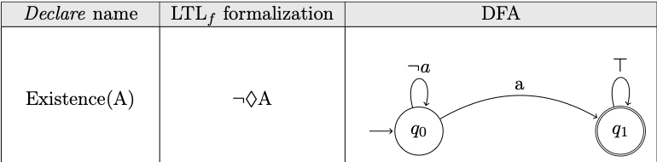
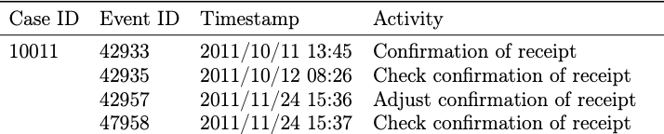
Conformance Checking
Model
Constraints
Organizational Event Logs​
Organizational Rules expressed as:
Declare Constraints
LTL-f
DFA
Organizational Event Logs:
Record previous processes executions
Composed of a set of traces
Each trace contains a set of events with several attributes
A Planning-based Approach for Leveraging Activity Life Cycle Information in Declarative Trace Alignment

Slide 6
Trace Alignment
Trace alignment involves aligning inconsistent traces with process models to achieve the following :
Determining whether a trace adheres to its corresponding process model.
Detecting the root causes and severity of any deviations.
Modifying and correcting the trace (actual behavior) to ensure compliance with the process model (expected behavior).
We scan the trace from beginning to end and at any position p we apply one of the following moves:
Add an activity to the trace at position p.
Del the activity at position p.
Skip the activity at position p.
Each move has a cost and we want to compute optimal alignments.
A Planning-based Approach for Leveraging Activity Life Cycle Information in Declarative Trace Alignment

Slide 7
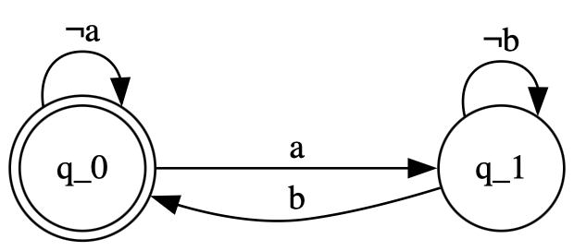
Example Process Model: Declare
Let a and b be two activities that we found in a trace t of the event log under examination.
A model constraint that may be:
If activity a occurs then, after a, there must be an occurrence of activity b
In Declare this constraint is formalized as Response(a,b)
automata based formulation
Response (a,b)
A Planning-based Approach for Leveraging Activity Life Cycle Information in Declarative Trace Alignment

Slide 8
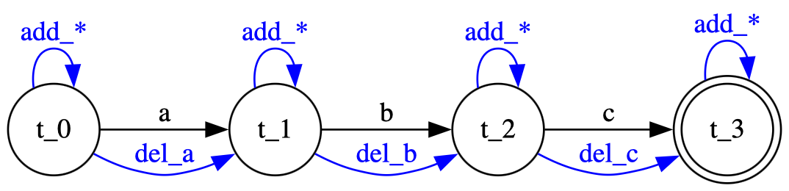
Solution Design: Trace Automaton
The solution to this problem is based on automata
Augment each automata with novel transitions accounting for add & del moves (the sync move will be the event as-is)
Let a trace t = <a, b, c> with a, b, c the order of activities in the trace
A trace t is accepted by the automaton if we can reach from the start state the final accepting state
For example it accepts <a, b, c> and <a, add_{a}, del_{b}, c>
but <a, c> is not accepted
This reflects the trace t
A Planning-based Approach for Leveraging Activity Life Cycle Information in Declarative Trace Alignment
G. De Giacomo, F. M. Maggi, A. Marrella, F. Patrizi, On the Disruptive Effectiveness of Automated Planning for LTLf-based Trace Alignment. AAAI 2017

Slide 9


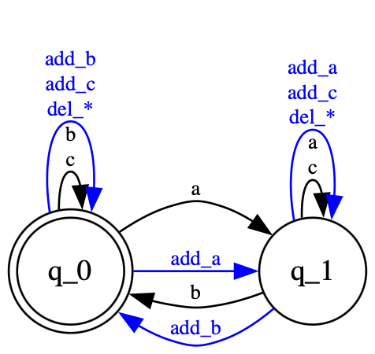
Solution Design: Model Automaton
For each constraint we have a different model automaton
Augment the base automaton for the Response(a,b)
For example it accepts <a, b> and <add_{a}, add_{b}, c>
but <a, b, a> is not accepted
Augmented automata for alphabet
<a, b, c>
Response (a,b)
A Planning-based Approach for Leveraging Activity Life Cycle Information in Declarative Trace Alignment
G. De Giacomo, F. M. Maggi, A. Marrella, F. Patrizi, On the Disruptive Effectiveness of Automated Planning for LTLf-based Trace Alignment. AAAI 2017

Slide 10
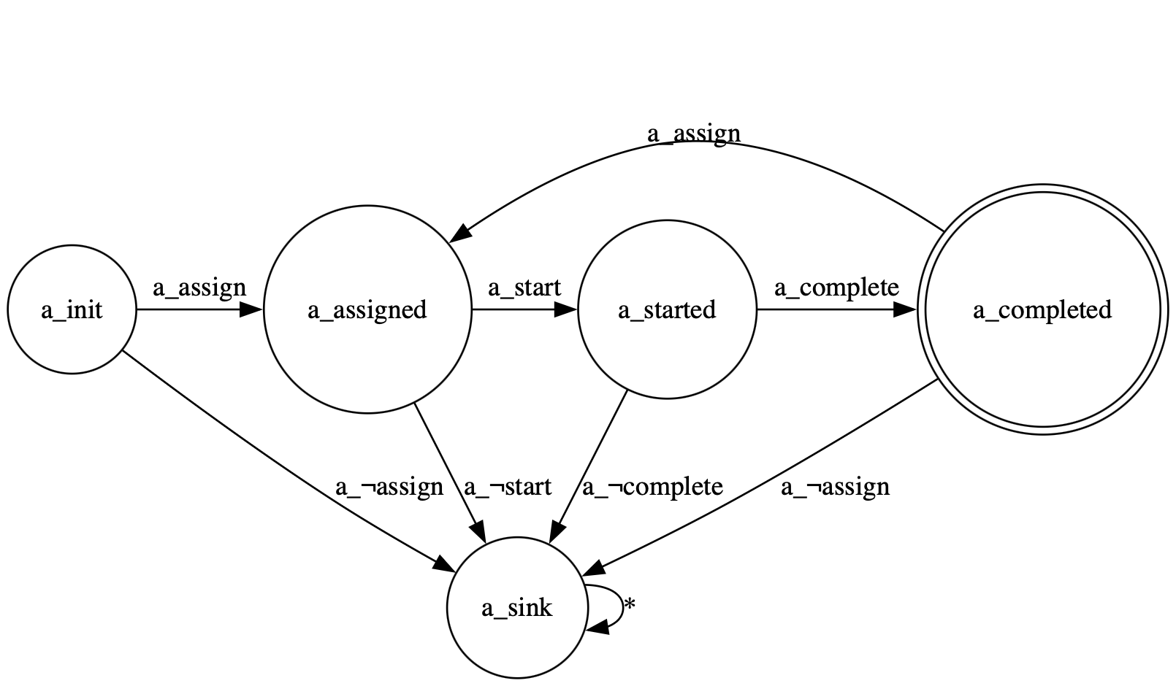
Solution Design: Life Cycle Automaton
For each activity a in the log we construct a life cycle automaton
Our automaton helps tracking the life cycle state of each activity
The automaton helps visualizing our life cycle model composed of three activity sub events <assign, start, complete>
Life Cycle Automaton
for a
A Planning-based Approach for Leveraging Activity Life Cycle Information in Declarative Trace Alignment

Slide 11
Solution Design: Life Cycle
Augment each life cycle automaton with <add*,del*> edges
For example any repetition of the sequence <a_{assign}, a_{start}, a_{complete}> will move the automaton in the final accepting state
Any out-of-order violation to the life cycle sequence will move the automaton in a sink state from which it cannot exit
This ensures that if the automaton reaches that state, the computation ends in a non-accepting state
This life cycle sequence must be respected
A Planning-based Approach for Leveraging Activity Life Cycle Information in Declarative Trace Alignment

Slide 12
Final Solution to our problem
A solution to will be a sequence of synchronous steps performed in :
All augmented model constraint automata
All augmented life cycle constraint automata
The trace automaton
Such that at the end of the computation each automaton is in at least one accepting state.
In other words, we effectively employ a series of <add*,del*,skip> moves to align the trace with respect to the model & life cycle constraints
A Planning-based Approach for Leveraging Activity Life Cycle Information in Declarative Trace Alignment

Slide 13
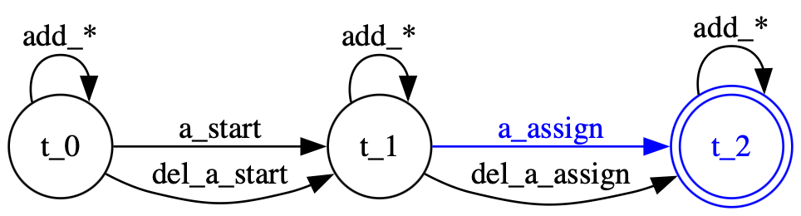
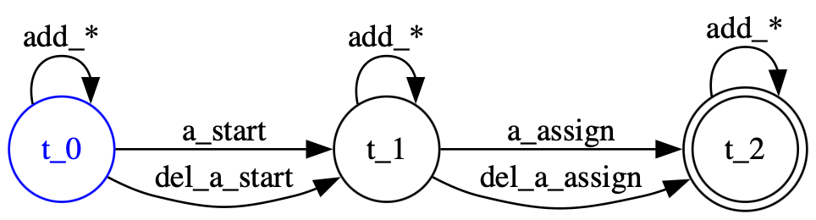
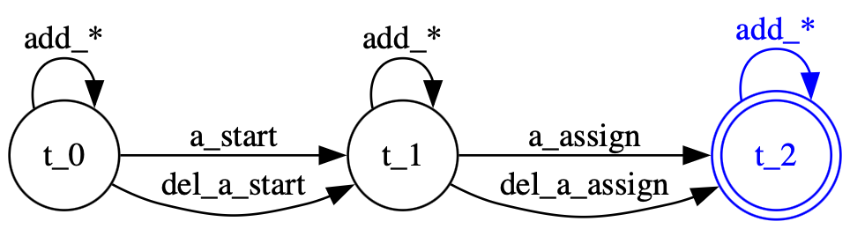
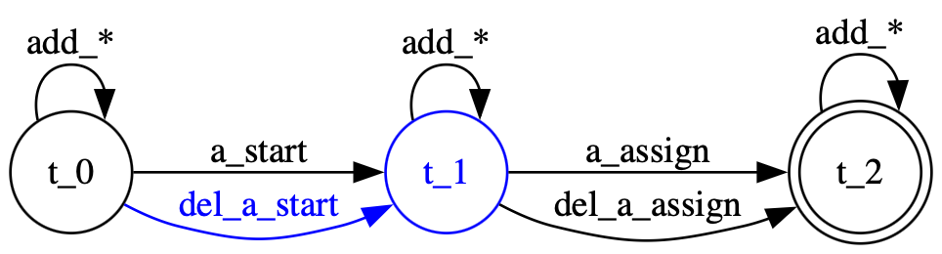
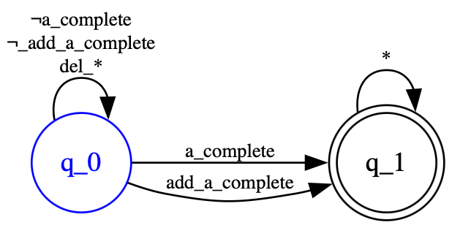
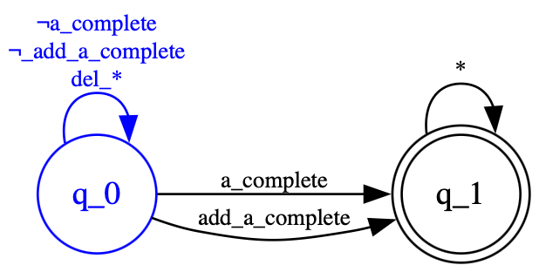
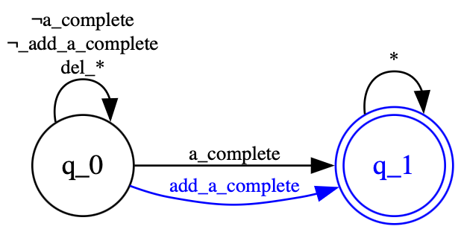
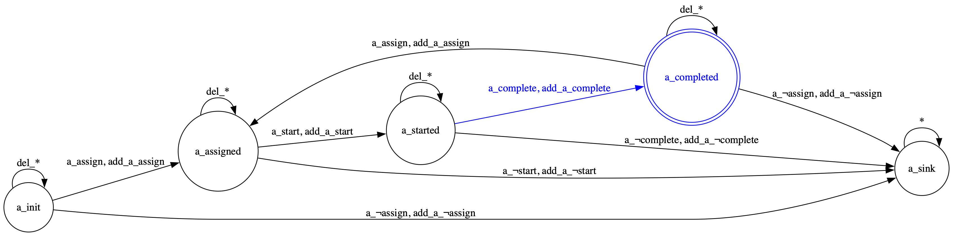
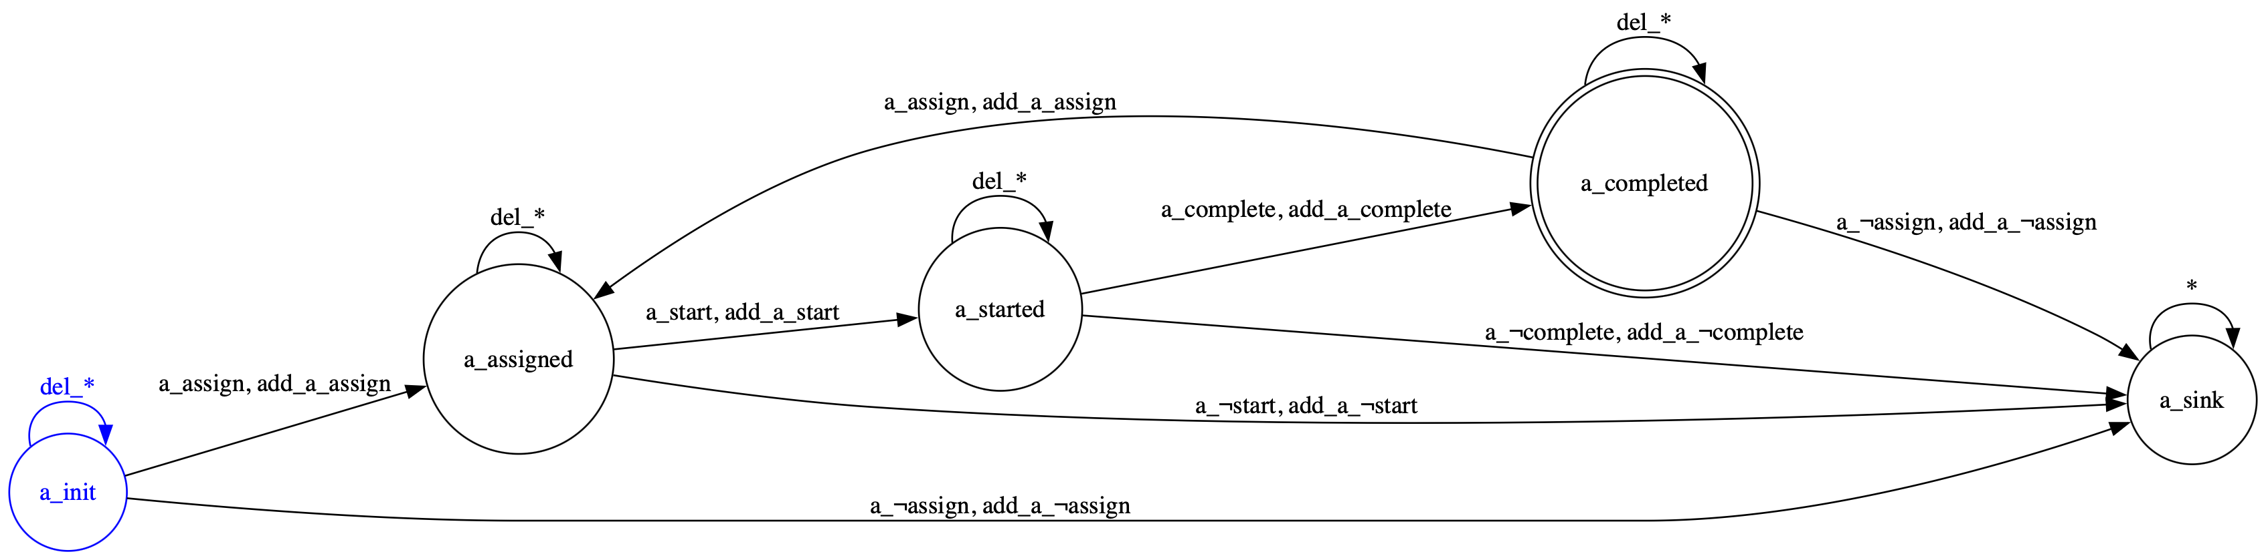
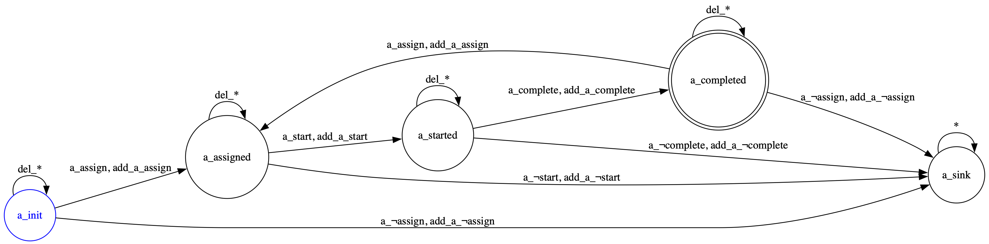
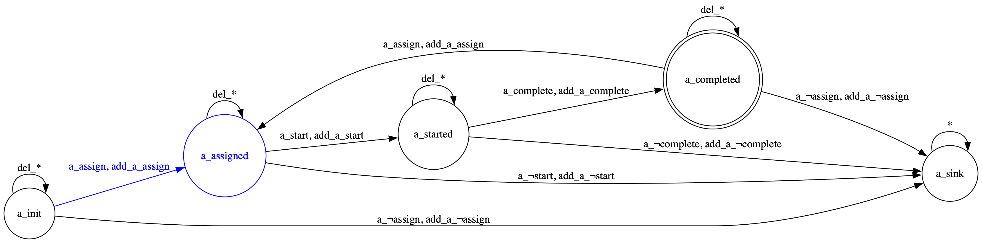
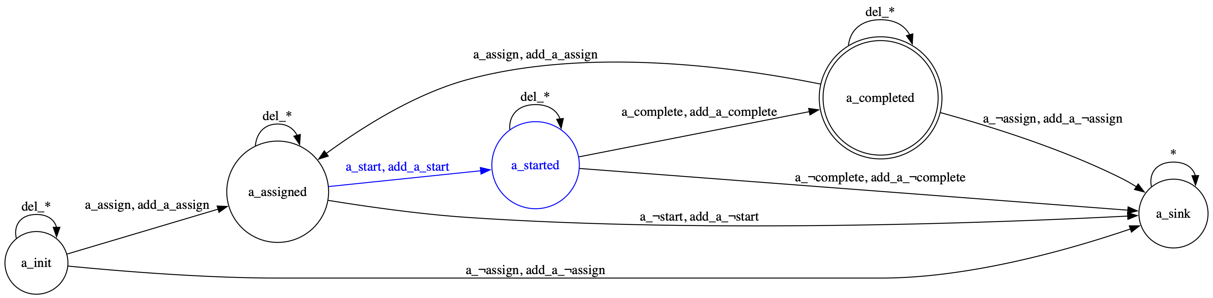
A Running Example t = <a_{start}, a_{assign}>
A Simple Example
A Planning-based Approach for Leveraging Activity Life Cycle Information in Declarative Trace Alignment

Slide 14
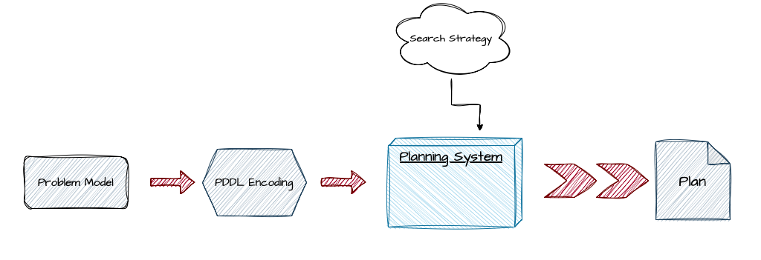
Trace alignment encoding in PDDL
Encoding the problem in a language that can be understood by state-of-the-art planners
PDDL is the language used to encode the problem in a domain and a problem file
The planning system receives the files in input and uses a strategy to search in the state space
The output solution will be a plan of actions that lead all the automata to at least one accepting state
The optimal plan minimizes the cost of the plan
For the problem file:
The initial state --> all automata in their starting states
The goal state --> all automata in at least one accepting state
For the domain file:
We use domain propositions to
to track the automata structures and dynamics
The possible actions for the planner:
Add & Del with unitary cost
Sync with zero cost
A Planning-based Approach for Leveraging Activity Life Cycle Information in Declarative Trace Alignment

Slide 15
Algorithm & Implementation
The algorithm:
Delete states that cannot appear in any possible goal path (sink states)
Identify and group (on their label) the relevant transitions (between different states)
Generate all the possible combination of transitions for add, del and sync planning actions
The implementation of the Life Cycle Aligner:
Is a stand-alone java application
Takes as input:
XES event log
One or more XML/DOT model files
Gives as output:
A list of <domain.pddl, problem.pddl> files
A file containing the overall results of the computed alignments
A Planning-based Approach for Leveraging Activity Life Cycle Information in Declarative Trace Alignment

Slide 16
Experimental Setup: Noise Injection
We implemented also a tool written in python that inject the required amount of noise into each trace of the log
The Noiser.py injects noise into event logs by modifying traces using three moves: Add (add an activity), Del (delete an activity), and Swap (swap two activities).
It calculates the total number of deviations to apply and distributes them across these moves.
All the logs are initially generated with Rum tool with the specified alphabet and constraint model.
Each log is formatted and then noisified using are tool
Each tested log is generated with respect to all the possible combinations with:
The model with the settled number of constraints (e.g 1,3,5,7).
The alphabet activities already shown (9).
The trace length parameter (e.g 10,20,30).
The noise percentage (e. g, 0\% corresponds to no noise).
A Planning-based Approach for Leveraging Activity Life Cycle Information in Declarative Trace Alignment

Slide 17
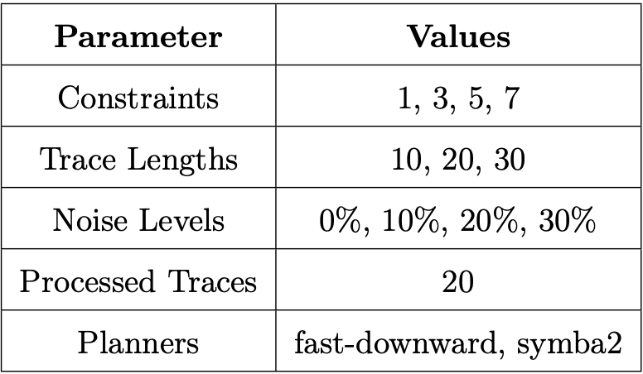
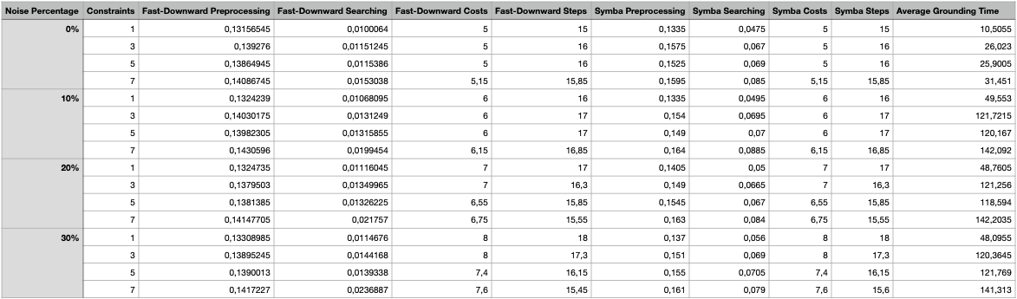
Experimental Setup: Settings
Up to 9 different activities in a trace t
Declare models with 1, 3, 5 or 7 constraints
20 traces processed for each event log
2 different state-of-the-art planners used
A Planning-based Approach for Leveraging Activity Life Cycle Information in Declarative Trace Alignment

Slide 18
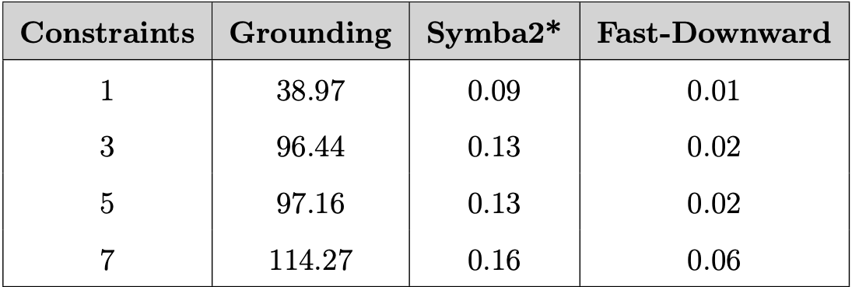
Evaluation: Grounding vs Searching Time
The Tool provides to the planner an hardened version of the problem and this takes time
The life cycle model highly influences performances
This means that the domain & problem are strictly coupled contrasting the original PDDL aim
BUT this reduces drastically the pre-processing and searching time of both planners
The life cycles of ALL the activities in the log are correctly enforced
A Planning-based Approach for Leveraging Activity Life Cycle Information in Declarative Trace Alignment

Slide 19
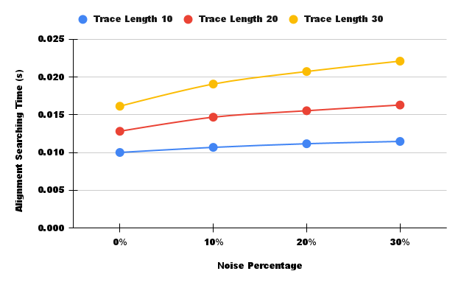
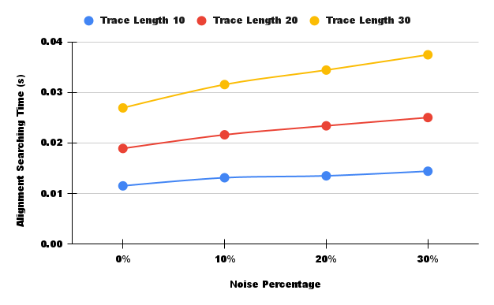
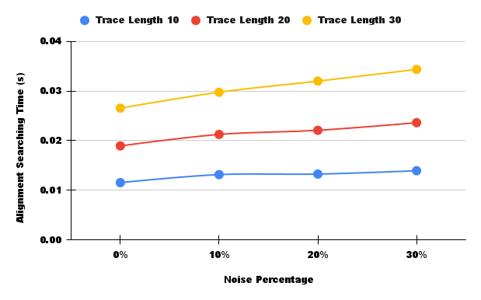
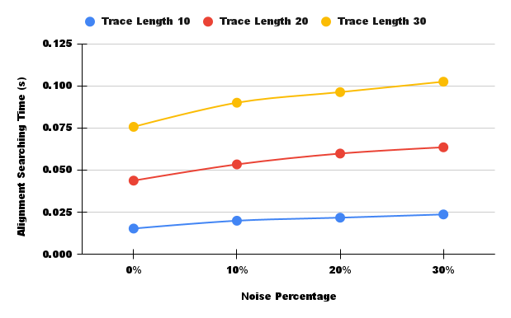
Evaluation: Searching Time
A Planning-based Approach for Leveraging Activity Life Cycle Information in Declarative Trace Alignment

Slide 20
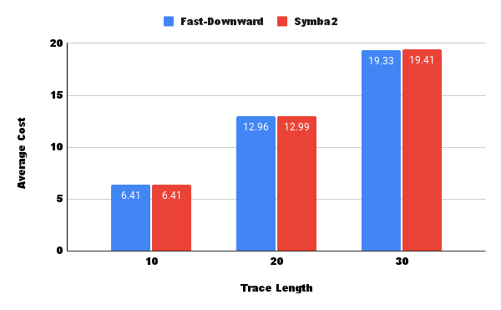
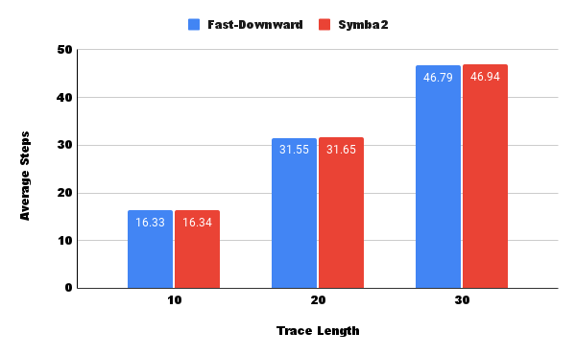
Evaluation: Cost and Steps
A Planning-based Approach for Leveraging Activity Life Cycle Information in Declarative Trace Alignment

Slide 21
Conclusions & Future Works
We have designed a solution to the trace alignment problem that also accounts for the life cycle of each activity in the log
We have implemented a tool that takes as input a log file and a model file and outputs the domain and problem PDDL files along with the results of the trace alignment for each trace
We have implemented a script that injects the specified amount of noise into a log
We have evaluated the results under different experimental conditions
Future works could focus on:
enhancing our solution considering interleaving life cycles of the same activity
the cost of a correction could depend on the life cycle state
activity specific life cycles could be considered
evaluation could be performed on different planners or different life cycles models
A Planning-based Approach for Leveraging Activity Life Cycle Information in Declarative Trace Alignment

Slide 22
Thank You For Your Attention!
A Planning-based Approach for Leveraging Activity Life Cycle Information in Declarative Trace Alignment
Titolo Presentazione
01/07/2020
Dipartimento di Ingegneria Informatica, Automatica e Gestionale
Corso di Laurea magistrale in Engineering in Computer Science

