Slide 1


A Planning-based Approach for Leveraging Activity Life Cycle Information in Declarative Trace Alignment
Department of Computer, Control and Management Engineering
Master Degree of Engineering in Computer Science
Candidate:
Gianmarco Bordin
Thesis Advisor:
Prof. Andrea Marrella
Titolo Presentazione
01/07/2020
Academic Year 2023/2024
Notes:
Good afternoon everyone,
Today, I’m going to present our novel approach for declarative trace
alignment. Our technique accounts for the activity lifecycle and exploits AI
planning to find solutions in an automated fashion.

Slide 2
​Thesis Roadmap
Solution Design
Implementation
Experimental Evaluation
Background & Problem Statement
Conclusions & Future Works
A Planning-based Approach for Leveraging Activity Life Cycle Information in Declarative Trace Alignment
Notes:
During this presentation we will follow our thesis roadmap. Let’s proceed step
by step:
1. We start with the problem statement and the research goal.
2. Then, we present our proposed solution.
3. Next, we provide an overview of the algorithm and the implementation of our
approach.
4. The experimental evaluation will follow.
5. Finally, we conclude with insights into future research directions.

Slide 3
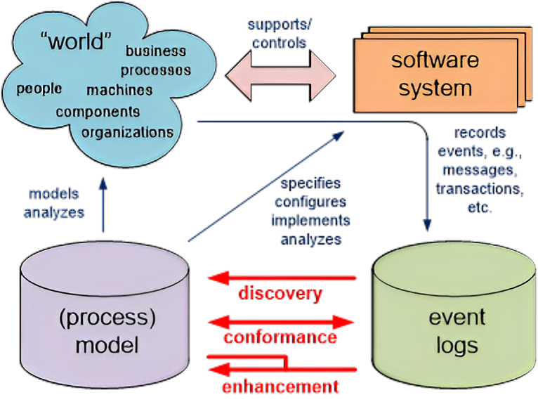
In the context of Process Mining
A Planning-based Approach for Leveraging Activity Life Cycle Information in Declarative Trace Alignment
Notes:
Nowadays, organizations aim at enhancing their business processes where
machines and people interact to achieve business goals. Software supports and
controls these processes and registers previous processes executions in event
logs. These logs keep track of traces of events that contain different process
information.
Process mining is a data-driven technique used to understand, track, and
improve processes by analyzing data from information systems. Process mining
starts from the raw log files and has three principal activities:
●
Discovery → Where event logs are analyzed to discover process models
that specify sw systems and analyze real world behaviors.
●
Enhancement → Focuses on improving existing processes by leveraging
insights gained from data analysis, exploiting advanced technologies
such as AI and ML to optimize processes.
●
Conformance → Where we check the degree of conformance of these logs
with respect to established constraint models.

Slide 4



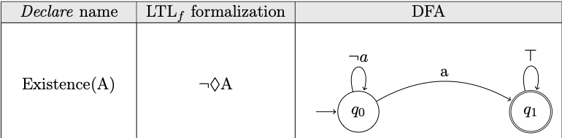
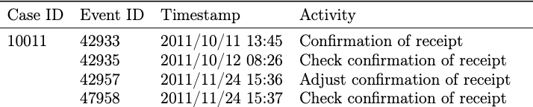
Conformance Checking
OrganizationModel
Constraints
Organization Event Logs​
Organizational Rules expressed as:
Declare Constraints
LTL-f
DFA
Organizational Event Logs:
Record previous processes executions
Composed of a set of traces
Each trace contains a set of events with several attributes
A Planning-based Approach for Leveraging Activity Life Cycle Information in Declarative Trace Alignment
Notes:
We focus on conformance checking where the degree of conformance of event logs
is analyzed. A log is composed of a set of traces that contains sequences of
events each with different attributes values. However, human behavior often
introduces deviations from the expected process behavior. The goal of
conformance checking is to verify whether these processes adhere to the model
constraints. These models can be expressed using declarative constraints in
languages such as LTL on finite traces or as deterministic finite automata.

Slide 5
Trace Alignment
Involves aligning inconsistent traces with process models:
Determining whether a trace adheres to its corresponding process model.
Detecting the root causes and severity of any deviation.
Modifying and correcting the trace (actual behavior) to ensure compliance with the process model (expected behavior).
Add an activity
Possible Modifications
Del an activity
Skip an activity
A Planning-based Approach for Leveraging Activity Life Cycle Information in Declarative Trace Alignment
Notes:
Within conformance checking, a technique used is trace alignment.
●
We want to determine whether a trace adheres to its corresponding
process model.
●
●
Detecting the root causes and severity of any deviations.
Modifying and correcting the trace (actual behavior) to ensure
compliance with the process model (expected behavior).
This is achieved by adding, deleting, or skipping events in the trace. Each of
these modifications has an associated cost, and the goal is often to find
optimal alignments.

Slide 6
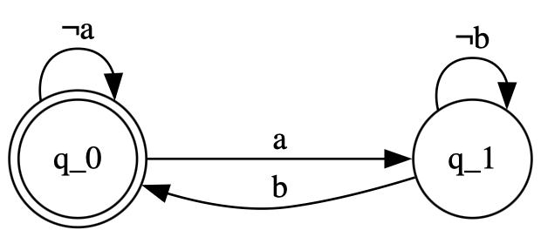
Declare Modelling Language
Declare is a non-prescriptive modelling language
We can define regulations/constraints between activities in a trace
Response (a,b)
Automaton
Ltl-f formula
□(A ⇒ ♢B)
A Planning-based Approach for Leveraging Activity Life Cycle Information in Declarative Trace Alignment
Notes:
Declare is a non-prescriptive-declarative modelling language used to express
rules.
Non-Prescriptive Models don't mandate a strict flow of activities; instead,
they define a set of constraints or rules that must be adhered to. Beyond
these constraints, any sequence of events is allowed. It is used to define
constraints between process activities. Each Declare constraint has a
corresponding LtL-f formula and an automata based formalization.

Slide 7
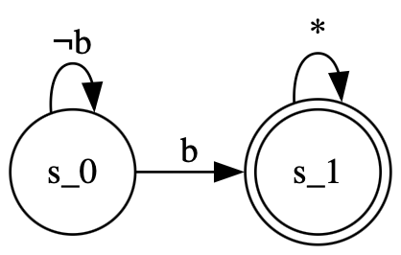


Example Declare Model
A Declare model D consists of a set A of activities involved in a process and a collection of temporal constraints defined over A
To each constraint corresponds an automaton
A process must adhere to all the constraints defined in D
Declare Model D
1. Existence (b)
The activity b must occur
<a,b,c>
<e,d,a>
2. Response (a,b)
If a occurs then b eventually occurs after a ​
<a,c,b>
<a,c,d,e>
A Planning-based Approach for Leveraging Activity Life Cycle Information in Declarative Trace Alignment
Notes:
Declare is a non-prescriptive-declarative modelling language used to express
rules.
Non-Prescriptive Models don't mandate a strict flow of activities; instead,
they define a set of constraints or rules that must be adhered to. Beyond
these constraints, any sequence of events is allowed. It is used to define
constraints between process activities. Each Declare constraint has a
corresponding LtL-f formula and an automata based formalization.

Slide 8
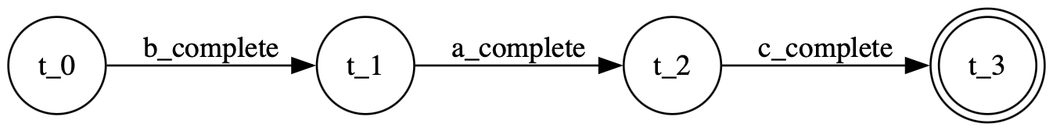
Problem Statement
Existing techniques take into account only already completed activities
The Need of activity-life cycle constraints in many processes
The design of a solution exploiting the power of AI Automated Planning
A Planning-based Approach for Leveraging Activity Life Cycle Information in Declarative Trace Alignment
Notes:
In sectors like manufacturing, the activity lifecycle is critical, as logs
often record errors that need detailed examination. Current techniques focus
only on when activities are completed, ignoring intermediate stages like
started or assigned.
To address this, I developed a new approach using AI automated planning to
analyze processes based on their lifecycle.

Slide 9
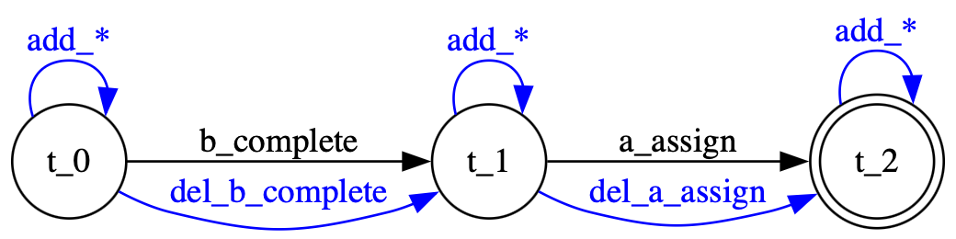
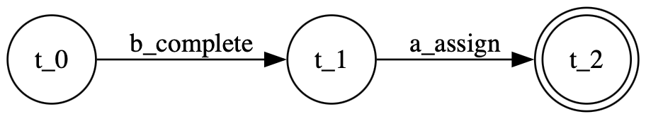
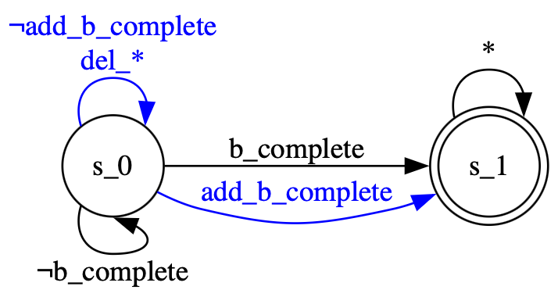
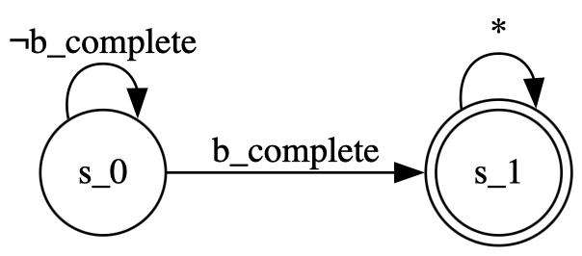
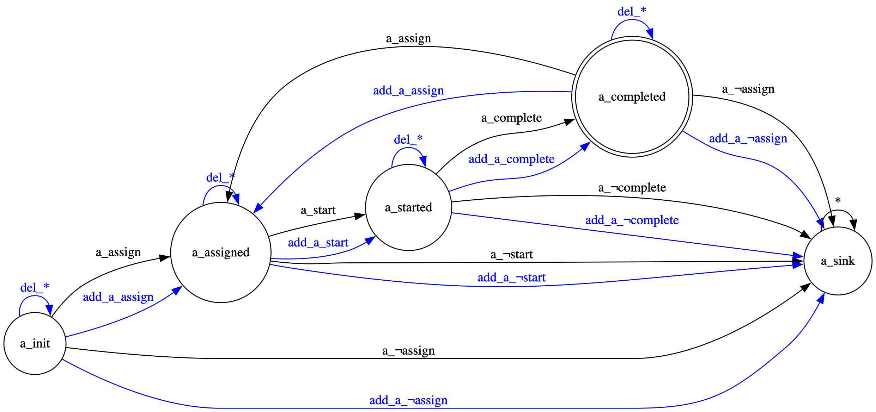
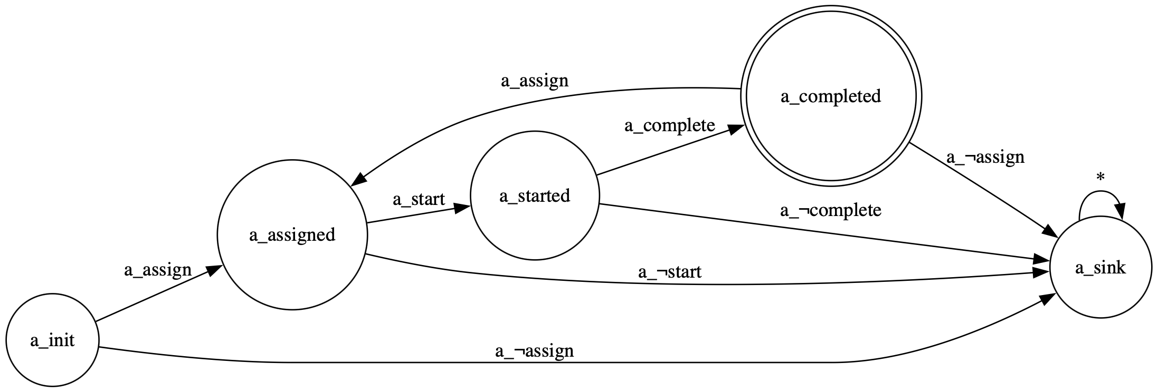
Automata-Based Solution
Trace Layer
<b_{complete}, a_{assign}>
Model Layer
Existence(b_{complete})
Life Cycle Layer
Assign --> Start --> Complete
A Planning-based Approach for Leveraging Activity Life Cycle Information in Declarative Trace Alignment
Notes:
Our approach uses an automata-based formulation to define:
1. Trace Automaton: We model the trace as an automaton and augment it by
adding possible actions in trace alignment.
2. Model Automaton: Similarly, for each constraint we construct and augment an
automaton for the process model.
3. Lifecycle Enforcement: To ensure lifecycle enforcement in trace alignment,
we construct a lifecycle automaton for each activity in the trace. Each
activity lifecycle includes three sub-events: assign, start, and complete. We
augment this automaton and use sink states to enforce the correct lifecycle
model and topological order.
We use add, delete, and sync moves to correct the trace so that it aligns with
both the model and lifecycle constraints.

Slide 10
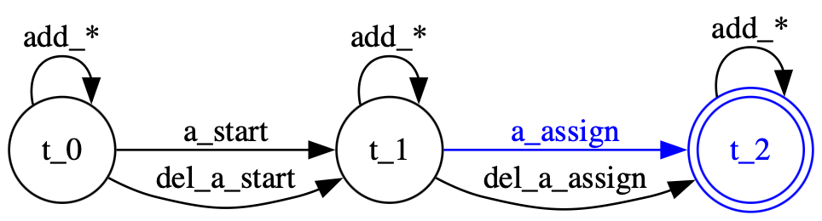
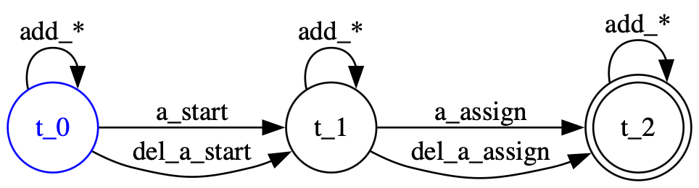
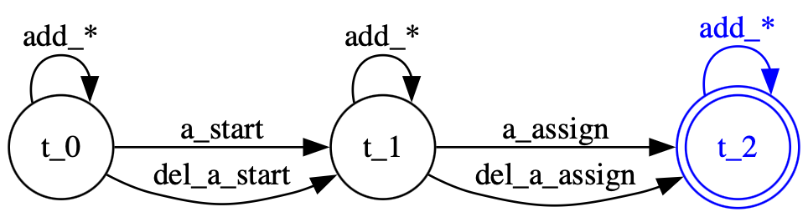
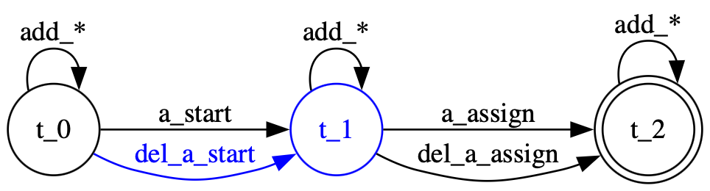
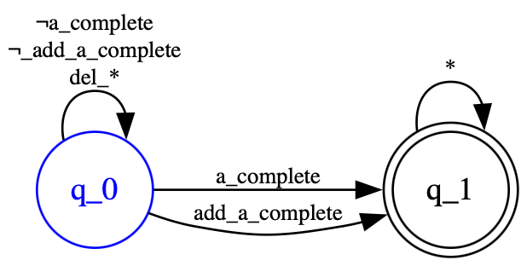
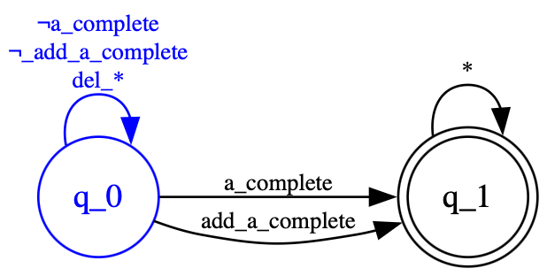
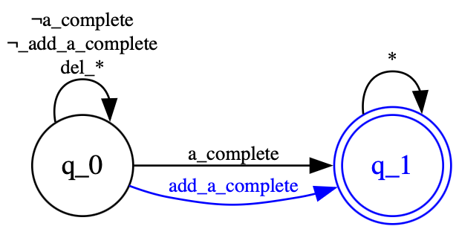
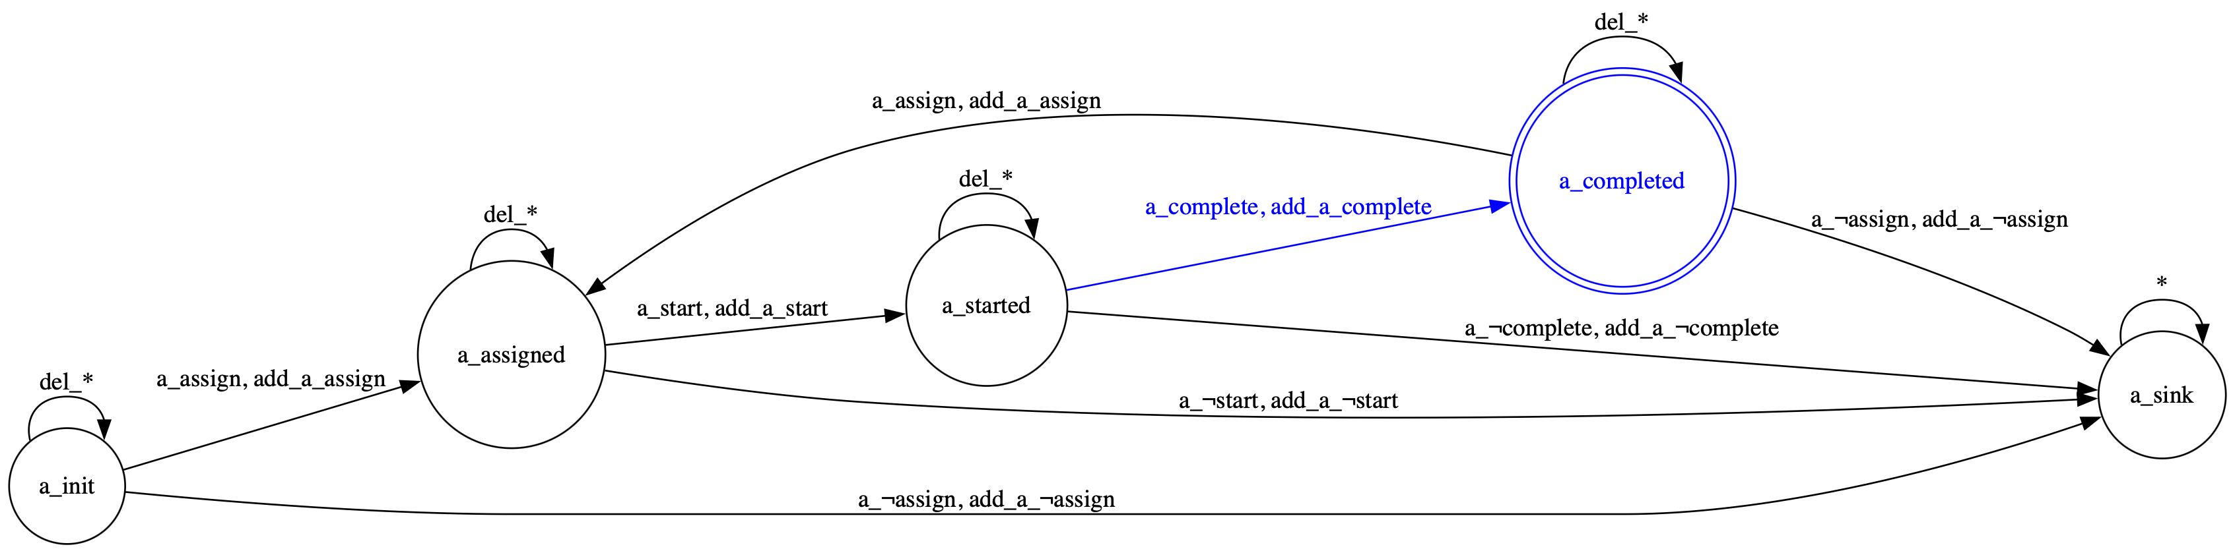
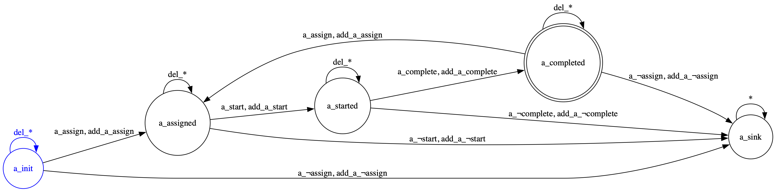
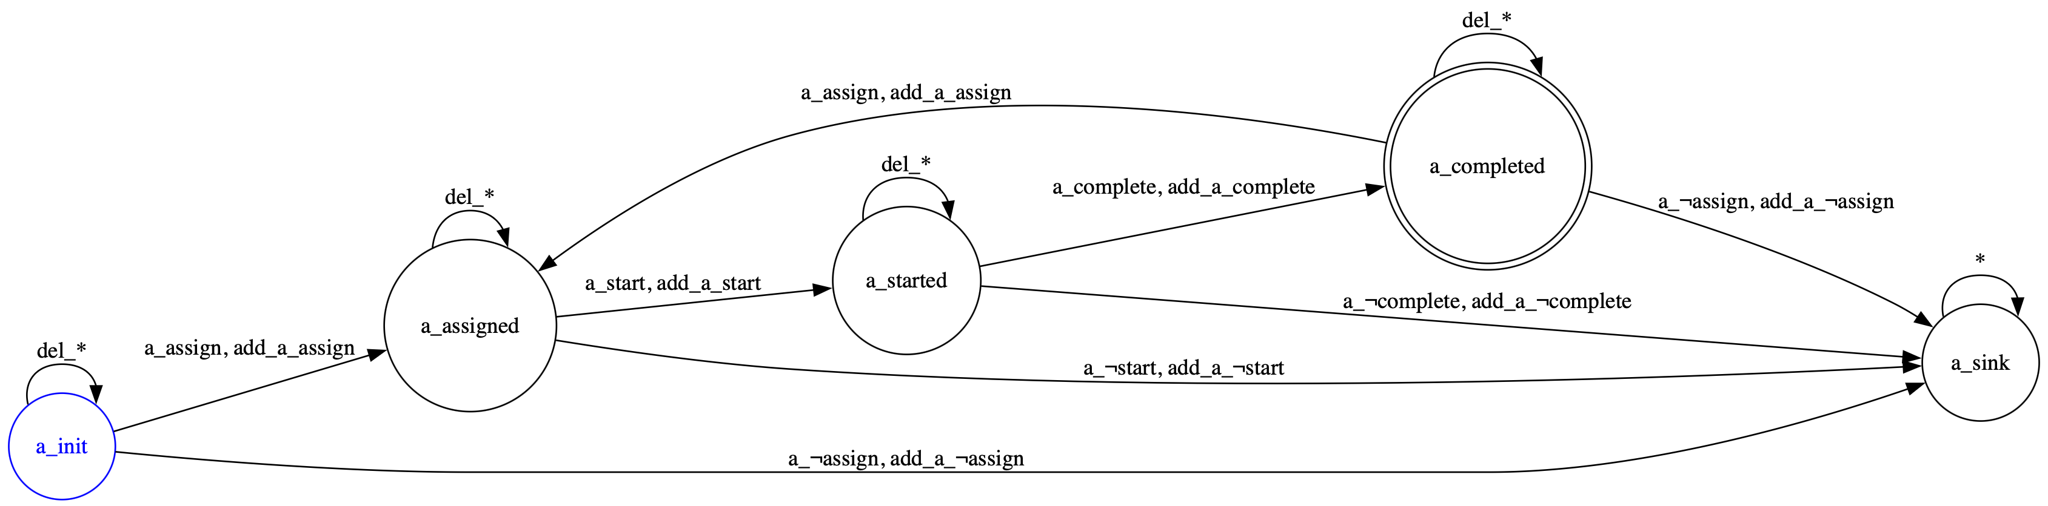
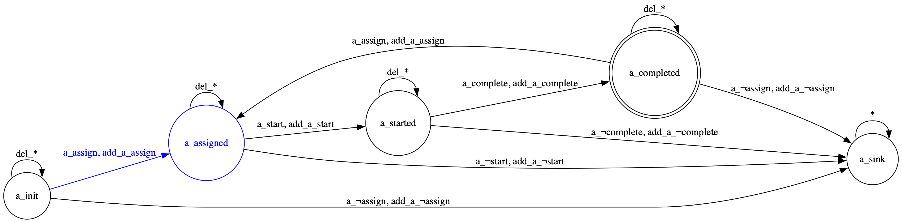
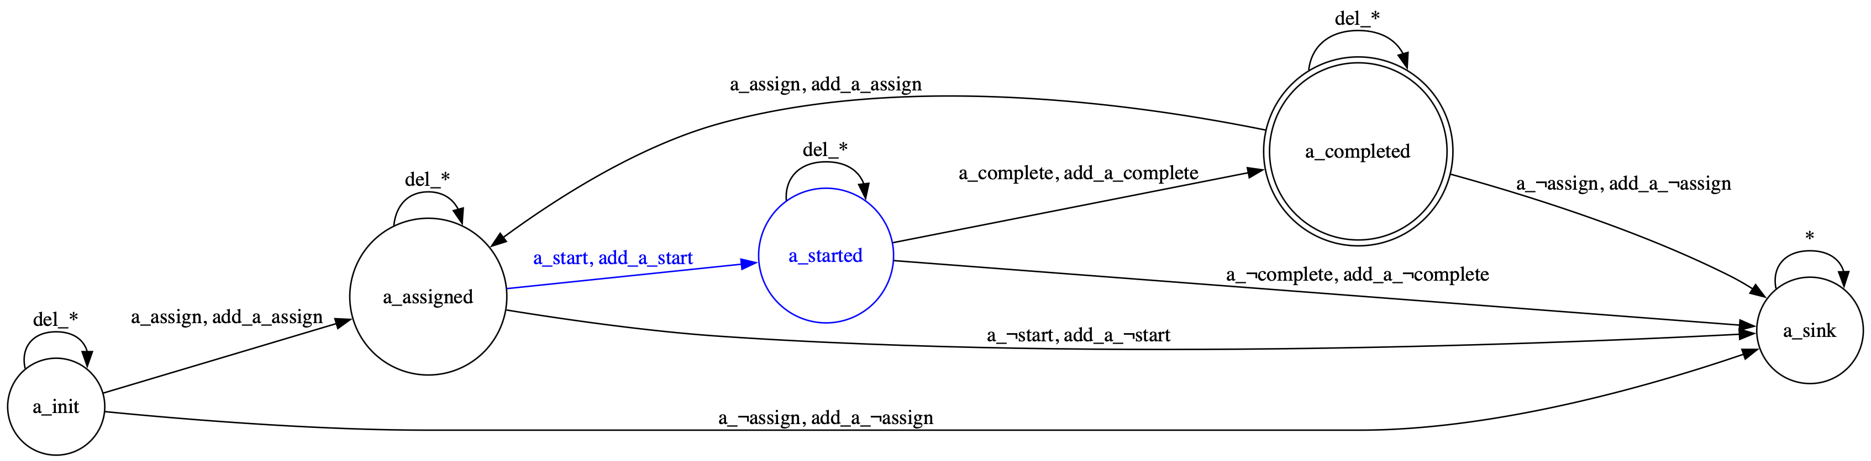
An optimal Solution t = <a_{start} , a_{assign} , a_{start} , a_{complete}>
A Running Example t = <a_{start} , a_{assign}>
A Simple Example
Trace Layer
<a_{start}, a_{assign}>
Model Layer
Existence(a_{complete})
a_{complete}
Life Cycle Layer
a_{assign} --> a_{start} --> a_{complete}
Assign --> Start --> Complete
A Planning-based Approach for Leveraging Activity Life Cycle Information in Declarative Trace Alignment

Slide 11
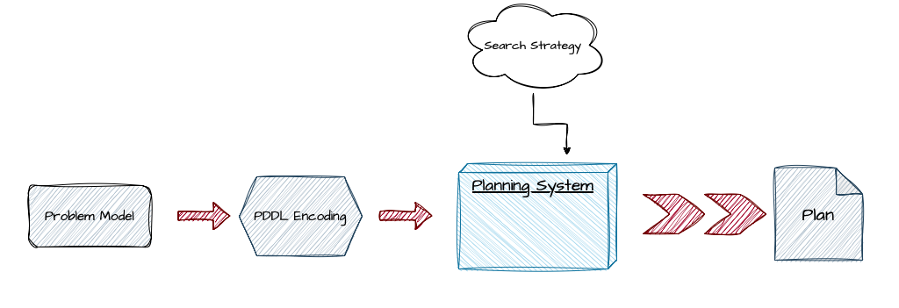
Trace alignment encoding in PDDL
AI Planning a model-based approach
PDDL Problem file:
The initial state --> All automata in their starting states
The goal state --> All automata in at least one accepting state
PDDL Domain file:
Domain propositions track automata structures and dynamics
Add, Del (with unitary cost) & Sync (with zero cost)
Planning Weakness:
Space-Complete even for simple models
A Planning-based Approach for Leveraging Activity Life Cycle Information in Declarative Trace Alignment
Notes:
To leverage AI automation, we encode our solution into a planning domain
description language (PDDL) that can be understood by state-of-the-art
planners. The planner receives a domain-problem pair and uses a search
strategy to generate a plan of actions that leads to the goal automaton
states.
●
●
Domain File: Encodes the dynamics and structure of the automata using
propositions. Possible actions include add, delete, and sync moves.
Problem File: Encodes the specific instance to solve, including the
initial and goal states.

Slide 12
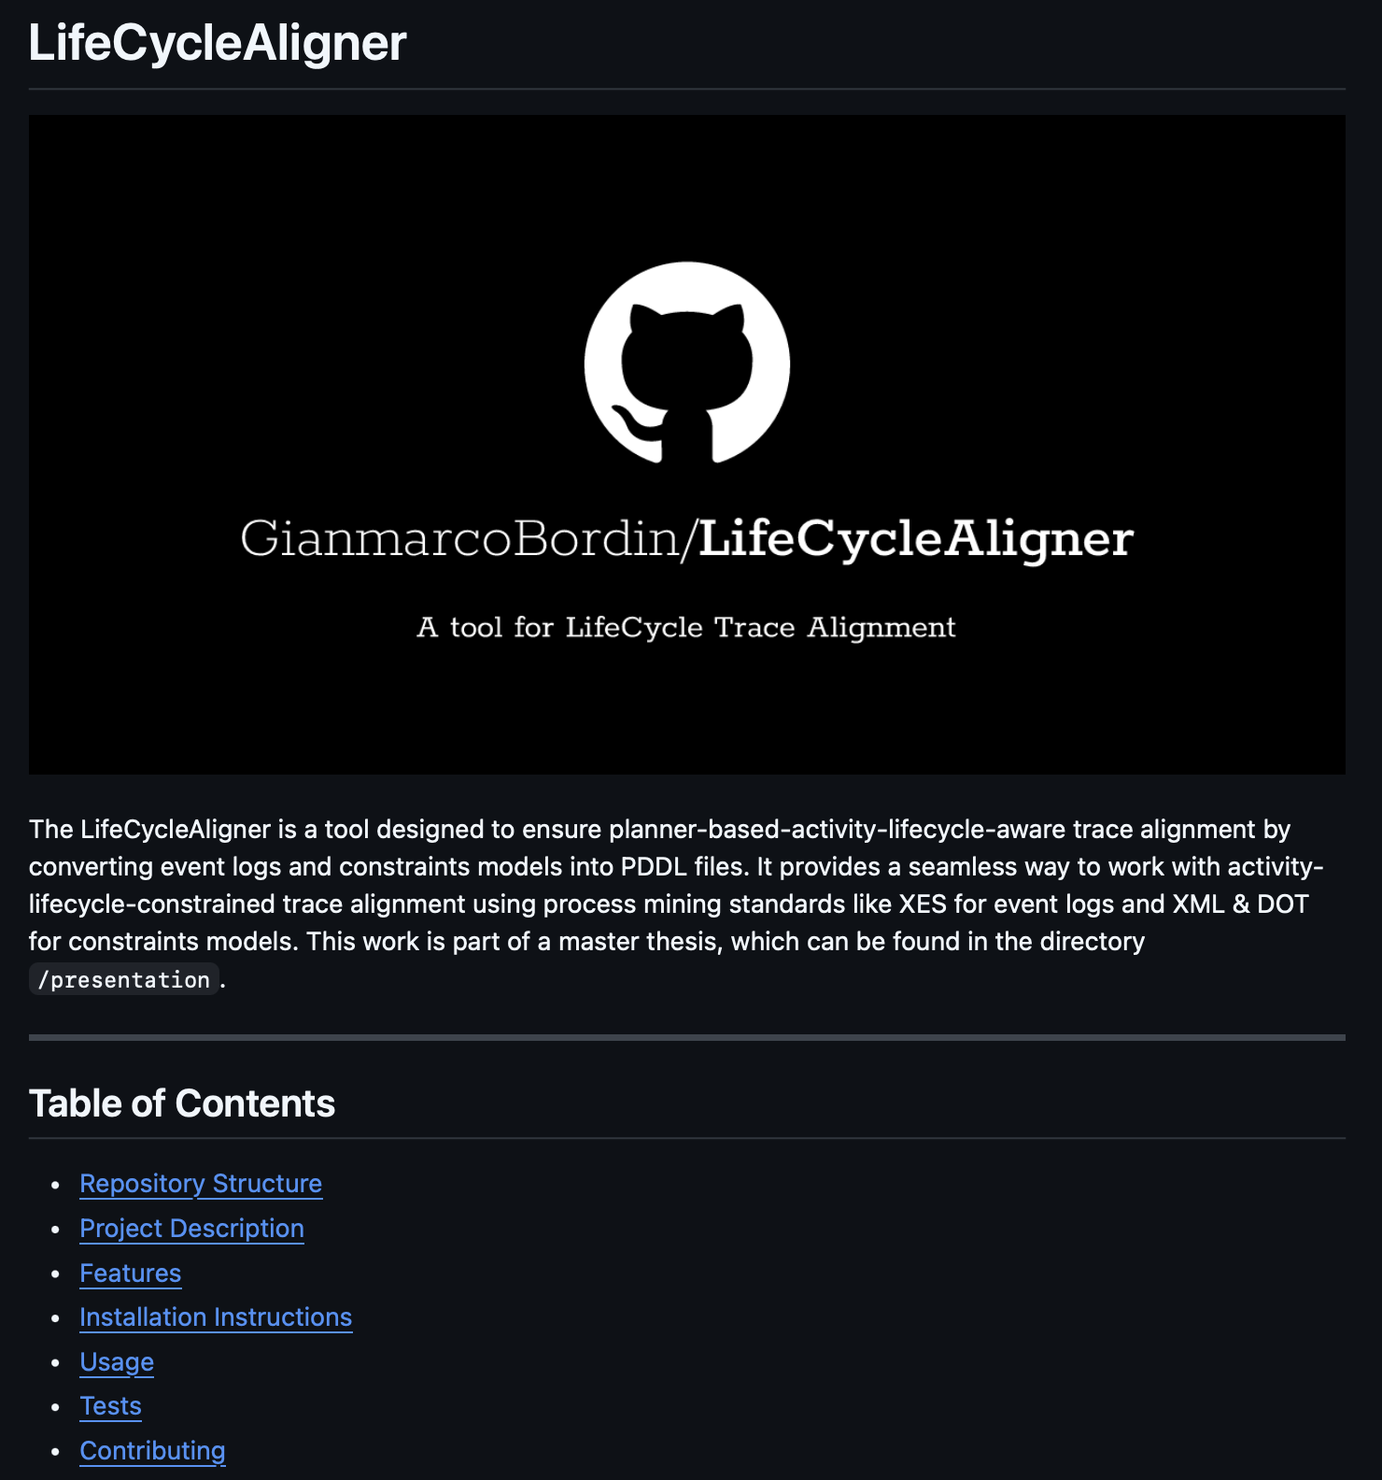
Grounding Algorithm Implementation
The algorithm:
Delete states that cannot appear in any possible goal path
Identify and group (on their label) the relevant transitions
Generate all the possible combination of transitions for add, del and sync planning actions
The implementation of the Life Cycle Aligner:
Takes as input:
XES event log
One or more XML/DOT model files
Gives as output:
A list of <domain.pddl, problem.pddl> files
A file containing the overall results of the alignments
A Planning-based Approach for Leveraging Activity Life Cycle Information in Declarative Trace Alignment
Github Repository at: https://github.com/GianmarcoBordin/LifeCycleAligner
Notes:
Our algorithm hardens the automata by eliminating sink states and impossible
paths. It then generates the planning actions (add, delete, sync) for each
combination of relevant transitions.
We developed a CLI-based Java application that:
●
●
●
Takes an event log file and a series of model files as input.
Outputs the corresponding PDDL domain and problem files.
Runs these instances through a planner and provides a file with the
overall execution results.
The project is open source at our github repository.

Slide 13
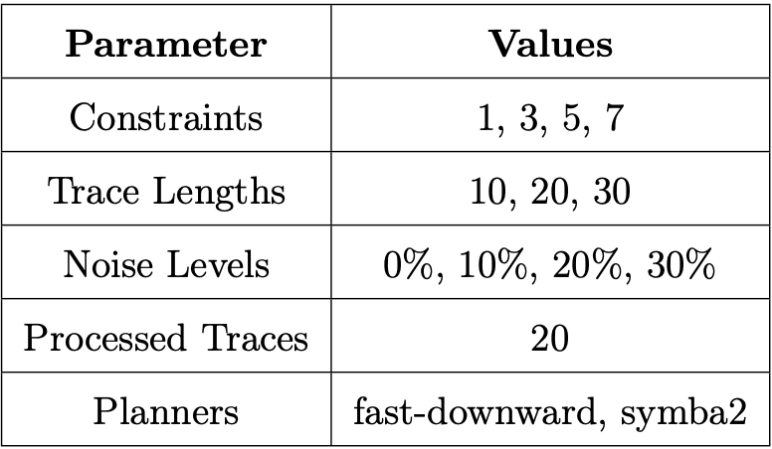
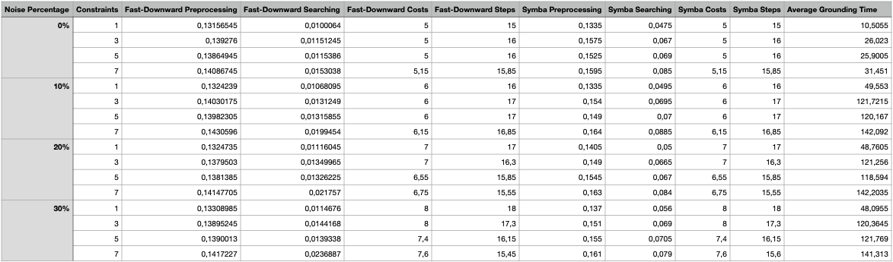
Experimental Setup: Settings
Up to 9 different activities in a trace t
Our Noiser.py implementation injects the selected noise amount into each trace of the log
Traces corrupted: Add, Del, and Swap
Results for trace length 10
A Planning-based Approach for Leveraging Activity Life Cycle Information in Declarative Trace Alignment
Notes:
We now provide our experimental setup.
We generated synthetic logs according to a specific declare model and trace
length parameter, using the RUM java-tool. Moreover, we implemented a Python
script, noiser.py, to format and inject noise into the logs based on specific
noise required for the specific experiment. The noise tool calculates the
required quantity of add, delete, and swap moves to “dirty” the examined log
traces. We used an alphabet of 9 activities and processed 20 traces per log.
We tested the below discussed metrics with two famous state-of-the-art
planners: fast-downward and symba2*. In the experimental settings table, we
see the results for trace length 10.

Slide 14
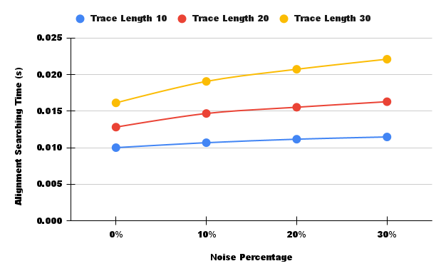
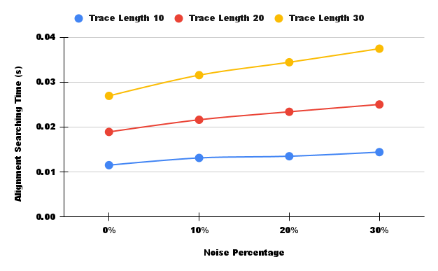
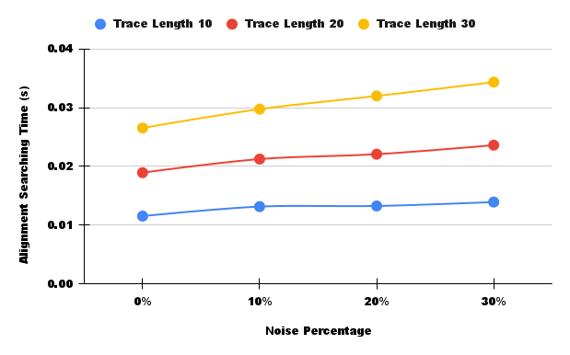
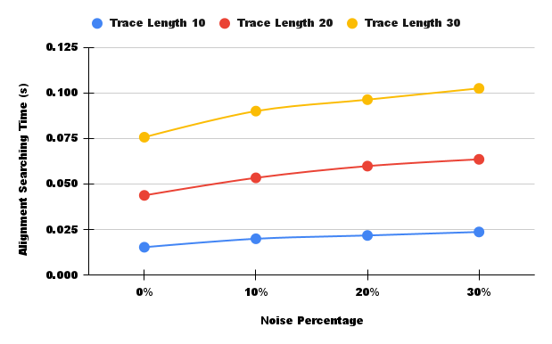
Evaluation: Searching Time
1 constraint
3 constraints
5 constraints
7 constraints
A Planning-based Approach for Leveraging Activity Life Cycle Information in Declarative Trace Alignment
Notes:
The plots show that search time increases sublinearly with noise percentage,
as expected. This trend is confirmed also for the trace length metric, showing
that there is no substantial increase in the searching time.
Our tool significantly reduces preprocessing and searching time for
state-of-the-art planners. Additionally, all activity lifecycles in the logs
were corrected.

Slide 15
Conclusions & Future Works
For each activity in the log the life cycle is respected
LifeCycleAligner Java application outputs PDDL files trace alignments results from log & model files
Noiser.py tool injects the specified amount of noise into a log
Future works could focus on:
Life cycle state cost dependency
Activity or Activity-Group specific life cycles
Evaluation on different planners and/or different life cycles models
A Planning-based Approach for Leveraging Activity Life Cycle Information in Declarative Trace Alignment
Notes:
We designed a solution for the trace alignment problem that accounts for the
lifecycle of each activity in the log. We developed an algorithm implemented
in our Java tool, created a noise injection script for evaluation, and
analyzed the overall performance.
Future research directions include:
●
●
●
Considering lifecycle state-dependent costs.
Testing with specific life cycle models for different groups of
activities.
Extending the evaluation to include different planners and lifecycle
models.
Thank you for your attention. I am happy to answer your questions.

Slide 16
Thank You For Your Attention!
A Planning-based Approach for Leveraging Activity Life Cycle Information in Declarative Trace Alignment
Titolo Presentazione
01/07/2020
Dipartimento di Ingegneria Informatica, Automatica e Gestionale
Corso di Laurea magistrale in Engineering in Computer Science

