Slide 1


A Planning-based Approach for Leveraging Activity Life Cycle Information in Declarative Trace Alignment
Dipartimento di Ingegneria Informatica, Automatica e Gestionale
Corso di Laurea magistrale in Engineering in Computer Science
Candidate:
Gianmarco Bordin
Thesis Advisor:
Prof. Andrea Marrella
Titolo Presentazione
01/07/2020
Academic Year 2023/2024

Slide 2
​Thesis Roadmap
Solution Design
Algorithm & Implementation
Experimental Evaluation
Problem & Research Goal
Conclusions & Future Works
A Planning-based Approach for Leveraging Activity Life Cycle Information in Declarative Trace Alignment

Slide 3
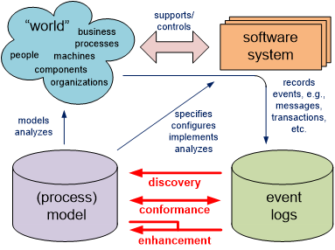
In the context of Process Mining
A Planning-based Approach for Leveraging Activity Life Cycle Information in Declarative Trace Alignment

Slide 4



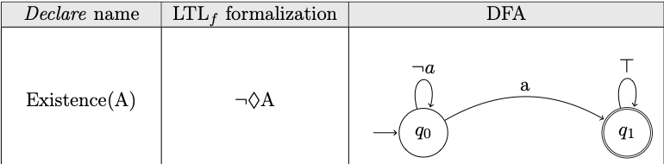
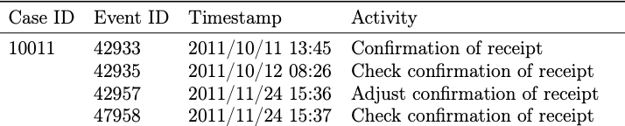
Conformance Checking
Model
Constraints
Organizational Event Logs​
Organizational Rules expressed as:
Declare Constraints
LTL-f
DFA
Organizational Event Logs:
Record previous processes executions
Composed of a set of traces
Each trace contains a set of events with several attributes
A Planning-based Approach for Leveraging Activity Life Cycle Information in Declarative Trace Alignment

Slide 5
Trace Alignment
Involves aligning inconsistent traces with process models:
Determining whether a trace adheres to its corresponding process model.
Detecting the root causes and severity of any deviations.
Modifying and correcting the trace (actual behavior) to ensure compliance with the process model (expected behavior).
A Planning-based Approach for Leveraging Activity Life Cycle Information in Declarative Trace Alignment

Slide 6
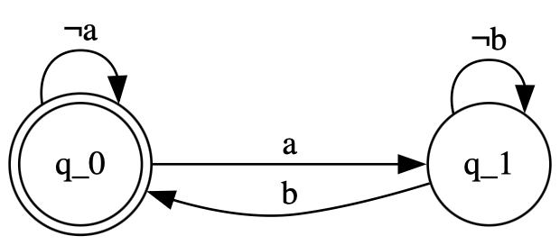
Declare Process Model
Declare is a non-prescriptive modelling language
Is used to define constraints between activities
Response (a,b)
automata based formulation
Ltl-f formula
□(A ⇒ ♢B)
A Planning-based Approach for Leveraging Activity Life Cycle Information in Declarative Trace Alignment

Slide 7
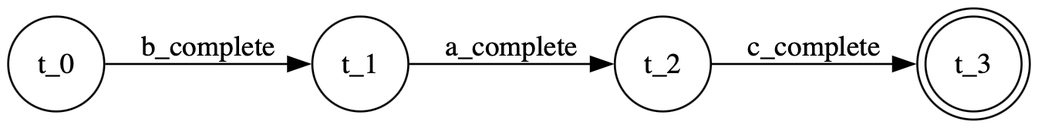
Problem Statement
Existing techniques take into account only already completed activities
The Need of activity-life cycle constraints in many processes
We design a solution exploiting the power of AI Automated Planning
A Planning-based Approach for Leveraging Activity Life Cycle Information in Declarative Trace Alignment
G. De Giacomo, F. M. Maggi, A. Marrella, F. Patrizi, On the Disruptive Effectiveness of Automated Planning for LTLf-based Trace Alignment. AAAI 2017

Slide 8
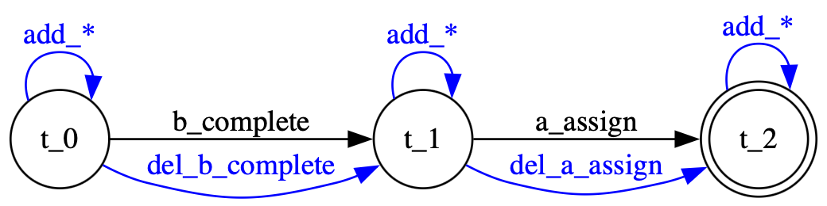
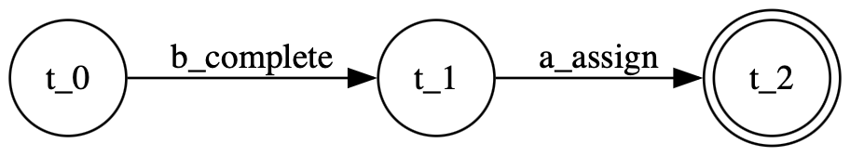
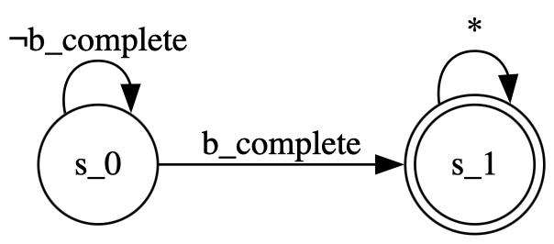
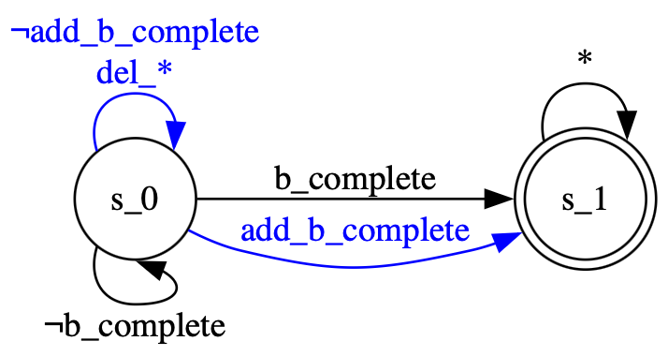
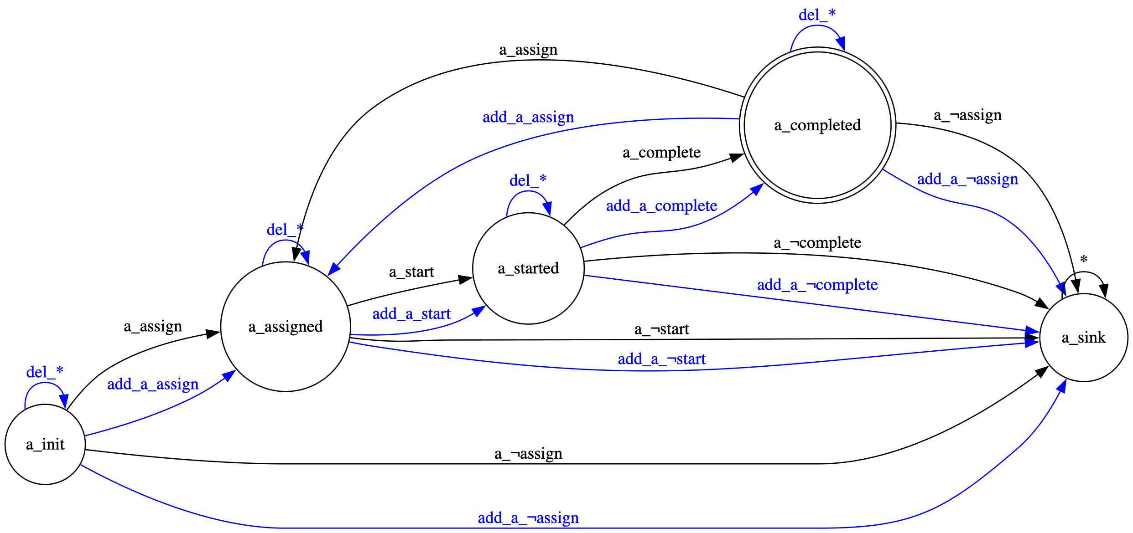
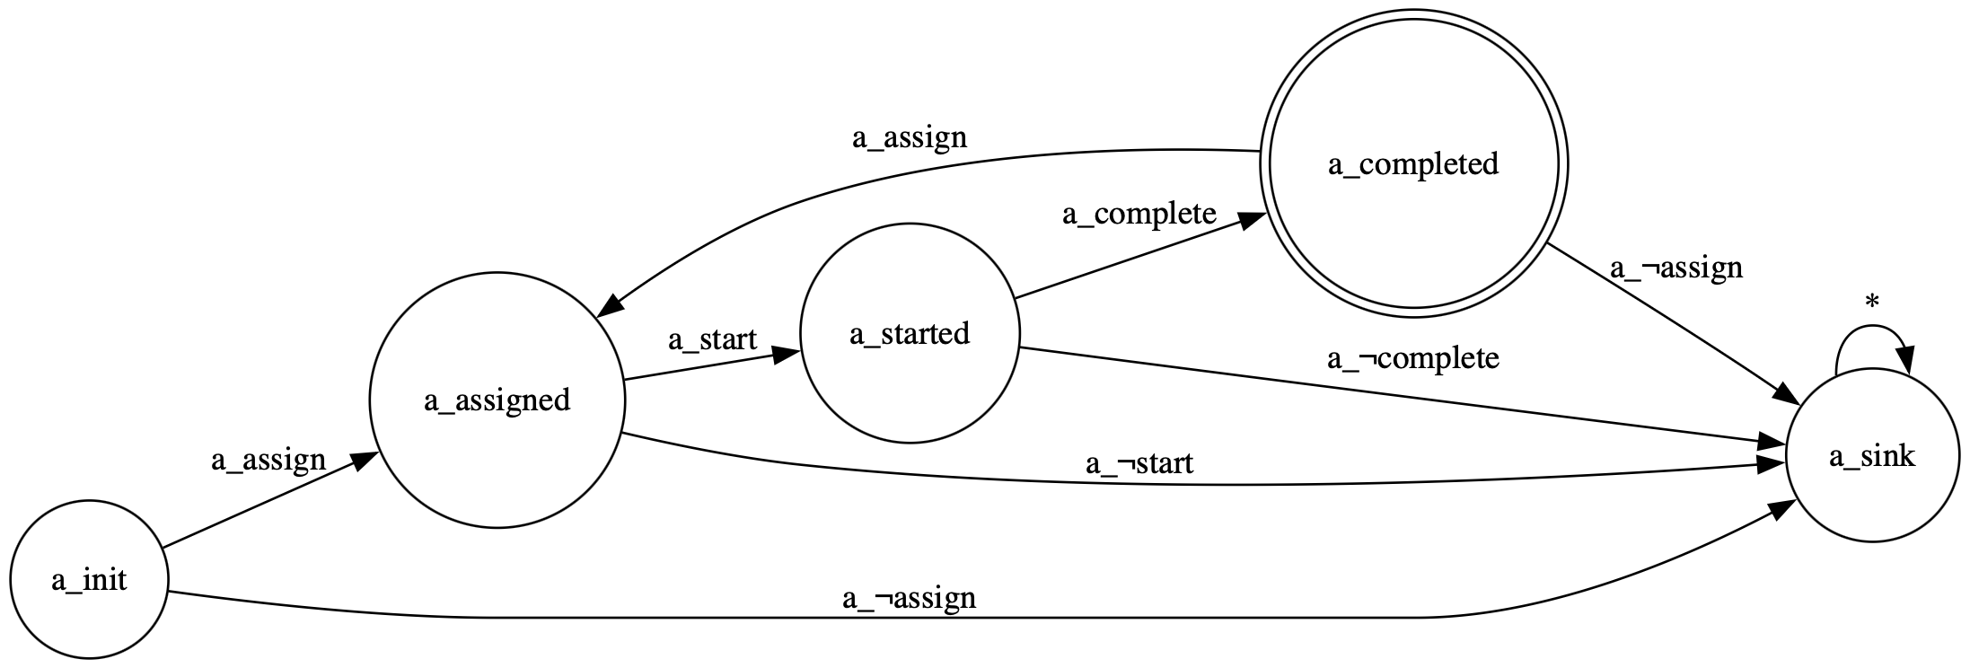
Automata-Based Solution
A Planning-based Approach for Leveraging Activity Life Cycle Information in Declarative Trace Alignment

Slide 9
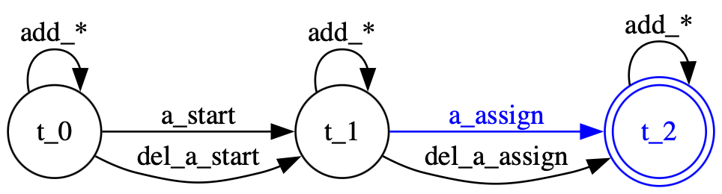
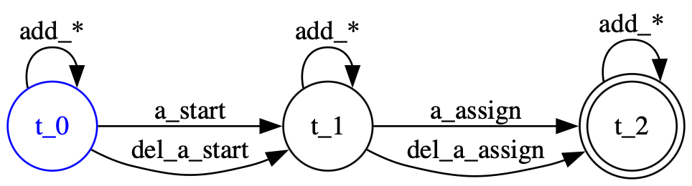
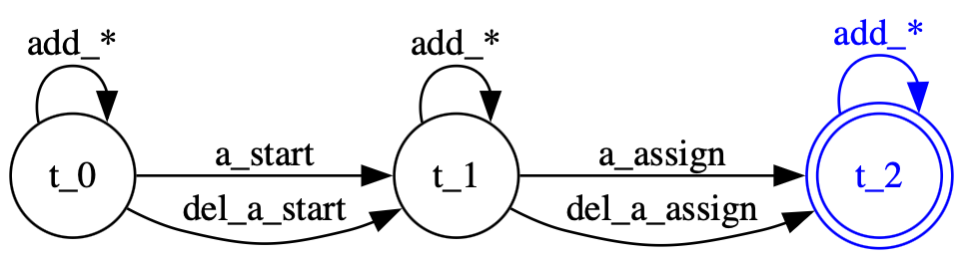
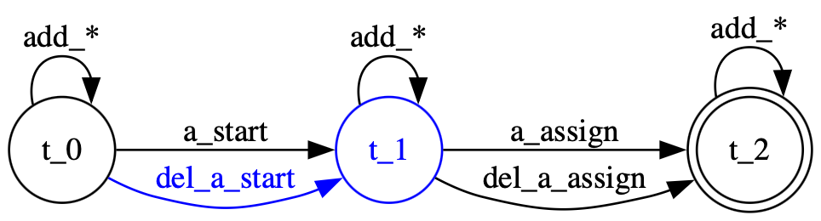
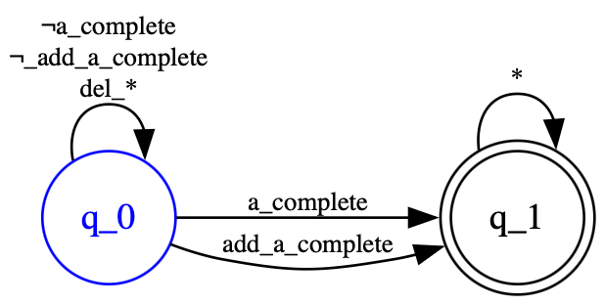
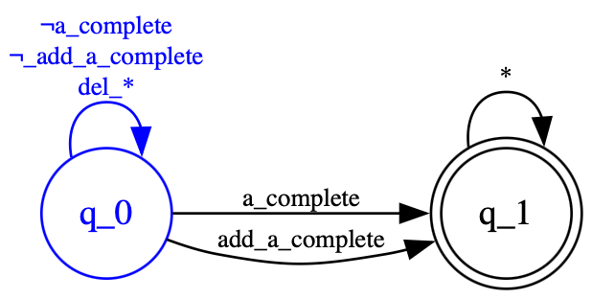
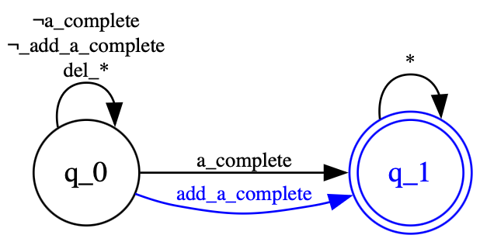
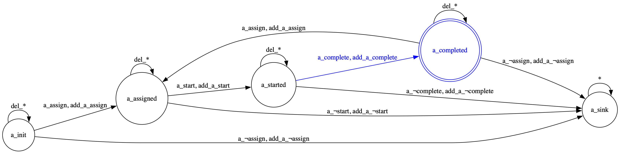
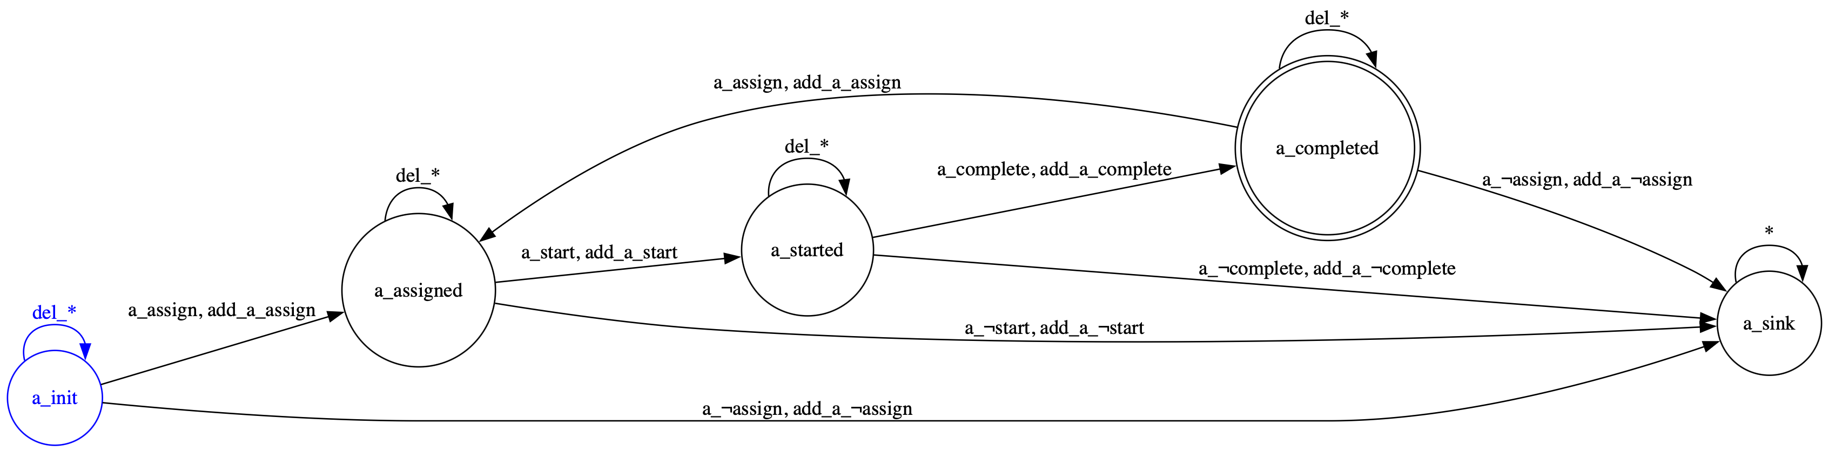
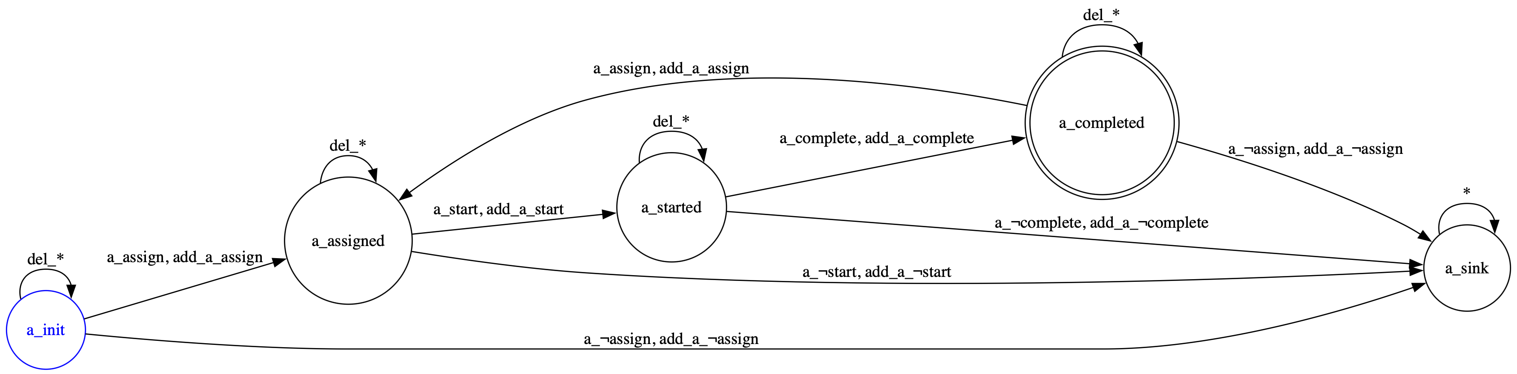
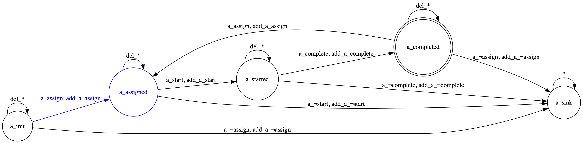
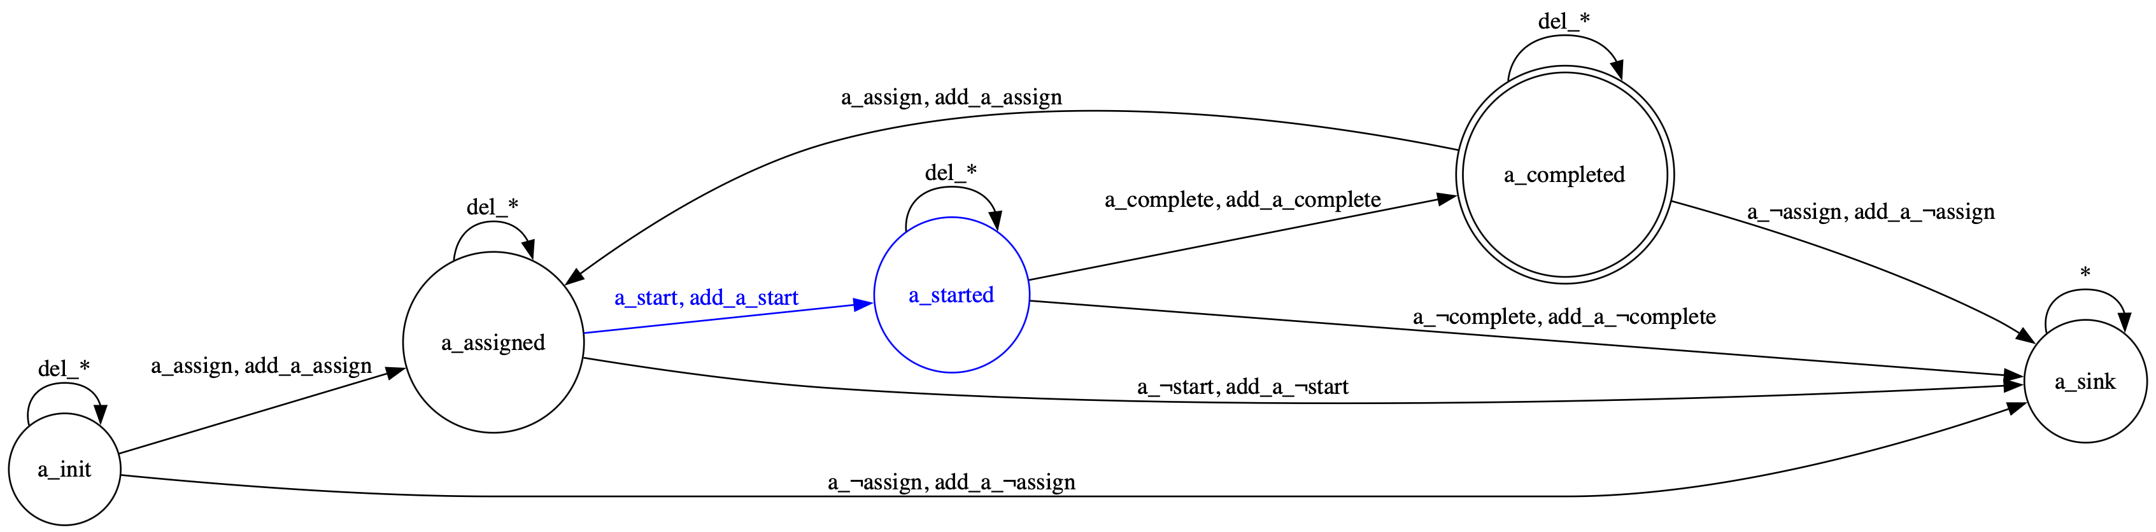
A Running Example t = <a_{start}, a_{assign}>
A Simple Example
A Planning-based Approach for Leveraging Activity Life Cycle Information in Declarative Trace Alignment

Slide 10
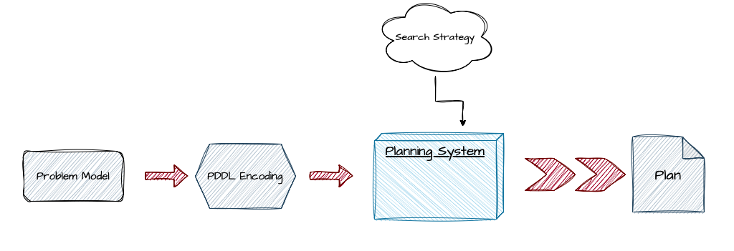
Trace alignment encoding in PDDL
Problem file:
The initial state --> All automata in their starting states
The goal state --> All automata in at least one accepting state
Domain file:
Domain propositions track automata structures and dynamics
Add, Del (with unitary cost) & Sync (with zero cost)
A Planning-based Approach for Leveraging Activity Life Cycle Information in Declarative Trace Alignment

Slide 11
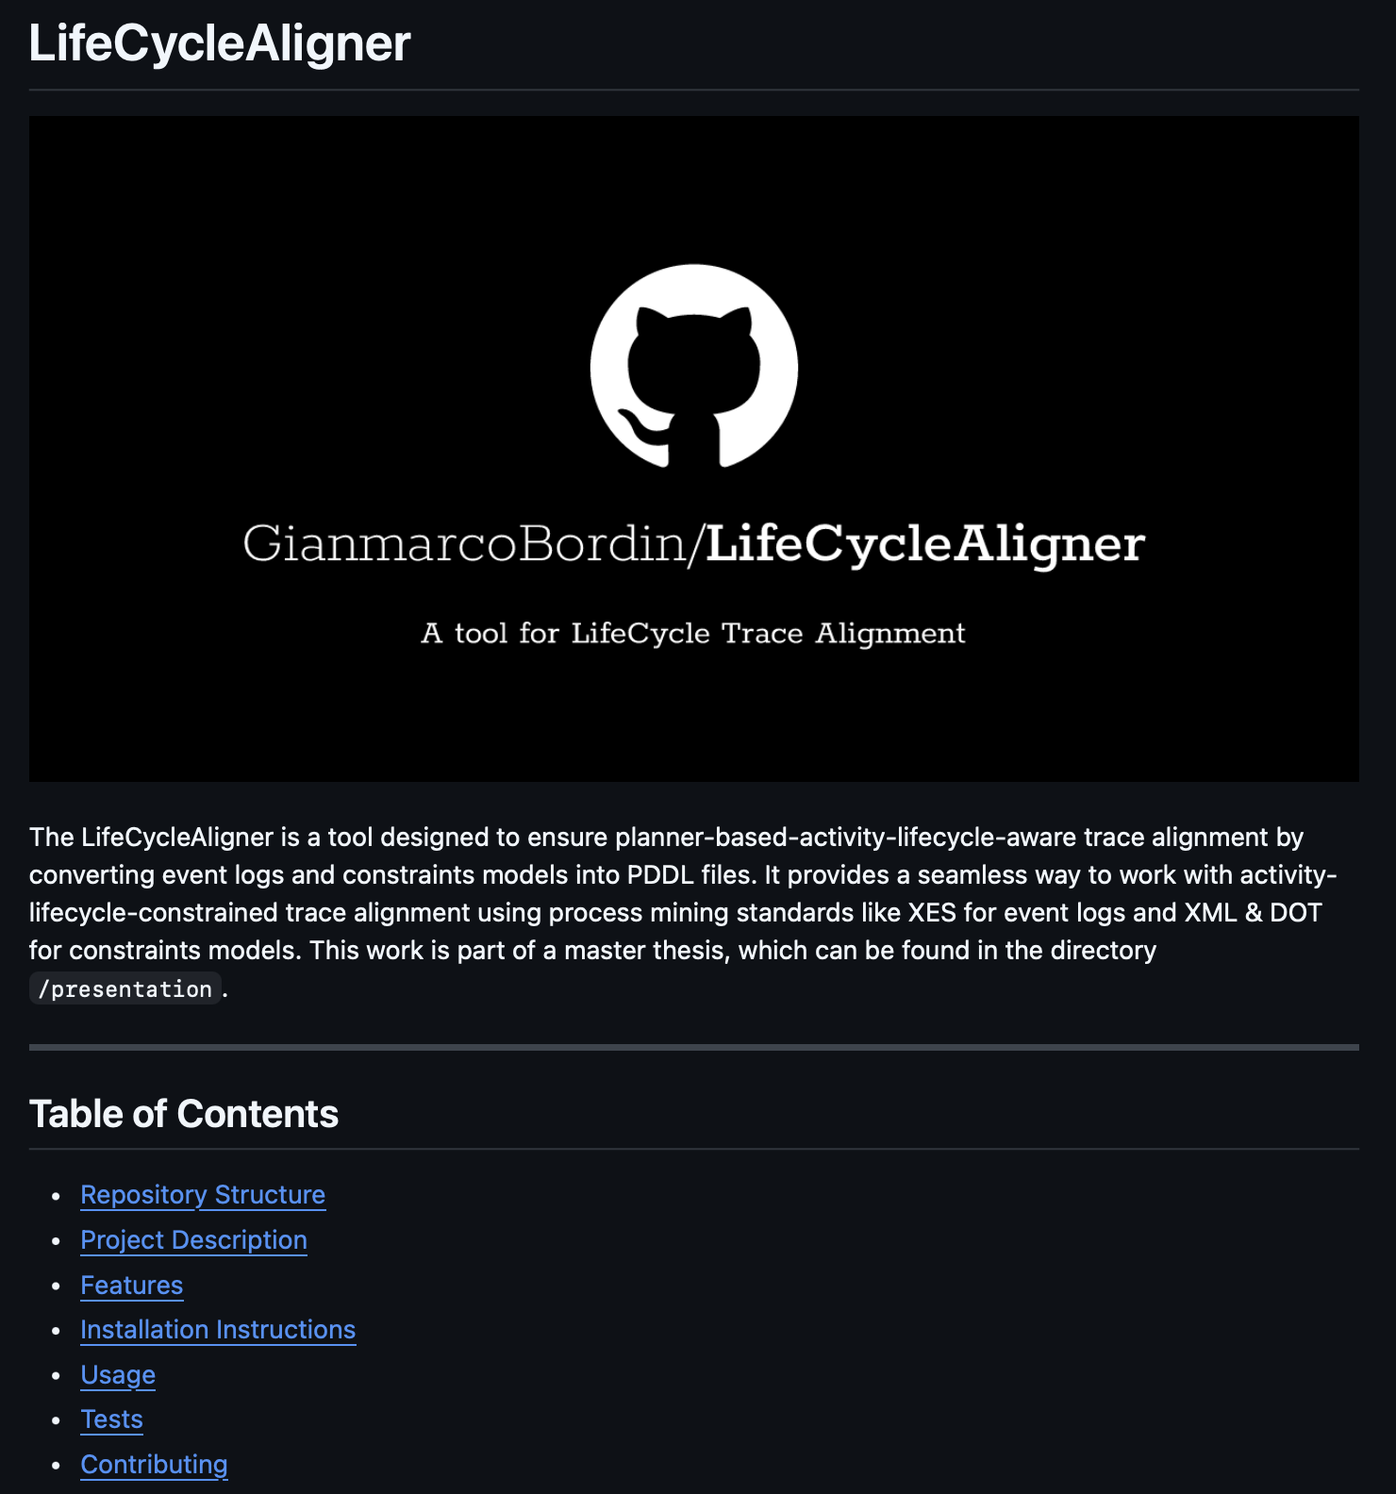
Grounding Algorithm Implementation
The algorithm:
Delete states that cannot appear in any possible goal path
Identify and group (on their label) the relevant transitions
Generate all the possible combination of transitions for add, del and sync planning actions
The implementation of the Life Cycle Aligner:
Takes as input:
XES event log
One or more XML/DOT model files
Gives as output:
A list of <domain.pddl, problem.pddl> files
A file containing the overall results of the alignments
A Planning-based Approach for Leveraging Activity Life Cycle Information in Declarative Trace Alignment
Github Repository at: https://github.com/GianmarcoBordin/LifeCycleAligner

Slide 12
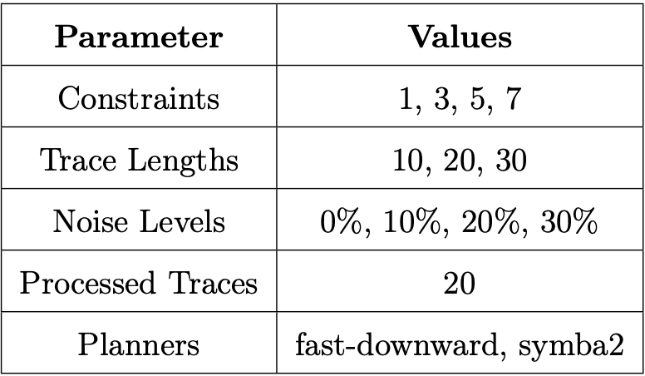
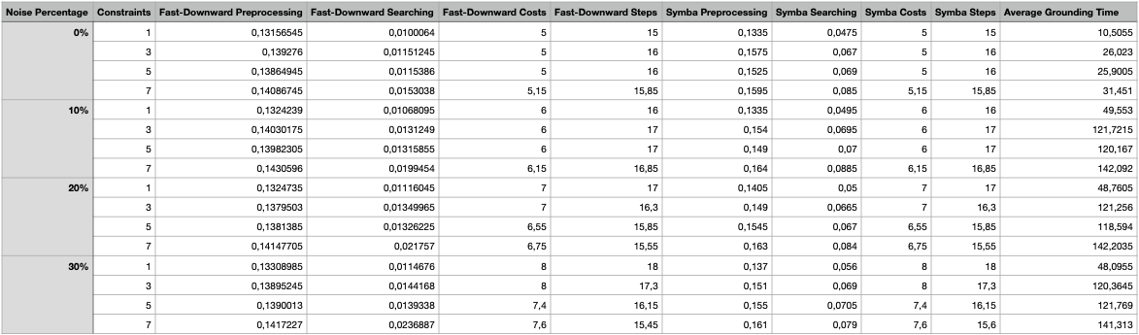
Experimental Setup: Settings
Up to 9 different activities in a trace t
Our Noiser.py implementation injects the selected noise amount into each trace of the log
Traces corrupted: Add, Del, and Swap
Results for trace length 10
A Planning-based Approach for Leveraging Activity Life Cycle Information in Declarative Trace Alignment

Slide 13
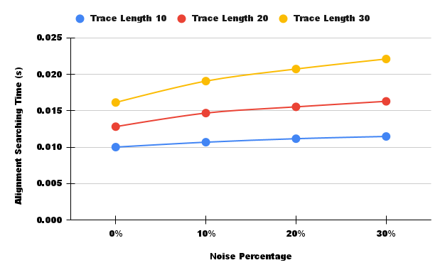
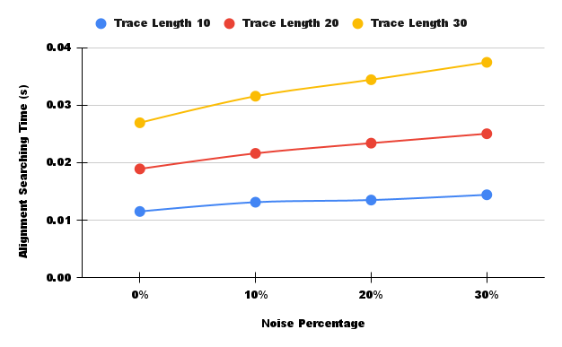
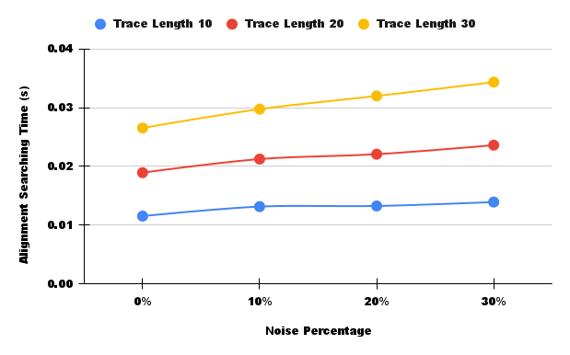
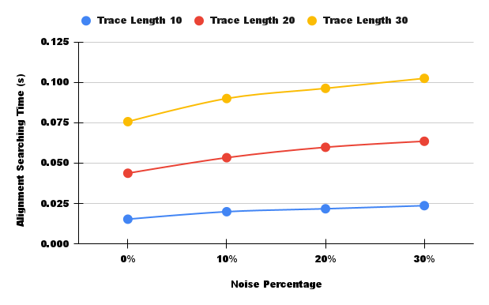
Evaluation: Searching Time
A Planning-based Approach for Leveraging Activity Life Cycle Information in Declarative Trace Alignment

Slide 14
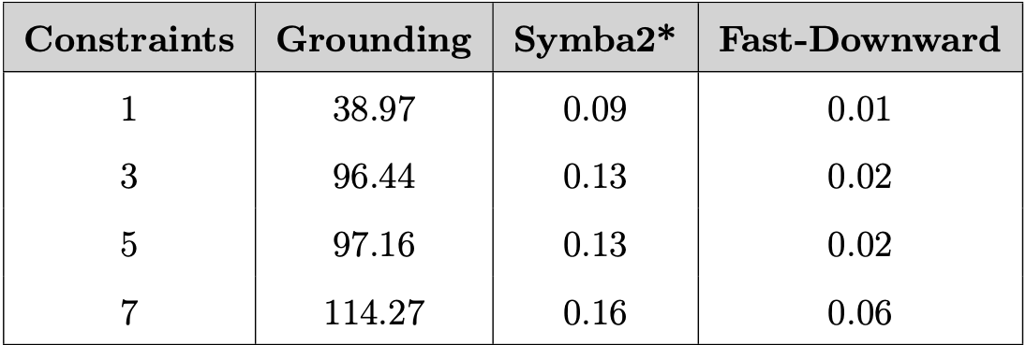
Evaluation: Grounding vs Searching Time
The life cycle model highly influences performances
The model constraints growth augment state space and so searching time
The life cycles of ALL the activities in the log are correctly enforced
A Planning-based Approach for Leveraging Activity Life Cycle Information in Declarative Trace Alignment

Slide 15
Conclusions & Future Works
LifeCycleAligner java application outputs PDDL files trace alignments results from log & model files
For each activity in the log the life cycle is respected
Noiser.py tool injects the specified amount of noise into a log used in the described evaluation
Future works could focus on:
Life cycle state cost dependency
Activity or Activity-Group specific life cycles
evaluation on different planners and/or different life cycles models
A Planning-based Approach for Leveraging Activity Life Cycle Information in Declarative Trace Alignment

Slide 16
Thank You For Your Attention!
A Planning-based Approach for Leveraging Activity Life Cycle Information in Declarative Trace Alignment
Titolo Presentazione
01/07/2020
Dipartimento di Ingegneria Informatica, Automatica e Gestionale
Corso di Laurea magistrale in Engineering in Computer Science

