Slide 1
Gait-ViViT: A Video Processing Model for Parkinson’s Disease Detection
Gianmaria Romano - 2105539
Supervisor: Professor Marco Raoul Marini
Applied Computer Science and Artificial Intelligence
Sapienza University of Rome
Academic Year 2025/2026

Slide 2
Roadmap
Aims and Scope
Datasets
Video Processing
Rendering and Preprocessing
01
02
03
04
05
06
07
Model Implementation
Training Configuration
Evaluation and Conclusions

Slide 3
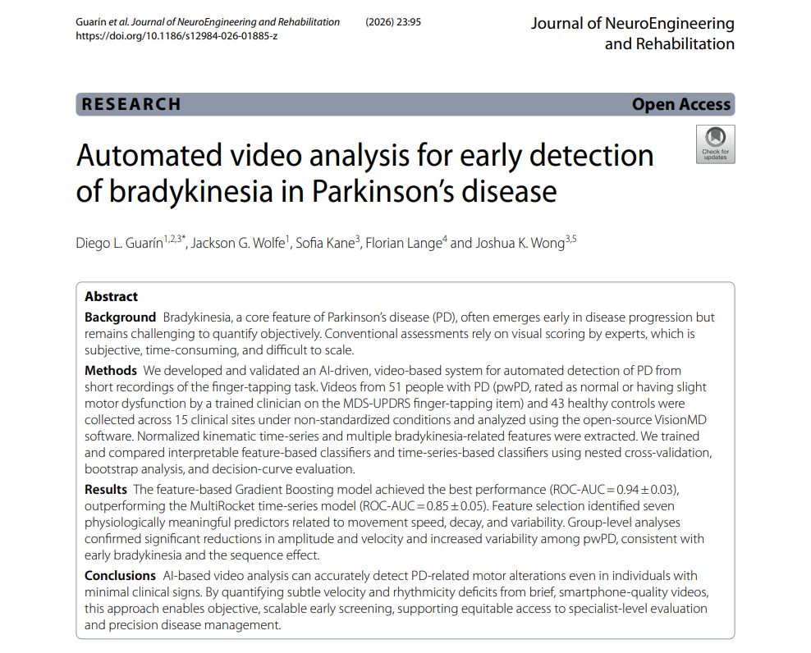

Aims and Scope
Parkinson’s disease is a neurodegenerative disease of the central nervous system whose symptoms include hyperkinetic and hypokinetic features.
While current disease assessments remain subjective, recent research suggests that computer vision assessments can provide an objective alternative.
For this reason, this project aims to adapt existing video processing models to gait-based Parkinson’s disease detection.
https://github.com/GianmariaRomano/Gait-ViViT

Slide 4
Datasets
Kaggle MMU Visual-Based Parkinson’s Disease Dataset
Connie et al., 2022
F-BioGate Dataset
Musso et al., 2026
This dataset contains 150 files of healthy subjects and 142 files of patients with Parkinson’s disease.
This dataset contains 2448 videos, which come in different formats, representing healthy subjects.
Strengths
  Samples for both healthy and sick subjects are provided.
  Sick subjects can exhibit various degrees of the disease, allowing for generalization.
Strengths
  The dataset is very large, allowing to achieve more reliable results during training.
  The dataset shows a wide range of actions and subjects, increasing data diversity.
Limitations
  The dataset is too small to be used alone.
  Only coordinate keypoints are provided, requiring to create synthetic renderings.
Limitations
  This dataset contains healthy subjects only.
  To avoid bias, only RGB videos can be used, still requiring renderings for consistency.

Slide 5
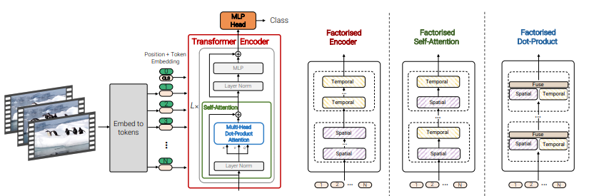
Video Processing
Computer vision deals with extracting and processing information from digital images and videos using machine learning techniques.
Current research is shifting its focus from convolutional neural networks to transformer-based architectures.
Example: Arnab et al.’s Video Vision Transformer model.

Slide 6
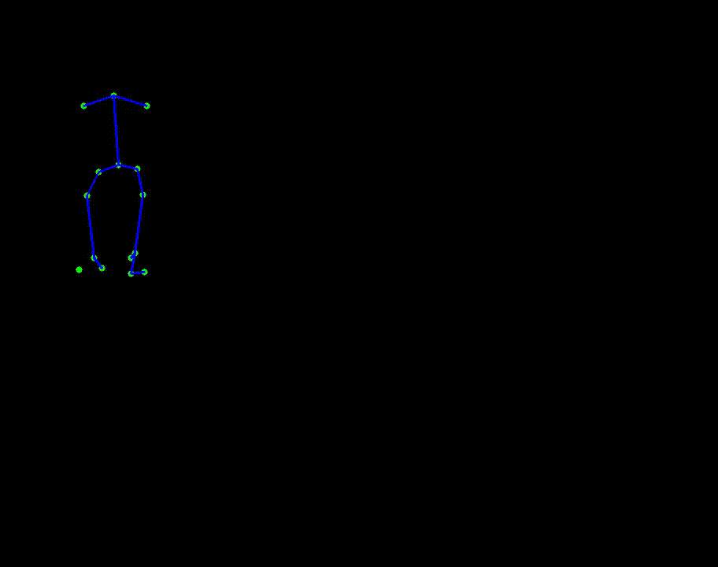
Video Rendering
Synthetic videos are created by extracting keypoint coordinates and processing them using dedicated Python libraries.
To avoid capturing noise, keypoints are drawn on a frame if and only if the sampling confidence score meets a chosen threshold.
The rendered video is made readable and stored in a dedicated dataframe.
Example: Rendered skeleton of a subject from the Kaggle MMU Dataset.

Slide 7
Frame Extraction and Preprocessing
Frame extraction is performed using confidence-based uniform frame sampling.
After removing corrupted or noisy frames, 32 frames are uniformly sampled from the input video.
Each frame is read and cleaned using a median blur filter before being resized to the target shape (224, 224).
  If a frame could not be read, it is replaced by duplicating an adjacent frame or using a black placeholder frame.
For each valid video, the sequence of extracted frames is converted into a PyTorch tensor and saved in a dataframe that will be used during training.
Source Dataset | Videos
Kaggle MMU Dataset | 248
F-BioGate Dataset | 814
Class Label | Videos
0 (Healthy) | 947
1 (Parkinson) | 115

Slide 8
Model Implementation
The chosen architecture will be based on Hugging Face’s VivitForVideoClassification class, allowing for transfer learning.
The model receives a batch of B tensors of shape (C, T, H, W) and, after extracting non-overlapping tokens, it prepends a classification token to the sequence.
The extracted sequence passes through the transformer encoder block, which alternates between attention blocks and MLPs.
The output representation of the classification token is passed to the classification head to compute logits.

Slide 9
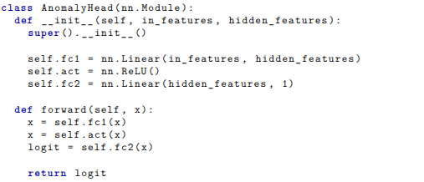
Classification Head
While the original Video Vision Transformer was trained to perform multi-class classification, the goal of this project is to perform binary classification.
The new classification head consists of a linear layer followed by a ReLU activation and a second linear layer.
Passing the classification token to this layer returns a one-dimensional logit that will be used to predict the class label.

Slide 10
Dataset Splitting
Problems of splitting the dataset as it is:
Class imbalance between labels.
The risk of data leakage.
The training, validation and testing datasets are created using the StratifiedKFold function, which combines K-fold cross-validation and stratified sampling, splitting with respect to patient IDs to avoid data leakage while preserving class distributions.
All the generated folds are used in order to obtain more statistically robust results during training.
Subset | Desired Proportion | Number of Items
Training | 70% | ≈ 744
Validation | 10% | ≈ 106
Testing | 20% | ≈ 212

Slide 11
Training Configurations
Linear Probing
Full Finetuning
Linear probing consists of freezing the backbone and training just the head.
This phase is shorter and uses a more aggressive learning rate during training.
Learning rate scheduling is stabilized using linear warmups.
Finetuning focuses on training the entire model to perform a new task.
This phase is longer, but, to avoid overfitting, an early stopping mechanism is introduced.
Hyperparameter combinations are explored using grid search.
Configuration | Choice
Optimizer | SGD with Weight Decay
Learning Rate Scheduler | Cosine Annealing
Loss Function | Weighted Binary Cross-Entropy

Slide 12
Performance Metrics
For a more rigorous analysis, various versions of the classification head are used during training.
An ablation study is also conducted in order to investigate the model’s behaviour as the classification threshold varies.
Since the model is trained on an imbalanced dataset, alternative performance metrics need to be used for performance evaluation.
Precision
The proportion of correct true predictions among all positive predictions.
Recall
The proportion of correct true predictions among all ground-truth positives.
F1-Score
A harmonic mean between precision and recall, which will be high only if both metrics are good.
Version | Upscaling Factor | Activation Function
1 | 2.0 | ReLU
2 | 1.0 | ReLU
3 | 4.0 | ReLU
4 | 2.0 | GELU
5 | 1.0 | GELU
6 | 4.0 | GELU

Slide 13
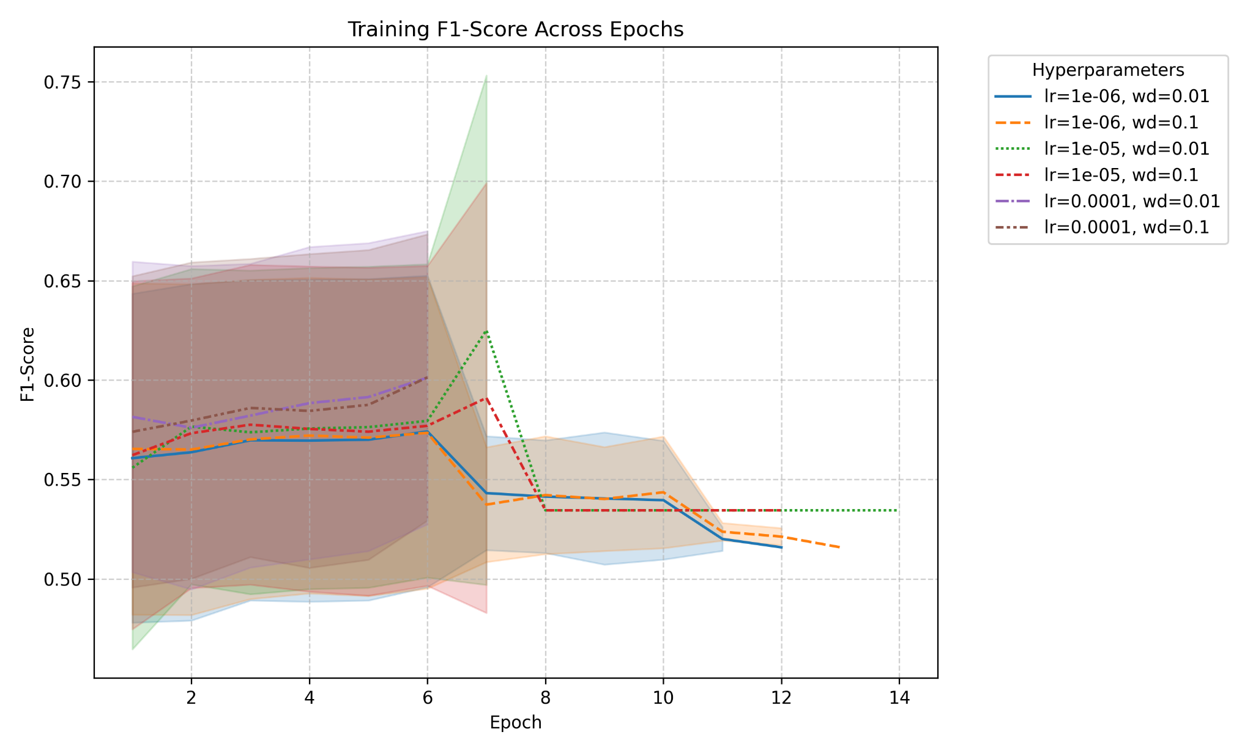
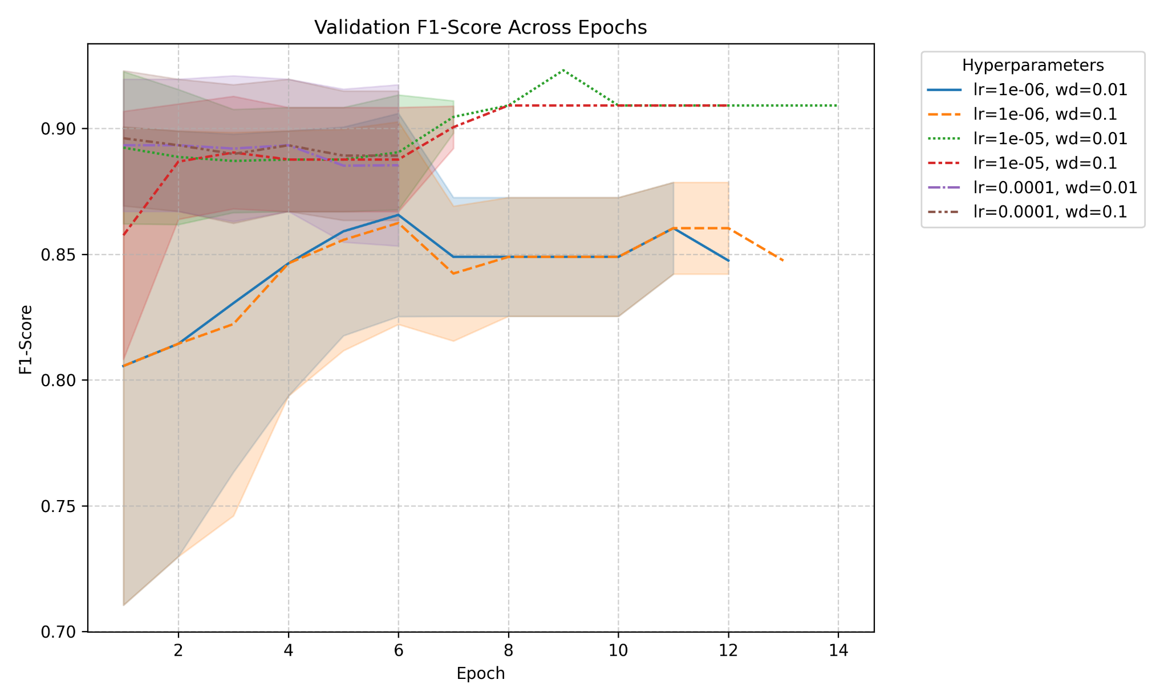
Performance Evaluation
Example: Training and validation performance for Version 1 (Upscaling Factor = 2.0; Activation Function = ReLU) of the model.

Slide 14
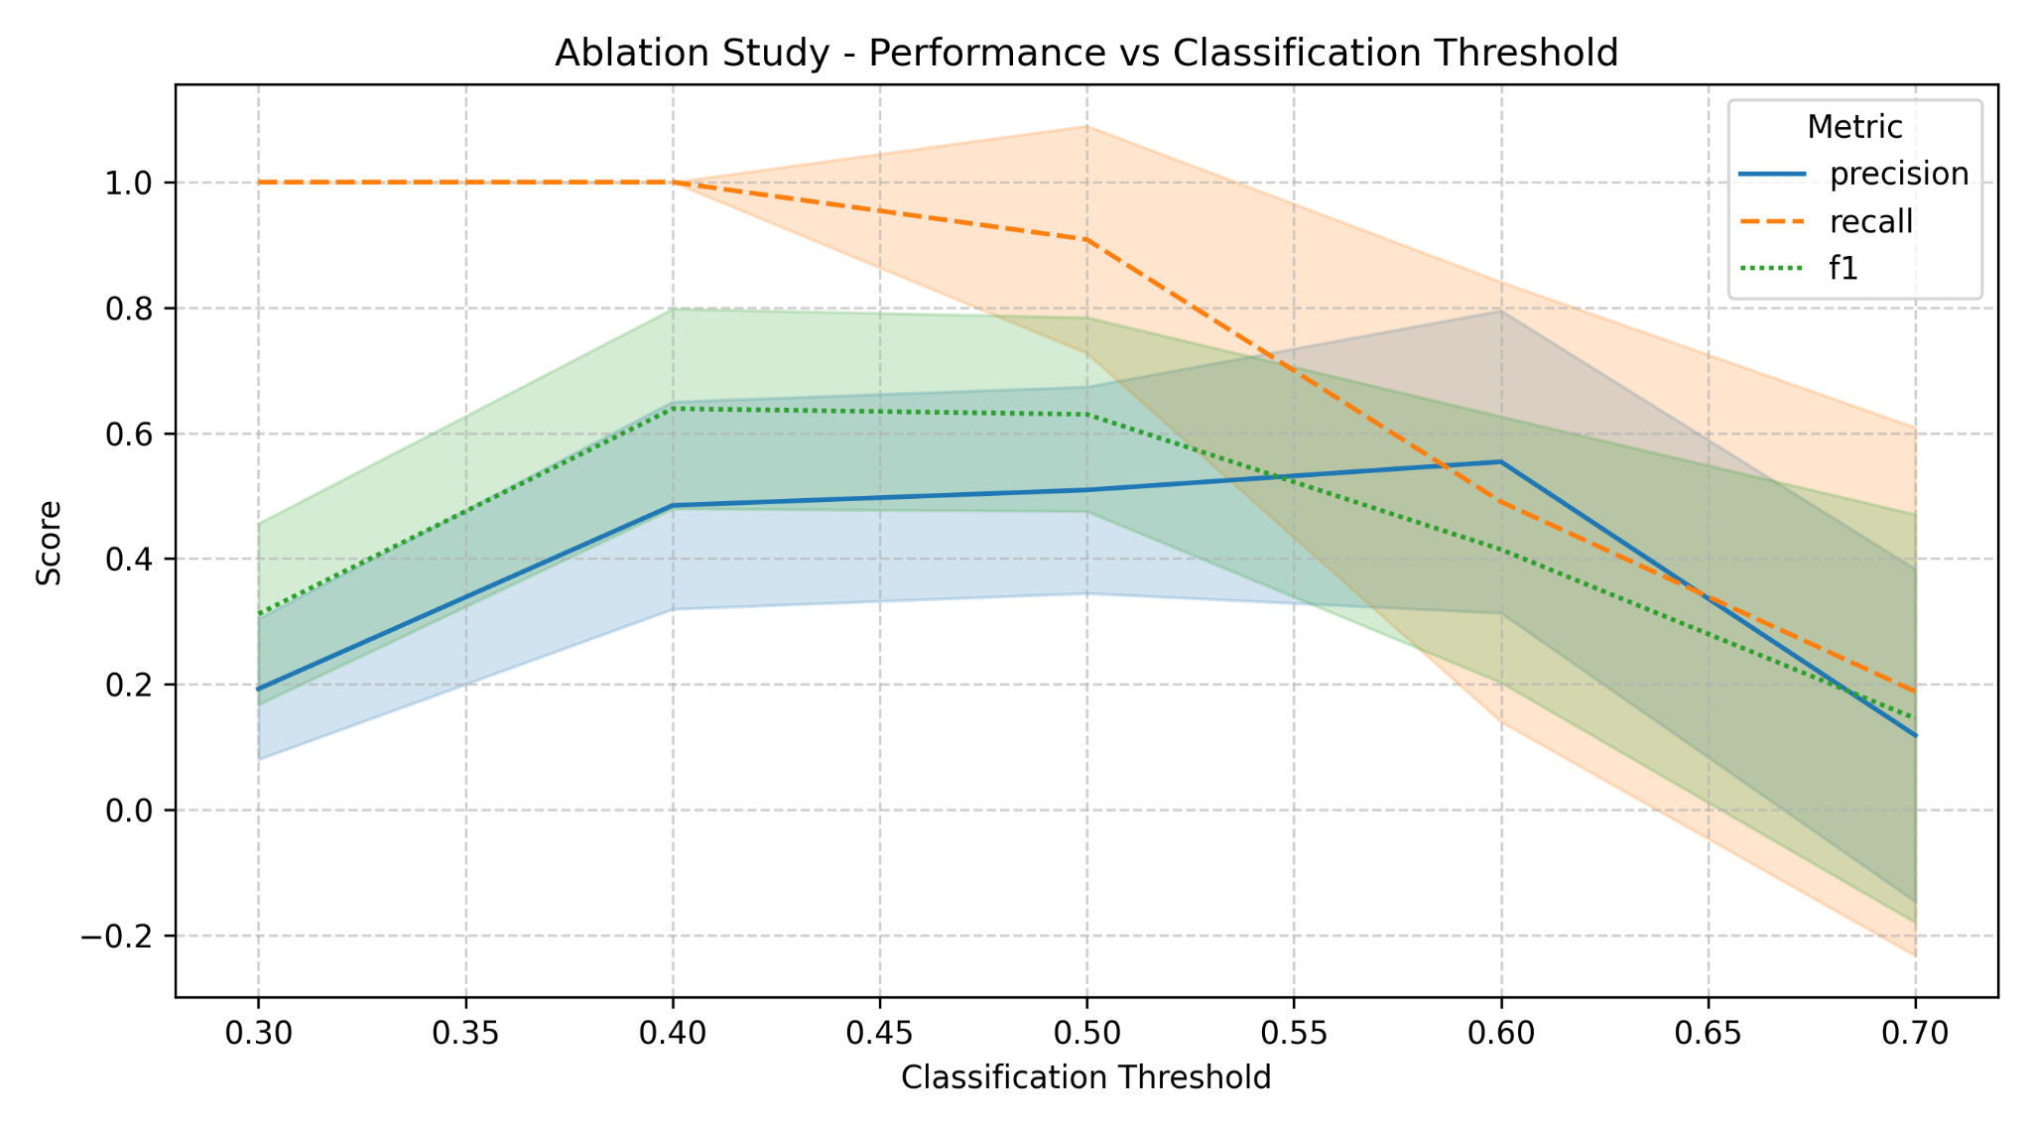
Ablation Study
The ablation study confirms that model performance tends to stay unstable at any classification threshold, suggesting that transformers might not be suitable for this task.
Version | Testing F1-Score (μ ± σ)
1 | 0.630 ± 0.155
2 | 0.644 ± 0.151
3 | 0.654 ± 0.154
4 | 0.661 ± 0.166
5 | 0.660 ± 0.147
6 | 0.664 ± 0.160
Example: Results of the ablation study for Version 1 of the model.

Slide 15
Alternative Architectures
Since 1000 videos are not enough to properly train a transformer-based architecture, the dataset has also been used to train simpler models to check whether they could yield more consistent results.
Cascaded Network
Few-Shot Action Detection Model
This model consists of a pre-trained ResNet backbone followed by a LSTM network.
This architecture ended up yielding worse results compared to the transformer model as it achieved similar metrics but with a higher loss.
A likely cause can be attributed to the fact that cascaded models struggle to generalize on imbalanced data.
This model consists of the Video Vision Transformer backbone followed by a temporal cross transformer.
Training this architecture using episodic learning yields better and more consistent performance compared to the transformer model.
This suggests that a simpler model can be more viable for this task.

Slide 16
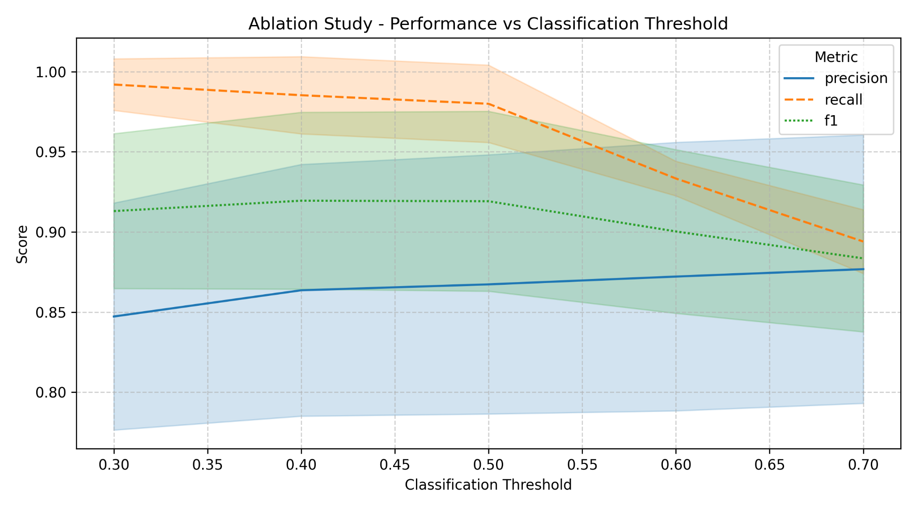
Ablation Study
The performance improvement when passing to the few-shot architecture is reflected in the ablation study as well.
Performance slightly decreases when using higher classification thresholds, but it still outperforms the transformer model.
Fluctuation is also much lower compared to the other structures.

Slide 17
Conclusions
Strengths
Limitations
Assessment takes a broader range of symptoms into consideration.
Transfer learning makes this model more computationally viable for large-scale use.
Using synthetic videos allows to comply with data privacy regulations.
Currently available datasets are too small and often contain different types of information, resulting in less reliable results during training.
Using transfer learning gives less flexibility during model implementation.
Future work can focus on exploring different backbones or training settings, as well as studying whether using real videos can yield better performance compared to using synthetic renderings only.

Slide 18
Thank you for your attention!
Gianmaria Romano - 2105539
Supervisor: Professor Marco Raoul Marini
Applied Computer Science and Artificial Intelligence
Sapienza University of Rome
Academic Year 2025/2026

