Slide 1
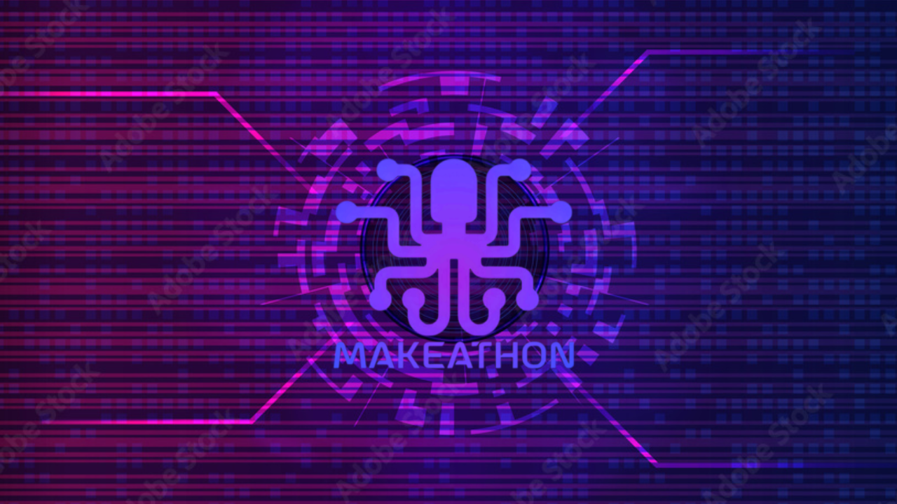

Introducing a 3-phase Chatbot: 1. Natural language query 2. SQL Query 3. Natural language response based on sql query results
Entersoft- Chatbot Challenge

Slide 2
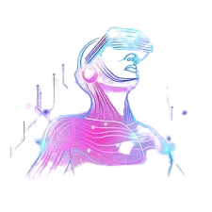
Entersoft Chatbot
Our chatbot leverages GPT-3.5 Turbo in the backend to formulate SQL queries dynamically, driven by user inquiries and the ERP dataset integrated within the model.

Slide 3

Entersoft Chatbot
The SQL query is subsequently executed, retrieving corresponding records from the database, which are then processed by ChatGPT. ChatGPT formulates a natural language response based on these records, which is then presented to the user within the chatbot interface.

Slide 4

Entersoft Chatbot
This approach allows the user to utilize the chatbot as a personal assistant for quick access to data-driven answers.

Slide 5
Entersoft Chatbot
Building upon our current capabilities, the next step for our chatbot is to enhance its natural language understanding (NLU) capabilities. By improving its ability to comprehend natural language, the bot will be able to accept questions and commands more intuitively from users. This advancement will further enhance the user experience, allowing for more seamless interactions and efficient retrieval of information.
Voice Commands

Slide 6
Thank you for your attention!
Ioannis Tournis
Maria Michailidi
Nikolaos Georgiadis
Panagiotis Giovanos
Konstantinos Fragkos

