Slide 1
EnergyOS
OpenESPI
Project Deep Dive
John Teeter
Updated: Mar 12, 2012

Slide 2
Agenda
Session 1 – OpenESPI Project Overview
Mission/Vision
Open Source License – Apache 2
Links and Access
Getting Started
The Working Parts
Session 2 – OpenESPI/javaSpring Development Environment
GitHub.com/energyos/OpenESPI
VMWare Ubuntu Virtual Machine
Eclipse Indigo, Apache Maven
Eclipse AspectJ, Apache Tomcat6
Session 3 - What is Spring Framework?
Overview of the Basics
Spring Data
Spring Security/OAuth
Spring JAX-RS
Session 4 – What is Apache Wink
About
Example
Annotations
Session 5 – OpenESPI/javaSpring Code Walk
Eclipse Projects
Project Structure
Development Tree
About
Overview of the Basics

Slide 3
Session 1 – Project Overview
The mission of the OpenESPI project is to provide an open source, public licensed implementation of the NAESB REQ.21 Energy Services Provider Interface (ESPI) standard, including profiles and testing frameworks, suitable for commercial deployments.
Open Source: All contributions are provided with open and transparent access
Public License: All IP developed and/or provided must adhere to the Apache 2 License
ESPI Standard: The baseline requirements of the implementation are as described in the NAESB REQ.21 and associated artifacts
Profiles: specific profiles of the ESPI standard will be supported
Frameworks: We intend to leverage the works of active collaboration efforts as we develop specific ESPI implementations

Slide 4
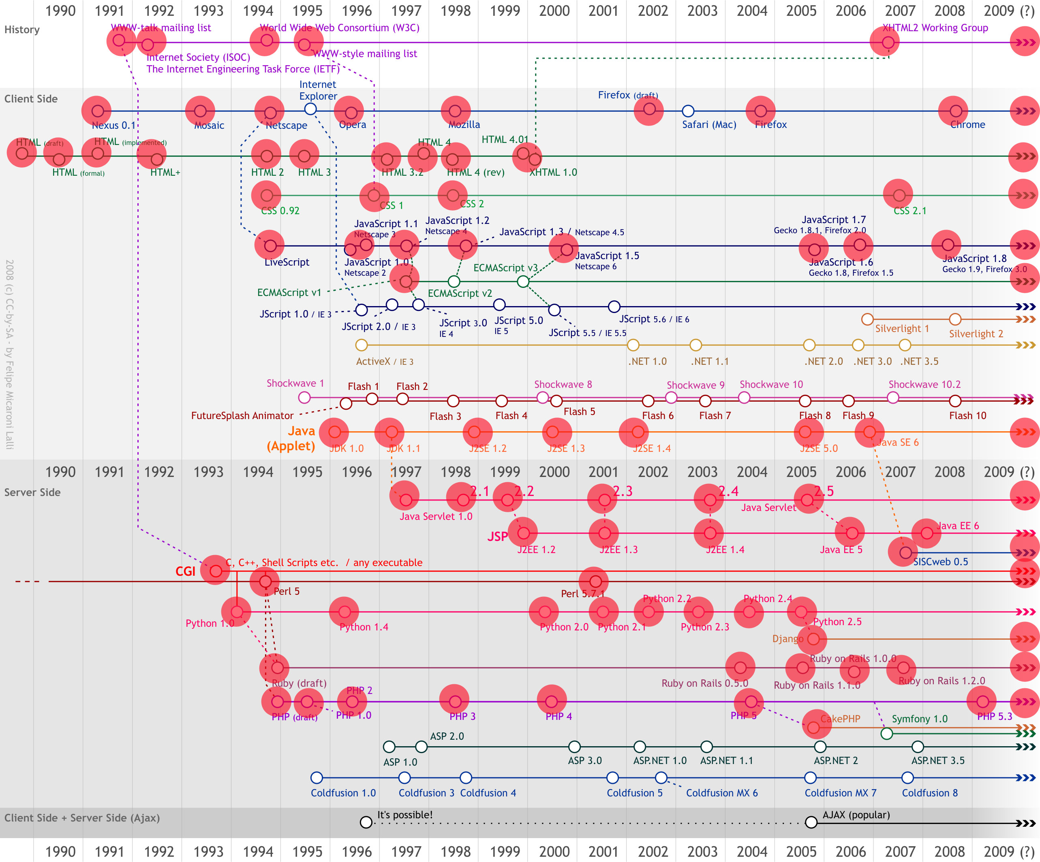
Session 1 – Open Source
The Web
1990
2009
Open
Source
Public
License

Slide 5
Session 1 – Public License
There are many to choose from (http://www.opensource.org/licenses)
Our intent is to insure that the contributions of the community can be re-used and that the re-use may be either placed back within the community, or used for innovations within the private/commercial space.
Apache License, Version 2.0
…
You may add Your own copyright statement to Your modifications and may provide additional or different license terms and conditions for use, reproduction, or distribution of Your modifications, or for any such Derivative Works as a whole, provided Your use, reproduction, and distribution of the Work otherwise complies with the conditions stated in this License.
…
Our Goal is to provide a platform to accelerate innovation!

Slide 6
Session 1 – Public License
/*******************************************************************************
* Copyright (c) 2011, 2012 EnergyOS.Org
*
* Licensed by EnergyOS.Org under one or more contributor license agreements.
* See the NOTICE file distributed with this work for additional information
* regarding copyright ownership. The EnergyOS.org licenses this file
* to you under the Apache License, Version 2.0 (the "License"); you may not
* use this file except in compliance with the License. You may obtain a copy
* of the License at:
*
* http://www.apache.org/licenses/LICENSE-2.0
*
* Unless required by applicable law or agreed to in writing,
* software distributed under the License is distributed on an
* "AS IS" BASIS, WITHOUT WARRANTIES OR CONDITIONS OF ANY
* KIND, either express or implied. See the License for the
* specific language governing permissions and limitations
* under the License.
*
*******************************************************************************/

Slide 7
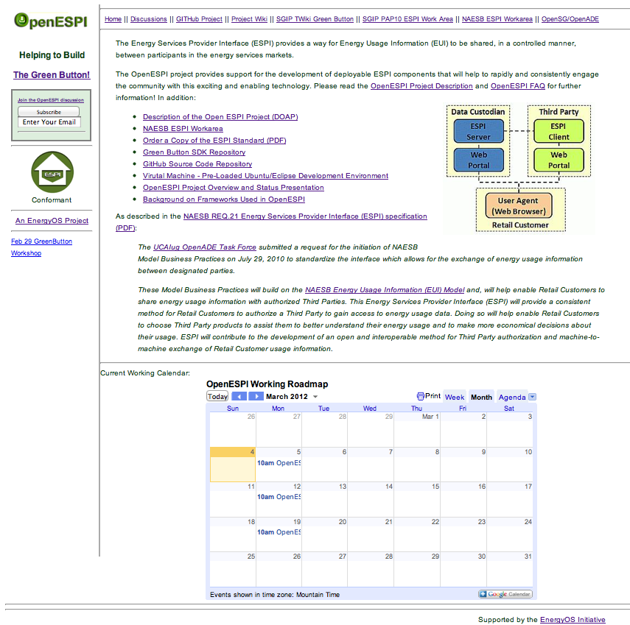
Session 1 – Links and Access
Primary Home Page
http://www.openespi.org
GitHub Project
Code Repository
Issues
Wiki
Project Description
Project FAQ
GitHub Usage & Setup
Development Packages & Frameworks
IDE (Eclipse) Setup
Testing Tools
Virtual Machine Setup
Meeting Minutes
Project Descriptions
Java Spring Project
Green Button SDK
Testing
Discussion Group
http://groups.google.com/group/energyos_espi/
Requires GitHUB ID

Slide 8
Session 1 – Getting Started
Purchase the NAESB Standards (REQ21, REQ18, REQ19)
http://www.naesb.org/misc/naesb_matl_order_espi_standards.pdf ($50 each)
Review the ESPI and PAP10 EUI Artifacts
http://naesb.org/termsofuse_form.asp?doc=espi_model.eap
http://naesb.org/termsofuse_form.asp?doc=espi.xsd
http://www.naesb.org/pdf4/naesb_EUI_model_supporting_docs.zip
Download and Initialize the ESPI Development Virtual Machine
http://www.openespi.org/vm.html
Instructions in the GitHub energyos/OpenESPI wiki (with links from the above)
VM Ware required (free for windows, $s for the Mac)
Setup the your GitHub access (see the VM and GitHub in ESPI FAQ)
Fork the energyos/OpenESPI repository
Start Eclipse and Import the projectSet.pfs (ref: VM setup):
<?xml version="1.0" encoding="UTF-8"?> <psf version="2.0"> <provider id="org.eclipse.egit.core.GitProvider"> <project reference="1.0, https://github.com/{gitUserName}/OpenESPI.git,master,javaspring/common"/> <project reference="1.0, https://github.com/gitUserName}/OpenESPI.git,master,javaspring/DataCustodian"/> <project reference="1.0, https://github.com/{gitUserName}/OpenESPI.git,master,javaspring/ThirdParty"/> </provider>
</psf>

Slide 9
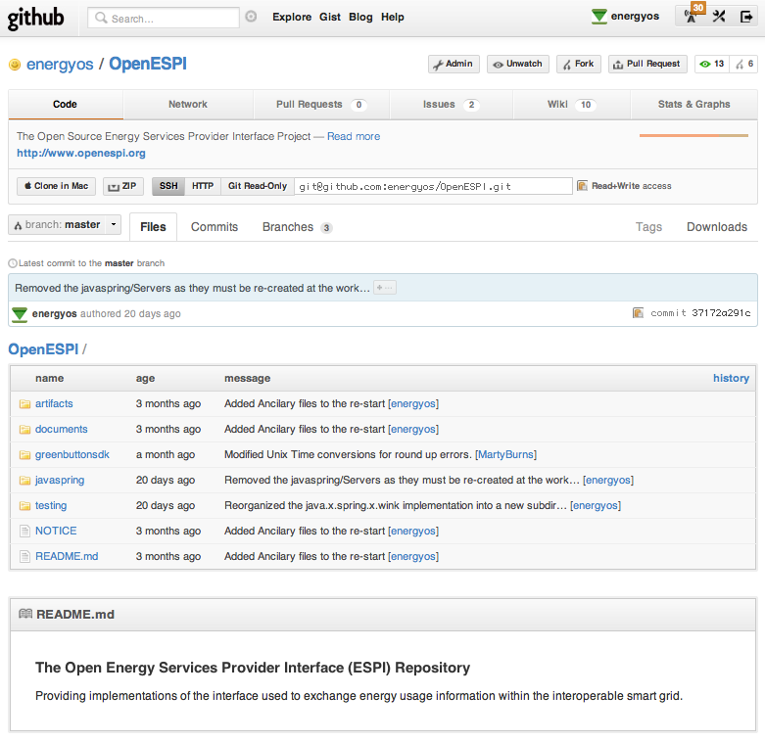
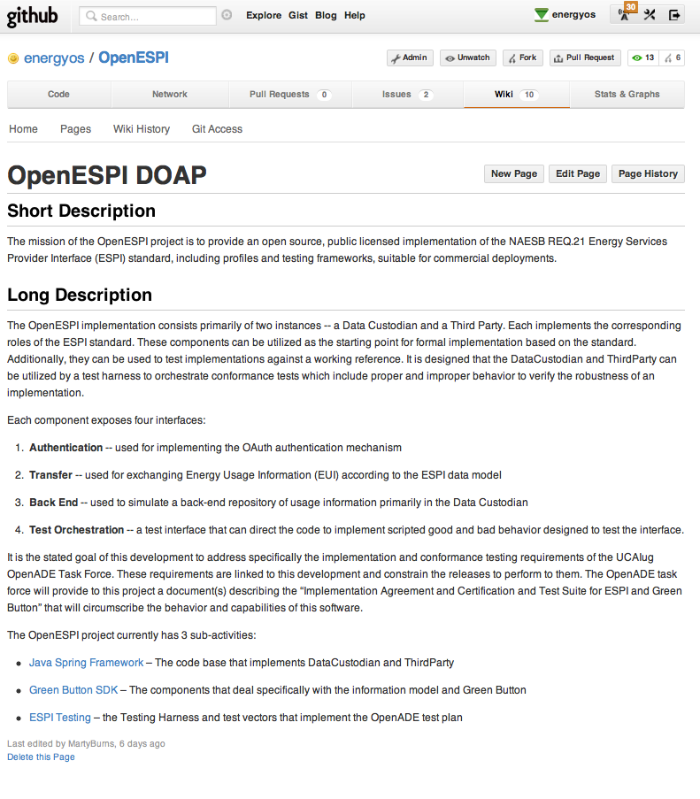
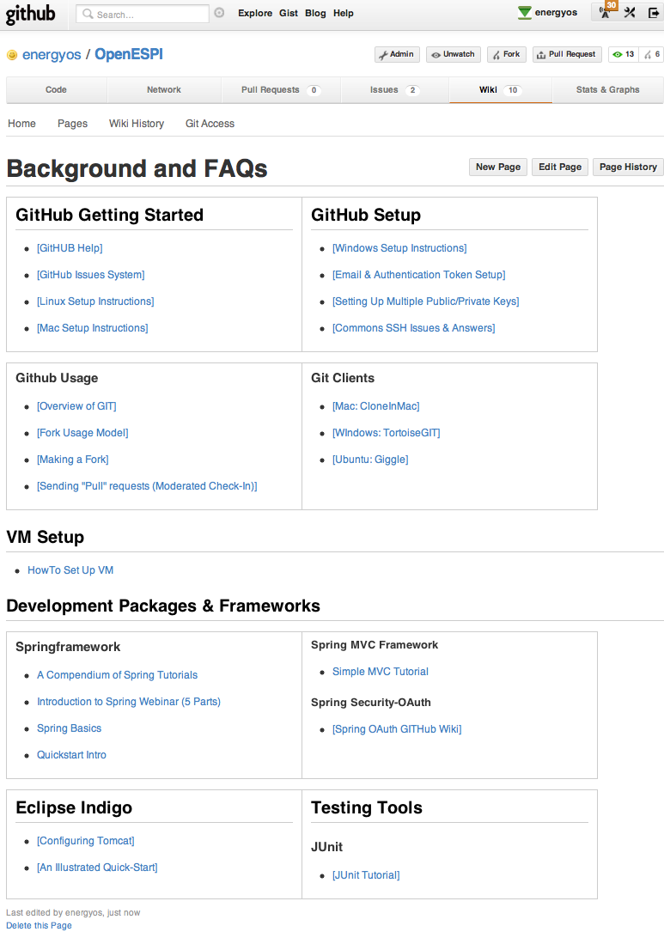
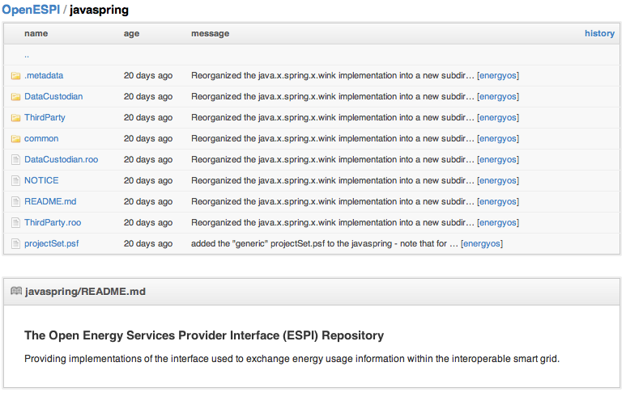
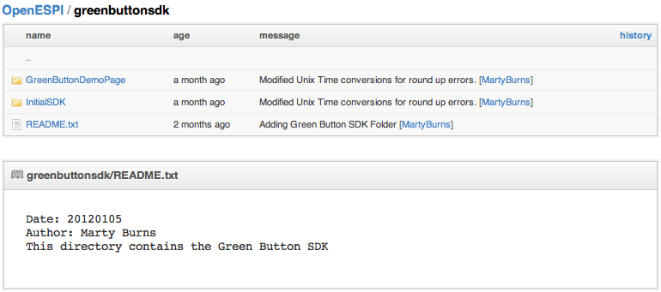
Session 1 – Getting Started
Github.com Repository: http://github.com/energyos/OpenESPI

Slide 10
OpenESPI/javaSpring Working Parts
Retail Consumer
Third Party
Data Custodian
Spring Social
OAuth
Spring Social
Spring REST
AtomPub
Spring REST
Spring Data
Spring Framework
Spring Framework
Spring Data
RESTful Exchanges
EUI
Repository
Tomcat/Apache
Tomcat/Apache
EUI
Repository
HTTP/HTTPS
Linux/Windows/OSX
ISO Stack (IPv6/IPv4)
Linux/Windows/OSX

Slide 11
Session 1 – Working Parts
RESTful
AtomPub
Service (Controller)
Information Repository
OAuth
Framework
Data Abstractions
Test Injector
Retail Consumer
Data Custodian
Third Party Service Provider

Slide 12
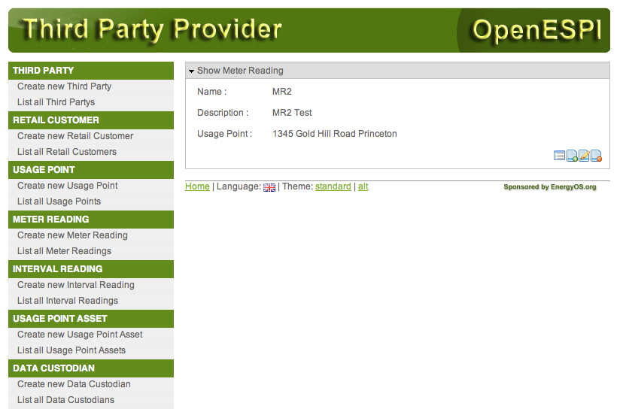
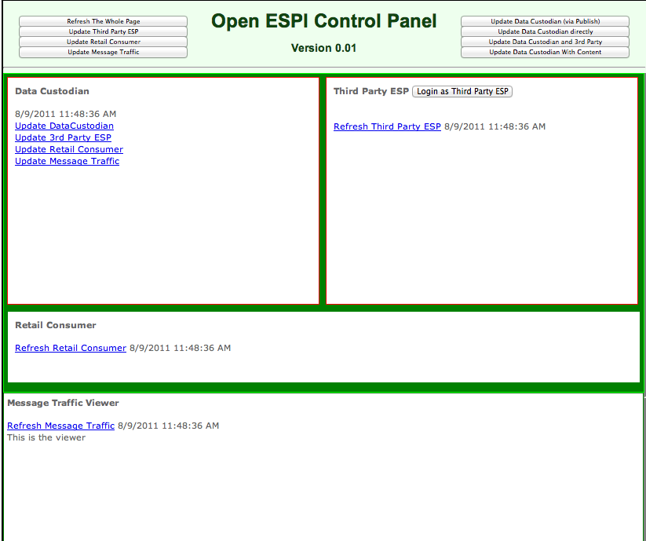
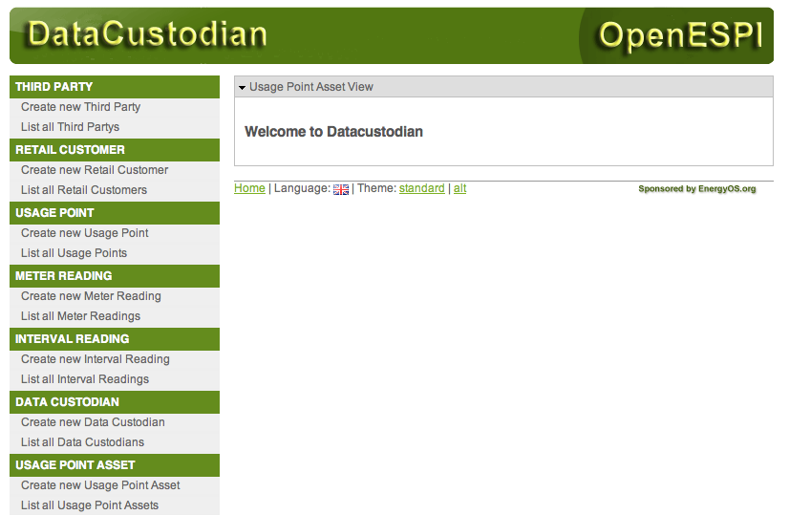
Session 1 – Working Parts - Models, Views, & Controlers
Models
EUI Profiles
ESPI Contexts
Services Hooks
Views
Management
Operations
Testing
Controllers
Data Custodian
Third Party Service Provider
Retail Consumer

Slide 13
Agenda – Session 2
Session 1 – OpenESPI Project Overview
Mission/Vision
Open Source License – Apache 2
Links and Access
Getting Started
The Working Parts
Session 2 – OpenESPI/javaSpring Development Environment
GitHub.com/energyos/OpenESPI
VMWare Ubuntu Virtual Machine
Eclipse Indigo, Apache Maven
Eclipse AspectJ, Apache Tomcat6
Session 3 - What is Spring Framework?
Overview of the Basics
Spring Data
Spring Security/OAuth
Spring JAX-RS
Session 4 – What is Apache Wink
About
Example
Annotations
Session 5 – OpenESPI/javaSpring Code Walk
Eclipse Projects
Project Structure
Development Tree
About
Overview of the Basics

Slide 14






Session 2 – OpenESPI/javaSpring Development Environment
GitHub.com -- Source Code Management
VMWare & Ubuntu -- Pre-Configured Dev. Environment
Eclipse Indigo – Integrated Development Environment
Apache Maven – Project Build & Deployment Management
Eclipse AspectJ – Aspect Oriented Programing (Security/REST/Testing)
Apache Tomcat6 – Web Services

Slide 15


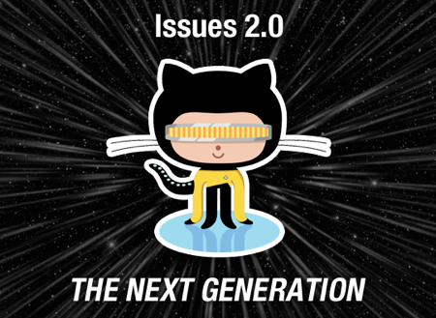
Session 2 – GitHub Repository
Code
Documents
Artifacts
javaSpring
GreenButtonSDK
Test
Wiki
Description of a Project (DOAP)
FAQ
Setup Guides
Meeting Notes
Issues & Milestones
Kinds
Tags
#hashTags
Owners
Dates

Slide 16
Session 2 – VMWare Ubuntu Virtual Machine
Downloading & Setup
Basic Components
Future Releases
Issues Tag: #VM
www.openespi.org/vm.html
Ubuntu
Wiki Setup Pages
Eclipse Indigo
Tomcat 6
Emacs
Desktop and Tools
Version 11.10
One User Account
Authorized User
User1 : Password
Quarterly Milestones

Slide 17
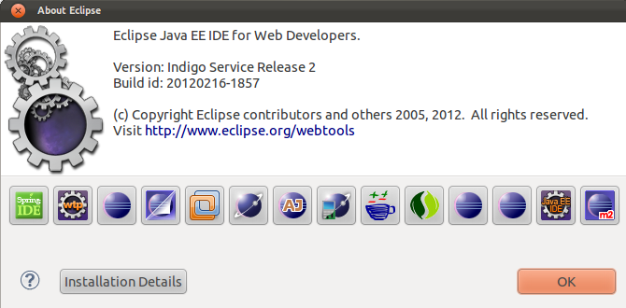
Session 2 – Eclipse Indigo
Baseline Start
Basic Components
Future Releases
Issues Tag: #eclipse
Basic Components
Spring (IDE STS)
Eclipse Web Tools Platform
Eclipse m2e (maven)
Eclipse Packaging
Eclipse Egit
Eclipse AspectJ
Eclipse Modeling
VMWare
Eclipse Data Tools
Eclipse Mylyn

Slide 18
Session 2 – Apache Maven
Overview
POM Files
Build Environment
Software Project Management
Project Comprehension
Guidelines for Best Practices
Quality Project Information
Project Object Model
XML Representation
Who – What – Where Lifecycles
One Stop Shop for All Things Project
Issues Tag: #maven
http://maven.apache.org/what-is-maven.html
http://maven.apache.org/pom.html#What_is_the_POM
<project xmlns="http://maven.apache.org/POM/4.0.0"
xmlns:xsi="http://www.w3.org/2001/XMLSchema-instance"
xsi:schemaLocation="http://maven.apache.org/POM/4.0.0 http://maven.apache.org/xsd/maven-4.0.0.xsd">
<modelVersion>4.0.0</modelVersion>
<groupId>org.energyos.espi</groupId>
<artifactId>DataCustodian</artifactId>
<version>0.0.1</version>
</project>

Slide 19
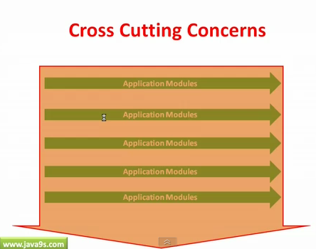
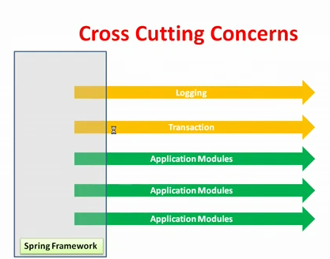
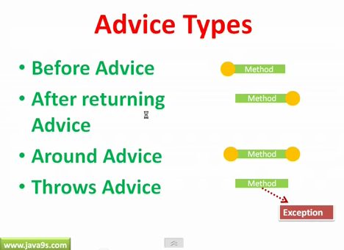
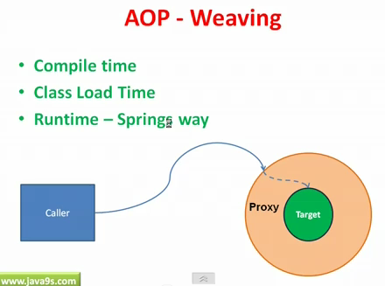
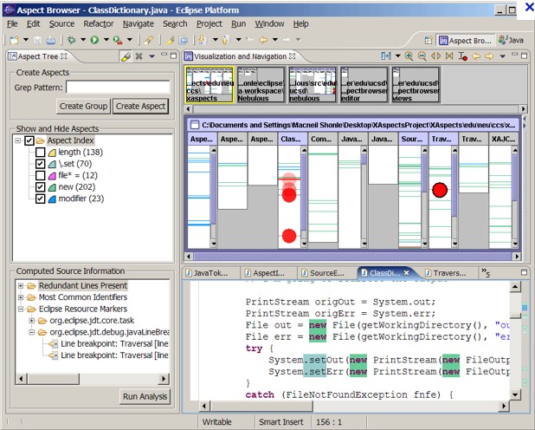
Session 2 – Eclipse AspectJ
Overview
Aspect Oriented Programming (AOP)
Modularizing Cross-Cutting Concerns (like Transaction Mgnt, Security & Logging)
Advice – Defines what needs to be applied and when. Information (security credentials or logging info) relevant to the cross-cutting concerns.
Jointpoints – where the advice is applied
PointCuts – Combinations of different jointpoints where advice needs to be applied. Places in application where Cross-Cutting Concerns apply (where transactional, security or logging behaviors might happen)
Aspects – Applying the advice at Pointcuts
Aspect “Weaving” – Injecting advice code into the application: Compile time, Load time, Run time - Spring way
Currently in Code Base from SpringRoo constructions
Related to the testing infrastructure of the codebase
Numerous (1000+) “Markers” to AspectJ
Issues Tag: #AspectJ
References:
http://eclipse.org/aspectj/docs.php
http://eclipse.org/aspectj/doc/released/quick5.pdf
http://www.eclipse.org/articles/Article-Introducing-AJDT/article.html
http://www.youtube.com/watch?v=6XzvLAe02pA
http://www.youtube.com/watch?v=j5JeFZLIa5o&feature=related

Slide 20
Session 2 – Apache Tomcat
Overview
Tomcat6
Eclipse Integration
Deployment
Java Servlet
JavaServer Pages
Issues Tag: #TC
Scalable
Mission Critical
Servlet 2.5
JSP 2.1
Tested and Stable
Multiple Server Instances
Dynamic Configurations
Automatic Deployments
Multiple Platform
Eclipse and Maven Integration
Integrated Testing
Should we use Tomcat 7?

Slide 21
Agenda – Session 3
Session 1 – OpenESPI Project Overview
Mission/Vision
Open Source License – Apache 2
Links and Access
Getting Started
The Working Parts
Session 2 – OpenESPI/javaSpring Development Environment
GitHub.com/energyos/OpenESPI
VMWare Ubuntu Virtual Machine
Eclipse Indigo, Apache Maven
Eclipse AspectJ, Apache Tomcat6
Session 3 - What is Spring Framework?
Overview of the Basics
Spring Data
Spring Security/OAuth
Spring JAX-RS
Session 4 – What is Apache Wink
About
Example
Annotations
Session 5 – OpenESPI/javaSpring Code Walk
Eclipse Projects
Project Structure
Development Tree
About
Overview of the Basics

