Slide 1
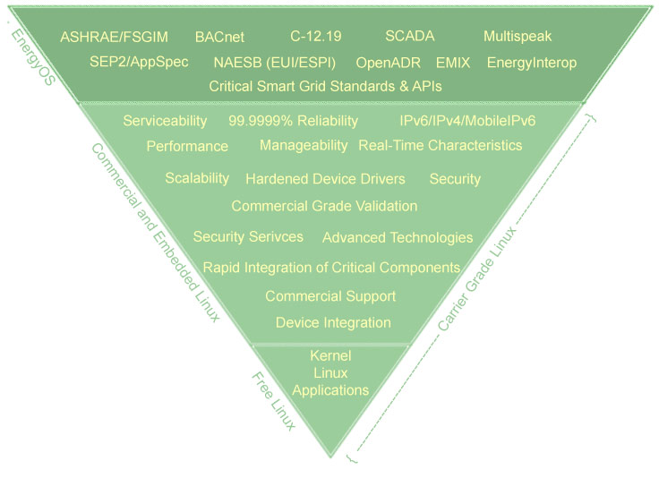
OpenESPI Development Project
Retail Consumer
Third Party
Data Custodian
Spring Social
OAuth
Spring Social
Apache Wink
Apache Wink
Spring Data
Spring Framework
AtomPub
Spring Framework
Spring Data
EUI
Repository
RESTful Exchanges
EUI
Repository
Tomcat/Apache
Tomcat/Apache
HTTP/HTTPS
Linux/Windows/OSX
Linux/Windows/OSX
ISO Stack (IPv6/IPv4)
An EnergyOS
Project
Development and Test Environment
Marty Burns, Hypertek Inc. John Teeter, People Power

Slide 2
An Open Source Community Project
Proposed development environment and development components
Possible component model
Test environment
Development Dashboard
Initial Java Packages – Followed by C++
Implementation is Underway
Join the Community: www.openespi.org

Slide 3
Development Environment
Delopment and test environment
Eclipse IDE for project development
Use Java (followed by C++) as development languages
Produce class libraries for DataCustodian, RetailCustomer, and ThirdParty
Spring Framework/Spring Social for Oauth Support
Apache Wink for AtomPub Support
Use Firefox as the host web browser
Use Apache/Tomcat as the web server with PHP support
JUnit and Spring Framework Testing Environments
Use Selenium for test orchestration and target stimulus
Use a web page for each actor as the test harness
Logging via wireshark
Sample Services Portal: http://www.openespi.org/portal

Slide 4
Model/View/Controler Component Model
Three SW Components – DataCustodian, ThirdParty, RetailCustomer
Actor
Information Repository
Atom Publishing
EUI
Conformant
OAuth
Back End
Target Test Stimulus
Shared Information Model

Slide 5
OpenESPI Deployment Packaging
Retail Consumer
Third Party
Data Custodian
Spring Social
OAuth
Spring Social
Apache Wink
AtomPub
Apache Wink
Spring Data
Spring Framework
Spring Framework
Spring Data
RESTful Exchanges
EUI
Repository
Tomcat/Apache
Tomcat/Apache
EUI
Repository
HTTP/HTTPS
Linux/Windows/OSX
ISO Stack (IPv6/IPv4)
Linux/Windows/OSX

Slide 6
Test environment
DataCustodian
Customer access page
RetailCustomer
Customer
EUI page
ThirdParty
Customer access page
Developer
Management Dashboard
Web Stimulus
Web Stimulus
Firefox/Selenium Scripting
Web Stimulus
Target Stimulus
Target Stimulus
Web Stimulus
Target Stimulus
Target Stimulus

Slide 7
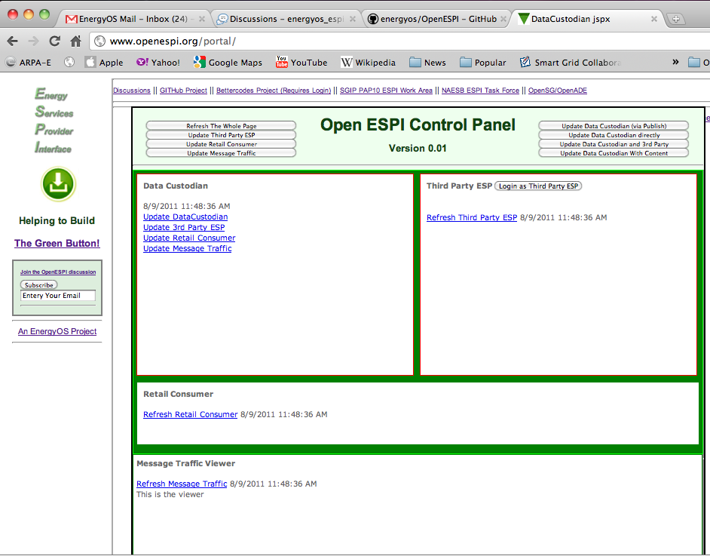
http://OpenESPI/Portal
A Work
In
Progress

