Slide 1

Orders Monitoring Assessment Preview
2023 - efood remote assessment - Giannis Karousos - karousosg@hotmail.com - 6988261450

Slide 2


Remote Assessment
Monthly
SaaS
Big Query
The
process
Dashboard
Orders Analysis
Users Analysis
Breakfast Coupons Strategies
2023 - efood remote assessment - Giannis Karousos - karousosg@hotmail.com - 6988261450

Slide 3
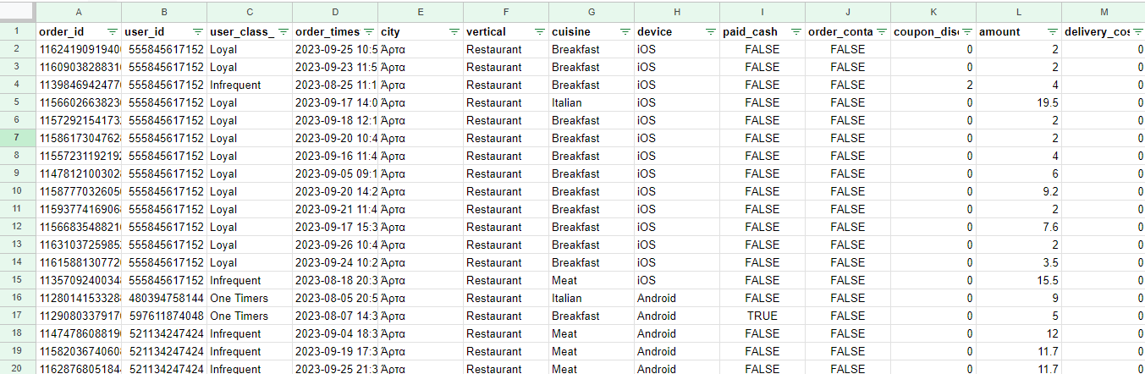
Remote Assessment
The
dataset
2023 - efood remote assessment - Giannis Karousos - karousosg@hotmail.com - 6988261450

Slide 4
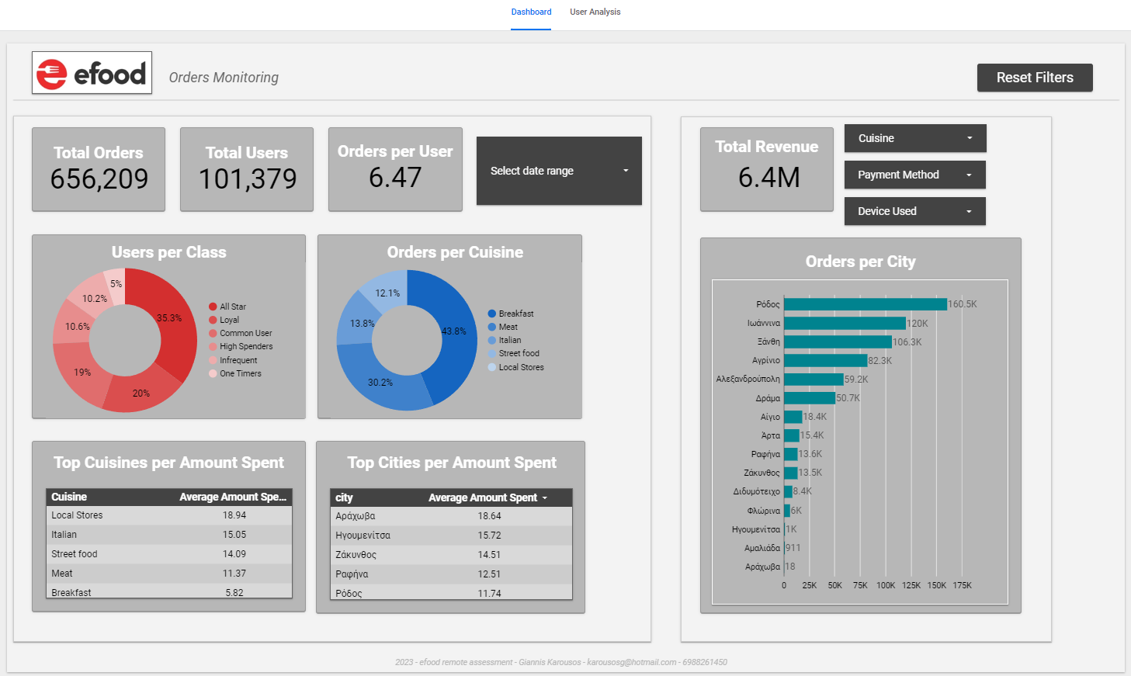
Remote Assessment
The
Dashboard
2023 - efood remote assessment - Giannis Karousos - karousosg@hotmail.com - 6988261450

Slide 5
Remote Assessment
Total revenue for August & September (no delivery cost)
Total
Revenue
2023 - efood remote assessment - Giannis Karousos - karousosg@hotmail.com - 6988261450

Slide 6
Some metrics to get the whole picture!
Remote Assessment
Important
Metrics
2023 - efood remote assessment - Giannis Karousos - karousosg@hotmail.com - 6988261450

Slide 7
Remote Assessment
The most dominant class is All Star!
The most dominant cuisine is Breakfast!
Class
Cuisine
2023 - efood remote assessment - Giannis Karousos - karousosg@hotmail.com - 6988261450

Slide 8
Remote Assessment
Rodos has the most orders while Ioannina comes next!
Arahova users spent the most on average!
Top
Cities
2023 - efood remote assessment - Giannis Karousos - karousosg@hotmail.com - 6988261450

Slide 9
Remote Assessment
Local Stores are the most expensive on average!
Top
Cuisines
2023 - efood remote assessment - Giannis Karousos - karousosg@hotmail.com - 6988261450

Slide 10
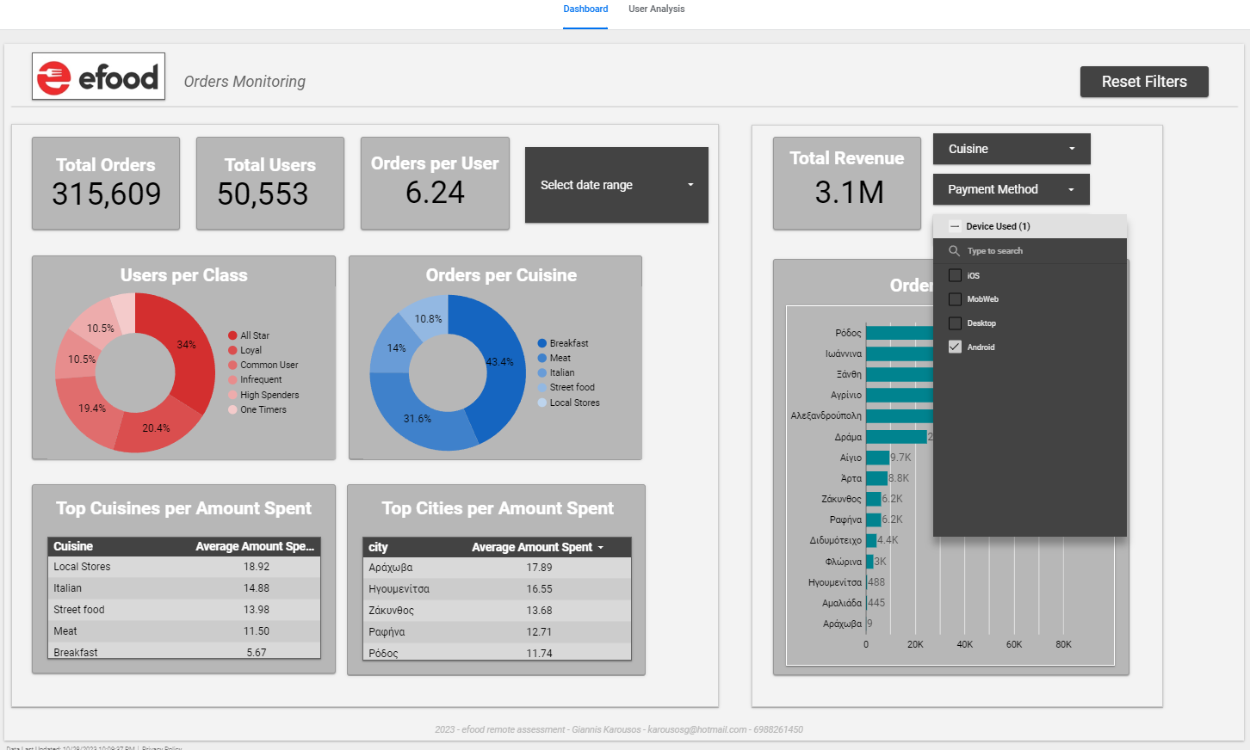
Remote Assessment
Getting into the Android users!
Top
Cuisines
2023 - efood remote assessment - Giannis Karousos - karousosg@hotmail.com - 6988261450

Slide 11
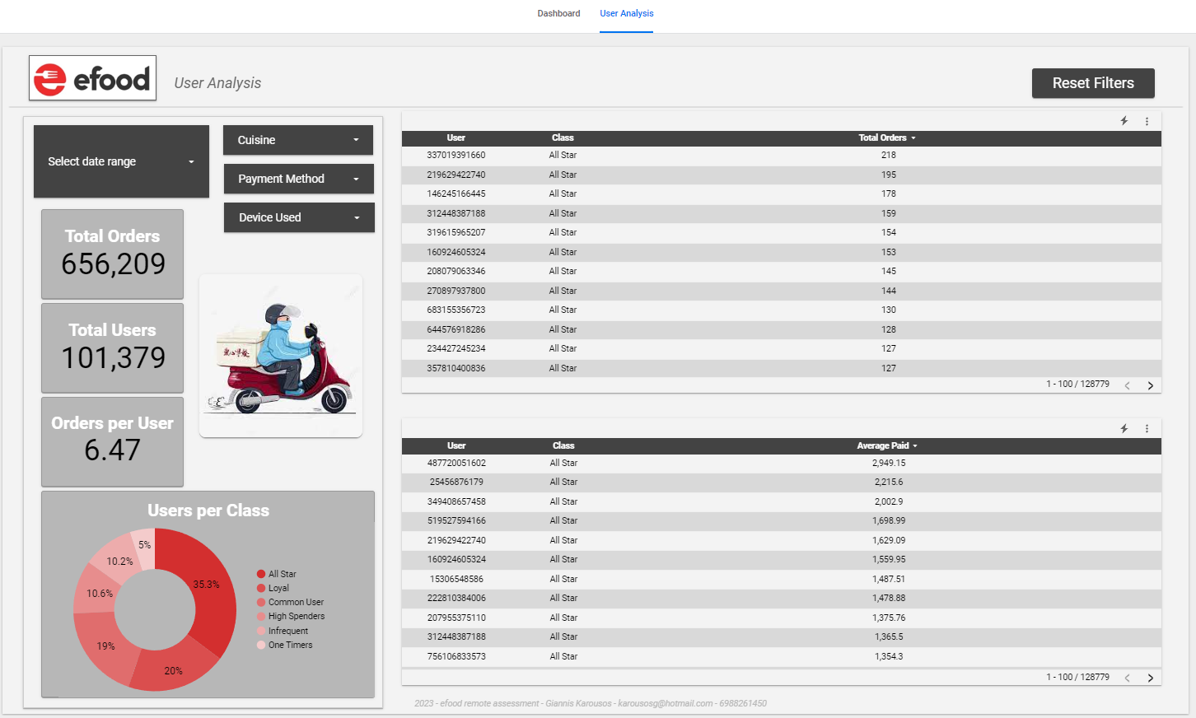
Remote Assessment
Some top users!
Top
Cuisines
2023 - efood remote assessment - Giannis Karousos - karousosg@hotmail.com - 6988261450

Slide 12

Remote Assessment
COUPON STRATEGY A
High Frequency & Opportunity to Increase.
Users who order frequently but spend less might be encouraged to try more premium items with the right incentive. (263 users)
Average order amount spent < 5
Total breakfast orders >= 50
COUPON STRATEGY B
Low Frequency, High Spend.
Users who spend a lot, we need them to order more frequently. (495 users)
Average order amount spent >=10
Total breakfast orders <= 20
Breakfast
Coupons
Strategies
COUPON STRATEGY C
High Frequency but Inactive.
Users who used to order breakfast frequently but haven't placed an order in a while. We need them back! (242 users)
Inactivity > 30 days
Total breakfast orders >= 30
**Veronika Alexander, Sophie Tripp, and Paul J. Zak. (2010). Preliminary Evidence for the
Neurophysiologic Effects of Online Coupons: Changes in Oxytocin, Stress, and Mood. Psychology & Marketing
2023 - efood remote assessment - Giannis Karousos - karousosg@hotmail.com - 6988261450

