Slide 1
Java
From Python to Java

Slide 2
Java is −
Object Oriented − In Java, everything is an Object. Java can be easily extended since it is based on the Object model.
Platform Independent − Unlike many other programming languages including C and C++, when Java is compiled, it is not compiled into platform specific machine, rather into platform independent byte code. This byte code is distributed over the web and interpreted by the Virtual Machine (JVM) on whichever platform it is being run on.
Simple − Java is designed to be easy to learn. If you understand the basic concept of OOP Java, it would be easy to master.
Secure − With Java's secure feature it enables to develop virus-free, tamper-free systems. Authentication techniques are based on public-key encryption.
Architecture-neutral − Java compiler generates an architecture-neutral object file format, which makes the compiled code executable on many processors, with the presence of Java runtime system.
Portable − Being architecture-neutral and having no implementation dependent aspects of the specification makes Java portable. Compiler in Java is written in ANSI C with a clean portability boundary, which is a POSIX subset.
Robust − Java makes an effort to eliminate error prone situations by emphasizing mainly on compile time error checking and runtime checking.
Multithreaded − With Java's multithreaded feature it is possible to write programs that can perform many tasks simultaneously. This design feature allows the developers to construct interactive applications that can run smoothly.
Interpreted − Java byte code is translated on the fly to native machine instructions and is not stored anywhere. The development process is more rapid and analytical since the linking is an incremental and light-weight process.
High Performance − With the use of Just-In-Time compilers, Java enables high performance.
Distributed − Java is designed for the distributed environment of the internet.
Dynamic − Java is considered to be more dynamic than C or C++ since it is designed to adapt to an evolving environment. Java programs can carry extensive amount of run-time information that can be used to verify and resolve accesses to objects on run-time.

Slide 3
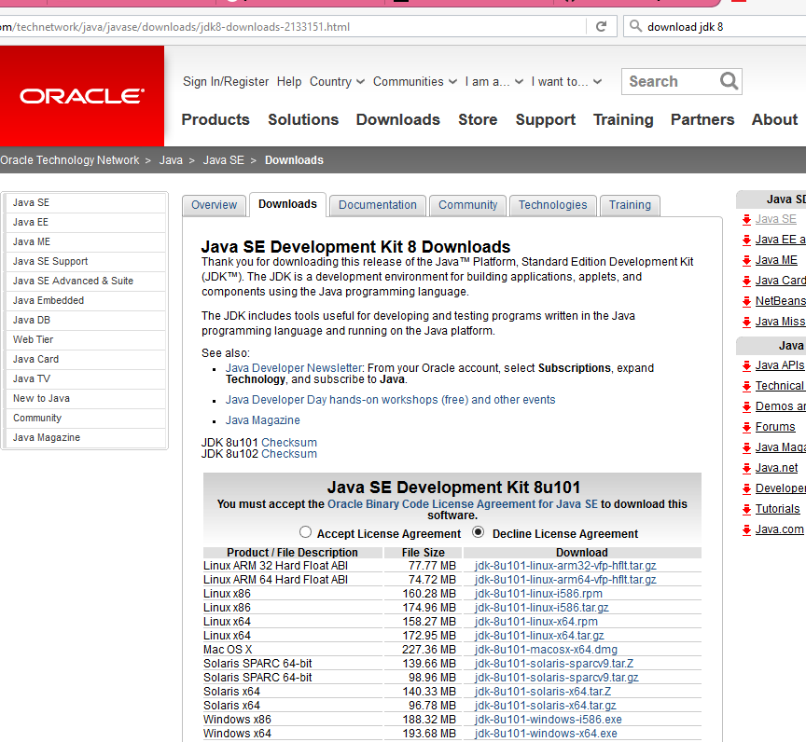
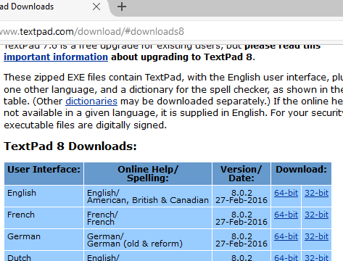
Requirements
Java SE Development Kit 8
Download Textpad

Slide 4
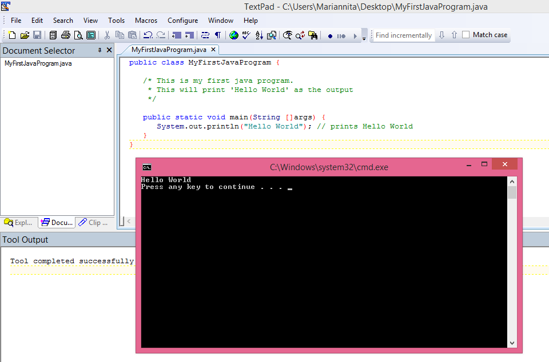
Execute Java Program
1)Compile: Tools ->External Tools ->Compile
2)Run: Tools ->External Tools ->Run Java Application

Slide 5
If you prefer cmd
Open notepad and add the code as above.
Save the file as: MyFirstJavaProgram.java.
Open a command prompt window and go to the directory where you saved the class. Assume it's C:\.
Type 'javac MyFirstJavaProgram.java’ and press enter to compile your code. If there are no errors in your code, the command prompt will take you to the next line (This will work only if the path variable is set).
Now, type ' java MyFirstJavaProgram ' to run your program.
You will be able to see ' Hello World ' printed on the window

Slide 6
What is a Java Program
When we consider a Java program, it can be defined as a collection of objects that communicate via invoking each other's methods
Object − Objects have states and behaviors. Example: A dog has states - color, name, breed as well as behavior such as wagging their tail, barking, eating. An object is an instance of a class.
Class − A class can be defined as a template/blueprint that describes the behavior/state that the object of its type supports.
Methods − A method is basically a behavior. A class can contain many methods. It is in methods where the logics are written, data is manipulated and all the actions are executed.
Instance Variables − Each object has its unique set of instance variables. An object's state is created by the values assigned to these instance variables.

Slide 7
Basic Syntax (1)
Case Sensitivity − Java is case sensitive, which means identifier Hello and hello would have different meaning in Java.
Class Names − For all class names the first letter should be in Upper Case. If several words are used to form a name of the class, each inner word's first letter should be in Upper Case.
Example: class MyFirstJavaClass
Method Names − All method names should start with a Lower Case letter. If several words are used to form the name of the method, then each inner word's first letter should be in Upper Case.
Example: public void myMethodName()
Program File Name − Name of the program file should exactly match the class name. When saving the file, you should save it using the class name (Remember Java is case sensitive) and append '.java' to the end of the name
Example: Assume 'MyFirstJavaProgram' is the class name. Then the file should be saved as 'MyFirstJavaProgram.java'
public static void main(String args[]) − Java program processing starts from the main() method which is a mandatory part of every Java program.

Slide 8
Basic Syntax (2)
There can be only one public class per source file.
A source file can have multiple non-public classes.
If the class is defined inside a package, then the package statement should be the first statement in the source file.
If import statements are present, then they must be written between the package statement and the class declaration. If there are no package statements, then the import statement should be the first line in the source file.

Slide 9
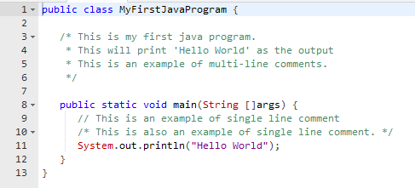
Comments in Java
Java supports single-line and multi-line comments

Slide 10
Java Identifiers
All identifiers should begin with a letter (A to Z or a to z), currency character ($) or an underscore (_).
After the first character, identifiers can have any combination of characters.
A key word cannot be used as an identifier.
Identifiers are case sensitive.
identifiers: age, $salary, _value, __1_value.
illegal identifiers: 123abc, -salary.

Slide 11
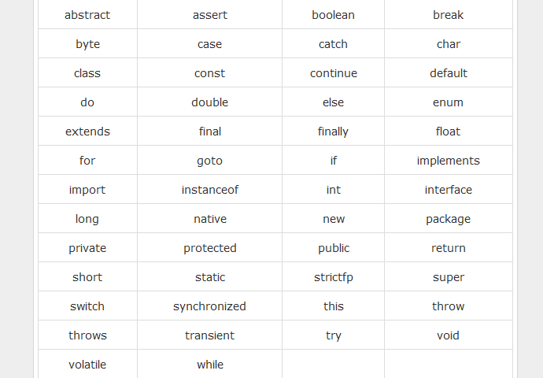
Java Keywords

Slide 12
Java Modifiers
Like other languages, it is possible to modify classes, methods, etc., by using modifiers. There are two categories of modifiers −
Access Modifiers − default, public , protected, private
Non-access Modifiers − final, abstract, strictfp

Slide 13
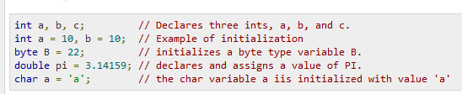
Java Variables (1)
A variable provides us with named storage that our programs can manipulate.
Each variable in Java has a specific type, which determines the size and layout of the variable's memory; the range of values that can be stored within that memory; and the set of operations that can be applied to the variable.
You must declare all variables before they can be used and remember that their type cannot be changed.

Slide 14
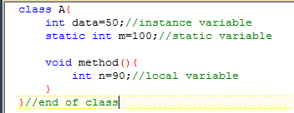
Java Variables (2)
Local Variables
A variable that is declared inside the method is called local variable.
Class Variables (Static Variables)
A variable that is declared as static is called static variable. It cannot be local.
Instance Variables (Non-static Variables)
A variable that is declared inside the class but outside the method is called instance variable . It is not declared as static.

Slide 15
Data Types (1)
Primitive Data Types
Reference/Object Data Types

Slide 16
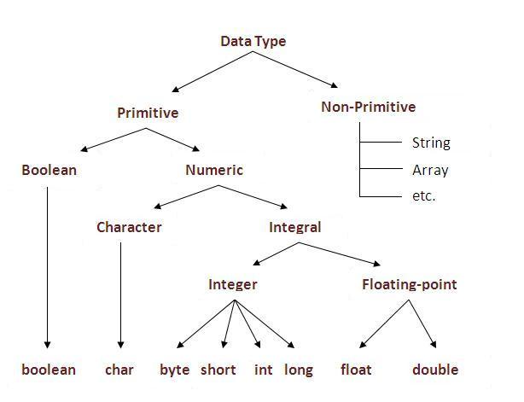
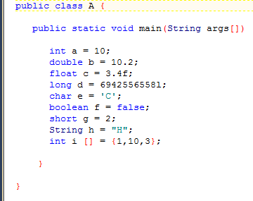
Data Types(2)

Slide 17
Reference Data Types
Reference variables are created using defined constructors of the classes. These variables are declared to be of a specific type that cannot be changed. For example, Employee, Puppy, etc.
Class objects and various type of array variables come under reference datatype.
Default value of any reference variable is null.
A reference variable can be used to refer any object of the declared type or any compatible type.
Example: Animal animal = new Animal("giraffe");

Slide 18
Primitive Data Types (1)
byte
short
int
long
Minimum value is -128Maximum value is 127 (inclusive)
Default value is 0
Byte data type is used to save space in large arrays, mainly in place of integers, since a byte is four times smaller than an integer.
e.g.: byte a = 100, byte b = -50
Minimum value is -32,768
Maximum value is 32,767 (inclusive)
Short data type can also be used to save memory as byte data type. A short is 2 times smaller than an integer
Default value is 0.
Example: short s = 10000, short r = -20000
Minimum value is - 2,147,483,648
Maximum value is 2,147,483,647(inclusive)
Integer is generally used as the default data type for integral values unless there is a concern about memory.
The default value is 0
e.g.: int a = 100000, int b = -200000
Minimum value is -9,223,372,036,854,775,808
Maximum value is 9,223,372,036,854,775,807 (inclusive)
This type is used when a wider range than int is needed
Default value is 0L
e.g.: long a = 100000L, long b = -200000L

Slide 19
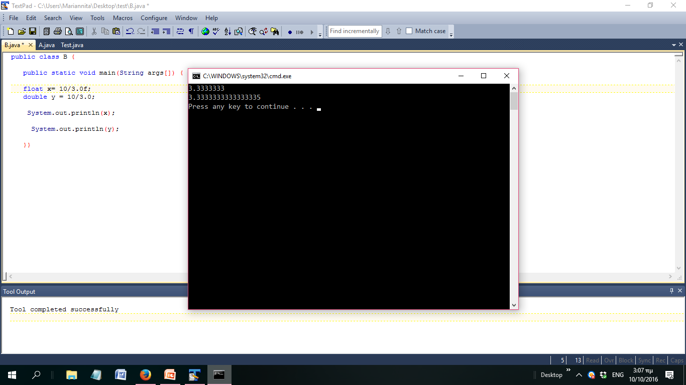
Primitive Data Types (2)
float
double
boolean
char
Float is mainly used to save memory in large arrays of floating point numbers
Default value is 0.0f
Float data type is never used for precise values such as currency
e.g.: float f1 = 234.5f
double data type is a double-precision 64
This data type is generally used as the default data type for decimal values, generally the default choice
Double data type should never be used for precise values such as currency
Default value is 0.0d
e.g.: double d1 = 123.4
boolean data type represents one bit of information
There are only two possible values: true and false
This data type is used for simple flags that track true/false conditions
Default value is false
e.g.: boolean one = true
char data type is a single 16-bit Unicode character
Minimum value is '\u0000' (or 0)
Maximum value is '\uffff' (or 65,535 inclusive)
Char data type is used to store any character
e.g. : char letterA = 'A'
Float data type is a single-precision 32-bit
Float vs Double

Slide 20
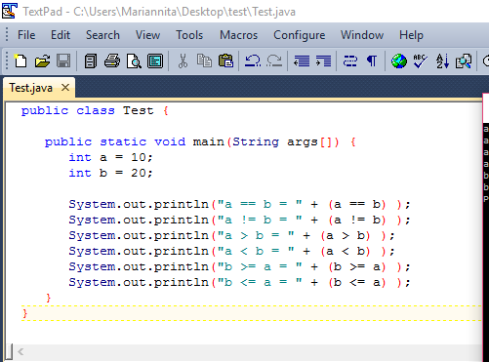
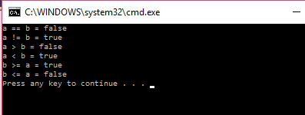
The Relational Operators

Slide 21
The Logical Operators
Operator | Description | Example
&& (logical and) | Called Logical AND operator. If both the operands are non-zero, then the condition becomes true. | (A && B) is false
|| (logical or) | Called Logical OR Operator. If any of the two operands are non-zero, then the condition becomes true. | (A || B) is true
! (logical not) | Called Logical NOT Operator. Use to reverses the logical state of its operand. If a condition is true then Logical NOT operator will make false. | !(A && B) is true

Slide 22
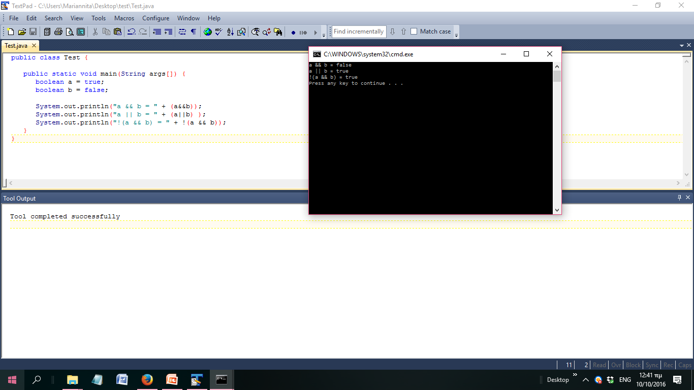
The Logical Operators

Slide 23
The Assignment Operators
Operator | Description
= | Simple assignment operator. Assigns values from right side operands to left side operand.
+= | Add AND assignment operator. It adds right operand to the left operand and assign the result to left operand.
-= | Subtract AND assignment operator. It subtracts right operand from the left operand and assign the result to left operand.
*= | Multiply AND assignment operator. It multiplies right operand with the left operand and assign the result to left operand.
/= | Divide AND assignment operator. It divides left operand with the right operand and assign the result to left operand.
%= | Modulus AND assignment operator. It takes modulus using two operands and assign the result to left operand.

Slide 24
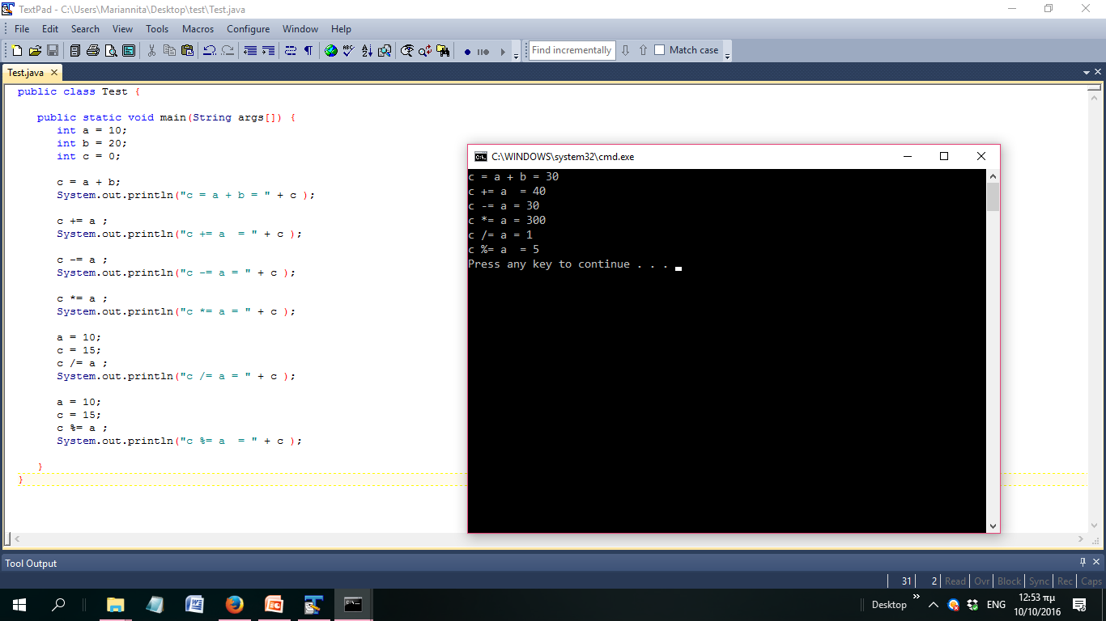
The Assignment Operators

Slide 25
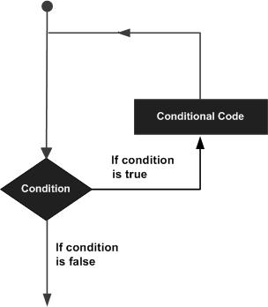
loops
A loop statement allows us to execute a statement or group of statements multiple times and following is the general form of a loop statement in most of the programming languages

Slide 26
loops
While
A while loop statement in Java programming language repeatedly executes a target statement as long as a given condition is true
for
A for loop is a repetition control structure that allows you to efficiently write a loop that needs to be executed a specific number of times.
A for loop is useful when you know how many times a task is to be repeated.
do...while
A do...while loop is similar to a while loop, except that a do...while loop is guaranteed to execute at least one time.

Slide 27
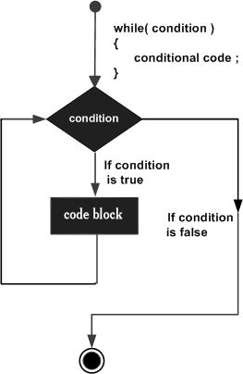
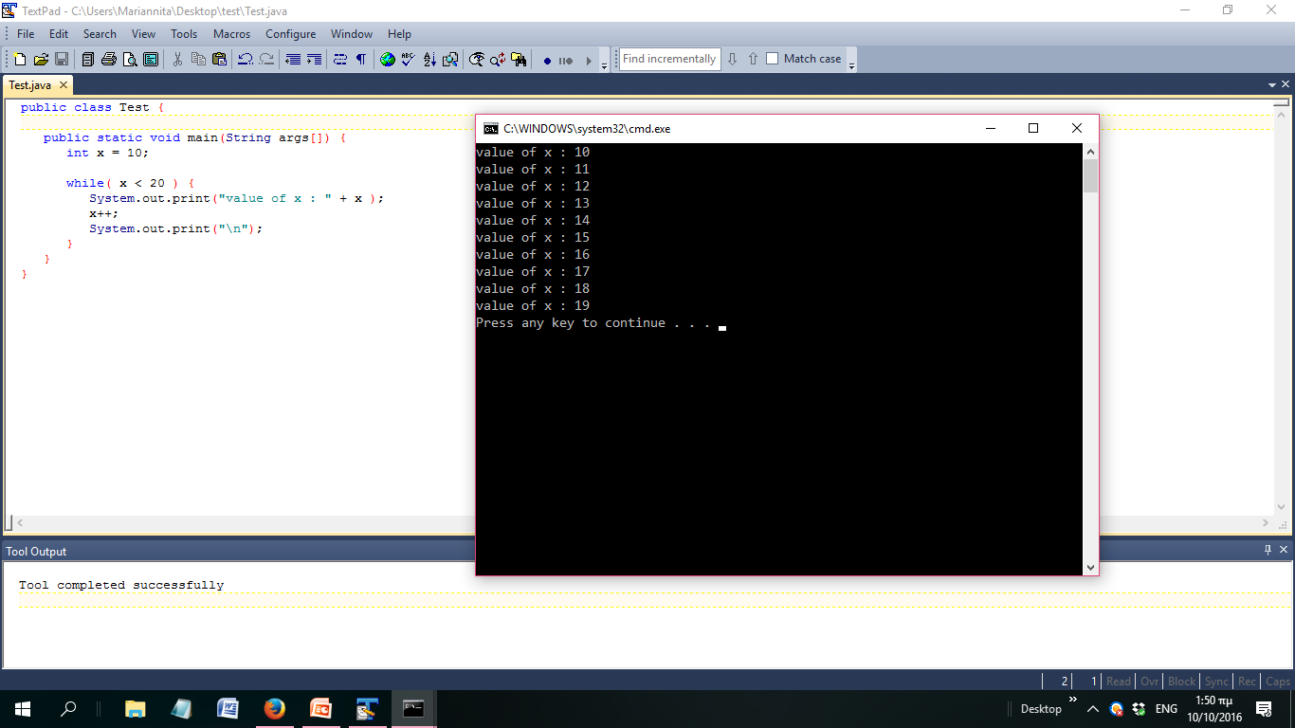
while

Slide 28
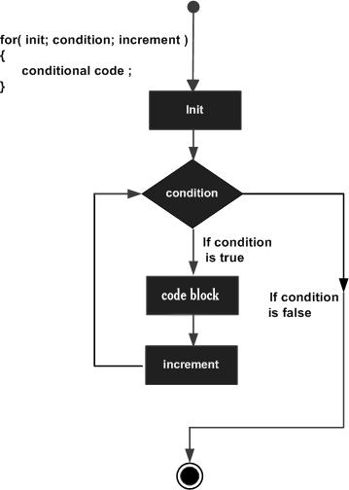
for

Slide 29
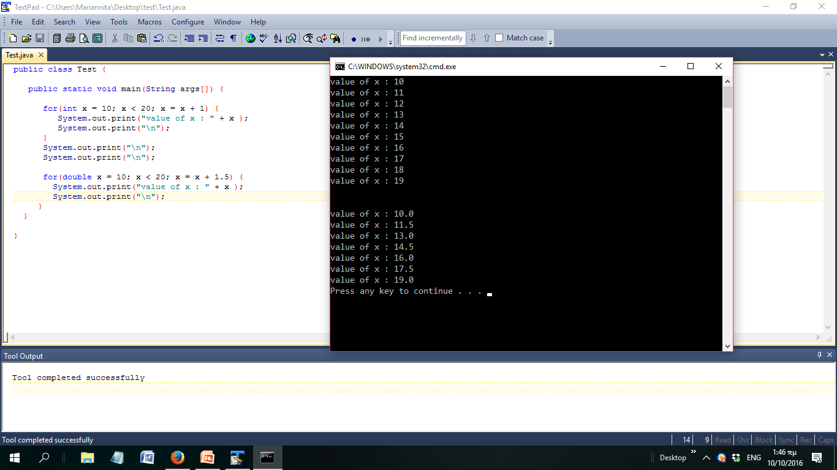
for

Slide 30
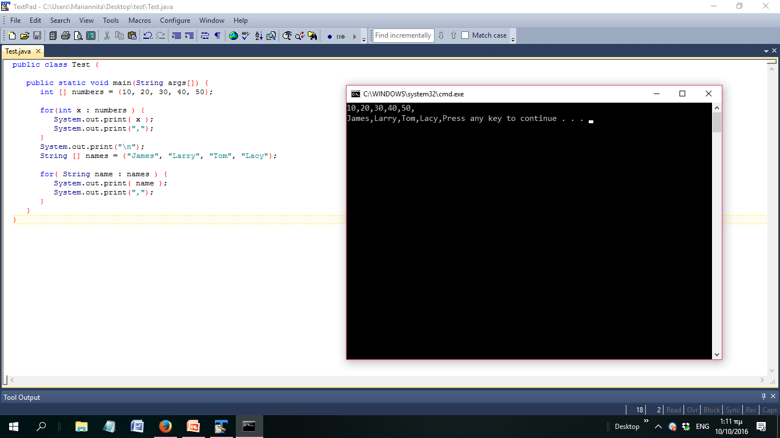
Enhanced for loop in Java
This is mainly used to traverse collection of elements including arrays.
for(declaration : expression) {
// Statements
}

Slide 31
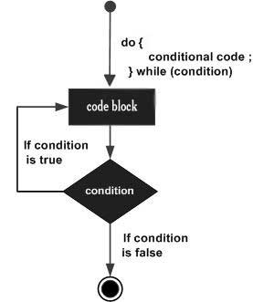
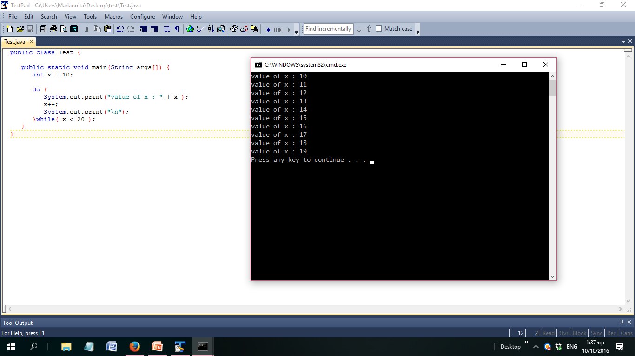
do...while

Slide 32
Loop Control Statements
Loop control statements change execution from its normal sequence. When execution leaves a scope, all automatic objects that were created in that scope are destroyed.
break statement
When the break statement is encountered inside a loop, the loop is immediately terminated and the program control resumes at the next statement following the loop.
continue statement
In a for loop, the continue keyword causes control to immediately jump to the update statement.
In a while loop or do/while loop, control immediately jumps to the Boolean expression.

Slide 33
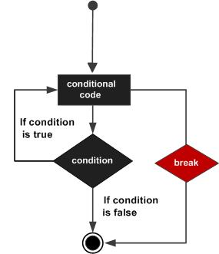
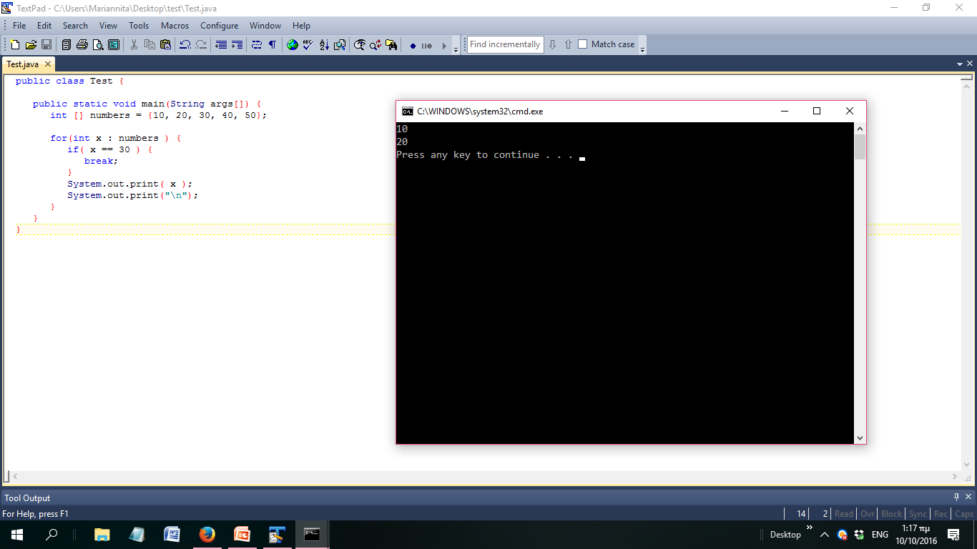
break

Slide 34
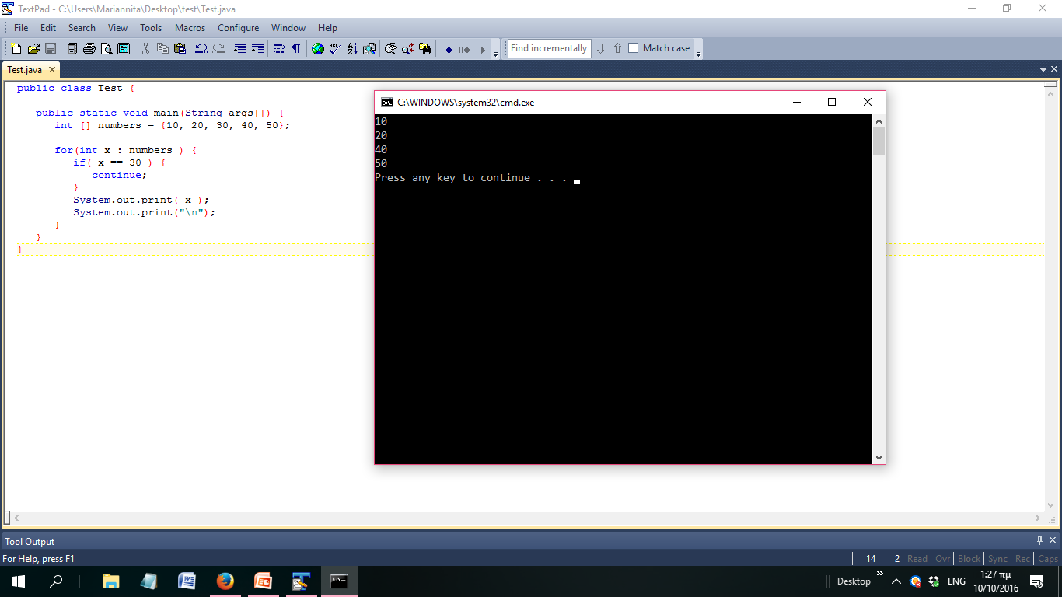
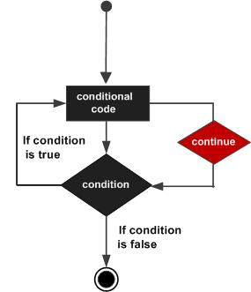
continue

Slide 35
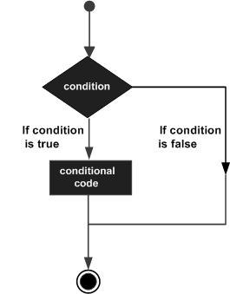
types of decision making statements
if
if...else
nested if
switch

Slide 36
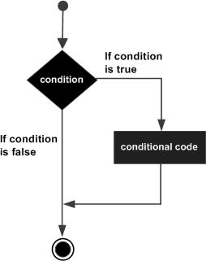
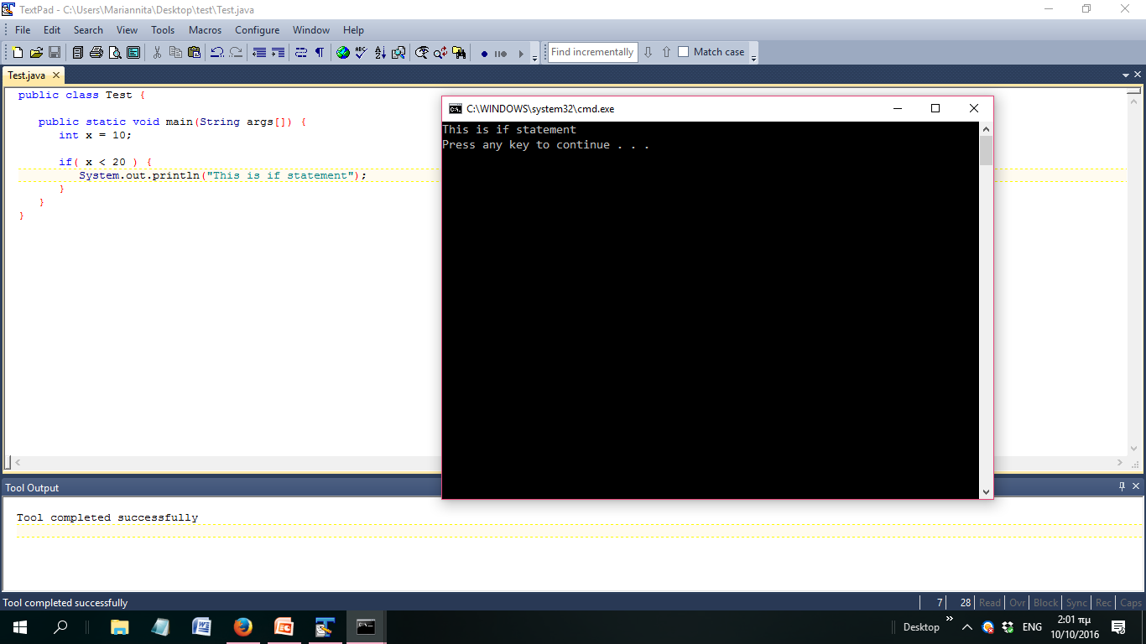
If statement
if(Boolean_expression) {
// Statements will execute if the Boolean expression is true
}

Slide 37
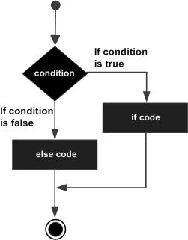
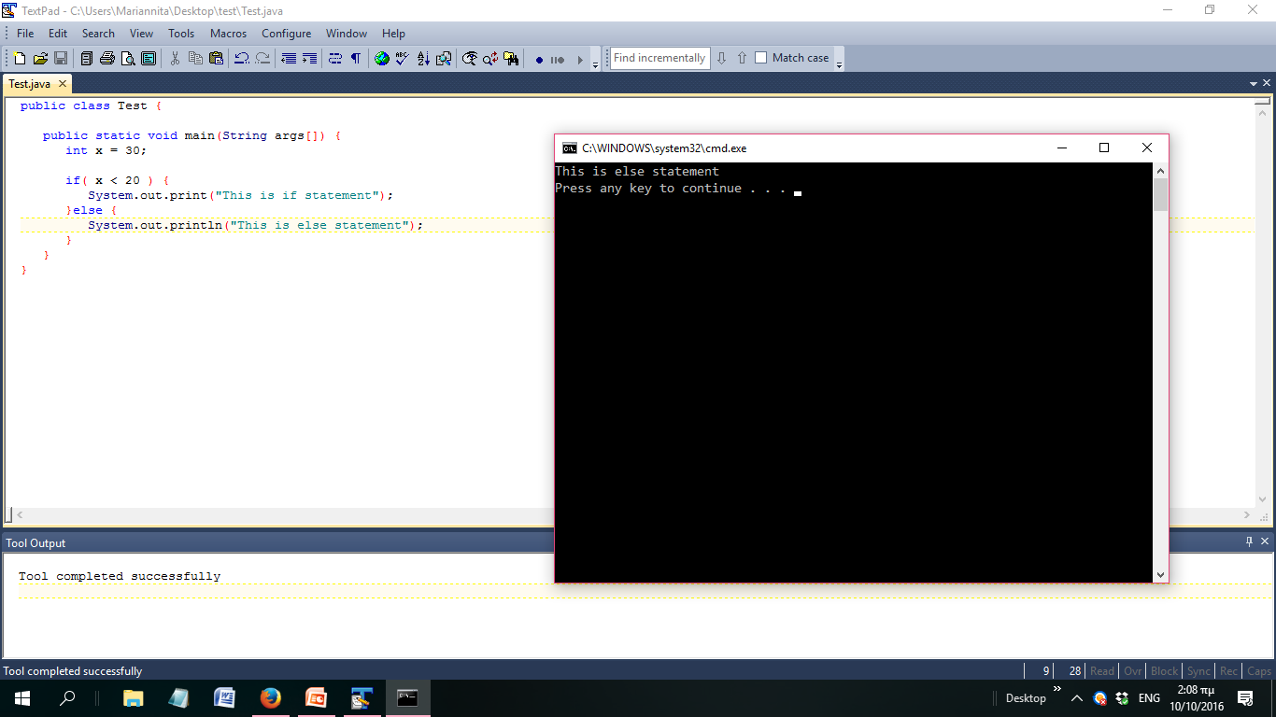
if...else statement (1)
if(Boolean_expression) {
// Executes when the Boolean expression is true
}else {
// Executes when the Boolean expression is false
}

Slide 38
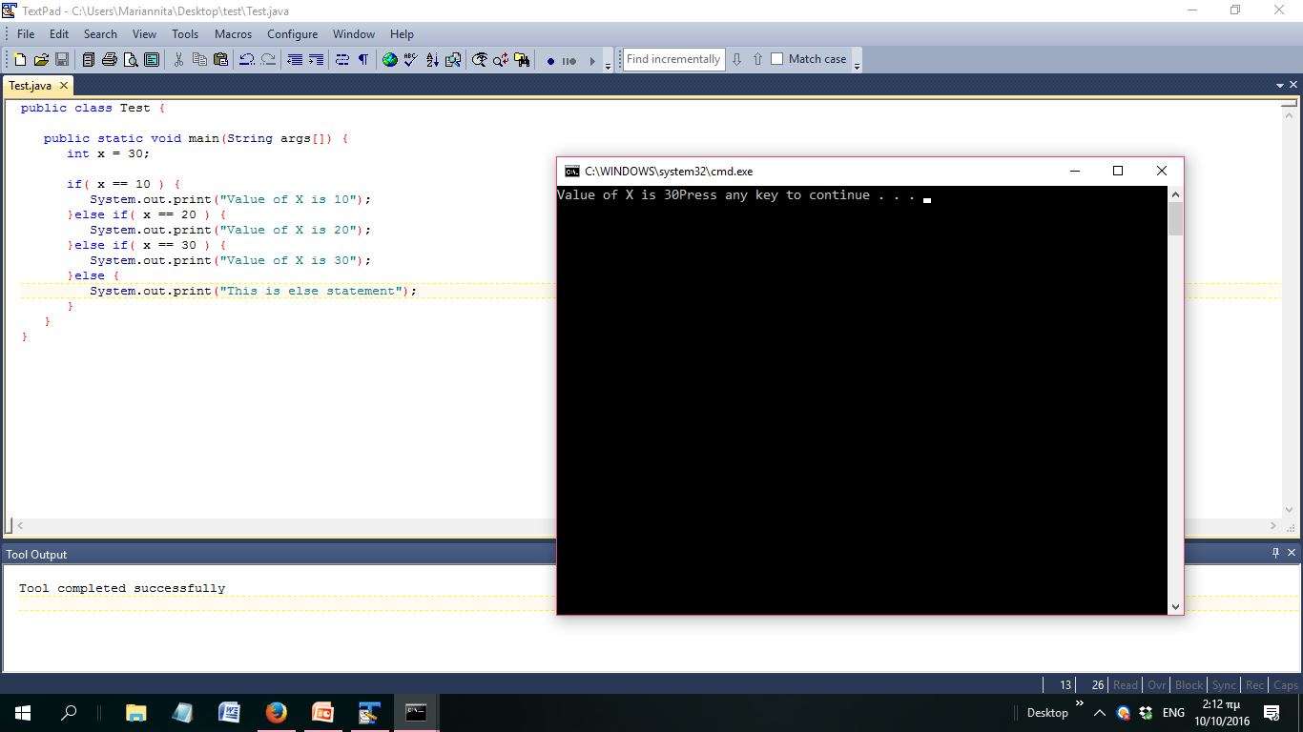
if...else statement (2)
if(Boolean_expression 1) {
// Executes when the Boolean expression 1 is true
} else if(Boolean_expression 2) {
// Executes when the Boolean expression 2 is true
} else if(Boolean_expression 3) {
// Executes when the Boolean expression 3 is true
} else {
// Executes when the none of the above condition is true
}

Slide 39
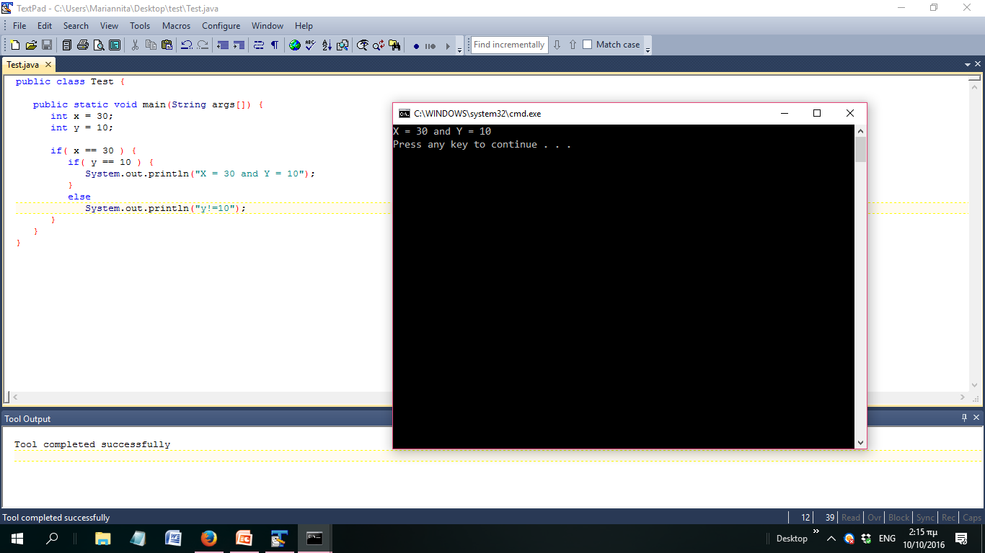
nested if statement
if(Boolean_expression 1) {
// Executes when the Boolean expression 1 is true
if(Boolean_expression 2) {
// Executes when the Boolean expression 2 is true
}
}

Slide 40
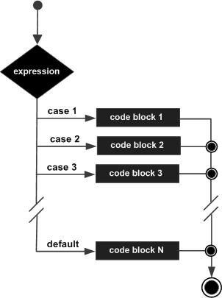
Switch statement (1)
A switch statement allows a variable to be tested for equality against a list of values. Each value is called a case, and the variable being switched on is checked for each case
The variable used in a switch statement can only be integers, convertable integers (byte, short, char), strings and enums.
You can have any number of case statements within a switch. Each case is followed by the value to be compared to and a colon.
The value for a case must be the same data type as the variable in the switch and it must be a constant or a literal.
When the variable being switched on is equal to a case, the statements following that case will execute until a break statement is reached.
When a break statement is reached, the switch terminates, and the flow of control jumps to the next line following the switch statement.
Not every case needs to contain a break. If no break appears, the flow of control will fall through to subsequent cases until a break is reached.
A switch statement can have an optional default case, which must appear at the end of the switch. The default case can be used for performing a task when none of the cases is true. No break is needed in the default case.

Slide 41
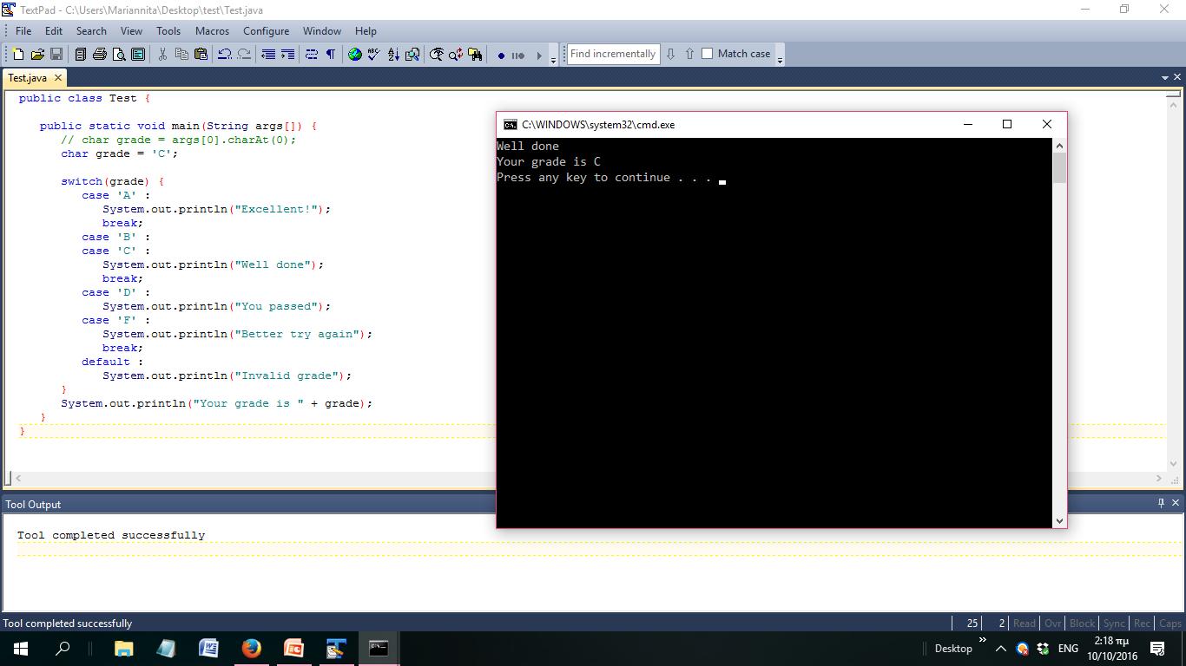
Switch statement (2)

Slide 42
Creating Format Strings (1)
You have printf() and format() methods to print output with formatted numbers.
Using String's static format() method allows you to create a formatted string that you can reuse, as opposed to a one-time print statement

Slide 43
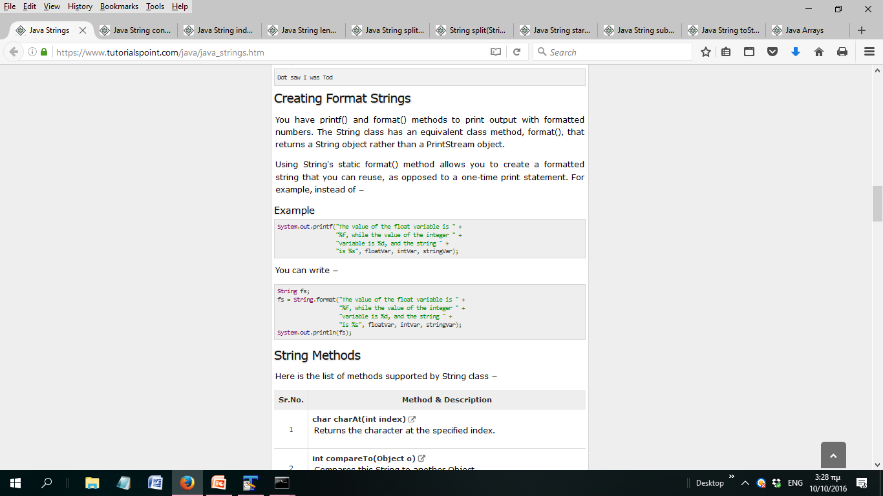
Creating Format Strings (1)
Which is equivalent to this:

Slide 44
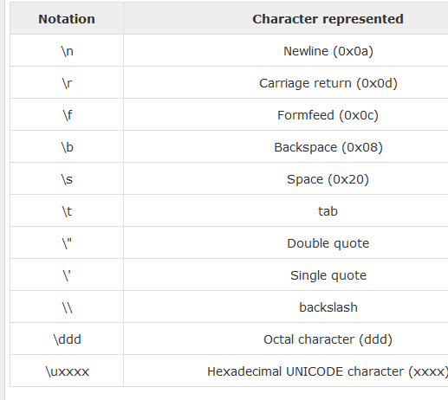
escape sequences

Slide 45
Useful String Methods (1)
Method | Explanation
String concat(String str) | Concatenates the specified string to the end of this string.
int length() | Returns the length of this string.
String[] split(String regex) | Splits this string around matches of the given regular expression.
String[] split(String regex, int limit) | Splits this string around matches of the given regular expression.
String substring(int beginIndex, int endIndex) | Returns a new string that is a substring of this string.
String substring(int beginIndex.) | Returns a new string that is a substring of this string

Slide 46
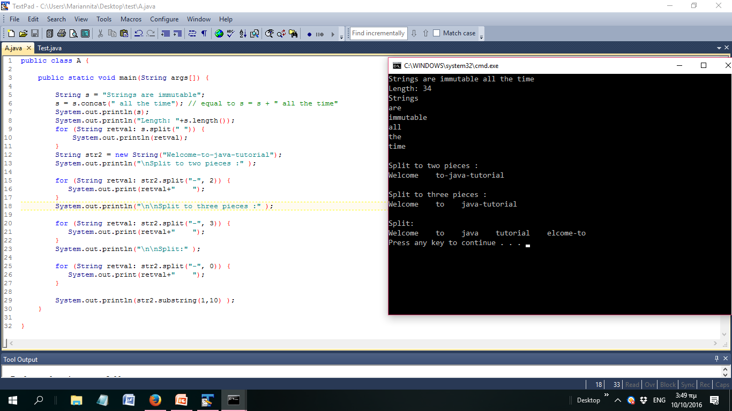
Useful String Methods (2)

Slide 47
The Arithmetic Operators (1)
Operator | Description
+ (Addition) | Adds values on either side of the operator.
- (Subtraction) | Subtracts right-hand operand from left-hand operand.
* (Multiplication) | Multiplies values on either side of the operator.
/ (Division) | Divides left-hand operand by right-hand operand.
% (Modulus) | Divides left-hand operand by right-hand operand and returns remainder.
++ (Increment) | Increases the value of operand by 1.
-- (Decrement) | Decreases the value of operand by 1.

Slide 48
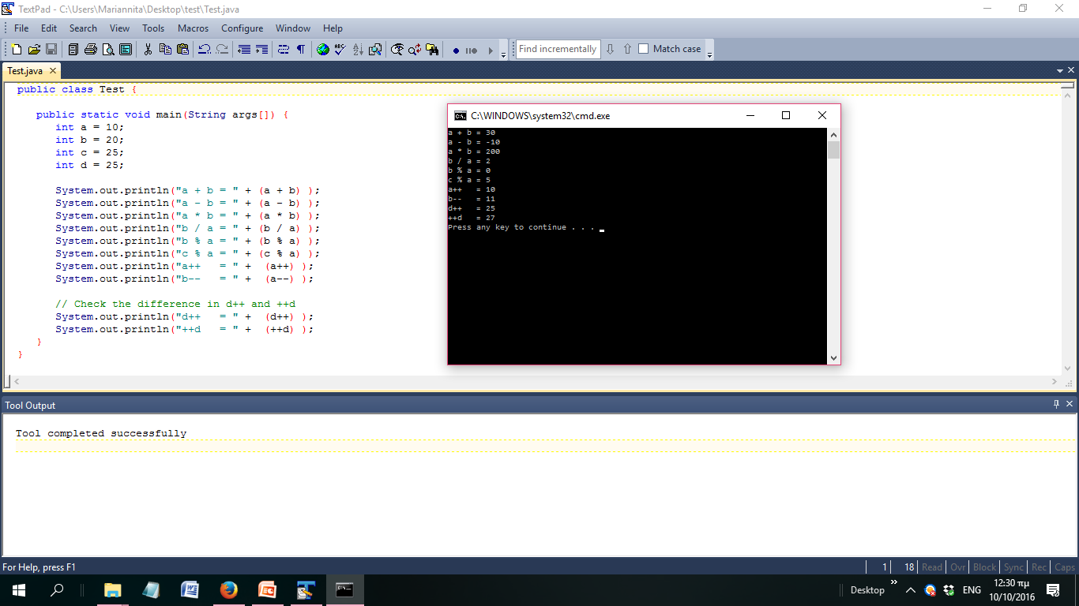
The Arithmetic Operators (2)

Slide 49
Useful Methods for Numbers (1)
Method | Explanation
parseInt() | This method is used to get the primitive data type of a certain String.
abs() | Returns the absolute value of the argument.
ceil() | Returns the smallest integer that is greater than or equal to the argument. Returned as a double.
floor() | Returns the largest integer that is less than or equal to the argument. Returned as a double.
rint() | Returns the integer that is closest in value to the argument. Returned as a double.
round() | Returns the closest long or int, as indicated by the method's return type to the argument.
min() | Returns the smaller of the two arguments.
max() | Returns the larger of the two arguments.
exp() | Returns the base of the natural logarithms, e, to the power of the argument.
log() | Returns the natural logarithm of the argument.
pow() | Returns the value of the first argument raised to the power of the second argument.

Slide 50
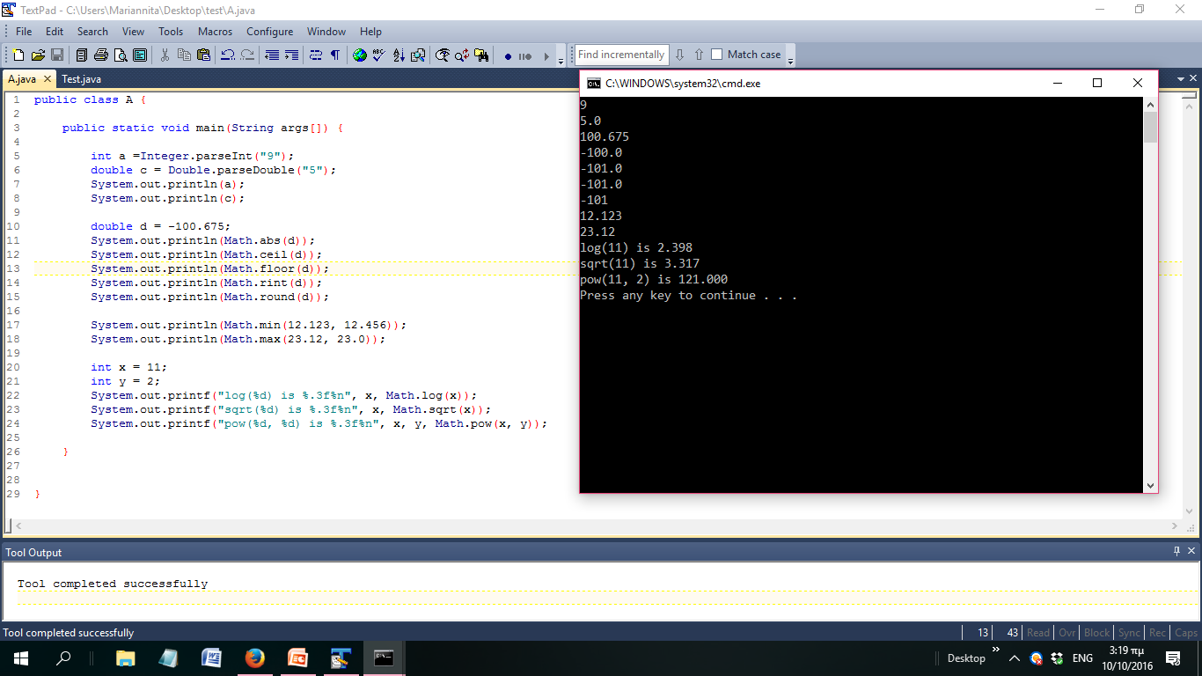
Useful Methods for Numbers (2)

Slide 51
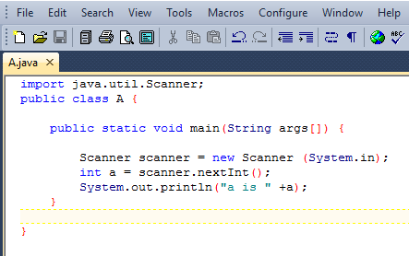
How to take input from the user
Integers: nextInt()
Double: nextDouble()
Float: nextFloat
Boolean: nextBoolean
String: nextLIne()

Slide 52
Exercises
Implement the first set of exercises from pythonTutorial1 in java

