Slide 1
Unsupervised Discovery of
Mid-Level Discriminative Patches
Research Project Master AI WS 15/16
Group 4
Salil Bhat, Ioannis Papadopoulos,
Stefan Selzer, Chang Sun

Slide 2
Outline
Motivation
Definition
Approach
Project Plan

Slide 3
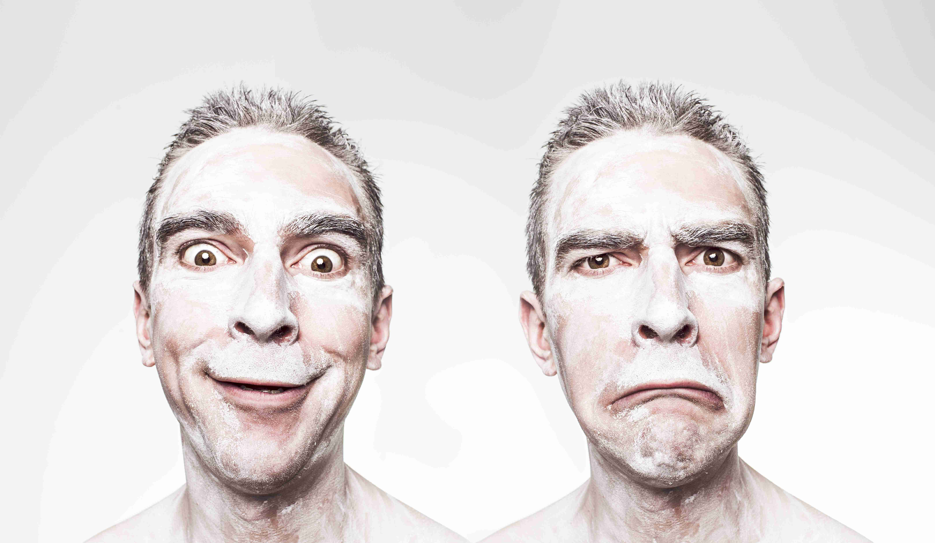
Objective
Classification of facial expressions

Slide 4
Deliverables
Extensible code
  C++
  OpenCV
Documentation

Slide 5
Mid-Level Discriminative Patch
Part of an image describing one feature
Representative
Different
Detectable with high precision

Slide 6
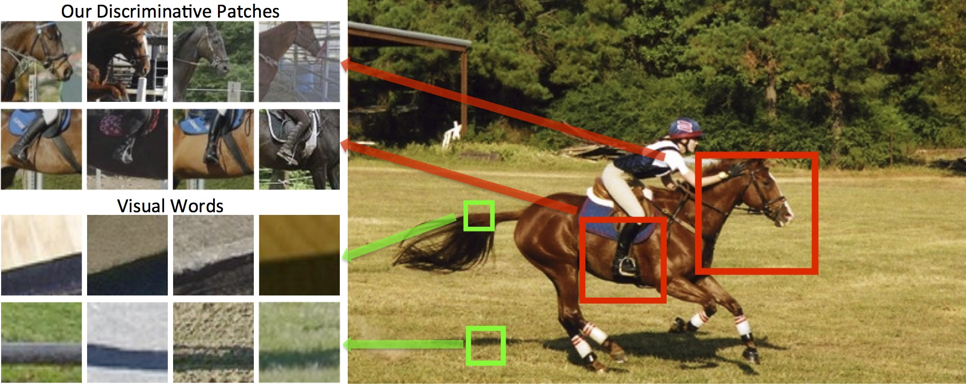
Example

Slide 7
Unsupervised Discovery
Linear Support Vector Machine
K-means clustering
Proper setup of datasets for training and validation

Slide 8
Algorithm

Slide 9
Patch Ranking
Purity : Sum of top cluster's SVM detection score
Discriminativness : Ratio of detector firings on D to union of D and N

Slide 10
Project Setup
CMake buildtool
Doxygen documentation
OpenCV version 2.4.11
Github code repository
Discussion group on facebook

Slide 11
First Steps
Familiarize with project background
Implement prototypes
  Feature extractor using Histogram of Oriented Gradients
  Clusterer using k-means
  Classifier using Support Vector Machine
Find appropriate datasets

Slide 12
Next Steps (1)
Implement
  Prototypes as modules
  Datastructures
  IO (visual debugging)
  Overall algorithm
  Supplementary methods

Slide 13
Next Steps (2)
Organize the datasets
  Categorization
  Positives / negatives
  Training / validation

Slide 14
References
Singh et al., ”Unsupervised discovery of mid-level discriminative patches.”, Computer Vision-ECCV 2012: pp 73-86. (2012)
Doersch et al. „What makes Paris look like Paris?.“ , ACM Transactions on Graphics 31, no. 4 (2012)

Slide 15
Questions ?

Slide 16
Thank you for your attention!
Stefan Selzer
s.selzer@student.maastrichtuniversity.nl

