Slide 1
Linear Support Vector Machine
Non-probabilistic binary linear classifier
Hyperplane with maximized distance to nearset data point on each side
Linearly separable problem space
Support vectors: points on margin
Supervised learning model

Slide 2
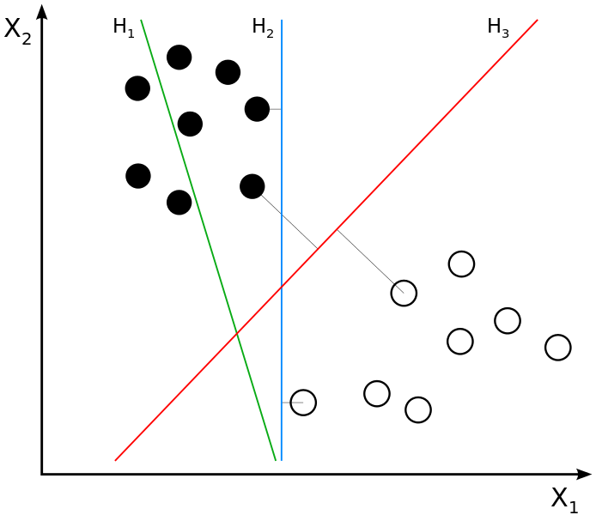
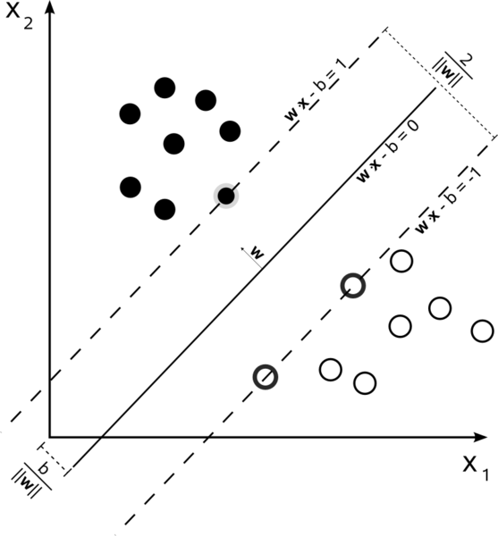
Linear Support Vector Machine Example

Slide 3
Project Usecase
One classifier for each detected patchcluster
Trained positive for one category of facial expressions
Best classifiers according to purity and discriminativness chosen
Rest discarded

Slide 4
Support Vector Machine OpenCV
Training input:
  Matrix for training data
    Rows ~ images
  Matrix for labels
    Rows ~ positive or negative
Testing output:
  label / distance
  Support vectors

Slide 5


OpenCV Prototype
Unit tests with simple images

Slide 6
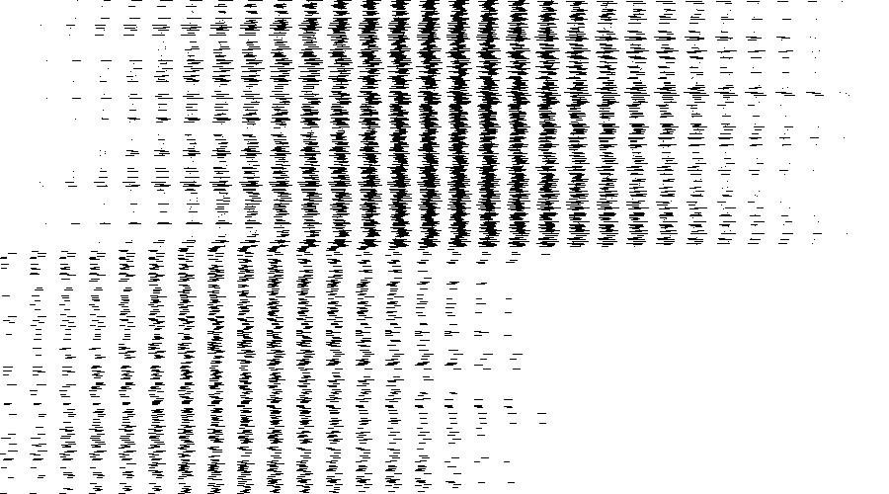
OpenCV Prototype
Setup works
Poor results

Slide 7
Project Setup
CMake build configuration for platform independent development
Doxygen configuration for in code documentation

