Slide 1
Mid-Level Discriminative Patches
Research Project Master AI Group 4
Salil Bhat, Ioannis Papadopoulos,
Stefan Selzer, Chang Sun

Slide 2
Outline
Objective
Current State
Future Work
Group 4 - Unsupervised Discovery of Mid-Level Discriminative Patches

Slide 3
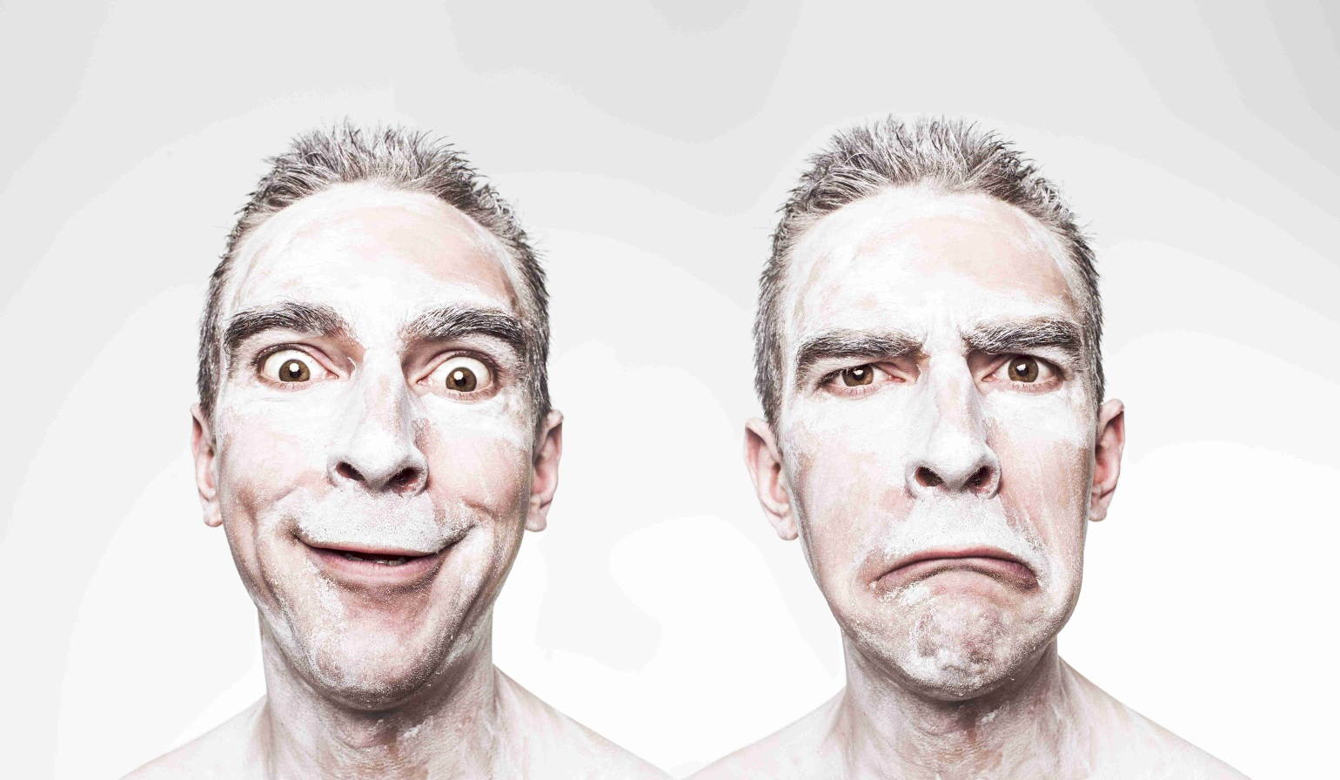
Objective
Classification of facial expressions
Group 4 - Unsupervised Discovery of Mid-Level Discriminative Patches

Slide 4
Deliverables
Suitable results on classification of facial expressions
Codebase
  Easy-to-use
  Well documented
  Extensible
Group 4 - Unsupervised Discovery of Mid-Level Discriminative Patches

Slide 5
Mid-Level Discriminative Patch
Part of an image describing one feature
Representative
Different
Detectable with high precision
Singh et al., ”Unsupervised discovery of mid-level discriminative patches.”, Computer Vision-ECCV 2012: pp 73-86. (2012)
Group 4 - Unsupervised Discovery of Mid-Level Discriminative Patches

Slide 6
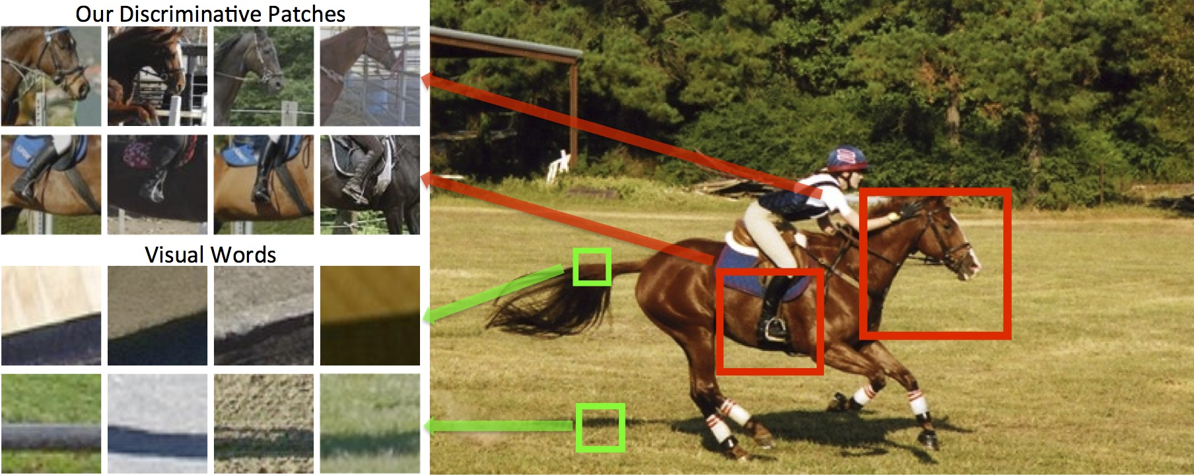
Example
Group 4 - Unsupervised Discovery of Mid-Level Discriminative Patches

Slide 7
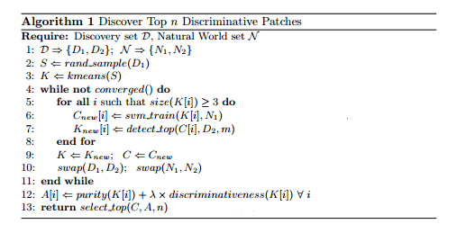
Discovery Algorithm
Group 4 - Unsupervised Discovery of Mid-Level Discriminative Patches

Slide 8
Code Setup
CMake build configuration
  Platform independent
  Automatically generates C++ compiler and linker configurations
    Makefiles
    Visual Studio Project Files
    …
Group 4 - Unsupervised Discovery of Mid-Level Discriminative Patches

Slide 9
Documentation Setup
Doxygen
  Inline code documentation
  Extended comments
  Automatically generates HTML code interface documentation
Group 4 - Unsupervised Discovery of Mid-Level Discriminative Patches

Slide 10
State of the Application
Setup of training and validation datasets
Feature extraction using OpenCV HOGDescriptor
Training and prediction through OpenCV SVM
Group 4 - Unsupervised Discovery of Mid-Level Discriminative Patches

Slide 11
Future Steps
Clustering ?
Manual extraction of perfect clusters ?
More data !
Group 4 - Unsupervised Discovery of Mid-Level Discriminative Patches

Slide 12
References
Singh et al., ”Unsupervised discovery of mid-level discriminative patches.”, Computer Vision-ECCV 2012: pp 73-86. (2012)
Doersch et al. „What makes Paris look like Paris?.“ , ACM Transactions on Graphics 31, no. 4 (2012)
Group 4 - Unsupervised Discovery of Mid-Level Discriminative Patches

Slide 13
Questions ?
Group 4 - Unsupervised Discovery of Mid-Level Discriminative Patches

Slide 14
Thank you for your attention!
Salil Bhat
Giannis Papadopoulos
Chang Sun
Stefan Selzer
s.selzer@student.maastrichtuniversity.nl
Group 4 - Unsupervised Discovery of Mid-Level Discriminative Patches

