Slide 1
Recognition of human facial expressions by mid-level discriminative patches
Research Project Master AI
Group 4
Stefan Selzer, Chang Sun
Salil Bhat, Ioannis Papadopoulos,

Slide 2
Outline
Introduction
Approach
Dataset
Experiments
Future Work
Group 4 - Unsupervised Discovery of Mid-Level Discriminative Patches

Slide 3
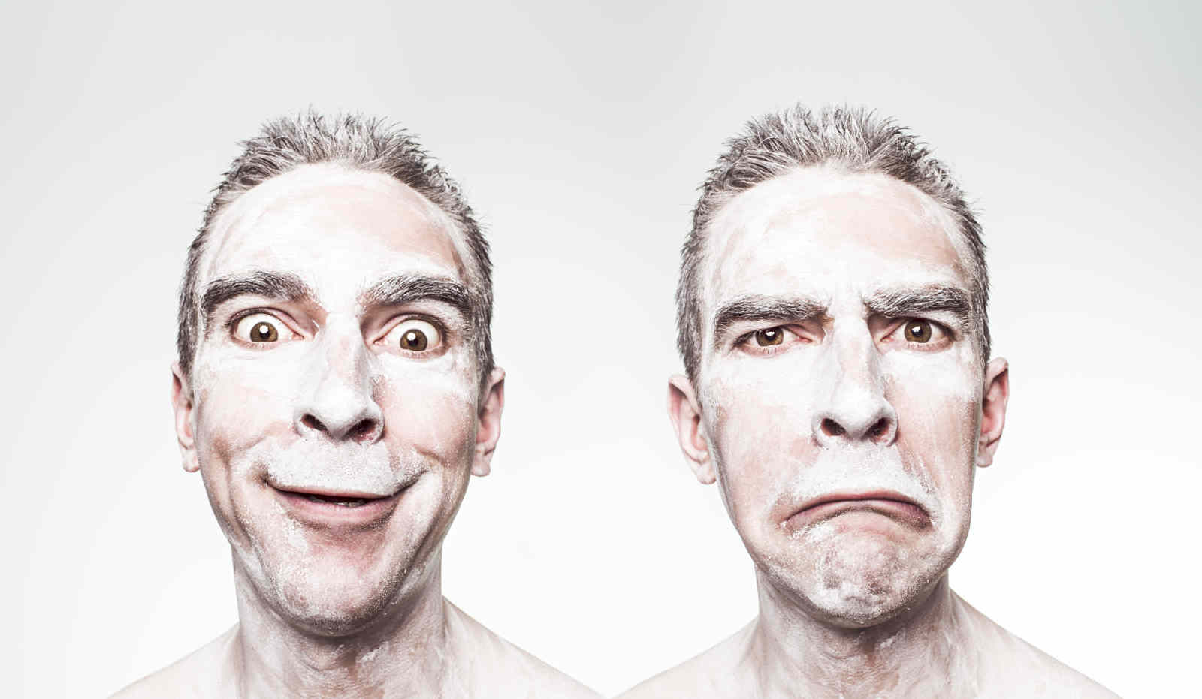
Objective
Classification of facial expressions
Group 4 - Unsupervised Discovery of Mid-Level Discriminative Patches

Slide 4
Deliverables
Extensible code
  C++
  OpenCV
Documentation
Group 4 - Unsupervised Discovery of Mid-Level Discriminative Patches

Slide 5
Mid-Level Discriminative Patch
Part of an image describing one feature
Representative
Different
Detectable with high precision
Group 4 - Unsupervised Discovery of Mid-Level Discriminative Patches

Slide 6
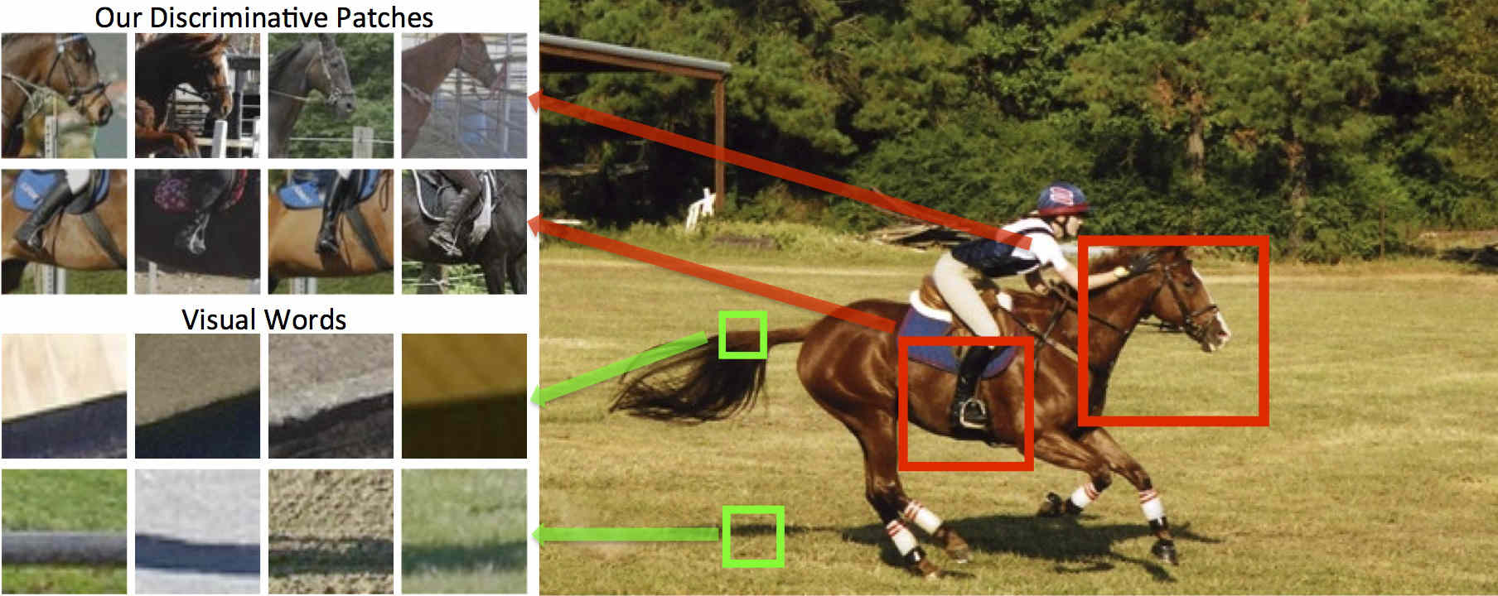
Example
Group 4 - Unsupervised Discovery of Mid-Level Discriminative Patches

Slide 7
About Dataset
Requirements:
  Focus on facial features
  Uniform size, pixel and angle.
  Kinds of participants.
Group 4 - Unsupervised Discovery of Mid-Level Discriminative Patches

Slide 8
About Dataset
Based on CK+ Dataset
5105 images of 123 adults
Images have Uniform Standard
Neutral faces & seven facial expressions
Group 4 - Unsupervised Discovery of Mid-Level Discriminative Patches

Slide 9
Emotion Label
Neutral + Seven Emotions :
Neutral Anger
Contempt Disgust
Fear Happy
Sadness Surprise
Group 4 - Unsupervised Discovery of Mid-Level Discriminative Patches

Slide 10
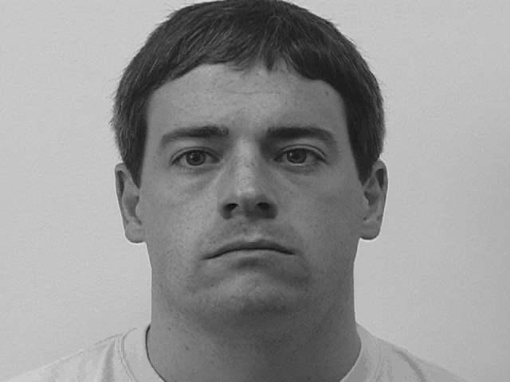
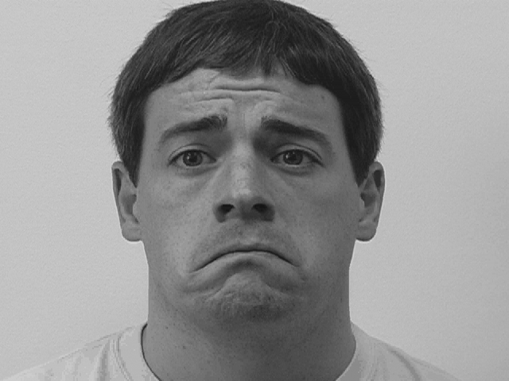
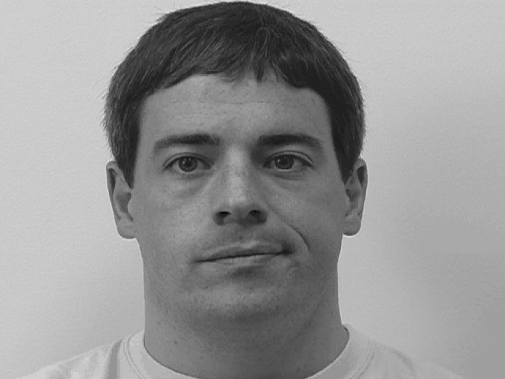
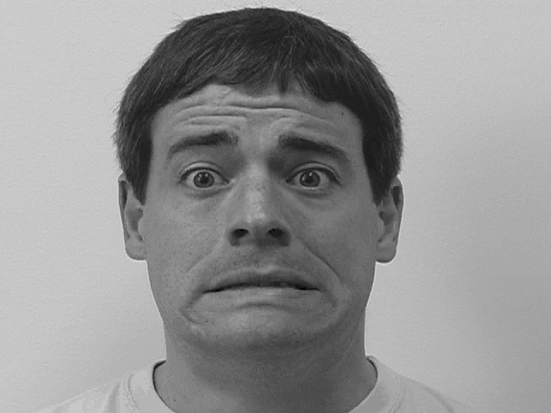
Neutrall
Sadness
Contempt
Fear
Group 4 - Unsupervised Discovery of Mid-Level Discriminative Patches

Slide 11
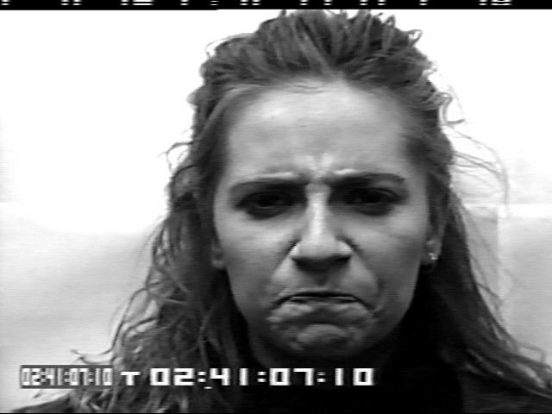
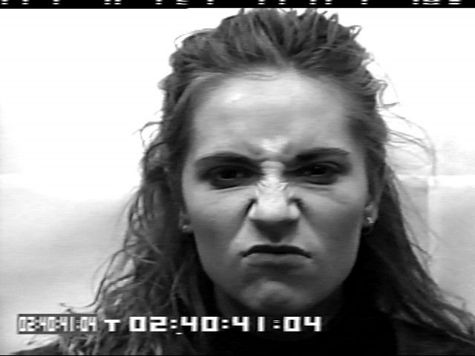
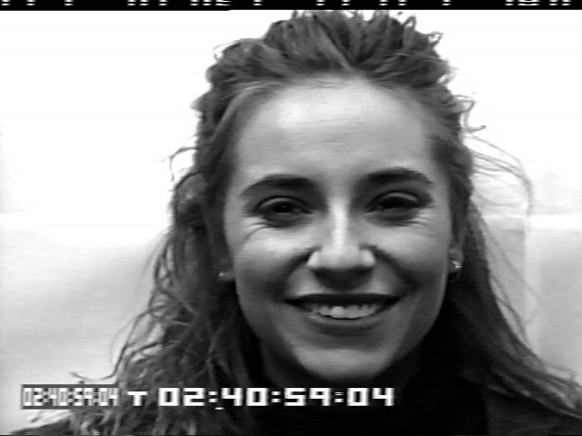
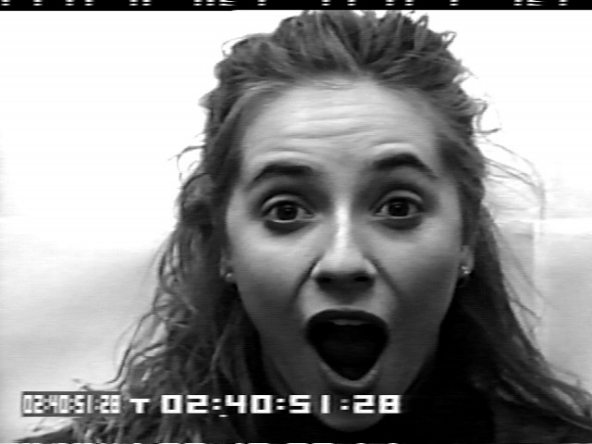
Angry
Disgust
Happy
Surprise
Group 4 - Unsupervised Discovery of Mid-Level Discriminative Patches

Slide 12
Ratio of Correct Detection
Mouth Patches
 | 32*32 | 64*64 | 96*96
Angry | 0.7782 | 0.8064 | 0.797
Contempt | 0.6170 | 0.6598 | 0.6702
Disgust | 0.6918 | 0.7953 | 0.8039
Fear | 0.7510 | 0.8287 | 0.8307
Happy | 0.8959 | 0.9121 | 0.9154
Neutral | 0.7974 | 0.8577 | 0.8501
Sadness | 0.8589 | 0.8651 | 0.8693
Surprise | 0.8975 | 0.8970 | 0.8963
Group 4 - Unsupervised Discovery of Mid-Level Discriminative Patches

Slide 13
Ratio of Correct Detection
Patches of the part between eyes
 | 32*32 | 64*64 | 96*96
Angry | 0.7971 | 0.812 | 0.7857
Contempt | 0.4468 | 0.4574 | 0.4681
Disgust | 0.6983 | 0.7155 | 0.7306
Fear | 0.7071 | 0.7649 | 0.7351
Happy | 0.8503 | 0.8503 | 0.8329
Neutral | 0.7438 | 0.7845 | 0.7921
Sadness | 0.7324 | 0.7697 | 0.7635
Surprise | 0.7317 | 0.7485 | 0.7165
Group 4 - Unsupervised Discovery of Mid-Level Discriminative Patches

Slide 14
Ratio of Correct Detection
Left-eye Patches
 | 32*32 | 64*64 | 96*96
Angry | 0.5865 | 0.6786 | 0.7068
Contempt | 0.6596 | 0.5745 | 0.5532
Disgust | 0.7629 | 0.7629 | 0.7716
Fear | 0.6096 | 0.6295 | 0.6394
Happy | 0.6074 | 0.6605 | 0.6529
Neutral | 0.6802 | 0.6996 | 0.7093
Sadness | 0.5207 | 0.5041 | 0.5021
Surprise | 0.7652 | 0.7683 | 0.7561
Group 4 - Unsupervised Discovery of Mid-Level Discriminative Patches

Slide 15
Ratio of Correct Detection
Right-eye Patches
 | 32*32 | 64*64 | 96*96
Angry | 0.5733 | 0.6466 | 0.6654
Contempt | 0.5638 | 0.5106 | 0.617
Disgust | 0.7177 | 0.7414 | 0.7155
Fear | 0.6414 | 0.6076 | 0.6096
Happy | 0.6367 | 0.6334 | 0.6833
Neutral | 0.7099 | 0.7272 | 0.7383
Sadness | 0.5 | 0.5207 | 0.5456
Surprise | 0.7896 | 0.8171 | 0.8079
Group 4 - Unsupervised Discovery of Mid-Level Discriminative Patches

Slide 16
Ratio of Correct Detection
Facial Region
 | 32*32 | 64*64 | 96*96
Angry | 0.6165 | 0.6316 | 0.6297
Contempt | 0.4894 | 0.5000 | 0.4043
Disgust | 0.7109 | 0.8793 | 0.9267
Fear | 0.3540 | 0.6574 | 0.6056
Happy | 0.808 | 0.9317 | 0.9360
Neutral | 0.7203 | 0.8260 | 0.8225
Sadness | 0.5996 | 0.5830 | 0.6432
Surprise | 0.8765 | 0.9405 | 0.9665
Group 4 - Unsupervised Discovery of Mid-Level Discriminative Patches

Slide 17
Result of Prediction of Aligned Patches
Mouth Patches
Time | Angry | Disgust | Fear | Happy | Sadness | Surprise
1 | neutral | neutral | contempt | neutral | neutral | neutral
2 | neutral | neutral | neutral | neutral | neutral | neutral
3 | neutral | neutral | neutral | neutral | neutral | neutral
4 | neutral | disgust | neutral | disgust | neutral | neutral
5 | neutral | neutral | neutral | happy | neutral | neutral
6 | neutral | neutral | disgust | happy | neutral | disgust
7 | neutral | disgust | fear | happy | neutral | surprise
8 | neutral | disgust | fear | happy | neutral | surprise
9 | neutral | disgust | fear | happy | sadness | surprise
10 | contempt | disgust | fear | happy | sadness | surprise
11 | neutral | disgust | fear | happy | sadness | surprise
12 | contempt | disgust | fear | happy | sadness | surprise
Group 4 - Unsupervised Discovery of Mid-Level Discriminative Patches

Slide 18
Result of Prediction of Unaligned Patches
For Surprise Emotion
Patch | Left Eye | Right Eye | Mouth | Part bewteen Eyes
1 | fear | disgust | surprise | sadness
2 | fear | fear | disgust | sadness
3 | disgust | surprise | happy | neutral
4 | surprise | disgust | happy | neutral
5 | fear | fear | disgust | disgust
6 | disgust | fear | sadness | surprise
7 | disgust | surprise | sadness | surprise
8 | fear | sadness | disgust | disgust
9 | surprise | angry | surprise | surprise
10 | surprise | angry | disgust | surprise
Group 4 - Unsupervised Discovery of Mid-Level Discriminative Patches

Slide 19
References
Singh et al., ”Unsupervised discovery of mid-level discriminative patches.”, Computer Vision-ECCV 2012: pp 73-86. (2012)
Doersch et al. „What makes Paris look like Paris?.“ , ACM Transactions on Graphics 31, no. 4 (2012)
Group 4 - Unsupervised Discovery of Mid-Level Discriminative Patches

Slide 20
Questions ?
Group 4 - Unsupervised Discovery of Mid-Level Discriminative Patches

Slide 21
Thank you for your attention!
s.selzer@student.maastrichtuniversity.nl
i.papadopoulos@student.maastrichtuniversity.nl
c.sun@student.maastrichtuniversity.nl
s.baht@student.maastrichtuniversity.nl
Group 4 - Unsupervised Discovery of Mid-Level Discriminative Patches

