Slide 1
Unsupervised Discovery of
Mid-Level Discriminative Patches
Research Project Master AI WS 15/16
Group 4
Salil Bhat, Ioannis Papadopoulos,
Stefan Selzer, Chang Sun

Slide 2
Outline
Motivation
Definition
Approach
Current state
Next steps

Slide 3
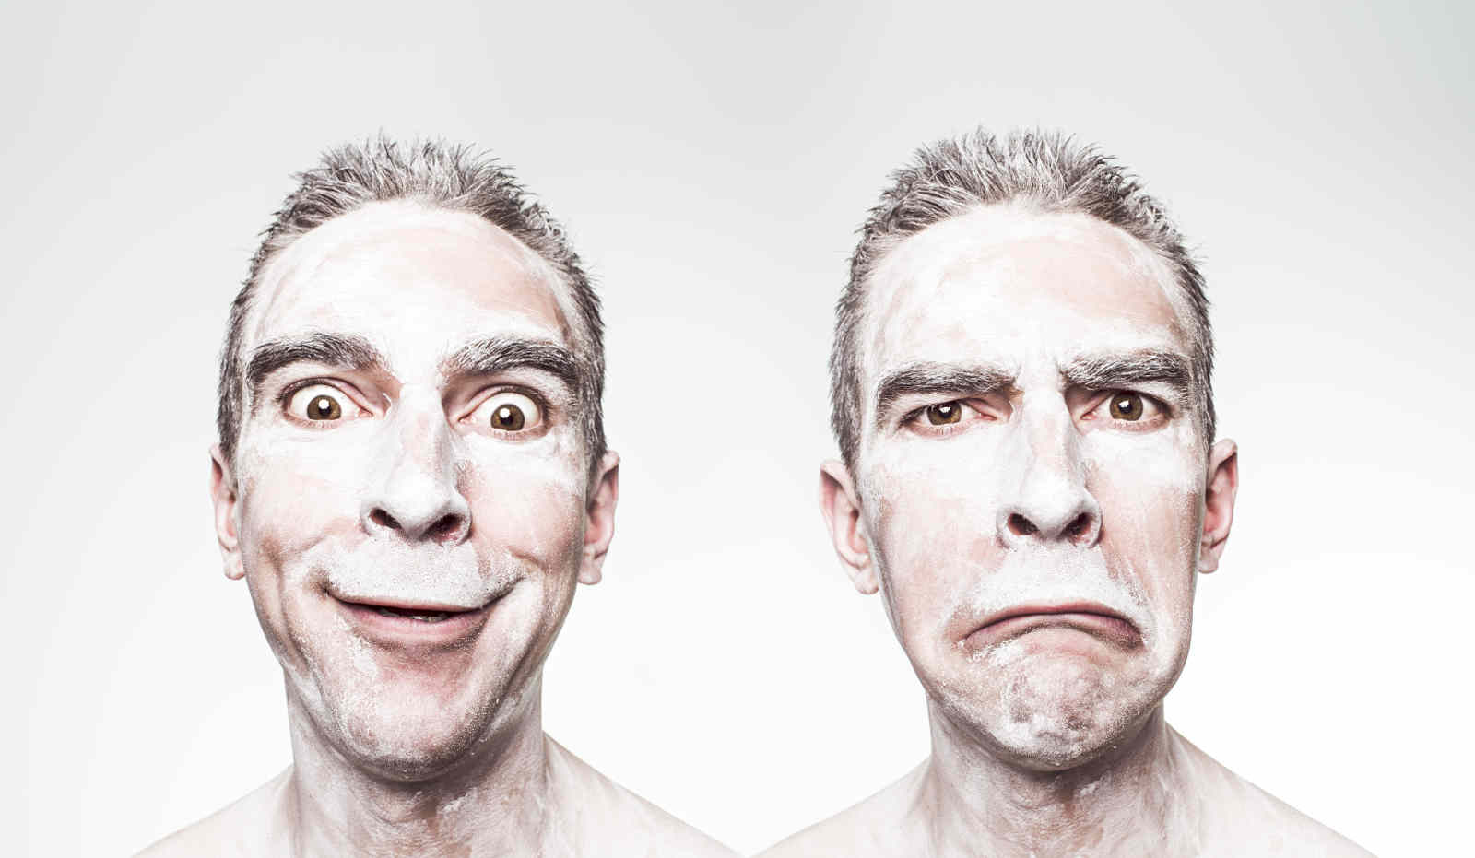
Objective
Classification of facial expressions

Slide 4
Deliverables
Extensible code
  C++
  OpenCV
Documentation

Slide 5
Mid-Level Discriminative Patch
Part of an image describing one feature
Representative
Different
Detectable with high precision

Slide 6
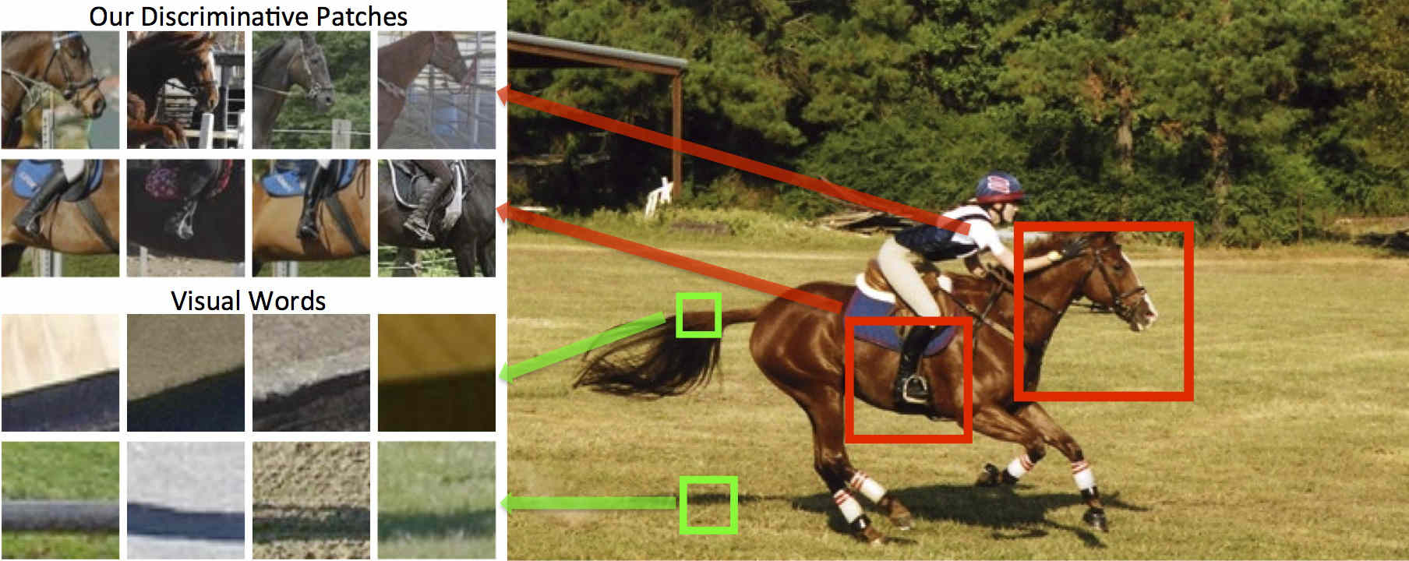
Example

Slide 7
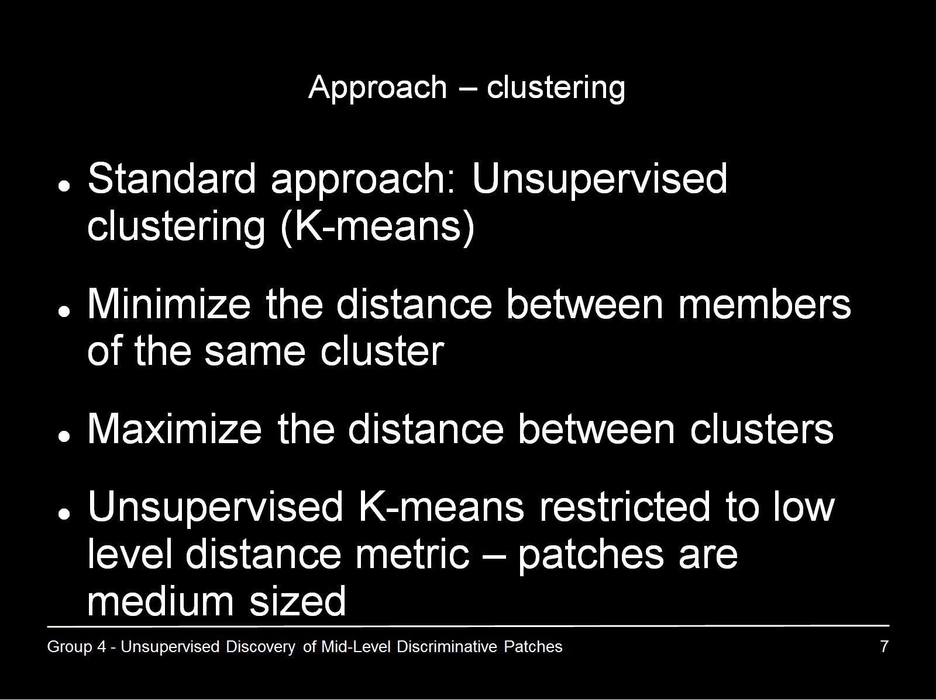
Approach – clustering

Slide 8
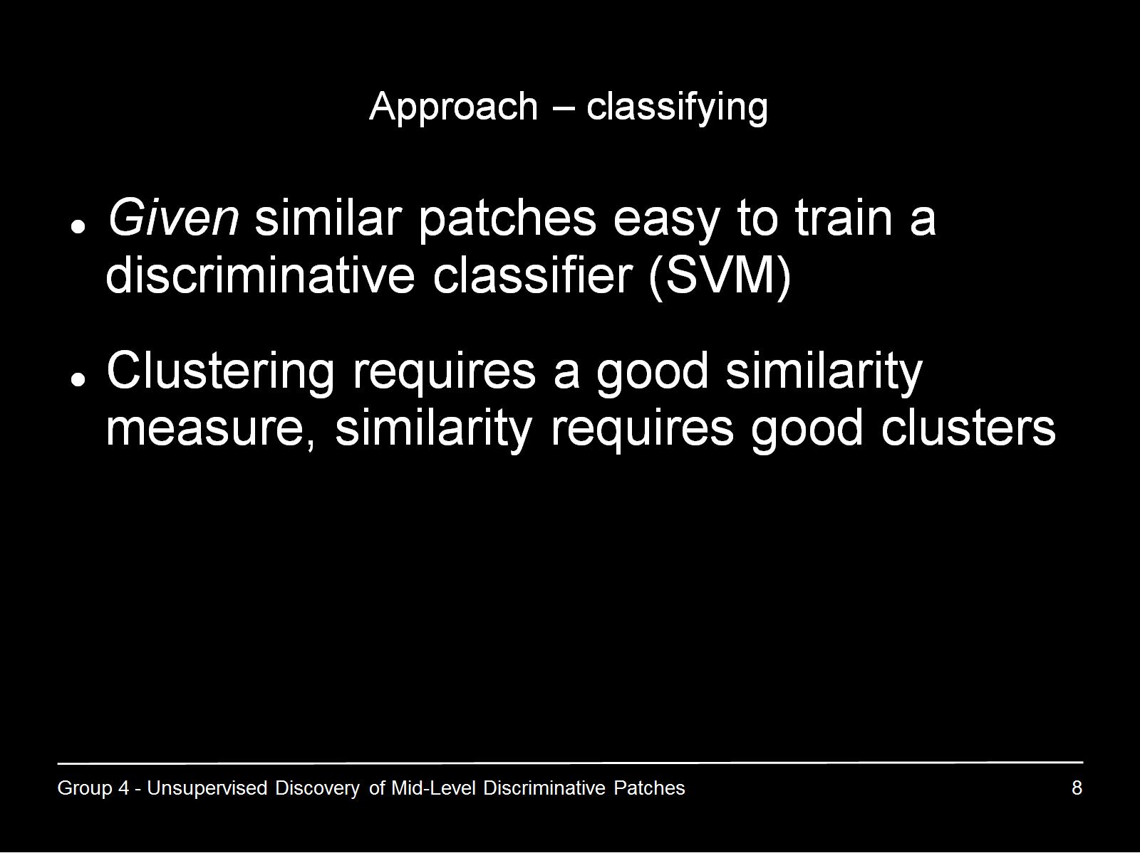
Approach – classifying

Slide 9
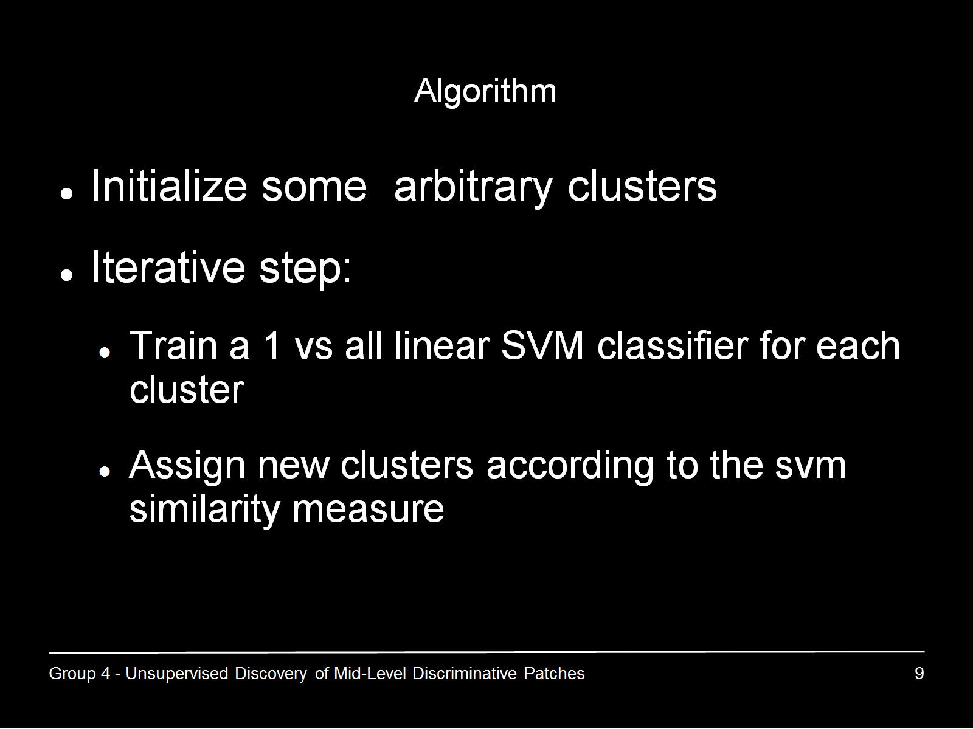
Algorithm

Slide 10
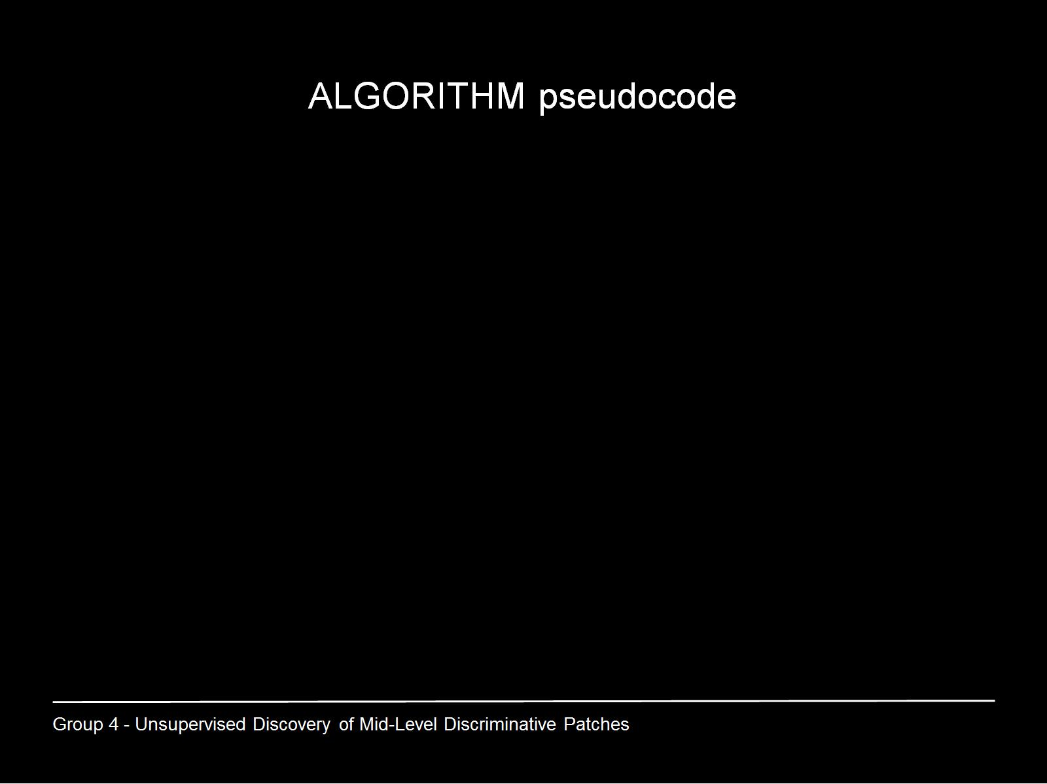
ALGORITHM pseudocode

Slide 11
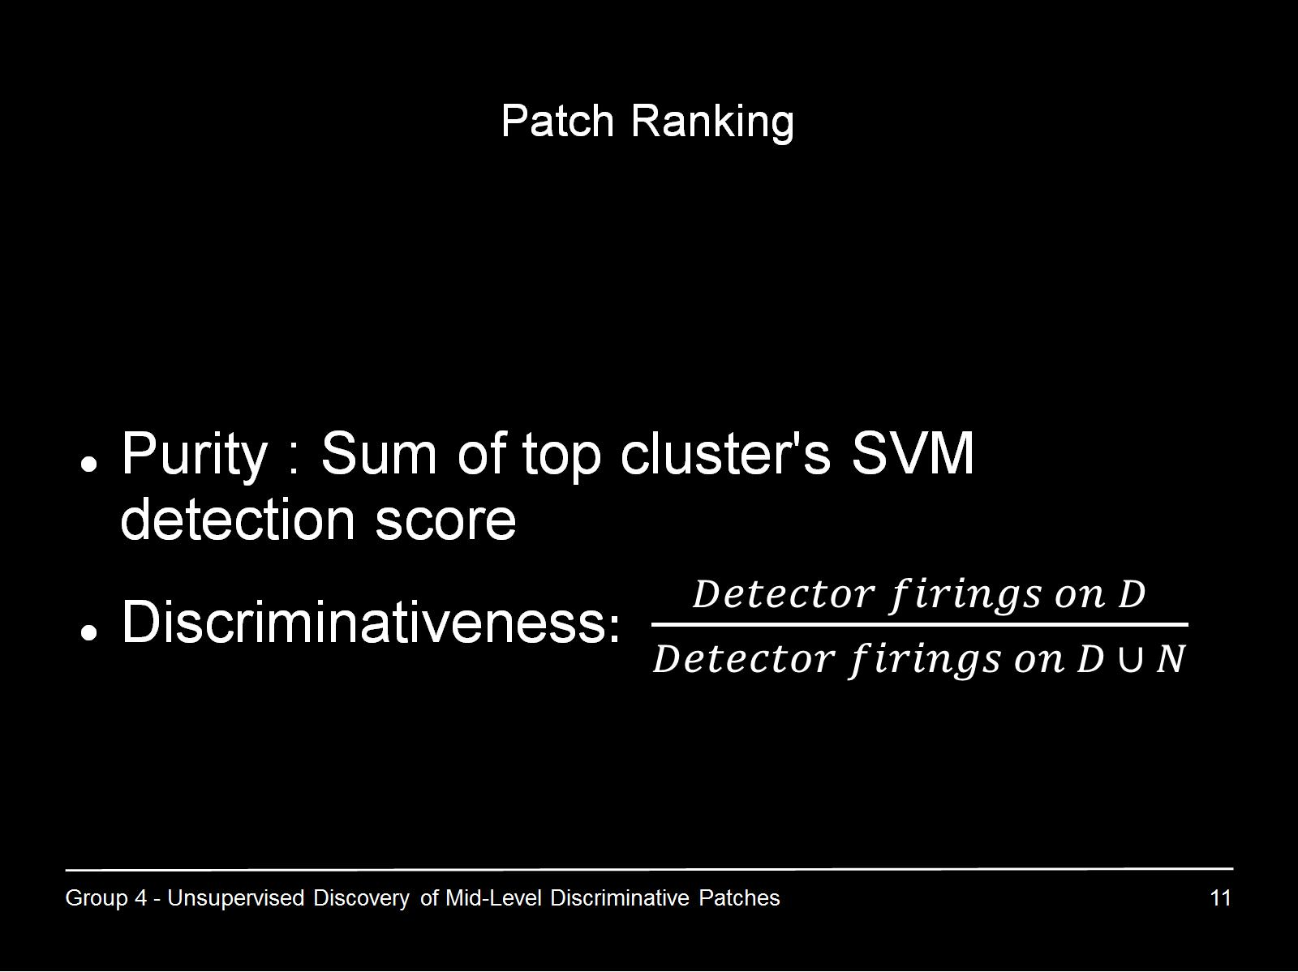
Patch Ranking

Slide 12
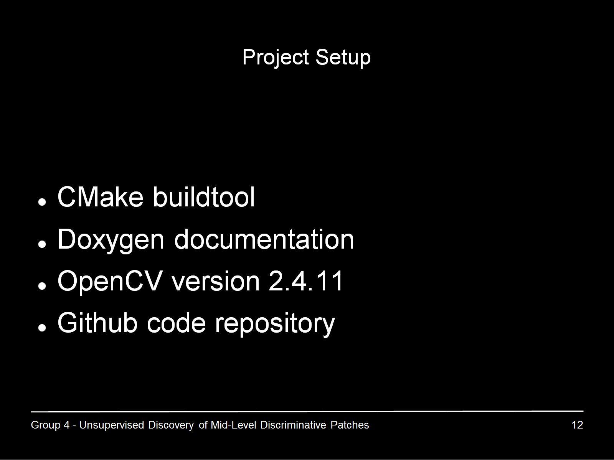
Project Setup

Slide 13
Progress so far
Familiarize with project background
Implement prototypes
  Feature extractor using Histogram of Oriented Gradients
  Clusterer using k-means
  Classifier using Support Vector Machine
Find appropriate datasets

Slide 14
About Dataset
Task: Find/Create/Annotate the proper dataset
Requirements:
  Focus on facial features
  Uniform size, pixel, lighting and angle.
  Different expressions of one person.

Slide 15
About Dataset
Based on CK+ Dataset
561 images of 123 adults (B&W, Color)
Images have Uniform Standard
Neutral faces & seven facial expressions

Slide 16
Emotion Label
0 Neutral 1 Anger
2 Contempt 3 Disgust
4 Fear 5 Happy
6 Sadness 7 Surprise

Slide 17
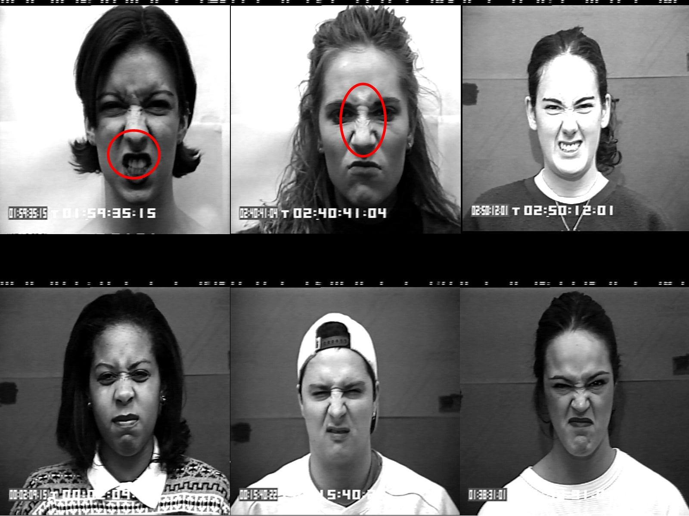

Slide 18
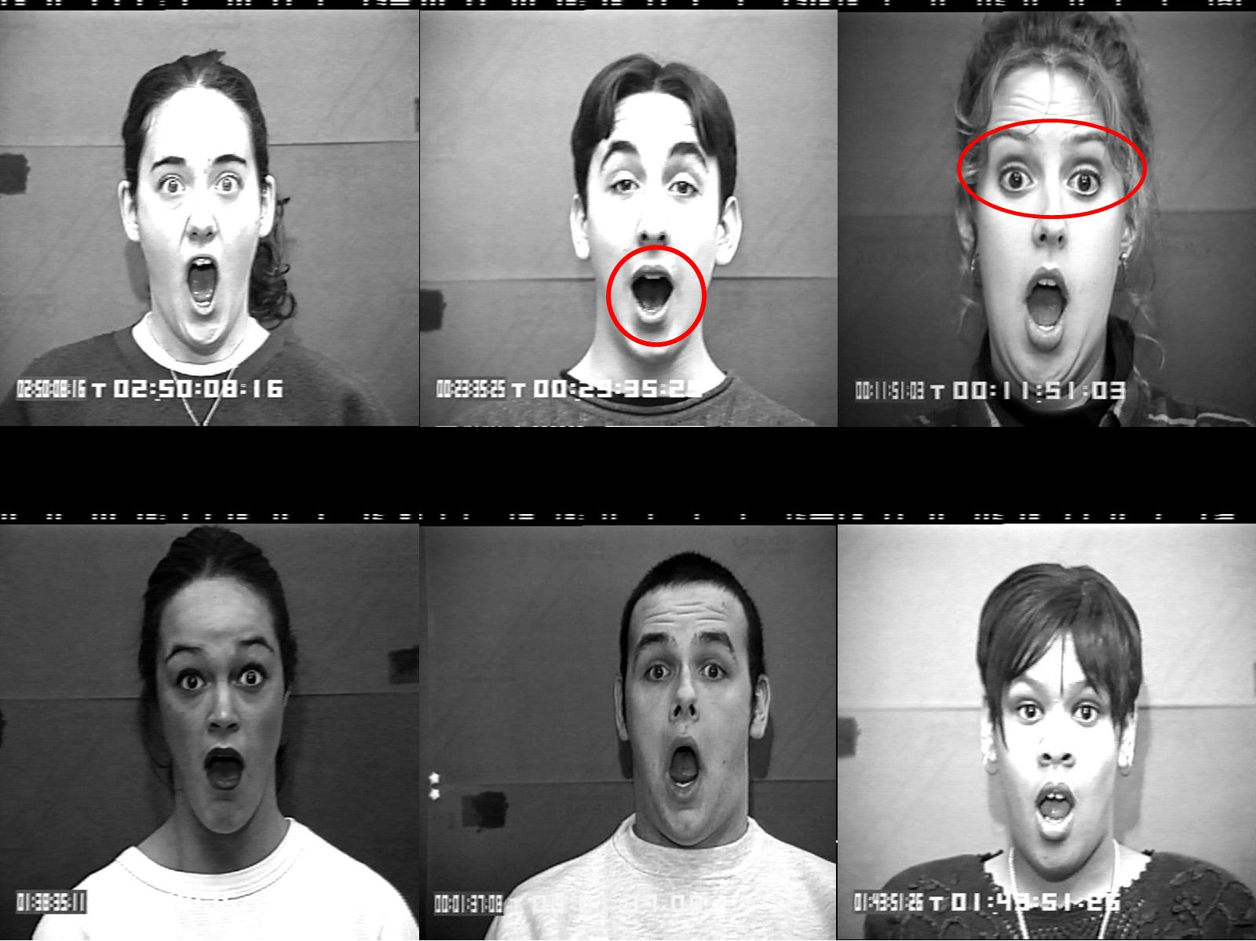

Slide 19
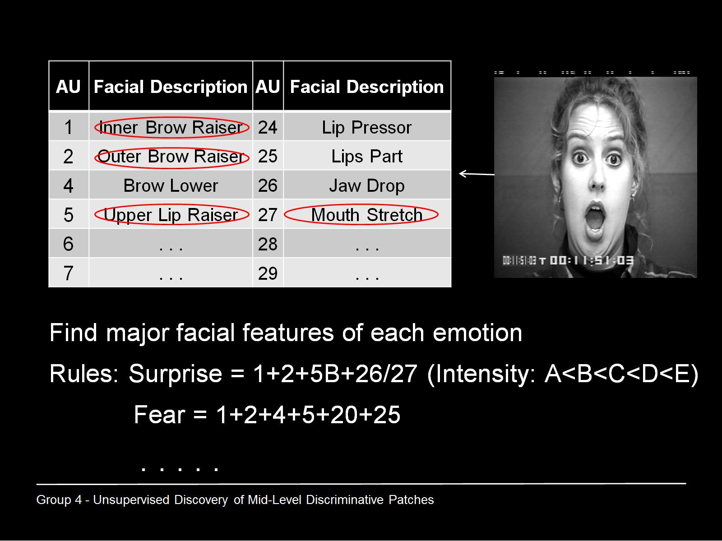

Slide 20
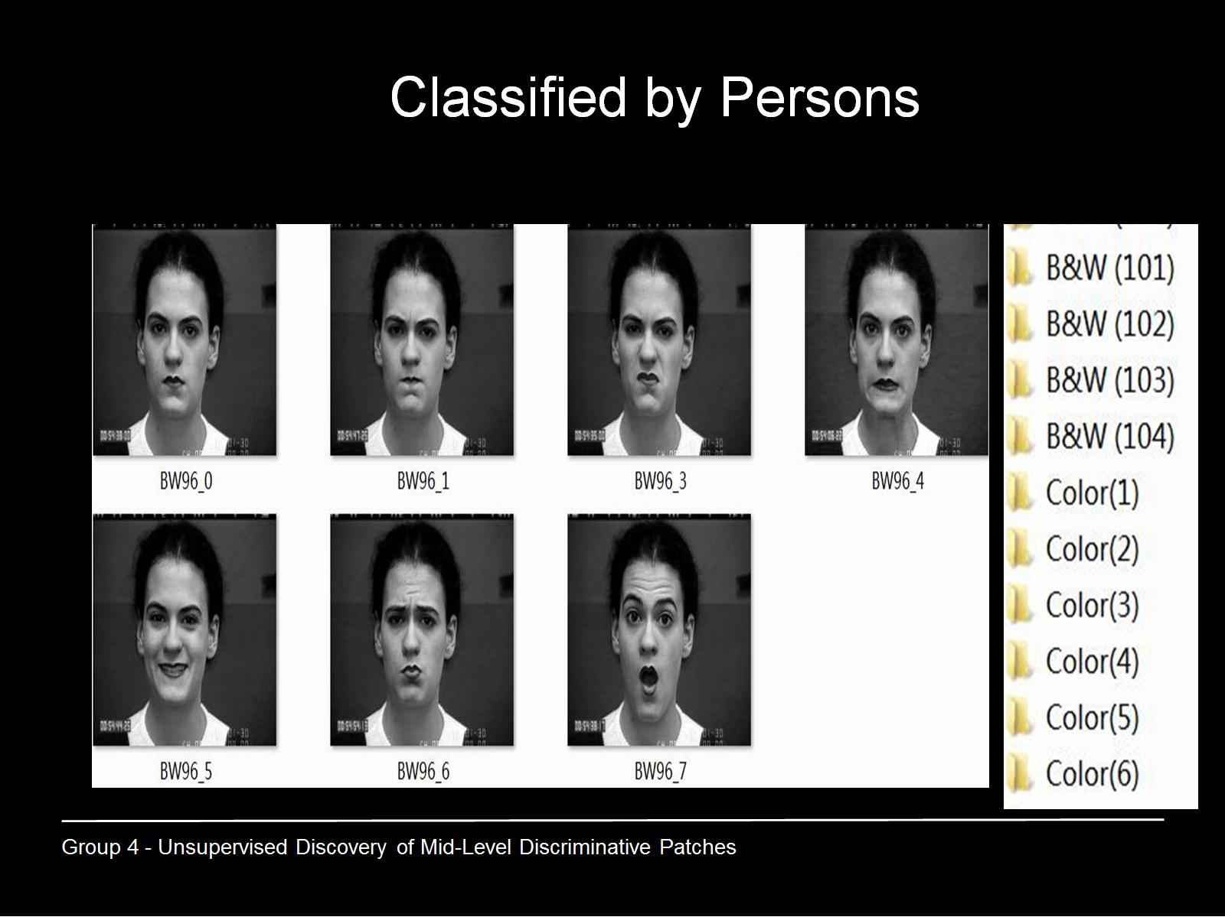
Classified by Persons

Slide 21
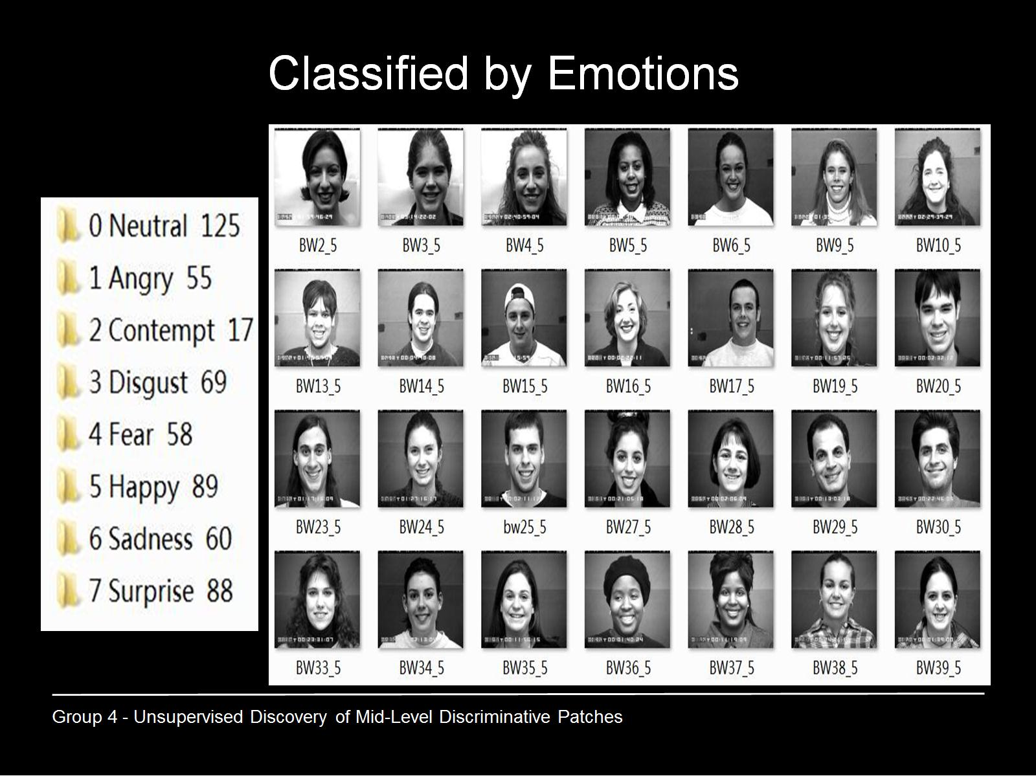
Classified by Emotions

Slide 22
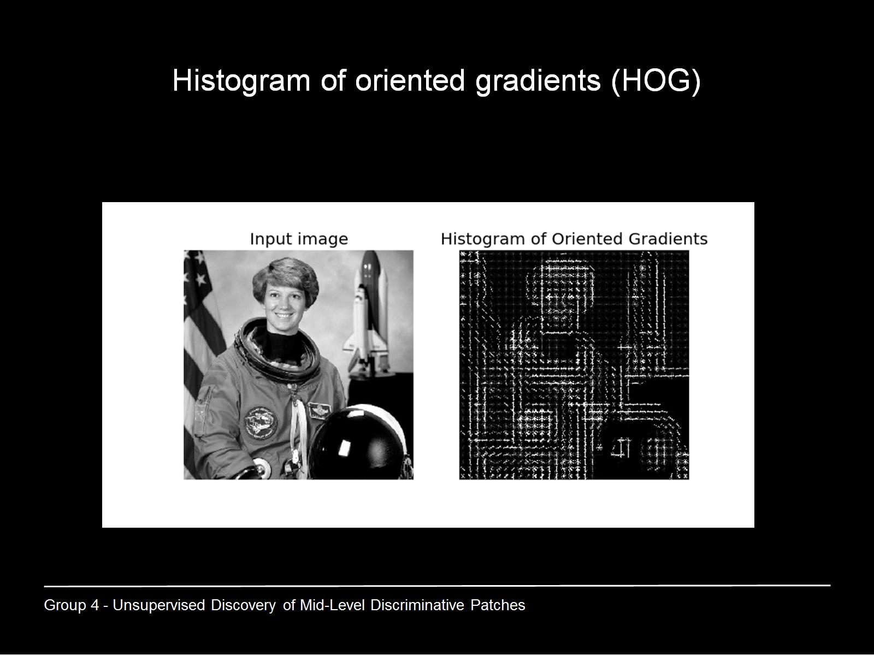
Histogram of oriented gradients (HOG)

Slide 23
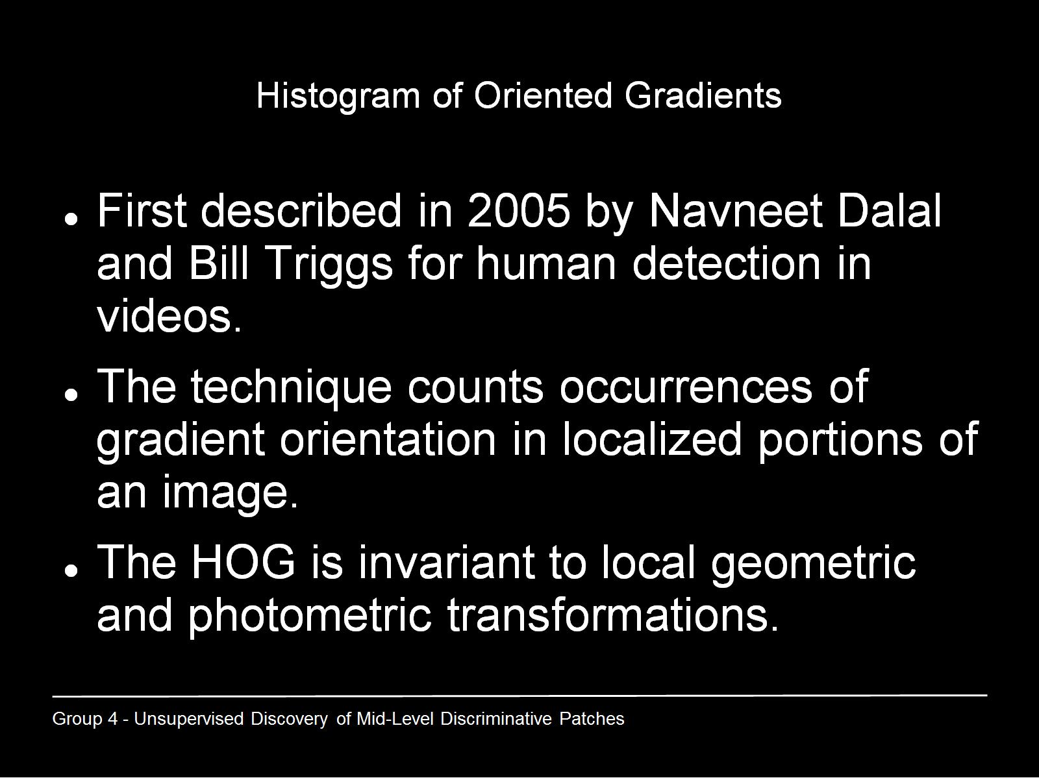
Histogram of Oriented Gradients

Slide 24
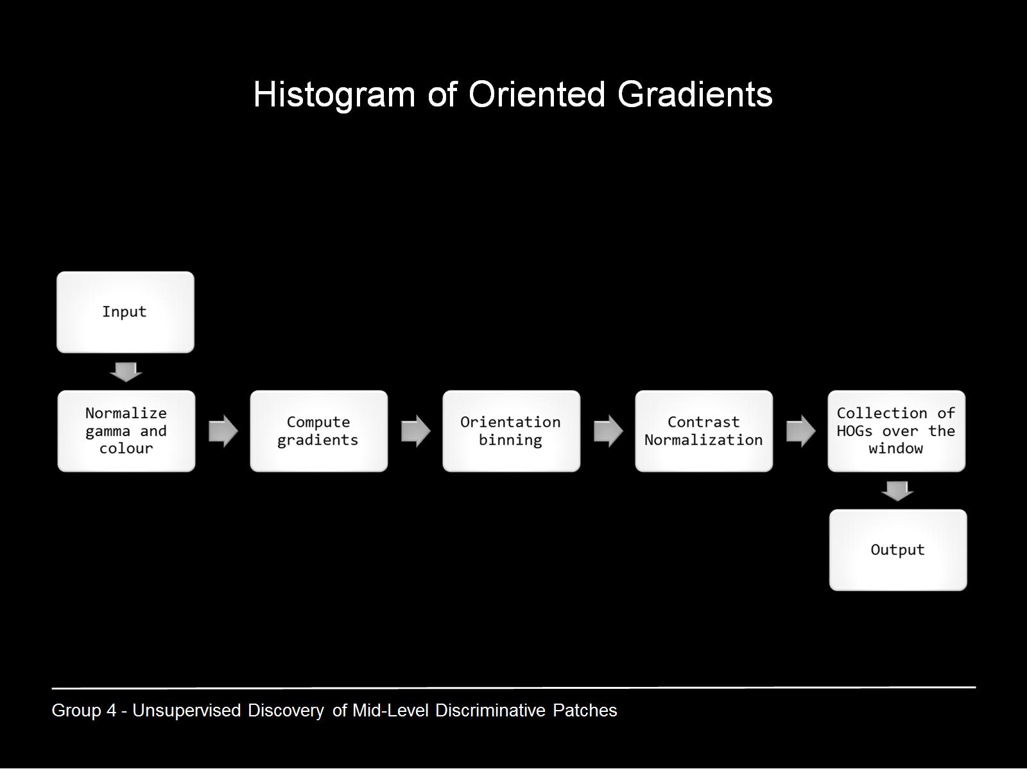
Histogram of Oriented Gradients

Slide 25
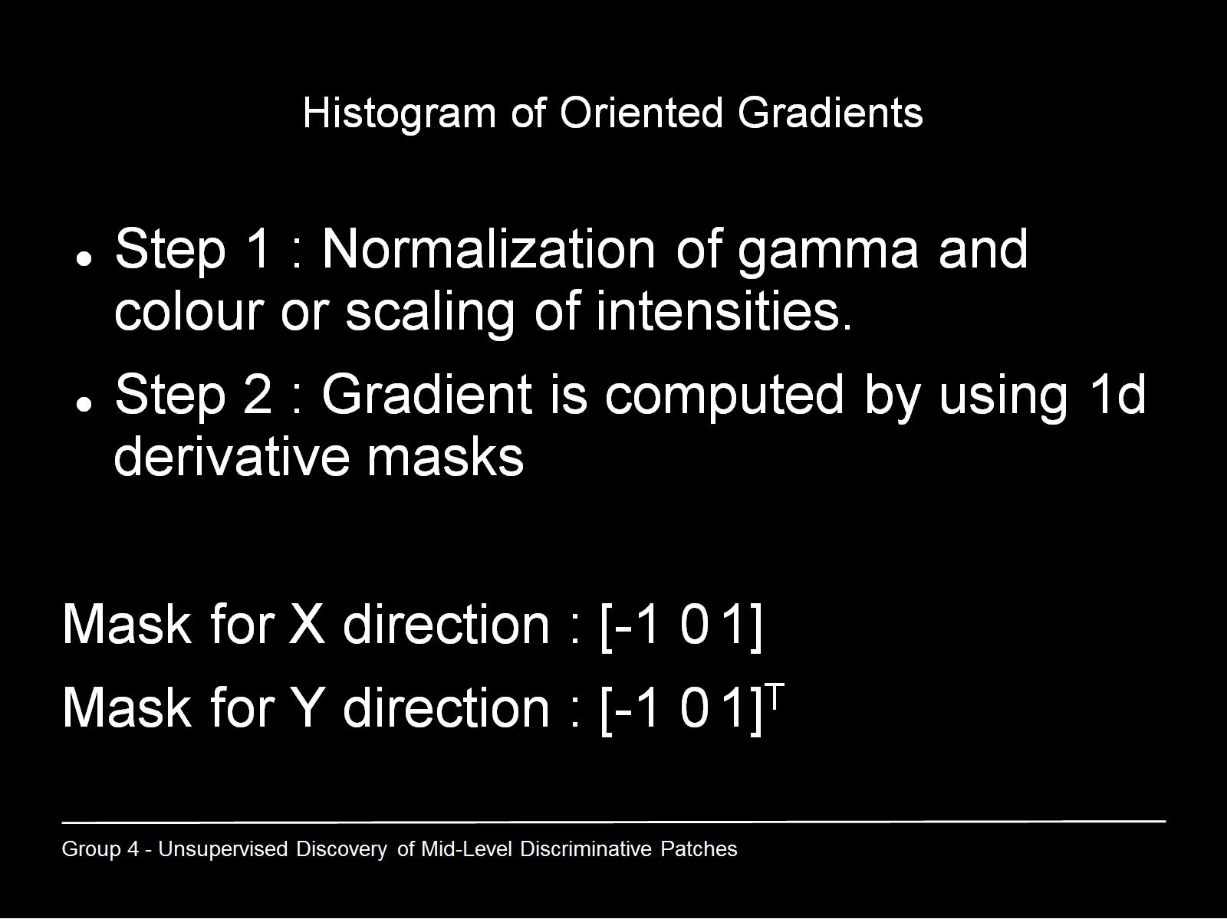
Histogram of Oriented Gradients

Slide 26
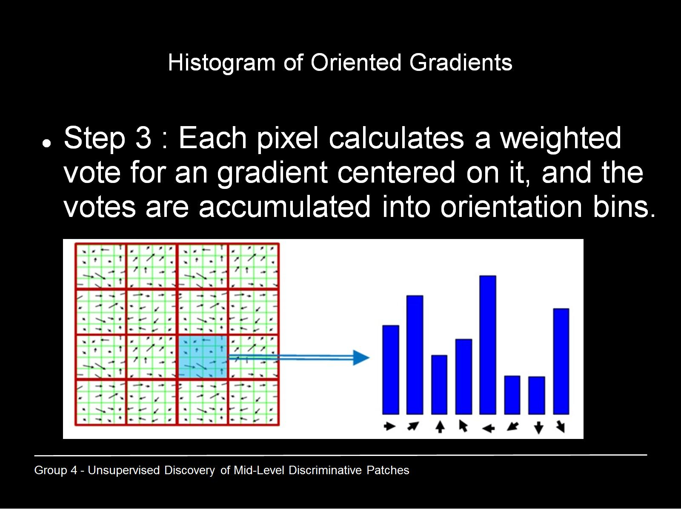
Histogram of Oriented Gradients

Slide 27
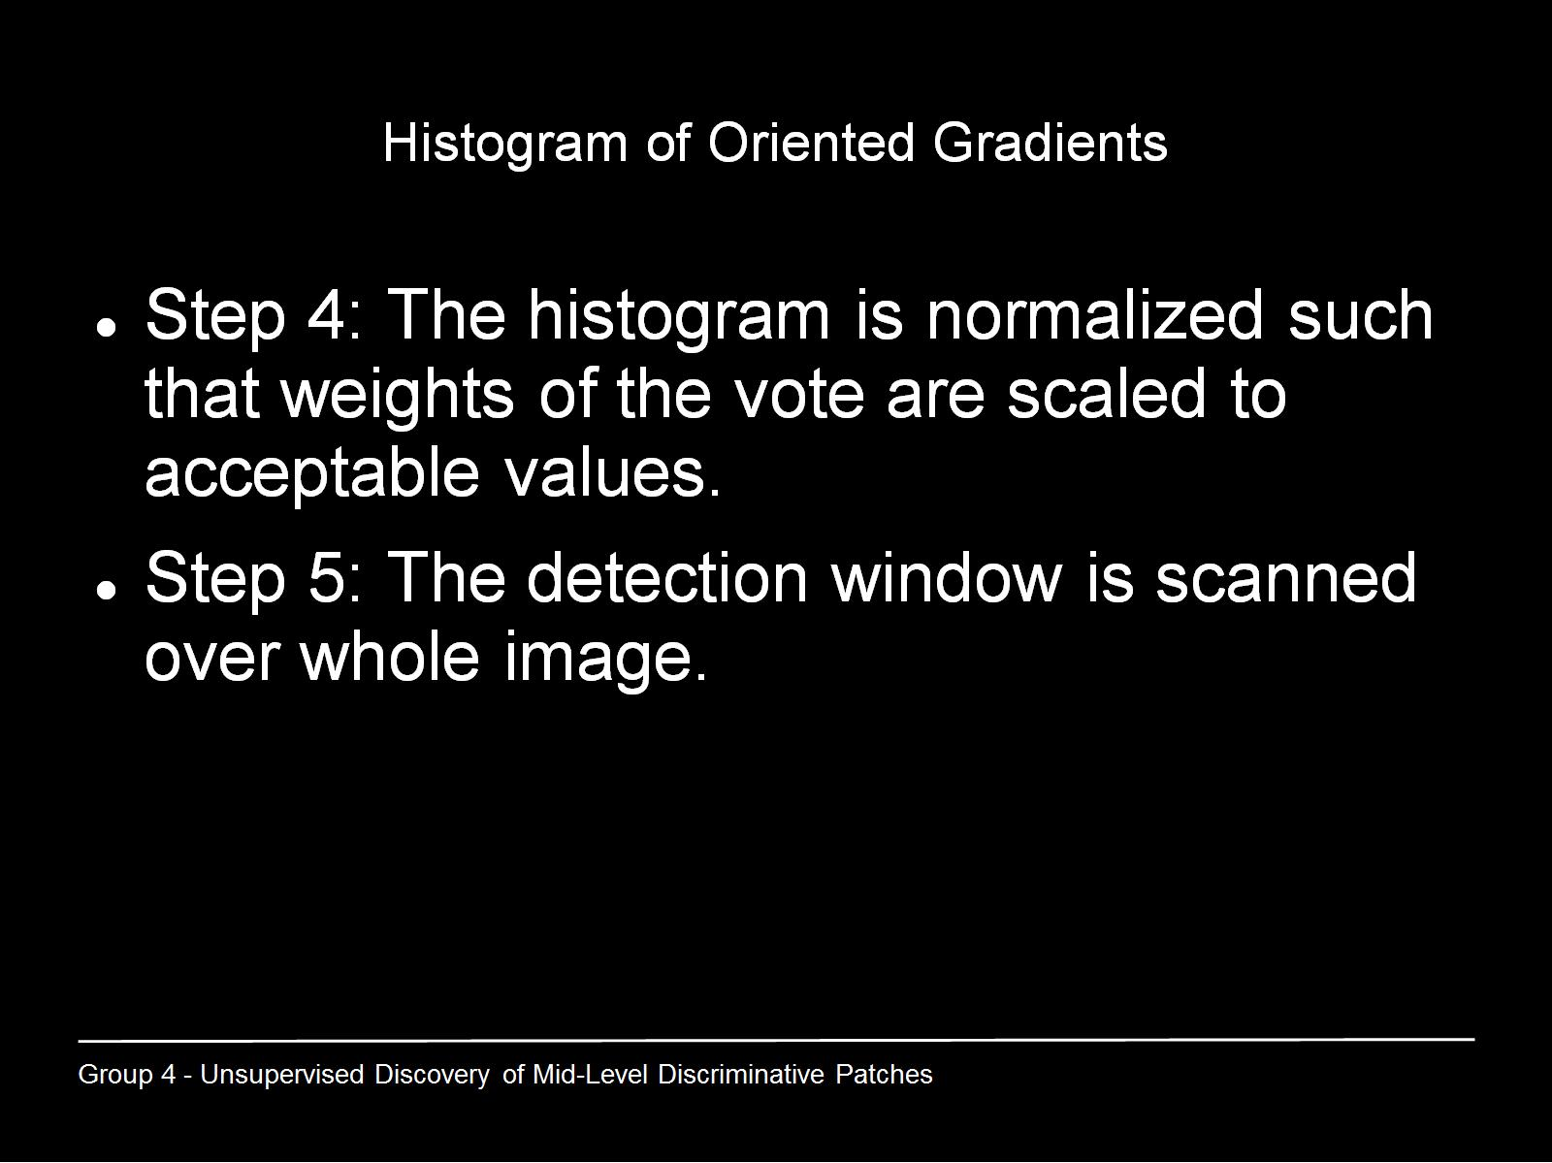
Histogram of Oriented Gradients

Slide 28
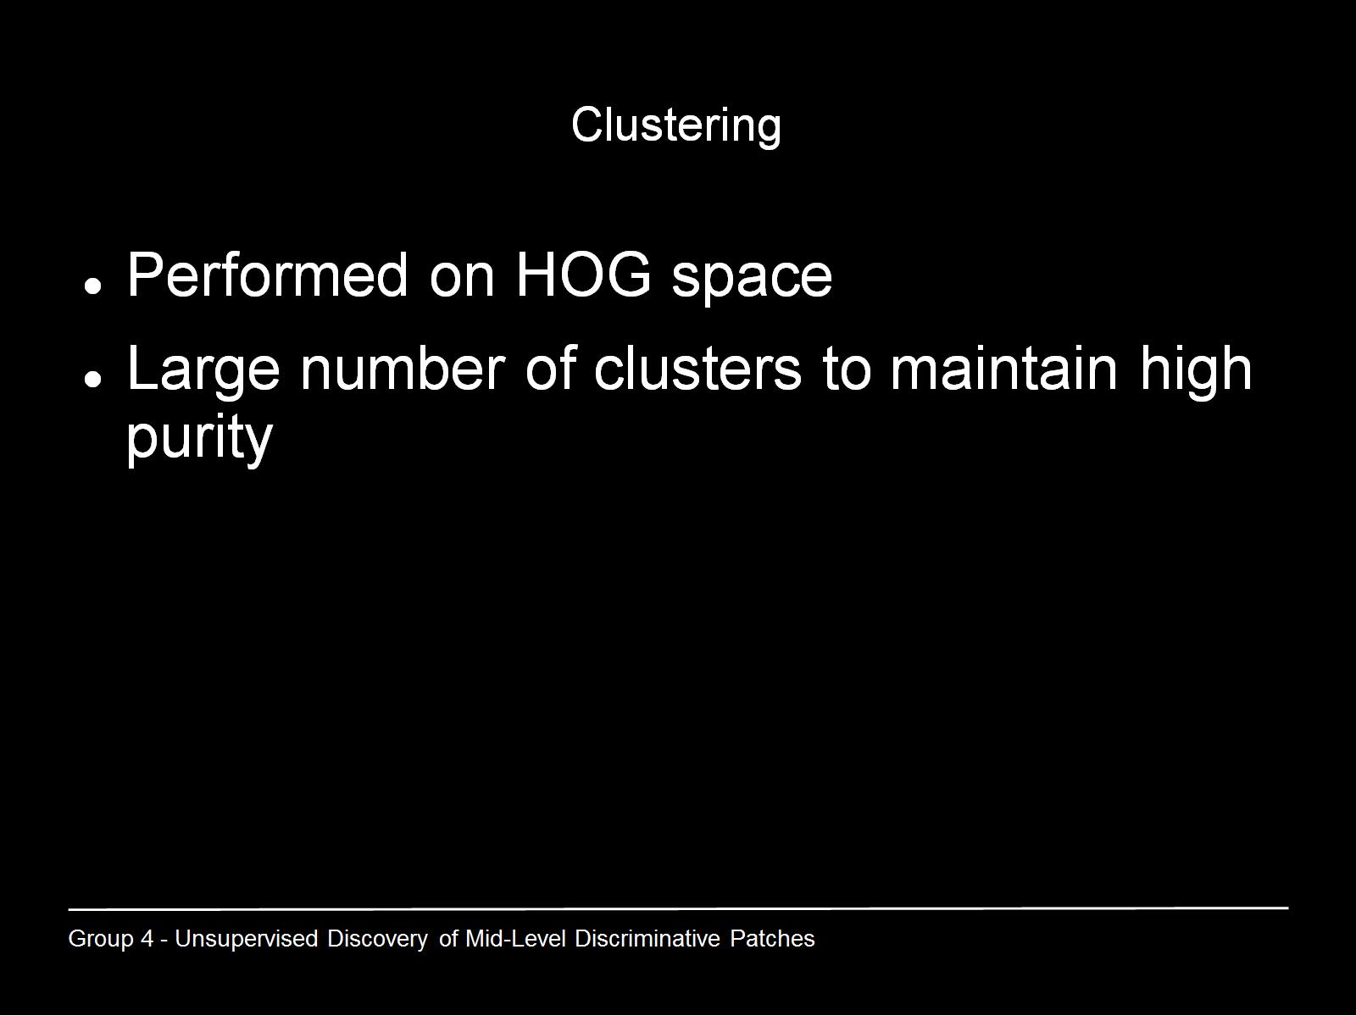
Clustering

Slide 29
Linear Support Vector Machine
Non-probabilistic binary linear classifier
Hyperplane with maximized distance to nearset data point on each side
Linearly separable problem space
Support vectors: points on margin
Supervised learning model

Slide 30
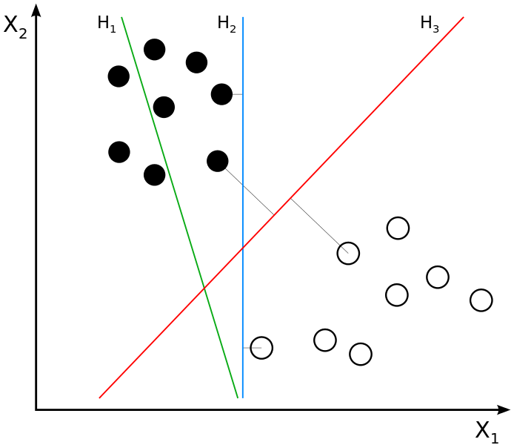
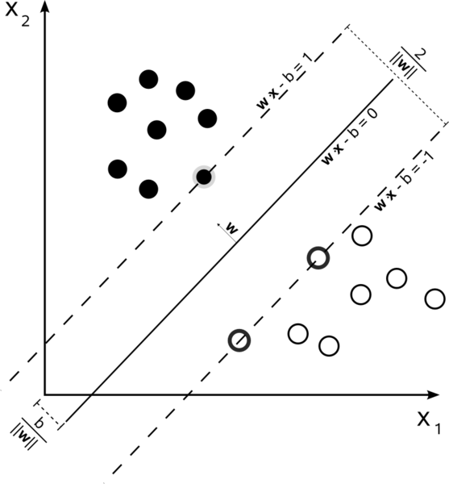
Linear Support Vector Machine Example

Slide 31
Support Vector Machine OpenCV
Training input:
  Matrix for training data
    Rows ~ images
  Matrix for labels
    Rows ~ positive or negative
Testing output:
  label / distance
  Support vectors

Slide 32


OpenCV Prototype
Unit tests with simple images

Slide 33
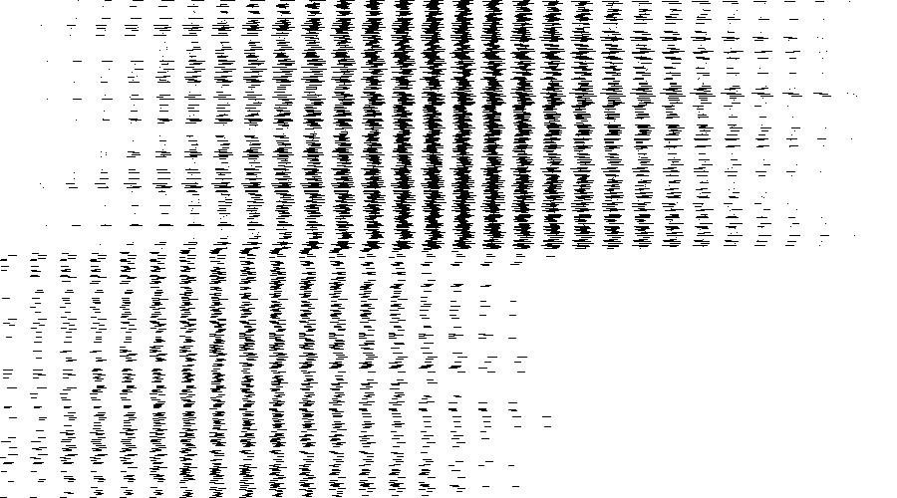
OpenCV Prototype
Setup works
Poor results

Slide 34
Project Setup
CMake build configuration for platform independent development
Doxygen configuration for in code documentation

Slide 35
Next Steps (1)
Implement
  Prototypes as modules
  Datastructures
  IO (visual debugging)
  Overall algorithm
  Supplementary methods

Slide 36
Next Steps (2)
Organize the datasets
  Categorization
  Positives / negatives
  Training / validation

Slide 37
References
Singh et al., ”Unsupervised discovery of mid-level discriminative patches.”, Computer Vision-ECCV 2012: pp 73-86. (2012)
Doersch et al. „What makes Paris look like Paris?.“ , ACM Transactions on Graphics 31, no. 4 (2012)

Slide 38
Questions ?

Slide 39
Thank you for your attention!
s.selzer@student.maastrichtuniversity.nl
i.papadopoulos@student.maastrichtuniversity.nl
c.sun@student.maastrichtuniversity.nl
s.baht@student.maastrichtuniversity.nl

