Slide 1

MPC Tutorial
Linear MPC and Robust Tube MPC
경북대학교 기계공학과 한경석 교수

Slide 2
1. MPT3 Toolbox & Ex. 1
이 곳에 네번째 소제목을 적어주세요
CONTENTS
2. Disturbance model based LQ MPC & Ex. 2
3. Velocity form based LQ MPC & Ex. 3
4. Robust Tube MPC & Ex. 4

Slide 3
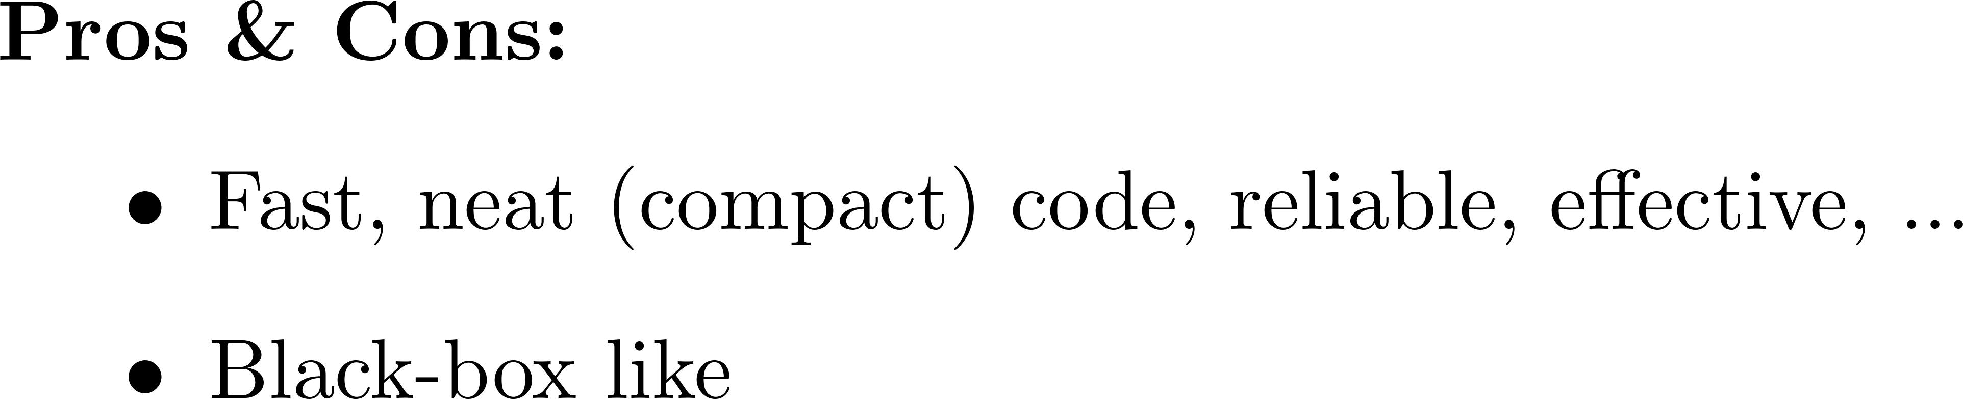





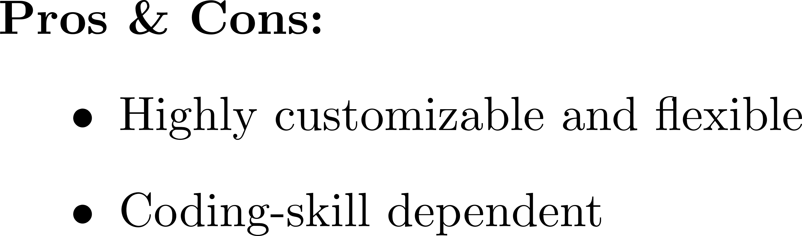

MPC Toolbox vs. Manual Coding

Slide 4
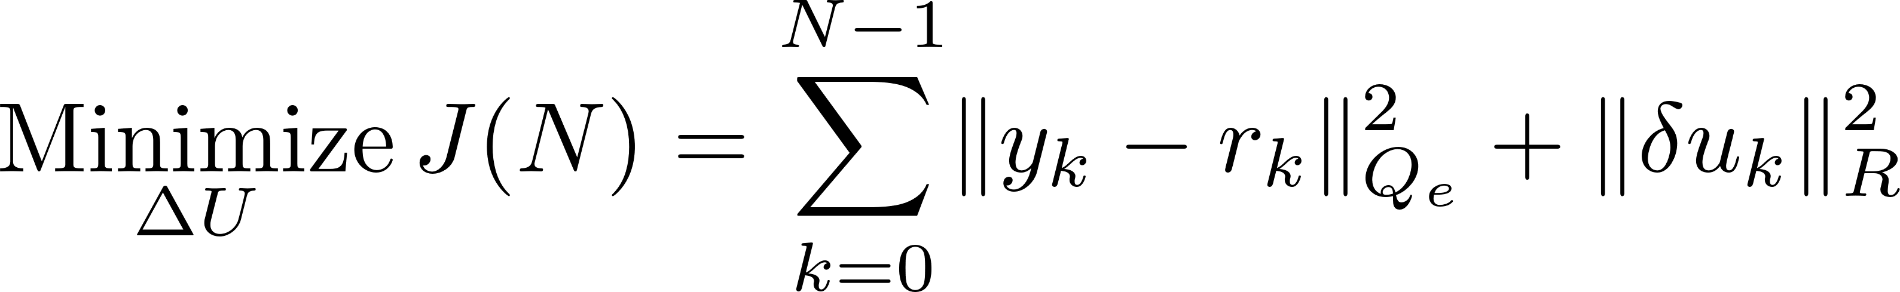
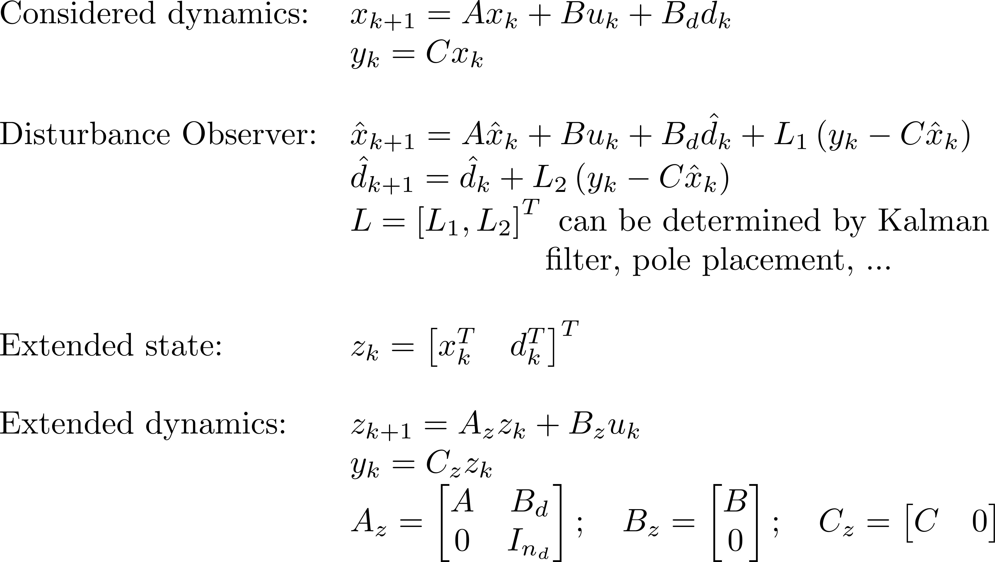
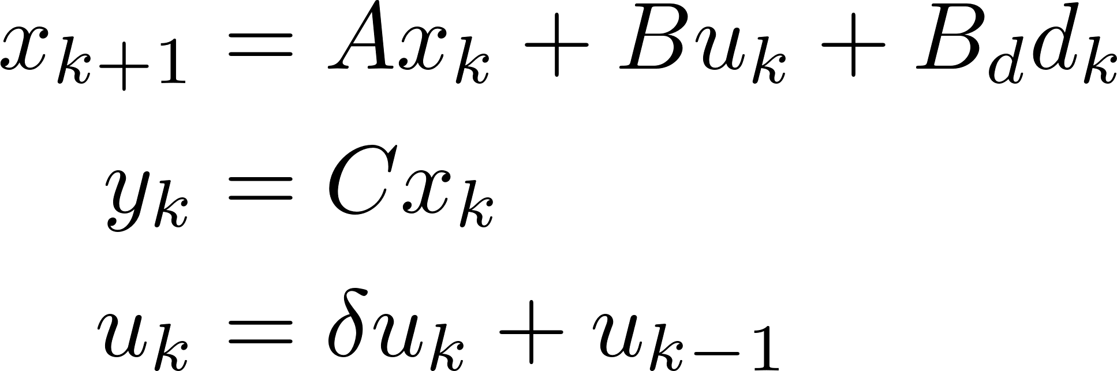
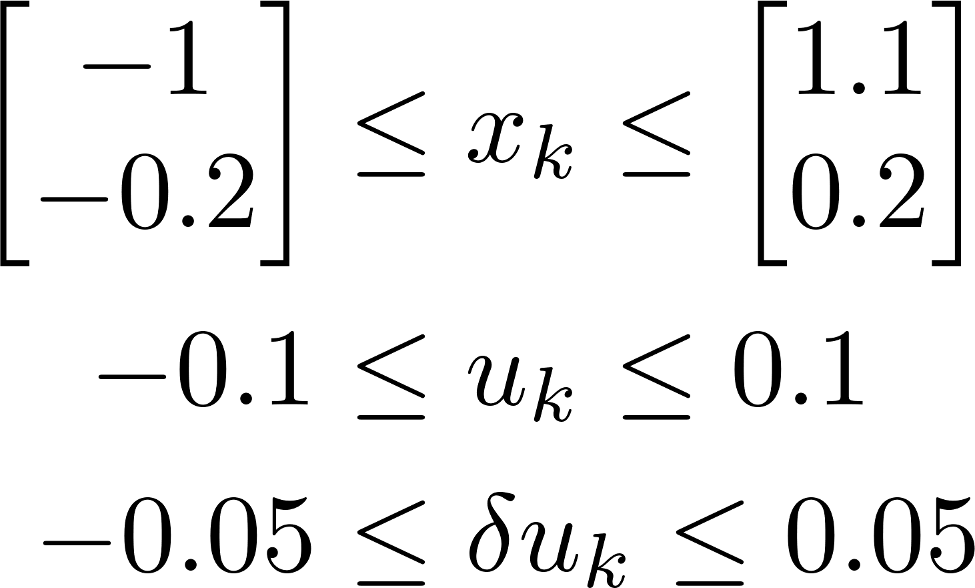
Tutorial: Disturbance Model based Offset-free Tracking MPC
Optimal Control Problem (OCP)
Extended Dynamics

Slide 5
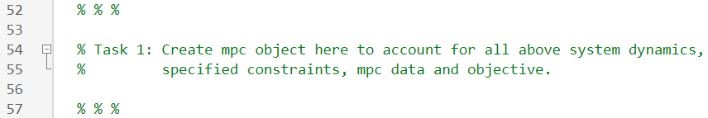
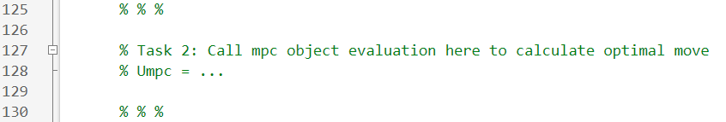
Homework
Exercise 1
MPC Formulation
Tracking MPC Design using MPT3
Objective: to be familiar with & effectively apply basic functions of MPT3 toolbox
Given: a MATLAB file named “EX1_DoubleIntegrator_with_DO_MPT3” with two part deleted. Fill those parts!
Task 1: Create an MPC object using MPT3 Toolbox to account for system dynamics, specified constraints, MPC data and cost function.
Task 2: Call the MPC object created in Task 1 to compute the optimal control move at each time step.

Slide 6
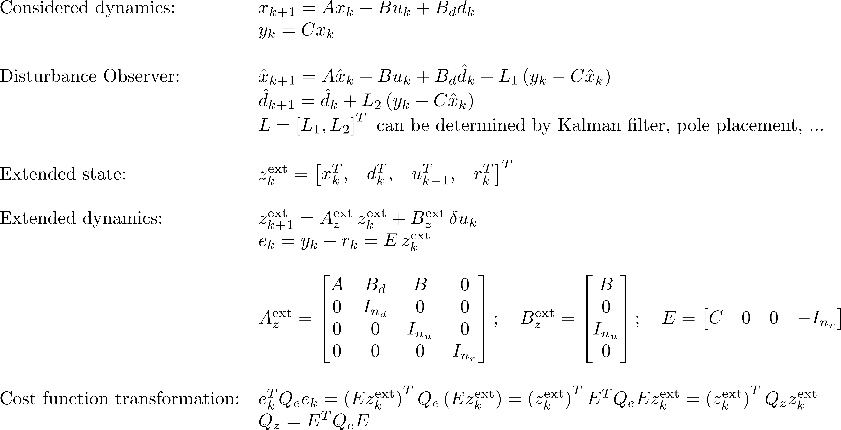
Tutorial: Disturbance Model based Offset-free Tracking MPC
Extended Dynamics
Step 1: Extending dynamics

Slide 7
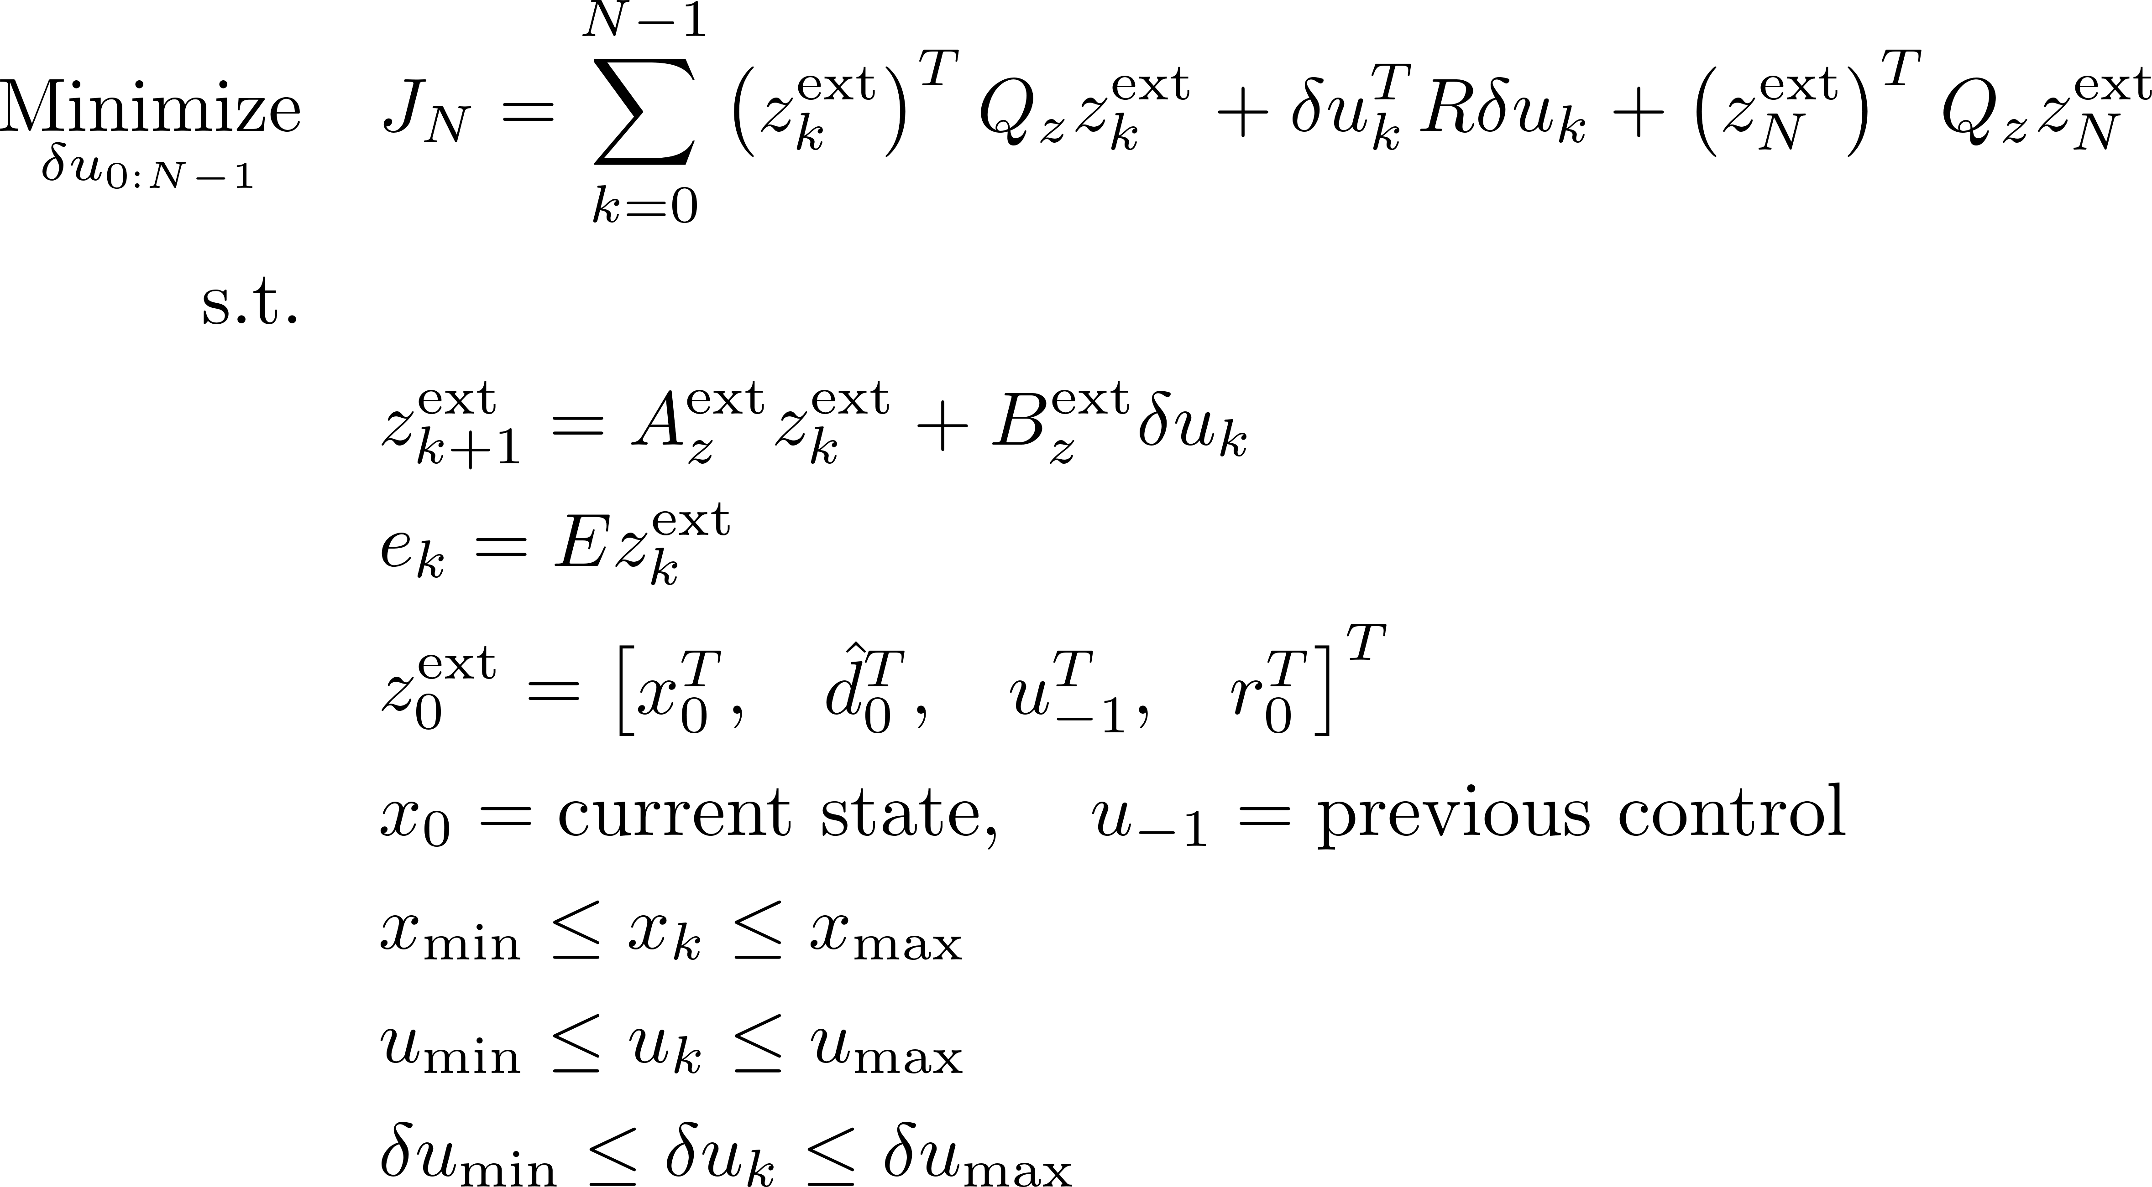
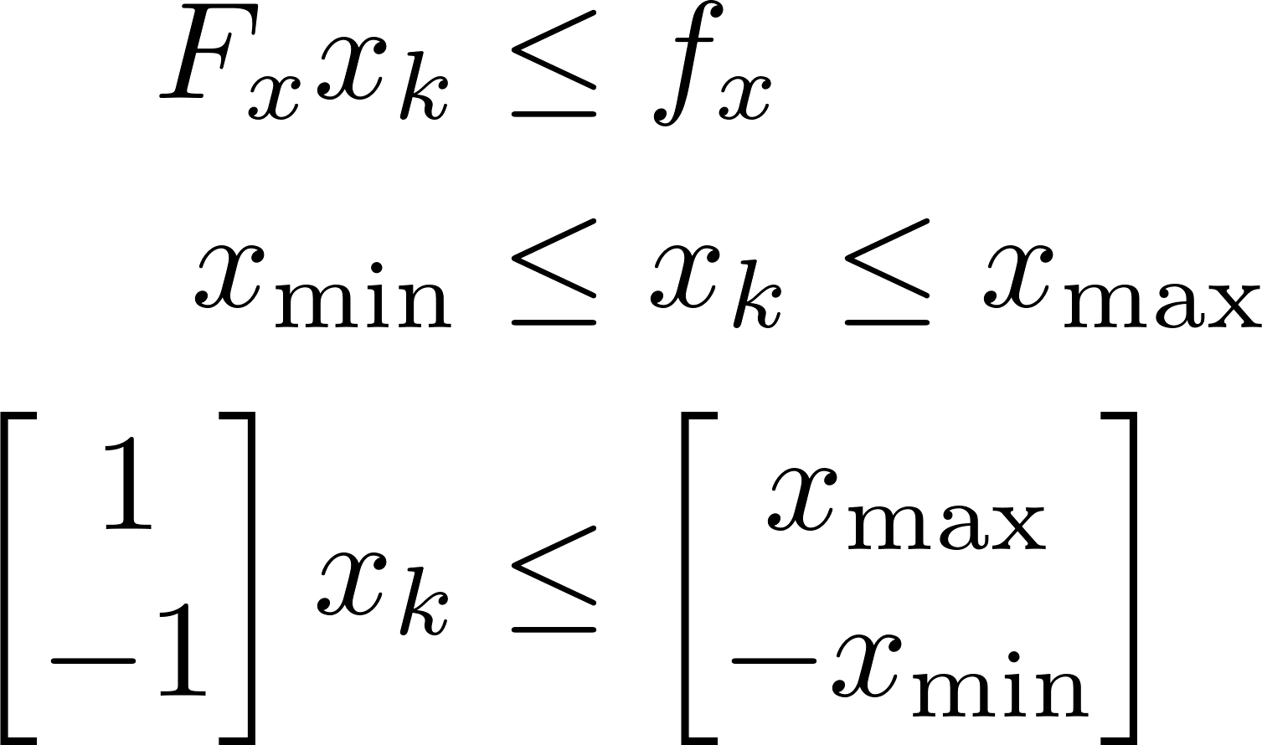
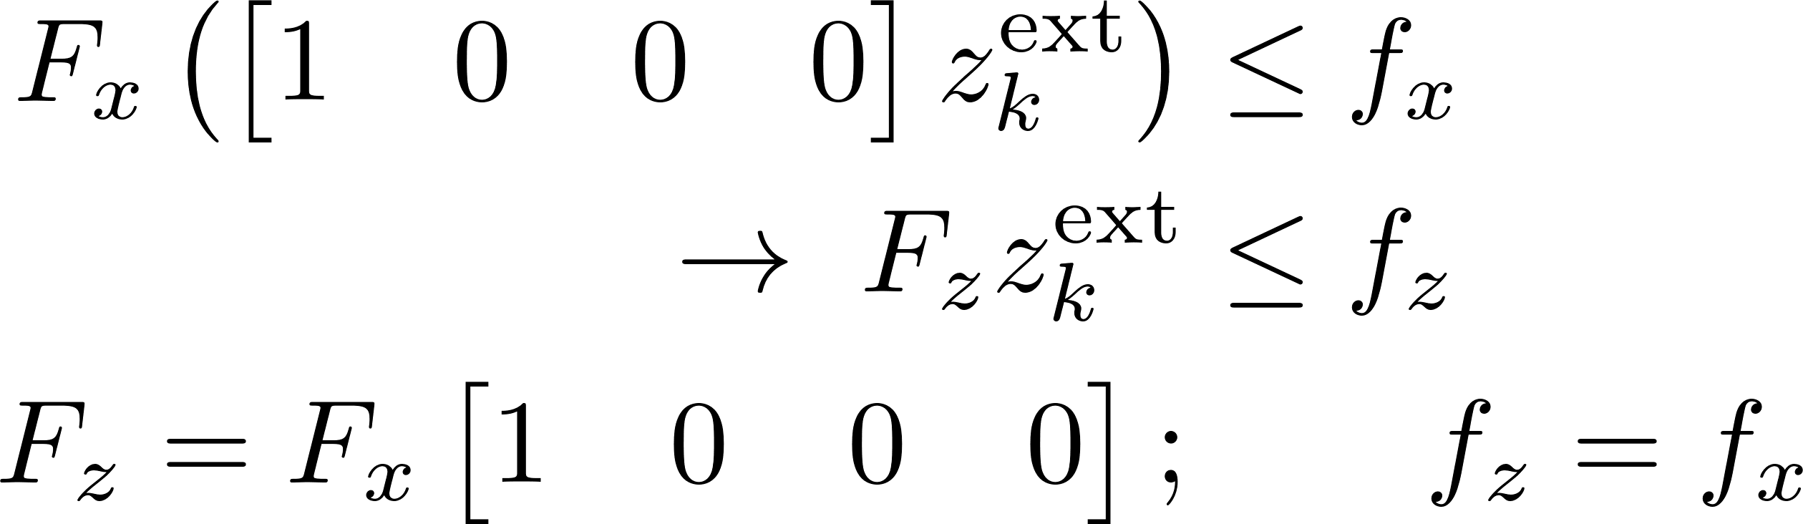
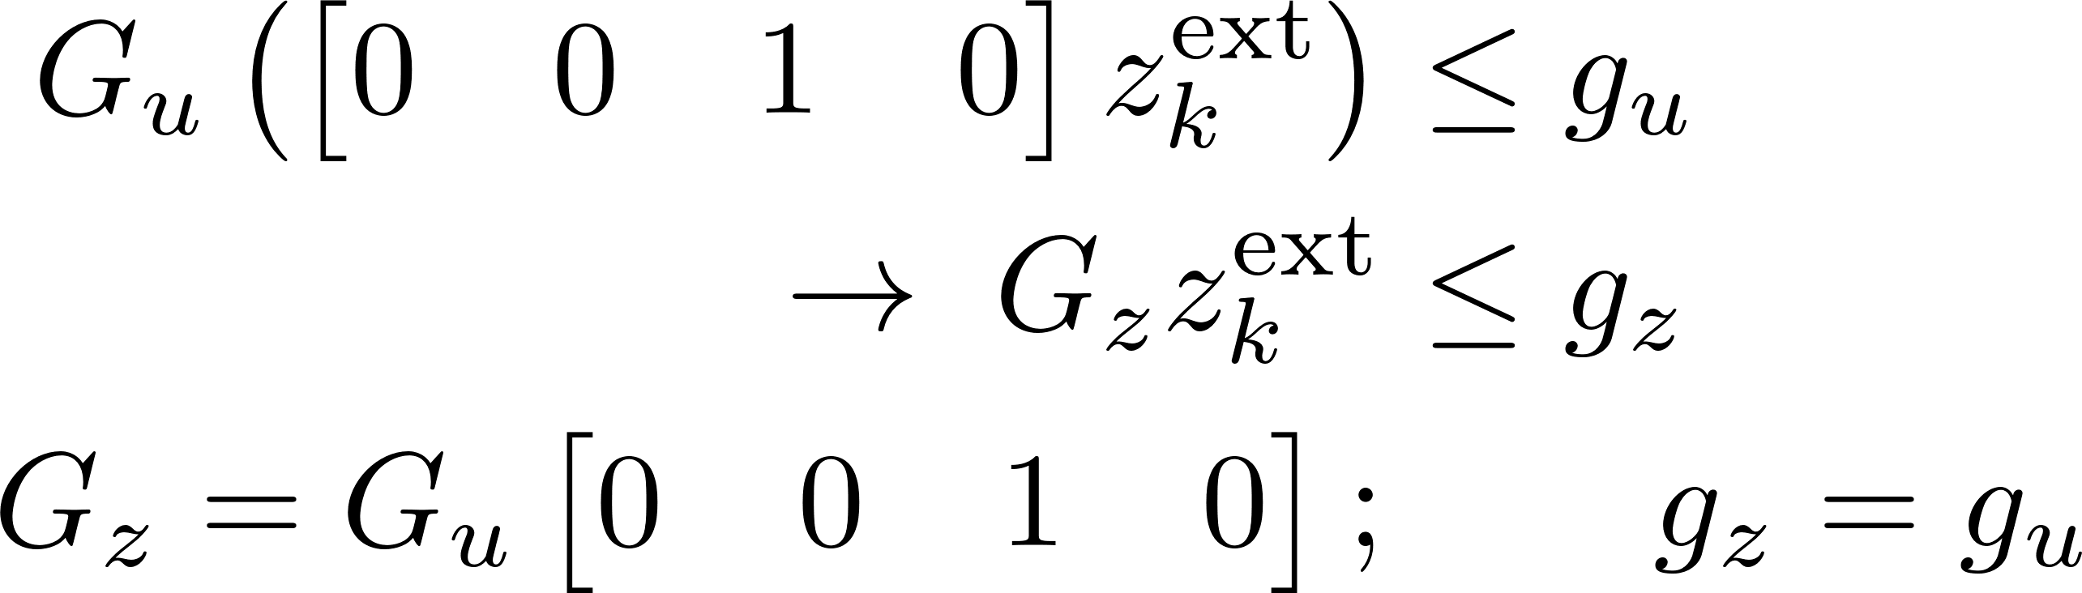

Tutorial: Disturbance Model based Offset-free Tracking MPC
Optimal Control Problem
H-representation
Step 2: Expressing state, control constraints in terms of extended state

Slide 8
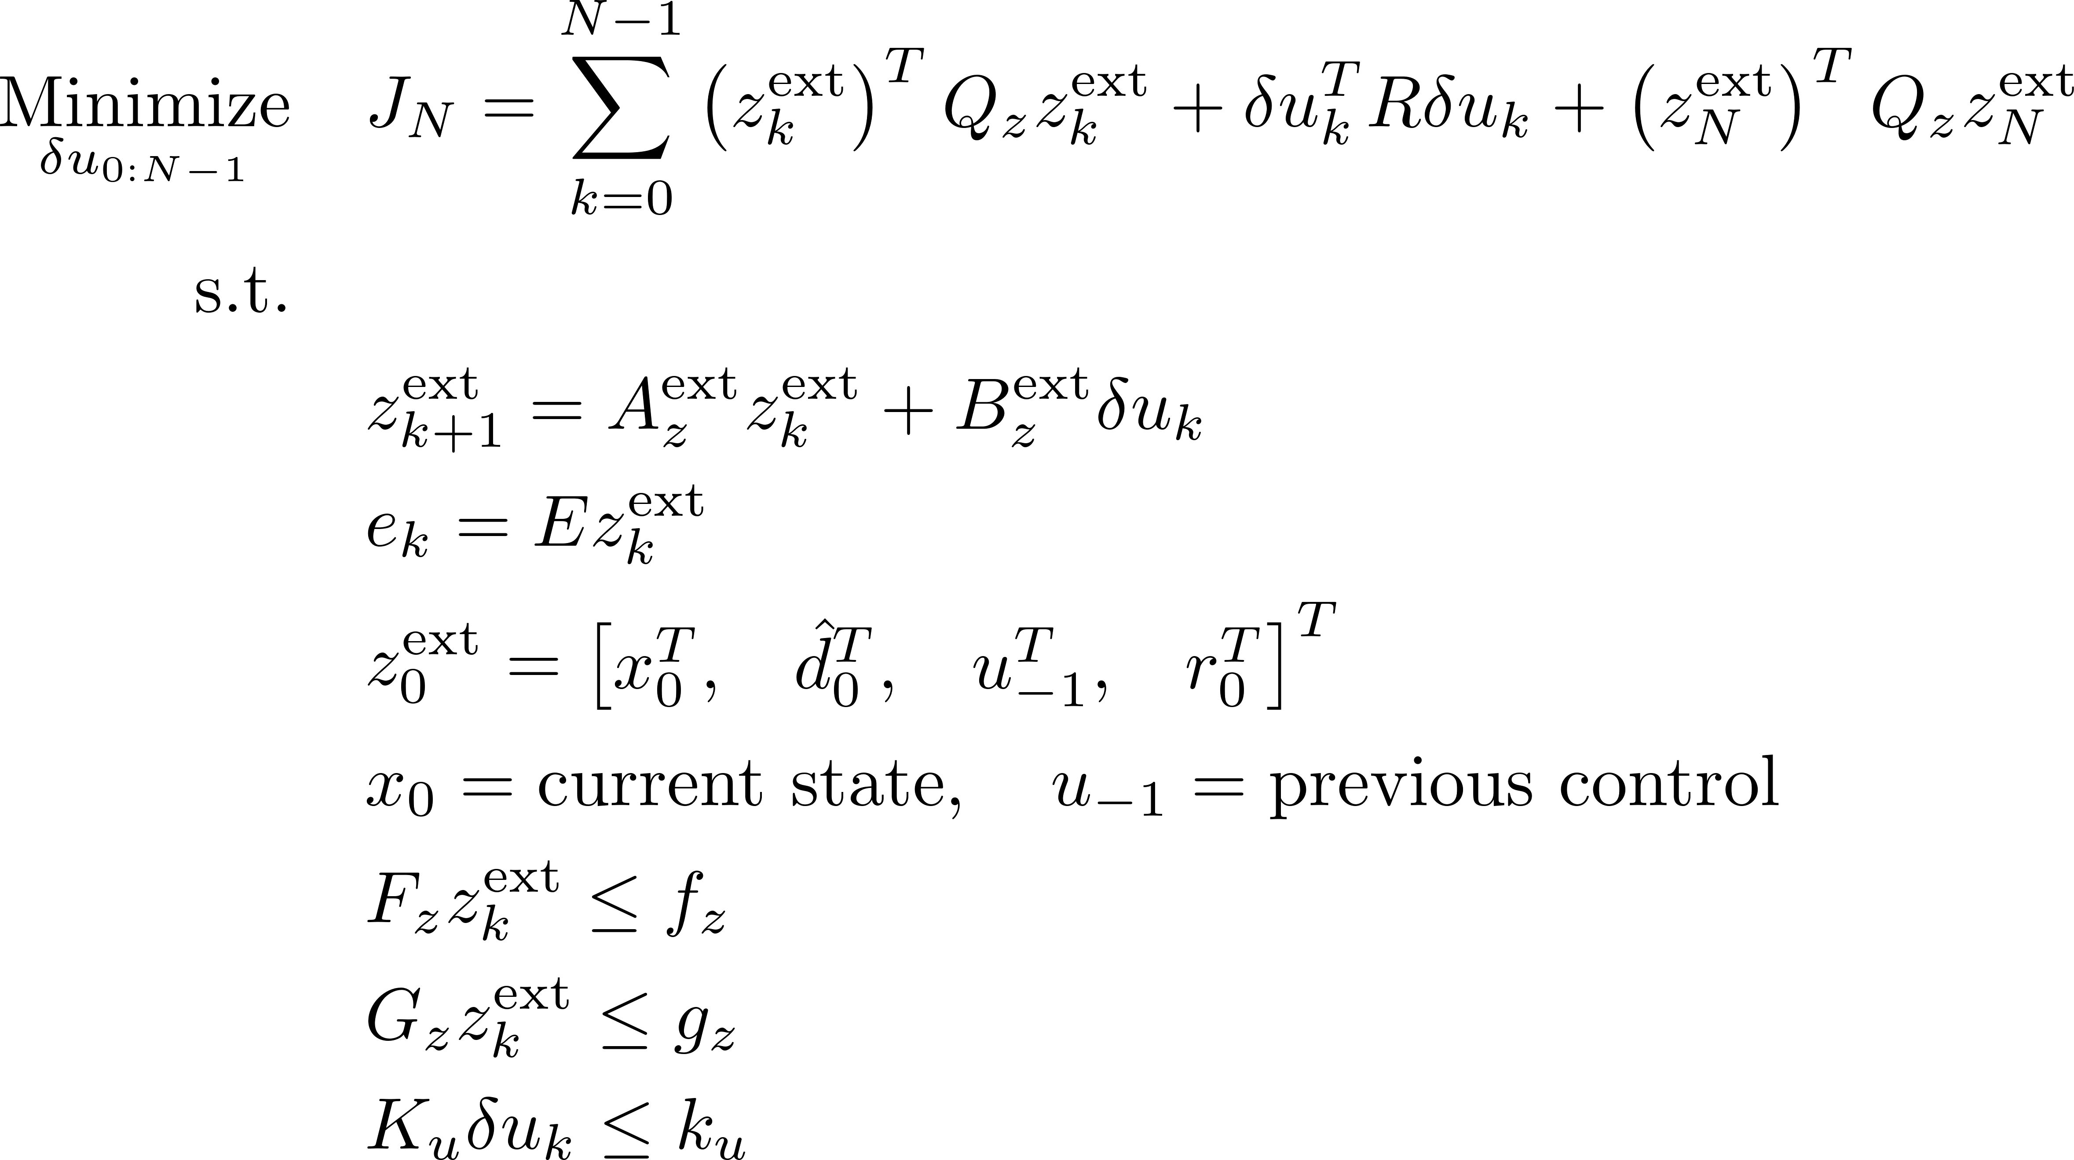
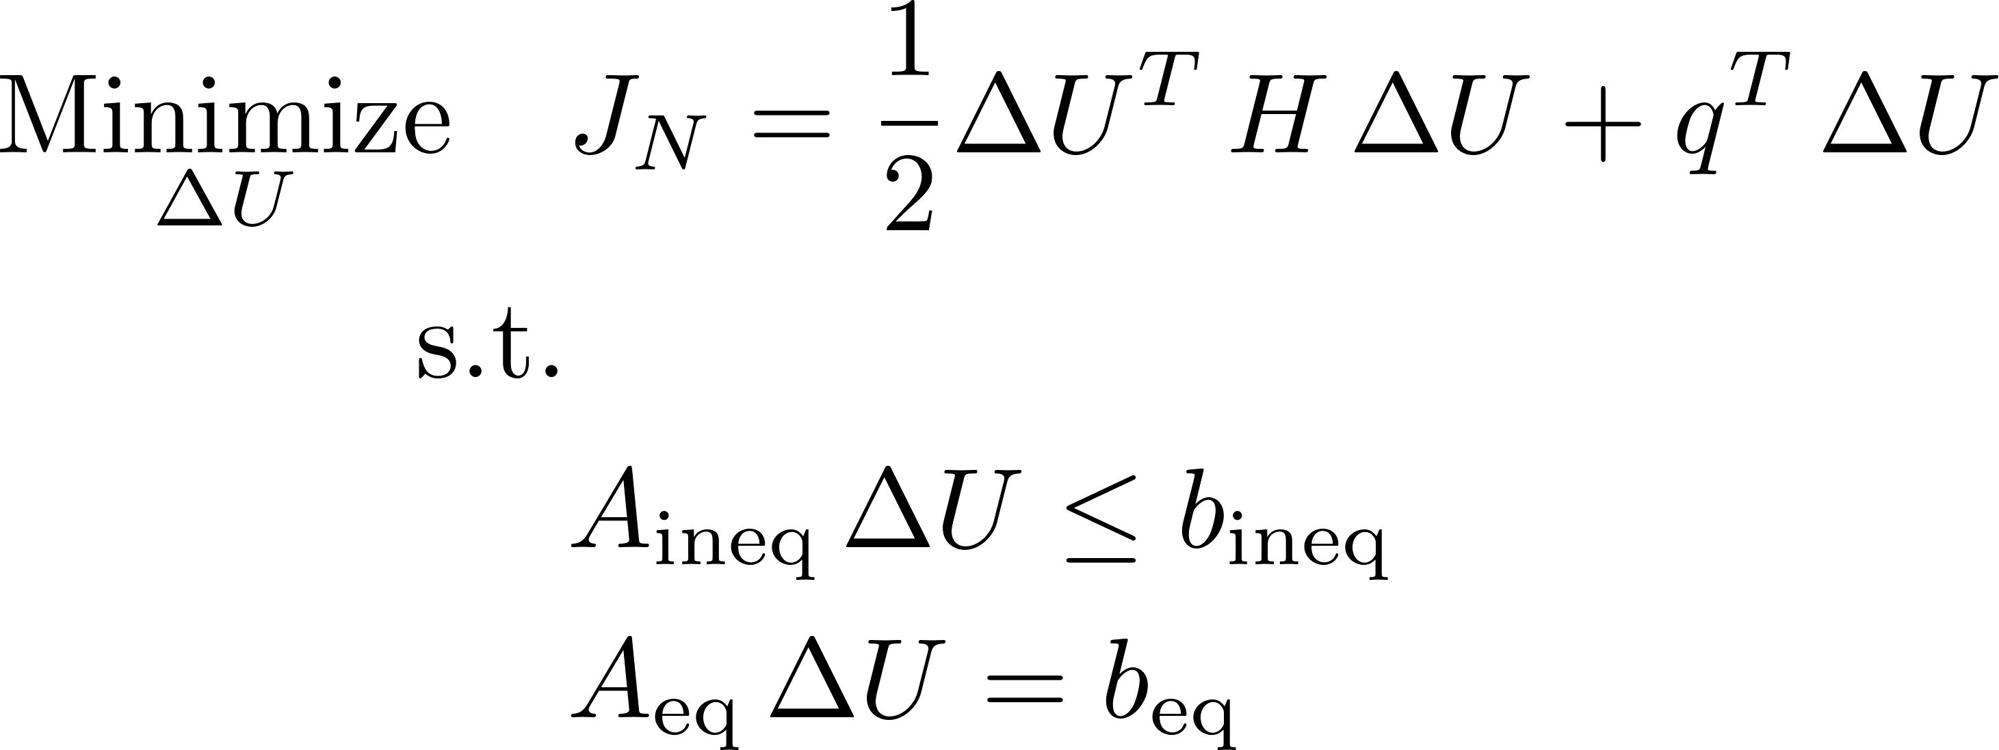
Tutorial: Disturbance Model based Offset-free Tracking MPC
Optimal Control Problem
Quadratic Programming
Step 3: Transforming Optimal Control Problem into Quadratic Programming

Slide 9
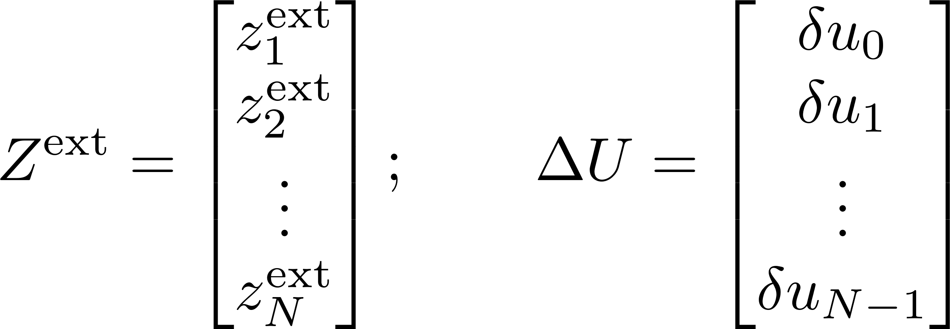
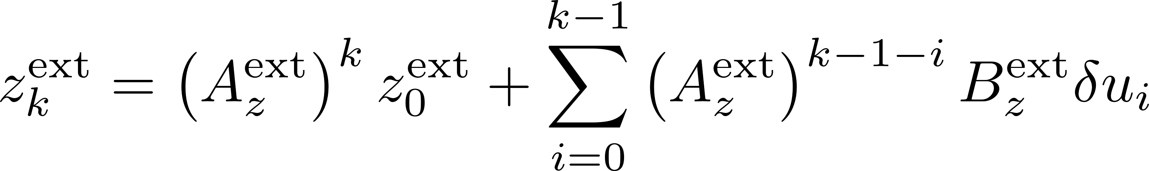
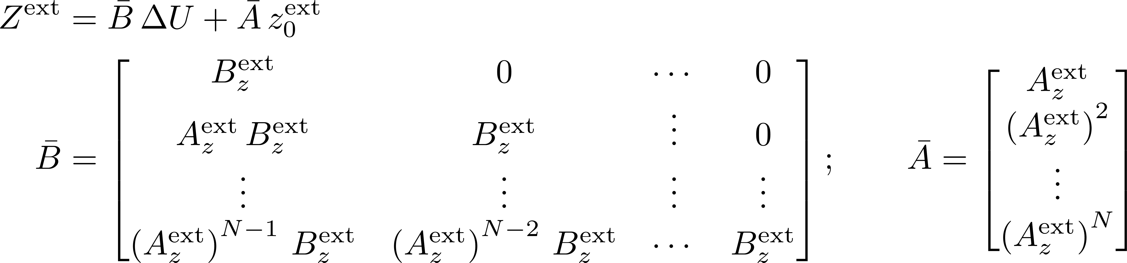

Tutorial: Disturbance Model based Offset-free Tracking MPC
Extended State Dynamics
Step 3.1: Stacking states controls
Step 3.2: Deriving the state-control relation

Slide 10
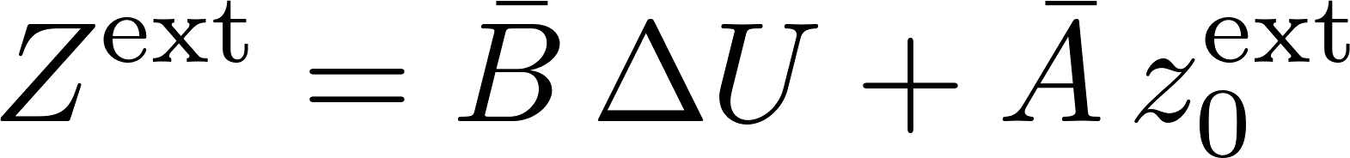
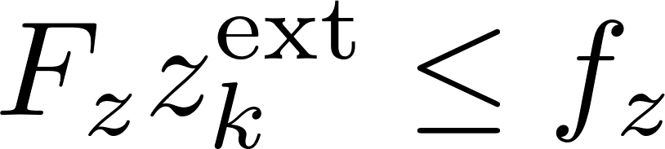
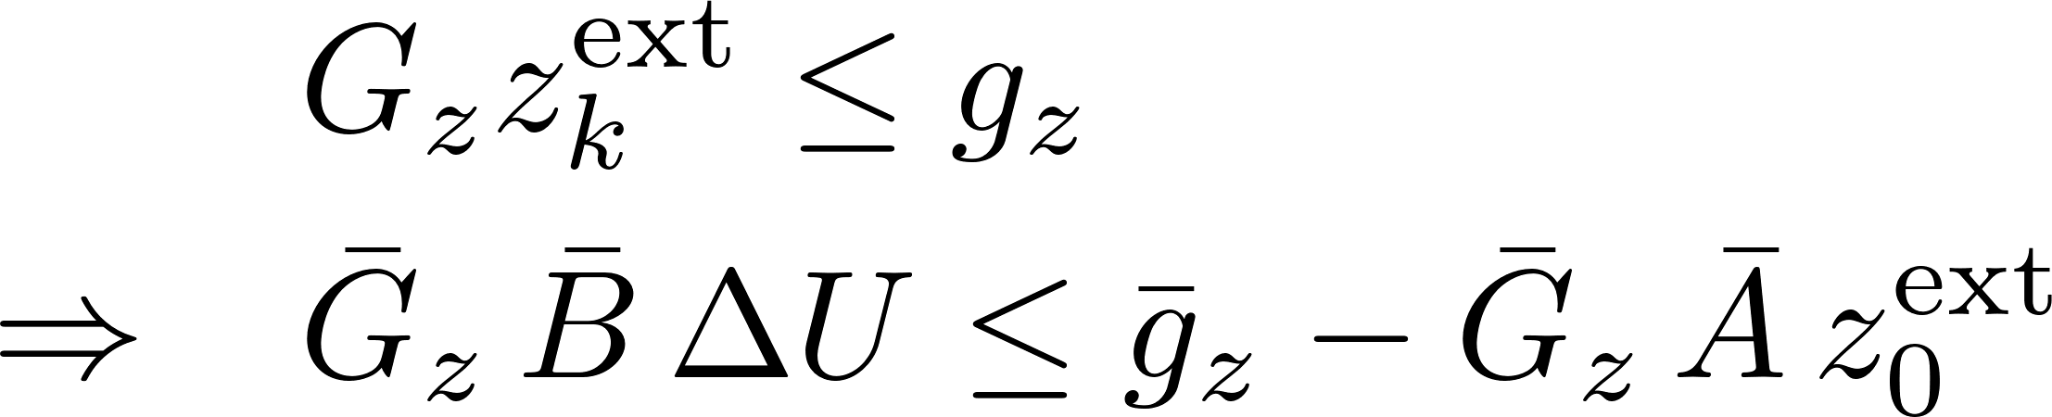
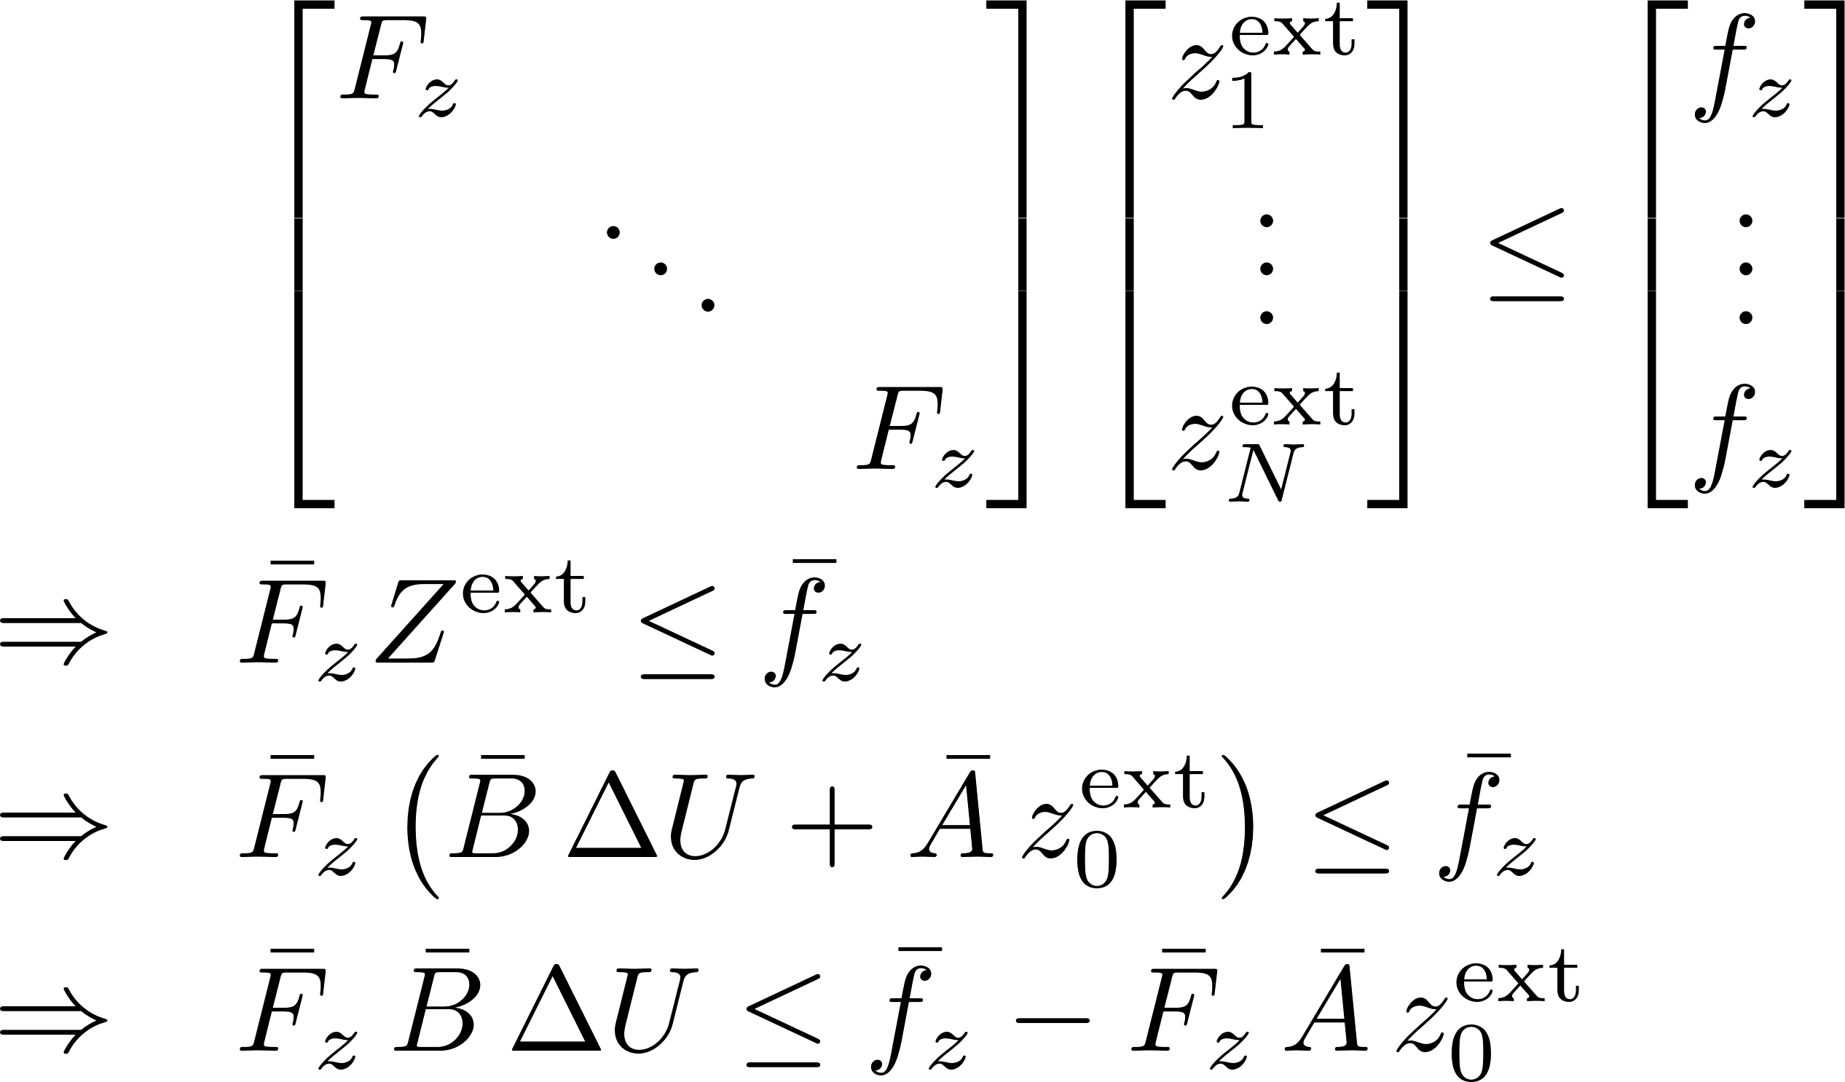
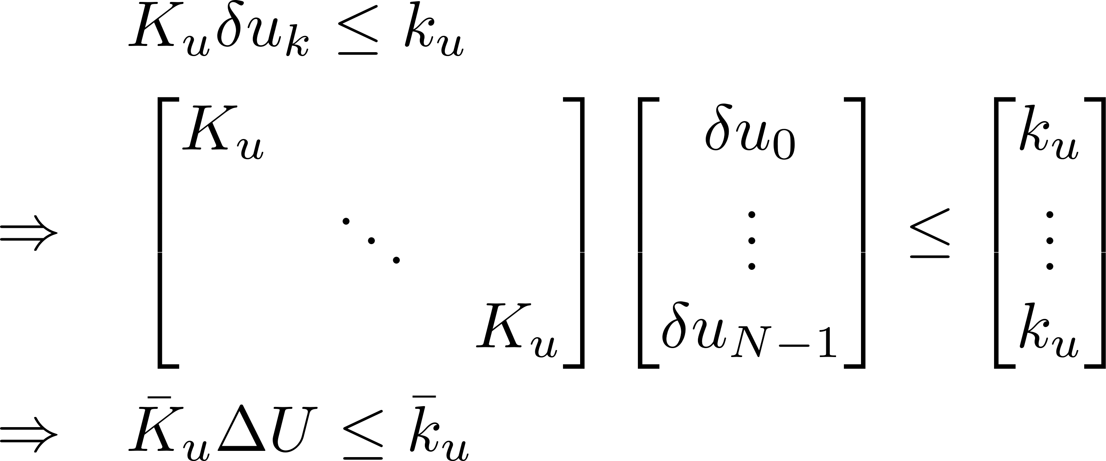
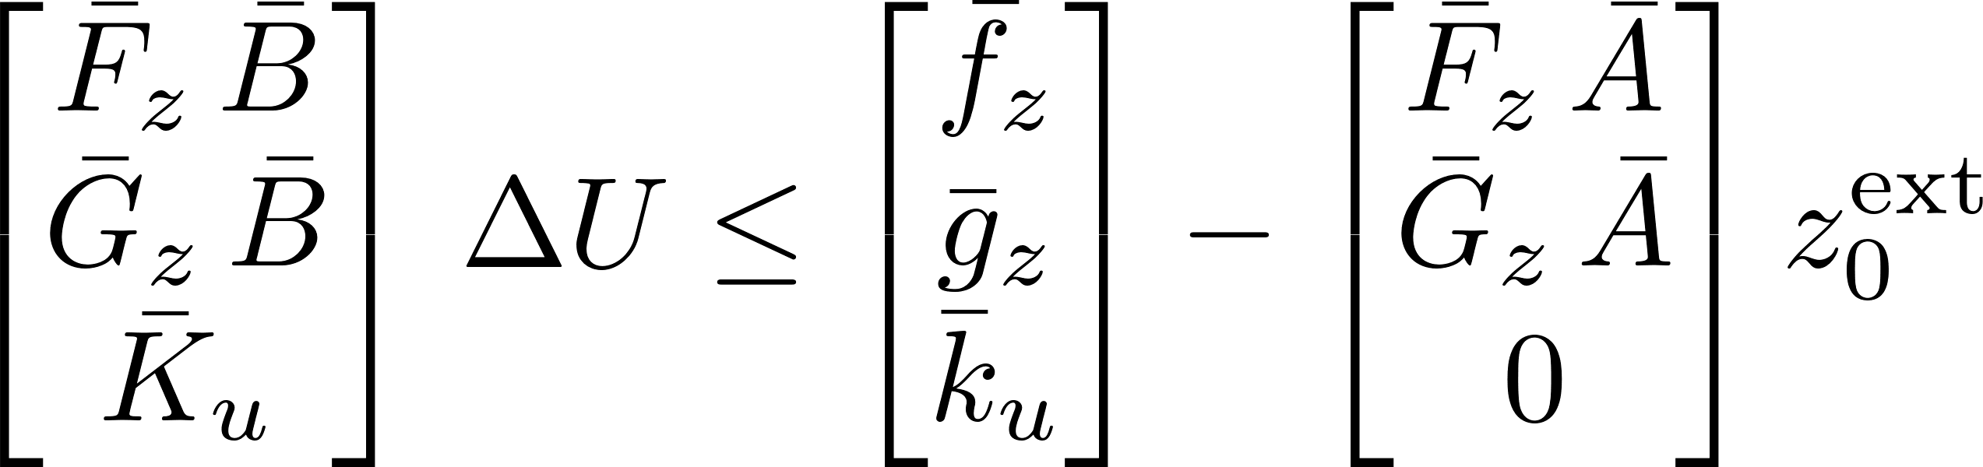

Tutorial: Disturbance Model based Offset-free Tracking MPC
Step 3.2: Deriving the state-control relation
Step 3.3: Transforming constraints

Slide 11
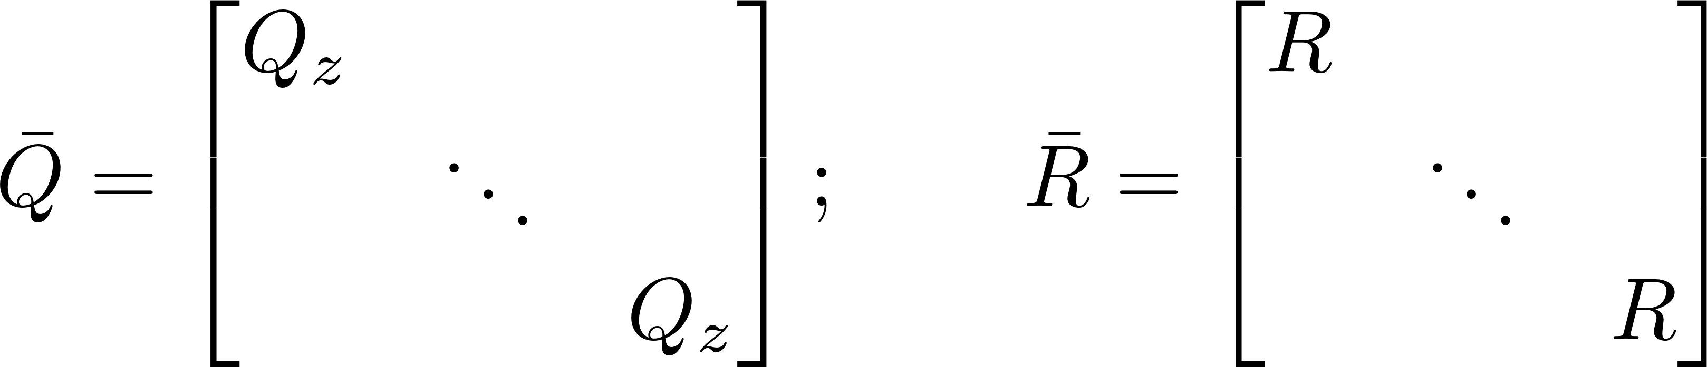
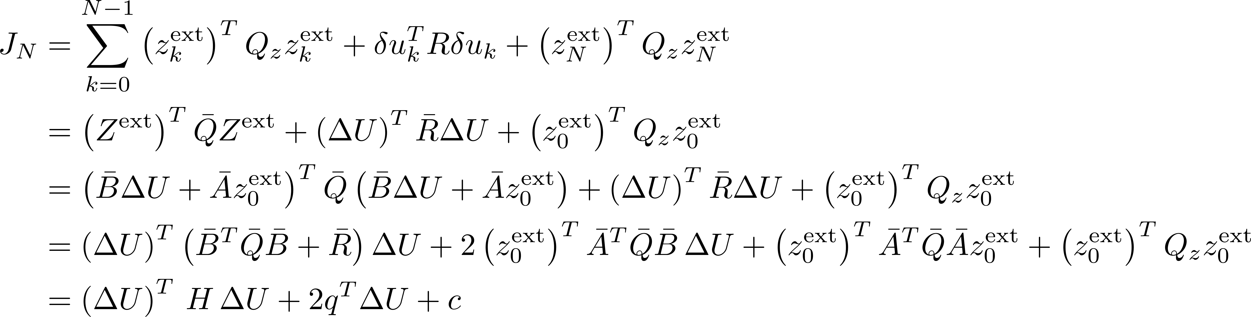
Tutorial: Disturbance Model based Offset-free Tracking MPC
Step 3.2: Deriving the state-control relation
Step 3.4: Transforming objective function

Slide 12
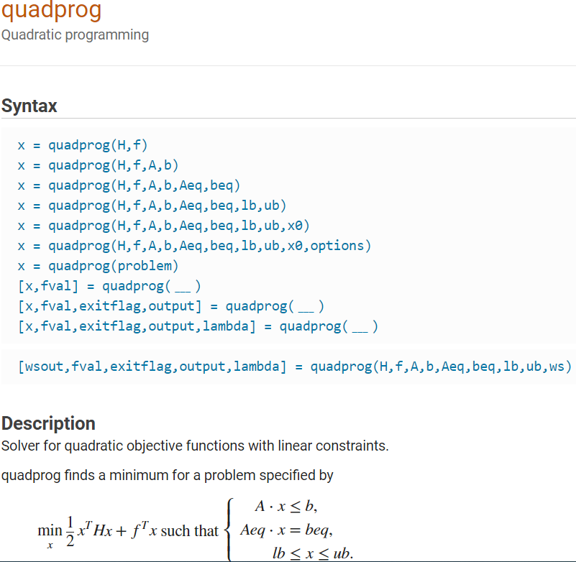
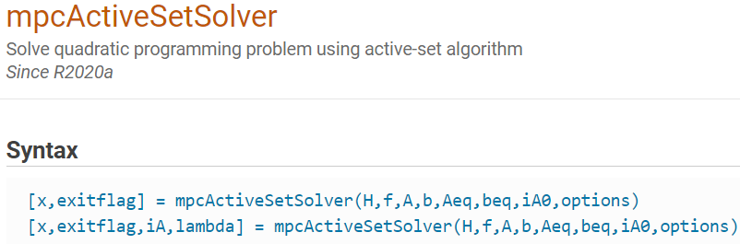
Tutorial: Disturbance Model based Offset-free Tracking MPC
Quadratic Programming
Step 3.5: Calling QP solver at each time step

Slide 13
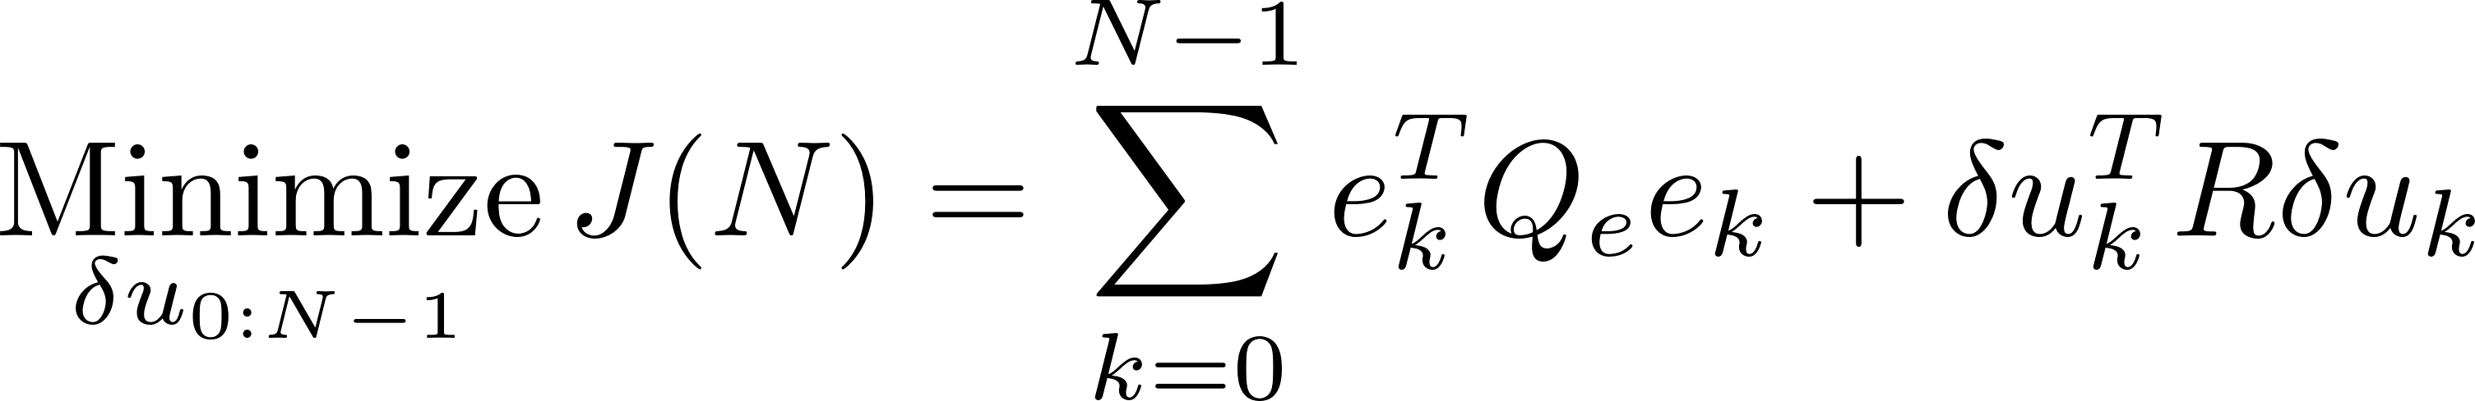
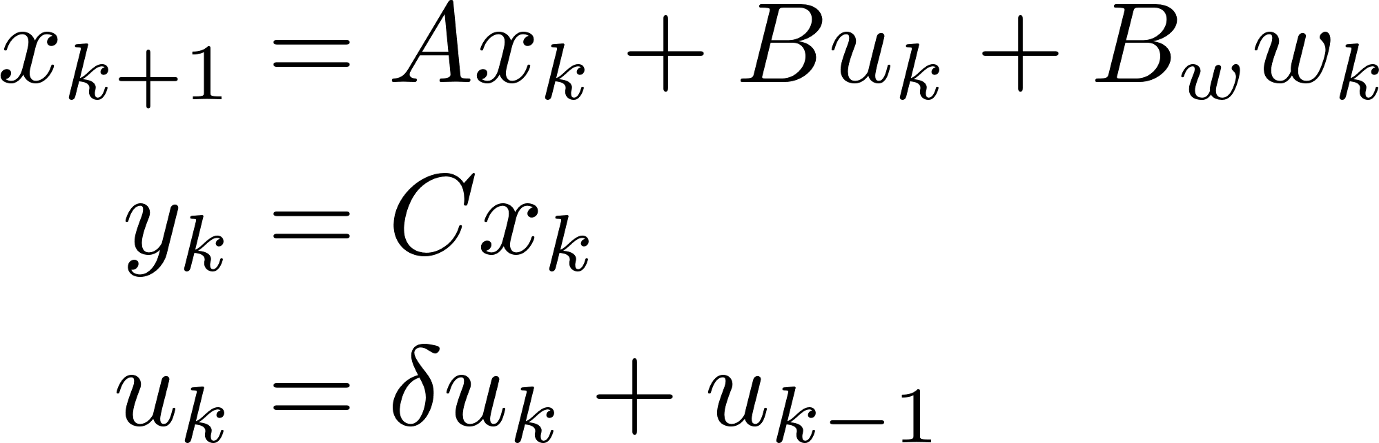
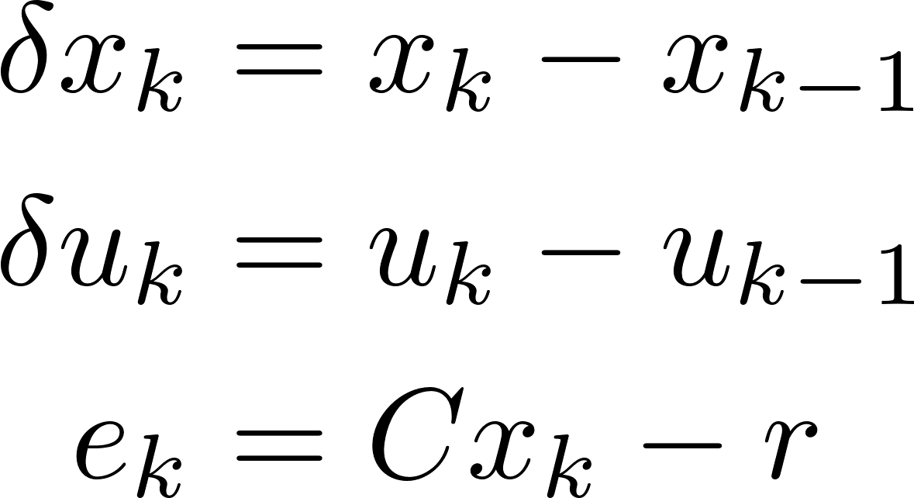
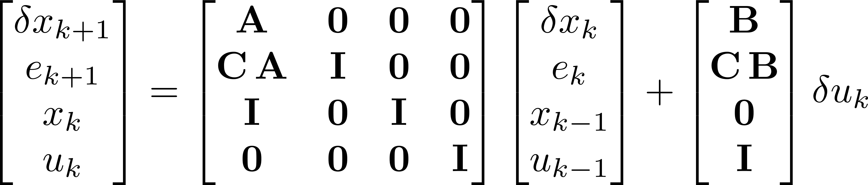
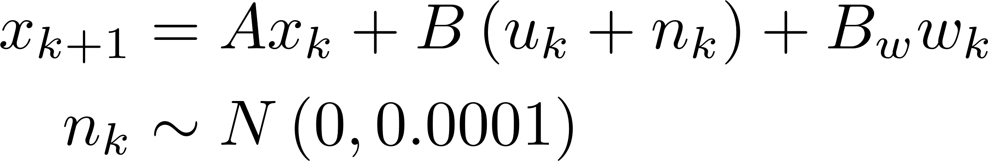
Homework
Exercise 2
Optimal Control Problem
Tracking MPC Design using Velocity form-based LQMPC
Objective: to learn the customization and flexibility of manual coding
Given: a sample MATLAB file named “SAMPLE_DoubleIntegrator_with_DO_LQMPC.m” that realizes the Disturbance model offset-free tracking MPC.
Task: Based on the given sample code, create a similar file to realize the Velocity form-based offset-free tracking MPC. Terminal penalty matrix must be included. No disturbance observer is needed. No noise is considered. However, students are encouraged to add process noise (control input noise) to observe its impact on the control system.

Slide 14
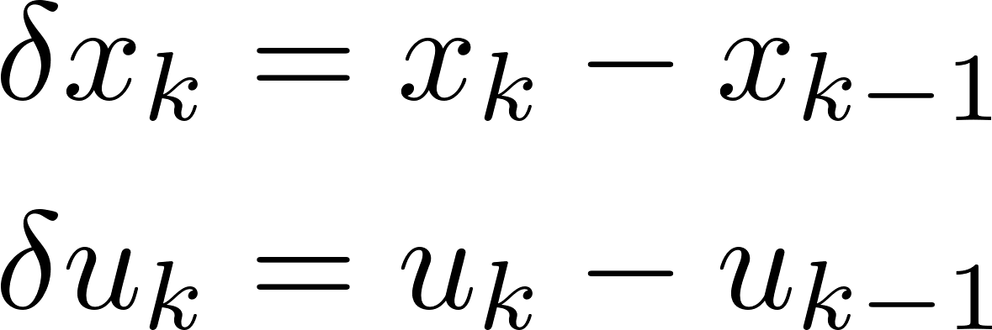
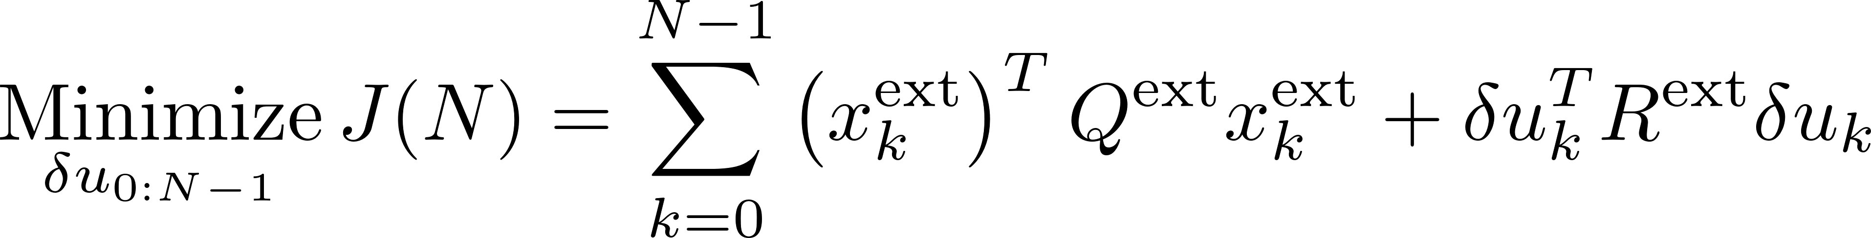


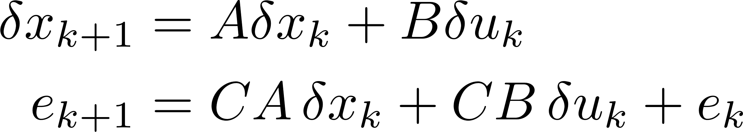
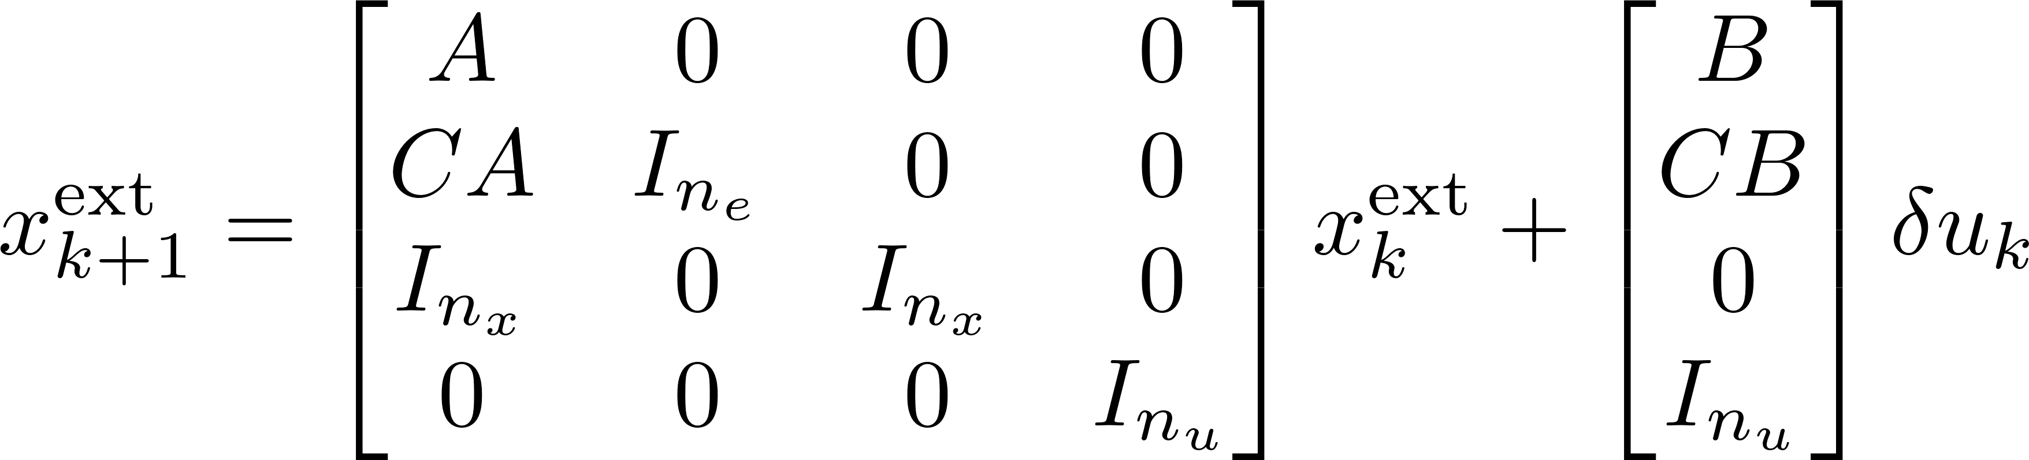


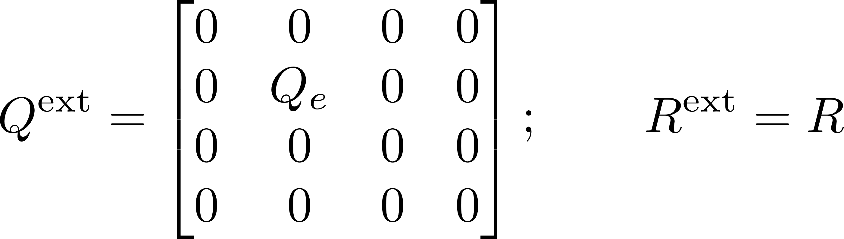
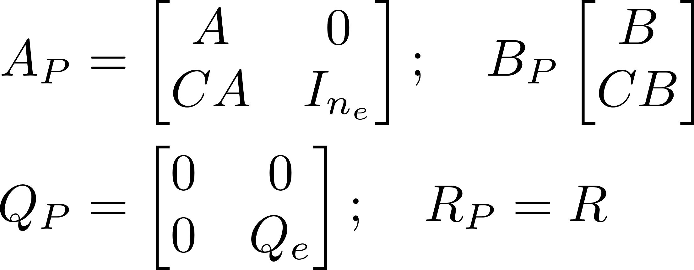
Tutorial: Velocity form-based Offset-free Tracking MPC
Incremental (rate-based) model
Optimal Control Problem
Extended Dynamics
Terminal Penalty P
Penalty Matrices

Slide 15
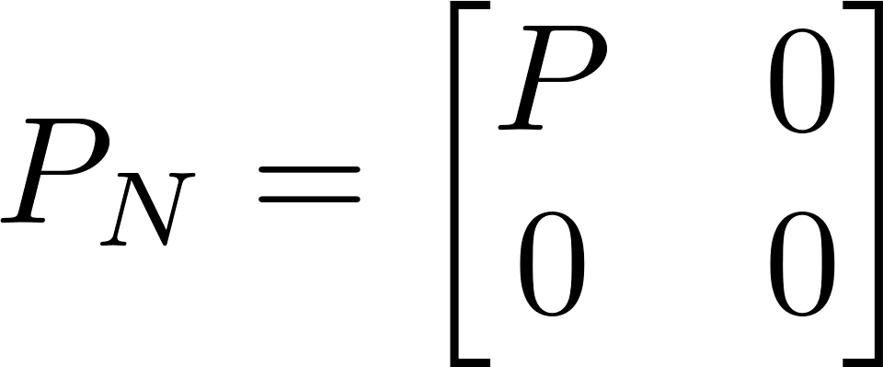
Tutorial: Velocity form-based Offset-free Tracking MPC
Optimal Control Problem
Now derive the OCP-QP transformation again!

Slide 16
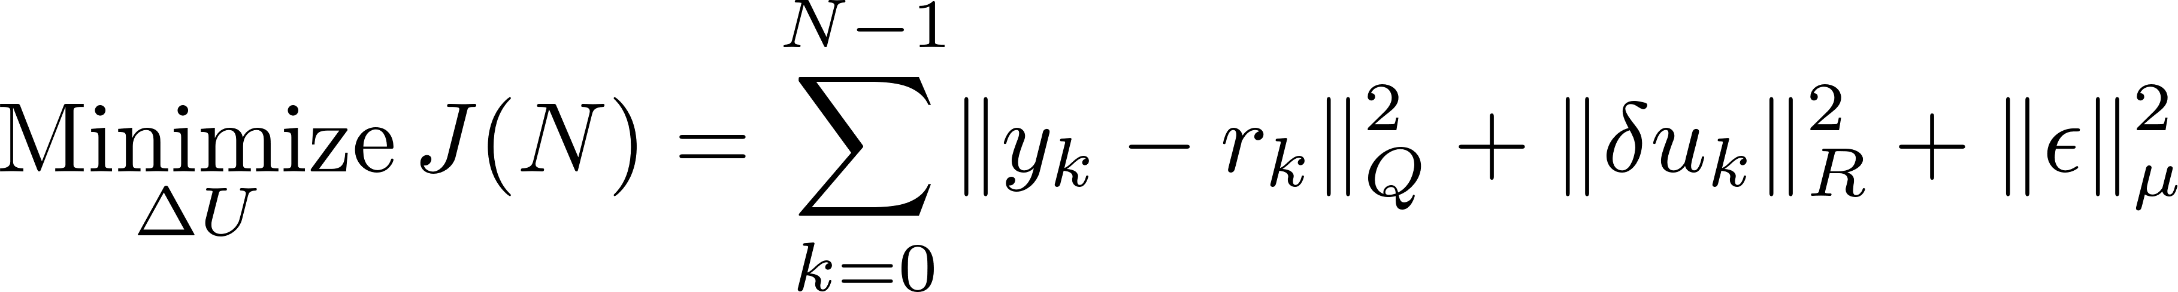
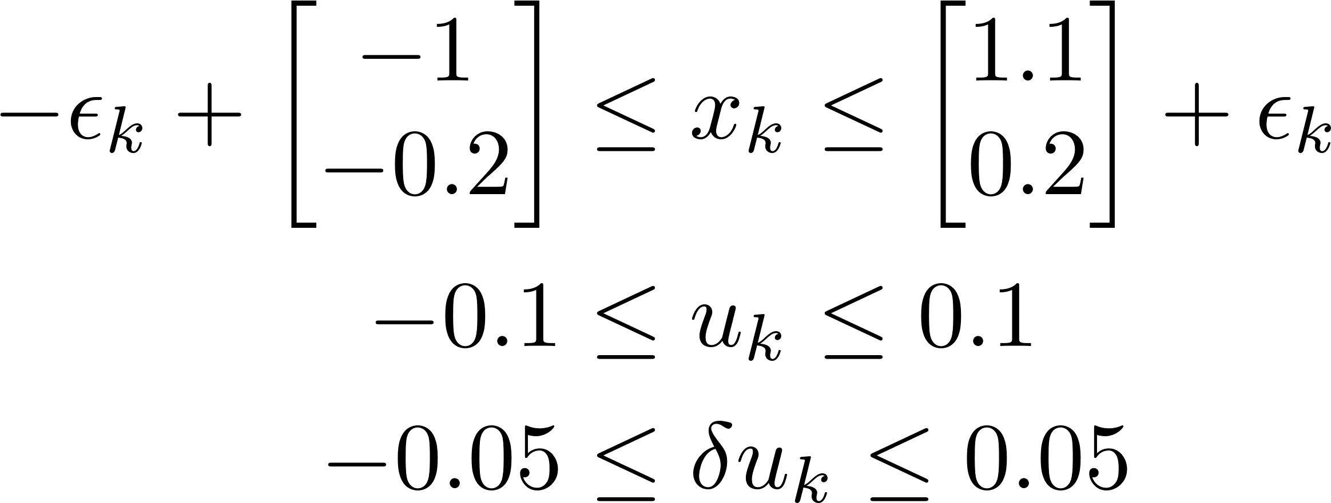

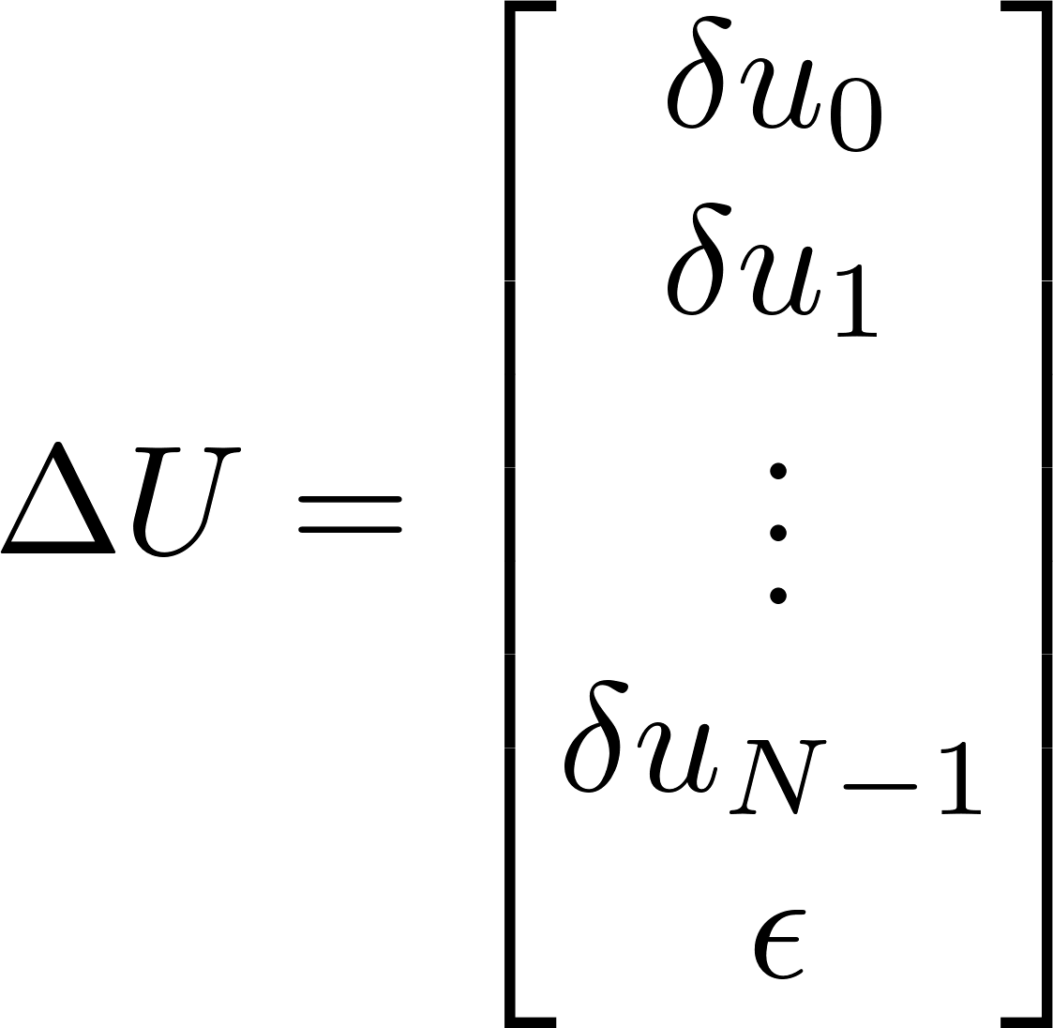
Homework
Exercise 3
Optimal Control Problem
Tracking MPC Design using Velocity form-based LQMPC with soft constraints
Objective: to learn the customization and flexibility of manual coding
Given: a sample MATLAB file named “SAMPLE_DoubleIntegrator_with_DO_LQMPC.m” that realizes the Disturbance model offset-free tracking MPC.
Task: Modify the Velocity form-based offset-free tracking MPC to include soft constraints on system states.
Note: add process noise and compare results of Ex. 3 and Ex.4, draw out possible conclusion.

Slide 17
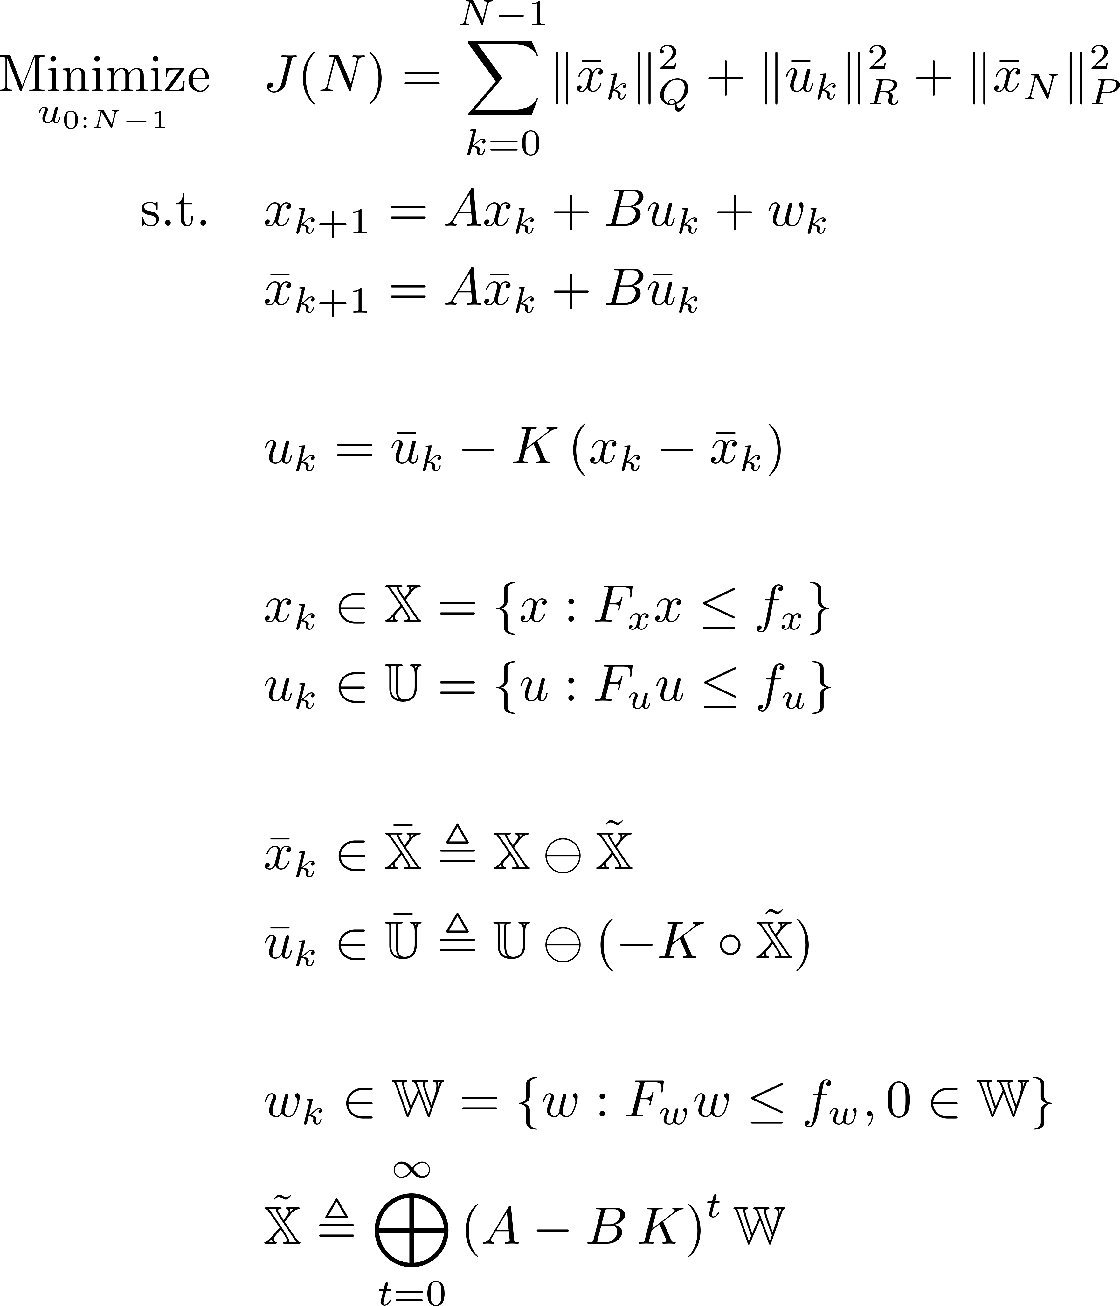
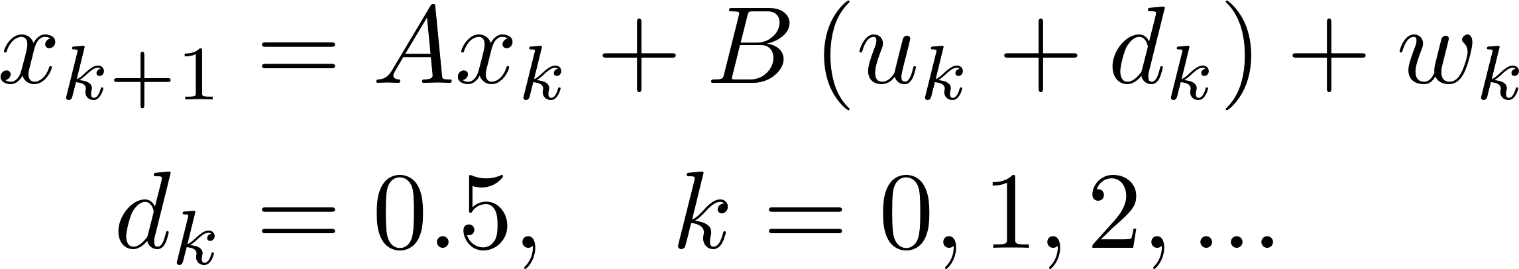
Homework
Exercise 4
Robust Tube MPC Formulation
Robust Tube MPC Design with Measured Disturbance
Objective: to understand the basics of Tube MPC and to learn how to customize it to include additional information.
Actual dynamics
Nominal dynamics
Given: a sample MATLAB file named “SAMPLE_Tube_MPC.m” that realizes the Robust Tube MPC.
Control policy
Original constraints
Task: No disturbance observer or noise is required. Given a constant, always available disturbance constantly affects control input, modify the formulation and the given MATLAB file to include this measured disturbance.
Tightened constraints
Disturbance invariant set

Slide 18
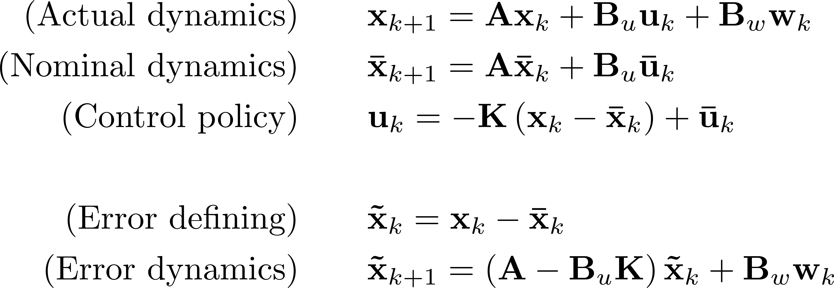
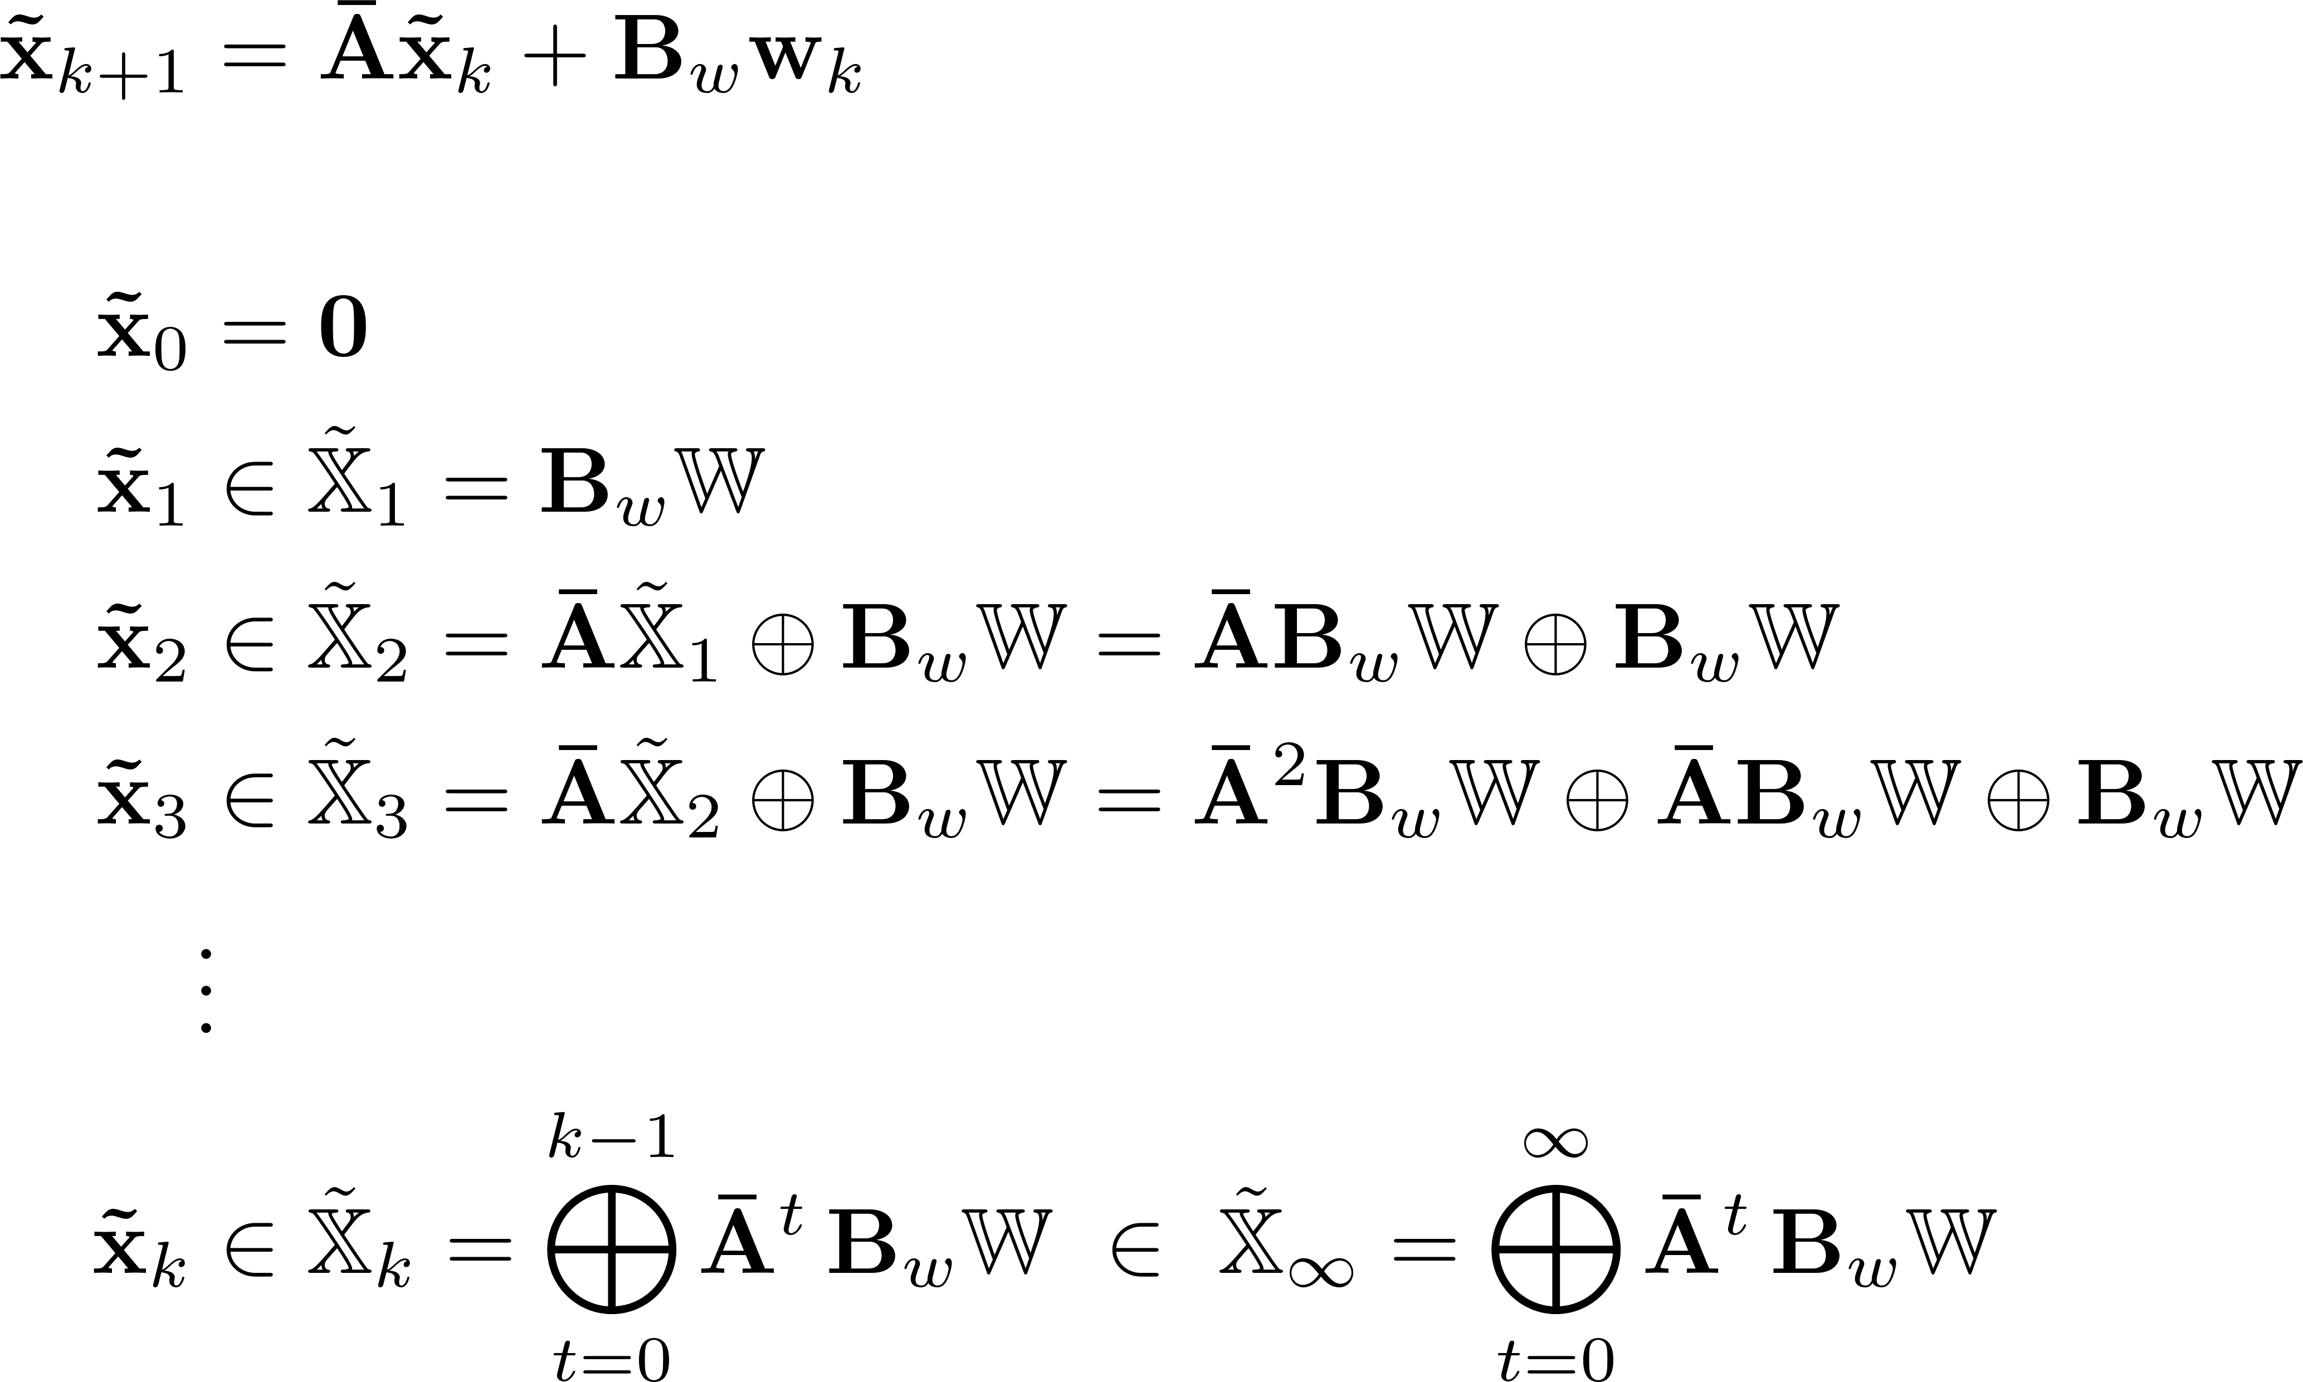
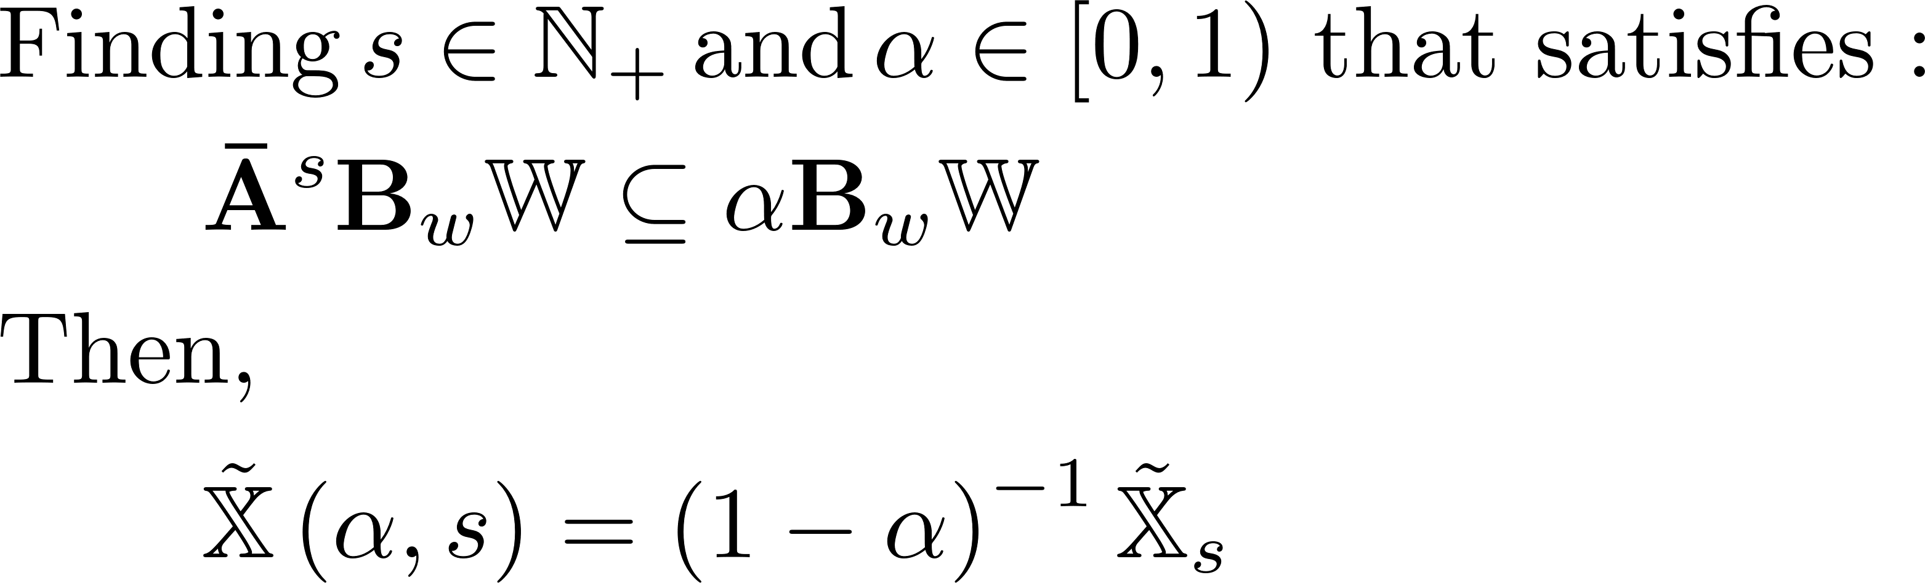

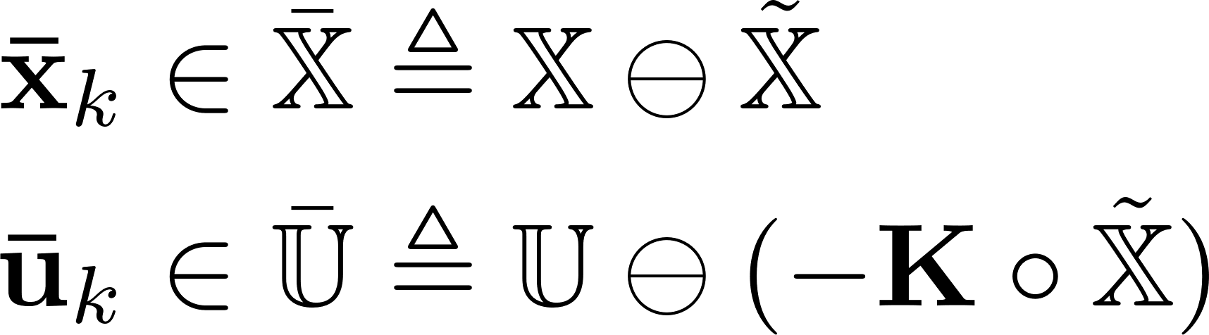
Tutorial: Robust Tube MPC Formulation
(1) From what is given…
(2) To the Robust Positively Invariant (RPI) set…
(3) To the outer approximation of RPI set…
(4) To the tightened state, control sets
Rakovic, S.V. Kerrigan, E.C., Kouramas, K.I., and Mayne, D.Q., “Invariant approximations of the minimal robust positively invariant set,” IEEE Transactions on Automatic Control, Vol. 50, No. 3, pp. 406-410, 2005.

