Slide 1
Classification and Prediction
What is classification? What is prediction?
Issues regarding classification and prediction
Classification by decision tree induction
Bayesian classification
Rule-based classification
Classification by back propagation
July 17, 2015
Data Mining: Concepts and Techniques

Slide 2
Classification vs. Prediction
Classification
  predicts categorical class labels (discrete or nominal)
  classifies data (constructs a model) based on the training set and the values (class labels) in a classifying attribute and uses it in classifying new data
Prediction
  models continuous-valued functions, i.e., predicts unknown or missing values.
  Ex. Manager want to predict how much a given customer will spend during the sale at shop.
  This is numeric prediction so normally Regression is used here.
July 17, 2015
Data Mining: Concepts and Techniques

Slide 3
Typical applications
  Loan approval: Ex. Which loan applications are Safe or risky for bank.
  Target marketing Ex. Customer with given profile will
  buy new computer or not.
  Medical diagnosis : Ex. Medical researcher may want to analyze cancer data to predict which one of three treatments a patient should receive.
  Fraud detection: It detects whether there is fraud or not.
July 17, 2015
Data Mining: Concepts and Techniques

Slide 4
Classification—A Two-Step Process
Model construction: describing a set of predetermined classes
  Each tuple/sample is assumed to belong to a predefined class, as determined by the class label attribute
  The set of tuples used for model construction is training set
  The model is represented as classification rules, decision trees, or mathematical formulae
Model usage: for classifying future or unknown objects
  Estimate accuracy of the model
    The known label of test sample is compared with the classified result from the model
    Accuracy rate is the percentage of test set samples that are correctly classified by the model
    Test set is independent of training set, otherwise over-fitting will occur
  If the accuracy is acceptable, use the model to classify data tuples whose class labels are not known
July 17, 2015
Data Mining: Concepts and Techniques

Slide 5



Process (1): Model Construction
Classification
Algorithms
Training
Data
Classifier
(Model)
IF rank = ‘professor’
OR years > 6
THEN tenured = ‘yes’
July 17, 2015
Data Mining: Concepts and Techniques

Slide 6




Process (2): Using the Model in Prediction
Classifier
Testing
Data
Unseen Data
(Jeff, Professor, 4)
Tenured?
July 17, 2015
Data Mining: Concepts and Techniques

Slide 7
Supervised vs. Unsupervised Learning
Supervised learning (classification)
  Supervision: The training data (observations, measurements, etc.) are accompanied by labels indicating the class of the observations
  New data is classified based on the training set
Unsupervised learning (clustering)
  The class labels of training data is unknown
  Given a set of measurements, observations, etc. with the aim of establishing the existence of classes or clusters in the data
July 17, 2015
Data Mining: Concepts and Techniques

Slide 8
Classification and Prediction
What is classification? What is prediction?
Issues regarding classification and prediction
Classification by decision tree induction
Bayesian classification
Rule-based classification
Classification by back propagation
July 17, 2015
Data Mining: Concepts and Techniques

Slide 9
Issues: Data Preparation
Data cleaning
  Preprocess data in order to reduce noise and handle missing values
Relevance analysis (feature selection)
  Remove the irrelevant or redundant attributes
Data transformation
  Generalize and/or normalize data
July 17, 2015
Data Mining: Concepts and Techniques

Slide 10
Issues: Evaluating Classification Methods
Accuracy
  classifier accuracy: predicting class label
  predictor accuracy: guessing value of predicted attributes(Finding Missing values)
Speed
  time to construct the model (training time)
  time to use the model (classification/prediction time)
Robustness: handling noise and missing values
Scalability: efficiency in disk-resident databases
Interpretability
  understanding and insight provided by the model
Other measures, e.g., goodness of rules, such as decision tree size or compactness of classification rules
July 17, 2015
Data Mining: Concepts and Techniques

Slide 11
Classification and Prediction
What is classification? What is prediction?
Issues regarding classification and prediction
Classification by decision tree induction
Bayesian classification
Rule-based classification
Classification by back propagation
July 17, 2015
Data Mining: Concepts and Techniques

Slide 12
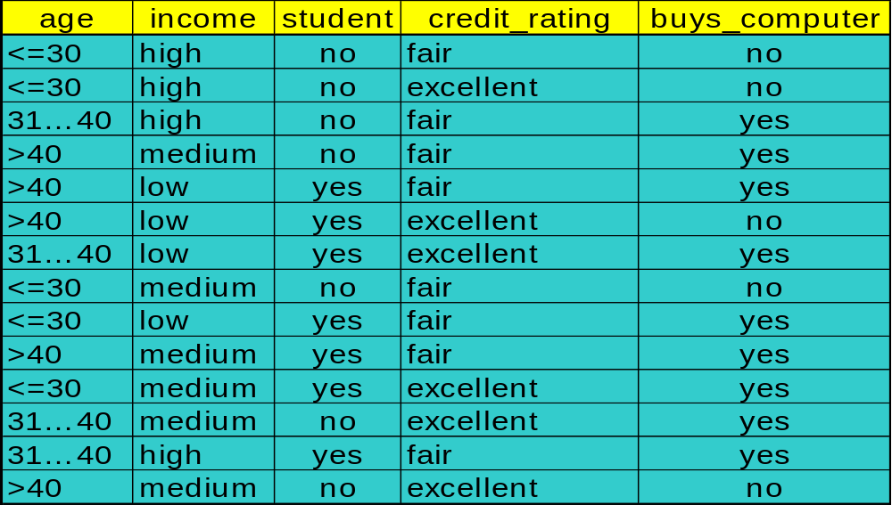
Decision Tree Induction: Training Dataset
July 17, 2015
Data Mining: Concepts and Techniques

Slide 13
Output: A Decision Tree for “buys_computer”
age?
<=30
overcast
>40
31..40
student?
yes
credit rating?
no
yes
excellent
fair
no
yes
no
yes
July 17, 2015
Data Mining: Concepts and Techniques

Slide 14
Algorithm for Decision Tree Induction
Basic algorithm (a greedy algorithm)
  Tree is constructed in a top-down recursive divide-and-conquer manner
  At start, all the training examples are at the root
  Attributes are categorical (if continuous-valued, they are discretized in advance)
  Examples are partitioned recursively based on selected attributes
  Test attributes are selected on the basis of a heuristic or statistical measure (e.g., information gain)
Conditions for stopping partitioning
  All samples for a given node belong to the same class
  There are no remaining attributes for further partitioning – majority voting is employed for classifying the leaf
  There are no samples left
July 17, 2015
Data Mining: Concepts and Techniques

Slide 15
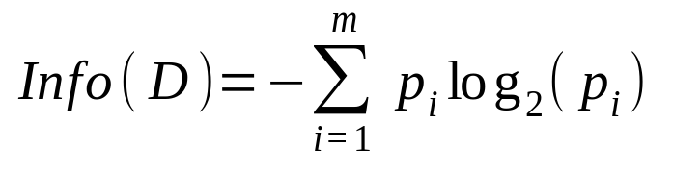
Attribute Selection Measure: Information Gain (ID3/C4.5)
Select the attribute with the highest information gain
Let p_{i} be the probability that an arbitrary tuple in D belongs to class C_{i}, estimated by |C_{i, D}|/|D|
Expected information (entropy) needed to classify a tuple in D:
July 17, 2015
Data Mining: Concepts and Techniques
Notes:
I : the expected information needed to classify a given sample
E (entropy) : expected information based on the partitioning into subsets by A

Slide 16
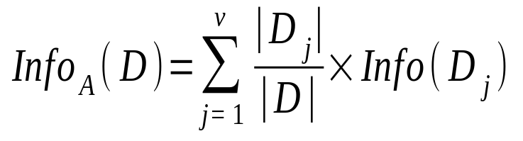
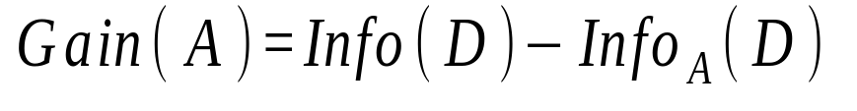
Information needed (after using A Attribute to split D into v ((Different values in attribute A) partitions) to classify D:
|D_{j}| is total number of tuples in D, that have outcome a_{j} of A.
Information gained by branching on attribute A
July 17, 2015

Slide 17
Class P: buys_computer = “yes”
Class N: buys_computer = “no”
July 17, 2015

Slide 18
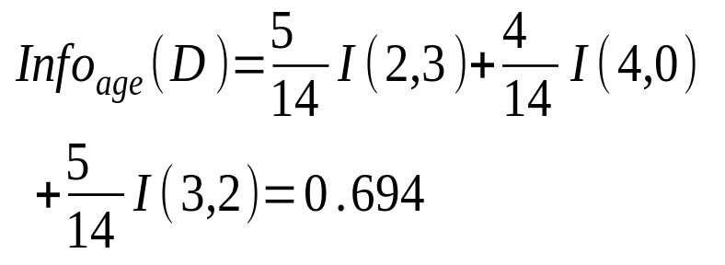
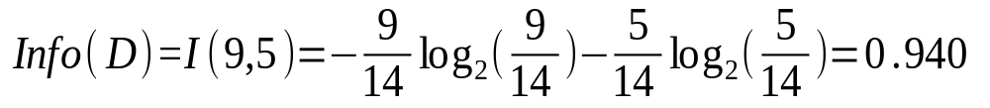

Attribute Selection: Information Gain
Class P: buys_computer = “yes”
Class N: buys_computer = “no”
means “age <=30” has 5 out of 14 samples, with 2 yes’es and 3 no’s. Hence
Similarly,
July 17, 2015

Slide 19
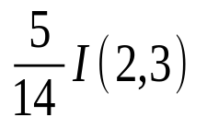
Attribute Selection: Information Gain
Class P: buys_computer = “yes”
Class N: buys_computer = “no”
means “age <=30” has 5 out of 14 samples, with 2 yes’es and 3 no’s. Hence
Similarly, Find
Gain (income)
Gain (Student)
Gain (Credit_Rating)
July 17, 2015

Slide 20
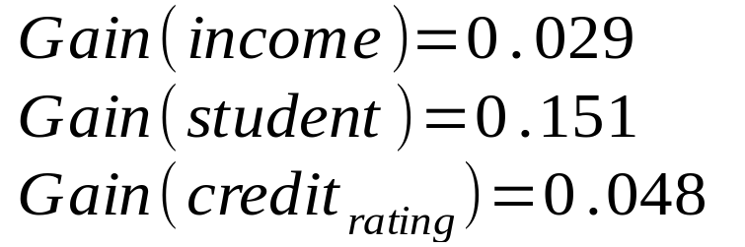
Data Mining: Concepts and Techniques
July 17, 2015

Slide 21
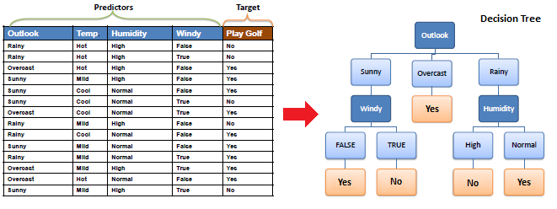
Data Mining: Concepts and Techniques
July 17, 2015

Slide 22
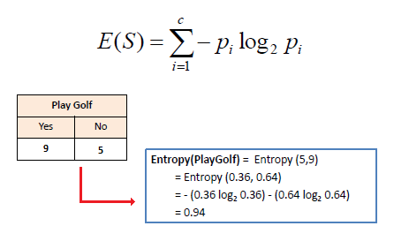
Data Mining: Concepts and Techniques
July 17, 2015

Slide 23
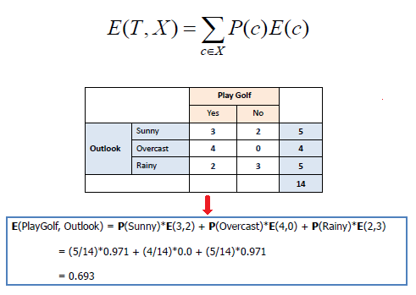
Data Mining: Concepts and Techniques
July 17, 2015

Slide 24
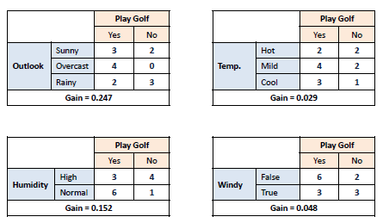
Data Mining: Concepts and Techniques
July 17, 2015

Slide 25
Computing Information-Gain for Continuous-Value Attributes
Let attribute A be a continuous-valued attribute
Must determine the best split point for A
  Sort the value A in increasing order
  Typically, the midpoint between each pair of adjacent values is considered as a possible split point
    (a_{i}+a_{i+1})/2 is the midpoint between the values of a_{i} and a_{i+1}
  The point with the minimum expected information requirement for A is selected as the split-point for A
Split:
  D1 is the set of tuples in D satisfying A ≤ split-point, and D2 is the set of tuples in D satisfying A > split-point
July 17, 2015

Slide 26
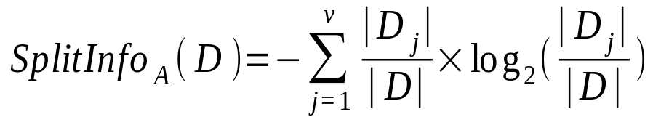
Gain Ratio for Attribute Selection (C4.5)
Information gain measure is biased towards attributes with a large number of values
Ex. Product_ID It may consist of large number of partitions, each one contain only one tuple.
Information gain of such attribute is maximal.
C4.5 (a successor of ID3) uses gain ratio to overcome the problem (normalization to information gain using split information value.)
July 17, 2015
Data Mining: Concepts and Techniques

Slide 27
GainRatio(A) = Gain(A)/SplitInfo(A)
Ex. Gain ratio(income) = 0.029/0.926 = 0.031
The attribute with the maximum gain ratio is selected as the splitting attribute
Data Mining: Concepts and Techniques
July 17, 2015

Slide 28
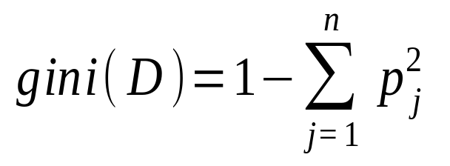
Gini index (CART, IBM IntelligentMiner)
Gini index measures the impurity of D,a data partition or set of training tuples
If a data set D contains examples from n classes, gini index, gini(D) is defined as
where p_{j} is the relative frequency of class j in D |C_{j, D}|/|D|
Ex. Income has three possible values, namely {low, medium, high}, then there are possible 8 subsets, we exclude {low, medium, high}, {}
so there are 2³ -2 possible ways to form two partitions of the data, D, based on binary split of A.
July 17, 2015
Data Mining: Concepts and Techniques

Slide 29
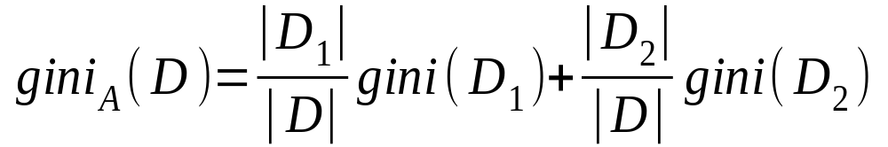

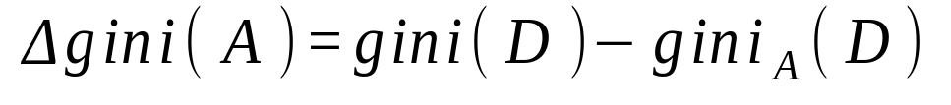
is computing a weighted sum of the impurity of each resulting partition.
For a discrete-valued attribute, the subset that gives the minimum Gini
index for that attribute is selected as its splitting subset.
Reduction in Impurity:
If a data set D is split on A into two subsets D₁ and D₂, the gini index gini(D) is defined as
July 17, 2015

Slide 30
The attribute provides the smallest gini_{split}(D) (or the largest reduction in impurity) is chosen to split the node.
Data Mining: Concepts and Techniques
July 17, 2015

Slide 31
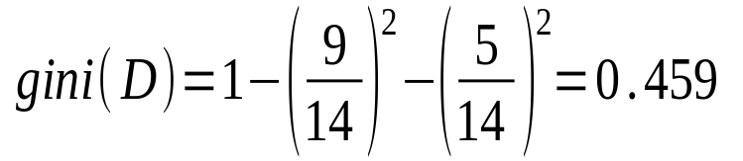
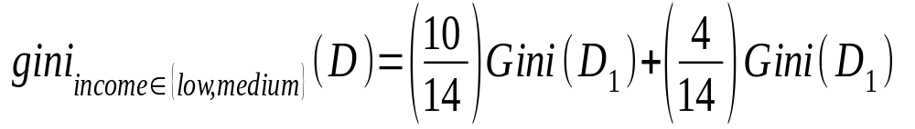
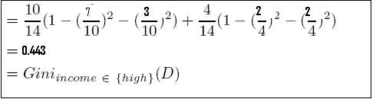
Gini index (CART, IBM IntelligentMiner)
Ex. D has 9 tuples in buys_computer = “yes” and 5 in “no”
Suppose the attribute income partitions D into 10 in D₁: {low, medium} and 4 in D₂
  Find values for gini_{{medium,high}} and gini_{{low,high}}
July 17, 2015
Data Mining: Concepts and Techniques

Slide 32
  but gini_{{medium,high}} is 0.450 and gini_{{low,high}} is 0.458
  Now apply same method on other attributes age, student, credit rating.
Data Mining: Concepts and Techniques
July 17, 2015

Slide 33
  For age best splitting subset is gini{youth,senior} or {middle_aged} is 0.375/0.357 and student and credit rating are binary attributes with Gini Index 0.367 and 0.429 Respectively.
  Finally attribute age with splitting subst {youth,senior} gives minimum Gini index, 0.459-0.357=0.102
Data Mining: Concepts and Techniques
July 17, 2015

Slide 34
Comparing Attribute Selection Measures
The three measures, in general, return good results but
  Information gain:
    biased towards multivalued attributes
  Gain ratio:
    tends to prefer unbalanced splits in which one partition is much smaller than the others
  Gini index:
    biased towards multivalued attributes
    has difficulty when number of classes is large
    tends to favor tests that result in equal-sized partitions and purity in both partitions
July 17, 2015
Data Mining: Concepts and Techniques

Slide 35
Overfitting and Tree Pruning(Repetition and Replication)
Overfitting: An induced tree may overfit the training data
  Too many branches, some may reflect irregularities due to noise or outliers
  Poor accuracy for unseen samples
Two approaches of Tree pruning:
  Prepruning: Halt tree construction early—do not split a node if this would result in the goodness measure falling below a threshold
    Difficult to choose an appropriate threshold.
    High thresholds could result in oversimplified trees
    Low thresholds could result in very little simplification.
July 17, 2015
Data Mining: Concepts and Techniques

Slide 36
  Postpruning: Remove branches from a “fully grown” tree.
  A subtree at a given node is pruned by removing its branches and replacing it with a leaf.
  The leaf is labled with most frequent class among the subtree being replaced.
    Use a set of data different from the training data to decide which is the “best pruned tree”
Data Mining: Concepts and Techniques
July 17, 2015

Slide 37
Bayesian Classification: Why?
A statistical classifier: performs probabilistic prediction, i.e., predicts class membership probabilities such as the probability that given tuple belongs to which class.
Foundation: Based on Bayes’ Theorem.
Performance: A simple Bayesian classifier, known as naive Bayesian classifier, has comparable performance with decision tree and selected neural network classifiers.
July 17, 2015
Data Mining: Concepts and Techniques

Slide 38
Incremental: Each training example can incrementally increase/decrease the probability that a hypothesis is correct prior knowledge can be combined with observed data
Standard: Even when Bayesian methods are computationally inflexible, they can provide a standard of optimal decision making against which other methods can be measured.

Slide 39
Bayesian Theorem: Basics
Let X be a data sample (“evidence”): class label is unknown
Let H be a hypothesis that X belongs to class C
Classification is to determine P(H|X), the probability that the hypothesis holds given the observed data sample X
Suppose x is described by attribute age and income , 35 year old customer with income 40000, suppose H(Hypothesis) is customer will buy computer then,
P(H/X) reflects the probability that customer x will buy a computer given that we know the customers age and income.
July 17, 2015
Data Mining: Concepts and Techniques

Slide 40
P(H) (prior probability), the initial probability
  E.g., X or any given customer will buy computer, regardless of age, income, …
P(X): probability that sample data is observed
It is probability that person from our set of customers is 35 years old and income is 40,000.
P(X|H) (posteriori probability), the probability of observing the sample X, given that the hypothesis holds
  E.g., It is the probability that customer x is 35 year old and income is 40,000 given that we know customer will buy a computer.

Slide 41
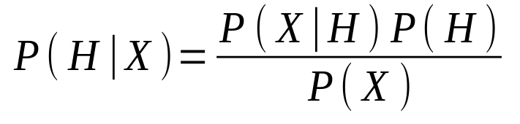
Bayesian Theorem
Given training data X, posteriori probability of a hypothesis H, P(H|X), follows the Bayes theorem
Informally, this can be written as
  posteriori = likelihood x prior/evidence
Predicts X belongs to C_{i} if the probability P(C_{i}|X) is the highest among all the P(C_{k}|X) for all the k classes
Practical difficulty: require initial knowledge of many probabilities, significant computational cost
July 17, 2015

Slide 42
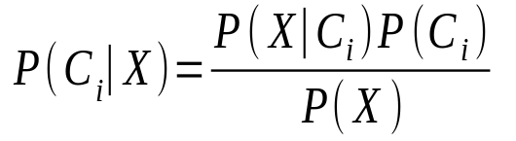

Towards Naïve Bayesian Classifier
Let D be a training set of tuples and their associated class labels, and each tuple is represented by an n attribute vector X = (x₁, x₂, …, x_{n})
Suppose there are m classes C₁, C₂, …, C_{m}.
Classification is to derive the maximum posteriori, i.e., the maximal P(C_{i}|X)
This can be derived from Bayes’ theorem
Since P(X) is constant for all classes, only
needs to be maximized
July 17, 2015

Slide 43

Naïve Bayesian Classifier: Training Dataset
Class:
C1:buys_computer = ‘yes’
C2:buys_computer = ‘no’
Data sample
X = (age <=30,
Income = medium,
Student = yes
Credit_rating = Fair)
July 17, 2015
Data Mining: Concepts and Techniques

Slide 44
Data Mining: Concepts and Techniques
July 17, 2015

Slide 45
Data Mining: Concepts and Techniques
July 17, 2015

Slide 46
Data Mining: Concepts and Techniques
July 17, 2015

Slide 47
Data Mining: Concepts and Techniques
July 17, 2015

Slide 48
Data Mining: Concepts and Techniques
July 17, 2015

Slide 49
Data Mining: Concepts and Techniques
July 17, 2015

Slide 50
Data Mining: Concepts and Techniques
July 17, 2015

Slide 51
Data Mining: Concepts and Techniques
July 17, 2015

Slide 52
Data Mining: Concepts and Techniques
July 17, 2015

Slide 53
Data Mining: Concepts and Techniques
July 17, 2015

Slide 54
Data Mining: Concepts and Techniques
July 17, 2015

Slide 55
Data Mining: Concepts and Techniques
July 17, 2015

Slide 56
Data Mining: Concepts and Techniques
July 17, 2015

Slide 57
Data Mining: Concepts and Techniques
July 17, 2015

Slide 58
Data Mining: Concepts and Techniques
July 17, 2015

Slide 59
Data Mining: Concepts and Techniques
July 17, 2015

Slide 60
Data Mining: Concepts and Techniques
July 17, 2015

Slide 61
Data Mining: Concepts and Techniques
July 17, 2015

Slide 62
Data Mining: Concepts and Techniques
July 17, 2015

Slide 63
Data Mining: Concepts and Techniques
July 17, 2015

Slide 64
Data Mining: Concepts and Techniques
July 17, 2015

Slide 65
Data Mining: Concepts and Techniques
July 17, 2015

Slide 66
Data Mining: Concepts and Techniques
July 17, 2015

Slide 67
Data Mining: Concepts and Techniques
July 17, 2015

Slide 68
Data Mining: Concepts and Techniques
July 17, 2015

Slide 69
Data Mining: Concepts and Techniques
July 17, 2015

Slide 70
Data Mining: Concepts and Techniques
July 17, 2015

Slide 71
Data Mining: Concepts and Techniques
July 17, 2015

Slide 72
Data Mining: Concepts and Techniques
July 17, 2015

Slide 73
Data Mining: Concepts and Techniques
July 17, 2015

Slide 74
Data Mining: Concepts and Techniques
July 17, 2015

Slide 75
Data Mining: Concepts and Techniques
July 17, 2015

Slide 76
Data Mining: Concepts and Techniques
July 17, 2015

Slide 77
Data Mining: Concepts and Techniques
July 17, 2015

Slide 78
Data Mining: Concepts and Techniques
July 17, 2015

Slide 79
Data Mining: Concepts and Techniques
July 17, 2015

Slide 80
Data Mining: Concepts and Techniques
July 17, 2015

Slide 81
Data Mining: Concepts and Techniques
July 17, 2015

Slide 82
Data Mining: Concepts and Techniques
July 17, 2015

Slide 83
Data Mining: Concepts and Techniques
July 17, 2015

Slide 84
Data Mining: Concepts and Techniques
July 17, 2015

Slide 85
Data Mining: Concepts and Techniques
July 17, 2015

Slide 86
Data Mining: Concepts and Techniques
July 17, 2015

Slide 87
Data Mining: Concepts and Techniques
July 17, 2015

Slide 88
Data Mining: Concepts and Techniques
July 17, 2015

Slide 89
Data Mining: Concepts and Techniques
July 17, 2015

Slide 90
Data Mining: Concepts and Techniques
July 17, 2015

Slide 91
Data Mining: Concepts and Techniques
July 17, 2015

Slide 92
Data Mining: Concepts and Techniques
July 17, 2015

Slide 93
Data Mining: Concepts and Techniques
July 17, 2015

Slide 94
Data Mining: Concepts and Techniques
July 17, 2015

Slide 95
Data Mining: Concepts and Techniques
July 17, 2015

Slide 96
Data Mining: Concepts and Techniques
July 17, 2015

Slide 97
Data Mining: Concepts and Techniques
July 17, 2015

Slide 98
Data Mining: Concepts and Techniques
July 17, 2015

Slide 99
Data Mining: Concepts and Techniques
July 17, 2015

Slide 100
Data Mining: Concepts and Techniques
July 17, 2015

Slide 101
Data Mining: Concepts and Techniques
July 17, 2015

Slide 102
Data Mining: Concepts and Techniques
July 17, 2015

Slide 103
Data Mining: Concepts and Techniques
July 17, 2015

Slide 104
Data Mining: Concepts and Techniques
July 17, 2015

Slide 105
Data Mining: Concepts and Techniques
July 17, 2015

Slide 106
Data Mining: Concepts and Techniques
July 17, 2015

Slide 107
Data Mining: Concepts and Techniques
July 17, 2015

Slide 108
Data Mining: Concepts and Techniques
July 17, 2015

Slide 109
Data Mining: Concepts and Techniques
July 17, 2015

Slide 110
Data Mining: Concepts and Techniques
July 17, 2015

Slide 111
Data Mining: Concepts and Techniques
July 17, 2015

Slide 112
Data Mining: Concepts and Techniques
July 17, 2015

Slide 113
Data Mining: Concepts and Techniques
July 17, 2015

Slide 114
Data Mining: Concepts and Techniques
July 17, 2015

Slide 115
Data Mining: Concepts and Techniques
July 17, 2015

Slide 116
Data Mining: Concepts and Techniques
July 17, 2015

Slide 117
Data Mining: Concepts and Techniques
July 17, 2015

Slide 118
Data Mining: Concepts and Techniques
July 17, 2015

Slide 119
Data Mining: Concepts and Techniques
July 17, 2015

Slide 120
Data Mining: Concepts and Techniques
July 17, 2015

Slide 121
Data Mining: Concepts and Techniques
July 17, 2015

Slide 122
Data Mining: Concepts and Techniques
July 17, 2015

Slide 123
Data Mining: Concepts and Techniques
July 17, 2015

Slide 124
Data Mining: Concepts and Techniques
July 17, 2015

Slide 125
Data Mining: Concepts and Techniques
July 17, 2015

Slide 126
Data Mining: Concepts and Techniques
July 17, 2015

Slide 127
Data Mining: Concepts and Techniques
July 17, 2015

Slide 128
Data Mining: Concepts and Techniques
July 17, 2015

Slide 129
Data Mining: Concepts and Techniques
July 17, 2015

Slide 130
Data Mining: Concepts and Techniques
July 17, 2015

Slide 131
Data Mining: Concepts and Techniques
July 17, 2015

Slide 132
Data Mining: Concepts and Techniques
July 17, 2015

Slide 133
Data Mining: Concepts and Techniques
July 17, 2015

Slide 134
Data Mining: Concepts and Techniques
July 17, 2015

Slide 135
Data Mining: Concepts and Techniques
July 17, 2015

Slide 136
Data Mining: Concepts and Techniques
July 17, 2015

Slide 137
Data Mining: Concepts and Techniques
July 17, 2015

Slide 138
Data Mining: Concepts and Techniques
July 17, 2015

Slide 139
Data Mining: Concepts and Techniques
July 17, 2015

Slide 140
Data Mining: Concepts and Techniques
July 17, 2015

Slide 141
Data Mining: Concepts and Techniques
July 17, 2015

Slide 142
Data Mining: Concepts and Techniques
July 17, 2015

Slide 143
Data Mining: Concepts and Techniques
July 17, 2015

Slide 144
Data Mining: Concepts and Techniques
July 17, 2015

Slide 145
Data Mining: Concepts and Techniques
July 17, 2015

Slide 146
Data Mining: Concepts and Techniques
July 17, 2015

Slide 147
Data Mining: Concepts and Techniques
July 17, 2015

Slide 148
Data Mining: Concepts and Techniques
July 17, 2015

Slide 149
Data Mining: Concepts and Techniques
July 17, 2015

Slide 150
Data Mining: Concepts and Techniques
July 17, 2015

Slide 151
Data Mining: Concepts and Techniques
July 17, 2015

Slide 152
Data Mining: Concepts and Techniques
July 17, 2015

Slide 153
Data Mining: Concepts and Techniques
July 17, 2015

Slide 154
Data Mining: Concepts and Techniques
July 17, 2015

Slide 155
Data Mining: Concepts and Techniques
July 17, 2015

Slide 156
Data Mining: Concepts and Techniques
July 17, 2015

Slide 157
Data Mining: Concepts and Techniques
July 17, 2015

Slide 158
Data Mining: Concepts and Techniques
July 17, 2015

Slide 159
Data Mining: Concepts and Techniques
July 17, 2015

Slide 160
Data Mining: Concepts and Techniques
July 17, 2015

Slide 161
Data Mining: Concepts and Techniques
July 17, 2015

Slide 162
Data Mining: Concepts and Techniques
July 17, 2015

Slide 163
Data Mining: Concepts and Techniques
July 17, 2015

Slide 164
Data Mining: Concepts and Techniques
July 17, 2015

Slide 165
Data Mining: Concepts and Techniques
July 17, 2015

Slide 166
Data Mining: Concepts and Techniques
July 17, 2015

Slide 167
Data Mining: Concepts and Techniques
July 17, 2015

Slide 168
Data Mining: Concepts and Techniques
July 17, 2015

Slide 169
Data Mining: Concepts and Techniques
July 17, 2015

Slide 170
Data Mining: Concepts and Techniques
July 17, 2015

Slide 171
Data Mining: Concepts and Techniques
July 17, 2015

Slide 172
Data Mining: Concepts and Techniques
July 17, 2015

Slide 173
Data Mining: Concepts and Techniques
July 17, 2015

Slide 174
Data Mining: Concepts and Techniques
July 17, 2015

Slide 175
Data Mining: Concepts and Techniques
July 17, 2015

Slide 176
Data Mining: Concepts and Techniques
July 17, 2015

Slide 177
Data Mining: Concepts and Techniques
July 17, 2015

Slide 178
Data Mining: Concepts and Techniques
July 17, 2015

Slide 179
Data Mining: Concepts and Techniques
July 17, 2015

Slide 180
Data Mining: Concepts and Techniques
July 17, 2015

Slide 181
Data Mining: Concepts and Techniques
July 17, 2015

Slide 182
Data Mining: Concepts and Techniques
July 17, 2015

Slide 183
Data Mining: Concepts and Techniques
July 17, 2015

Slide 184
Data Mining: Concepts and Techniques
July 17, 2015

Slide 185
Data Mining: Concepts and Techniques
July 17, 2015

Slide 186
Data Mining: Concepts and Techniques
July 17, 2015

Slide 187
Data Mining: Concepts and Techniques
July 17, 2015

Slide 188
Data Mining: Concepts and Techniques
July 17, 2015

Slide 189
Data Mining: Concepts and Techniques
July 17, 2015

Slide 190
Data Mining: Concepts and Techniques
July 17, 2015

Slide 191
Data Mining: Concepts and Techniques
July 17, 2015

Slide 192
Data Mining: Concepts and Techniques
July 17, 2015

Slide 193
Data Mining: Concepts and Techniques
July 17, 2015

Slide 194
Data Mining: Concepts and Techniques
July 17, 2015

Slide 195
Data Mining: Concepts and Techniques
July 17, 2015

Slide 196
Data Mining: Concepts and Techniques
July 17, 2015

Slide 197
Data Mining: Concepts and Techniques
July 17, 2015

Slide 198
Data Mining: Concepts and Techniques
July 17, 2015

Slide 199
Data Mining: Concepts and Techniques
July 17, 2015

Slide 200
Data Mining: Concepts and Techniques
July 17, 2015

Slide 201
Data Mining: Concepts and Techniques
July 17, 2015

Slide 202
Data Mining: Concepts and Techniques
July 17, 2015

Slide 203
Data Mining: Concepts and Techniques
July 17, 2015

Slide 204
Data Mining: Concepts and Techniques
July 17, 2015

Slide 205
Data Mining: Concepts and Techniques
July 17, 2015

Slide 206
Data Mining: Concepts and Techniques
July 17, 2015

Slide 207
Data Mining: Concepts and Techniques
July 17, 2015

Slide 208
Data Mining: Concepts and Techniques
July 17, 2015

Slide 209
Data Mining: Concepts and Techniques
July 17, 2015

Slide 210
Data Mining: Concepts and Techniques
July 17, 2015

Slide 211
Data Mining: Concepts and Techniques
July 17, 2015

Slide 212
Data Mining: Concepts and Techniques
July 17, 2015

Slide 213
Data Mining: Concepts and Techniques
July 17, 2015

Slide 214
Data Mining: Concepts and Techniques
July 17, 2015

Slide 215
Data Mining: Concepts and Techniques
July 17, 2015

Slide 216
Data Mining: Concepts and Techniques
July 17, 2015

Slide 217
Data Mining: Concepts and Techniques
July 17, 2015

Slide 218
Data Mining: Concepts and Techniques
July 17, 2015

Slide 219
Data Mining: Concepts and Techniques
July 17, 2015

Slide 220
Data Mining: Concepts and Techniques
July 17, 2015

Slide 221
Data Mining: Concepts and Techniques
July 17, 2015

Slide 222
Data Mining: Concepts and Techniques
July 17, 2015

Slide 223
Data Mining: Concepts and Techniques
July 17, 2015

Slide 224
Data Mining: Concepts and Techniques
July 17, 2015

Slide 225
Data Mining: Concepts and Techniques
July 17, 2015

Slide 226
Data Mining: Concepts and Techniques
July 17, 2015

Slide 227
Data Mining: Concepts and Techniques
July 17, 2015

Slide 228
Data Mining: Concepts and Techniques
July 17, 2015

Slide 229
Data Mining: Concepts and Techniques
July 17, 2015

Slide 230
Data Mining: Concepts and Techniques
July 17, 2015

Slide 231
Data Mining: Concepts and Techniques
July 17, 2015

Slide 232
Data Mining: Concepts and Techniques
July 17, 2015

Slide 233
Data Mining: Concepts and Techniques
July 17, 2015

Slide 234
Data Mining: Concepts and Techniques
July 17, 2015

Slide 235
Data Mining: Concepts and Techniques
July 17, 2015

Slide 236
Data Mining: Concepts and Techniques
July 17, 2015

Slide 237
Data Mining: Concepts and Techniques
July 17, 2015

Slide 238
Data Mining: Concepts and Techniques
July 17, 2015

Slide 239
Data Mining: Concepts and Techniques
July 17, 2015

Slide 240
Data Mining: Concepts and Techniques
July 17, 2015

Slide 241
Data Mining: Concepts and Techniques
July 17, 2015

Slide 242
Data Mining: Concepts and Techniques
July 17, 2015

Slide 243
Data Mining: Concepts and Techniques
July 17, 2015

Slide 244
Data Mining: Concepts and Techniques
July 17, 2015

Slide 245
Data Mining: Concepts and Techniques
July 17, 2015

Slide 246
Data Mining: Concepts and Techniques
July 17, 2015

Slide 247
Data Mining: Concepts and Techniques
July 17, 2015

Slide 248
Data Mining: Concepts and Techniques
July 17, 2015

Slide 249
Data Mining: Concepts and Techniques
July 17, 2015

Slide 250
Data Mining: Concepts and Techniques
July 17, 2015

Slide 251
Data Mining: Concepts and Techniques
July 17, 2015

Slide 252
Data Mining: Concepts and Techniques
July 17, 2015

Slide 253
Data Mining: Concepts and Techniques
July 17, 2015

Slide 254
Data Mining: Concepts and Techniques
July 17, 2015

Slide 255
Data Mining: Concepts and Techniques
July 17, 2015

Slide 256
Data Mining: Concepts and Techniques
July 17, 2015

Slide 257
Data Mining: Concepts and Techniques
July 17, 2015

Slide 258
Data Mining: Concepts and Techniques
July 17, 2015

Slide 259
Data Mining: Concepts and Techniques
July 17, 2015

Slide 260
Data Mining: Concepts and Techniques
July 17, 2015

Slide 261
Data Mining: Concepts and Techniques
July 17, 2015

Slide 262
Data Mining: Concepts and Techniques
July 17, 2015

Slide 263
Data Mining: Concepts and Techniques
July 17, 2015

Slide 264
Data Mining: Concepts and Techniques
July 17, 2015

Slide 265
Data Mining: Concepts and Techniques
July 17, 2015

Slide 266
Data Mining: Concepts and Techniques
July 17, 2015

Slide 267
Data Mining: Concepts and Techniques
July 17, 2015

Slide 268
Data Mining: Concepts and Techniques
July 17, 2015

Slide 269
Data Mining: Concepts and Techniques
July 17, 2015

Slide 270
Data Mining: Concepts and Techniques
July 17, 2015

Slide 271
Data Mining: Concepts and Techniques
July 17, 2015

Slide 272
Data Mining: Concepts and Techniques
July 17, 2015

Slide 273
Data Mining: Concepts and Techniques
July 17, 2015

Slide 274
Data Mining: Concepts and Techniques
July 17, 2015

Slide 275
Data Mining: Concepts and Techniques
July 17, 2015

Slide 276
Data Mining: Concepts and Techniques
July 17, 2015

Slide 277
Data Mining: Concepts and Techniques
July 17, 2015

Slide 278
Data Mining: Concepts and Techniques
July 17, 2015

Slide 279
Data Mining: Concepts and Techniques
July 17, 2015

Slide 280
Data Mining: Concepts and Techniques
July 17, 2015

Slide 281
Data Mining: Concepts and Techniques
July 17, 2015

Slide 282
Data Mining: Concepts and Techniques
July 17, 2015

Slide 283
Data Mining: Concepts and Techniques
July 17, 2015

Slide 284
Data Mining: Concepts and Techniques
July 17, 2015

Slide 285
Data Mining: Concepts and Techniques
July 17, 2015

Slide 286
Data Mining: Concepts and Techniques
July 17, 2015

Slide 287
Data Mining: Concepts and Techniques
July 17, 2015

Slide 288
Data Mining: Concepts and Techniques
July 17, 2015

Slide 289
Data Mining: Concepts and Techniques
July 17, 2015

Slide 290
Data Mining: Concepts and Techniques
July 17, 2015

Slide 291
Data Mining: Concepts and Techniques
July 17, 2015

Slide 292
Data Mining: Concepts and Techniques
July 17, 2015

Slide 293
Data Mining: Concepts and Techniques
July 17, 2015

Slide 294
Data Mining: Concepts and Techniques
July 17, 2015

Slide 295
Data Mining: Concepts and Techniques
July 17, 2015

Slide 296
Data Mining: Concepts and Techniques
July 17, 2015

Slide 297
Data Mining: Concepts and Techniques
July 17, 2015

Slide 298
Data Mining: Concepts and Techniques
July 17, 2015

Slide 299
Data Mining: Concepts and Techniques
July 17, 2015

Slide 300
Data Mining: Concepts and Techniques
July 17, 2015

Slide 301
Data Mining: Concepts and Techniques
July 17, 2015

Slide 302
Data Mining: Concepts and Techniques
July 17, 2015

Slide 303
Data Mining: Concepts and Techniques
July 17, 2015

Slide 304
Data Mining: Concepts and Techniques
July 17, 2015

Slide 305
Naïve Bayesian Classifier: An Example
X = (age <= 30 , income = medium, student = yes, credit_rating = fair)
P(C_{i}): P(buys_computer = “yes”) = 9/14 = 0.643
P(buys_computer = “no”) = 5/14= 0.357
Compute P(X|C_{i}) for each class
P(age = “<=30” | buys_computer = “yes”) = 2/9 = 0.222
P(age = “<= 30” | buys_computer = “no”) = 3/5 = 0.6
P(income = “medium” | buys_computer = “yes”) = 4/9 = 0.444
P(income = “medium” | buys_computer = “no”) = 2/5 = 0.4
July 17, 2015
Data Mining: Concepts and Techniques

Slide 306
P(student = “yes” | buys_computer = “yes) = 6/9 = 0.667
P(student = “yes” | buys_computer = “no”) = 1/5 = 0.2
P(credit_rating = “fair” | buys_computer = “yes”) = 6/9 = 0.667
P(credit_rating = “fair” | buys_computer = “no”) = 2/5 = 0.4
X = (age <= 30 , income = medium, student = yes, credit_rating = fair)
P(X|C_{i}) : P(X|buys_computer = “yes”) = 0.222 x 0.444 x 0.667 x 0.667 = 0.044
P(X|buys_computer = “no”) = 0.6 x 0.4 x 0.2 x 0.4 = 0.019
P(X|C_{i})*P(C_{i}) : P(X|buys_computer = “yes”) * P(buys_computer = “yes”) = 0.028
P(X|buys_computer = “no”) * P(buys_computer = “no”) = 0.007
Therefore, X belongs to class (“buys_computer = yes”)
July 17, 2015

Slide 307
Find class label for X = (age >40 , income = medium, student = yes, credit_rating = excellent)
Find class label for X=(age=31 to 40, income=medium, student=yes ,credit_rating=excellent)
Data Mining: Concepts and Techniques
July 17, 2015

Slide 308
Naïve Bayesian Classifier: Comments
Advantages
  Easy to implement
  Good results obtained in most of the cases
Disadvantages
  Assumption: class conditional independence, therefore loss of accuracy
  Practically, dependencies exist among variables
    E.g., hospitals: patients: Profile: age, family history, etc.
    Symptoms: fever, cough etc., Disease: lung cancer, diabetes, etc.
    Dependencies among these cannot be modeled by Naïve Bayesian Classifier
How to deal with these dependencies?
  Bayesian Belief Networks
July 17, 2015
Data Mining: Concepts and Techniques

Slide 309
Using IF-THEN Rules for Classification
Represent the knowledge in the form of IF-THEN rules
  R: IF age = youth AND student = yes THEN buys_computer = yes
  Rule antecedent/precondition vs. rule consequent
Assessment of a rule: coverage and accuracy
  n_{covers} = # of tuples covered by R
  n_{correct} = # of tuples correctly classified by R
  coverage(R) = n_{covers} /|D| /* D: training data set */
  accuracy(R) = n_{correct} / n_{covers}
July 17, 2015
Data Mining: Concepts and Techniques

Slide 310
If more than one rule is triggered, need conflict resolution
Size ordering: assign the highest priority to the triggering rules that has the “toughest” requirement (i.e., with the most attribute test)
Class-based ordering: decreasing order of prevalence or mis classification cost per class
Rule-based ordering (decision list): rules are organized into one long priority list, according to some measure of rule quality or by experts

Slide 311
Rule Extraction from a Decision Tree
age?
<=30
31..40
>40
Rules are easier to understand than large trees
One rule is created for each path from the root to a leaf
Each attribute-value pair along a path forms a conjunction: the leaf holds the class prediction
Rules are mutually exclusive and exhaustive
student?
yes
credit rating?
no
yes
excellent
fair
no
yes
no
yes
Example: Rule extraction from our buys_computer decision-tree
  IF age = young AND student = no THEN buys_computer = no
  IF age = young AND student = yes THEN buys_computer = yes
  IF age = mid-age THEN buys_computer = yes
  IF age = old AND credit_rating = excellent THEN buys_computer = yes
  IF age = young AND credit_rating = fair THEN buys_computer = no
July 17, 2015

Slide 312
Rule Extraction from the Training Data
Sequential covering algorithm: Extracts rules directly from training data
Typical sequential covering algorithms: FOIL, AQ, CN2, RIPPER
Rules are learned sequentially, each for a given class C_{i} will cover many tuples of C_{i} but none (or few) of the tuples of other classes
Steps:
  Rules are learned one at a time
  Each time a rule is learned, the tuples covered by the rules are removed
  The process repeats on the remaining tuples unless termination condition, e.g., when no more training examples or when the quality of a rule returned is below a user-specified threshold
Comp. w. decision-tree induction: learning a set of rules simultaneously
July 17, 2015
Data Mining: Concepts and Techniques

Slide 313
Classification: A Mathematical Mapping
Classification:
  predicts categorical class labels
E.g., Personal homepage classification
  x_{i} = (x₁, x₂, x₃, …), y_{i} = +1 or –1
  x₁ : # of a word “homepage”
  x₂ : # of a word “welcome”
Mathematically
  x ∈ X = ℜ^{n}, y ∈ Y = {+1, –1}
  We want a function f: X → Y
July 17, 2015
Data Mining: Concepts and Techniques

Slide 314
Linear Classification
Binary Classification problem
The data above the red line belongs to class ‘x’
The data below red line belongs to class ‘o’
Examples: SVM, Perceptron, Probabilistic Classifiers
x
x
x
x
x
x
x
x
o
x
o
x
o
o
o
o
o
o
o
o
o
o
o
July 17, 2015
Data Mining: Concepts and Techniques

Slide 315
Discriminative Classifiers
Advantages
  prediction accuracy is generally high
    As compared to Bayesian methods – in general
  robust, works when training examples contain errors
  fast evaluation of the learned target function
    Bayesian networks are normally slow
Criticism
  long training time
  difficult to understand the learned function (weights)
    Bayesian networks can be used easily for pattern discovery
  not easy to incorporate domain knowledge
    Easy in the form of priors on the data or distributions
July 17, 2015
Data Mining: Concepts and Techniques

Slide 316
The k-Nearest Neighbor Algorithm
All instances correspond to points in the n-D space
The nearest neighbor are defined in terms of Euclidean distance, dist(X₁, X₂)
Target function could be discrete- or real- valued
For discrete-valued, k-NN returns the most common value among the k training examples nearest to x_{q}
_
.
_
_
.
+
_
.
+
.
.
_
x_{q}
+
_
.
+
July 17, 2015

Slide 317
Vonoroi diagram: the decision surface induced by 1-NN for a typical set of training examples

Slide 318
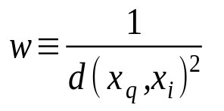
Discussion on the k-NN Algorithm
k-NN for real-valued prediction for a given unknown tuple
  Returns the mean values of the k nearest neighbors
Distance-weighted nearest neighbor algorithm
  Weight the contribution of each of the k neighbors according to their distance to the query x_{q}
    Give greater weight to closer neighbors
Robust to noisy data by averaging k-nearest neighbors
Curse of dimensionality: distance between neighbors could be dominated by irrelevant attributes
  To overcome it, axes stretch or elimination of the least relevant attributes
July 17, 2015
Data Mining: Concepts and Techniques

Slide 319
What Is Prediction?
(Numerical) prediction is similar to classification
  construct a model
  use model to predict continuous or ordered value for a given input
Prediction is different from classification
  Classification refers to predict categorical class label
  Prediction models continuous-valued functions
Major method for prediction: regression
  model the relationship between one or more independent or predictor variables and a dependent or response variable
Regression analysis
  Linear and multiple regression
  Non-linear regression
  Other regression methods: generalized linear model, Poisson regression, log-linear models, regression trees
July 17, 2015
Data Mining: Concepts and Techniques

