Slide 1
Human Computer Interfacing
Group : A5
Gibraan Jafar 421037
Usman Khan 421054
Amey Gondhalkar 421040
Aayush Jain 421045

Slide 2

Identifying specialised user groups
Students
Faculties
University staff
University Alumni
Developers

Slide 3

Related Facilities
Applying for each semester
Applying for various scholarships
Results and Revaluation
Downloading syllabus
Applying for masters or PhD
NPTEL certification courses
Feedback
Debugging maintenance and upgrade by developers

Slide 4

Suggestions
Minimalistic design with only most important links on main page
Securing broken links and end points
Availability of all content in multiple languages or in a single language understood by all
Uniform hosting of the entire website on a singular domain

Slide 5

User Persona
Name : Shubham Bopate
Branch : TY B Tech Computer
Hobbies: Enjoys watching movies and web series, reading books, acting and drama, inquisitive, full stack developer, go getter, loves adventures, interested in competitive coding.
Needs: Strong internet connection, powerful laptop, reliable electricity connection, scholarship, etc.
Pain points : Confusing and difficult to navigate website, difficulty in understanding language content, worried about website being insecure
Goals: Short term goals include getting placed in a reputed company with good package, become GS in final year, maintain a good CGPA, long term goals include, starting his own IT company, represent india in kabaddi, get his name in forbes magazine.

Slide 6
Contextual Inquiry
Questionnaire:
What was the last time you visited SPPU website?
Did you find what you were looking for?
Do you need any help navigating the website?
Would you be interested in having a dedicated application along with the website?
Insights/Analysis:
I visited the website on the time of my results and not after then till date.
I found my doubts but i needed a help of my senior to navigate through the website
I would most certainly like a dedicated application along with this website hoping the application would make my work easy.

Slide 7
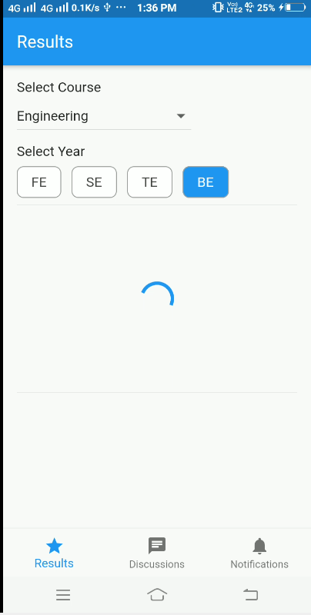
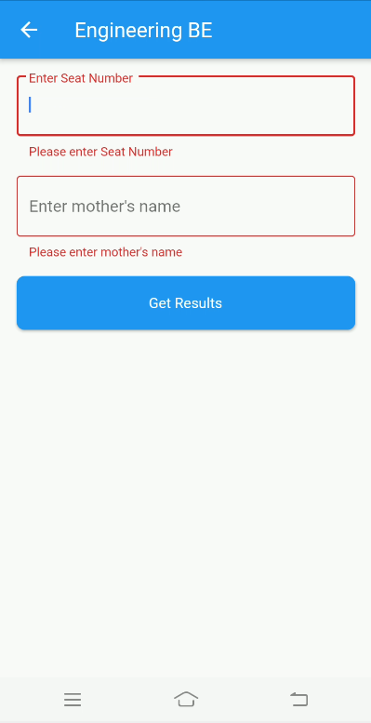
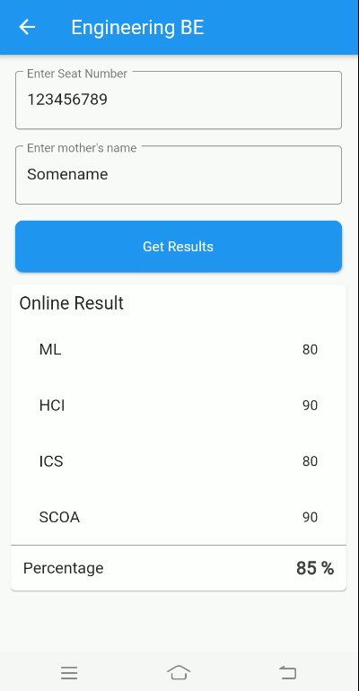
Interface prototype

Slide 8
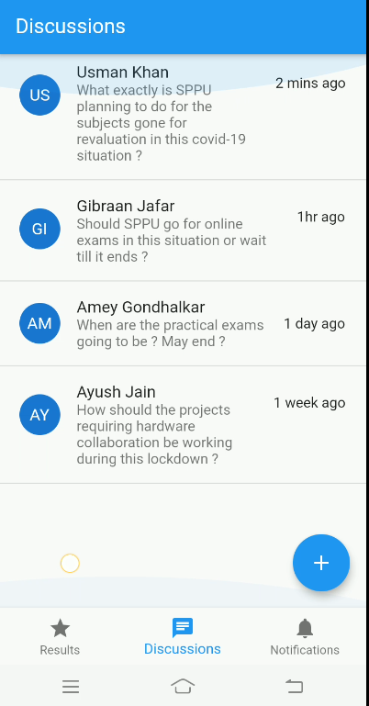
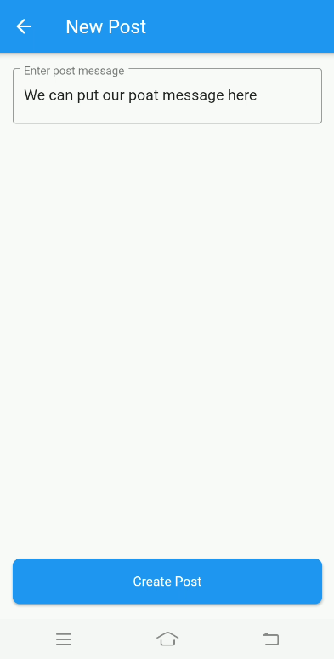
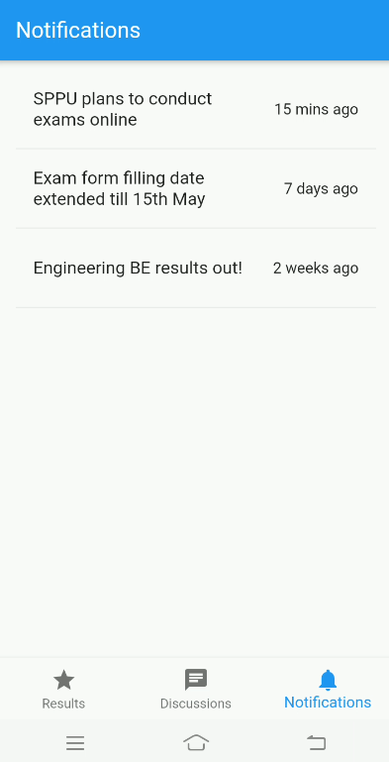
Interface Prototype

Slide 9
Evaluate Interface
Neilson’s Evaluation Technique
Visibility of system status: In our interface the user gets a visible realistic timeline of the expected application deadline, exam schedule, results dates and the evaluation schedule
Match between the system and the real world: Unlike the website interface our application simulates the journey of the student throughout the university by providing the student notifications and information relevant to him at that particular stage
Aesthetic and minimalist design: With consistent fonts, colour palette, colour depth, resolution, layout and orientation the interface of our application does not strain the senses of the user.
Flexibility and efficiency of use: With a minimal number of clicks unlike the website the student can go from one part of the website to another very smoothly. This makes our application more flexible and efficient for the use of the student users.
Recognition rather than recall: Unlike the website our application is very less intensive of the users memory but provides a visual edge to remember and recall. This in turn helps the user by not straining their memory and provides a pleasant interaction with the application.

Slide 10
Evaluate Interface Cognitive Walkthrough
The assessor judge the performance of the user based on the following criteria:
Will the user try and achieve the right outcome?
Yes, the user will achieve the right outcome.
Will the user notice that the correct action is available to them?
Yes, the user is able to easily determine the correct course of action.
If the correct action is performed will the user see that progress is being made towards their intended outcome?
Yes, the user will get an intuitive idea that he/she is making progress towards their intended outcome.
Does the user at any point of time feel the urge to quit/exit/ask for any help?
10/10 users do not feel the need for any help.
9/10 users do not feel the urge to quit.

Slide 11
Thank you for your patience

