Slide 1
Cache Memory
Intro

Slide 2
Levels of Memory

Slide 3
Levels of Memory

Slide 4
Levels of Memory

Slide 5
Levels of Memory

Slide 6
Cache Performance
hit or miss:
find memory loaction in cache
does not find memory location in cache
hit ratio = hit/(hit + miss)
number of hits/ totoal accesses

Slide 7
Cache Performance
miss rate: fraction of momory references not found in cache
miss rate = 1 - hit rate
Typical miss rates:
3-10% for L1
quite small(<1%) for L2

Slide 8
Cache Performance
hit time: time to deliver a liine in the cache to the processor includes time to determine whether the line is in the cache.
Typical times:
1-2 clock cycle for L1
5-20 clock cycle for L2

Slide 9
Calculation avg Access Time
example: 2 level cache, DRAM
L1 costs 1 cycle to acces and has miss rate of 10%
L2 cache costs 10 cycles toaccess hs miss rate of 2%
DRAM costs 80 cycles to access(no miss rate)
Then avg meory access time(AMAT) would be:
1+ always access L1 cache
0.1*10+ propability miss in L1 cache * time to access L2
0.1*0.02*80 probablity miss in L1 cache * probability miss in L2
cache * time to access DRAM
= 2.16 clock cycles

Slide 10
Cache Mapping
3 models are commonly used
Direct Mapping
Associative Mapping
Set-Associative Mapping

Slide 11
Direct Mapping
The simplest kind of mapping.
Each block in memory has one and only one place where its cache line will be held. If a part of the memory block is occupied when a new one is loaded, we replace the old one.
The address space consists of two parts, and the cache stores only the tag.
Index
Tag
The mapping is done using the equation x = y % n
X = block number in cache,
y = block number of memory,
n = number of blocks in cache
Direct mapping's performance is good in the best case, but quickly suffers. It is directly proportional to its hit ratio.

Slide 12
Fully Associative Mapping
In some ways the opposite thought of direct mapping. Any memory block can go into any cache line. This means that we need another way of identification.
This is achieved by using word ID bits to find which in the block is needed. The tag then becomes all of the remaining bits in the line.
Highly flexible, and generally considered to have the best performance in terms of hit/miss ratio.
There is a price to pay for this though: To check if an address exist in the cache, we must compare all existing entries tags. We also must implement a replacement algorithm, such as Least Recently Used (LRU).
Ideally used for very small caches, because as cache size rises, checking through the cache takes too much time.

Slide 13
Set Associative Mapping
A mixture between direct and fully associative mapping. The idea is to combine the best of both worlds, the hit ratio of fully associative, and the simple calculations of direct mapping.
Instead of only allowing only one line that a memory block can map to, it will group a few lines together to form a set. That block can then map to any line in the set.
Allows each word in the cache to have two or more words in the memory for the same index address.
To find an address, first look at the indexes of the set and then search the tag fields of all lines in the set for the address.
The number of sets can vary, usually from 2, 4, 8, and 16.
Past sets of four lines, we start seeing reduced gains.

Slide 14
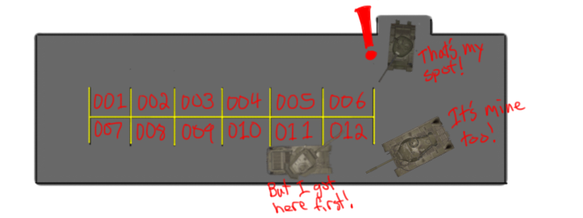
Direct Mapping Analogy
Given a student ID, you may only park in the space that matches the first 3 numbers of your ID number.
A potential problem arises when we have lots of students with the same first 3 numbers in their ID. There will be lots of competition for the same space.
The upside is that you will know right away if your spot is available, and you don't spend much time searching.

Slide 15
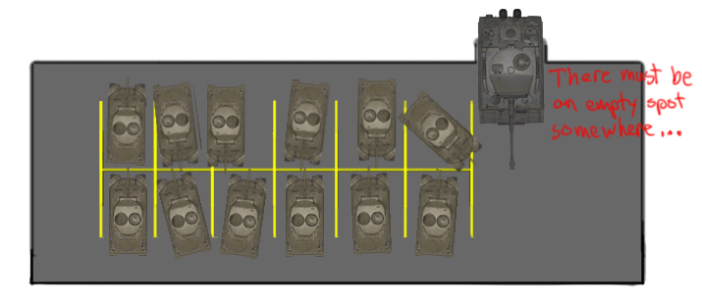
Full Associative Mapping Analogy
It doesn't matter what your ID is, you can park anywhere you want to!
But, what if all the spaces are filled?
You will end up driving to every single one looking for an empty spot before going through the process of kicking one out.

Slide 16
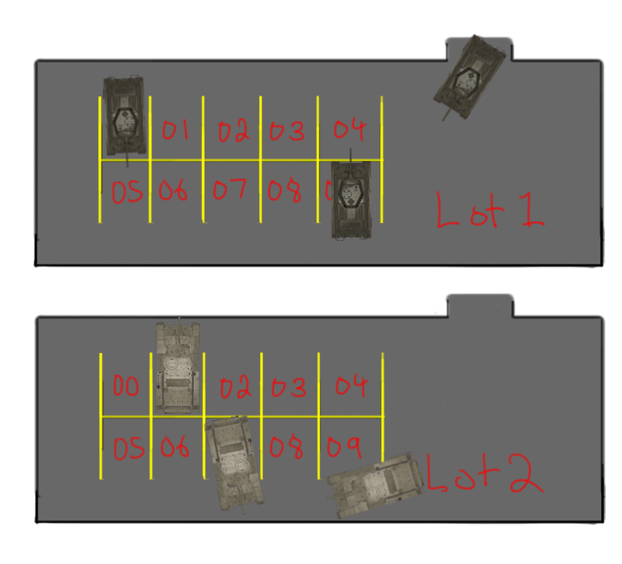
Set Associative Mapping Analogy
Your parking lot is based on the first digit of your student ID number, and you can park anywhere in that lot, but only in that lot.
This gives you some flexibility about where to park. You don't have to search the entire campus to find a spot, and there's potentially less competition for a spot.

