Slide 1

slideshow for pls make my app for me I tried v hard
By Dan

Slide 2
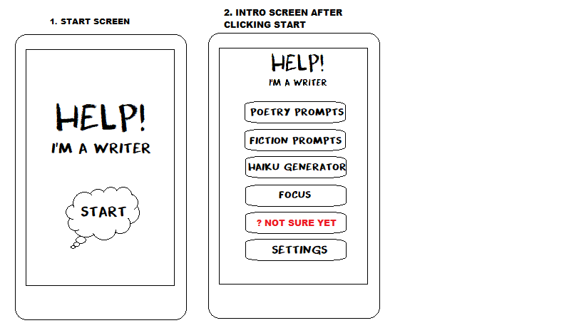
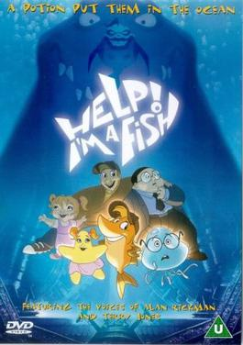
The app is called ‘Help! I’m a Writer’, named after the 2000s masterpiece ‘help! I’m a fish’

Slide 3
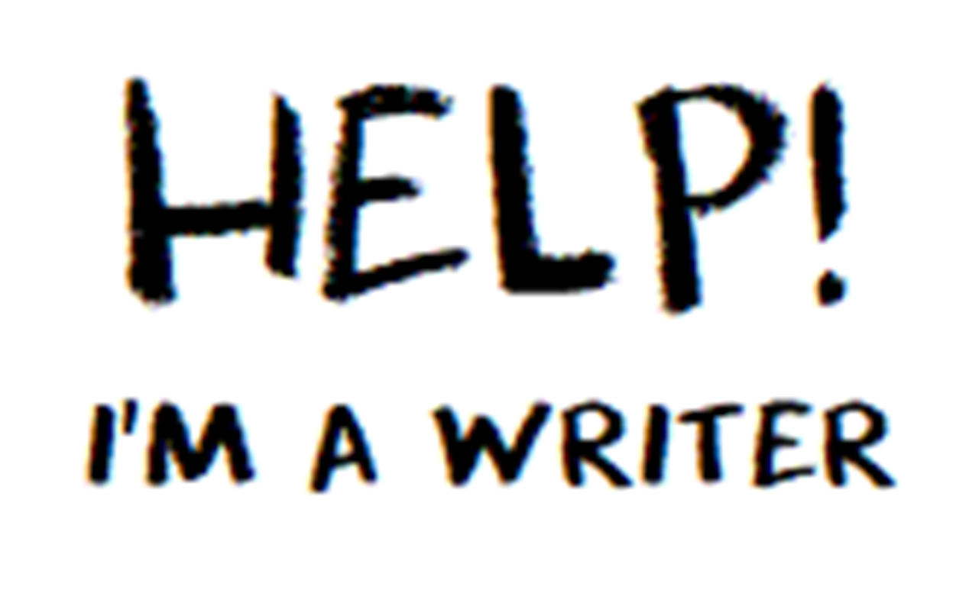
Help! I’m a Writer
The idea of HIAW is to be like a 5 in 1 app for writers who need help with the first push; starting a piece, brainstorming, and focusing on their writing.
The target audience is writers and aspiring writers who want to make time to write but can’t seem to make it happen – although the app is accessible to anyone
My main purpose is to get people to make progress or even finish a piece they’ve been sitting on, or start a masterpiece
Why? Bc I have these issues and I’m bad at time management

Slide 4
the app’s features
From the start screen, the user will be offered a range of features, these include;
Poetry prompts
Fiction prompts
A Haiku (poem) generator
Focus
I used dk cool crayon font bc it reminds me of mario sunshine ☺
And there’s also settings but that’s not as important it’s mostly humble brags

Slide 6
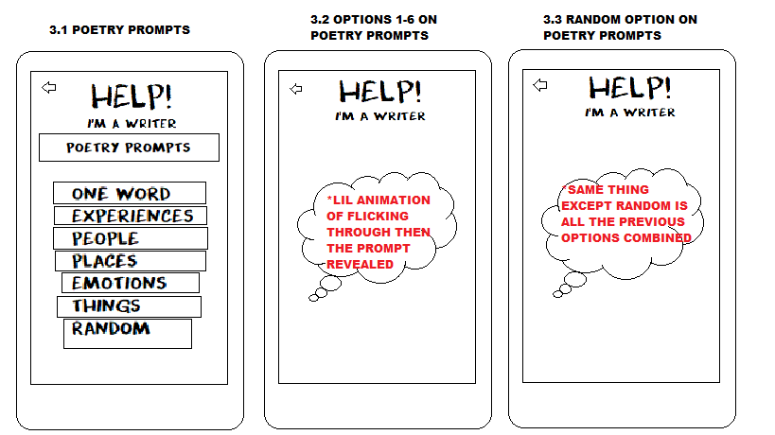

Slide 7
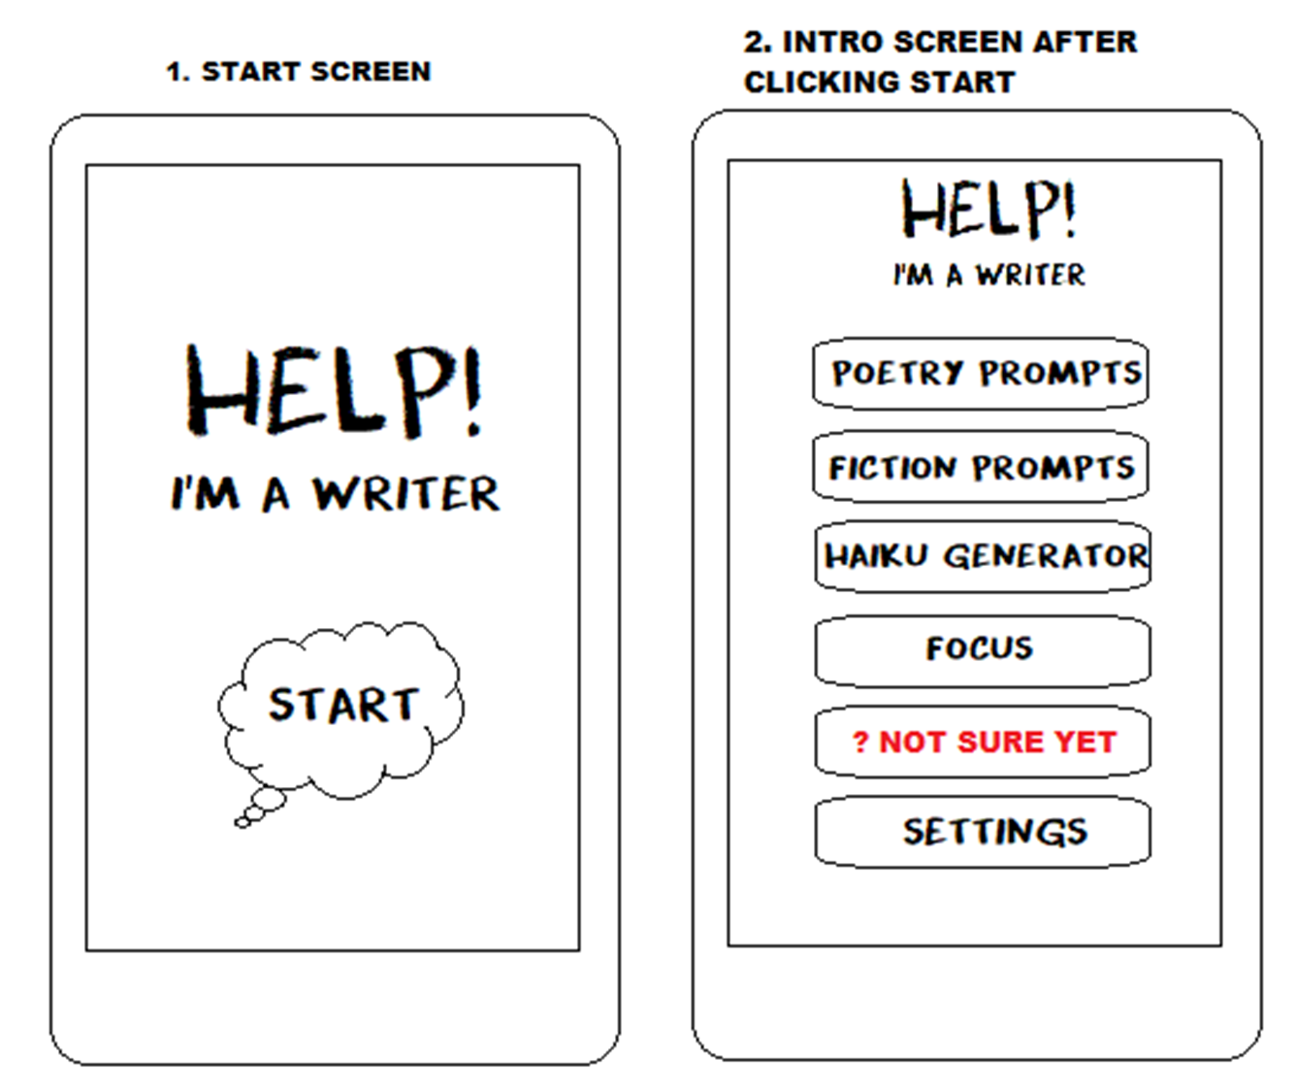

Slide 8
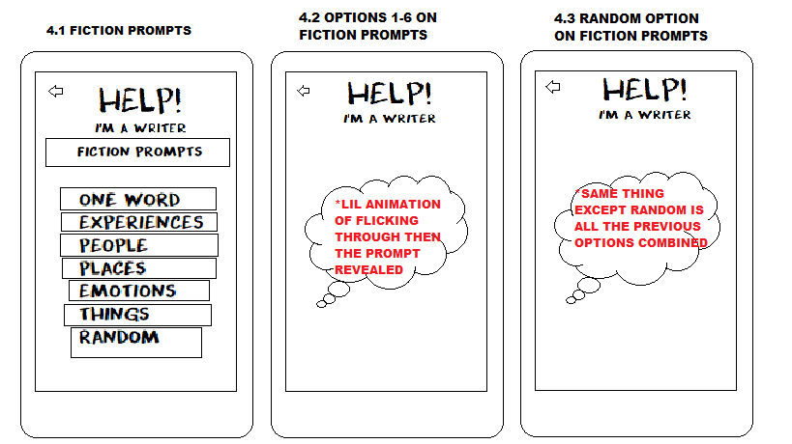

Slide 10
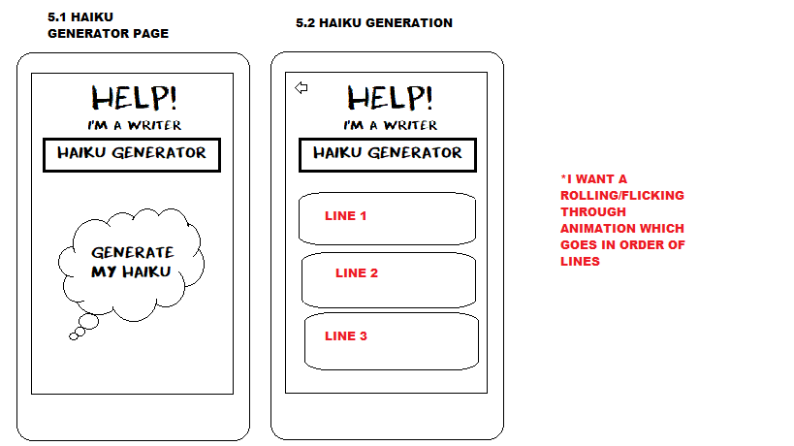

Slide 12
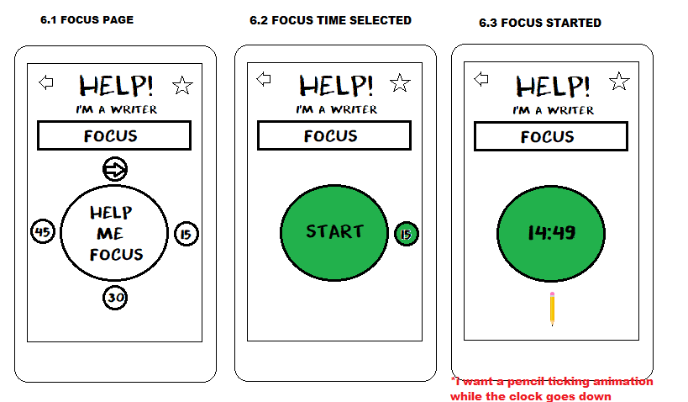

Slide 13
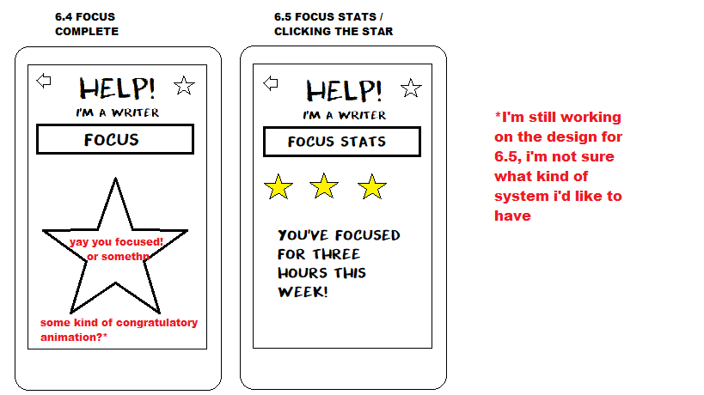

Slide 15
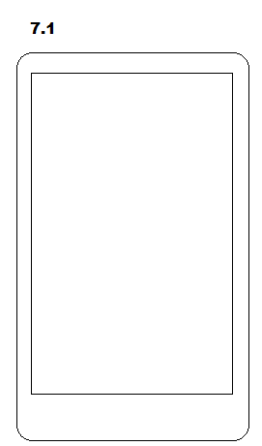
Idk man
Open to ideas

Slide 17
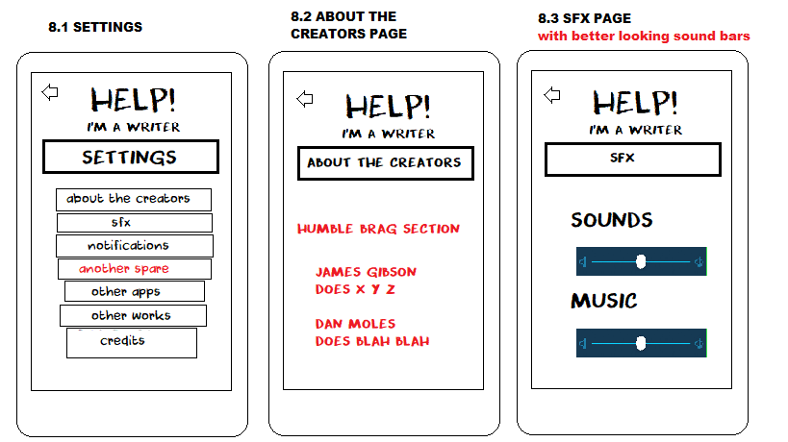

Slide 18
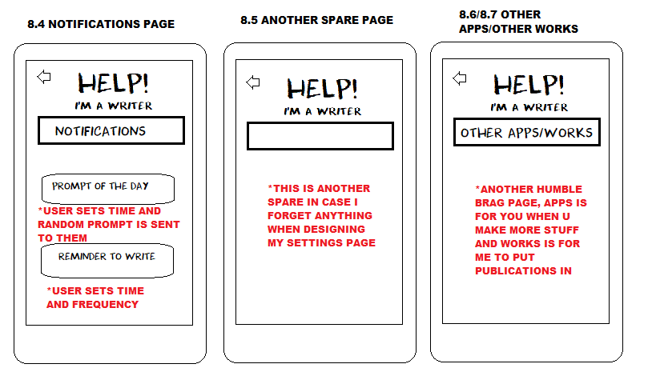

Slide 19
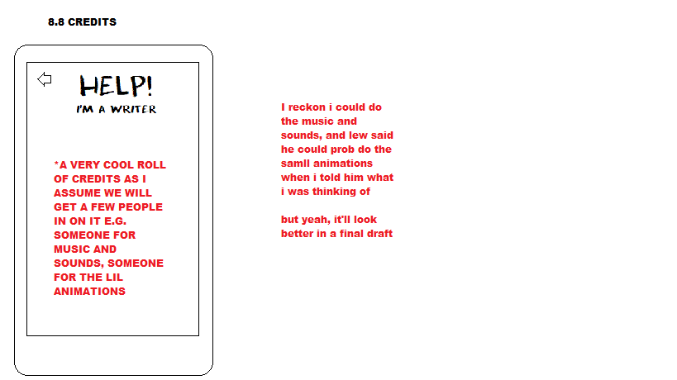

Slide 20
Can it be monetised?
Idk
Ideas I’ve had posed to me are:
Watch ads to fill up a virtual library of books once a day
Promote it and someone will buy it for money

Slide 21
Future plans
Expand the app
Make more ‘Help!’ apps
Make the ‘other apps’ / ‘other works’ sections FAT

Slide 22

suggested by dragons mum and dad pt.1
Optional scoreboard for hours focused in a week with writer’s names for other users to see and use
Analysis/ feedback on strengths
Workshopping (comments could be put forward to be posted)
Set up a twitter page for the app to take recommendations and feedback
This twitter will also retweet journals that are currently open for submissions so users get help that way too once their pieces are done

Slide 23
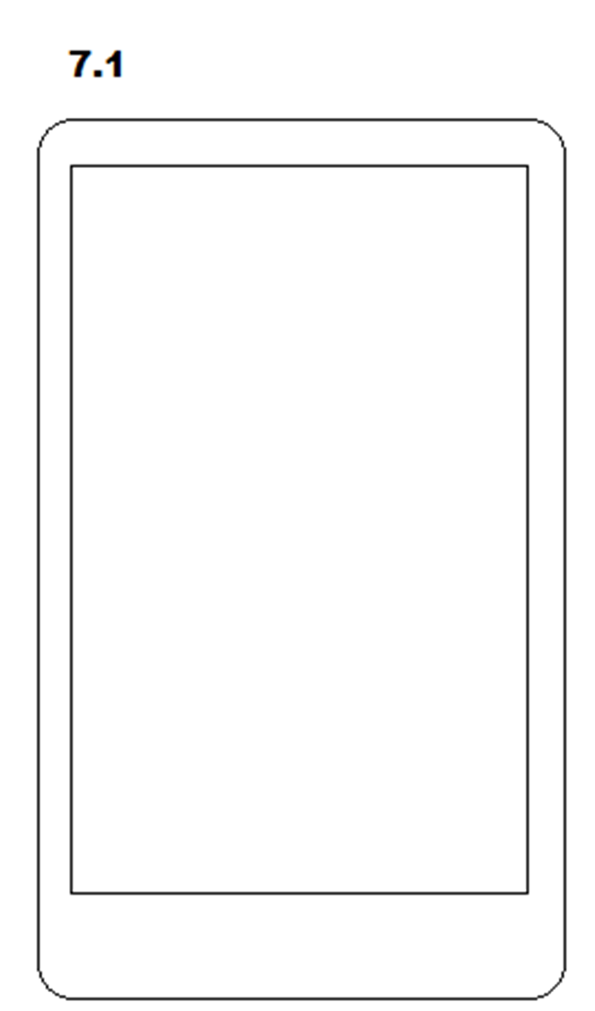
suggested by dragons mum and dad pt.2
These fall under stuff we could put on 7.1 (the other button I was brainstorming for)
Workshopping (comments could be put forward to be posted)
Poem of the week competitions – users are promoted on the app, poems or short pieces can be submitted on twitter or the app to be chosen and put on the app once a week as a weekly winner(but may have issues w copyright?)

Slide 24
Animation suggestions by dragons mum and dad
Mum wants lew to animate a little figure/person walking across the screen holding up the prompt once it is selected for the poetry and fiction prompts
She also posed a character walking up and slapping a star on the screen for the focus section to say well done
This is all the feedback we have so far, open to more

Slide 25
Any questions?
uwu

