Slide 1
Workshop 3 Team 45
Student name | Student Number
Kane Gibson | GBSKAN001
Matthew Jacobs | JCBMAT006
Tshiamo Seleki | SLKTSH006
Katlego Kgomari | KGMKAT002

Slide 2
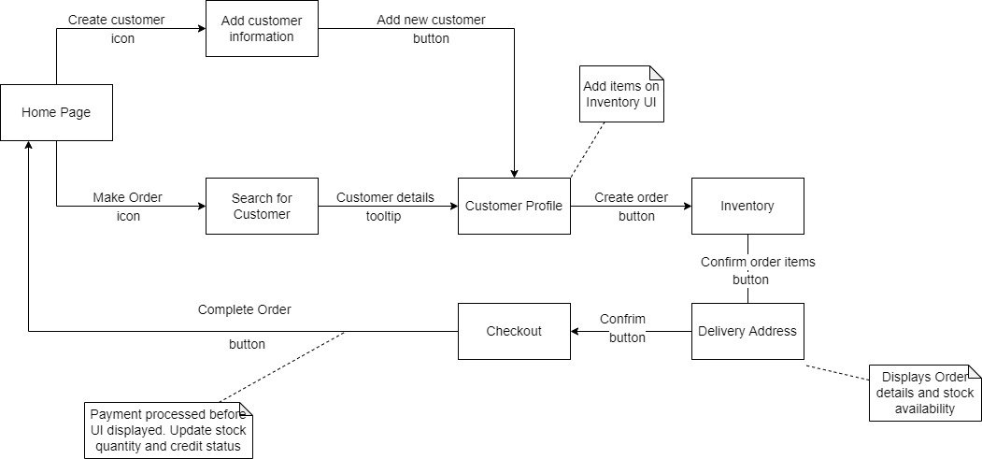
Task 1

Slide 3


Logo
Poppel
Main Menu
Marketing Department
User ID: MJ001
Home
Inventory
Current Orders
Your Colleagues
Poppel News
Make Order
Create Customer
Contacts
Keep calm and Pitso on

Slide 4

Logo
Poppel
Main Menu
Marketing Department
User ID: MJ001
Home
Inventory
Current Orders
Your Colleagues
Poppel News
Make Order
Create Customer
Contacts
Keep calm and Pitso on

Slide 5
Logo
Poppel
Create a Customer
Marketing Department
User ID: MJ001
Home
Inventory
Current Orders
Enter customer details
ID
0203095123089
Name
Kane Jacobs
Phone
063 680 6442
Fax
155 5658 2454
Email
kanejacs@gmail.com
Address
2 Stellson, Botasig, Cape Town 7552
Create Customer
Cancel
Keep calm and Pitso on

Slide 6
Customer successfully created
Logo
Poppel
Create a Customer
Marketing Department
User ID: MJ001
Home
Inventory
Current Orders
Enter customer details
ID
Customer successfully created
Customer ID:5 Name: Kane
0203095123089
Name
Kane Jacobs
Phone
063 680 6442
Fax
155 5658 2454
Email
kanejacs@gmail.com
OK
Address
2 Stellson, Botasig, Cape Town 7552
Create Customer
Cancel
Keep calm and Pitso on

Slide 7
Logo
Poppel
Main Menu
Marketing Department
User ID: MJ001
Home
Inventory
Current Orders
Your Colleagues
Poppel News
Make Order
Create Customer
Contacts
Keep calm and Pitso on

Slide 8
Logo
Poppel
Main Menu
Marketing Department
User ID: MJ001
Home
Inventory
Current Orders
Your Colleagues
Poppel News
Make Order
Create Customer
Contacts
Keep calm and Pitso on

Slide 9
Logo
Poppel
Make an Order
Marketing Department
User ID: MJ001
Select a Customer
Shoprite
Checkers
Woolworths
Spar
…
Cancel
Keep calm and Pitso on

Slide 10

Logo
Poppel
Make an Order
Marketing Department
User ID: MJ001
Add items to order
Customer: Shoprite
Inventory (click item to delete)
Product | Stock | Price Per Unit
Cola | 2500 | R 15
Kit Kat | 1702 | R 10
Wine gums | 2000 | R 12
Jelly Tots | 0 | R 8
Apple Toffee | 725 | R8
Product | Quantity | Price Per Unit | Total Price
Total Items: 0
Total Order Price: R0
Back
Confirm Order
Cancel
Keep calm and Pitso on

Slide 11
Logo
Poppel
Make an Order
Marketing Department
User ID: MJ001
Add items to order
Customer: Shoprite
Choose a Quantity for Kit Kat
Inventory (click item to delete)
Product | Stock | Price Per Unit
Cola | 2500 | R 15
Kit Kat | 1702 | R 10
Wine gums | 2000 | R 12
Jelly Tots | 0 | R 8
Apple Toffee | 725 | R8
Product | Quantity | Price Per Unit | Total Price
10
Cancel
Total Items: 0
OK
Total Order Price: R0
Back
Confirm Order
Cancel
Keep calm and Pitso on

Slide 12
Logo
Poppel
Make an Order
Marketing Department
User ID: MJ001
Add items to order
Customer: Shoprite
Inventory (click item to delete)
Product | Stock | Price Per Unit
Cola | 2500 | R 15
Kit Kat | 1702 | R 10
Wine gums | 2000 | R 12
Jelly Tots | 0 | R 8
Apple Toffee | 725 | R8
Product | Quantity | Price Per Unit | Total Price
Kit Kat | 10 | R 15 | R150
Total Items: 10
Total Order Price: R150
Back
Confirm Order
Cancel
Keep calm and Pitso on

Slide 13
Logo
Poppel
Make an Order
Marketing Department
User ID: MJ001
Add items to order
Customer: Shoprite
Choose a Quantity for Apple Toffee
Inventory (click item to delete)
Product | Stock | Price Per Unit
Cola | 2500 | R 15
Kit Kat | 1702 | R 10
Wine gums | 2000 | R 12
Jelly Tots | 0 | R 8
Apple Toffee | 725 | R8
Product | Quantity | Price Per Unit | Total Price
Kit Kat | 10 | R 15 | R150
55
Cancel
Total Items: 10
OK
Total Order Price: R150
Back
Confirm Order
Cancel
Keep calm and Pitso on

Slide 14

Logo
Poppel
Make an Order
Marketing Department
User ID: MJ001
Add items to order
Customer: Shoprite
Inventory (click item to delete)
Product | Stock | Price Per Unit
Cola | 2500 | R 15
Kit Kat | 1702 | R 10
Wine gums | 2000 | R 12
Jelly Tots | 0 | R 8
Apple Toffee | 725 | R8
Product | Quantity | Price Per Unit | Total Price
Kit Kat | 10 | R 15 | R150
Apple Toffee | 55 | R 10 | R550
Total Items: 65
Total Order Price: R700
Back
Confirm Order
Cancel
Keep calm and Pitso on

Slide 15
Logo
Poppel
Make an Order
Marketing Department
User ID: MJ001
Add items to order
Customer: Shoprite
Remove Apple Toffee from inventory?
Inventory (click item to delete)
Product | Stock | Price Per Unit
Cola | 2500 | R 15
Kit Kat | 1702 | R 10
Wine gums | 2000 | R 12
Jelly Tots | 0 | R 8
Apple Toffee | 725 | R8
Product | Quantity | Price Per Unit | Total Price
Kit Kat | 10 | R 15 | R150
Apple Toffee | 55 | R 10 | R550
Cancel
Total Items: 65
OK
Total Order Price: R700
Back
Confirm Order
Cancel
Keep calm and Pitso on

Slide 16
Logo
Poppel
Make an Order
Marketing Department
User ID: MJ001
Add items to order
Customer: Shoprite
Inventory (click item to delete)
Product | Stock | Price Per Unit
Cola | 2500 | R 15
Kit Kat | 1702 | R 10
Wine gums | 2000 | R 12
Jelly Tots | 0 | R 8
Apple Toffee | 725 | R8
Product | Quantity | Price Per Unit | Total Price
Kit Kat | 10 | R 15 | R150
Total Items: 10
Total Order Price: R150
Back
Confirm Order
Cancel
Keep calm and Pitso on

Slide 17
Logo
Poppel
Make an Order
Marketing Department
User ID: MJ001
Add items to order
Customer: Shoprite
Choose a Quantity for Wine Gums
Inventory (click item to delete)
Product | Stock | Price Per Unit
Cola | 2500 | R 15
Kit Kat | 1702 | R 10
Wine gums | 2000 | R 12
Jelly Tots | 0 | R 8
Apple Toffee | 725 | R8
Product | Quantity | Price Per Unit | Total Price
Kit Kat | 10 | R 15 | R150
2001
Cancel
Total Items: 10
OK
Total Order Price: R150
Back
Confirm Order
Cancel
Keep calm and Pitso on

Slide 18
Logo
Poppel
Make an Order
Marketing Department
User ID: MJ001
Add items to order
Customer: Shoprite
Not Enough Stock
Inventory (click item to delete)
Product | Stock | Price Per Unit
Cola | 2500 | R 15
Kit Kat | 1702 | R 10
Wine gums | 2000 | R 12
Jelly Tots | 0 | R 8
Apple Toffee | 725 | R8
Product | Quantity | Price Per Unit | Total Price
Kit Kat | 10 | R 15 | R150
Total Items: 10
OK
Total Order Price: R150
Back
Confirm Order
Cancel
Keep calm and Pitso on

Slide 19
Logo
Poppel
Make an Order
Marketing Department
User ID: MJ001
Add items to order
Customer: Shoprite
Inventory (click item to delete)
Product | Stock | Price Per Unit
Cola | 2500 | R 15
Kit Kat | 1702 | R 10
Wine gums | 2000 | R 12
Jelly Tots | 0 | R 8
Apple Toffee | 725 | R8
Product | Quantity | Price Per Unit | Total Price
Kit Kat | 10 | R 15 | R150
Total Items: 10
Total Order Price: R150
Back
Confirm Order
Cancel
Keep calm and Pitso on

Slide 20
Logo
Poppel
Make an Order
Marketing Department
User ID: MJ001
Add items to order
Customer: Shoprite
Choose a Quantity for Cola
Inventory (click item to delete)
Product | Stock | Price Per Unit
Cola | 2500 | R 15
Kit Kat | 1702 | R 10
Wine gums | 2000 | R 12
Jelly Tots | 0 | R 8
Apple Toffee | 725 | R8
Product | Quantity | Price Per Unit | Total Price
Kit Kat | 10 | R 15 | R150
2350
Cancel
Total Items: 10
OK
Total Order Price: R150
Back
Confirm Order
Cancel
Keep calm and Pitso on

Slide 21
Logo
Poppel
Make an Order
Marketing Department
User ID: MJ001
Add items to order
Customer: Shoprite
Credit limit reached
Inventory (click item to delete)
Product | Stock | Price Per Unit
Cola | 2500 | R 15
Kit Kat | 1702 | R 10
Wine gums | 2000 | R 12
Jelly Tots | 0 | R 8
Apple Toffee | 725 | R8
Product | Quantity | Price Per Unit | Total Price
Kit Kat | 10 | R 15 | R150
Total Items: 10
OK
Total Order Price: R150
Back
Confirm Order
Cancel
Keep calm and Pitso on

Slide 22
Logo
Poppel
Make an Order
Marketing Department
User ID: MJ001
Add items to order
Customer: Shoprite
Inventory (click item to delete)
Product | Stock | Price Per Unit
Cola | 2500 | R 15
Kit Kat | 1702 | R 10
Wine gums | 2000 | R 12
Jelly Tots | 0 | R 8
Apple Toffee | 725 | R8
Product | Quantity | Price Per Unit | Total Price
Kit Kat | 10 | R 15 | R150
Total Items: 10
Total Order Price: R150
Back
Confirm Order
Cancel
Keep calm and Pitso on

Slide 23
Logo
Poppel
Make an Order
Marketing Department
User ID: MJ001
Add items to order
Customer: Shoprite
Confirm Order
Inventory (click item to delete)
Product | Stock | Price Per Unit
Cola | 2500 | R 15
Kit Kat | 1702 | R 10
Wine gums | 2000 | R 12
Jelly Tots | 0 | R 8
Apple Toffee | 725 | R8
Product | Quantity | Price Per Unit | Total Price
Kit Kat | 10 | R 15 | R150
Cancel
Total Items: 10
OK
Total Order Price: R150
Back
Confirm Order
Cancel
Keep calm and Pitso on

Slide 24
Logo
Poppel
Make an Order
Marketing Department
User ID: MJ001
Add items to order
Customer: Shoprite
Order Successful!
Picking List
Kit Kat x 10
(picking list emailed to warehouse)
Inventory (click item to delete)
Product | Stock | Price Per Unit
Cola | 2500 | R 15
Kit Kat | 1702 | R 10
Wine gums | 2000 | R 12
Jelly Tots | 0 | R 8
Apple Toffee | 725 | R8
Product | Quantity | Price Per Unit | Total Price
Kit Kat | 10 | R 15 | R150
Total Items: 10
OK
Total Order Price: R150
Back
Confirm Order
Cancel
Keep calm and Pitso on

Slide 25
Logo
Poppel
Main Menu
Marketing Department
User ID: MJ001
Home
Inventory
Current Orders
Your Colleagues
Poppel News
Make Order
Create Customer
Contacts
Keep calm and Pitso on

Slide 26
Logo
Poppel
Main Menu
Marketing Department
User ID: MJ001
Home
Inventory
Current Orders
Your Colleagues
Poppel News
Make Order
Create Customer
Contacts
Keep calm and Pitso on

Slide 27
Logo
Poppel
Inventory
Marketing Department
User ID: MJ001
Home
Inventory
Current Orders
Search for inventory
Product | Stock | Price Per Unit
Cola | 2500 | R 15
Kit Kat | 1702 | R 10
Wine gums | 2000 | R 12
Jelly Tots | 0 | R 8
Apple Toffee | 725 | R8
List Expired Products
Cancel
Keep calm and Pitso on

Slide 28
Logo
Poppel
Inventory
Marketing Department
User ID: MJ001
Home
Inventory
Current Orders
Search for inventory
Expired Products
Product | Stock | Price Per Unit
Cola | 2500 | R 15
Kit Kat | 1702 | R 10
Wine gums | 2000 | R 12
Jelly Tots | 0 | R 8
Apple Toffee | 725 | R8
Mountain Dew (330mL) x2
Smarties (40g) x50
Cadbury Mint Top Deck slabs (80g) x10
List Expired Products
Cancel
Keep calm and Pitso on

