Slide 1
BUSINESS SOLUTION FOR CREDIT CARD APPROVAL PREDICTION
Presented To, The Technical Lead
Presented By, Gibi Babu Maveliputhenpurayil,
Data Scientist Team
Presented On, 2026-02-02

Slide 2
Problem identification
Build a machine learning model to predict credit card approval for bank customers
Replace manual review process that takes several days with an instant, automated decision system
Improve efficiency and reduce operational costs.

Slide 3


Slide 4
Dataset details
Two datasets: application_details and credit_details
Merged using customer ID
First dataset:
438557 records and 27 features
Final dataset:
36,457 records and 17 features
Target variable:
1 → Good customer - 32166
0 → Bad customer- 4291

Slide 5
DATA PROCESSING
Cleaned missing and inconsistent values
Encoded categorical variables
Handled outliers in employment duration
Performed feature reduction after EDA
Addressed class imbalance during model evaluation

Slide 6
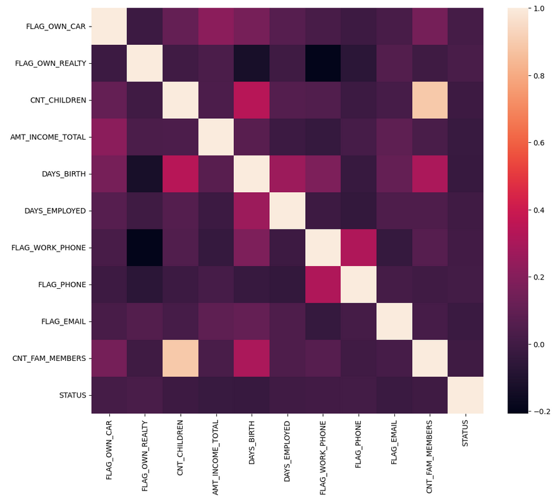
Correlation heat map

Slide 7
MODELS USED
Logistic Regression
K-Nearest Neighbors
Decision Tree
Random Forest
Gradient Boosting (Final Model)
Evaluation Metric: F1-score (Macro)
Validation Method: K-Fold Cross-Validation

Slide 8
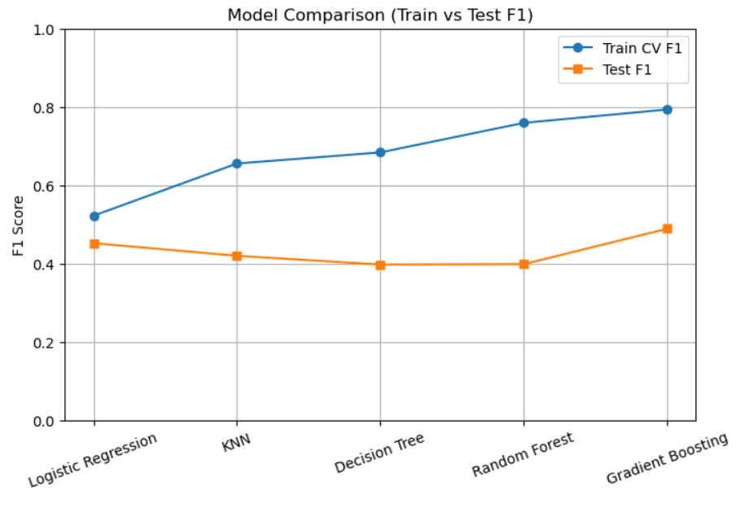
Model comparison

Slide 9
Hyper parameter tuning
Used Random Search CV
Best GB CV F1-macro: 0.8316132963009505
Best F1-macro on test set: 0.479092446126925
Best RF CV F1-macro: 0.7830794026439081
Best F1-macro on test set: 0.44028920468711047

Slide 10
BEST MODEL
Gradient Boosting Classifier
Best balance between majority and minority classes
Strong generalization on test data
Stable cross-validation performance
Best GB params: {'subsample': 0.8, 'n_estimators': 200, 'min_samples_split': 5, 'min_samples_leaf': 5, 'max_features': None, 'max_depth': 5, 'learning_rate': 0.1}

Slide 11
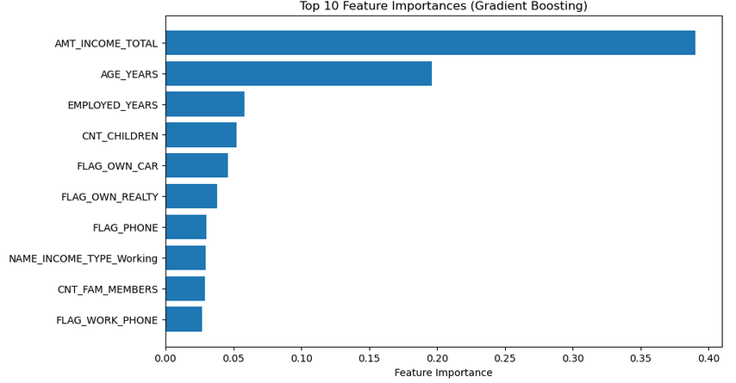
Feature importance

Slide 12
RECOMMENDATIONS
Enables instant credit approval decisions
Improves business efficiency
Reduces financial risk by identifying ineligible applicants

Slide 13
limitations
Class imbalance impacts minority-class prediction
Synthetic oversampling may not fully reflect real-world data

Slide 14
Future improvements
XGBoost / LightGBM
Cost-sensitive learning
Additional feature engineering
External data integration

Slide 15
conclusion
Model identifies total income, age, and employment duration as the most influential predictors of STATUS
Financial stability and employment history play a key role in classifying customers as ‘Good’ or ‘Bad’.

Slide 16


