Slide 1
Business Solution For Fake News Detection
Presented To, The Technical Lead
Presented By, Gibi Babu Maveliputhenpurayil,
Data Scientist Team
Presented On, 2026-03-07

Slide 2


Slide 3
PROBLEM IDENTIFICATION
Develop an automated NLP-based classification system that identifies whether a news article is fake or real within seconds
Reduce manual review time from multiple days to near real-time.
Achieve an F1-score of at least 85% on a labeled news dataset

Slide 4
Dataset details
The ISOT Fake News Dataset contains two types of articles fake and real News as two CSV files.
Collected from real world sources, from 2016 to 2017.
The truthful articles were obtained by crawling articles from Reuters.com (News website).
The fake news articles were collected from unreliable websites that were flagged by Politifact (a fact-checking organization in the USA) and Wikipedia.
The majority of articles focus on political and World news topics.
Each article contains the following information: article title, text, type and the date the article was published on.

Slide 5
DATA PROCESSING
Target variable: Status
1 → True- 21417
0 → Fake- 23481
First datset: 44,898 rows and 5 columns.
Final dataset:43557 rows and 17 columns.

Slide 6
DATA WRANGLING
The title and text columns were combined into a single content column.
The date column was cleaned.
Text was converted to lowercase.
Punctuation, special characters, and stopwords were removed.
Text was tokenized into individual words.
WordNet lemmatization was applied to reduce words to their base forms.

Slide 7
FEATURE ENGINEERING
A numeric feature content_length was created .
To analyze whether fake news articles use more aggressive language, toxicity scores were generated using the Detoxify model.
The following toxicity features were extracted:
toxicity
severe_toxicity
Obscene
Threat
Insult
identity_attack

Slide 8
EXPLORATORY DATA ANALYSIS
Shorter articles were slightly more likely to be fake, though not strongly predictive.
Fake news often contained sensational or politically charged language.
True news used formal reporting terminology.
Detoxify revealed that fake news exhibits higher levels of toxicity.

Slide 9
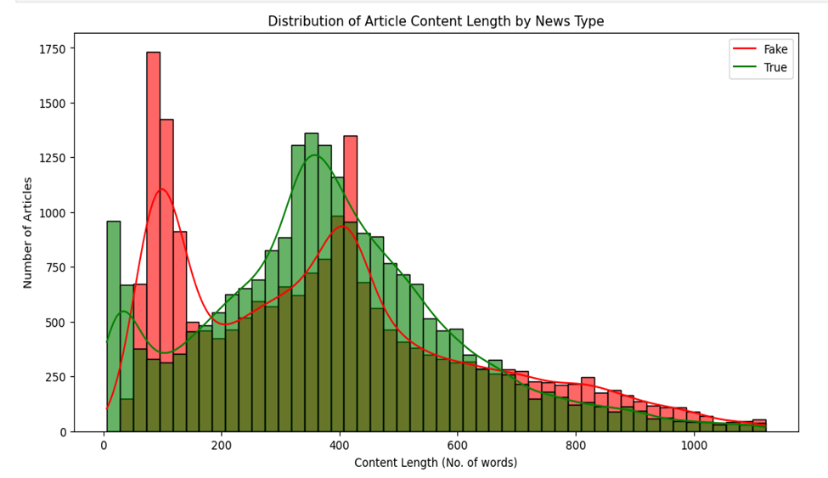

Slide 10
PREPROCESSING & TRAINING
Additional structural features were created:
Average Word Length
Unique Word Ratio
The subject category feature was removed to prevent bias.
The dataset was split into stratified training and testing sets to maintain class balance.
Numeric features were standardized.
Text data was converted into Word2Vec embeddings.

Slide 11
MODELING
The following models were trained and evaluated:
Logistic Regression
Linear SVM
Random Forest
XGBoost
Evaluation Metrics
Models were evaluated using:
Accuracy
Precision
Recall
F1 Score
ROC-AUC

Slide 12
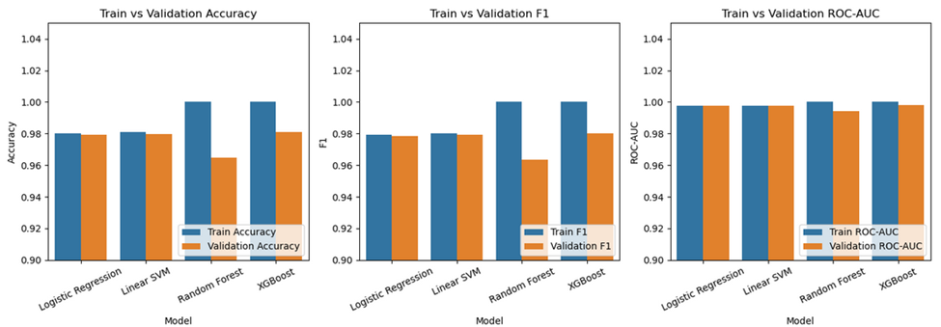
Model Performance:
Logistic Regression and Linear SVM achieved the strongest results:
F1-score ≈ 0.98
ROC-AUC > 0.99

Slide 13
HYPER PARAMETER TUNING
Used Random Search CV
Logistic Regression
Best CV F1-score: ~0.98
Test ROC-AUC: ~0.99
Linear SVM
Best CV F1-score: ~0.98
Test ROC-AUC: ~0.99

Slide 14
BEST MODEL
Logistic Regression
Faster training
Probability predictions
Easier interpretability
Better scalability
Best Logistic Regression params: {'C': np.float64(2.9753909473493882), 'penalty': 'l2', 'solver': 'liblinear'}

Slide 15
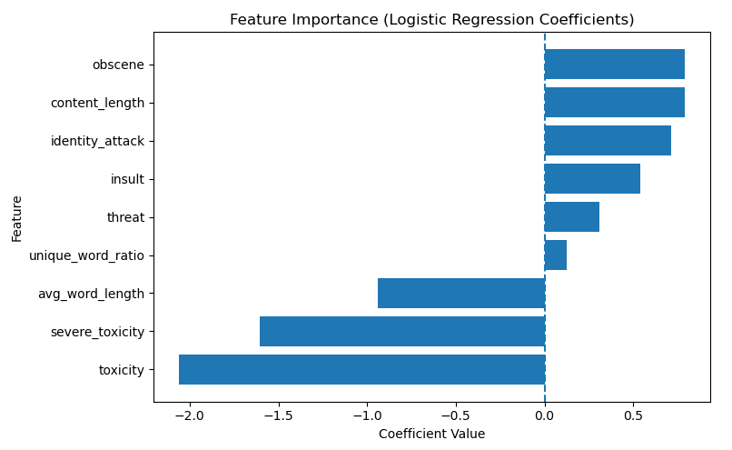
FEATURE IMPORTANCE

Slide 16
RECOMMENDATIONS
The fake news classification system demonstrates strong predictive performance and can support:
Journalists
Fact-checkers
Social media platforms
Platforms could integrate this model into content moderation systems to flag suspicious articles for further verification.
Combining linguistic features with additional signals such as source credibility, information propagation patterns may further improve detection accuracy.

Slide 17
LIMITATIONS
The dataset may not fully represent the diversity of real-world news sources.
Toxicity analysis was performed only on the first portion of each article to reduce computational cost.
Word2Vec embeddings capture semantic relationships but lack deeper contextual understanding compared to transformer-based models.

Slide 18
CONCLUSION
This project successfully developed a machine learning system for detecting fake news using Natural Language Processing.
By combining:
text embeddings
linguistic features
toxicity analysis
Multiple models were evaluated, with Logistic Regression emerging as the best-performing model.
The final model achieved:
F1-score ≈ 0.98
ROC-AUC > 0.99

Slide 19
FUTURE WORK
Using transformer-based models such as BERT.
Incorporating publisher credibility and social media features.
Expanding datasets to improve generalization.
Deploying the model as a real-time API or web application.

Slide 20


