Slide 1
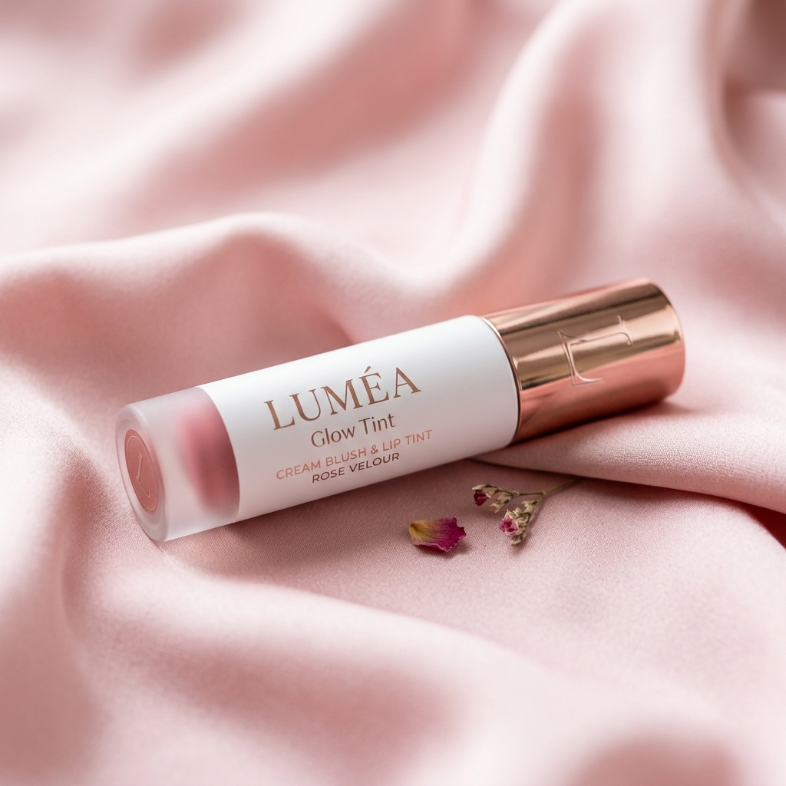
BEAUTY TECH PRESENTATION
LUMÉA
Glow, your way
A Modern Single-Product Beauty E-Commerce Platform
React 18 · Node.js Express · MySQL · Tailwind CSS
Project by: Kichu Khoirom (University Roll No. 2433548)
Degree: Bachelor of Computer Applications (BCA)
Institution: Gulzar Group of Institutions, Khanna, Punjab
Industry Internship: Viro Web Solution (Web Development)

Slide 2
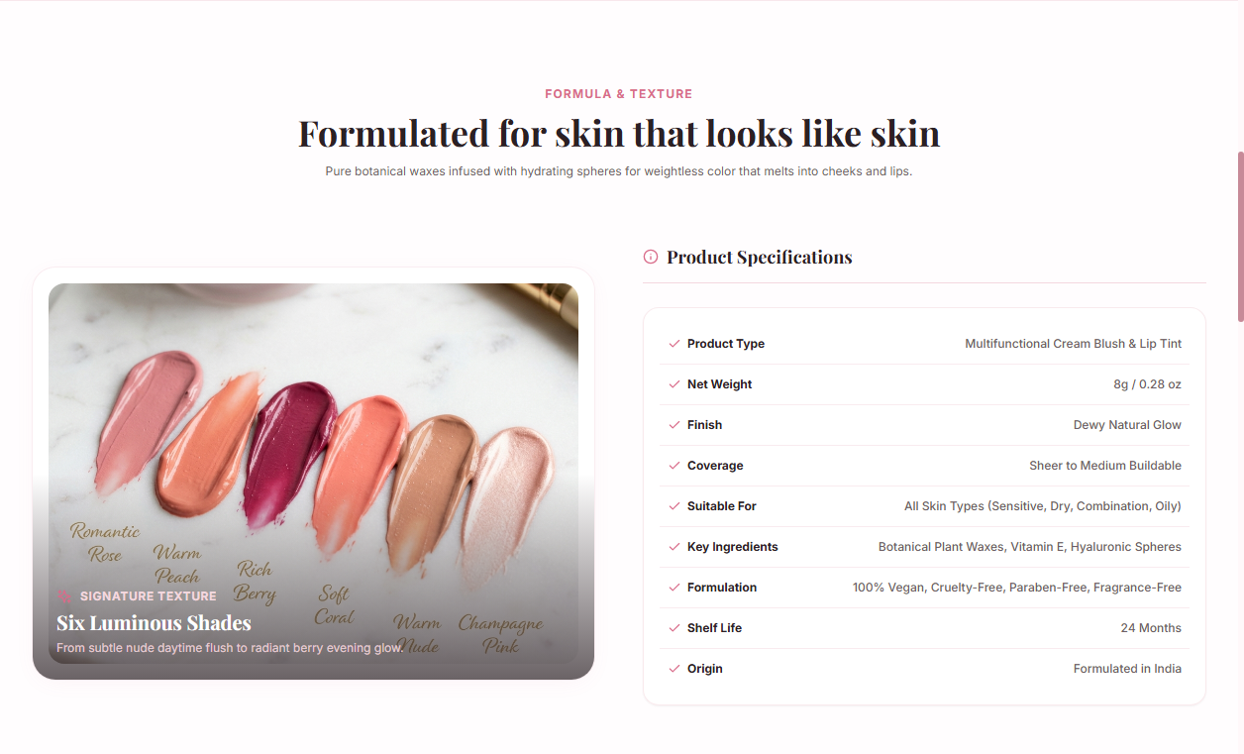
FLAGSHIP COSMETIC SHOWCASE
The Product — Luméa Glow Tint
🌸 Multifunctional Formula
A silky cream tint engineered to melt seamlessly into the skin for an effortless, buildable flush on cheeks, lips, and eyelids. Replaces 3 cosmetic products in 1 pocket-sized 8g component.
🌿 Clean & Conscious Beauty
Formulated with 100% vegan botanical waxes, cruelty-free certification, zero mineral oils, and enriched with hydrating jojoba and squalane for 12-hour continuous skin dewiness.
💎 Approachable Luxury (₹799)
Direct-to-consumer pricing with zero retail middleman markups. Ships free across India with Cash on Delivery (COD) support and a guaranteed 4.9★ customer satisfaction rating.

Slide 3
✦SHADE SPECTRUM & INCLUSIVITY
Curated Color Palette — 6 Signature Shades
Rose Petal
#D9828B · Soft Rosy Pink
Universal everyday blush for cool to neutral undertones
Peach Bloom
#EFA07F · Warm Coral Peach
Sun-kissed radiance ideal for light to medium warm skin
Berry Kiss
#A94B68 · Deep Rich Plum
Bold romantic statement tint for medium to deep undertones
Soft Coral
#E87970 · Fresh Coral Tangerine
Lively playful flush perfect for daytime lip and cheek glow
Nude Glow
#B97862 · Warm Terracotta Nude
Subtle sculpted neutral giving natural 'no-makeup' definition
Pink Champagne
#E8A5B5 · Shimmer Mauve Pink
Dewy highlighted glow with ultra-fine light-reflecting mica

Slide 4
✦PROBLEM & SOLUTION ANALYSIS
Market Challenge vs. The Luméa Experience
❌ Traditional Cosmetic E-Commerce
• Catalog Clutter: Overwhelming marketplaces with hundreds of unrelated products cause severe decision fatigue.
• Shade Hesitation: Static studio photos don't demonstrate shade warmth or skin undertone matching.
• Painful Checkout: Mandatory multi-page logins, hidden shipping fees, and broken UPI options lead to 70%+ cart drop-offs.
• Post-Purchase Anxiety: No live tracking visibility once an order is confirmed.
✨ The Luméa Single-Product Experience
• Laser-Focused D2C Storytelling: One hero formula perfected across 6 universally flattering shades.
• Live Swatch Synchronizer: Clicking any shade instantly switches photography, ambient glow, and inventory count.
• Frictionless Checkout: 1-click bag drawer, transparent pricing (₹799 with Free Shipping), and reliable Cash on Delivery.
• Total Transparency: Real-time 5-stage fulfillment stepper + self-service order cancellation & ticket desk.

Slide 5
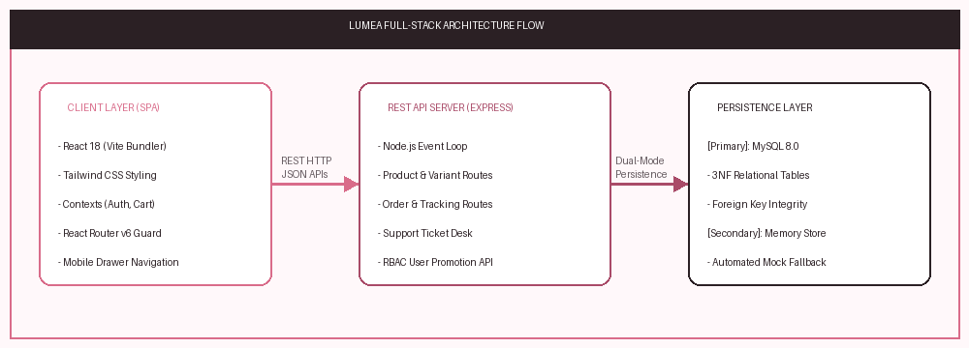
ENGINEERING FOUNDATION
Full-Stack Technology Architecture
⚡ React 18 + Vite 5.4
Single-Page Application frontend with declarative component hierarchy, custom context hooks (Cart, Auth, Notifications), and sub-second HMR updates.
⚡ Tailwind CSS 3.4
Utility-first design system with customized tokens (#FFF8FA, #D96C8A, #2B2024), 60 FPS mobile transforms, and zero layout drag.
⚡ Node.js & Express REST API
Asynchronous non-blocking backend server orchestrating products, orders, support tickets, and role verification.
⚡ MySQL 8.0 + In-Memory Fallback
Relational database in 3NF with automated zero-downtime fallback to an in-memory replica if database is unconfigured.

Slide 6
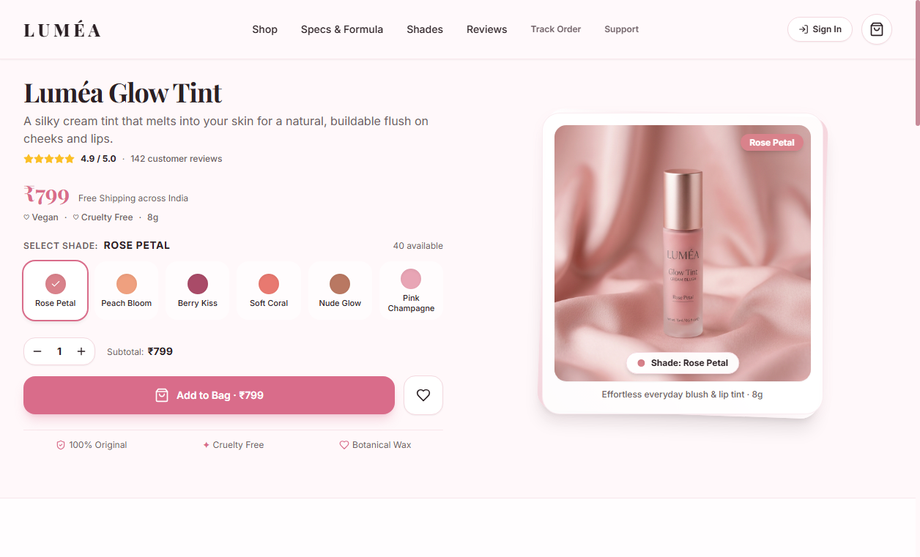
✦FRONTEND INTERACTIVITY & DESIGN
Interactive Storefront & Swatch Experience
Customer Journey Highlights:
1. Real-Time Swatch Switching:
Selecting any color swatch instantly updates the product photography, switches the ambient background glow, and renders stock availability.
2. Formula & Benefits Breakdown:
Dedicated sections showcase clean botanical ingredients (jojoba, squalane), cruelty-free pledge, and customer testimonials.
3. Persistent Cart Drawer:
An off-canvas bag slides into view with live quantity controls, subtotal calculations, and free delivery indicators across India.

Slide 7
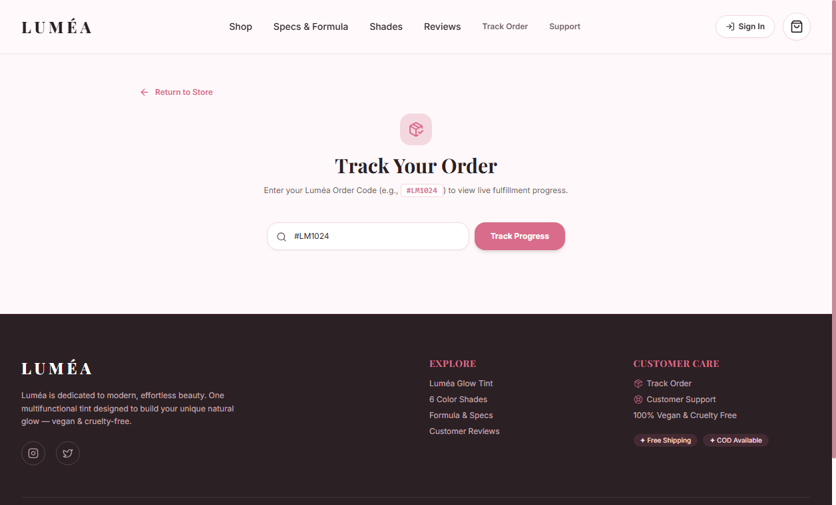
✦TRANSACTIONAL INTEGRITY
Checkout, Fulfillment & Order Tracking
🚚 Frictionless Checkout Flow
• Validates name, phone, city, and shipping address.
• Zero surprise fees: transparent ₹799 subtotal with free shipping.
• Active Cash on Delivery (COD) + friendly maintenance banner for UPI online payments.
📦 5-Stage Visual Order Stepper
• Search by order code (e.g. #LM1024) to inspect live progress.
• Visual Stepper: Pending ➔ Confirmed ➔ Processing ➔ Shipped ➔ Delivered.
• Customer Self-Cancellation: Allowed during pending state; restores inventory units automatically.

Slide 8
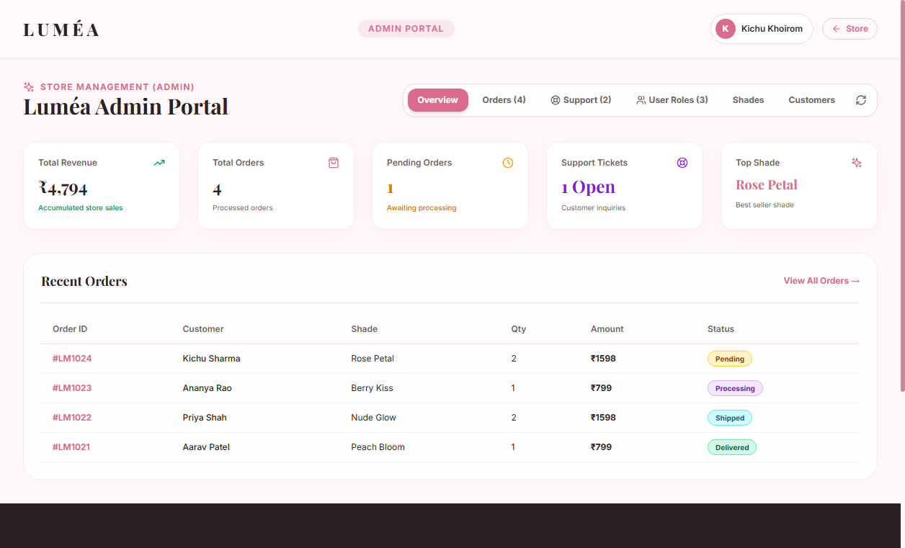
ROLE-BASED SECURITY
Administrative Control & RBAC Governance
Role-Based Access Hierarchy:
1. Super Admin (kichuKhoirom@gmail.com):
• Full administrative rights.
• Promote customers to Sub-Admin, demote roles, delete users.
• Access real-time revenue KPIs and support tickets.
2. Sub-Admin (pardeepsign@gmail.com):
• Order status management (update to Confirmed/Shipped).
• Customer support ticket resolution.
• Product inventory inspection.
3. Customer (james@gmail.com):
• Storefront shopping, order tracking, and ticket submission.
• Access to /admin is strictly blocked by Route Guard.

Slide 9

STABILITY & RESILIENCE
Performance Profiling & Fault Tolerance
⚡ 60 FPS Mobile Optimization
Heavyweight CSS backdrop-filter blurs were eliminated from general cards. On screens <= 640px, blurs are disabled entirely; on desktop, blur is isolated to the sticky header and hardware-accelerated with translateZ(0). Zero jank or drag.
🛡️ Multi-Tier Error Containment
Custom 404 Page renders a luxury gradient numeral with store recovery CTAs; dedicated /503 page offers retry connectivity; root-level React ErrorBoundary prevents blank-screen whiteouts.
🔄 Zero-Downtime Database Fallback
If the local MySQL database is offline or unconfigured, the backend automatically transitions to an in-memory replica pre-loaded with products, variants, sample orders, and user roles.

Slide 10
WHAT'S NEXT FOR LUMÉA
Future Roadmap & Project Conclusion
💳 Live Payment Gateway Integration
Direct integration with Razorpay and Cashfree webhooks for instant UPI QR code generation, credit/debit cards, and automated payment reconciliation.
🤳 AI-Powered Webcam Shade Matcher
Client-side computer vision engine using TensorFlow.js face landmark detection to analyze skin undertones in natural lighting and recommend the ideal tint shade.
📲 Automated WhatsApp & SMS Alerts
Instant order dispatch notifications, live delivery agent tracking links, and review requests powered by Gupshup / Twilio webhook messaging.
🌐 Regional Language Localization
Multilingual store localization (Hindi, Punjabi, English) to dramatically expand reach across diverse beauty customer segments in India.

