Slide 1
React.js
What it is, what it does.

Slide 2
Javascript library for building UI’s
Component based: build individual components and then display them when you want them based on state
JSX – using html-like code in javascript

Slide 3
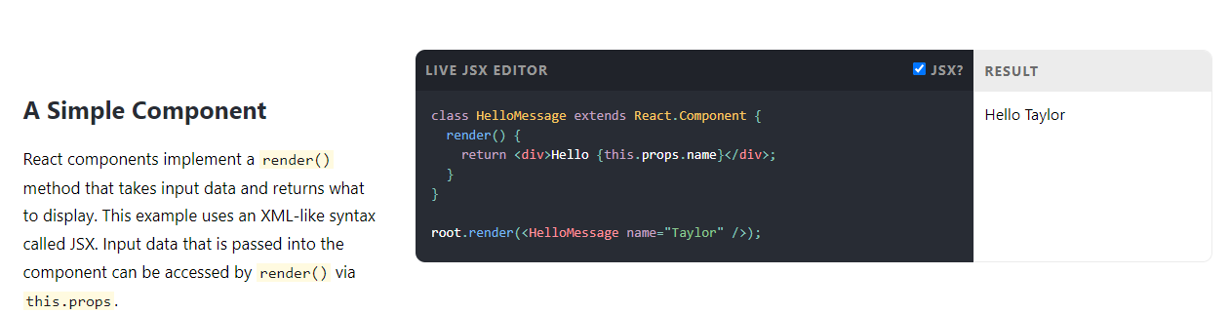

Slide 4
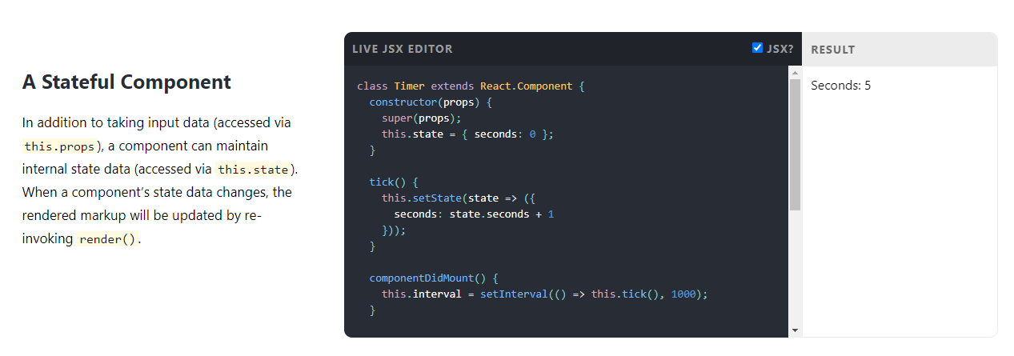

Slide 5
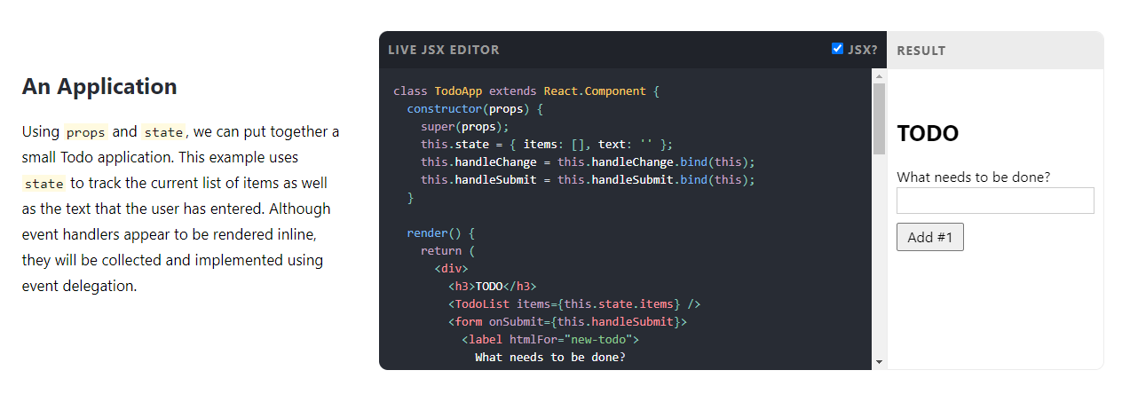

Slide 6
