Slide 1
Computer Architecture
Lecture 01:
Fundamentals of
Computer Design
BSc Computer Science

Slide 2
Lecture Outline
Evolution of Computer Technology
Computing Classes
Task of Computer Designer
Technology Trends
Costs and Trends in Cost
Things to Remember

Slide 3
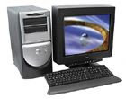
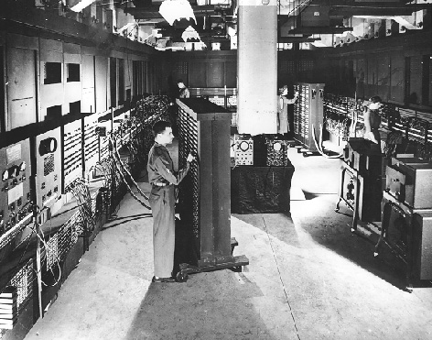
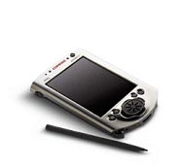

Introduction
CHANGE! It is exciting. It has never been more exciting!
It impacts every aspect of human life.
PC, 2003
PDA, 2003
Eniac, 1946
(first stored-program computer)
Occupied 50x30 feet room,
weighted 30 tonnes,
contained 18000 electronic valves, consumed 25KW of electrical power;
capable to perform 100K calc. per second
Bionic, 2003

Slide 4
Introduction (cont’d)
Continuous growth in performance due to advances in technology and innovations in computer design
  25-30% yearly growth in performance during 1970s
    Mainframes and minicomputers dominated the industry
  Microprocessors enabled 35%
  yearly growth in performance (late 1970s)
  RISCs (Reduced Instruction Set Computers) enabled 50% yearly growth in performance
  (early 1980s)
    Performance improvements through pipelining and ILP (Instruction Level Parallelism)

Slide 5
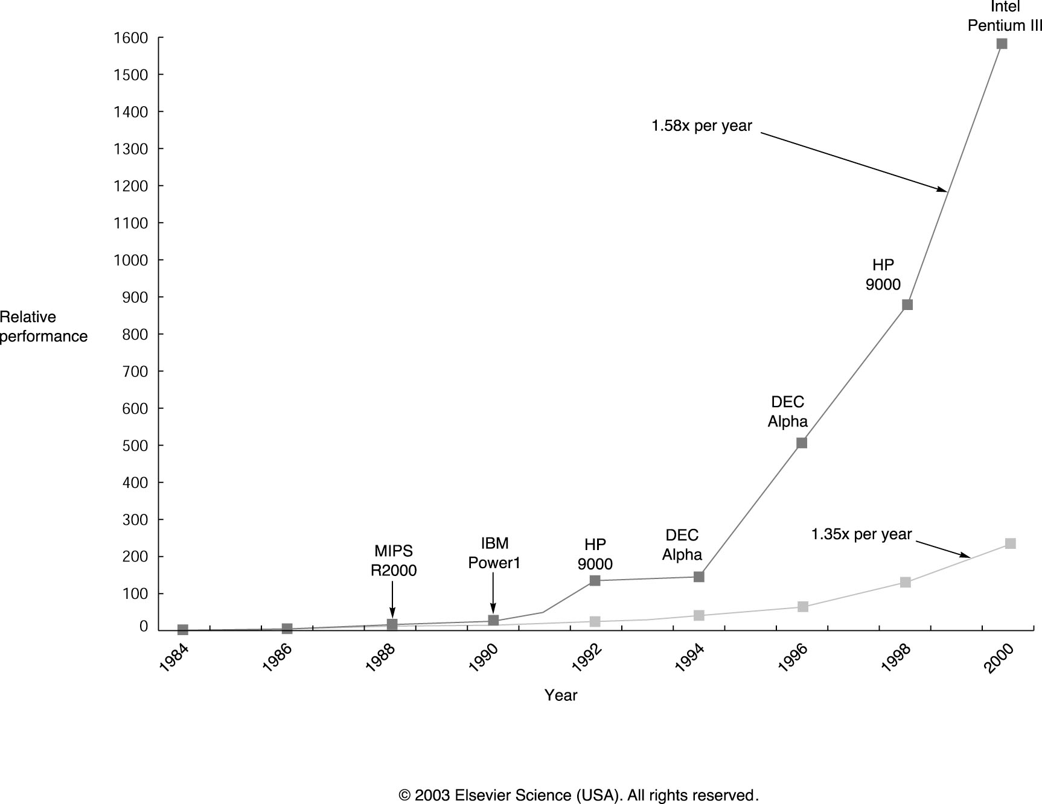
Microprocessor Perf. Growth

Slide 6
Effect of this Dramatic Growth
Significant enhancement of the capability
available to computer user
  Example: your today’s PC of less than $1000 has
  more performance, main memory and disk storage
  than $1 million computer in 1980s
Microprocessor-based computers dominate
  Workstations and PCs have emerged as major products
  Minicomputers - replaced by servers
  Mainframes - replaced by multiprocessors
  Supercomputers - replaced by large arrays of microprocessors

Slide 7
Computer Engineering Methodology
Market
Evaluate Existing
Systems for
Bottlenecks
Applications
Implementation
Complexity
Benchmarks
Technology
Trends
Implement Next
Generation System
Simulate New
Designs and
Organizations
Workloads
Notes:
This slide explains the Computer Engineering Methodology.
Forces that shape the filed are Technology Trends, Applications, and Market.
Typically, a first step in computer design is
Evaluation of the current systems for bottlenecks.
In this evaluation a set of benchmark programs
which represents target applications is used.
The second step is the most important one,
where a computer designer comes up with new designs, and organizations;
The effectiveness of each of them is verified using simulations
driven by a set of benchmark programs.
The next step is to select the implementation
for the next generation system with the minimal implementation complexity.
With this, we close the circle, and begin again new cycle/generation.

Slide 8
Changing Face of Computing
In the 1960s mainframes roamed the planet
  Very expensive, operators oversaw operations
  Applications: business data processing, large scale scientific computing
In the 1970s, minicomputers emerged
  Less expensive, time sharing
In the 1990s, Internet and WWW, handheld devices (PDA), high-performance consumer electronics for video games set-top boxes have emerged
Dramatic changes have led to 3 different computing markets
  Desktop computing, Servers, Embedded Computers

Slide 9
Desktop Computing
Spans low-end (<$1K)
to high-end (≈$10K) systems
Optimize price-performance
  Performance measured in the number of calculations and graphic operations
  Price is what matters to customers
Arena where the newest highest-performance processors appear
Market force: clock rate appears as the direct measure of performance

Slide 10
Servers
Provide more reliable file and computing services (Web servers)
Key requirements
  Availability – effectively provide service 24/7/365 (Yahoo!, Google, eBay)
  Reliability – never fails
  Scalability – server systems grow over time, so the ability to scale up the computing capacity is crucial
  Performance – transactions per minute

Slide 11
Embedded Computers
Computers as parts of other devices where their presence is not obviously visible
  E.g., home appliances, printers, smart cards, cell phones, palmtops
Wide range of processing power and cost
  ≈$1 (8-bit, 16-bit processors), $10 (32-bit capable to execute 50M instructions per second), ≈$100-200 (high-end video games and network switches)
Requirements
  Real-time performance requirement (e.g., time to process a video frame is limited)
  Minimize memory requirements, power

Slide 12
Computing Classes: A Summary
Feature | Desktop | Server | Embedded
Price of the system | $1K-$10K | $10K-$10M | $10-$100K
Price of the processor | $100-$1K | $200-$2K | $0.2-$200
Sold per year (from 2000) | 150M | 4M | 300M (only 32-bit and 64-bit)
Critical system design issues | Price-performance, graphics performance | Throughput, availability, scalability | Price, power consumption, application-specific performance

Slide 13
Task of Computer Designer
“Determine what attributes are important for a new machine; then design a machine to maximize performance while staying within cost constraints.”
Aspects of this task
  instruction set design
  functional organization
  logic design and implementation
  (IC design, packaging, power, cooling...)
Notes:
The task the computer designer faces is a complex one:
“Determine what attributes are important for a new machine; then design a machine to maximise performance while staying within cost constraints.”
The task has many aspects including:
instruction set design,
functional organization,
logic design and implementation (IC design, packaging, power, cooling...)

Slide 14
What is Computer Architecture?
Computer Architecture covers
all three aspects of computer design
  Instruction Set Architecture
    the computer visible to the assembler language programmer or compiler writer (registers, data types, instruction set,
    instruction formats, addressing modes)
  Organization
    high level aspects of computer’s design such as
    the memory system, the bus structure, and
    the internal CPU (datapath + control) design
  Hardware
    detailed logic design, interconnection and packing technology, external connections
Notes:
In the past, the term computer architecture often referred only to instruction set design.
In this course, the term computer architecture is intended to cover all three aspects of computer design.
Instruction Set Architecture refers to
the computer visible to the assembler language programmer or compiler writer (registers, data types, instruction set, instruction formats, addressing modes)
Organisation refers to
high level aspects of computer’s design such as the memory system, the bus structure, and the internal CPU (datapath + control) design
Hardware refers to
detailed logic design, interconnection and packing technology, external connections

Slide 15
Technology Trends
Integrated circuit technology – 55% /year
  Transistor density – 35% per year
  Die size – 10-20% per year
Semiconductor DRAM
  Density – 40-60% per year (4x in 3-4 years)
  Cycle time – 33% in 10 years
  Bandwidth – 66% in 10 years
Magnetic disk technology
  Density – 100% per year
  Access time – 33% in 10 years
Network technology (depends on switches and transmission technology)
  10Mb-100Mb (10years), 100Mb-1Gb (5 years)
  Bandwidth – doubles every year (for USA)
Notes:
Performance growth is due to
- the technology advances, where CMOS VLSI replaced older technologies, and
- advances in computer architecture, such as modern superscalar RISC processors designed to exploit more parallelism, new techniques that improve bandwidth of memory subsystem and input/output subsystem
Lower prices are due to
- simpler development, mass-production which decrease the development cost per unit, and
lower maintenance cost.

Slide 16
Cost, Price, and Their Trends
Price – what you sell a good for
Cost – what you spent to produce it
Understanding cost
  Learning curve principle – manufacturing costs decrease over time (even without major improvements in implementation technology)
    Best measured by change in yield – the percentage of manufactured devices that survives the testing procedure
  Volume (number of products manufactured)
    decreases the time needed to get down the learning curve
    decreases cost since it increases
    purchasing and manufacturing efficiency
  Commodities – products sold by multiple vendors in large volumes which are essentially identical
    Competition among suppliers lower cost

Slide 17
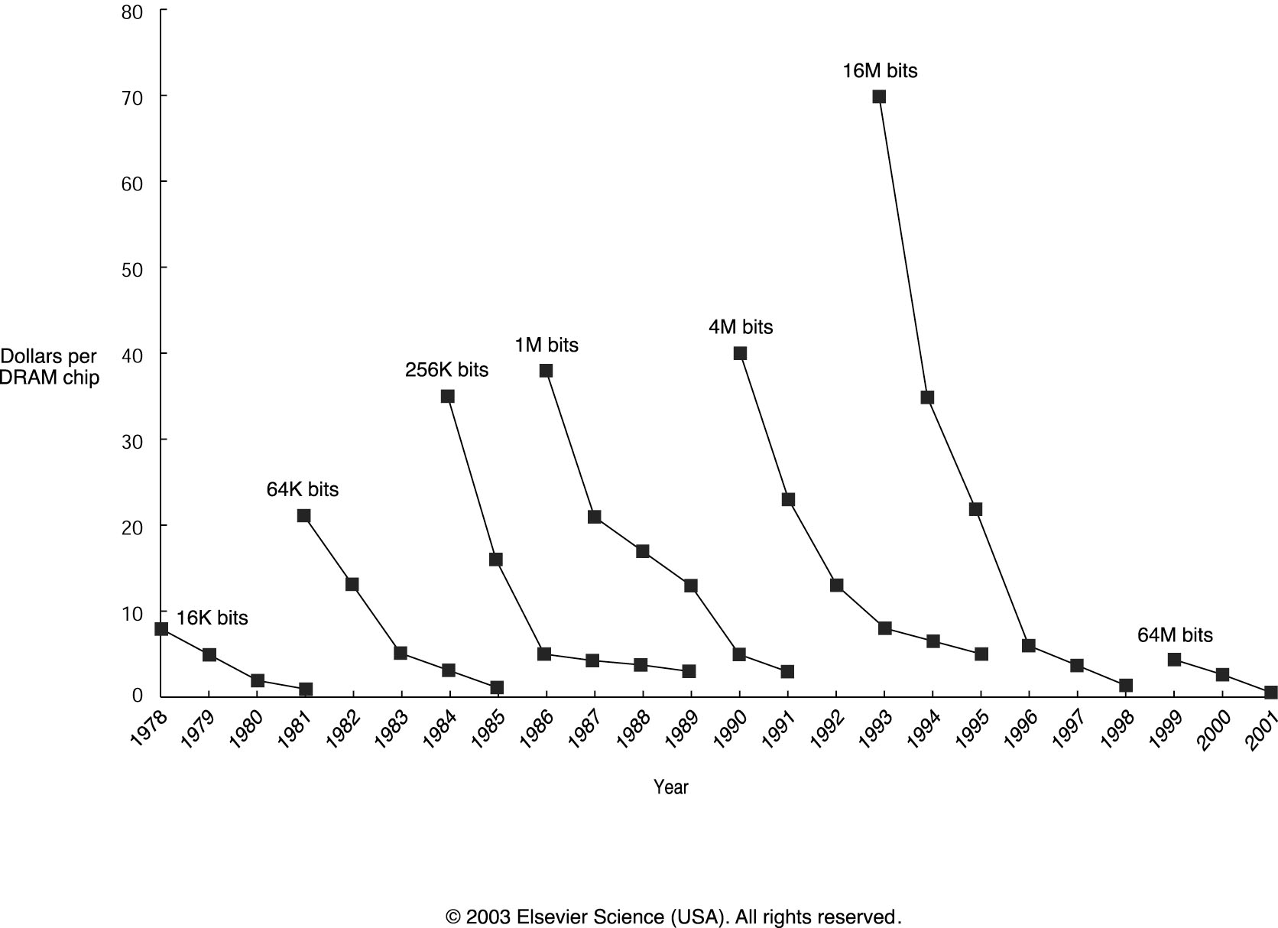
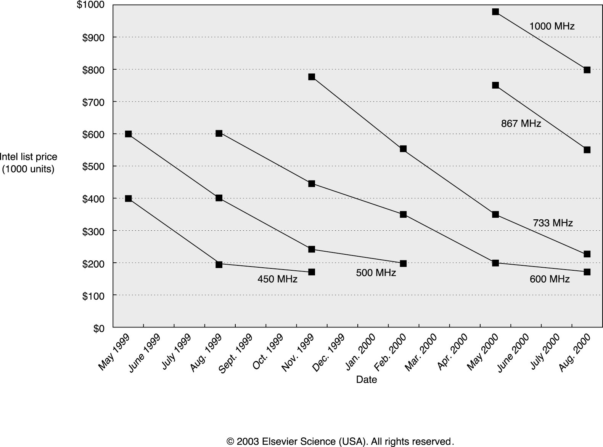
Prices of DRAM and Intel Pentium III

Slide 18
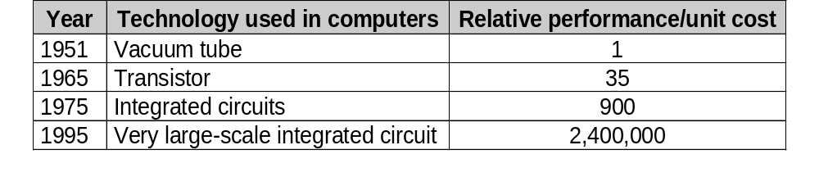
Integrated Circuits: Fueling Innovation
The manufacture of a chip begins with silicon, a substance found in sand
Silicon does not conduct electricity well and thus called semiconductor
A special chemical process can transform tiny areas of silicon to either:
  . Excellent conductors of electricity (like copper)
  . Excellent insulator from electricity (like glass)
  . Areas that can conduct or insulate under a special condition (a switch)
A transistor is simply an on/off switch controlled by electricity
Integrated circuits combines dozens of hundreds of transistors in a chip
Advances of the IC technology affect H/W and S/W design philosophy

Slide 19
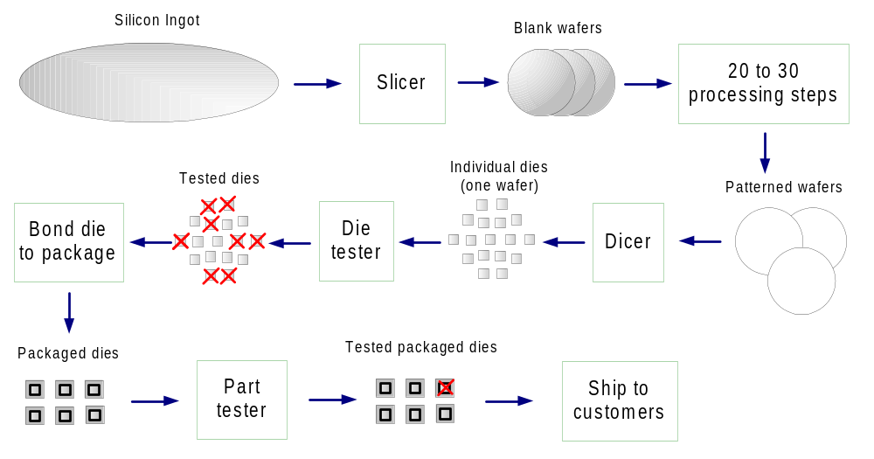
Microelectronics Process
Silicon ingot are 6-12 inches in diameter and about 12-24 inches long
The manufacturing process of integrated circuits is critical to the cost of a chip
Impurities in the wafer can lead to defective devices and reduces the yield

Slide 20
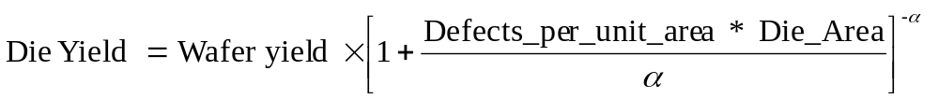
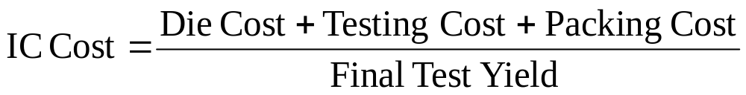
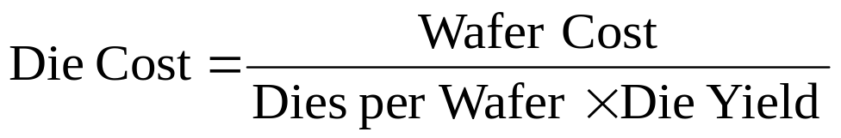
Integrated Circuits Costs
Die cost roughly goes with die area⁴
* Slide is courtesy of Dave Patterson

Slide 21
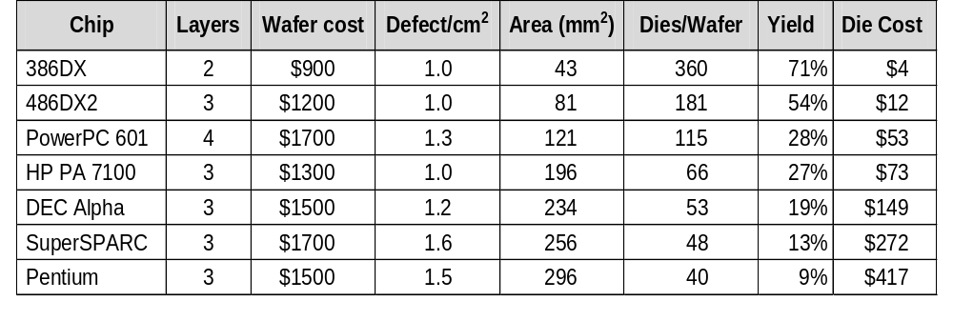
Real World Examples
  From "Estimating IC Manufacturing Costs,” by Linley Gwennap, Microprocessor Report, August 2, 1993, p. 15
* Slide is courtesy of Dave Patterson

Slide 22
Costs and Trends in Cost
Understanding trends in component costs (how they will change over time)
is an important issue for designers
Component prices drop over time without major improvements in
manufacturing technology
What affect cost
Learning curve:
  The more experience in manufacturing a component, the better the yield (the
  number of good devices/ total number of devices)
  In general, a chip, board or system with twice the yield will have half the cost.
  The learning curve is different for different components, thus complicating new
  system design decisions
Volume
  Larger volume increases rate of learning curve and manufacturing efficiency
  Doubling the volume typically reduce cost by 10%
Commodities
  Are essentially identical products sold by multiple vendors in large volumes
  Foil the competition and drive the efficiency higher and thus the cost down

Slide 23
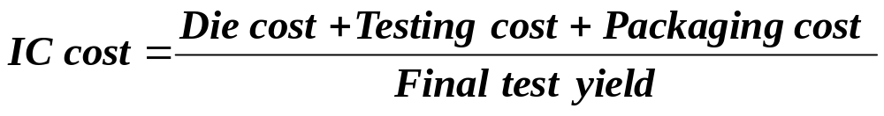
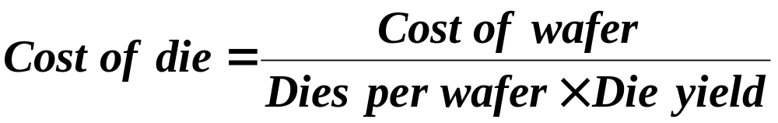
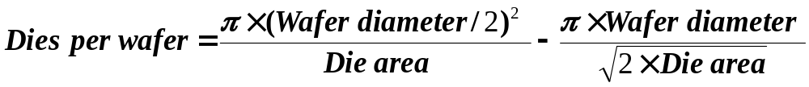
Integrated Circuits Variable Costs
Example: Find the number of dies per 20-cm wafer for a die that is 1.5 cm on a side.
Solution: Die area = 1.5x1.5 = 2.25cm².
Dies per wafer = 3.14x(20/2)²/2.25 – 3.14x20/(2x2.5)^{0.5}=110.

Slide 24
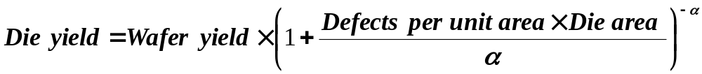
Integrated Circuits Cost (cont’d)
What is the fraction of good dies on a wafer – die yield
Empirical model
  defects are randomly distributed over the wafer
  yield is inversely proportional to the complexity of the fabrication process
Wafer yield accounts for wafers that are completly bad
(no need to test them); We assume the wafer yield is 100%
Defects per unit area: typically 0.4 – 0.8 per cm²
α corresponds to the number of masking levels;
for today’s CMOS, a good estimate is α=4.0

Slide 25


Integrated Circuits Cost (cont’d)
Example: Find die yield for dies with 1 cm and 0.7 cm on a side; defect density is 0.6 per square centimeter
  For larger die: (1+0.6x1/4)⁻⁴=0.57
  For smaller die: (1+0.6x0.49/4)⁻⁴=0.75
Die costs are proportional
to the fourth power of the die area
In practice

Slide 26
Real World Examples
Chip | ML | Line width | Wafer cost | Defect [cm²] | Area [mm²] | Dies/ wafer | Yield | Die cost
386DX | 2 | 0.90 | $900 | 1.0 | 43 | 360 | 71% | $4
486DX2 | 3 | 0.80 | $1200 | 1.0 | 81 | 181 | 54% | $12
PowerPC 601 | 4 | 0.80 | $1700 | 1.3 | 121 | 115 | 28% | $53
HP PA 7100 | 3 | 0.80 | $1300 | 1.0 | 196 | 66 | 27% | $73
Dec Alpha | 3 | 0.70 | $1500 | 1.2 | 234 | 53 | 19% | $149
SuperSPARC | 3 | 0.70 | $1700 | 1.6 | 256 | 48 | 13% | $272
Pentium | 3 | 0.70 | $1500 | 1.5 | 296 | 40 | 9% | $417
From "Estimating IC Manufacturing Costs,” by Linley Gwennap,
Microprocessor Report, August 2, 1993, p. 15
Typical in 2002:
30cm diameter wafer, 4-6 metal layers, wafer cost $5K-6K

Slide 27
Cost vs. Price
List Price
Average Discount
25% to 40%
Avg. Selling Price
Gross Margin
34% to 39%
Direct Cost
6% to 8%
Component Cost
15% to 33%
Component Costs: raw material cost for the system’s building blocks
Direct Costs (add 25% to 40%) recurring costs: labor, purchasing, scrap, warranty
Gross Margin (add 82% to 186%) nonrecurring costs:
R&D, marketing, sales, equipment maintenance, rental, financing cost, pretax profits, taxes
Average Discount to get List Price (add 33% to 66%): volume discounts and/or retailer markup
* Slide is courtesy of Dave Patterson

Slide 28
Things to Remember
Computing classes: desktop, server, embedd.
Technology trends
Cost
  Learning curve:
  manufacturing costs decrease over time
  Volume: the number of chips manufactured
  Commodity
 | Capacity | Speed
Logic | 4x in 3+ years | 2x in 3 years
DRAM | 4x in 3-4 years | 33% in 10 years
Disk | 4x in 3-4 years | 33% in 10 years

Slide 29
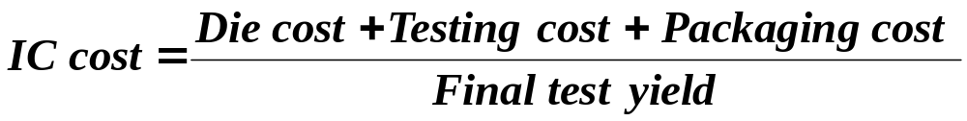
Things to Remember (cont’d)
Cost of an integrated circuit

