Slide 1
Computer Architecture
Lecture
Instruction Set Architecture (II)

Slide 2
Lecture’s Overview
Previous Lecture
  Classifications of Instruction set architecture
  (accumulator, stack, general-register)
  Various styles of addressing modes
  (Register, displacement, immediate, PC-relative
  Instruction types, operands and operations
  (Load/store, ALU, Control flow, procedure calls and return)
This Lecture
  Type and size of operands
  Encoding the instruction set
  The role of the compiler

Slide 3
Instruction Set Architecture (ISA)
software
instruction set
hardware
Goals:
Introduces the wide variety of design alternatives available to the instruction
set architect
Present a taxonomy of ISA alternatives and give some qualitative
assessment of the advantages and disadvantages of various approaches
Present and analyze some instruction set measurements that are largely
independent of a specific instruction set
Address the issue of languages and compilers and their bearing on
instruction set architecture
Show some examples of instructions set architecture
* Figure is courtesy of Dave Patterson

Slide 4
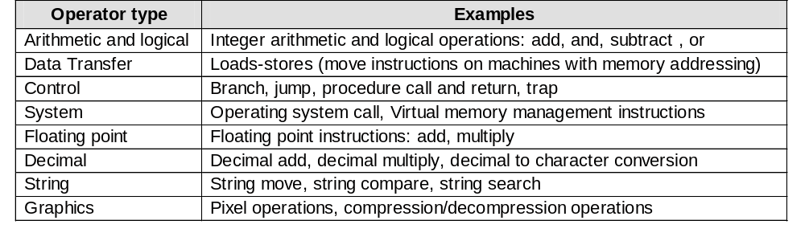
Operations in the Instruction Set
Arithmetic, logical, data transfer and control are almost standard categories
for all machines
System instructions are required for multi-programming environment
although support for system functions varies
Decimal and string instructions can be primitives, e.g. IBM 360 and the VAX
Support for floating point, decimal, string and graphics can be optionally
provided via co-processor
Some machines rely on the compiler to synthesize special operations such
as string handling

Slide 5
Operations for Media & Signal Process.
Single instruction multiple data (SIMD) and vector instructions
are commonly supported in DSPs commonly used in
multimedia and signal processing applications
Partitioned Add:
Perform multiple 16-bit addition on a 64-bit ALU since most data are narrow
Increases ALU throughput for multimedia applications
Paired single operations
Allow same register to be act as two operand to the same operations
Handy in dealing with vertices and coordinates
Multiply and accumulate
Very handy for calculating dot products of vectors (signal processing) and
matrix multiplication

Slide 6
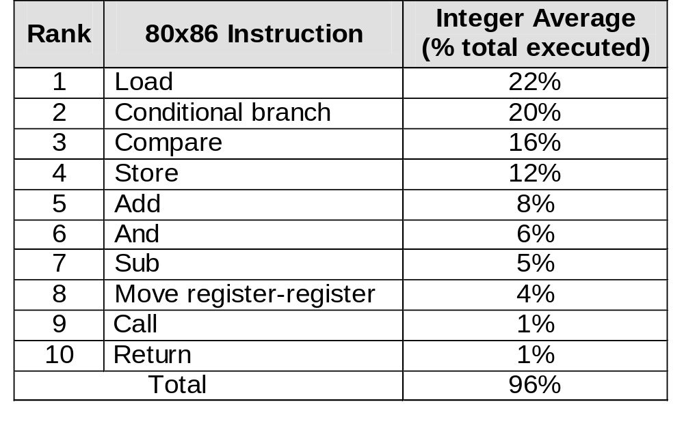
Frequency of Operations Usage
The most widely executed instructions are the simple operations of an
instruction set
The following is the average usage in SPECint92 on Intel 80x86
Make the common case fast by focusing on these operations

Slide 7
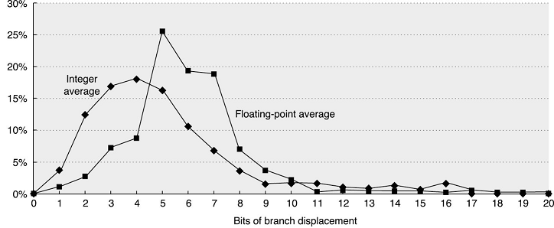
Destination Address Definition
Data is based SPEC2000 on Alpha
Relative addressing w.r.t. the program counter proved to be the best
choice for forward and backward branching or jumps (position independent)
To allow for dynamic loading of library routines, register indirect address
allows addresses to be loaded in special registers
(e.g. virtual functions in C++ and system calls in a case statement)

Slide 8
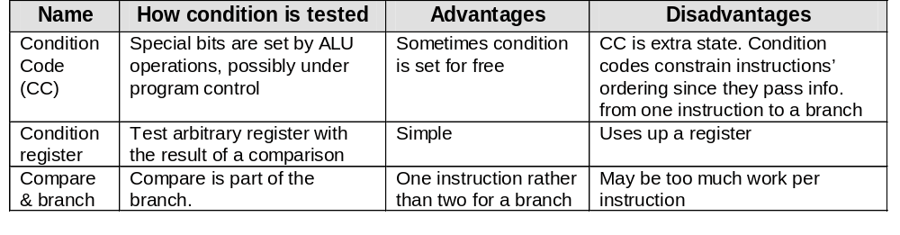
Condition Evaluation
Compare&branch can be efficient if majority
of conditions are comparison with zero
Remember to focus on the common case

Slide 9
Supporting Procedures
Execution of a procedure follows the following steps:
  Place parameters in a place accessible to the procedure
  Transfer control to the procedure
  Acquire the storage resources needed for the procedure
  Perform the desired task
  Place the results value in a place accessible to the calling program
  Return control to the point of origin
The hardware provides a program counter to trace instruction flow and manage transfer of control
Parameter Passing
Registers can be used for passing small number of parameters
A stack is used to spill registers of the current context and make room for the called procedure to run and to allow for large parameters to be passed
Storage of machine state can be performed by caller or callee
Handling of shared variables is important to ensure correct semantics and thus requires clear specifications in the library interface
Global variables stored in registers need careful handling

Slide 10
Type and Size of Operands
The type of an operand is designated by encoding it in the instruction
operation code
The type of an operand, e.g. single precision float, effectively gives its size
Common operand types include character, half word and word size integer,
single- and double-precision floating point
Characters are almost always in ASCII and integers are in 2’s complement
and floating point in IEEE 754
The 16-bit Unicode, used in Java is gaining popularity due the support for
international character sets
For business applications, some architecture support a decimal format in
binary coded decimal (BCD)
Depending on the size of the word, the complexity of handling different
operand types differs
DSP offers fixed point data types to support high precision floating point
arithmetic and to allow sharing single exponent multiple for multiple numbers
For Graphics applications vertex and pixel operands are added features

Slide 11
Size of Operands
Double-word data type is used for double-precision floating point operations and address storage in machines with a 64-bit wide address bus
Words are used for integer operations and for 32-bit address bus machines
Because the mix in SPEC, word and double-word data types dominates

Slide 12
Instruction Representation
Humans are taught to think in base 10 (decimal) but numbers may be represented in any base (123 in base 10 = 1111011 in binary or base 2)
Numbers are stored in computers as a series of high and low electronic signals (binary numbers)
Binary digits are called bits and considered the atom of computing
Each piece of an instruction is a number and placing these numbers together forms the instruction
Assembler translate the assembly symbolic instructions into machine language instructions (machine code)

Slide 13
Encoding an Instruction Set
Instruction encoding affects the size of the compiled program and the complexity of the CPU implementation
The operation is typically specified in one field called “opcode”
The addressing mode for the operand can be encoded with the operation or specified through a separate identifier in case of large number of supported modes
The architecture must balance between several competing factors:
  Desire to support as many registers and addressing modes as possible
  Effect of operand specification on the size of the instruction (program)
  Desire to simplify instruction fetching and decoding during execution
Fixed size instruction encoding simplify the CPU design while limiting the addressing modes supported
An architect caring about the code size can use variable size encoding
A hybrid approach is to allow variability by supporting multiple-sized instruction

Slide 14
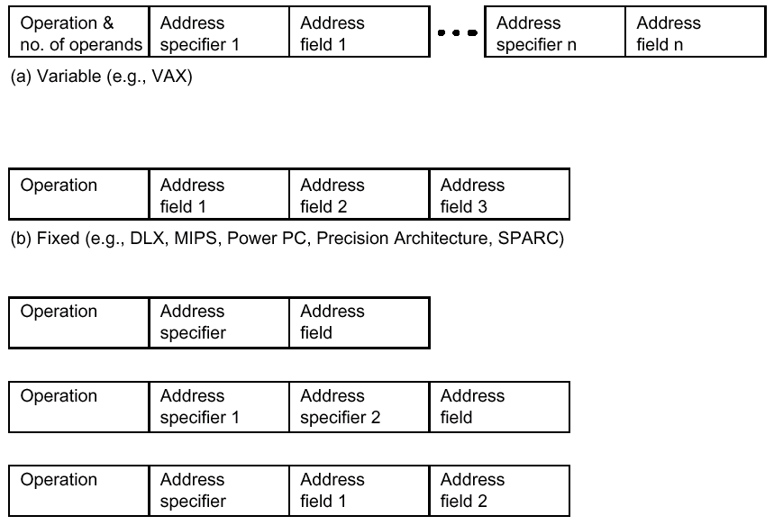
Encoding Examples

Slide 15
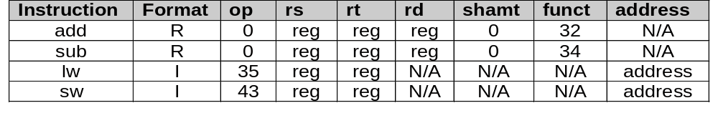
MIPS Instruction format
Register-format instructions:
op: Basic operation of the instruction, traditionally called opcode
rs: The first register source operand
rt: The second register source operand
rd: The register destination operand, it gets the result of the operation
shmat: Shift amount (explained in future lectures)
funct: This field selects the specific variant of the operation of the op field
Immediate-type instructions:
Some instructions need longer fields than provided for large value constant
The 16-bit address means a load word instruction can load a word within a
region of ± 2¹⁵ bytes of the address in the base register
Example: lw $t0, 32($s3) # Temporary register $t0 gets A[8]

Slide 16
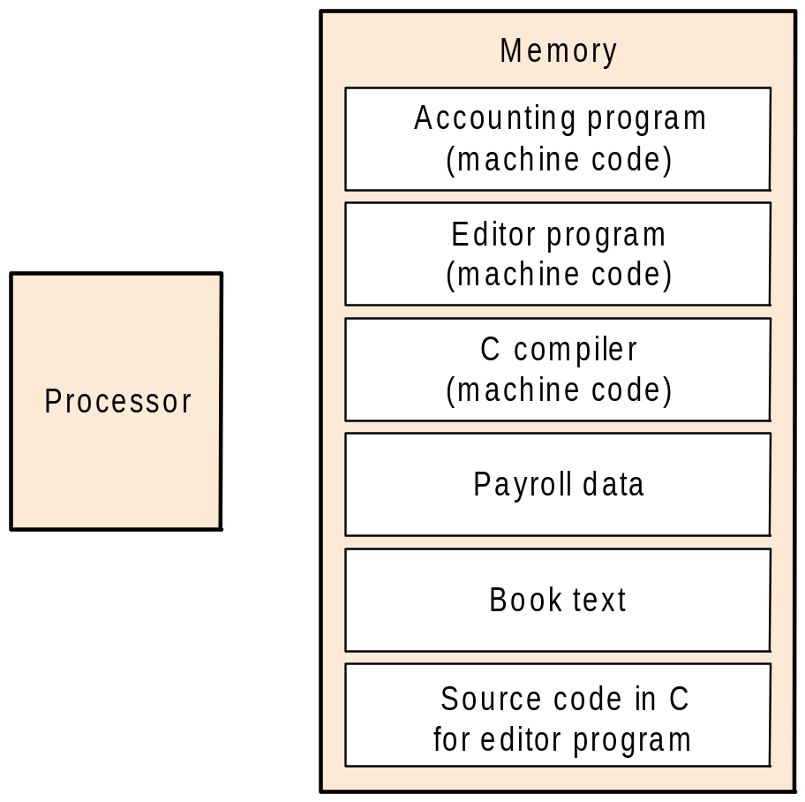
The Stored Program Concept
Learning how instructions are represented leads to discovering the secret of computing: “the stored-program concept”
Today’s computers are build on two key principles :
  Instructions are represented as numbers
  Programs can be stored in memory to be
  read or written just like numbers
The power of the concept:
memory can contain:
the source code for an editor
the compiled m/c code for the editor
the text that the compiled program is using
the compiler that generated the code

Slide 17
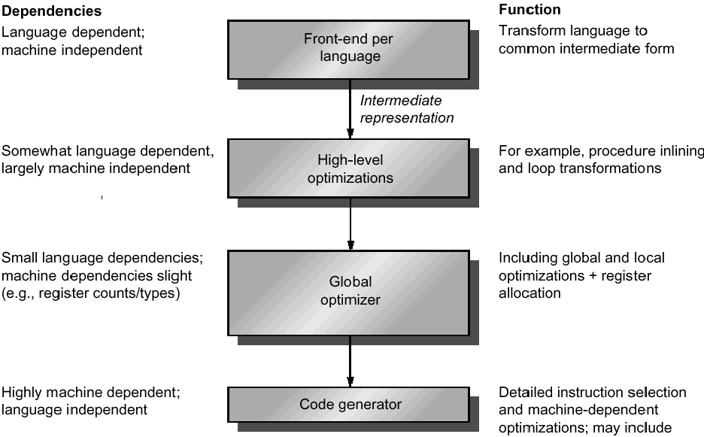
Typical Compilation

Slide 18
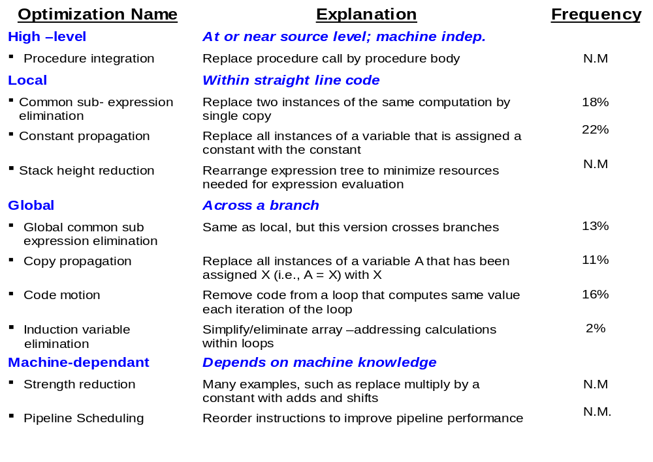
Major Types of Optimization

Slide 19
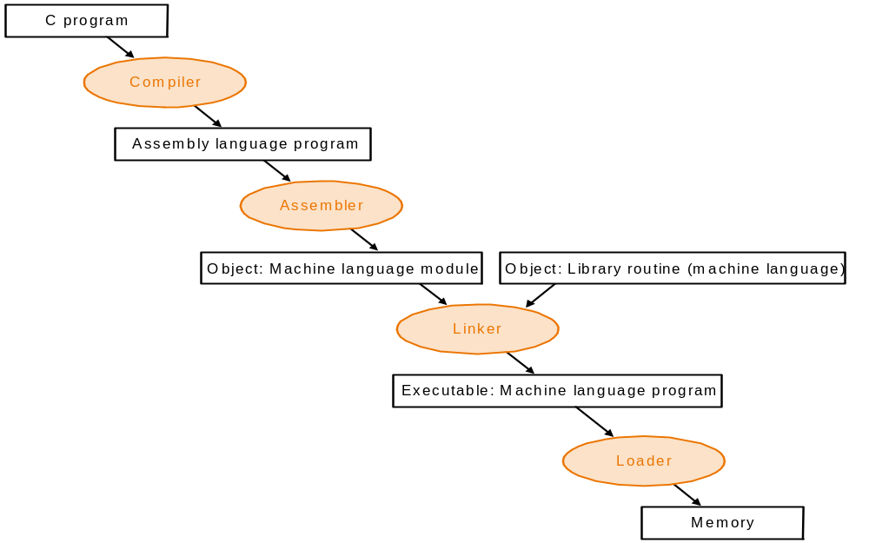
Starting a Program
Object files for Unix typically contains:
Header: size & position of components
Text segment: machine code
Data segment: static and dynamic variables
Relocation info: identify absolute memory ref.
Symbol table: name & location of labels,
procedures and variables
Debugging info: mapping source to object
code, break points, etc.
Linker
Place code & data modules
symbolically in memory
Determine the address of data &
instruction labels
Patch both internal & external ref.

Slide 20
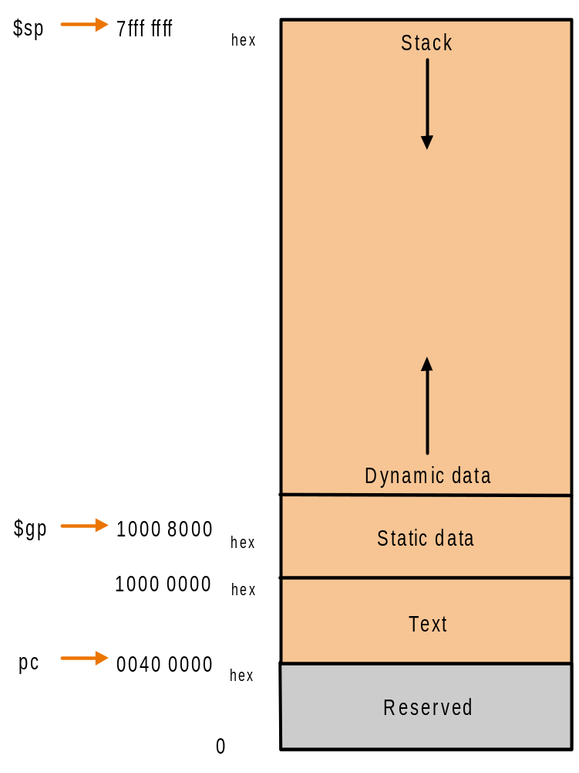
Loading Executable Program
To load an executable, the operating system follows these steps:
Reads the executable file header to
determine the size of text and data segments
Creates an address space large enough for
the text and data
Copies the instructions and data from the
executable file into memory
Copies the parameters (if any) to the main
program onto the stack
Initializes the machine registers and sets the
stack pointer to the first free location
Jumps to a start-up routines that copies the
parameters into the argument registers and
calls the main routine of the program

Slide 21
Effect of ISA on Compiler Complexity
Promote regularity
  Limit # register formats and variability of # operands in the instruction
  Avoid fixing a class of registers to some operations
  Separate addressing modes from operations to allow consistent handling
Provide primitives, not solutions
  Avoid being influenced by features of a particular high level programming Language (VAX provide call instruction with automatic context saving and does not allow for per-call optimization)
  Allow focusing on the enhancing the handling of common features
Simplify trade-offs among alternatives
  Simplify the analysis of special features such as cache and pipeline
  Allow of simultaneous activities to promote optimization
Favor static binding
  Avoid dynamically changing, at run time, values set at compile time to
  allow for optimization (e.g. changing the mask that indicates registers to be
  saved by the caller can diminish its value in case of separate compilation)

Slide 22
Compiler Support for Multimedia Instr.
Intel’s MMX and PowerPC AltiVec have small vector processing capabilities
targeting Multimedia applications
Intel added new set of instructions, called Streaming SIMD Extension
A major advantage of vector computers is hiding latency of memory access
by loading multiple elements and then overlapping execution with data transfer
Vector computers typically have strided and/or gather/scatter addressing to
perform operations on distant memory locations
Strided addressing allows memory access in increment larger than one
Gather/scatter addressing is similar to register indirect mode where the
address are stored instead of the data
Since data for multimedia applications are often streams sequential (unit
strided addressing limits the potential speedup
Limited vector processing makes them unpopular in the compiler
optimization and limits the use to hand coded routines
SIMD instructions on MMX and AltiVec tend to be solutions not primitives

Slide 23
Conclusion
Summary
  Type and size of operands
  (Famous data types, effect of operand size on design complexity)
  Encoding the instruction set
  (Fixed, variable and hybrid encoding, the store program concept)
  The role of the compiler
  (Compilation process, compiler optimization, linking and loading)
  Effect of ISA on Compiler Complexity
  (Regularity, Primitives, not solutions, Simplify trade-offs, Static binding)
Next Lecture
  Pipeline execution of instruction
  Pipeline hazards
Reading assignment is sections 2.5, …, 2.11 in text book
Notes:
We will take a break and talk about class philosophy.

