Slide 1
Computer Architecture
Lecture:
Fundamentals of
Computer Design (part 2)
BSc Computer Science

Slide 2
Outline
Review
Measuring and Reporting Performance
Quantitative Principles of
Computer Design
Things to Remember
Notes:
Here is the Outline of today’s lecture.
First, we shall give a short overview of major trends and breakthroughs in Computer Technology for last 50 years.
Then, we will give an answer to the question “What is Computer Architecture”.
After these two introductory topics we will consider Measuring and Reporting Performance and major Quantitative Principles of Computer Design.

Slide 3
Review
Computing classes: desktop, server, embedd.
Technology trends
Cost
  Learning curve:
  manufacturing costs decrease over time
  Volume: the number of chips manufactured
  Commodity
 | Capacity | Speed
Logic | 4x in 3+ years | 2x in 3 years
DRAM | 4x in 3-4 years | 33% in 10 years
Disk | 4x in 3-4 years | 33% in 10 years

Slide 4
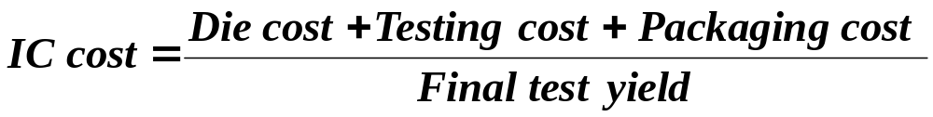
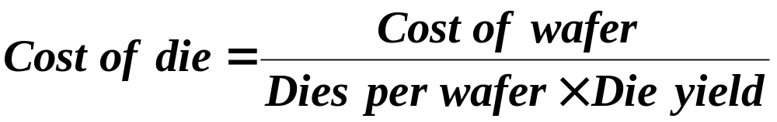
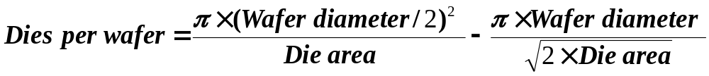
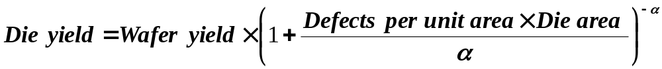
Review
Cost of an integrated circuit

Slide 5
The Role of Performance
Hardware performance is a key to the effectiveness of the entire system
Performance has to be measured and compared to evaluate various design and technological approaches
To optimize the performance, major affecting factors have to be known
For different types of applications, different performance metrics may be appropriate and different aspects of a computer system may be most significant
Instructions use and implementation, memory hierarchy and I/O handling are among the factors that affect the performance

Slide 6
Cost-Performance
Purchasing perspective: from a collection of machines, choose one which has
  best performance?
  least cost?
  best performance/cost?
Computer designer perspective:
faced with design options, select one which has
  best performance improvement?
  least cost?
  best performance/cost?
Both require: basis for comparison and
metric for evaluation
Notes:
Performance is as important for purchaser as for computer designer.
When purchase a computer you want to buy one which has the best performance and least cost, actually, the best performance/cost ratio.
Computer designer faced with number of design options want to select one which proved best performance improvement, at least cost, actually the best performance cost ration.
To make right choice both need basis for comparison, and metric for evaluation.

Slide 7
Two “notions” of performance
Which computer has better performance?
  User: one which runs a program in less time
  Computer centre manager:
  one which completes more jobs in a given time
Users are interested in reducing
Response time or Execution time
  the time between the start and
  the completion of an event
Managers are interested in increasing
Throughput or Bandwidth
  total amount of work done in a given time
Notes:
Discussing performance, the major question we want to answer is:
Which computer has better performance?
It is quite possible to get different answers;
So, a user may say “a computer is faster when a program runs in less time”,
while computer center manager may say “computer is faster when completes more jobs in a given time”.
Different answers are due to different points of view:
-Users are interested in reducing Response time or Execution time,
while Computer Center Managers are interested in increasing Throughput or Bandwidth.
Execution time is the time between the start and the completion of an event
Throughput or Bandwidth is defined as total amount of work done in a given time.
These can be a little confusing, so let’s se the following example.

Slide 8
An Example
Which has higher performance?
  Time to deliver 1 passenger?
    Concord is 6.5/3 = 2.2 times faster (120%)
  Time to deliver 400 passengers?
    Boeing is 72/44 = 1.6 times faster (60%)
Plane | DC to Paris [hour] | Top Speed [mph] | Passe -ngers | Throughput [p/h]
Boeing 747 | 6.5 | 610 | 470 | 72 (=470/6.5)
Concorde | 3 | 1350 | 132 | 44 (=132/3)

Slide 9
Performance Metrics
Response (execution) time:
  The time between the start and the completion of a task
  Measures user perception of the system speed
  Common in reactive and time critical systems, single-user computer, etc.
Throughput:
  The total number of tasks done in a given time
  Most relevant to batch processing (billing, credit card processing, etc.)
  Mainly used for input/output systems (disk access, printer, etc)
Examples:
  Replacing the processor of a computer with a faster version
  Enhance BOTH response time and throughput
  Adding additional processors to a system that uses multiple processors
  for separate tasks (e.g. handling of airline reservations system)
  Improves throughput ONLY
  Decreasing response time always improve throughput

Slide 10

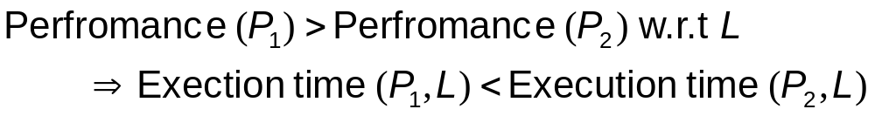
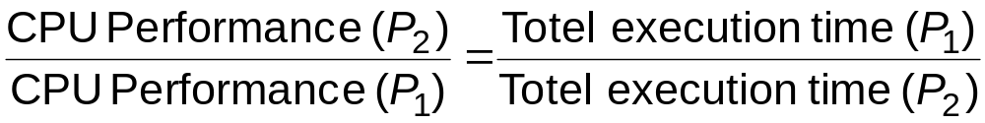
Response-time Metric
Maximizing performance means minimizing response (execution) time
Performance of Processor P₁ is better than P₂ if, for a given work load L, P₁ takes less time to execute L than P₂ does
Relative performance capture the performance ratio of
Processor P₁ compared to P₂ is, for the same work load

Slide 11
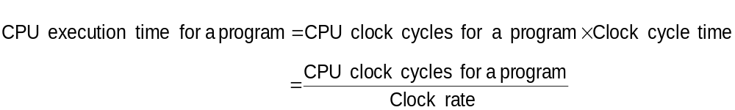
Designer’s Performance Metrics
Users and designers measure performance using different metrics
Designers looks at the bottom line of program execution
To enhance the hardware performance, designers focuses on reducing the clock cycle time and the number of cycles per program
Many techniques to decrease the number of clock cycles also increase the clock cycle time or the average number of cycles per instruction (CPI)

Slide 12
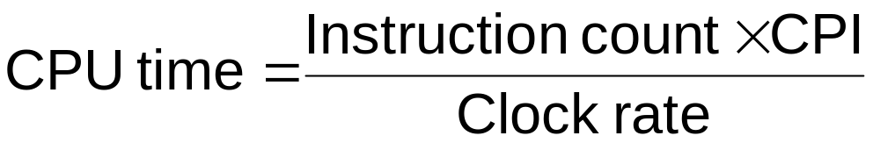
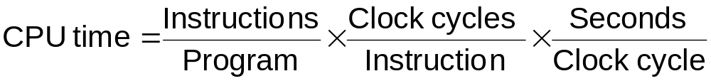
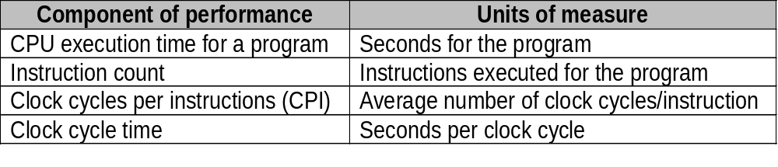
Calculation of CPU Time
CPU time = Instruction count × CPI × Clock cycle time
Or

Slide 13
Execution Time and Its Components
Wall-clock time, response time, elapsed time
  the latency to complete a task, including disk accesses, memory accesses, input/output activities,
  operating system overhead,...
CPU time
  the time the CPU is computing, excluding I/O or
  running other programs with multiprogramming
  often further divided into user and system CPU times
User CPU time
  the CPU time spent in the program
System CPU time
  the CPU time spent in the operating system
Notes:
Wall-clock time, response time, elapsed time
the latency to complete a task, including disk accesses, memory accesses, input/output activities, operating system overhead,...
CPU time
the time the CPU is computing, excluding I/O or running other programs with multiprogramming
often further divided into user and system CPU times
User CPU time
the CPU time spent in the program
System CPU time
the CPU time spent in the operating system performing tasks requested by the program

Slide 14
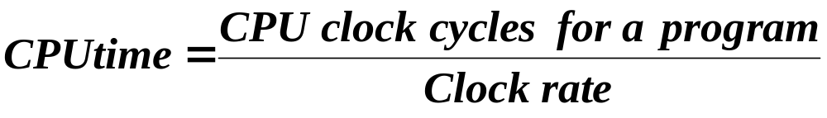
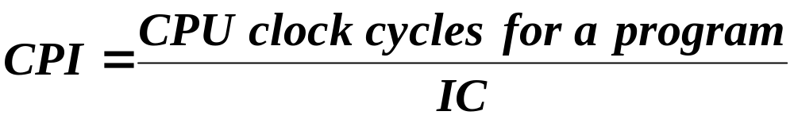
CPU Execution Time
Definitions
Instruction count (IC) = Number of instructions executed
Clock cycles per instruction (CPI)
CPI - one way to compare two machines with same instruction set, since Instruction Count would be the same
Notes:
We are particularly interested in CPU time.
CPU time for a program can be calculated in 2 ways:
CPU time = (CPU clock cycles for a program)x(Clock cycle time)
or
CPU time = (CPU clock cycles for a program)/(Clock cycle time)
In addition to the number of clock cycles needed to execute a program,
we can count the number of instructions executed (IC – Instruction Count)
If we know the number of clock cycles and the number of instructions
we can calculate the clock cycles per instruction
CPI (Clock cycles per instruction) = (CPU clock cycles for a program)/(IC).
Remember: you can use CPI to compare two different machines,
only if they have the same instruction set, i.e. they have the same IC.

Slide 15
How to Calculate 3 Components?
Clock Cycle Time
  in specification of computer
  (Clock Rate in advertisements)
Instruction count
  Count instructions in loop of small program
  Use simulator to count instructions
  Hardware counter in special register (Pentium II)
CPI
  Calculate:
  Execution Time / Clock cycle time / Instruction Count
  Hardware counter in special register (Pentium II)
Notes:
Clock Cycle Time
in specification of computer (1/(Clock Rate))
(Clock Rate in advertisements)
Instruction count
Count instructions in loop of small program
Use simulator to count instructions
Hardware counter in special register (Pentium II)
CPI
Calculate: Execution Time / Clock cycle time / Instruction Count
Hardware counter in special register (PII)

Slide 16
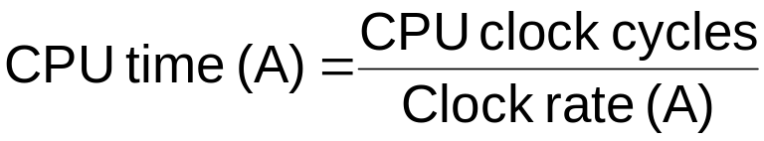
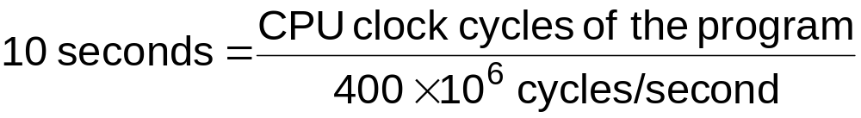
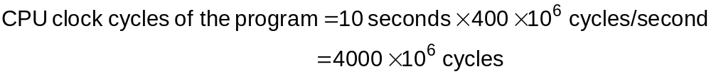
Example
A program runs in 10 seconds on a computer “A” that has 400 MHz clock. It is desirable to design a faster computer “B” that could run the program in 6 seconds. The designer has determined that a substantial increase in the clock speed is possible, however it would cause computer “B” to require 1.2 times as many clock cycles as computer “A”. What should be the clock rate of computer “B”?
To get the clock rate of the faster computer, we use the same formula

Slide 17
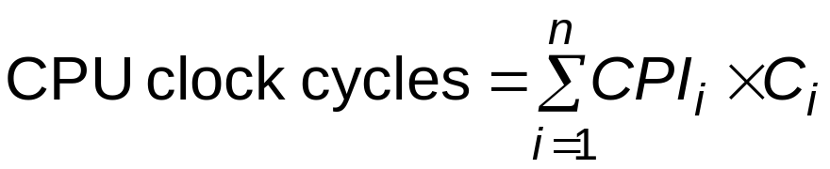
CPU Time
CPU execution time can be measured by running the program
The clock cycle is usually published by the manufacture
Measuring the CPI and instruction count is not trivial
Instruction counts can be measured by: a software profiling, using an
architecture simulator, using hardware counters on some architecture
The CPI depends on many factors including: processor structure,
memory system, the mix of instruction types and the implementation
of these instructions
Designers sometimes uses the following formula:
Where: C_{i} is the count of number of instructions of class i executed
CPI_{i} is the average number of cycles per instruction for that instruction class
n is the number of different instruction classes

Slide 18
Choosing Programs to Evaluate Per.
Ideally run typical programs with typical input before purchase, or before even build machine
  Engineer uses compiler, spreadsheet
  Author uses word processor, drawing program, compression software
Workload – mixture of programs and OS commands that users run on a machine
Few can do this
  Don’t have access to machine to “benchmark”
  before purchase
  Don’t know workload in future
Notes:
To evaluate a new machine user would simply compare execution time of her workload; Workload is mixture of programs and operating system commands that user run on a machine).
However few can do this.
Most must rely on other methods and often other evaluators, hoping that these methods will predict performance for their usage of the new machine.

Slide 19
Benchmarks
Different types of benchmarks
  Real programs (Ex. MSWord, Excel, Photoshop,...)
  Kernels - small pieces from real programs
  Toy Benchmarks - short, easy to type and run
  Synthetic benchmarks - code that matches frequency of key instructions and operations to real programs
Need industry standards so that different processors can be fairly compared
Companies exist that create these benchmarks: “typical” code used to evaluate systems
Notes:
There are 4 levels of programs used in such circumstances, listed below in decreasing order of accuracy of prediction.
-real programs like MSWord, Excel, Photoshop...
-kernels - small pieces extracted from real programs
-toy benchmarks - short, easy to type and run programs
-synthetic benchmarks - code that matches frequency of key instruction and operations to real programs
The question of right benchmarks is very important since the company thrive or go bankrupt depending on price/performance of their products relative to the others in the marketplace.
To make this comparison arena fair,
several companies and organization have been founded.

Slide 20
Benchmark Suites
SPEC - Standard Performance Evaluation Corporation
  originally focusing on CPU performance
  graphics benchmarks
  server benchmark
PC benchmarks
Transaction processing benchmarks Embedded benchmarks
Notes:
The most important benchmark suits are the following:
- SPEC which comes from Standard Performance Evaluation Corporation
- PC benchmarks like...
- Transaction processing benchmarks...
- Embeded benchmarks....

Slide 21
Quantitative Principles of Design
Where to spend time making improvements?
⇒ Make the Common Case Fast
  Most important principle of computer design:
  Spend your time on improvements where those improvements will do the most good
  Example
    Instruction A represents 5% of execution
    Instruction B represents 20% of execution
    Even if you can drive the time for A to 0, the CPU will only be 5% faster
Key questions
  What the frequent case is?
  How much performance can be improved by making that case faster?

Slide 22
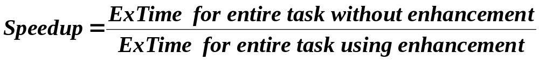
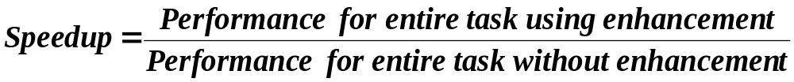
Amdahl’s Law
Suppose that we make an enhancement to a machine that will improve its performance; Speedup is ratio:
Amdahl’s Law states that the performance improvement that can be gained by a particular enhancement is limited by the amount of time that enhancement can be used

Slide 23
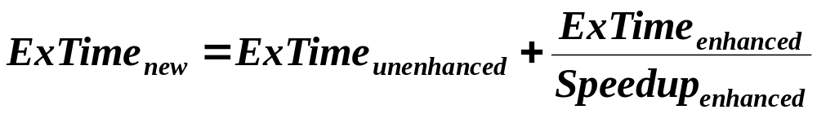
Computing Speedup
Fraction_{enhanced} = fraction of execution time in the original machine that can be converted to take advantage of enhancement (E.g., 10/30)
Speedup_{enhanced} = how much faster the enhanced code will run (E.g., 10/2=5)
Execution time of enhanced program will be sum of old execution time of the unenhanced part of program and new execution time of the enhanced part of program:
20
10
20
2

Slide 24
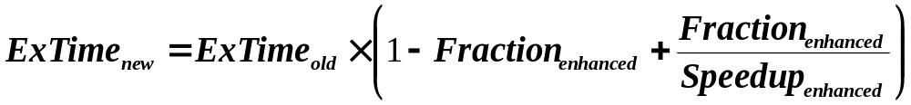
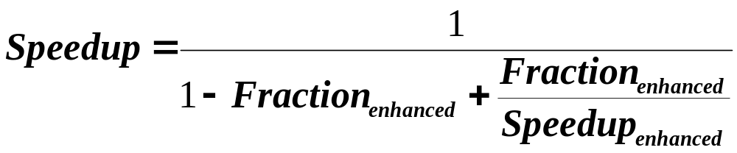
Computing Speedup (cont’d)
Enhanced part of program is Fraction_{enhanced},
so times are:
Factor out Time_{old} and divide by Speedup_{enhanced}:
Overall speedup is ratio of Time_{old} to Time_{new}:

Slide 25
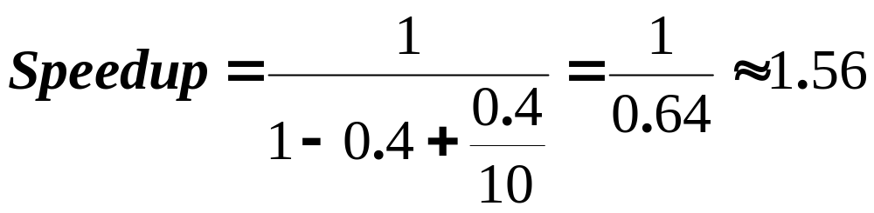
An Example
Enhancement runs 10 times faster and it affects 40% of the execution time
Fraction_{enhanced} = 0.40
Speedup_{enhanced} = 10
Speedup_{overall} = ?

Slide 26
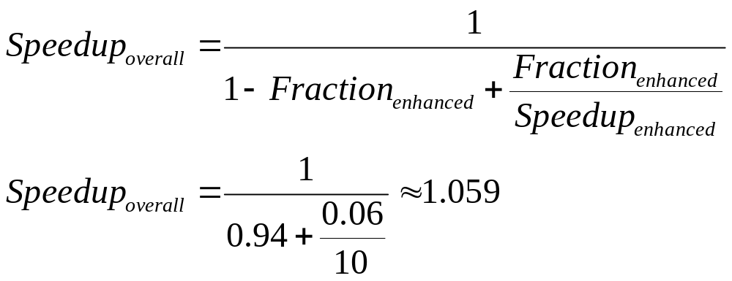
“Law of Diminishing Returns”
Suppose that same piece of code can now be enhanced another 10 times
Fraction_{enhanced} = 0.04/(0.60 + 0.04) = 0.0625
Speedup_{enhanced} = 10

Slide 27

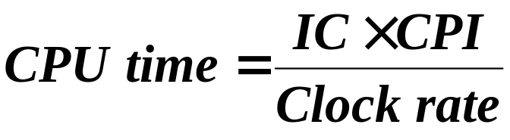
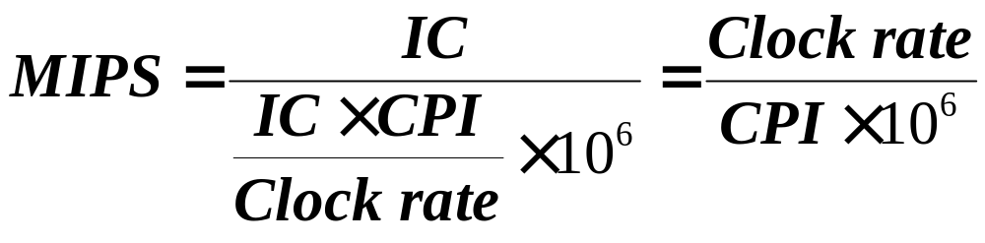
MIPS as a Measure for Comparing Performance among Computers
MIPS – Million Instructions Per Second

Slide 28
MIPS as a Measure for Comparing Performance among Computers (cont’d)
Problems with using MIPS
as a measure for comparison
  MIPS is dependent on the instruction set, making it difficult to compare MIPS of computers with different instruction sets
  MIPS varies between programs on the same computer
  Most importantly, MIPS can vary inversely to performance

Slide 29
Things to Remember
Execution, Latency, Res. time:
time to run the task
Throughput, bandwidth:
tasks per day, hour, sec
User Time
  time user needs to wait for program to execute:
  depends heavily on how OS switches between tasks
CPU Time
  time spent executing a single program: depends solely on design of processor (datapath, pipelining effectiveness, caches, etc.)

Slide 30

Things to Remember (cont’d)
Benchmarks: good products created when have good benchmarks
CPI Law
Amdahl’s Law

Slide 31
Things to Remember Cont’d
Costs and trends in cost
  (What affects cost, Cost of integrated circuits, cost versus price)
  Why measuring computer performance is important
  (Execution time is the only unimpeachable measure of performance)
  Different performance metrics
  (response time, throughput, CPU time)
  Performance comparison

Slide 32
Things to Remember Cont’d
A fundamental rule in computer architecture is to make the common case fast
The most accurate measure of performance is the execution time of representative real programs (benchmarks)
Execution time is dependent on the number of instructions per program, the number of cycles per instruction, and the clock rate
When designing computer systems, both cost and performance need to be taken into account

