Slide 1
COMMUNICATION FOR SOCIAL AND BEHAVIOUR CHANGE
Stephen Muthoga

Slide 2
Factors that contribute to behavior change
Physical stimuli-based on a person’s current physical state as well as fear of future pain discomfort or memory of past pain
Rational stimuli-Based on knowledge of reasoning-if people have the facts they choose to do the right thing
Emotional stimuli-based on the intensity of feeling of fear, love or hope
Skills –based on the person’s capacity to adopt and continue a new behavior
Family and personal networks-Based on the influence from family and peers
Social structures –Based on the impact of social economic legal and technological factors on the daily life of a person.

Slide 3
FIVE steps to behavior change.
Knowledge
Approval
Intention
Practice
Advocacy

Slide 4
Approaches to Behaviour Change
Dissemination-increase awareness by providing information to those who are open to learning about the desired behaviour
Education-promote learning comprehension and the acquisition of skills needed to adopt new behaviour in those who are motivated to learn
Persuasion-enhance acceptance of new health beliefs values and behaviors through rational arguments
Dialogue –promote mutual understanding and agreement through interpersonal and group discussions, shared experience and social network
Entertainment –promote enjoyment emotional stimulation and excitement by exposing the audience to the message through music, dance comedy and drama
Compliance-enhance compliance through positive or negative sanctions threats or incentives
Notes:
Ask the fellows to work in pairs and discuss the different approaches to change .Ensure the points listed below are included

Slide 5
Example of behavior change in a family planning programme
Analysis
Strategic Design
Development and Testing
Implementation and Monitoring
Evaluation and Re-planning

Slide 6
STEP 1: ANALYSIS
Analysis helps program us to:
Identify the issues about family planning to be addressed;
Understand the intended audience.
There are two components of analysis:
Situation analysis
Audience analysis.

Slide 7
STEP 1: ANALYSIS CONTD.
Situation analysis is gathering information about:
The issue (Increase CPR) of family planning and its severity.
Factors that could promote (education) or hinder change(religion).
Audience analysis is gathering information about:
The know edge, attitudes, skills, and behaviors of intended audience
Communication channels in the area where we plan to conduct our activity.

Slide 8
STRATEGIC DESIGN
Step 2: Strategic Design helps us to:
Define our project's objectives:
Decide the most effective way to achieve them; Create an implementation plan; and monitoring and evaluation plan. To define our project's objectives, we should make them SMART:
Specific;
Measurable;
Appropriate;
Realistic
Time-bound
If we want to increase CPR, then we should remember these things.

Slide 9
STRATEGIC DESIGN CONTD.
To prepare ourselves for making an implementation plan, we need to decide the most effective way to achieve our project's objectives,We should:
Select our approach to behavior change about family plannng;
State why and how we expect to affect change in our intended audience;
Select the partners and communication channels that proVde us the most effective access to our intended audience, resulting, if possible, in both mobilizing the community as a whole and reaching individuals through interpersonal communication.
Once we have made these decisions, we can develop an implementation plan with the following characteristics outlining our strategy:
Regular benchmarks to track our progress over time:
Clear responsibilities for a stakeholders:

Slide 10
DEVELOPMENT AND TESTING
Before we are ready to launch our BCC materials, we need to develop and test them. This helps us confirm that our product motivates our audience to change. To do so, we can conduct design workshops on family planning, which:
Include key stakeholders, such as field workers, and members of our intended audience;
Use participants input to determine whether our products meet our audience's needs;

Slide 11
Development and Testing Cont’d
Test our approach to the project and the ideas we include in our products. After the material is designed, we should pre-test it, noting whether all information is:
Clear;
Easy to remember
Socially appropriate
and culturally appropriate
Based on input from the workshop and pre-test, we can revise and retest the products.

Slide 12
ABOUT FAMILY PLANNING: STAGES OF BEHAVIOR CHANGE
Stage 1: Aware: If most of the people are unaware about family planning, then first of all we have to make awareness among people about the family planning. We have to explain cause-effect of family planning.
Stage 2: Motivation: Second steps is, we have to motivate them for taking family planning. And then they will prepare for this.
Stage 3: Action: 3rd step is, we have to identify for them how to take an action about this planning. Then they will start acting on this family planning.

Slide 13
ABOUT FAMILY PLANNING: STAGES OF BEHAVIOR CHANGE CONTD.
Stage 4: Maintenance: After staring action many people leave this. A suitable example for it is that about 62% is contraceptive use rate in Bangladesh. But 46% of them don't continue it. So we have to show for them an effective way how to maintain family planning program for long time with benefits.
Stage 5: Final stage
Termination: Finally, we have to make sure that they won't relapse their new practice about family planning.

Slide 14
SBCC HAS 3 CHARACTERISTICS:
SBCC is an interactive, researched and planned process
SBCC applies a socio-ecological model to find the tipping point for change
SBCC operates through three key strategies, namely
advocacy,
social mobilization, and
behavior change communication.

Slide 15
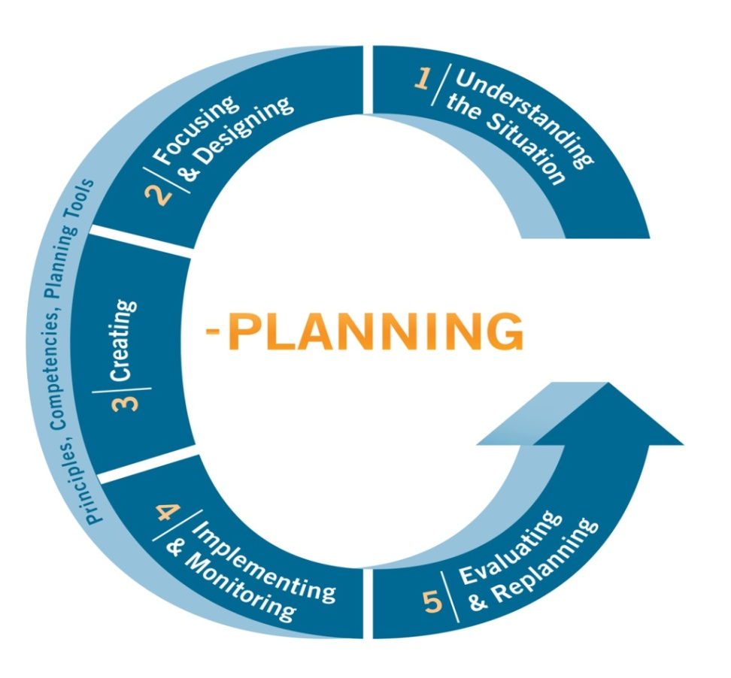
Characteristic 1. SBCC is a process
Steps:
1. Understanding the Context through situation & communication analysis
2. Focusing & Designing the Communication Strategy
3. Creating Interventions & Materials for Change
4. Implementing & Monitoring Change Processes
5. Evaluation & Replanning for Outcome and Sustainability

Slide 16
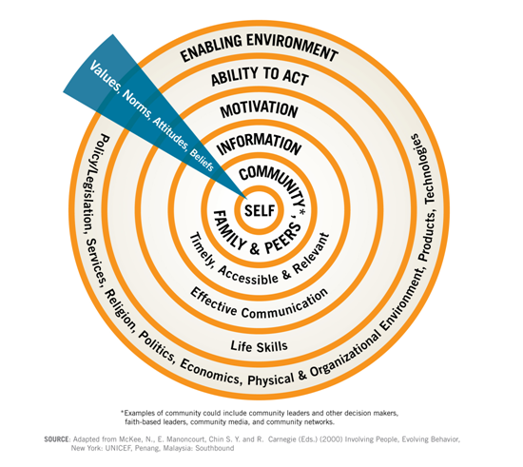
Characteristic 2: SBCC requires a Soci0-Ecological Model for analysis
Ecological means how people relate to their environment, shown by the rings
Self: Which people are directly affected by the problem or needed change?
Community, etc: Who and what is directly influencing “self”?
Enabling environment: Who and what is indirectly affecting “self”?
Ability to Act, motivation, information: Are these conditions addressed and what is available?
What values are manifested in socio/cultural norms, attitudes and behaviors across all rings?
Source: Adapted from McKee, Manoncourt, Chin and Carnegie (2000)
Notes:
There are a variety of theoretical models to choose from; but none of these are completely satisfactory by themselves.
The following model combines psychological and social theoretical perspectives to shift our conceptual thinking to a more holistic, namely ecological level.
This includes addressing not only knowledge and motivation but also skills and an enabling environment as well as gender.
Combines psychological and sociological perspectives to a more comprehensive namely ecological level.

Slide 17
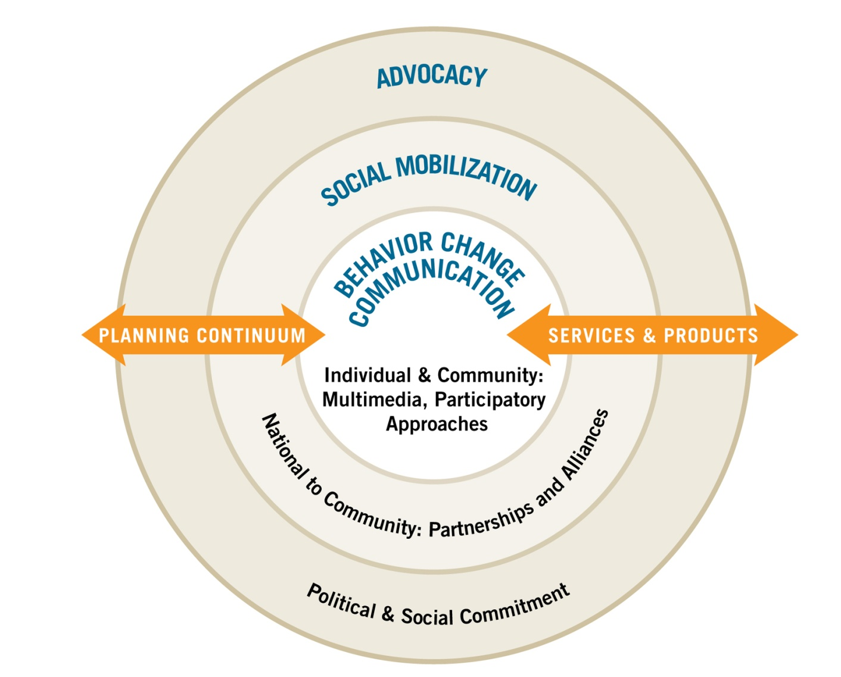
Characteristic 3. SBCC operates through three main strategies
Based on the socio-ecological analysis we can now choose the appropriate mix of strategies to address change:
advocacy to raise resources and political and social leadership commitment for development goals;
social mobilization for wider participation and ownership, including community mobilization; and
behavior change communication for changes in knowledge, attitudes and practices of specific participants/audiences in programs.
Notes:
Its not so much whose behavior do we need to change but what can communication do about the issues identified in the situation analysis; if that is e.g., no access to treatment, or no economical empowerment programs for women…. Advocacy and soc mob are an effective answer
Advocacy is a continuous and adaptive process of gathering, organizing, and formulating information into argument with a view to raising resources or gaining political and social leadership acceptance and commitment for a development program.
Social mobilization is a process of bringing together all practical inter-sectoral social partners to determine felt-need and to raise awareness of, and demand for, a particular development objective. It involves enlisting the participation of institutions, groups, networks and communities in identifying, raising and managing human and material resources. It aims to strengthen self-reliance and sustainability of achievements.
Behavior change communication is a research-based, consultative process of addressing knowledge, attitudes, and practices through identifying, analyzing, and segmenting audiences and participants in programs. BCC provides relevant information and motivation through well-defined strategies, using an appropriate mix of interpersonal, group and mass-media channels, including participatory methods.

Slide 18
MORE HARM THAN GOOD?
When we set out to improve life for others without a fundamental understanding of their point of view and quality of experience, we do more harm than good. (Lauren Reichelt, Tikkun, Winter 2011)

Slide 19
Why use theories and models?
Answers to key questions
Why a problem exists
Whom to select
What to know before taking action
How to reach people with impact
What strategies likely to cause change

Slide 20
Emphasis of some core theories
More
individual
Theory | Emphasis
Individual level
Health Belief Model Reasoned Action – Fishbein & Ajzen Stages of Change – Prochaska, DiClemente | Planned behavior, rational decision making processes (beliefs & subjective norms)
Fear Management – Witte | Interaction between cognition & emotion
Interpersonal level
Social learning – Bandura | Social comparison, learning from role models, self efficacy
Community level
Theory of Gender and Power Diffusion of Innovations - Rogers | Social influence, personal networks
Ecological Models | Behavior is a function of the person and its environment
More
social
Adapted from Douglas Storey—JHU, Center for Communication Programs

Slide 22
Evolution of key concepts

Slide 23
Evolution of key concepts
Older approaches tried to persuade individuals to change their health behaviors
Newer approaches try to create an enabling environment to encourage healthy behaviors
Newer approaches consider more than just individual behaviors
Source: Douglas Storey—JHU, Center for Communication Programs

Slide 24
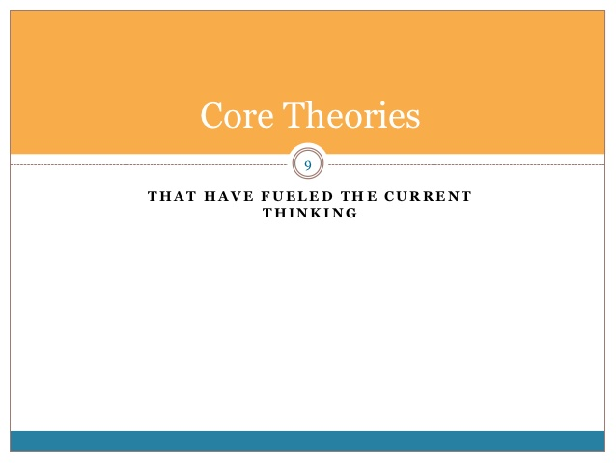

Slide 25
Three levels of theory
Level of Change | Change Process | Targets of Change
Individual level | Psychological | Personal behaviors
Interpersonal level | Psycho-social | Social Networks
Community level | Cultural & Social | Community development
Most theories can be sorted into three levels

Slide 26
