Slide 1

DEDAN KIMATHI UNIVERSITY OF TECHNOLGY PROJECT PROPOSAL FOR DEGREE IN BSc. INFORMATION TECHNOLOGY BY KIMANI PATRICK GICHINGA (C025-01-0966/2015) EBURSARY SYSTEM SUPERVISOR MR. MICHAEL KAMAU Submitted in partial fulfillment of the requirements for award of degree in BSc. Information Technology

Slide 2
Ebursary system
This is a system that is aimed at linking students/pupils with institutions(companies) offering bursaries. They can download bursary forms, fill them, scan and upload them for approval by the respective institutions.
Background of the study
Acts like Children’s Acts 2014 were created to ensure that every child is entitled to basic education.
In the past years, government administrations i.e. NARC and jubilee have pledged free primary education to all Kenyans children, even to the extent of providing free secondary education.
When free education was introduced, many thought all requirements will be catered for.
But parents goes to extent of paying some amount of fees to pay PTA teachers.
Some don’t manage because they fill this amount is still high. The same applies to those in schools of higher learning.
CDF kitty was been set to cater basically for education and infrastructural development. But most of this funds nowadays are used to offer bursaries considering that Kenya is third world country, resources should be channeled to infrastructural developments.
The laws of Kenya provides that the institutions set within a community should set aside some funds that are used to cater the needs of the community e.g. KenGen.
This amount may be channeled to education sector in bursary form.
Institutions need to upload the bursary form to the system.
Students/pupils downloads the form. Fill in and attach the documents needed as per the requirements. Then uploads waiting for approval/disapproval.

Slide 3
1.2 problem statement
Access to bursary form from SOME companies may be hectic if one has to travel to where they are located to get the form.
Also, knowing which companies that wish to offer bursaries may be difficult.
However, after one has applied for the bursary, it may also be difficult to recognize if one managed to be awarded the bursary.
One may be forced to keep on calling the institution receptionist to request for the same.
If officer in-charge of bursaries in a particular institution talks rude to the student, he/she may never be encouraged to apply again even though he/she is needy.

Slide 4
1.3 objectives
1.3.1 General objective
To link students and pupils with institutions offering bursaries.
1.3.2 Specific objectives
To create a centralize and widely accessible platform where students can access bursary forms from various institutions.
To provide accurate and timely information about new bursary application forms posted on Ebusary system by sending emails to the beneficiaries.
Equity to those receiving bursaries. One will receive funds equivalent to his/her school fees.

Slide 5
1.4 problem justification
UNESCO (United Nations Educational, Scientific and Cultural Organization) director confirms that most countries have promised to provide primary and secondary school to every child in their respective countries by the year 2030.
But they are mostly focusing on early childhood stage.
Furthermore, this “free education” does not cater for all school fees required in schools & universities.
Parents who pay for this fees still free that it is a huge burden that cannot able to cater unless they assisted.
When one finishes form four, he/she is left behind to struggle with his/her studies.
This however, has resulted to many youths failing to continue with their studies due to lack of sufficient fees.
If bursary application was to be centralized, students could never lack fees to cater for their learning as they could be applying them online to secure one.

Slide 6
1.5 Scope
Ebursary system will be expected to be commonly used in institutions of learning e.g. universities, secondary schools etc. and those that are will to offer bursaries to students.
1.6 Assumptions
The hardware resources required will be readily available e.g. a smart device which can access internet.
1.7 Limitations
Students in remote areas, where internet in not readily available, will not benefit from the system.
Also, those who have no access smart devices will not enjoy the system

Slide 7
Chapter two: Literature review
Donations are the major sources of funds for bursaries in most schools.
Donated to a given school as part of charity work.
Some the system developed to aid this include: wishbone organization system, kin Canada system, higher education loan board system and Latymer system.
All this system allows donors to assist students who are financially unstable.
However, because there are so many Kenyan who are needy, Ebursary system is aimed to link much more learners country wide regardless of school they are in.
Donors(institutions) are encouraged to provide bursaries as part of community building.
Case 1: wishbone system
Here donations are done to specific students.
One chooses on the system the student he/she want to offer bursary to.
Limitation: one must be from; Los Angeles, New York city and the Bay area.
Must be a performer, low-income earner and current high-school student.
Case 2: Latymer foundation system
It was founded by Latymer upper
aimed at raising funds that are used to support the expansion of bursary programme.
The system actually links the students and the alumni who usually contribute towards the programme.
Bursaries are awarded to students who are financially unstable and must be studying in that particular school.

Slide 8
.
Case 3: higher education loan board (HELB)
Is a state corporation that gives loans and bursaries to Kenyan students
Must be in an institution of higher learning for one to be a member
Though they provide loans to students, one who is need of applying a bursary must be much in need and usually given to very few people.
The loan taken by students is expected to be paid upon completion of their studies.
However, these loans and bursaries are issued to students in universities and colleges. Others do not benefit.
Case 4: Kin Canada system
This is a system in Canada that allows individuals or organizations to donate towards projects that are aimed at improving the livelihood of the community.
Donations are made to financially support initiatives such as bursaries and a number of donation campaigns.
Bursaries are only awarded based on financial need, community and volunteer involvement etc.
Due to this national contributions by the key donors, the volunteers, those who initially are supposed to pay lumpsum of money, they pay less.
Funds secondary and post-secondary education
Conclusion
Most of the system, despite them willing to assist, they are concentrating at one academic level i.e. university, secondary schools etc.
Others have systems that allows donors across the country to channel their funds to them, despite them having a very small population to handle.
Companies are not involved in bursaries provision.

Slide 9
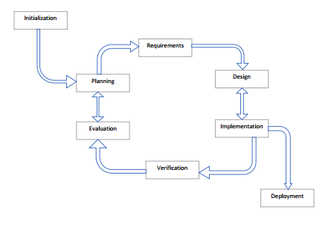
Chapter three: Methodology
3.1.1 Iterative model
Iterative model is will be most preferable model to develop web-based systems.
Because, it focusses on initial, simplified implementation which then progressively gains more complexity and a broader feature set until the final system is complete.
Has the following stages: initialization, planning and requirement gathering, design and coding, implementation, testing and evaluation.

Slide 10
3.2 Facts finding methods
3.2.1 Questionnaires
The questionnaire consists of open-ended and closed questionnaires.
Open-ended questionnaire aims at capturing the respondents’ own opinion about the system e.g. How the system will benefit them as a community.
Closed questionnaire are those that are meant to capture specific area of interest for the developer of the system.
3.2.2 Past records
Make use of the existing materials e.g. online materials to get information on the approximate number of students who are in need of the bursary and how Ebursary system will benefit them.
3.2.3 Data presentation
In this regard, pie charts shall be used to present the outcome of the results.

Slide 11
3.3 Method justification
Why iterative model?
There is rapid turnaround meaning that each stage of an iterative process can be slimmed down into smaller and smaller time frames so that to suit the needs of the project.
Why questionnaire and past records?
By use of questionnaire one is able to capture respondents’ own opinion about the system.
Pasts records will also give history of how other previous system worked before the new one is developed. And how the new system will more preferable.

Slide 12
3.3 Resources
Hardware
Computer
Hard disk
Modem
Software
Xampp server
Browser e.g. chrome
Editor e.g. atom

Slide 13
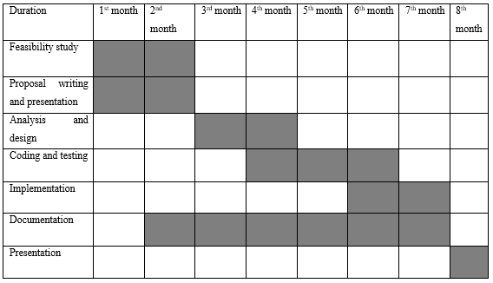
Appendices
Appendix A:

Slide 14
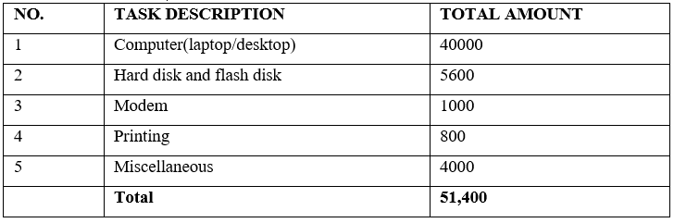
Appendix B

Slide 15
References
Bursaries - Latymer Foundation. (n.d.). Retrieved May 31, 2018, from https://www.latymerfoundation.org/bursaries/bursaries
Constituency Development Fund. (2017, August 12). In Wikipedia. Retrieved from https://en.wikipedia.org/w/index.php?title=Constituency_Development_Fund&oldid=795157511
Donate - Kin Canada. (n.d.). Retrieved May 31, 2018, from http://www.kincanada.ca/donate
HAL ROGERS ENDOWMENT FUND / KIN CANADA BURSARIES | Ways To Give. (n.d.). Retrieved May 31, 2018, from https://www.canadahelps.org/en/charities/hal-rogers-endowment-fund-kin-canada-bursaries/
Higher Education Loans Board - Empowering Dreams. (n.d.). Retrieved May 26, 2018, from http://www.helb.co.ke/
Jubilee’s free secondary education to kick off smoothly » Capital News. (2017, June 24). Retrieved May 29, 2018, from https://www.capitalfm.co.ke/news/2017/06/jubilees-free-secondary-education-kick-off-smoothly/
Kenya Law: Kenya Community Development Foundation. (n.d.). Retrieved May 31, 2018, from http://kenyalaw.org/kl/index.php?id=147
Latymer Foundation Hammersmith. (n.d.). Retrieved May 31, 2018, from http://www.latymerfoundation.org/
ogola.pdf. (n.d.). Retrieved from http://www.ossrea.net/publications/images/stories/ossrea/ogola.pdf
‘The Children Act’ Review: Emma Thompson’s Best Role Since ‘Wit’ – Variety. (n.d.). Retrieved May 30, 2018, from http://variety.com/2017/film/reviews/the-children-act-review-emma-thompson-1202553219/
United Nations Educational, Scientific and Cultural Organization. (n.d.). Retrieved May 26, 2018, from http://www.unesco.org/new/en/education/themes/leading-the-international-agenda/education-for-all/single-view/news/263_million_children_and_youth_are_out_of_school_from_primar/
Wishbone. (n.d.). Retrieved May 26, 2018, from https://www.wishbone.org/

