Slide 1

Guided by : Sir Zafar Nasir /Sir Qublai
Submitted by: Muhammad Hasham k112301(B)
Syed Ibtehaj Hassan k112126(B)
Muhammad Abdullah Mateen k112151(B)

Slide 2

Contents
Introduction & Scope
Project Description
Advantages of Automated Hospital Management System
Existing System
Requirement Specification
Elicit stakeholders requests
UML Diagram
Use Case Diagram
Fully Dressed Narration
Domain Model
Interaction Diagram
1.Sequence Diagram
2. Communication and Collaboration Diagram
Class Diagram
Context Level Diagram
Data Flow Diagram
Activity Diagram
USER INTERFACE

Slide 3

Introduction
Purpose
To perform automation of Hospital Management
The Software includes:-
Maintaining Patient details.
Providing Prescription, Precautions and Diet advice.
Billing and Report generation.
Scope
It can be used in any Hospital or Dispensary for maintaining patient details and their test results.

Slide 4
Project Description
The purpose of the project entitled as “HOSPITAL MANAGEMENT SYSTEM” is to computerize the Front Office Management of Hospital to develop software which is user friendly, simple, fast, and cost – effective. It deals with the collection of patient’s information, diagnosis details, etc. Traditionally, it was done manually. The main function of the system is to register and store patient details and doctor details and retrieve these details as and when required, and also to manipulate these details meaningfully System input contains patient details, diagnosis details; while system output is to get these details on to the CRT screen.
Our project Hospital Management system includes registration of patients, storing their details into the system, and also computerized billing in the pharmacy, and labs. Our software has the facility to give a unique id for every patient and stores the details of every patient and the staff automatically. It includes a search facility to know the current status of each room. User can search availability of a doctor and the details of a patient using the id.

Slide 5
The Hospital Management System can be entered using a username and password. It is accessible either by an administrator or receptionist. Only they can add data into the database. The data can be retrieved easily. The interface is very user-friendly. The data are well protected for personal use and makes the data processing very fast.
NEED 1. Efficiently maintains the details about the patient 2. Simultaneously updates changes made to any data, item in the entire data base. 3. It is faster than manual system

Slide 6
Advantages of Automated Hospital Management System
Immediate Access of data
Friendly user interface
Time saving
Data can be easily insert/update/delete
Saving paper work
Give facility of different types of Enquiry
Data’s are easily approachable.

Slide 7
Existing System
Existing system refers to the system that is being followed till now.
Presently all the hospital functionalities are done manually. That is if a patient want to consult a doctor he need to wait their till his chance called. This is very difficult process.
Out_Patient tickets are distributed directly. The main disadvantage is time consuming

Slide 8
Limitations of Existing System
Lack of security of data.
Time consuming.
Consumes large volume of paper work.
Manual work
No direct role for the higher officials.
To avoid all these limitations and make the system working more accurately it needs to be computerized.

Slide 9
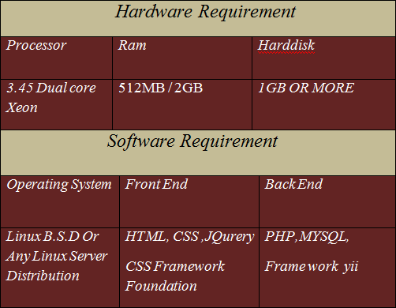
Requirement Specification

Slide 10
Elicit stakeholders requests
The stakeholders at the Hospital Management System are System Administrator, Patient, Management Staff, Nurses, Doctor, Database Administrator …..
A Doctor can take cases, Can give prescription to Patient, Do Operations, Review Patients Health.
Nurses can give Medicine to Patients, Coordinate with Doctors in Operations, Reports to Doctors, Monitors Patients and their health.
Staff can do Cleaning , Dispose Wastes, Maintain Beds and Rooms.
Patient Interact with Doctors, Follow Doctor Instruction, Pay Bills, and give Feedback about Doctors
Billing Section Patient Billing, Discharge Billing, Give Salaries to Nurses, Staff and Doctors, Maintain tax records.
System Administrator can remove and modify employee details can add and delete them
Receptionist can also add Patient via registration, Allot bed to Patients, Allot Patient Appointment according to the availability of Doctors.
Validation System validates every input and output going in and out of the Database.
Database System Stores Data and enforce Constraints.

Slide 11
UML
Static
Dynamic
Physical
Sequence
Use Case
Activity
Communication
Class
Object
Component
Deployment

Slide 12
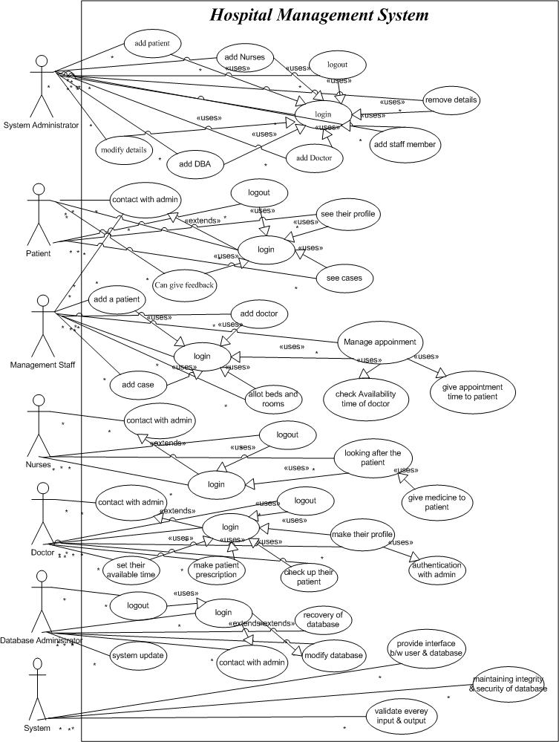
Use Case Diagram of HMS

Slide 13
Fully Dressed Narration
UC1: Login to System
Primary actors: System Administrator, Receptionist/Management Staff, Doctor , Patient, Nurse.
Trigger: User hits login Button in HMS home page.
Preconditions: The user is not yet logged in
Postconditions: The user can access the main menu of their Profile
Main Success scenario:
User types in his/her User Name
User types in his/her Password
System Validates given login parameters
System creates a new session for the user
Alternative flows:
User provides invalid login parameters.
System show warning about wrong parameters.

Slide 14
3.System redirects the user to the login page again.
4. User re enters his/her id and password.
Inclusive Use Case:
None?
Special requirements: System Response time less than 3 seconds
Technology and Data Variations List:
User wants to be remembered on a particular Pc.
Frequency of occurrence: Once every time use gets log out.
UC2: Logout from System
Primary actors: System Administrator, Receptionist/Management Staff, Doctor , Patient, Nurse.
Trigger: User hits logout Button in HMS home page.
Preconditions: The user is logged in
Postconditions: The user successfully gets logged out from his/her account
Main Success scenario:
User finishes his/her session by hitting logout option and get log out from HMS
Alternative flows:
Net gets disconnected:
System will automatically log out if net gets disconnected.
Inclusive Use Case:
Login.
Special requirements: System Response time less than 3 seconds
Technology and Data Variations List:
None?
Frequency of occurrence: Once every time use gets logged it.

Slide 15
UC3: Add/Register Patient
Primary actors: System Administrator, Receptionist/Management Staff
Trigger: Admin/ Receptionist hits register Patient Button in HMS home page.
Preconditions: Patient is not Already Registered
Postconditions: Patient gets Register
Main Success scenario:
New Patient comes to the hospital.
Admin/Receptionist starts a new Patient registration
Admin/Receptionist enters basic Patient information (Name, Age, Gender, Cnic of his/her or guardian, Phone Number, Illness)
System Assigns New Id and Password to Patient.
Admin/Receptionist saves Registration Form
System Displays Profile of new Patients.
Alternative flows:
at any time system fails:
Admin/ Receptionist restarts system, logs in and request recovery of prior state.
System reconstructs prior state
Admin/ Receptionist starts a new Patient registration
b) Any Required Field Left Blank in Registration Form
System signals error to Admin/Patient
Admin/ Receptionist enters missing field to get Patient Register.
Inclusive Use Case:
Login.
Special requirements: System Response time less than 3 seconds
Technology and Data Variations List:
Patient Id and Password could be generated by the system or entered

Slide 16
by Admin/ Receptionist.
Frequency of occurrence: Patient only gets registered once.
UC4: Add/Register Doctor
Primary actors: System Administrator
Trigger: Admin hits register Doctor Button in HMS home page.
Preconditions: Doctor is not Already Registered
Postconditions: Doctor gets Register
Main Success scenario:
Admin starts a new Doctor registration.
Admin enters basic Doctor information (Name, Age, Gender, Cnic of his/her, Phone Number, Illness)
Admin enters Qualifications (Degree, Specialty, Experience).
System Assigns New Id and Password to Doctor.
Admin saves Registration Form
System Displays Profile of new Doctor.
Alternative flows:
at any time system fails:
Admin restarts system, logs in and request recovery of prior state.
System reconstructs prior state
Admin starts a new Patient registration
Any Required Field Left Blank in Registration Form
System signals error to Admin
Admin enters missing field to get Doctor Register.
Inclusive Use Case:
Login.
Special requirements: System Response time less than 3 seconds
Technology and Data Variations List:
Doctor Id and Password could be generated by the system or entered by Admin/ Receptionist
Frequency of occurrence: Doctor only gets registered once.

Slide 17
UC5: Add/Register Staff person, Nurse
Primary actors: System Administrator
Trigger: Admin hits register Staff/Nurse Button in HMS home page.
Preconditions: Staff/Nurse is not Already Registered
Postconditions: Staff/Nurse gets Register
Main Success scenario:
Admin starts a new Staff/Nurse registration.
Admin enters basic Staff/Nurse information (Name, Age, Gender, Cnic of his/her, Phone Number, Illness)
Admin enters Staff/Nurse (Degree, Specialty, Experience)
System Assigns New Id and Password to Staff/Nurse.
Admin saves Registration Form
System Displays Profile of new Staff/Nurse.
Alternative flows:
at any time system fails:
Admin restarts system, logs in and request recovery of prior state.
System reconstructs prior state
Admin starts a new Patient registration
Any Required Field Left Blank in Registration Form
System signals error to Admin
Admin enters missing field to get Staff/Nurse Register.
Inclusive Use Case:
Add/Register Remove Doctor, Staff Member, Nurse.
Login.
Special requirements: System Response time less than 3 seconds
Technology and Data Variations List:
Staff/Nurse Id and Password could be generated by the system or entered by Admin/ Receptionist
Frequency of occurrence: Staff/Nurse only gets registered once.

Slide 18
UC6: Remove Doctor, Staff Member, Nurse
Primary actors: System Administrator
Trigger: Admin hits Remove Doctor/Staff/Nurse Button in HMS home page.
Preconditions: Doctor/Staff/Nurse is Currently Registered
Postconditions: Doctor/Staff/Nurse gets Removed.
Main Success scenario:
Admin enters Doctor/Staff/Nurse Id to first search them in Database.
Admin then hits Remove option by selecting the Doctor/Staff/Nurse tupple.
System then Confirms current action.
Admin confirms his/her action.

Slide 19
System removes Doctor/Staff/Nurse all information and profile.
System Displays Doctor/Staff/Nurse are successfully removed dialog and redirect to the Home Page.
Alternative flows:
At any time system fails:
Admin restarts system, logs in and request recovery of prior state.
System reconstructs prior state
Admin removes Doctor/Staff/Nurse.
Admin does not confirms his action and hits cancel
System signals action not confirmed and redirects to home page.
Inclusive Use Case:
Add/Register Remove Doctor, Staff Member, Nurse.
Login.
Special requirements: System Response time less than 3 seconds
Technology and Data Variations List:
None?
Frequency of occurrence: Doctor/Staff/Nurse only gets removed once.

Slide 20
UC7: Remove Patient
Primary actors: System Administrator/Receptionist
Trigger: Administrator/Receptionist hits Remove Patient Button in HMS home page.
Preconditions: Patient is Currently Registered
Postconditions: Patient gets Removed.
Main Success scenario:
Admin/Receptionist enters Patient Id to first search them in Database.
Admin/Receptionist then hits Remove option by selecting the Patient tupple.
System then Confirms the removal of current selection.
Admin/Receptionist confirms his/her action.
System removes Patient all information and profile.
System Displays Patient is successfully removed dialog and redirect to the Home Page.
Alternative flows:
At any time system fails:
Admin/Receptionist restarts system, logs in and request recovery of prior state.
System reconstructs prior state
Admin/Receptionist removes Patient.
Admin/Receptionist does not confirms his action and hits cancel
System signals action not confirmed and redirects to home page.
Inclusive Use Case:
Add/Register Patient.
Login.

Slide 21
Special requirements: Response time less than 3 seconds
Technology and Data Variations List:
None?
Frequency of occurrence: Patient only gets removed once.
UC8: Modify Information
Primary actors: System Administrator
Trigger: Admin hits Modify Information Button in HMS home page.
Preconditions: Person must be available in database
Postconditions: person’s information get modified.
Main Success scenario:
Person currently in System Asks System Admin to Modify his/her details.
Admin asks his/her id and enters it in the system.
System shows the information of the person.
Admin ask for information that needs to be modified.
Person tells the new Information.
Admin enters new information in the system and hit save button.
System then Confirms current action.
Admin confirms his/her action.
System save the information in database and show the new information.

Slide 22
Alternative flows:
At any time system fails:
Admin restarts system, logs in and request recovery of prior state.
System reconstructs prior state
Admin modifies the details and save again.
Admin does not confirms his action and hits cancel
System signals action not confirmed and redirects to home page.
Inclusive Use Case:
Login.
Add/Register Patient, Doctor, Staff Member/Receptionist, Nurse.
Special requirements: System Response time less than 3 seconds
Technology and Data Variations List:
None?
Frequency of occurrence: Person information can be modified multiple times.
UC9: View Profile
Primary actors: Doctor, Patients
Trigger: Doctor/Patient hits login button to login into his/her profile.
Preconditions: Doctor/Patient must be registered in the System.

Slide 23
Postconditions: Doctor/Patient get to view his/her profile.
Main Success scenario:
Doctor/Patient in internet browser opens HMS home page and hit login button.
Doctor/Patient then enter his/her id and password to get log in.
System After verifying entered id and password redirects home page to therir profile.
Doctor/Patient then gets to see their stored information in HMS.
Alternative flows:
Net gets disconnected:
System will automatically log out the logged in account if net gets disconnected.
System maintenance going on
System will show error message about System Maintenance
Inclusive Use Case:
Add/Register Patient, Doctor.
Login.
Special requirements: System Response time less than 3 seconds
Technology and Data Variations List:
None?
Frequency of occurrence: Doctor/Patient can view his/her profile multiple times.

Slide 24

UC10: View Cases
Primary actors: Patients
Trigger: Patient hits view cases button in his/her profile.
Preconditions: Person must have at least one case that he/she has given to Doctor
Postconditions: Person gets current information about his/her case.
Main Success scenario:
Patient while logged into his/he account views his/her cases by hitting view case button in his/her account.
Alternative flows:
Net gets disconnected:
System will automatically log out if net gets disconnected.
Inclusive Use Case:
Add/Register Patient.
Login.
Get Appointment.
Check Appointment.
Special requirements: System Response time less than 3 seconds
Technology and Data Variations List:
None?
Frequency of occurrence: Once logged in patient can view his/her case multiple times.

Slide 25
UC11: Get Appointment
Primary actors: Patients
Trigger: Patient goes to counter to get appoinment.
Preconditions: Patient if not registered must get registered first.
Postconditions: Patient gets Doctors Appointment.
Main Success scenario:
Patient if not already registered, gets registered in the System.
Registered Patient requests for the appointment from receptionist.
Receptionist checks Patient’s validity in the system.
Receptionist asks for Patient’s problem/disease/illness and assigns doctor according to the stated problem of the patient.
Patient gets appointment of the Doctor.
Alternative flows:
No doctor is available:
Patient will then have to contact receptionist.
Inclusive Use Case:
Login.
Add/Register Patient.
Special requirements: None?
Technology and Data Variations List:
None?
Frequency of occurrence: user can only get one appointment per day.

Slide 26
UC12: Manage Appointment
Primary actors: Receptionist
Trigger: Receptionist hits New Appointment button for that day.
Preconditions: Receptionist must be logged in the HMS.
Postconditions: Receptionist Successfully Enters all the appointment for that day.
Main Success scenario:
Receptionist hits the New Case button in Appointment Page.
Receptionist then ask Patient for their illness/disease and enters case in case dialog.
Receptionist then assigns Doctor according to the case of the Patient.
Receptionist then hits save button and create new appointment for the case.
Alternative flows:
No doctor is available for such disease:
Receptionist then have to recommend another hospital that have cure for such disease.
Inclusive Use Case:
Login.
Check Availability time of Doctor.

Slide 27
Give Medicine To Patient.
Special requirements: None?
Technology and Data Variations List:
None?
Frequency of occurrence: Receptionist can make one appointment for one case.
UC13: Check Patient
Primary actors: Doctor
Trigger: Doctor hits Appointment button in his profile.
Preconditions: Doctor must be logged in the HMS.
Postconditions: Doctor Checks up the Patient.
Main Success scenario:
Doctor Checks the Patient according to appointment allocated to him/her.
Doctor starts checkup by confirming the appointment in the system.
Doctor after checking patient marks the appointment checked.
Alternative flows:
Patient does not come:
Receptionist then sends in the next patient who has the appointment.
Inclusive Use Case:
Login.
Manage Appointment.

Slide 28
Special requirements: None?
Technology and Data Variations List:
None?
Frequency of occurrence: user can only get one prescription per visit or none.
UC14: Give Prescription
Primary actors: Doctor
Trigger: Doctor hits give prescription button HMS Home page.
Preconditions: Doctor must be logged in the HMS.
Postconditions: Doctor gives prescription to Patient.
Main Success scenario:
Doctor Checks the Patient via allocated appointment.
Doctor after checking patients gives prescription by hitting Prescription button in Home Page.
While in prescription form doctor enters Patients id and writes Prescription for his/her illness.

Slide 29
Doctor then hits save Button.
System asks for confirmation of action.
Doctor hits confirm.
Prescription gets saved in the system.
.
Alternative flows:
No prescription required:
Doctor after checking Patient decides that patient does not require any prescription so there will be no prescription for that visit of patient.
Inclusive Use Case:
Login.
Manage Appointment.
Check Patient.
Special requirements: System Response time less than 3 seconds
Technology and Data Variations List:
None?
Frequency of occurrence: user can only get one prescription per visit or none.

Slide 30
UC15: Give Response
Primary actors: Doctor
Trigger: Doctor hits give Response button in HMS Home page.
Preconditions: Doctor must be logged in the HMS.
Postconditions: Doctor gives response about patient’s case.
Main Success scenario:
Doctor reads patients case from his/her profile.
Doctor after reading patient’s case gives his/her response about the case.
Doctor then hits save Button.
System asks for confirmation of action.
Doctor hits confirm.
Response gets saved in the system.
.
Alternative flows:
Doctor may not gives response about the case if not required:
System will not enforce response for particular case.
Inclusive Use Case:
Login.
Manage Appointment.
Special requirements: System Response time less than 3 seconds
Technology and Data Variations List:
None?
Frequency of occurrence: Any Doctor can give multiple responses about any case.

Slide 31
UC16: Allocate Bed
Primary actors: Receptionist
Trigger: receptionist hits bed Allocation Button in Hms.
Preconditions: Receptionist must be logged in the HMS.
Postconditions: Receptionist Assigns Bed to Patient.
Main Success scenario:
Receptionist hits Allocate bed Button in Home Page of HMS.
System then shows the available bed in a ward.
Receptionist then assigns bed to the patient.
Alternative flows:
No bed available:
Receptionist then have to get bed available somehow.
Inclusive Use Case:
Login.
Add/Register Patient.
Manage Appointment.
Special requirements: Response time less than 3 seconds
Technology and Data Variations List:
None?
Frequency of occurrence: receptionist can assign only one bed to one patient
UC17: Look After Patients
Primary actors: Nurses
Trigger: Nurse hits patients prescription button.
Preconditions: Nurse must be logged in the HMS.
Postconditions: Nurse gives prescription to Patient.
Main Success scenario:
Nurse Checks the Patient Prescription given by the doctor by hitting prescription button.
Nurse then takes prescription and gives to the patient.
After giving prescription Nurse alters prescription status to done.

Slide 32
Alternative flows:
No prescription found for the patient:
Do noting.
Inclusive Use Case:
Login.
Add/Register Patient.
Allocate Bed.
Special requirements: Response time less than 3 seconds
Technology and Data Variations List:
None?

Slide 33
UC18: Input & output Validation
_{Primary actors: System}
Trigger: When anything is entered in the system.
Preconditions: System Must Be Working.
Postconditions: System successfully validates every data entered.
_{Main Success scenario:}
System checks the data when entered and verifies it.
System generates users id and password
System successfully saves the data into the database.
_{Alternative flows:}
_{System Crashes:}
_{Reboot the system.}
_{Inclusive Use Case:}
_{Login.}
_{Add/Register Patient.}
_{Allocate Bed.}
Special requirements: System Response time less than 3 seconds
Technology and Data Variations List:
_{None?}
Frequency of occurrence: System can run multiple times.
_{UC19: Do Operation}
_{Primary actors: Doctor}
Trigger: Doctor Starts Operation.
Preconditions: Patient must be registered and checked first.
Postconditions: Patient gets operated.
_{Main Success scenario:}
Doctor start operation by checking Patient’s case.
Nurse Assists Patient in operation
Doctor finishes the operation and gives his response about operation.
:

Slide 34
_{Alternative flows:}
_{Doctor does not come}
Operation gets postponed.
Inclusive Use Case:
Login.
Manage Appointment
Check Patient.
Allocate Bed.
Special requirements: None?

Slide 35
Technology and Data Variations List:
None?
Frequency of occurrence: Doctor can do multiple Operations.
UC20: Do Test
Primary actors: Patient
Trigger: Patient goes to get their test.
Preconditions: Patient must be registered and checked first.
Postconditions: Patient gets test report.
Main Success scenario:
Patient goes to nurse for his test that are prescribed by the Doctor.
Nurse Performs test on the Patient
Nurse gives patient test reports.
Patient gets tested
Alternative flows:
Nurse Not available:
Patient contacts to doctor.
Inclusive Use Case:
Registered.
Check Patient.
Give Prescription
Special requirements: None?
Technology and Data Variations List:
None?
Frequency of occurrence: Patient can have Multiple test.

Slide 36
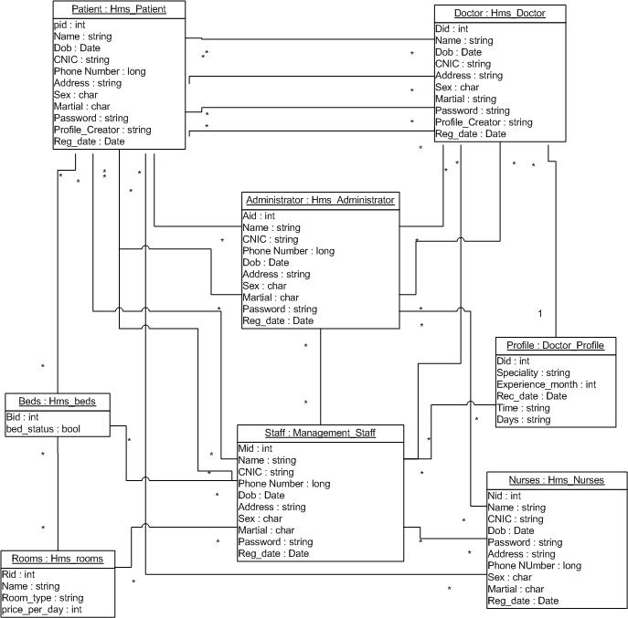

Domain Model Of HMS

Slide 37
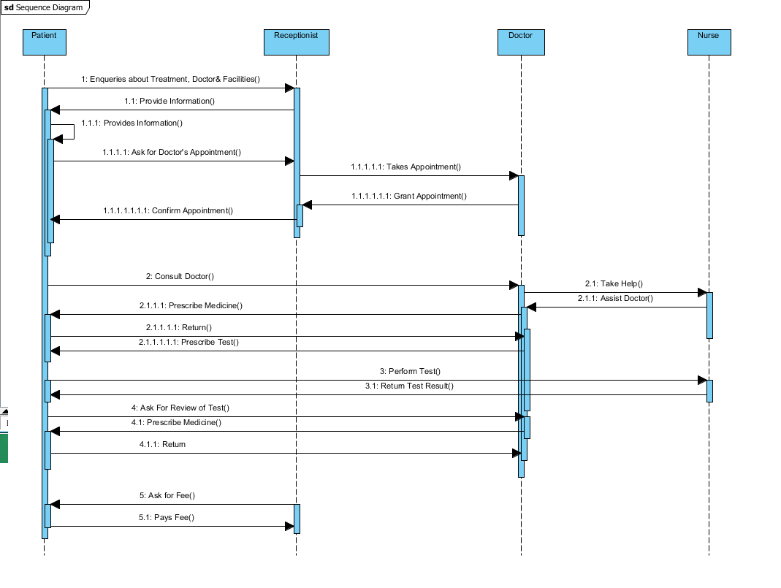

Slide 38
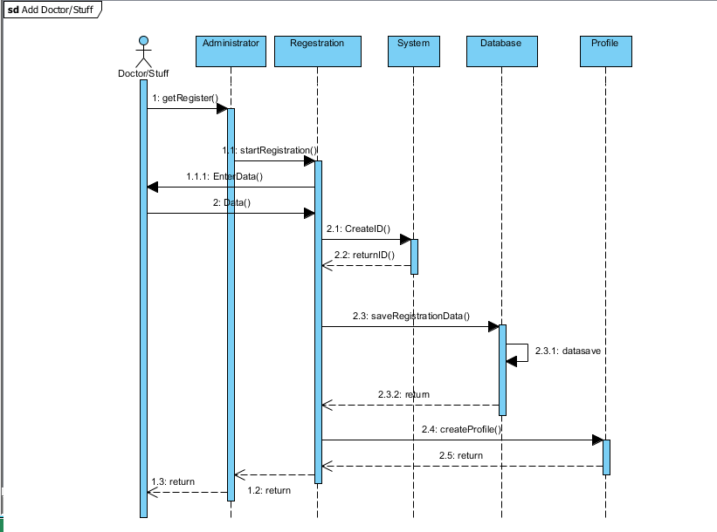

Slide 39
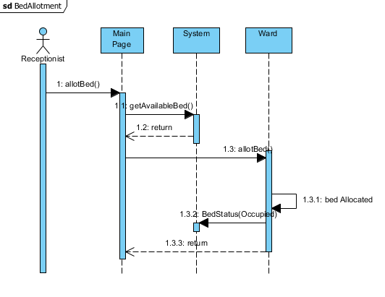

Slide 40
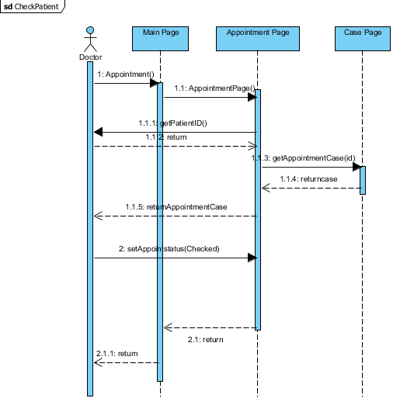

Slide 41
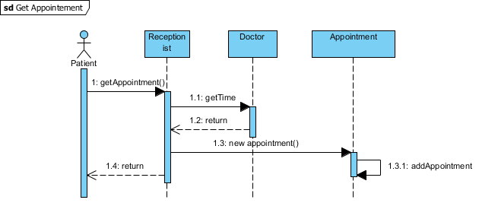

Slide 42
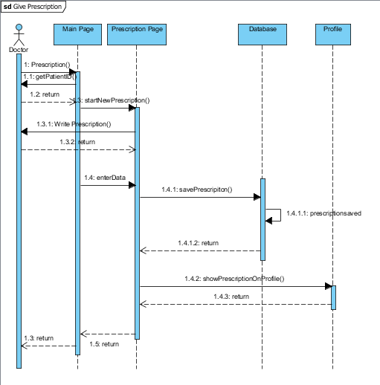

Slide 43
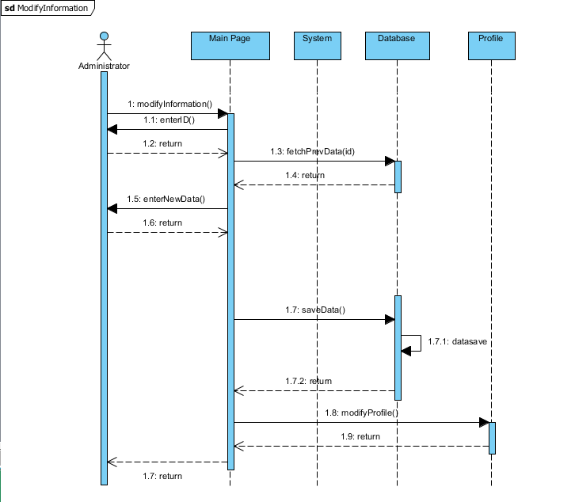

Slide 44
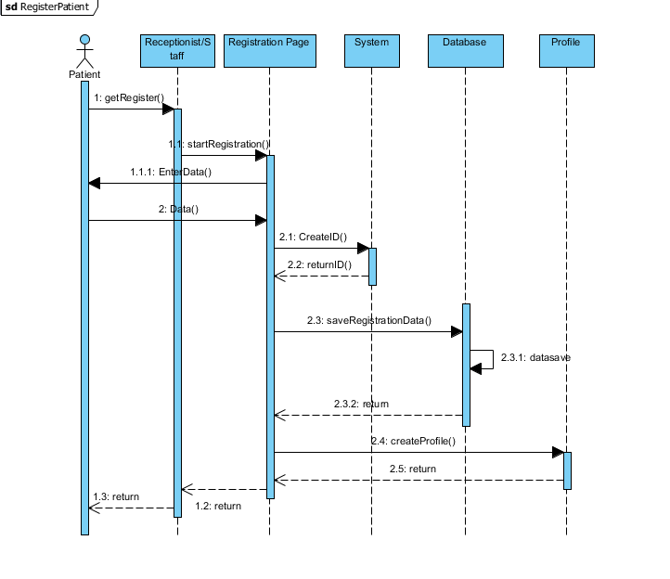

Slide 45
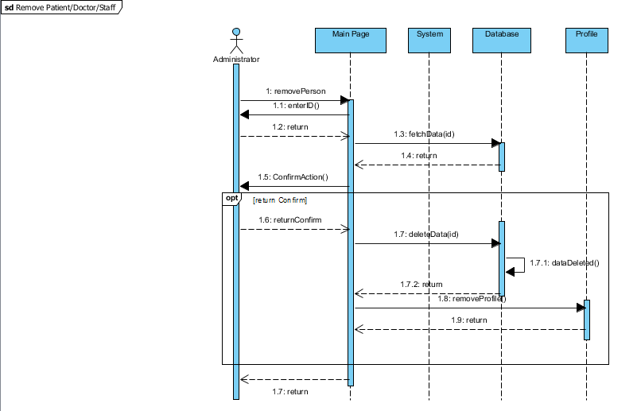

Slide 46
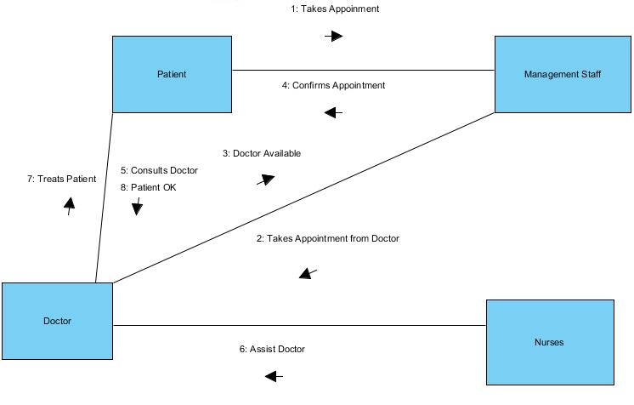

Collaboration / Communication Diagram of HMS

Slide 47
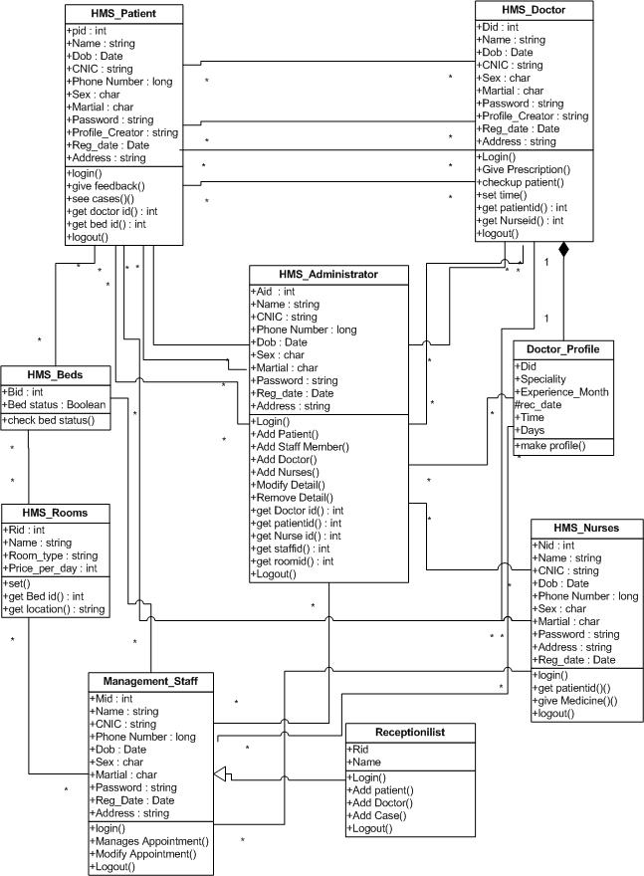

Class Diagram OF HMS

Slide 48
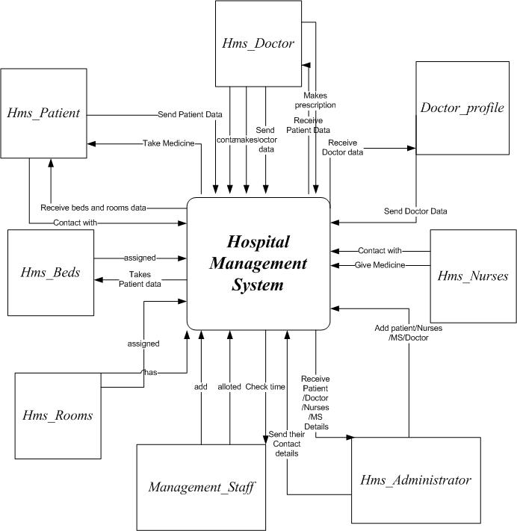

Context Level Diagram Of HMS

Slide 49
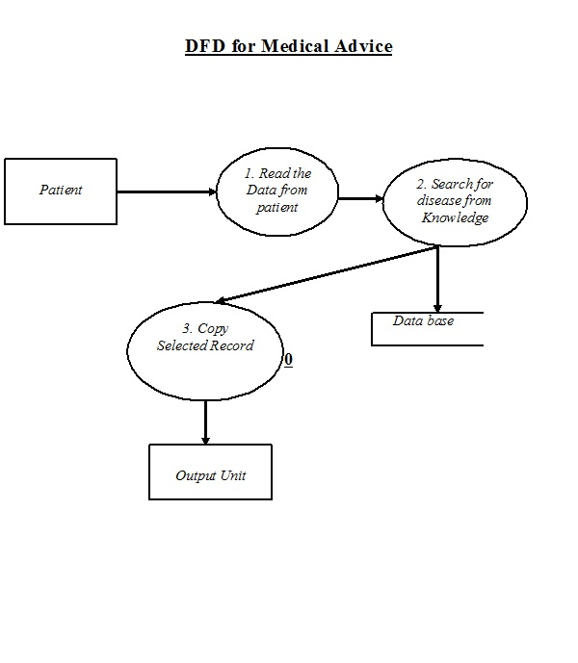


Slide 50
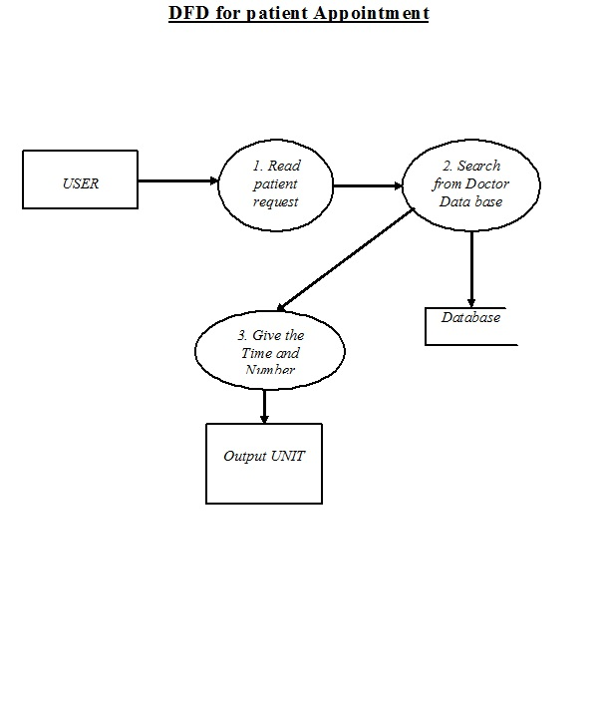


Slide 51
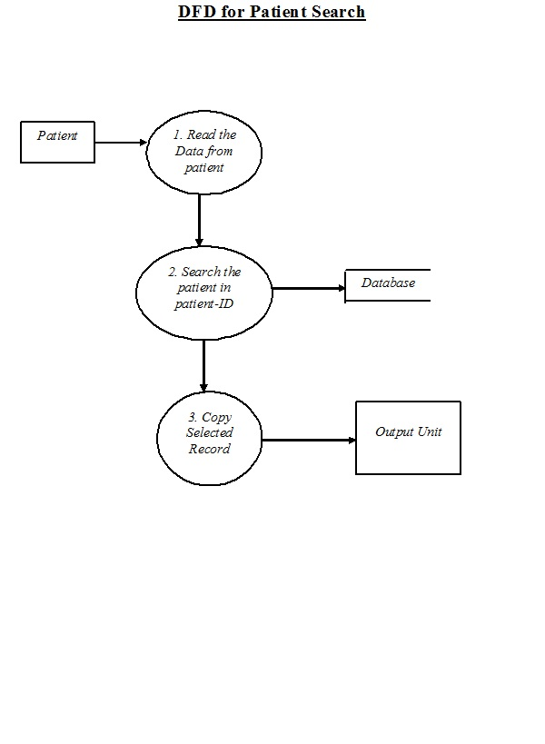


Slide 52
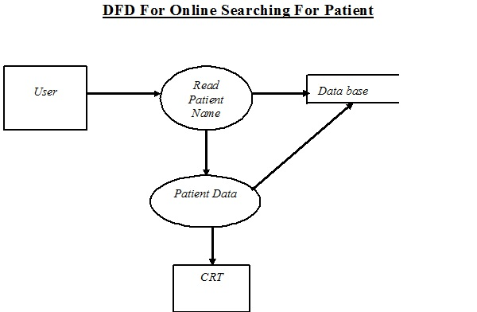

Slide 53
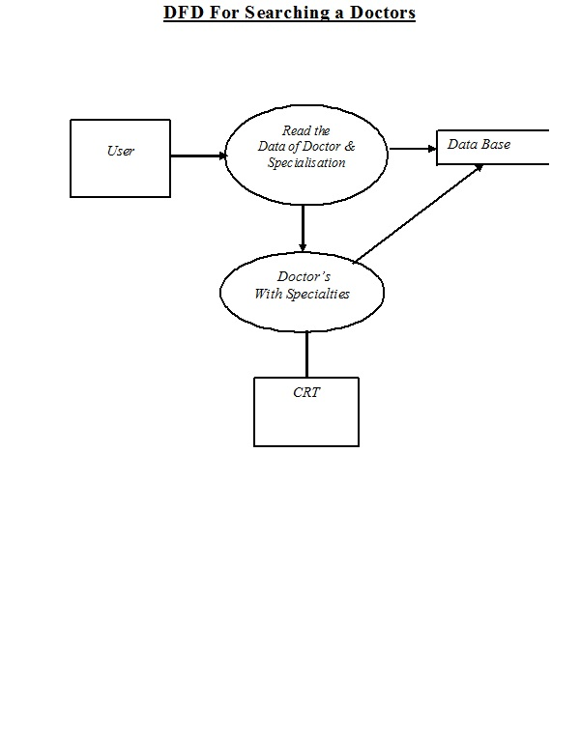


Slide 54
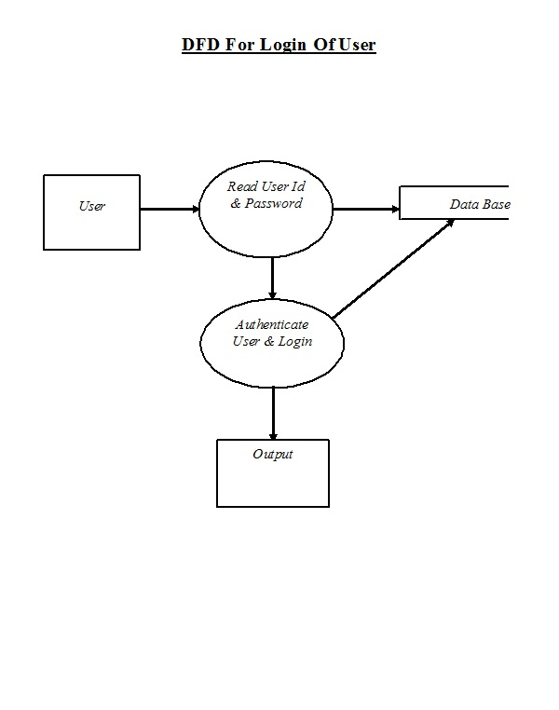


Slide 55
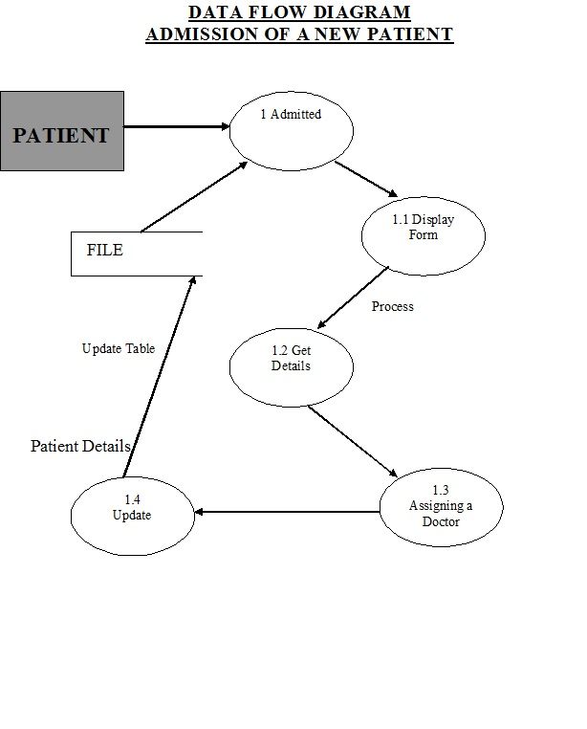


Slide 56
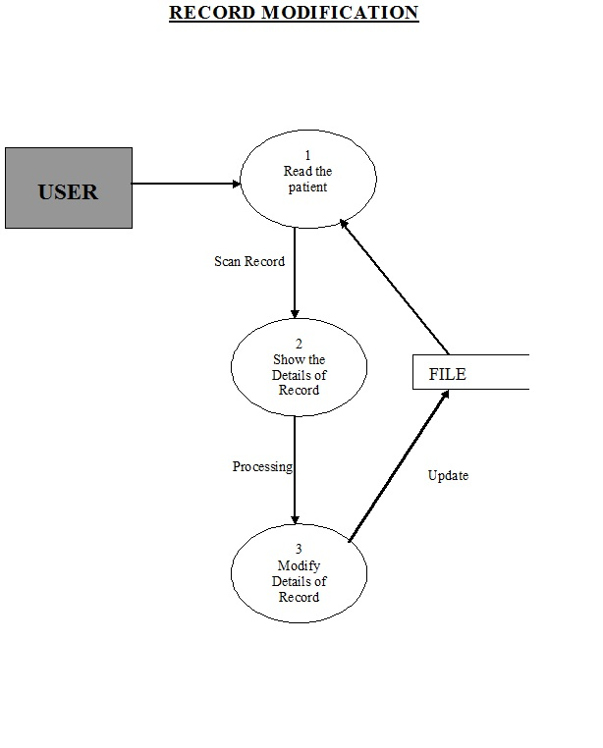


Slide 57
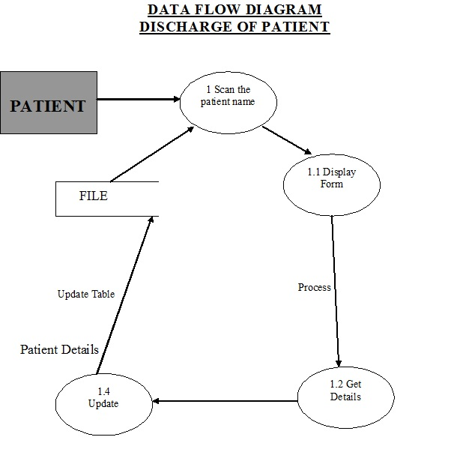


Slide 58
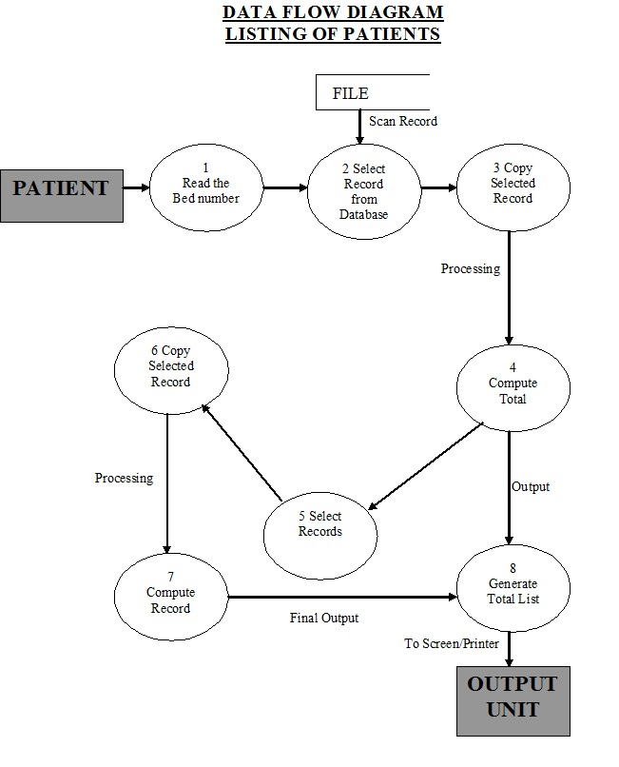


Slide 59
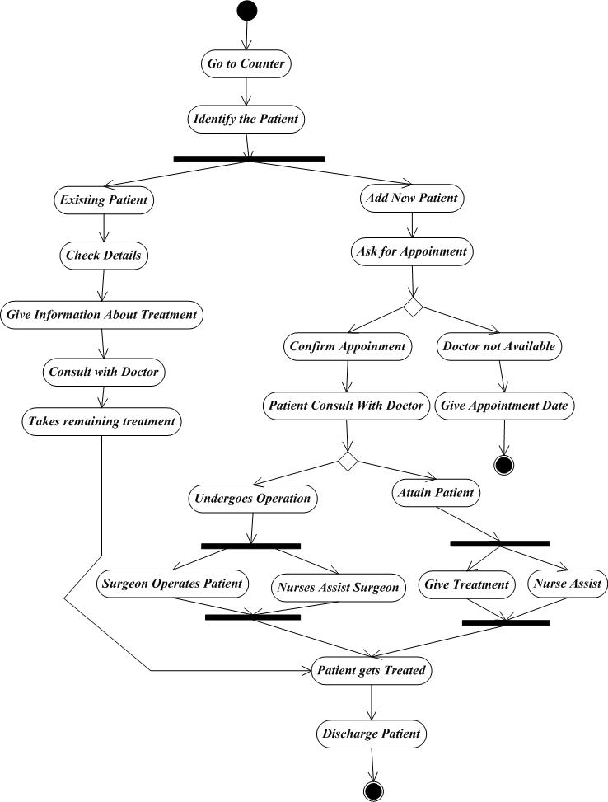

Activity Diagram of HMS

Slide 60
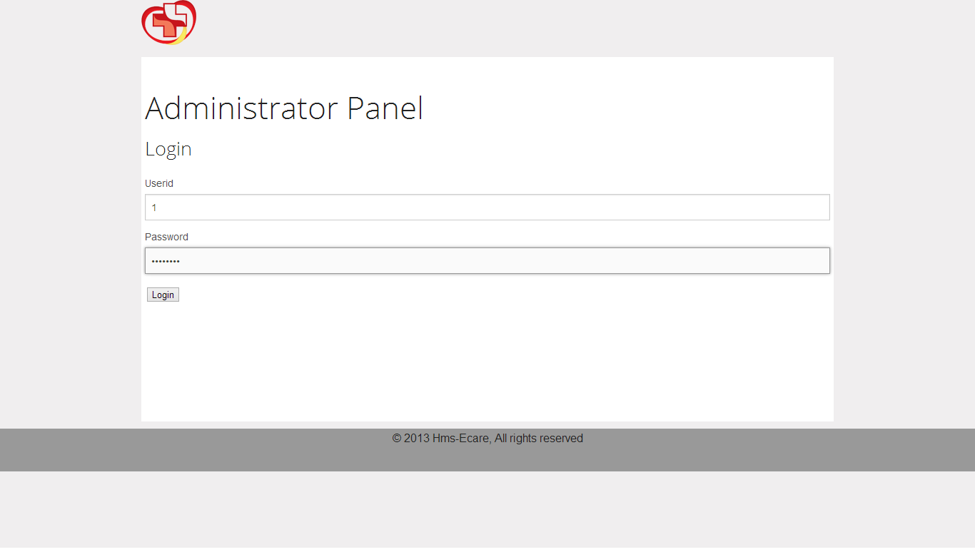

Slide 61
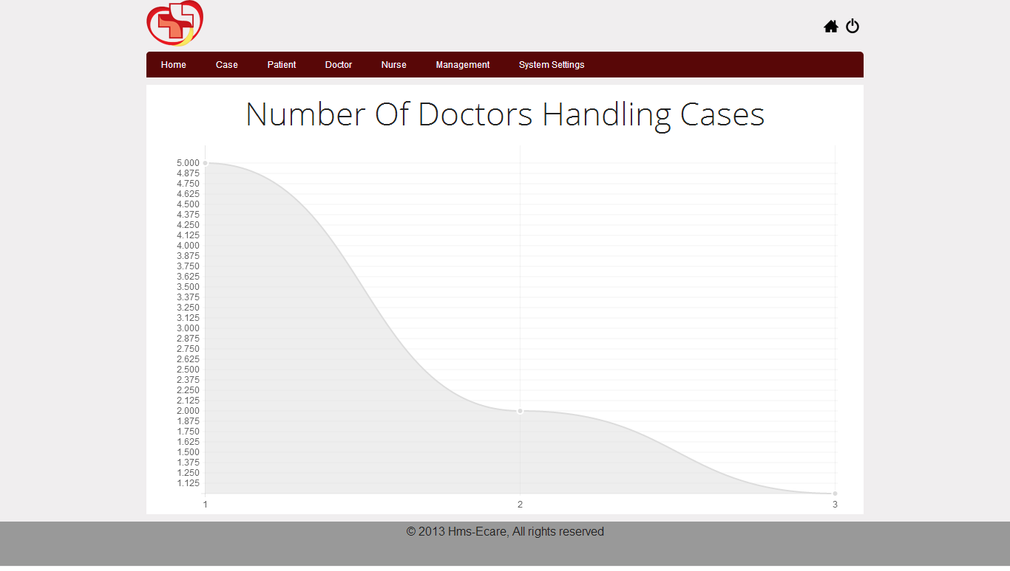

Slide 62
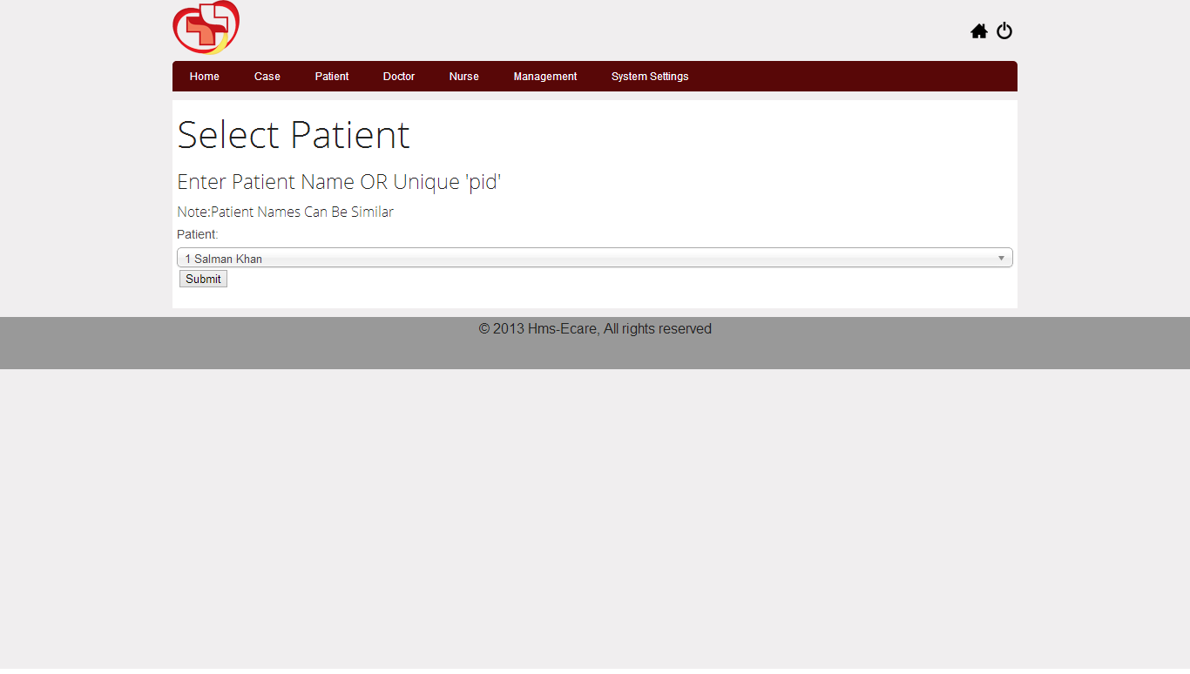

Slide 63
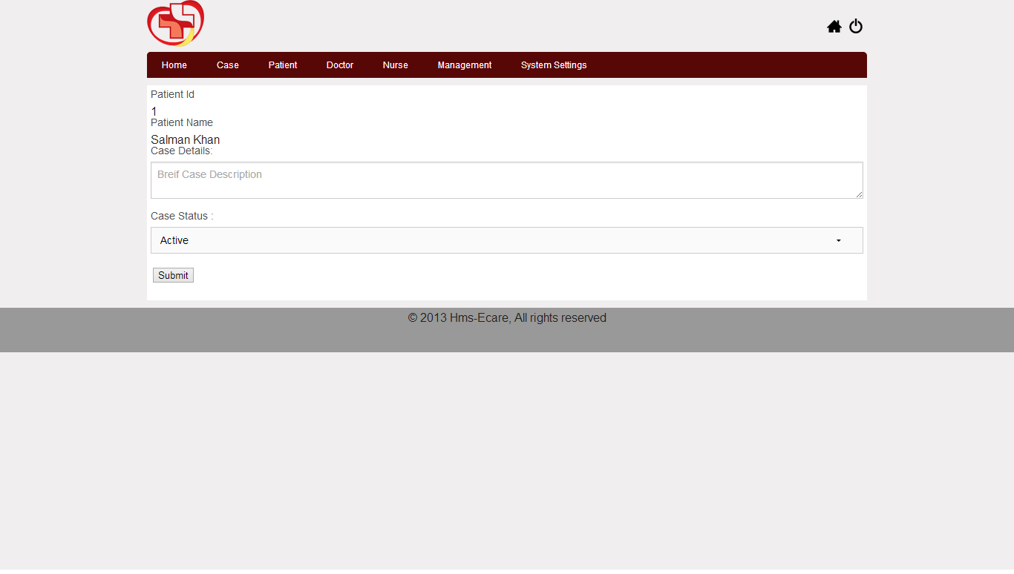

Slide 64
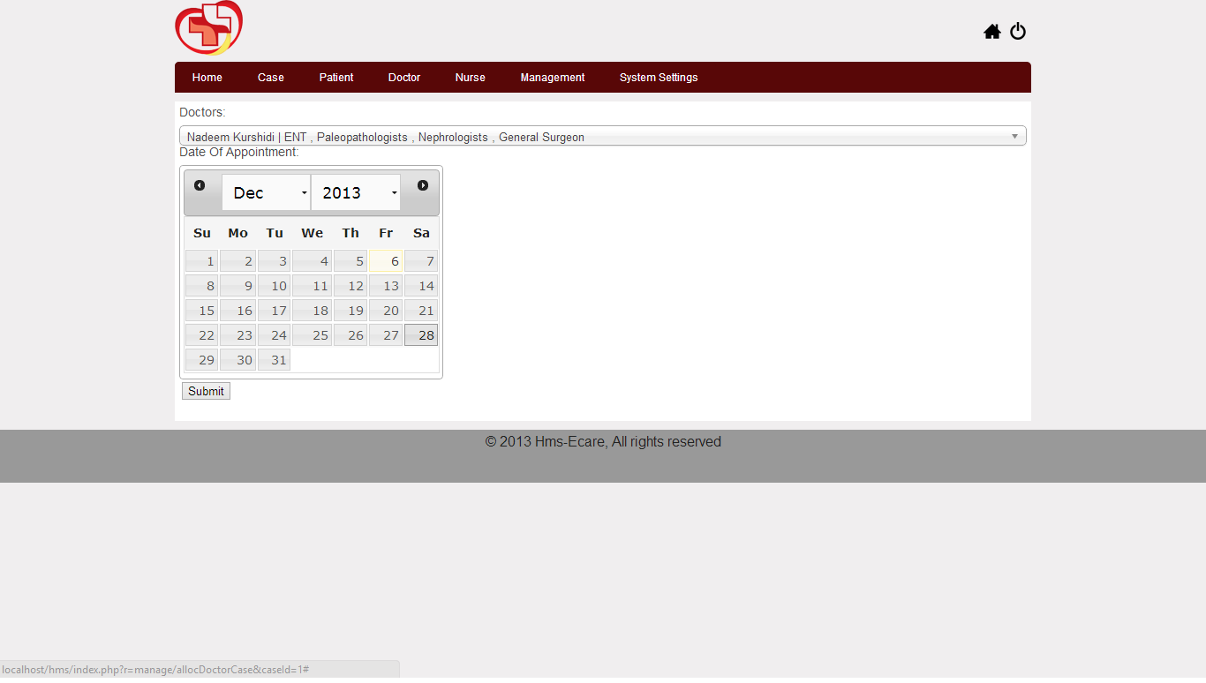

Slide 65
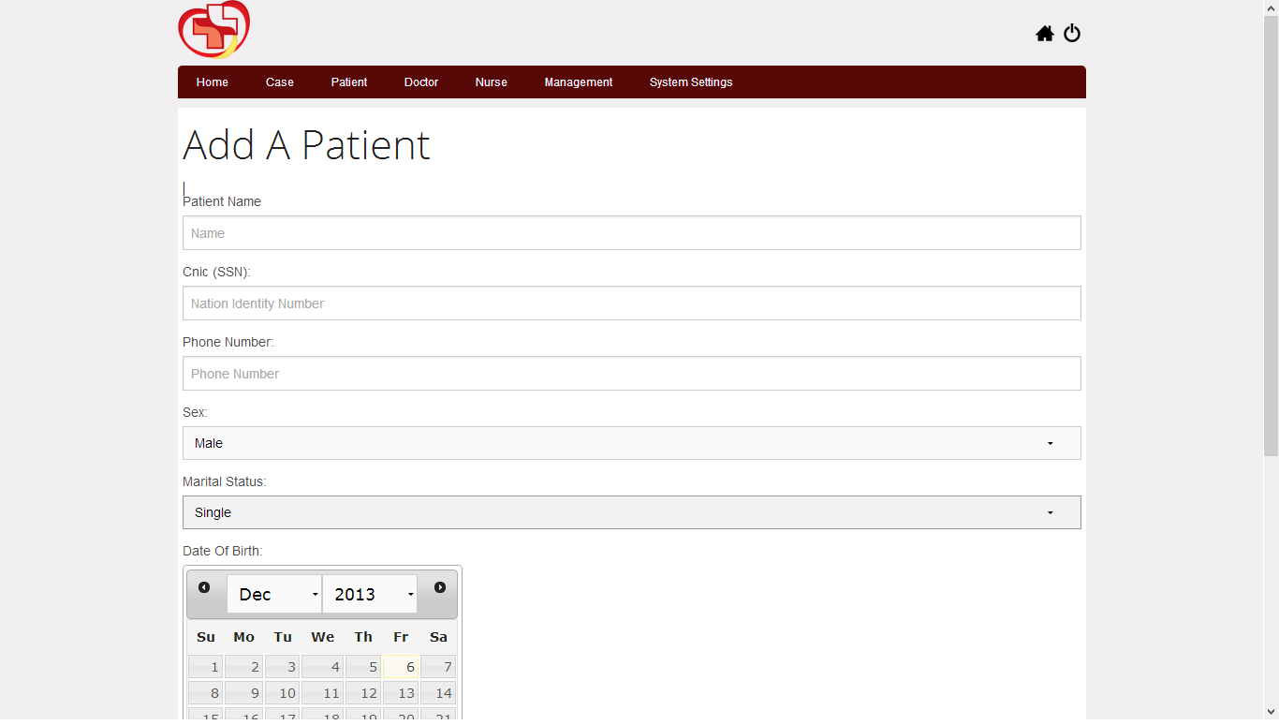

Slide 67
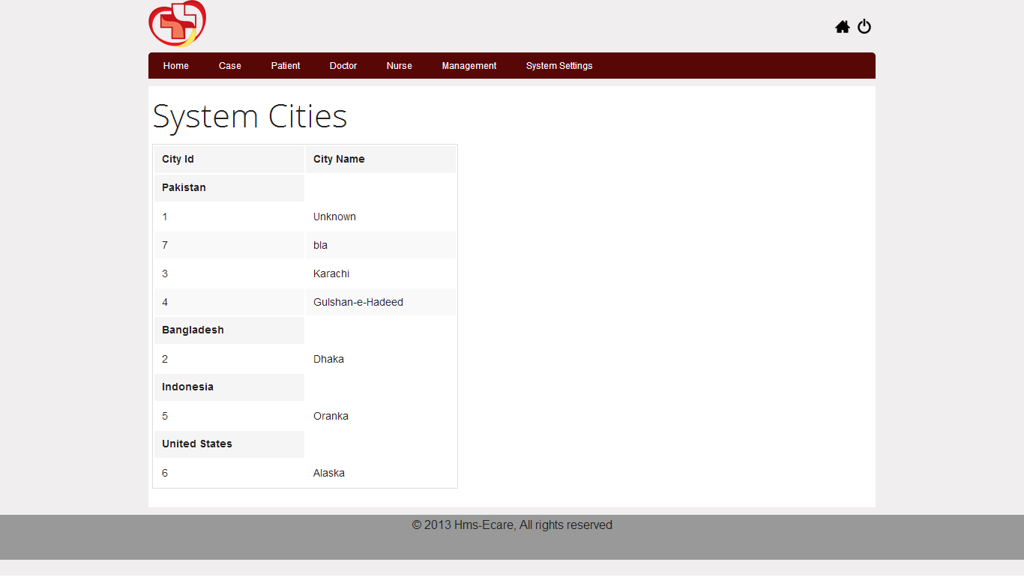

Slide 68
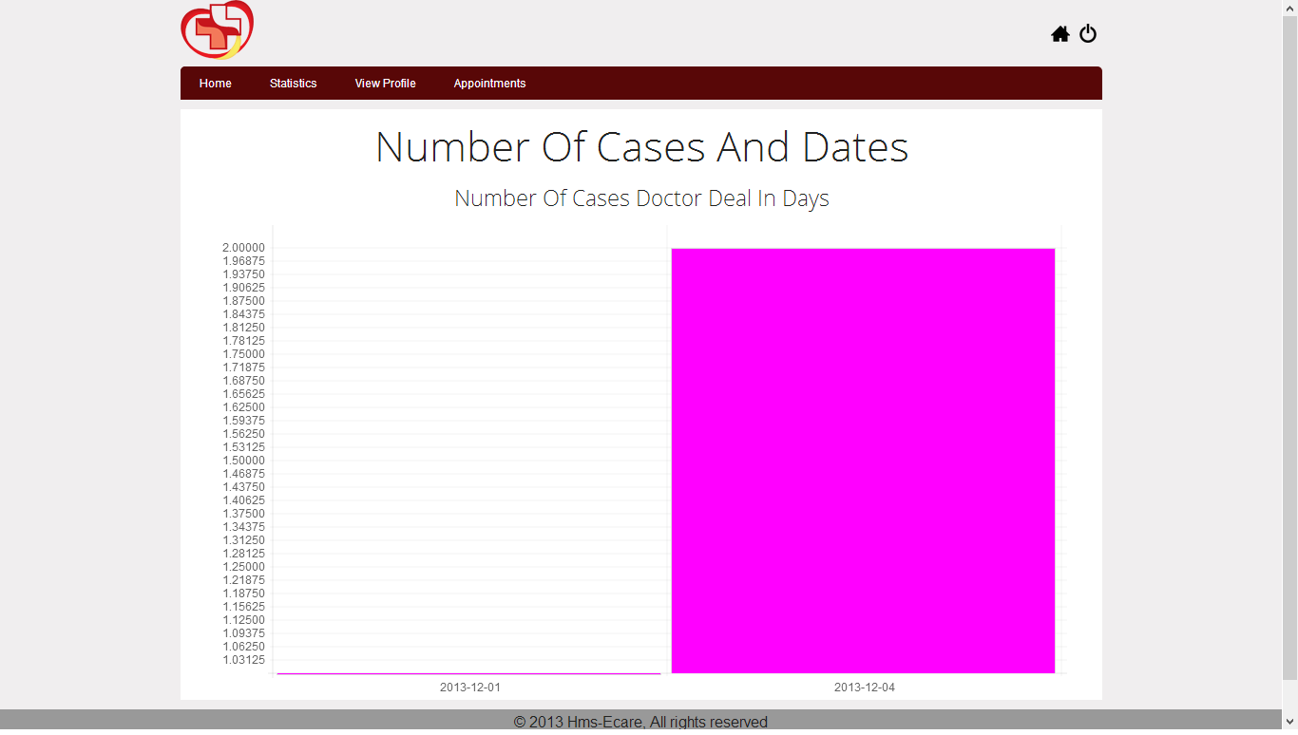

Slide 69
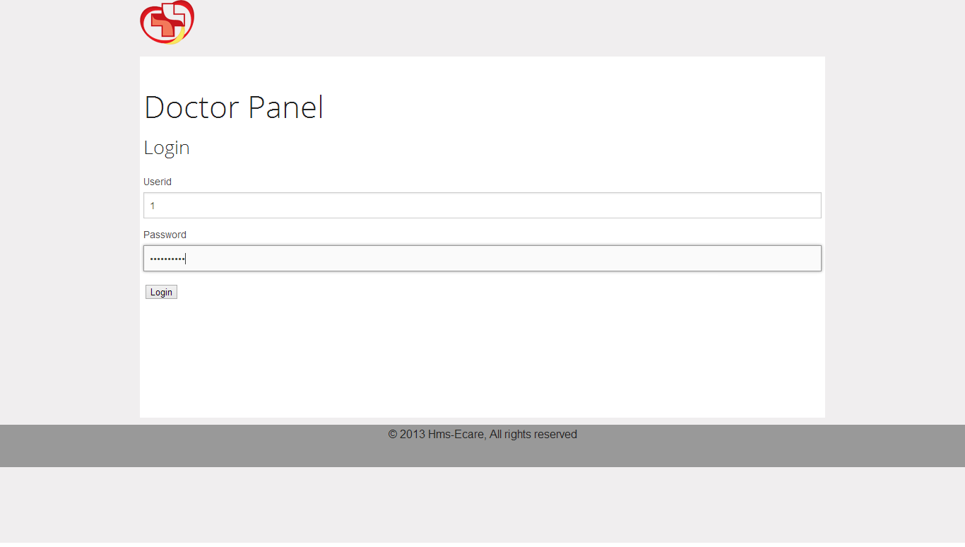

Slide 70
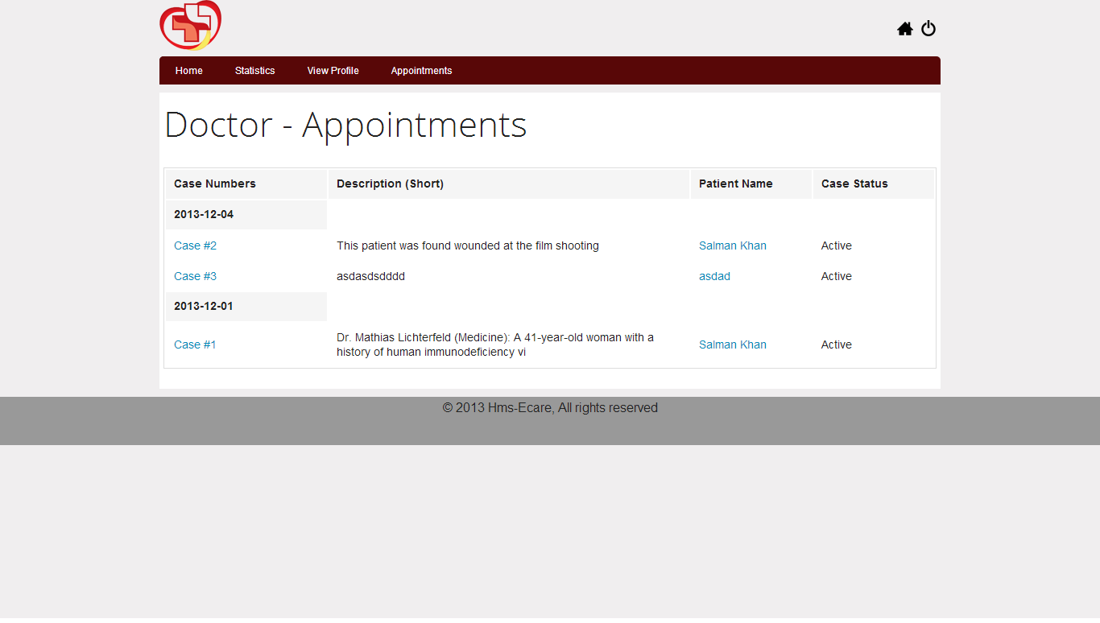

Slide 71
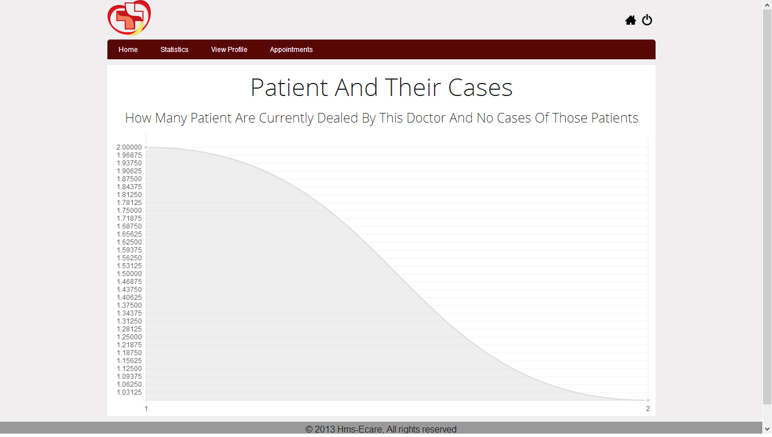

Slide 72
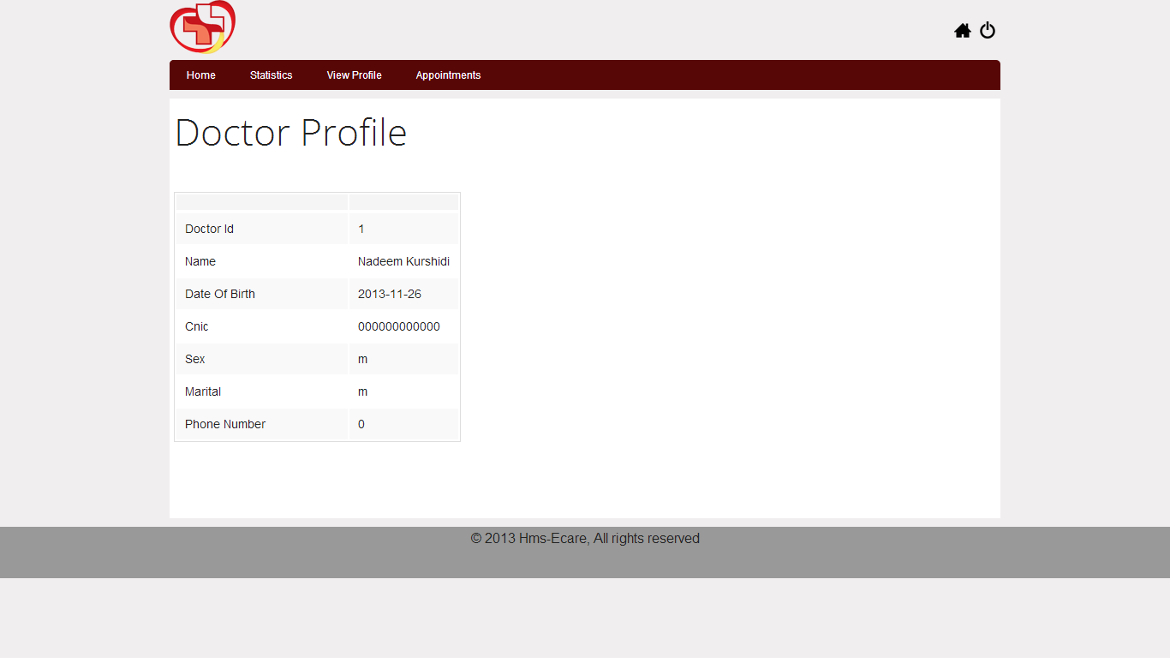

Slide 73
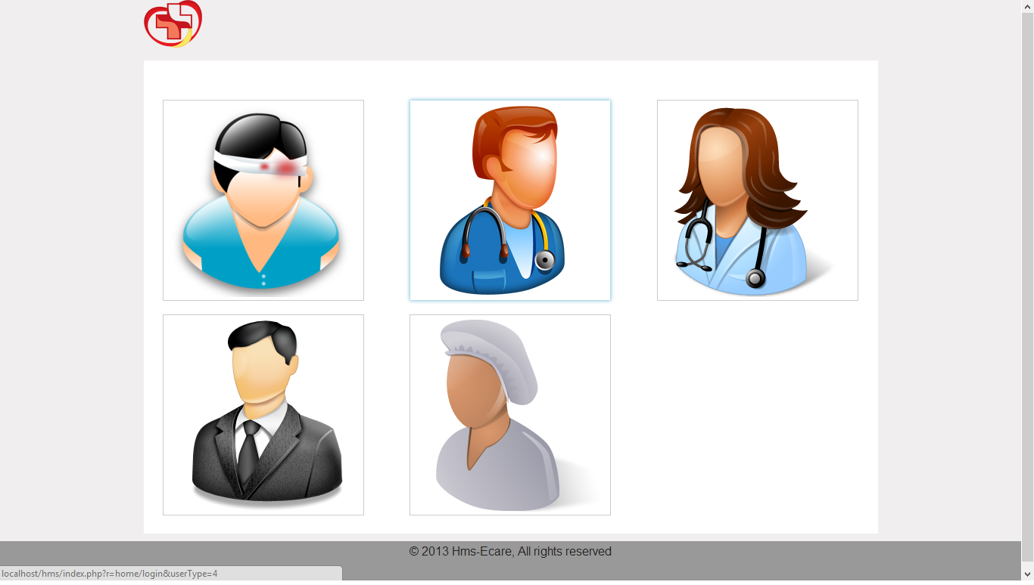

Slide 74


Slide 75
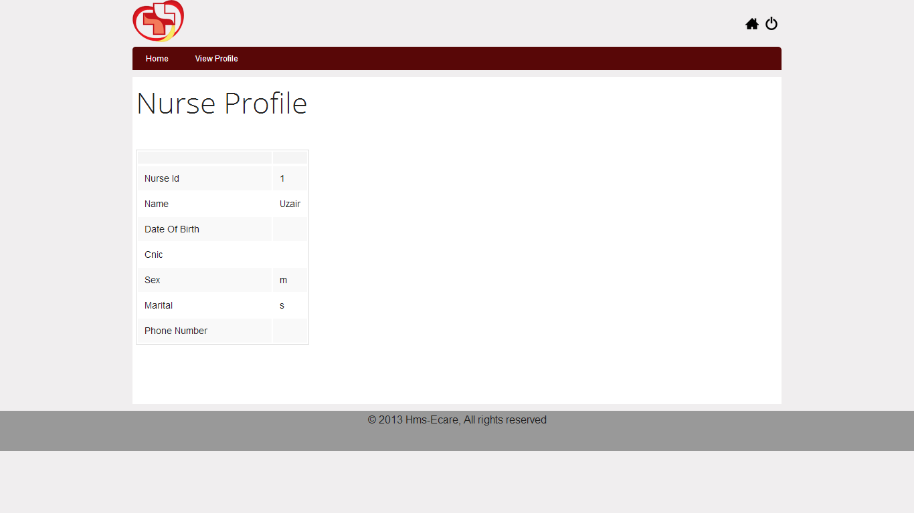

Slide 76
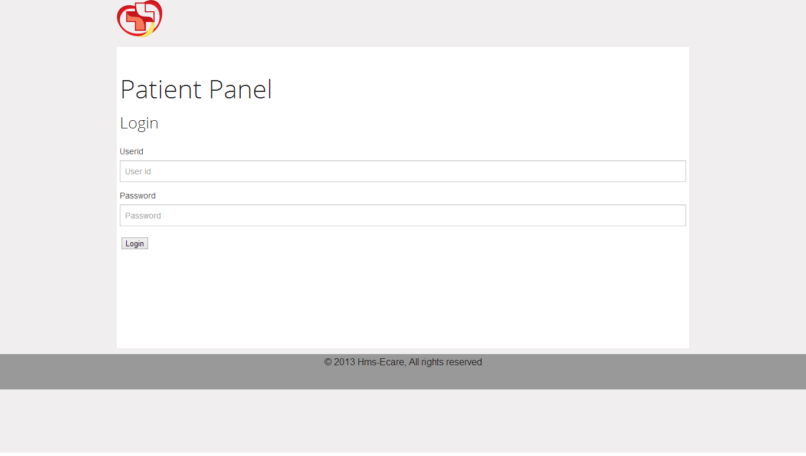

Slide 77
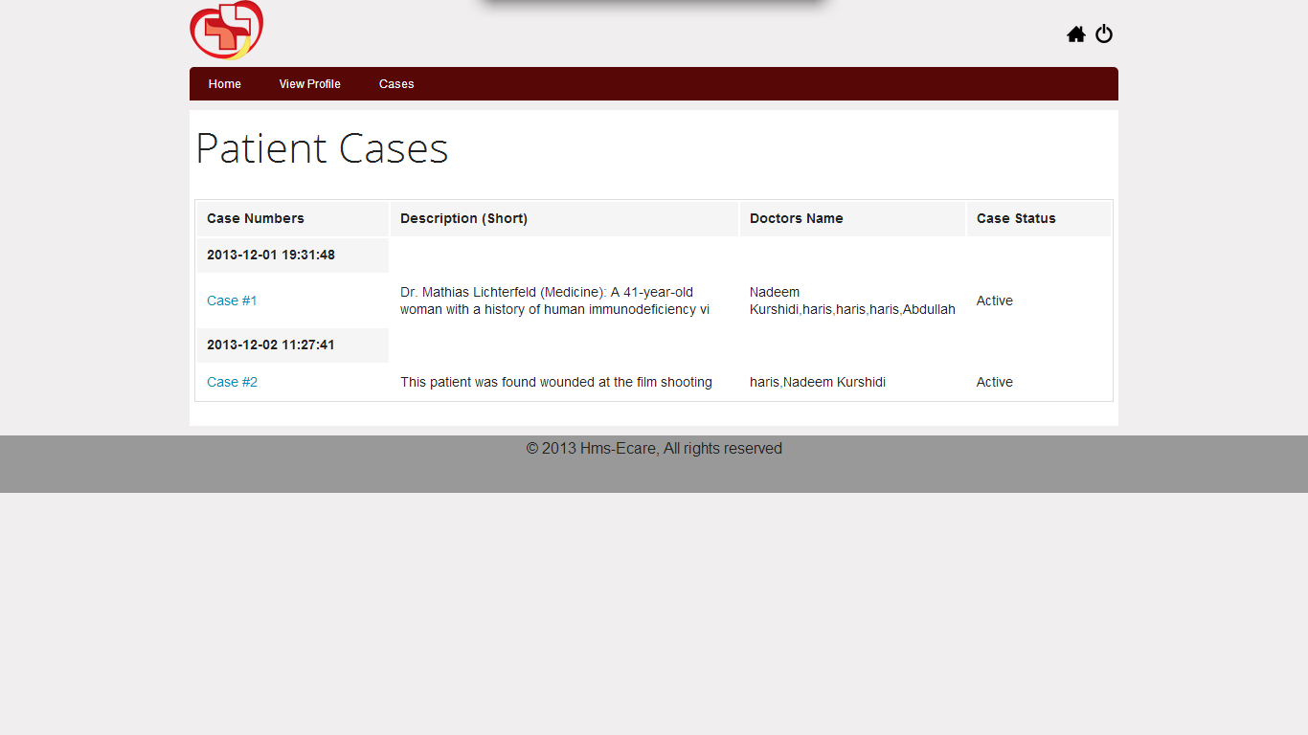

Slide 78
