Slide 1

Design and Development of a Scalable Cloud-Native Photo and Video Distribution Platform
Ifeanyi
Robinson
Module: COM769 – Scalable Advanced Software Solutions
Id here
I-MEET
Share Your Moments
MSc Computer Science

Slide 2
c
Modern media-sharing platforms must support rapid growth in users and content volume while maintaining acceptable performance and availability.
Background
and
Problem
Context
Traditional web applications, often implemented as monolithic systems, struggle to scale effectively due to tightly coupled components and reliance on single-node resources. As user demand increases, such systems experience degraded performance, service outages, and increased operational costs (Newman, 2015).
This project addresses the challenge of designing a scalable architecture for a photo and video distribution platform that supports both content creators and consumers
Together

Slide 3

Media-centric applications face unique scalability constraints:
Storage growth: Media files increase rapidly and exceed local filesystem limits
Concurrency: File-based databases (e.g. SQLite) suffer from locking under concurrent access
Performance: Serving large media directly from application servers creates bandwidth bottlenecks
Availability: Single-instance deployment introduces a single point of failure
Scalability Challenges in Media Platforms
Research indicates that such limitations necessitate distributed, cloud-native architectures to ensure elasticity and resilience (Dragoni et al., 2017).

Slide 4

Design
The primary design objectives of this project are:
To support scalable storage for unbounded media uploads
To enable horizontal scalability of backend services
To decouple application logic from media delivery
To provide a clear migration path from development to production cloud deployment
These objectives align with established cloud-native design principles emphasising loose coupling, stateless services and managed infrastructure (Pahl, 2015).
Objectives

Slide 5

Target System Architecture
The proposed system adopts a cloud-native, service-oriented architecture consisting of:
Frontend: Static web interface served via CDN
Backend: RESTful API built with Flask, designed to be stateless
Media Storage: Object storage service
Database: Managed relational database
Authentication: Role-based access control via identity services
Scalability Layer: Load balancing
This architectural separation enables independent scaling of components and improves fault tolerance (Burns and Oppenheimer, 2016)
Together

Slide 6

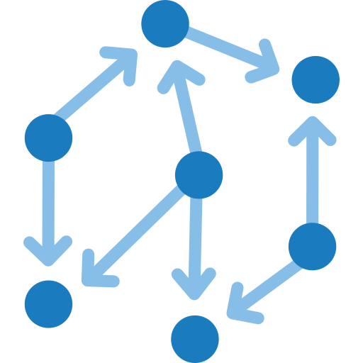


Scalability is achieved using principles from the Scale Cube model, particularly horizontal replication and functional decomposition (Newman, 2015).
Data Flow and Scalability Patterns
Creators upload content through the API, with metadata stored in the database
Creators
Consumers retrieve media via CDN-accelerated object storage
Consumer
Backend services remain stateless, allowing replicationD
Backend

Slide 7

Technology Selection and Rationale
Key technologies were selected based on scalability, simplicity, and cloud readiness:
Flask (Backend): Lightweight framework suitable for REST APIs and containerisation
Static Frontend Hosting: Reduces backend load and improves performance
Object Storage: Provides virtually unlimited scalability and durability
Managed Databases: Support concurrent access and automated maintenance
Such technology choices are consistent with best practices in cloud-native system design (Pahl, 2015).

Slide 8
Implementation Overview
The current implementation includes:
Creator media upload with metadata handling
Session-based authentication with role separation
Consumer browsing functionality
Local filesystem storage for media (development environment)
Local filesystem storage for media (development environment)
Persistent storage using SQLite (development environment)
This implementation functions as a development prototype, enabling validation of core functionality prior to cloud deployment

Slide 9

Advanced Features
c
The system incorporates several advanced features to enhance robustness and user experience:
Authentication and role management for creators and consumers
Rate limiting to prevent abuse and improve service reliability
CI/CD pipeline (planned) for automated testing and deployment
Continuous integration and delivery pipelines are widely recognised as critical for scalable and reliable software systems (Shahin et al., 2017).

Slide 10

Scalability Evaluation
c
The system was evaluated conceptually under increasing load:
10 users: System performs reliably
1,000 users: Database locking and file serving latency emerge
1,000,000 users: System fails without horizontal scaling and distrbuted storage
This evaluation demonstrates the necessity of cloud-based services for sustained scalability and availability.

Slide 11
Limitations
c
Single-instance deployment
File-based database constraints
Lack of caching and autoscaling
Current limitations include
I-MEET

Slide 12
Video Demonstration Overview
Functional operation of the application
Media upload and retrieval workflows
Backend request handling
Deployment readiness for cloud infrastructure
The recorded demonstration presents:
The video provides empirical evidence of system behaviour and design validity.

Slide 13
Conclusion
A clear understanding of scalability challenges in media platforms
The application of cloud-native architectural principles
A functional prototype with a well-defined path to scalable deployment
The solution reflects professional-level system design practices and provides a strong foundation for production-grade scalability.
This project demonstrates
Together

Slide 14
References
Armbrust, M. et al. (2010) ‘A view of cloud computing’, Communications of the ACM, 53(4), pp. 50–58.
Burns, B. and Oppenheimer, D. (2016) ‘Design patterns for container-based distributed systems’, IEEE Software, 33(6), pp. 52–57.
Dragoni, N. et al. (2017) ‘Microservices: Yesterday, today, and tomorrow’, Present and Ulterior Software Engineering, pp. 195–216.
Newman, S. (2015) Building Microservices. Sebastopol: O’Reilly Media.
Pahl, C. (2015) ‘Containerization and the PaaS cloud’, IEEE Cloud Computing, 2(3), pp. 24–31.
Shahin, M., Babar, M.A. and Zhu, L. (2017) ‘Continuous integration, delivery and deployment’, Journal of Systems and Software, 123, pp. 1–17.

Slide 15

Thank You

