Slide 1

Business Intelligence Analysis on streaming platforms
Presented by Gideon Dennis Shanthi

Slide 2
agenda
Industry Overview
Platform analysis(Prime Video)
Key Insights
Strategic recommendation
Expected impact

Slide 3
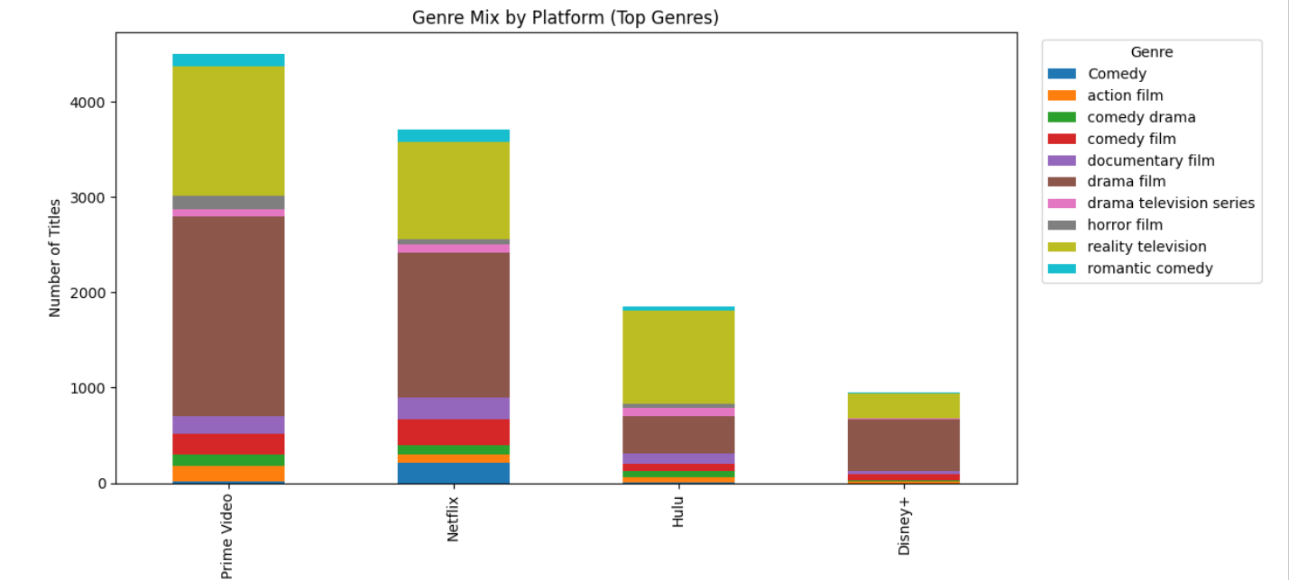
Industry Overview
Insight:
Drama films and reality TV make up the vast majority of content on Prime Video, Netflix, and Hulu, acting as the core anchors for watch-time
Prime Video and Netflix compete as massive aggregators based on sheer volume, while Hulu and Disney+ rely on much smaller, curated libraries

Slide 4
Industry Overview
1. Competitive Rivalry - High
2. Threat of New Entrants - High
3. Bargaining Power of Buyers - High
4. Bargaining Power of Suppliers - High
5. Threat of Substitutes - High
Conclusion:
To survive the high buyer power and intense rivalry, platforms cannot just rely on older back-catalogs. They must find a strategic balance between content volume and critical quality

Slide 5
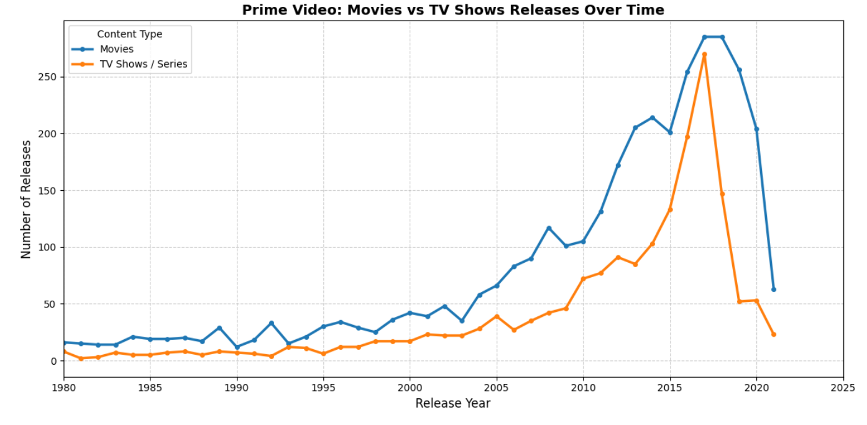
Platform analysis (Prime Video)
Insight:
Prime Video's massive scale compared to the other platforms
Although, it has more movies than TV shows

Slide 6
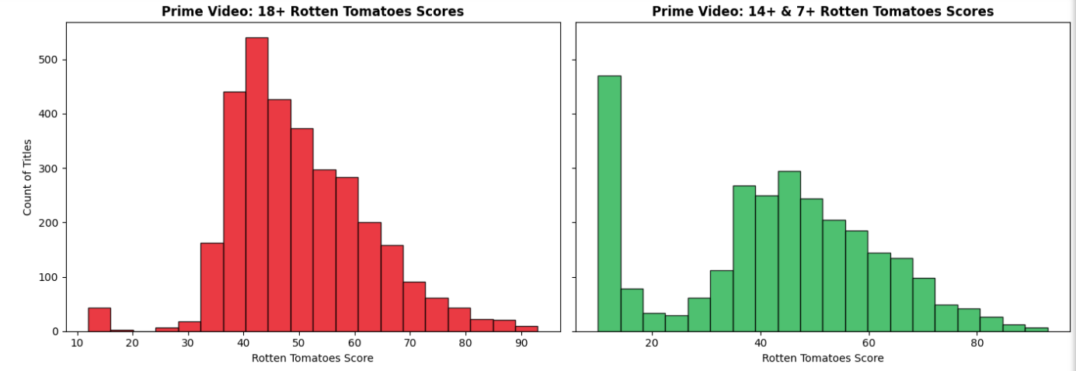
Platform analysis (Prime Video)
Insight:
Prime Video has aggressively targeted the adult demographic, showing a massive, exponential surge in 18+ content over the last decade that completely dwarfs the mature libraries of Netflix, Hulu, and Disney+
We can see the family content has less rating comparatively, almost most family content(around 450) have score below 10, out of 100

Slide 7
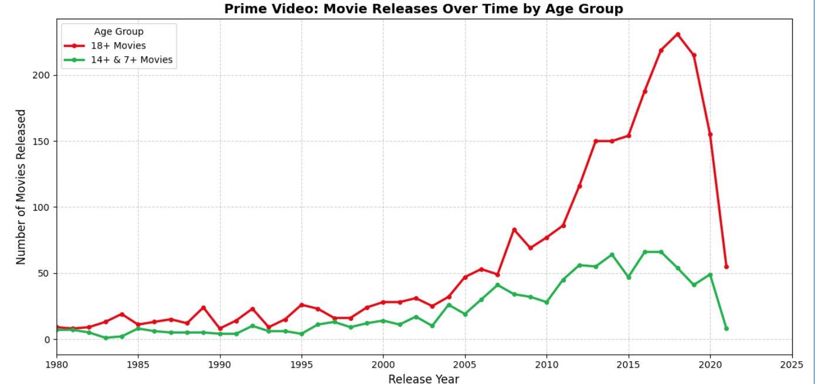
Platform analysis (Prime Video)
Insight:
Prime Video acts as a "catch-all" aggregator, dominating 18+ content while still serving all other age groups
Over the years, we can see the 18+ movies have raised exponential level reaching 200+ movie releases in 2018
But, family oriented movies, have seen a steady growth throughout the years

Slide 8
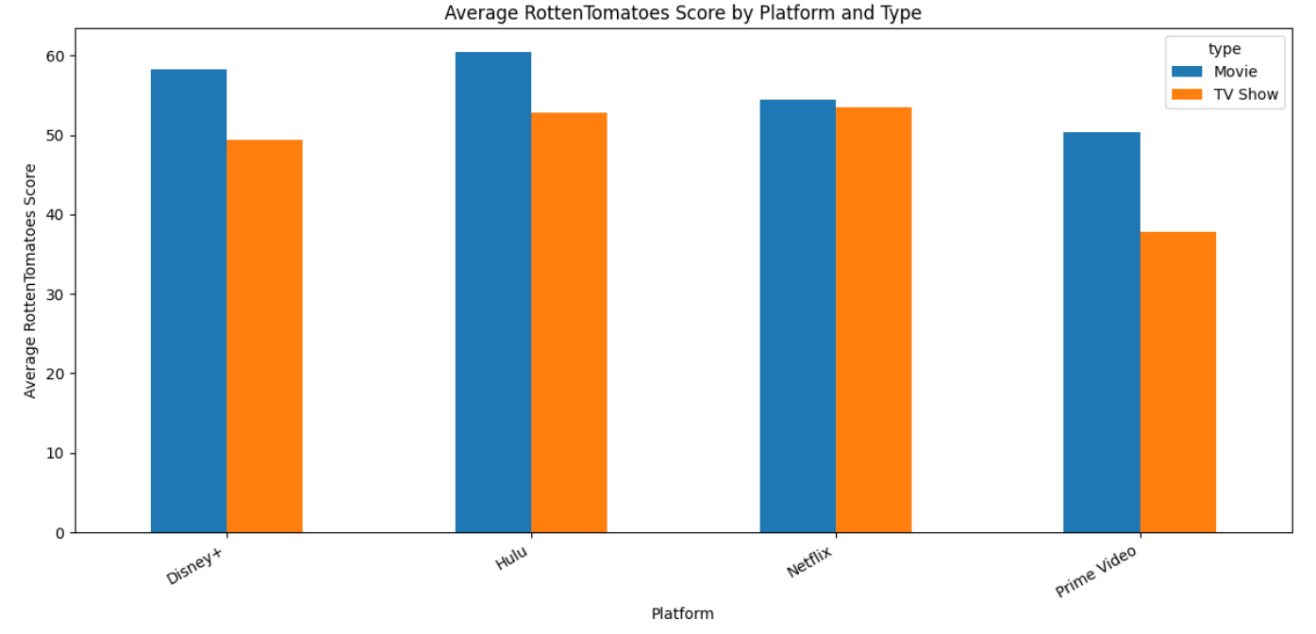
Platform analysis (Prime Video)
Strengths
Prime Video boasts the highest total volume of content, dominating the market with over 4,000 movies and nearly 2,000 TV shows
Weaknesses
Prime Video has the lowest median Rotten Tomatoes score (~47) among its peers
A roughly 2:1 ratio of movies to TV shows may make week-to-week subscriber retention difficult

Slide 9
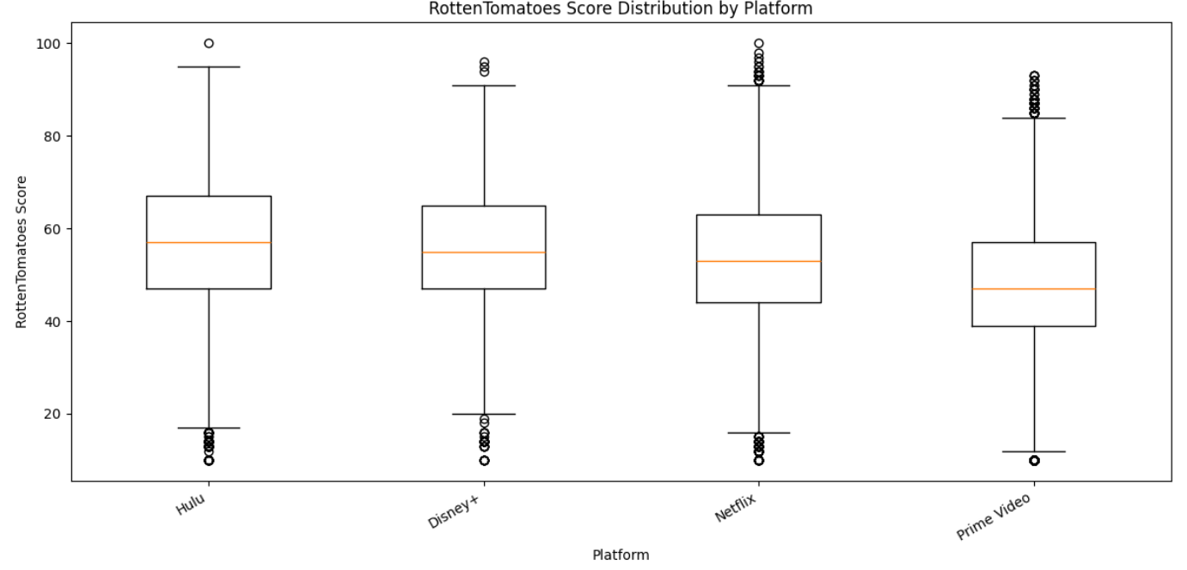
Platform analysis (Prime Video)
Opportunities
With such a massive library, better UI curation could help surface high-quality hidden gems
Reality television makes up over 30% of its top genres; leaning into this format could drive high engagement
Threats
Competitors with higher average critical acclaim (like Hulu and Disney+) threaten to pull away viewers who prefer curated, high-quality viewing over endless scrolling

Slide 10
Strategic Recommendations
Continue leveraging massive content volume as a primary competitive moat, ensuring users never feel the need to look elsewhere for sheer variety
Implement advanced, personalized recommendation engines to cure user "choice paralysis" and surface hidden gems from the massive catalog
Shift a portion of the budget toward high-quality, episodic original series to drive weekly cultural conversations and improve average critical reception
Expand investment in unscripted and reality television, which the data shows is a top-performing, highly engaging, and cost-effective genre
Deeper integration of Prime Video with the broader Amazon retail ecosystem (e.g., shopping tie-ins, exclusive Prime perks) to maximize overall subscriber lifetime value

Slide 11
Expected Impact
Balancing the massive movie library with more episodic TV shows will reduce churn and keep users subscribed month-to-month
Improving discoverability and UI curation will reduce scrolling time and increase the average daily watch-time per user
Investing in prestige originals will shift Prime Video's reputation from just a "catch-all volume library" to a premium, award-winning entertainment destination
Continuing to scale youth content alongside its massive 18+ library will solidify its position as the ultimate household-shared platform
Higher engagement on Prime Video directly correlates to higher retention for the overarching Amazon Prime subscription, driving broader retail and ecosystem success

