Slide 1
HealthCare: early detection of diabetes
TECHCRUSH CAPSTONE PROJECT
PRESENTATION BY TEAM DATAVERSE

Slide 2
BACKGROUND
Diabetes affects millions and often goes undetected early. Traditional screening can be resource-intensive but there is need for a more efficient and targeted approach.
By leveraging data to identify high-risk individuals for focused intervention a mobile health clinic wants to pre-screen patients for diabetes using basic health indicators to reduce hospital crowding and detect diabetes at the early development stages.

Slide 3
Problem statement
Use EDA to uncover factors that greatly influence the risk of diabetes and develop a classification model using machine learning to predict if a person has diabetes based on vital indicators like BMI, glucose levels, insulin levels, and age.

Slide 4
Data set Used
Pima Indian heritage dataset was used in this study, containing 768 records of female patients with 8 diabetes indicators studied (Glucose, BMI, Insulin, Blood Pressure, Skin Thickness, Age, Number of Pregnancies, Diabetes Pedigree Function)

Slide 5
Methodology
Data Cleaning and Classification: errors, inconsistencies, missing values, and duplicates in a dataset was identified and corrected
Features Selection
Model Building
Model Evaluation

Slide 6
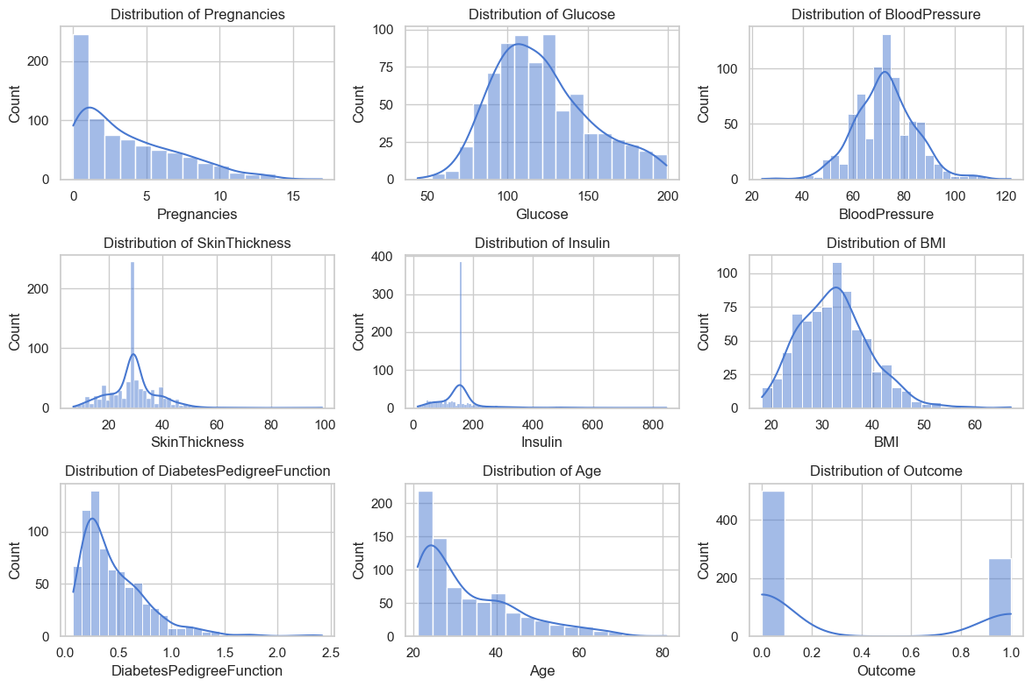
RAW DATA OVERVIEW

Slide 7
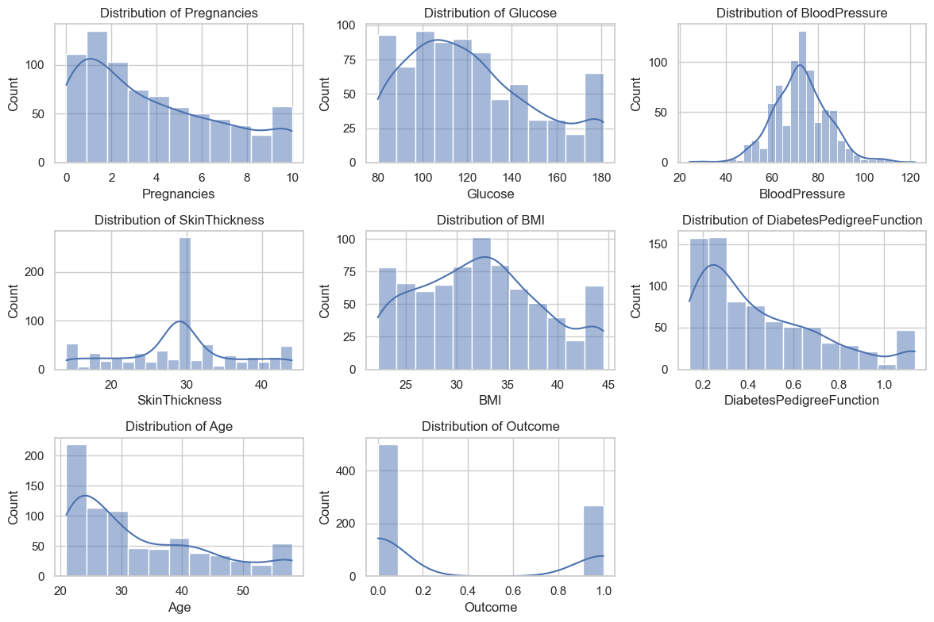
PROCESSED DATA OVERVIEW

Slide 8
PROCESSED DATA Observations
Univariate Analysis shows that patients with diabetes tend to have higher Glucose and BMI levels. Distribution of Age is right-skewed with most patients in their 20s to 40s
Bivariate Analysis highlights the relationships between Glucose, BMI, Age, and Pregnancies are positively correlated with diabetes outcome.
Glucose shows the strongest correlation.

Slide 9
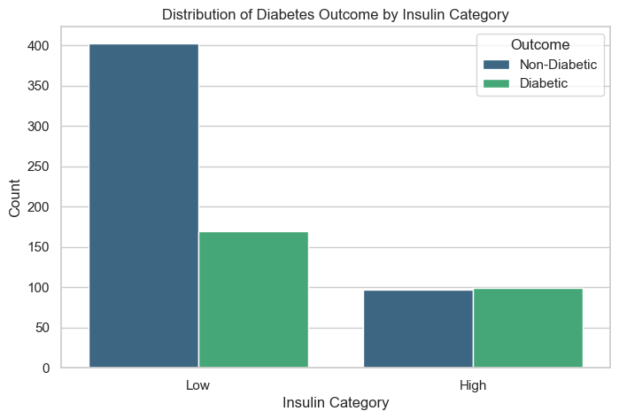
Insulin classification BASED ON OUTCOME

Slide 10
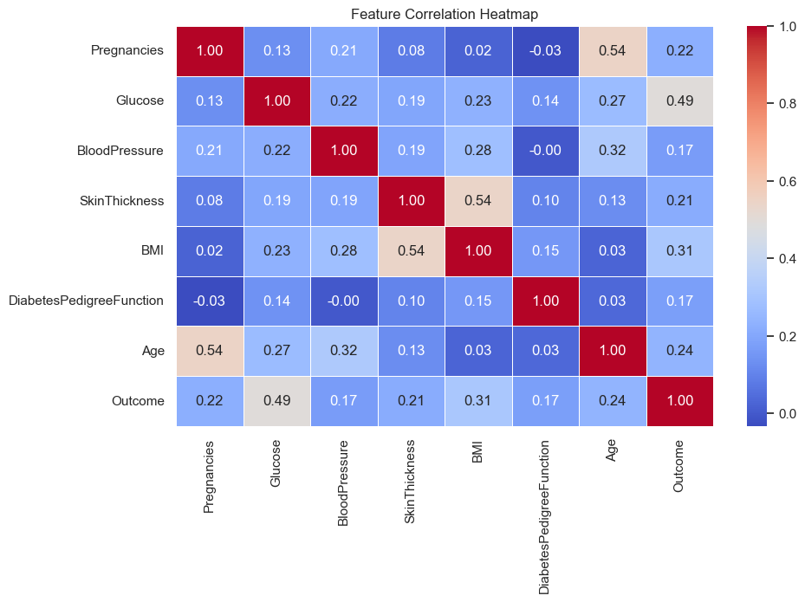
Features correlation

Slide 11
FEATUREs SELECTION
Recursive Feature Elimination (RFE) was used to rank and remove less important features.
Handling Multicollinearity was done by dropping one of those features with high correlation (BMI & Skin Thickness and Pregnancies & Age), to reduce overlapping features in modelling.
Based on RFE, the top selected features were Pregnancies, Glucose, BMI, Diabetes Pedigree Function and Low Insulin.

Slide 12
Model building
Data splitting into training and testing set
Trained multiple models’ classifiers which included Logistic Regression, Random Forest, Support Vector Machine (SVM)
The best performing model for the prediction is RANDOM FOREST CLASSIFIER with an accuracy of 78.99%
Employed the use of GridSearchCV for hyperparameter tuning to find the best configuration for the model

Slide 13
MODEL PRECISION, RECALL and F1-SCORE
 | CLASS 0 (NON- DIABETES) | CLASS 1 (DIABETES)
PRECISION | 0.87 | 0.63
RECALL | 0.74 | 0.80
F1-SCORE | 0.80 | 0.70
MACRO AVERAGE |  | 0.74
WEIGHTED AVERAGE |  | 0.76

Slide 14
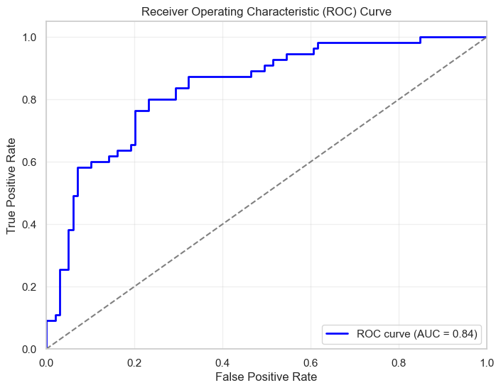
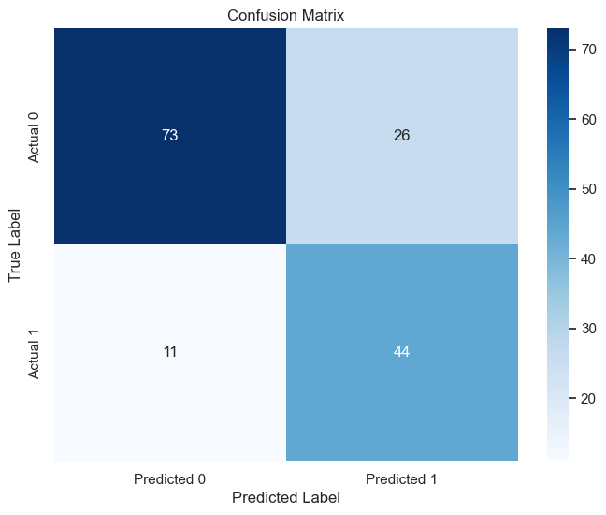
MODEL EVALUATION ON TEST DATA

Slide 15
RESULTS
Challenges faced in data handling and what approach was used to resolve it.

Slide 16
CONCLUSION
Team DataVerse has successfully created a diabetic predictive model which helps in early detection of diabetes, and when deployed into an application, API or healthcare setting can help in the reduction of crowd in the hospital by giving them an opportunity to easily detect if they are diabetic or not.

Slide 17
THANK YOU TECHCRUSH FROM ALL OF US TEAM DATAVERSE

