Slide 1
HealthCare: early detection of diabetes
TECHCRUSH CAPSTONE PROJECT
PRESENTATION BY TEAM DATAVERSE

Slide 2
BACKGROUND & PROBLEM STATEMENT
Diabetes is a condition where the body struggles to regulate blood sugar due to insufficient insulin production or ineffective use, causing high blood sugar and potential health issues. Affecting millions, it often goes undetected early, and traditional screening is resource intensive, highlighting the need for efficient, targeted approaches.
By leveraging data and using EDA to identify high-risk individuals and develop a classification model using machine learning, a mobile health clinic wants to pre-screen patients for diabetes using basic health indicators like insulin, glucose levels, BMI, to reduce hospital crowding and detect diabetes at the early development stages.

Slide 3
Data set used & Methodology
Pima Indian heritage dataset was used in this study, containing 768 records of female patients with 8 diabetes indicators studied (Glucose, BMI, Insulin, Blood Pressure, Skin Thickness, Age, Number of Pregnancies, Diabetes Pedigree Function)
Data Cleaning and Classification: errors, inconsistencies, missing values, and duplicates in a dataset was identified and corrected
Features Selection
Model Building
Model Evaluation

Slide 4
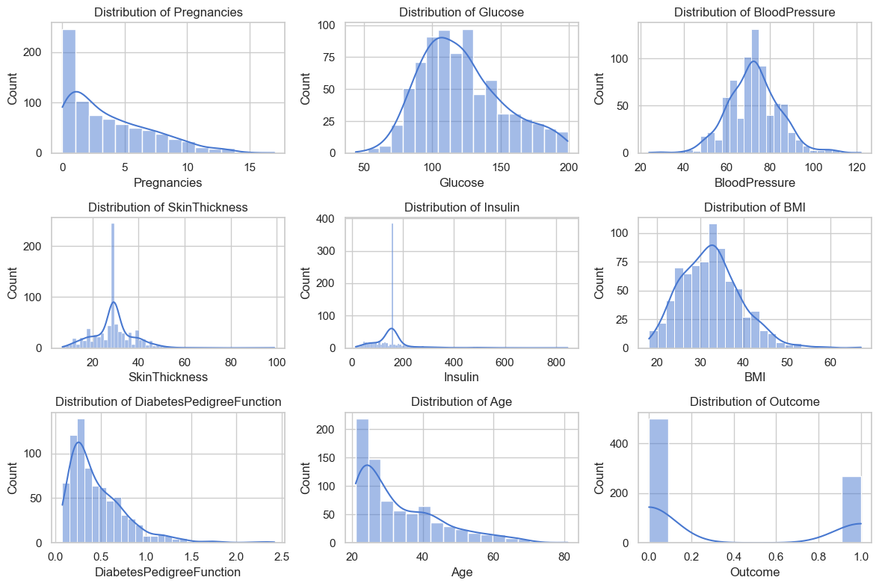
RAW DATA OVERVIEW

Slide 5
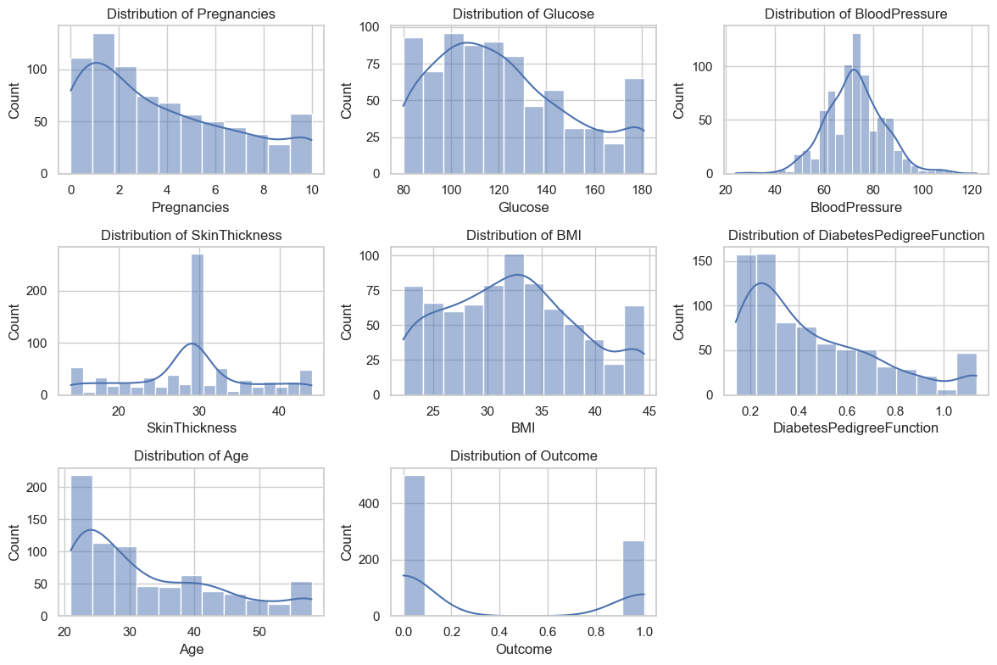
PROCESSED DATA OVERVIEW

Slide 6
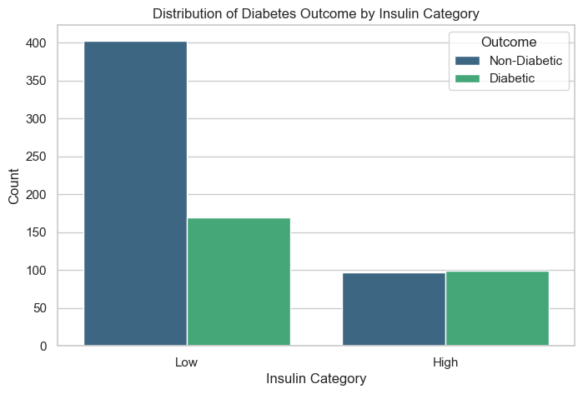
Insulin classification BASED ON OUTCOME

Slide 7
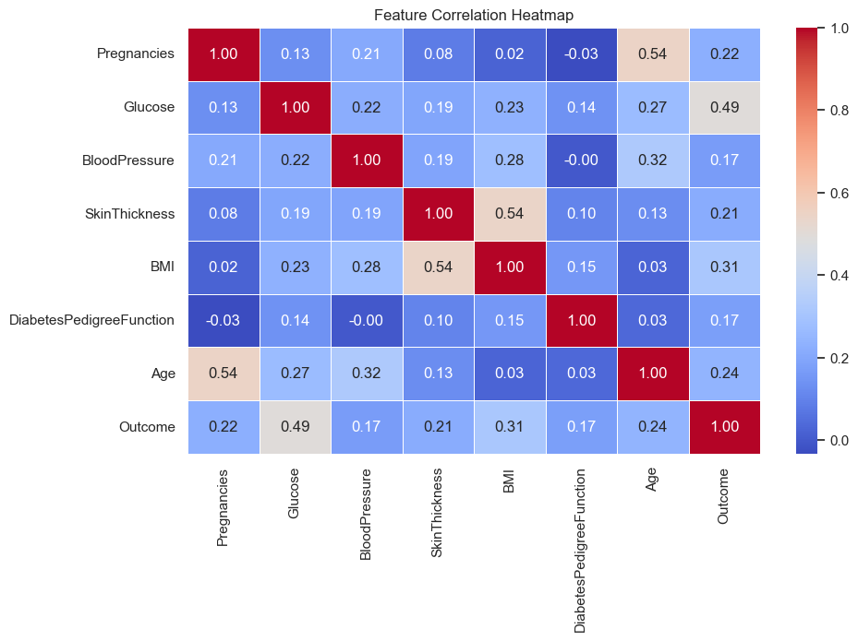
Features correlation

Slide 8
Observations from Data handling
Univariate analysis reveals diabetic patients have higher Glucose and BMI levels, with Age distribution right-skewed, mostly in the 20s–40s.
Bivariate analysis shows positive correlations between Glucose, BMI, Age, Pregnancies, and diabetes outcome, with Glucose having the strongest correlation.
Creating an insulin category which grade the patients in the order of high, medium and low helps us identify low insulin level among the causes of diabetes .

Slide 9
Challenges from data set
Zero values in key features (Glucose: 5, Blood Pressure: 35, BMI: 11, Insulin: 374) were identified as missing data because they were medically unrealistic. These were imputed using the median value of each column to handle outliers robustly.
The dataset is imbalanced, with 500 non-diabetic (65.1%) and 268 diabetic (34.9%) records. This imbalance risks models over-predicting non-diabetic cases, potentially missing critical diabetic diagnoses. Careful handling was done ensure accurate detection of diabetic cases

Slide 10
FEATUREs SELECTION & Model BUILDING
Recursive Feature Elimination (RFE) was applied to rank and eliminate less important features.
To address multicollinearity, highly correlated features (BMI & Skin Thickness, Pregnancies & Age) were reduced by dropping one from each pair.
The top features selected by RFE were Pregnancies, Glucose, BMI, Diabetes Pedigree Function, and Low Insulin.
Data was split into training and testing sets.
Multiple classifiers (Logistic Regression, Random Forest, SVM) were trained, with Random Forest performing best at 78.99% accuracy.
GridSearchCV was used for hyper parameter tuning to optimize the model.

Slide 11
MODEL PRECISION, RECALL and F1-SCORE
 | CLASS 0 (NON- DIABETES) | CLASS 1 (DIABETES)
PRECISION | 0.87 | 0.63
RECALL | 0.74 | 0.80
F1-SCORE | 0.80 | 0.70
MACRO AVERAGE |  | 0.74
WEIGHTED AVERAGE |  | 0.76

Slide 12
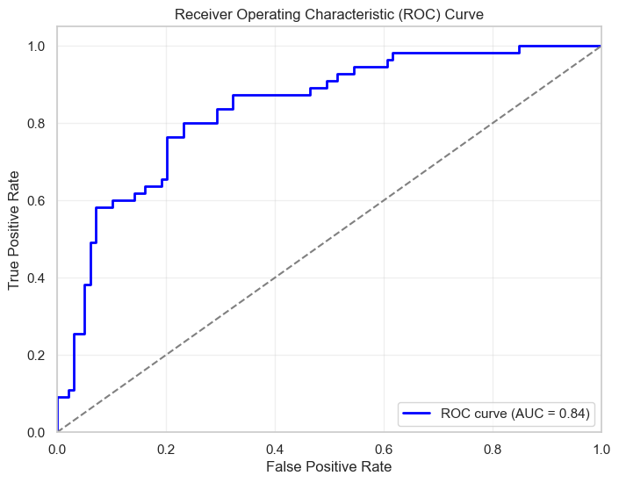
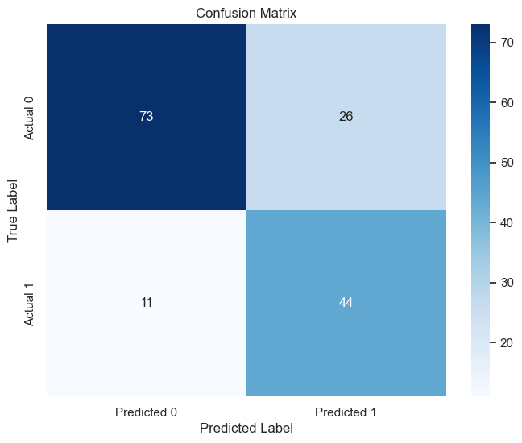
MODEL EVALUATION ON TEST DATA

Slide 13
CONCLUSION
Team DataVerse has successfully created a reliable predictive model for early diabetes detection, enabling clinics to prioritize at-risk patients, optimize resource use, and improve patient outcomes through timely intervention.
Our model for early diabetes detection, when integrated into an application, API, or healthcare system, will help reduce hospital overcrowding by enabling easy self-screening for diabetes risk.

Slide 14
THANK YOU TECHCRUSH FROM ALL OF US TEAM DATAVERSE

